Slide 1
Machine Learning for Non Linear Corrections in the LHC
Alejandro Börjesson Carazo
21/08/2023

Slide 2
Summary
Introduction
Theoretical Background
Methods
Results
MADX-PTC vs MADNG RDT tracking
Example of simple bayesian optimization for the LHC
Conclusion and future improvements
Backup slides

Slide 3
Introduction
Exploring possible ways ML can help RDT Correction
Nonlinear corrections in IRs currently use a lot of different methods, explore ways to correct all RDTs at once with ML
Bayesian Optimization
Supervised learning
ML Is computationally intensive, needing hundreds of thousands of data points, NL simulations usually are too slow
Using MADNG to test possible uses of faster computation
Model creation, error generation
Tracking RDTs

Slide 4

Theoretical Background: Bayesian Optimization
Bayesian optimization is a sequential design strategy for global optimization of black-box functions with as few iterations as possible
For cheap functions to compute, a grid search approach might be possible
Bayesian optimization uses Bayes theorem to iteratively update our knowledge of the objective function
Approximation of the ground truth function with a surrogate function, usually Gaussian process
Finding next sample point with an acquisition function for example expected improvement function, this function quantifies how good each point is as a guess
Exploration Exploitation hyperparameters help us tune the algorithm!
[1] Fig 1. Bayesian optimization

Slide 5
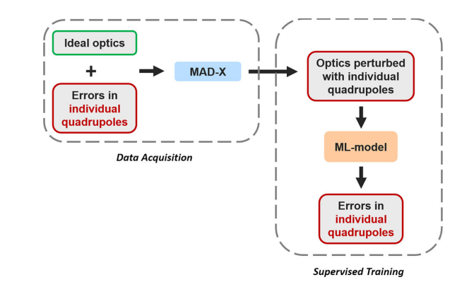
Theoretical Background: Supervised Learning
Supervised learning is a type of ML that uses labelled data to improve
As shown in Elenas paper and in my previous presentation linear errors can be predicted using ML, and linear models perform best
The idea is to apply the same method to predict non linear errors using non linear optic parameters, RDTs
There are multiple models that allow for non linear modelling such as neural networks
In progress
[2] Fig 2. Data pipeline for linear errors

Slide 6
Methods: Simulation requirements for ML
In order to create a useful ML model, good data is the most important requirement
Meaningful observables, in this case RDTs
High volumes of data! => Fast simulations
Realistic and unbiased …
Tracking + OMC analysis: Too slow
MADX-PTC: Too slow
MADNG: Fast!

Slide 7

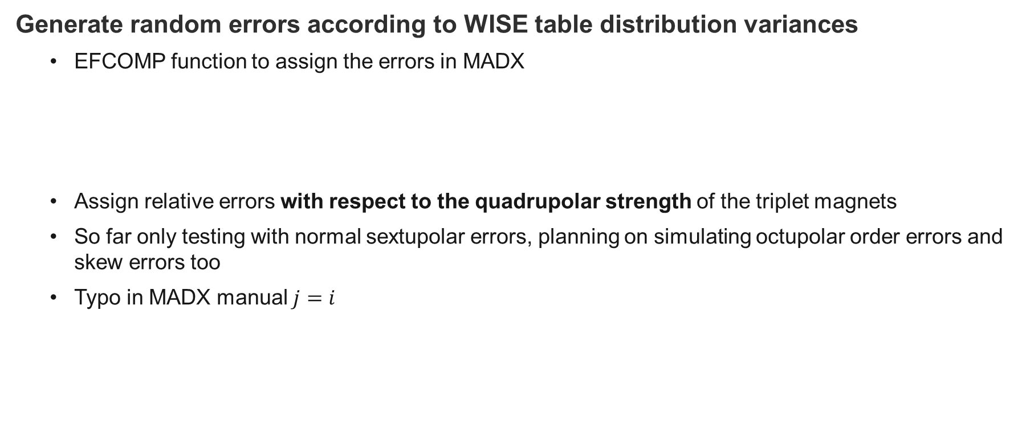
Methods: MADX-PTC Error Simulation
Generate random errors according to WISE table distribution variances
EFCOMP function to assign the errors in MADX
Assign relative errors with respect to the quadrupolar strength of the triplet magnets
So far only testing with normal sextupolar errors, planning on simulating octupolar order errors and skew errors too
Typo in MADX manual $j=i$

Slide 8
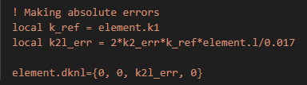
Methods: MADNG Error Simulation
Assigning the same errors in MADNG 0.9.7-pre
Elements have a dknl and dksl attribute
Applying the same formula as in MADX documentation and multiplying by element length the same KNL errors are obtained
PYMADNG Was also used since it provides an easy to use python API
Using the “trkrdt” method in MADNG, much faster!

Slide 9
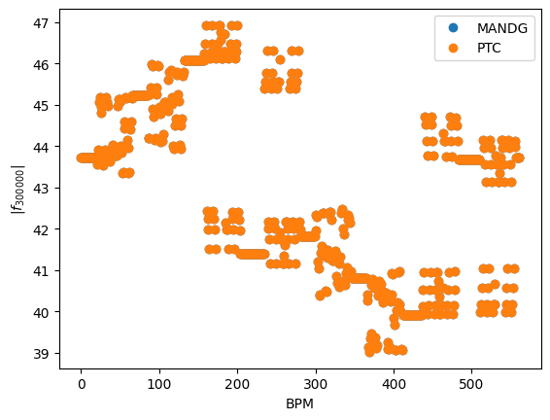
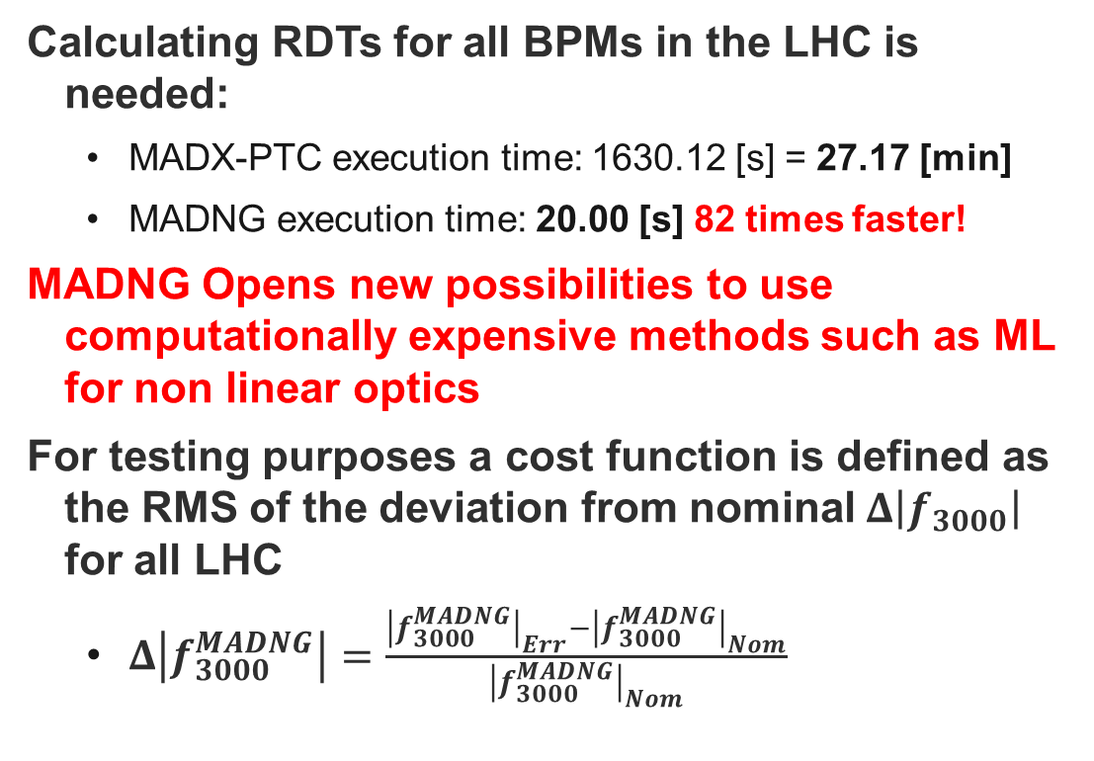
Results: MADNG vs PTC for RDT tracking
Calculating RDTs for all BPMs in the LHC is needed:
MADX-PTC execution time: 1630.12 [s] = 27.17 [min]
MADNG execution time: 20.00 [s] 82 times faster!
MADNG Opens new possibilities to use computationally expensive methods such as ML for non linear optics
For testing purposes a cost function is defined as the RMS of the deviation from nominal$Δ\left|f_{3000}\right|$ for all LHC
$Δ\left|f_{3000}^{MADNG}\right|=\frac{{\left|f_{3000}^{MADNG}\right|}_{Err}−{\left|f_{3000}^{MADNG}\right|}_{Nom}}{{\left|f_{3000}^{MADNG}\right|}_{Nom}}$
Fig 3. Nominal RDTs MADNG vs PTC

Slide 10

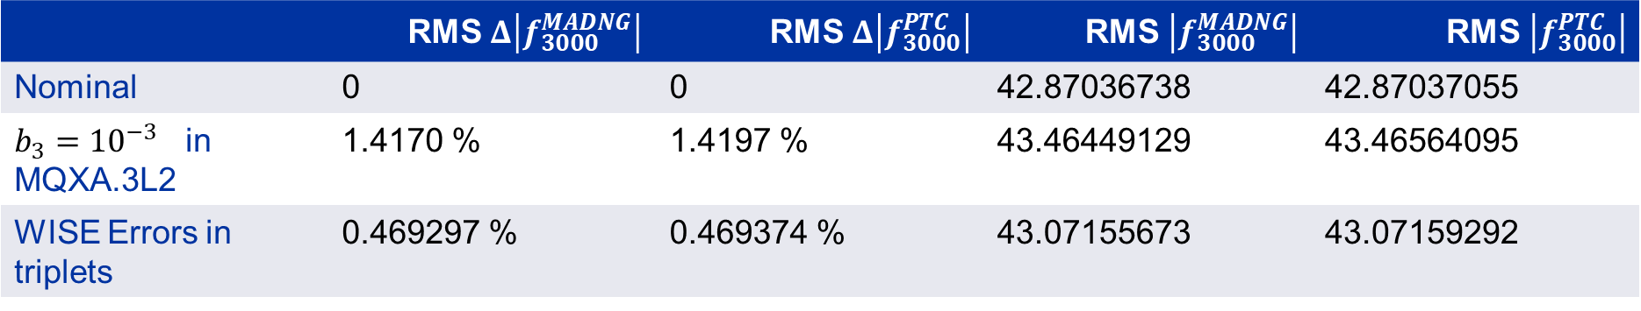
Results: MADNG vs PTC for RDT tracking
 | RMS $Δ\left|f_{3000}^{MADNG}\right|$ | RMS$Δ\left|f_{3000}^{PTC}\right|$ | RMS$\left|f_{3000}^{MADNG}\right|$ | RMS$\left|f_{3000}^{PTC}\right|$
Nominal | 0 | 0 | 42.87036738 | 42.87037055
$b_{3}={10}^{−3}$ in MQXA.3L2 | 1.4170 % | 1.4197 % | 43.46449129 | 43.46564095
WISE Errors in triplets | 0.469297 % | 0.469374 % | 43.07155673 | 43.07159292
Tab 1. Example cost function comparison
Differences between scripts ranging between $10^{−5}\%, 10^{−3}\%$ more than enough for ML

Slide 11
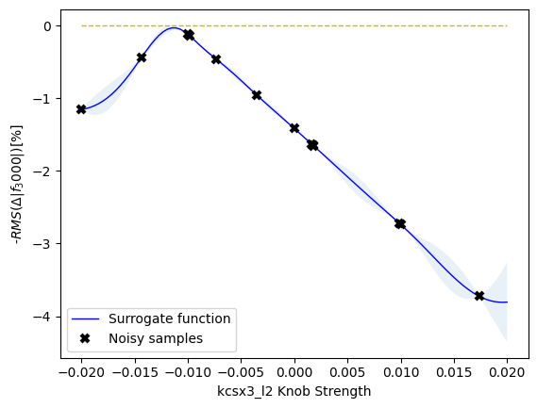
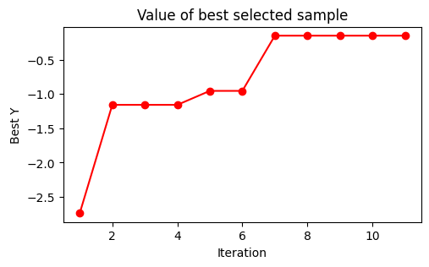
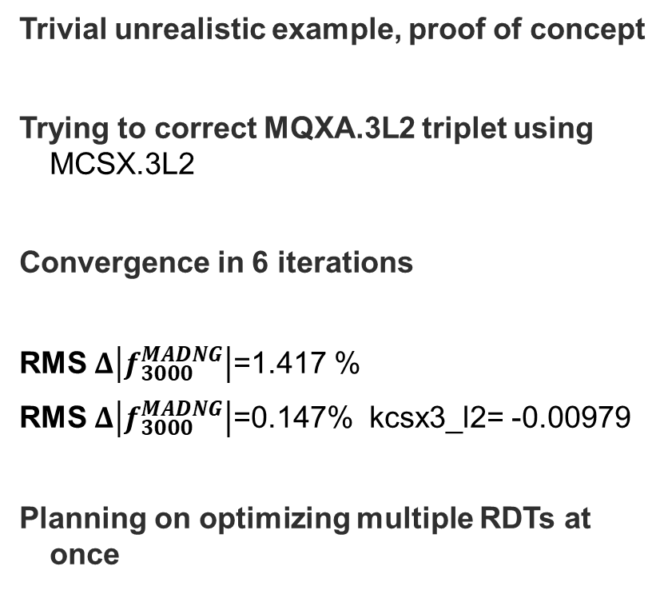
Results: Simple Bayesian Optimization for sextupolar errors in the LHC
Trivial unrealistic example, proof of concept
Trying to correct MQXA.3L2 triplet using MCSX.3L2
Convergence in 6 iterations
RMS $Δ\left|f_{3000}^{MADNG}\right|$=1.417 %
RMS $Δ\left|f_{3000}^{MADNG}\right|$=0.147% kcsx3_l2= -0.00979
Planning on optimizing multiple RDTs at once
Fig 4. Bayesian optimization results for ten iterations

Slide 12
Conclusions and Future Improvements
Experience as a new user in MADNG vs MADX:
Since MADNG is still in development it has a steep learning curve as of today
However since MADNG is based in LuaJIT this allows for more flexibility than MADX
Using MADX-PTC a ML application for RDT optimization is not feasible, MADNG proves to be a very powerful tool, and much faster
ML For RDT optimization:
Further testing must be done to see how useful Bayesian optimization might be, more error types, more correctors…
After finally setting up the error generation section the ML part can be explored more in depth, using BO or more classical ML
ML For tune signal denoising (autoencoders):
In progress..

Slide 13
References
[1] Fig 1. Bayesian optimization. By AnotherSamWilson - Own work, CC BY-SA 4.0, https://commons.wikimedia.org/w/index.php?curid=84842869
[2] Fig 1. Data pipeline. "Supervised learning-based reconstruction of magnet errors in circular accelerators" by E. Fol, 2021, https://doi.org/10.1140/epjp/s13360-021-01348-5

Slide 14
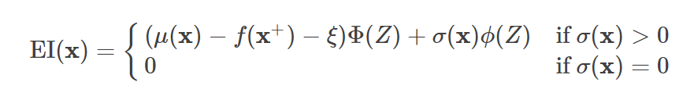
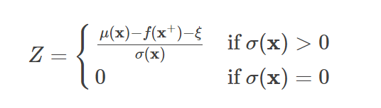

Backup slides: Bayesian Optimization
The Bayesian optimization procedure is as follows. For t=1,2,… repeat:
Find the next sampling point $x_{t}$ by optimizing the acquisition function over the Gaussian Process $x_{t}=argmax_{x} u(x|D_{1:t−1})$
Obtain a possibly noisy sample $y_{t}=f(x_{t})+ε$from the objective function$f$
Add the sample to previous samples $D_{1:t}=D_{1:t−1},(x_{t},y_{t})$and update the surrogate function
$$x^{+}:Best point φ:PDF Φ:CDF ξ:Exploration Explotation hyperparameter$$

Slide 15
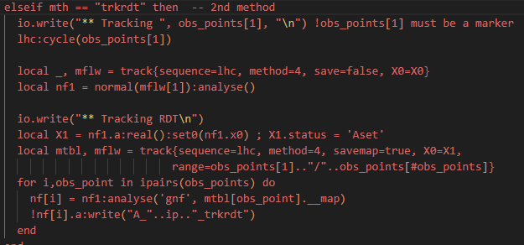

Backup slides
trkrdt Method in MADNG 0.9.7-pre is a much faster method than cycling

Slide 16
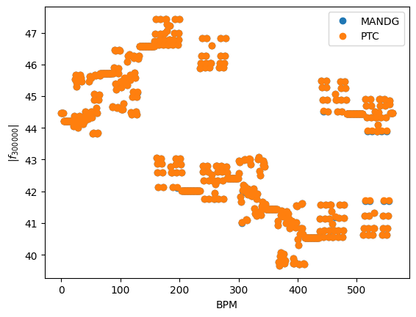
Backup slides

