Slide 1
Supervised learning for Non Linear Corrections in the LHC
Alejandro Börjesson Carazo
14/12/2023

Slide 2
Summary
Introduction
Methods
Results
ML Model
Response Matrix
Response Matrix vs ML Corrections
Performance on Xing Angle setup
Conclusion
Backup slides

Slide 3
Introduction
Recap of the work done thus far in ML for non linear optics
Setting up MADNG simulation for RDT tracking and testing bayesian optimization techniques. Testing against PTC. Bayesian optimization scales poorly with number of correctors, so for this case is not a straight forward technique to apply.
Researching the possibilities of using supervised learning (SL) techniques, SL is a more straight forward technique and can be used as a base for improving Bayesian optimization methods
Testing results against a response matrix approach

Slide 4
Methods: Data generation
Generate RDT data using MADNG datasets vary in size from 7k to 100k samples running on HTCondor
MADX-PTC execution time: 27.17 [min]
MADNG execution time: 20.00 [s] 82 times faster!
Errors assigned to ALL the triplets in all IPs according to the WISE tables [1] [1]
Only predict errors for IP1 and IP5 triplets

Slide 5
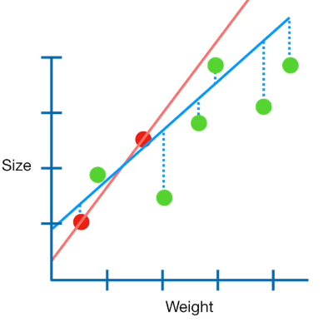
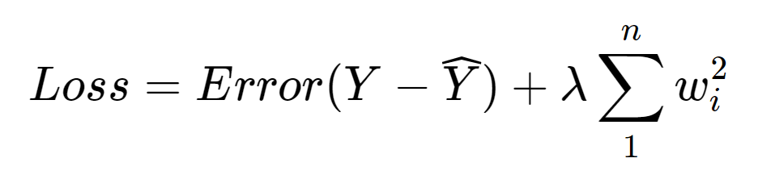
Methods: Supervised Learning
Best results with bagging ridge regression
Ensemble of 10 different regressions trained on different subsets of the data
Input: 8 different RDTs simulated all around 376 BPMs in the LHC => 6016 Dim
Output: K2L, K2SL, K3L and K3SL Errors in the main quadrupoles for IP1 and IP5 => 64 Dim
Also tested using all BPMs, without these performance worsen notably
[2] Fig 1. Ridge regression

Slide 6
Methods: Supervised Learning
Diagram with triplets! (maybe in data generation)
Present setup
Crossing angle scans, amplitude detuning, rdts
=> Can we use only rdts for all orders make question clear
[2] Fig 1. Ridge regression

Slide 7
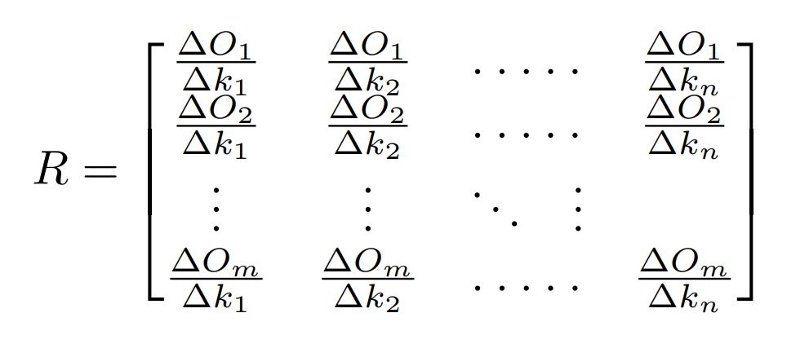
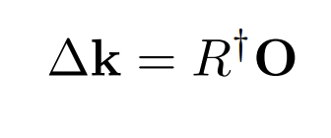
Methods: Response Matrix
The response matrix is defined as follows for a set of m observables we need to create n simulations changing different correction magnets
Multiple approaches were tested
Using the same observables and magnets as the previously explained ML method

Slide 8
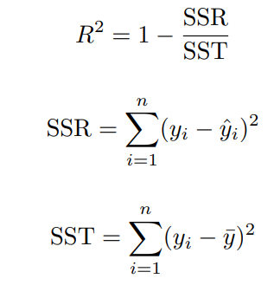
Methods: Performance metrics
Coefficient of determination: R²
R² is a measure that indicates the proportion of the variance in the dependent variable that is predictable from the independent variable
EXPLAIN SSR SST, EASY AND UNDERSTANDABLE
Mean Average Error: MAE
Average absolute error made by the model
Corrected coefficient of determination: CORR R²
R² for the predicted sum over all the triplet errors side of each IP

Slide 9
Results: ML Model
Finding a subset of best quality observables 40 RDTs and 376 BPMs
This means a 30080 dimension input!
Feature extraction:
Most correlated RDTs with error
Highest amplitude in tune signal RDTs
Beware of complex conjugate RDTs
Cutout IR bpms to be closer to meas
Include results with ALL bpms show!
Only 8 RDTs are chosen at the moment!
Horizontal: | Vertical:
OCT. 4000 | OCT. 0220
SEXT. 3000 | SEXT. 1020
S. SEXT. 2010 | S. SEXT. 0030
S. OCT. 2101 | S. OCT. 0121
Tab 1. RDTs chosen as input

Slide 10
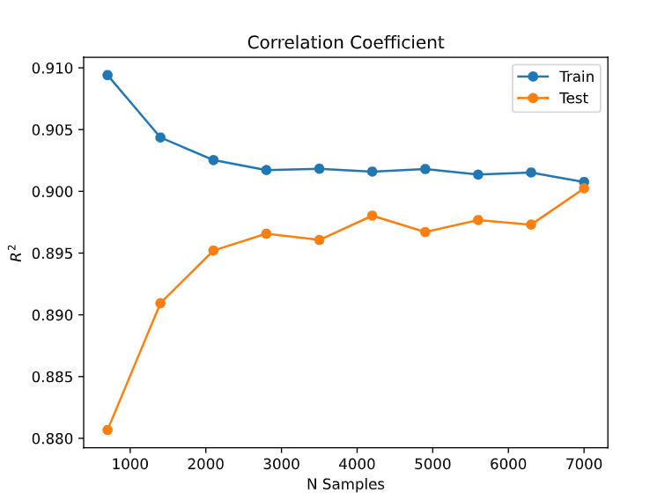
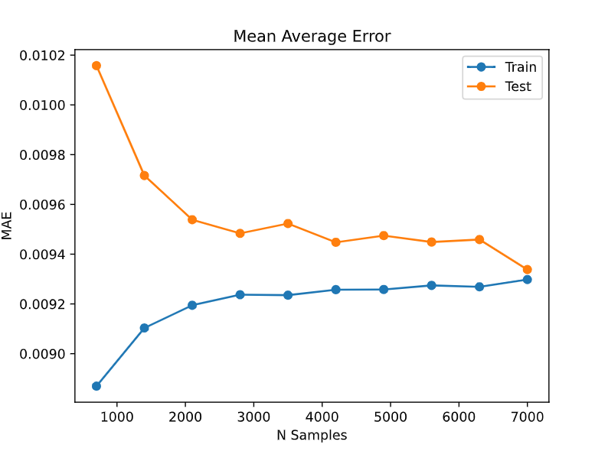
Results: ML Model
Error Type | Set | R2 | MAE [KNL U] | CORR. R2
K2L | Train | 0.630 | 0.000134 | 0.981
 | Test | 0.611 | 0.000136 | 0.980
K2SL | Train | 0.693 | 0.000179 | 0.989
 | Test | 0.694 | 0.000180 | 0.989
K3L | Train | 0.988 | 0.009432 | 0.995
 | Test | 0.988 | 0.009552 | 0.995
K3SL | Train | 0.343 | 0.027764 | 0.707
 | Test | 0.328 | 0.027765 | 0.695
ALL | Train | 0.902 | 0.009126 | 0.971
 | Test | 0.902 | 0.009144 | 0.970
Fig 2. Performance VS dataset size
Tab 2. Best training results
Make a comment in K3SL due to
make labels readable

Slide 11
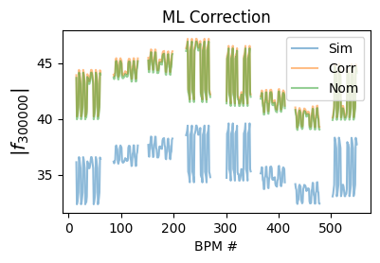
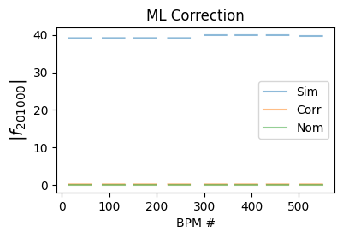
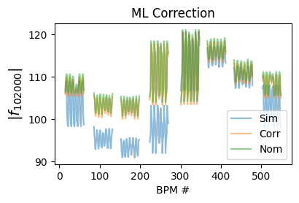
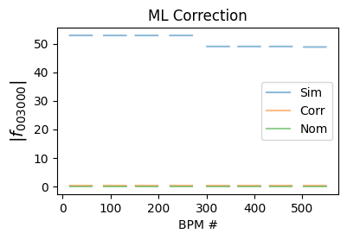
Fig 3. Example Sample correction for sextupolar RDTs

Slide 12
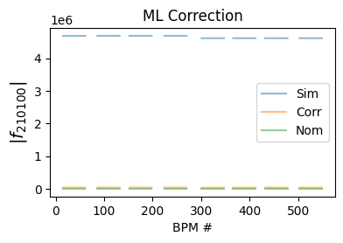
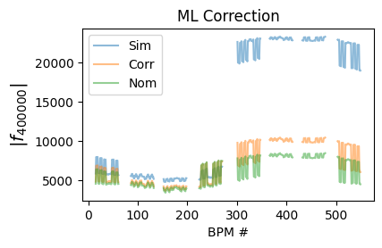
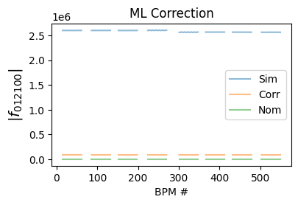
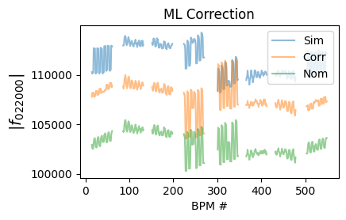
Fig 3. Example Sample correction for octupolar RDTs

Slide 13
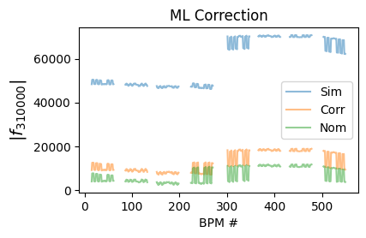
Results: ML Model
All RDTs seem to be corrected, even ones that where not used in the algorithm ie. 3100
Struggling to correct RDT 0220
Is second order from sextupoles
Fig 3. Performance in a RDT that is not included in the model

Slide 14
Results: Response Matrix
First approach:
Single matrix for all orders
Octupolar RDTs are much bigger, trying to normalize the observables
Not trivial, did not work
Second approach:
One matrix per error type, using all RDTs
Not working
Third approach:
One matrix per error type, using relevant RDTs for each matrix, same inputs as ML, WORKS!

Slide 15
Results: Response Matrix
R² Does not make sense for the response matrix as a metric
As you know it fails completely at locating errors
STRONG STATMENENT, if it does not make sense dont add
How good are these correction?
Error Type | R2 | MAE [KNL U] | CORR. R2
K2L | -0.262 | 0.546 | -0.850
K2SL | -0.273 | 0.551 | -0.638
K3L | -10.99 | 1.411 | -14.88
K3SL | -0.290 | 0.549 | -0.918
ALL | -2.968 | 0.773 | -4.147
Tab 3. Performance of the RM as a regressor

Slide 16
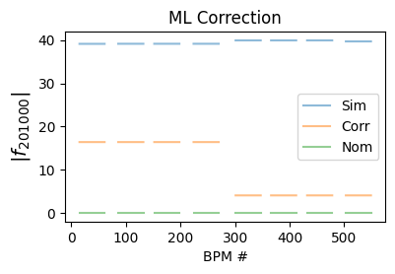
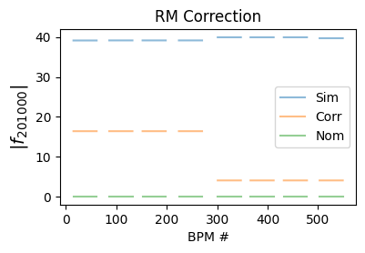
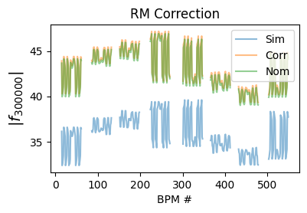
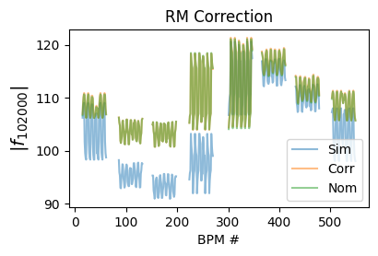
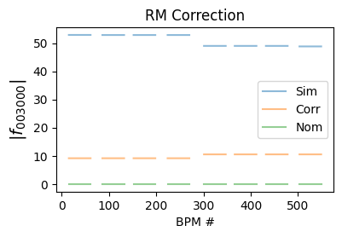
Fig 3. Example Sample correction for sextupolar RDTs

Slide 17
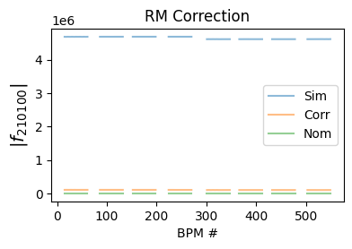
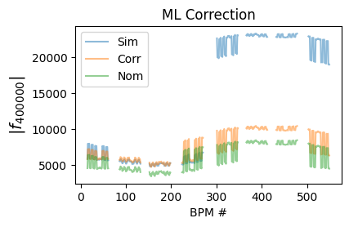

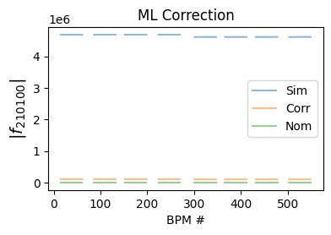
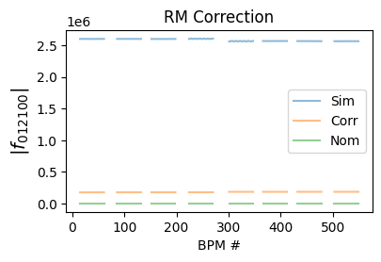
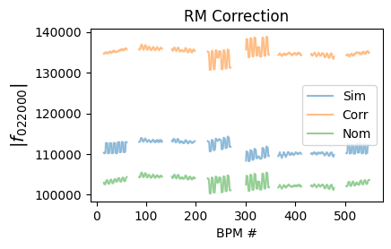
Fig 3. Example Sample correction for sextupolar RDTs

Slide 18
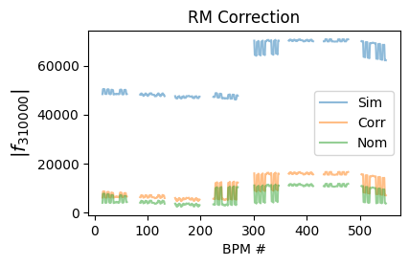
Results: Response Matrix
All RDTs s. 3100
Struggling to correct RDT 0220 AGAIN!
Fig 3. Performance in a RDT that is not included in the model

Slide 19
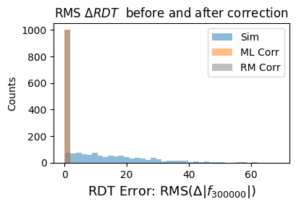
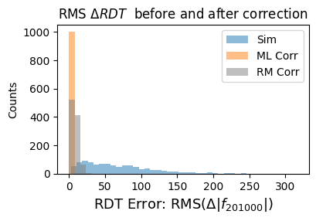
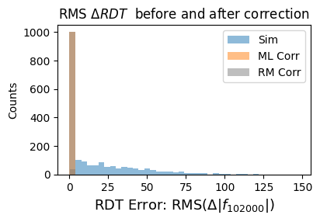
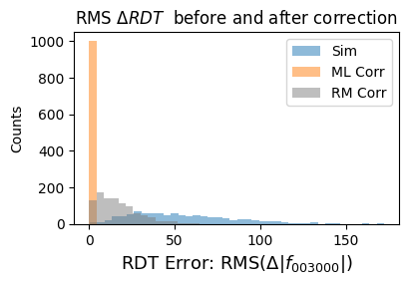
Histogram for Comparison for RM vs ML corrections

Slide 20
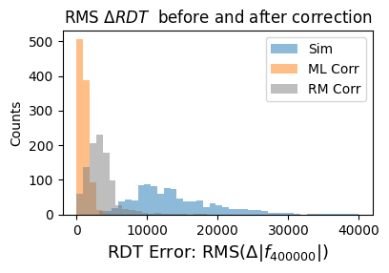
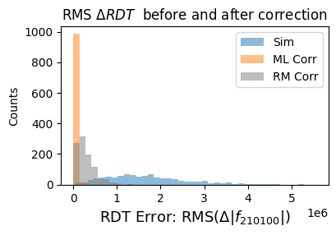
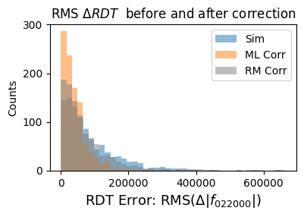
Histogram for Comparison for RM vs ML corrections

Slide 21
Results: Response Matrix VS ML Correction
Working as intended, except for RDT 0220 again, ¿why?
The ML correction performs better in all RDTs
I have found that it is usually more robust than the response matrix approach
Make statement that the corrections are SIMULTANEOUS

Slide 22
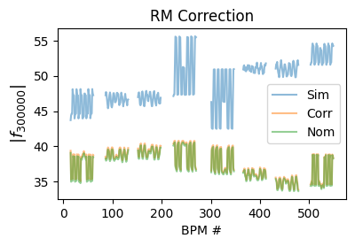
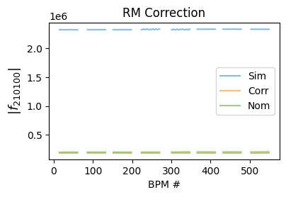
Results: Performance with Xing angles
ML Model:
Training on data with xing angle yields other working model
TBD: Try corrections from the no-xing ML model on a xing angle setup (maybe not mention)
RESULTS PROMISING, appear to be more accurate tan response matrix, full results TBD
Fig 1. Example RDT Machine Learning Correction with xing angles

Slide 23
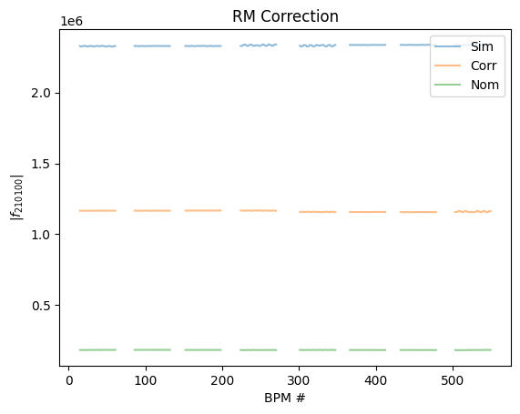
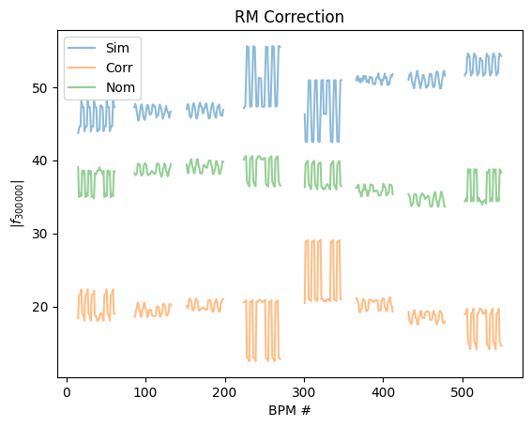
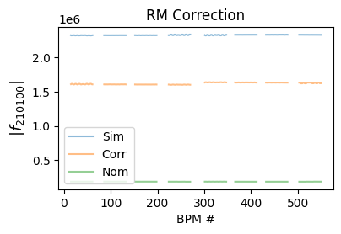
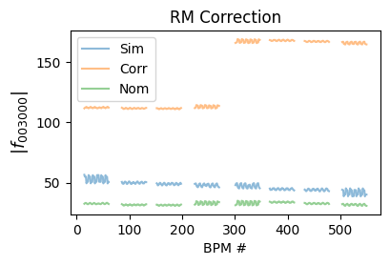
Results: Performance with Xing angles
Response matrix:
Due to feed down the response matrix approach treating all orders separately fails to correct RDTs
CUT IT
Fig 1. Example RDT Response matrix Correction with xing angles

Slide 24
Conclusions
Thus far machine learning seems to be a feasible tool for correcting multiple RDTs at once
Performance is more robust and yields better results than an equivalent response matrix method
Correcting the RDT f2002 has been a challenge, in order to fix this more observables can be used, better understanding of this fact is still on going
In order to make this usable in commissioning setting a realistic noise must be modelled as well as using the actual correctors

Slide 25
References
[1] Fig 1. Example Ridge regression. “Regularization Part 1: Ridge (L2) Regression" by J. Stamer, 2018, https://www.youtube.com/watch?v=Q81RR3yKn30
[2] Magnetic model of the inner triplet quadrupole MQXB. By Joe Di Marco et al. 2009, https://edms.cern.ch/ui/file/2458932/1/fidel_magnet_report_MQXB_doc_cpdf.pdf
[3] Magnetic model of the LHC interaction region quadrupoles MQXA. By N. Ohuchi and E. Todesco, 2009, https://edms.cern.ch/ui/file/2458928/1/fidel_magnet_report_MQXA_docx_cpdf.pdf

Slide 26
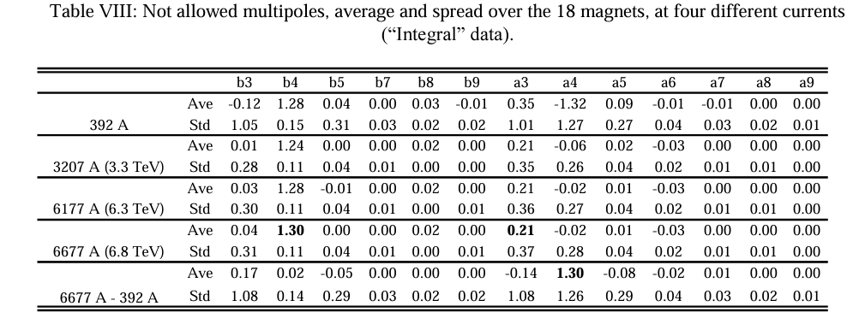
Backup Slides
MQXA Average and Standard error [2]

Slide 27
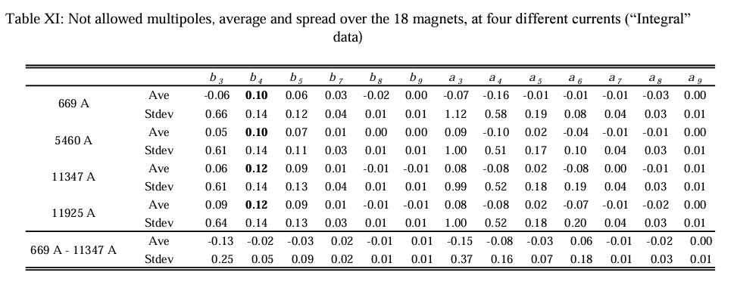
Backup Slides
MQXB Average and Standard error [3]

Slide 28
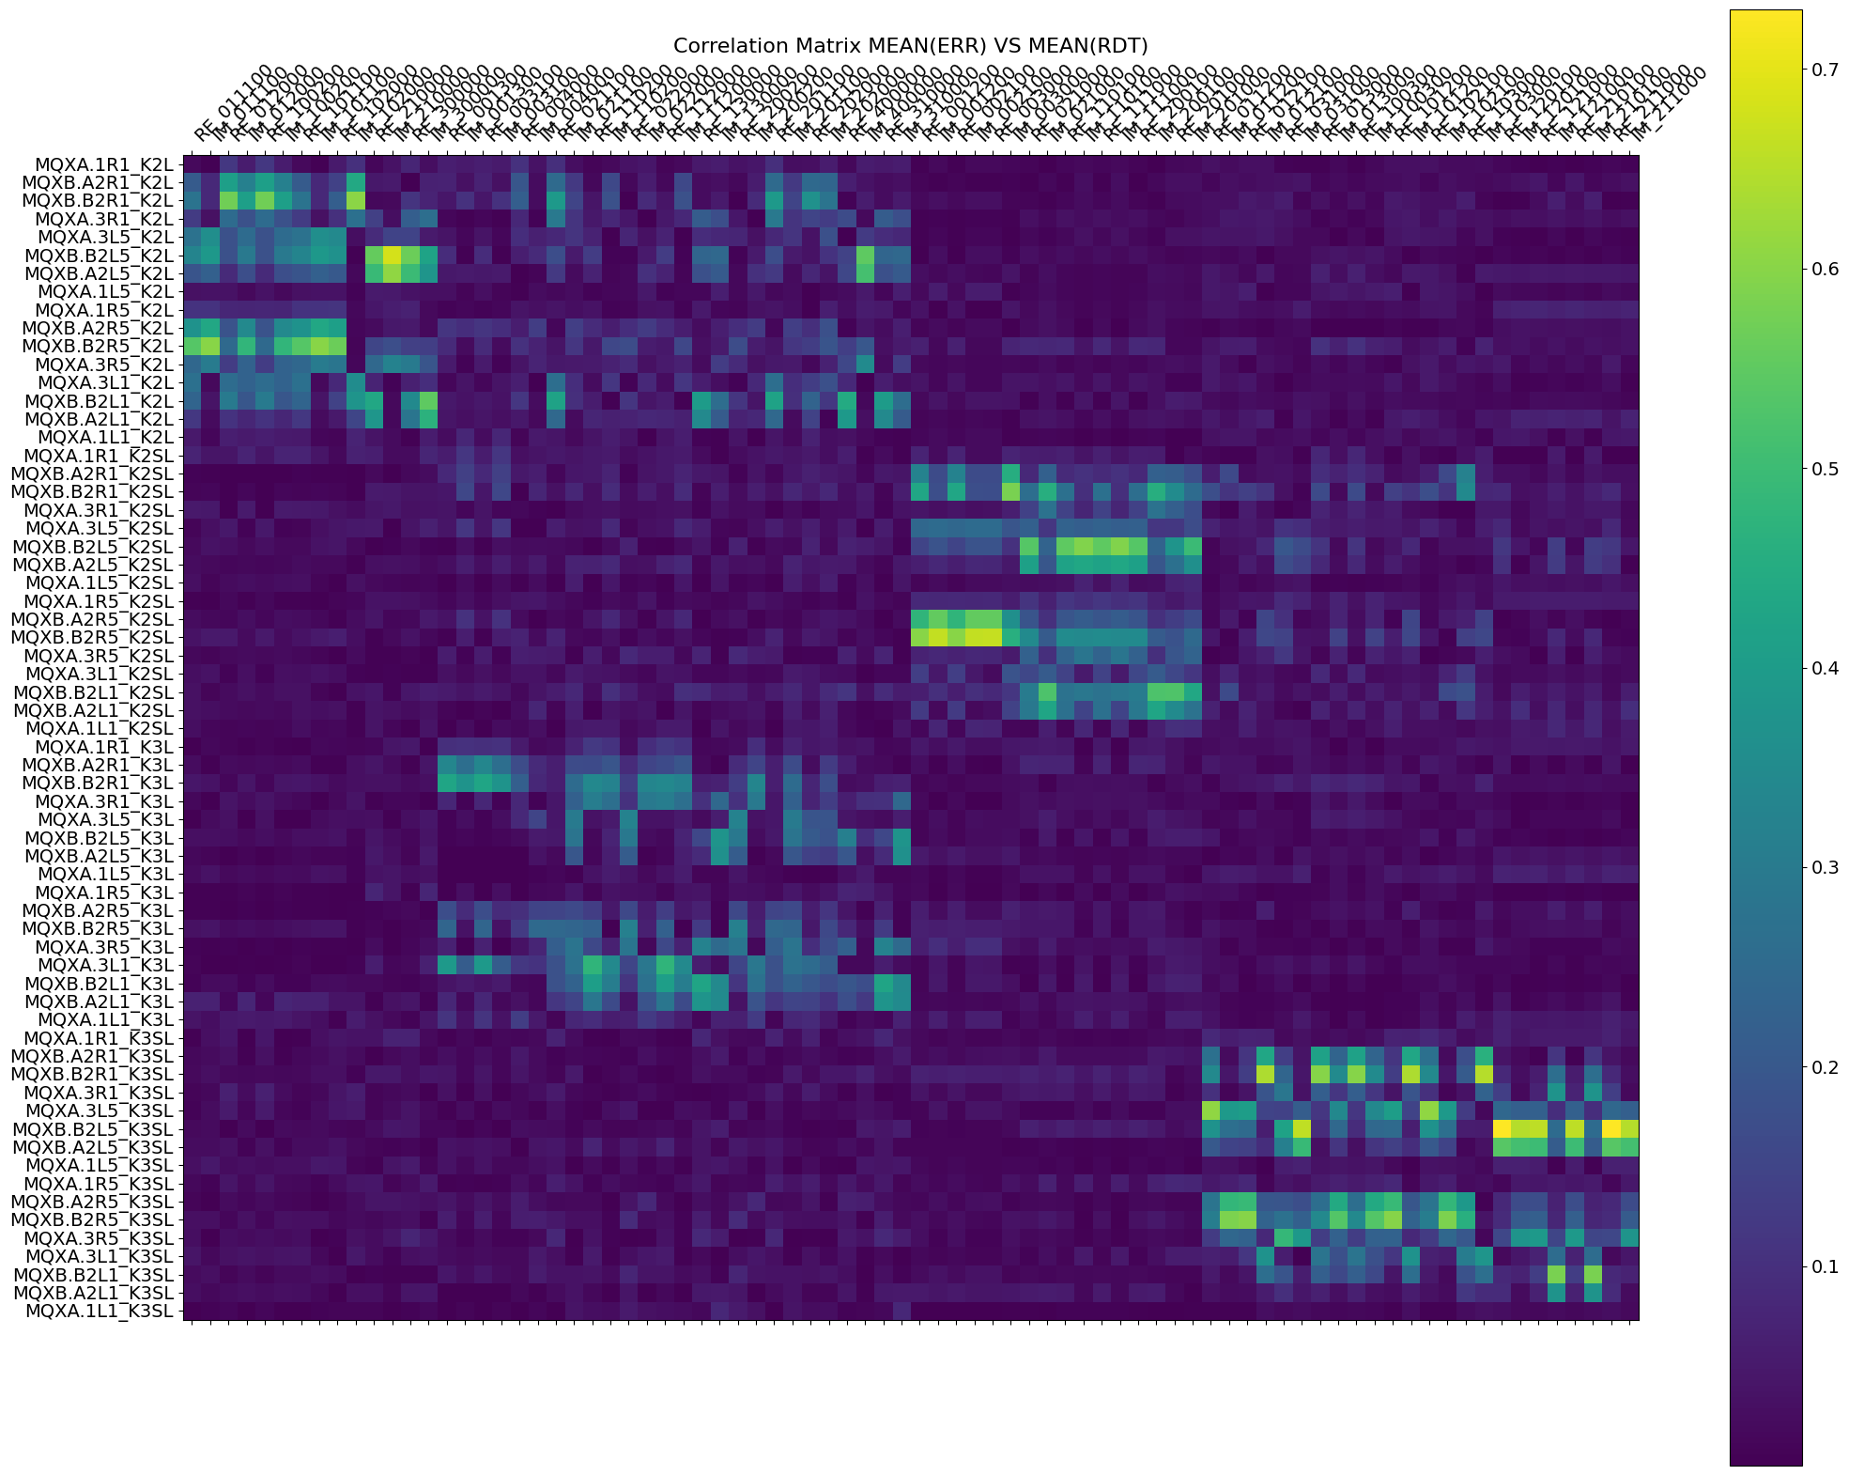
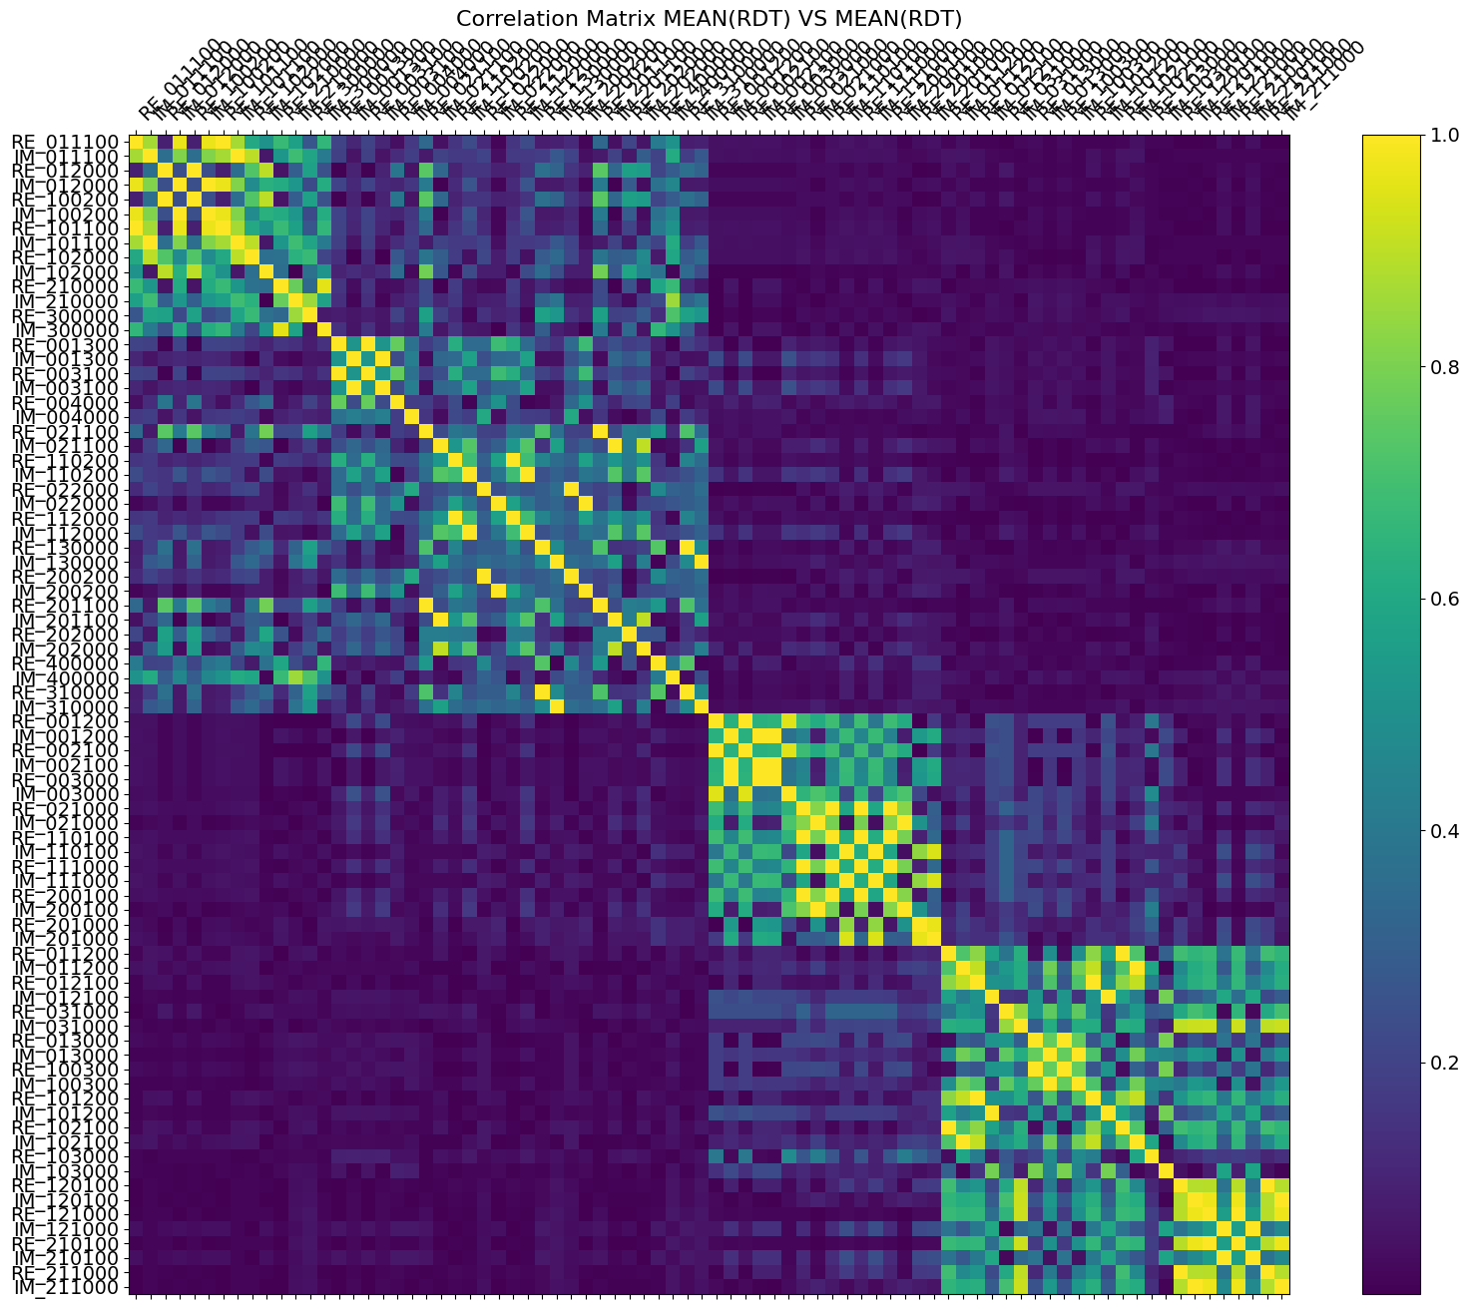
Backup Slides
Correlation Matrix with no xing angle setup

Slide 29
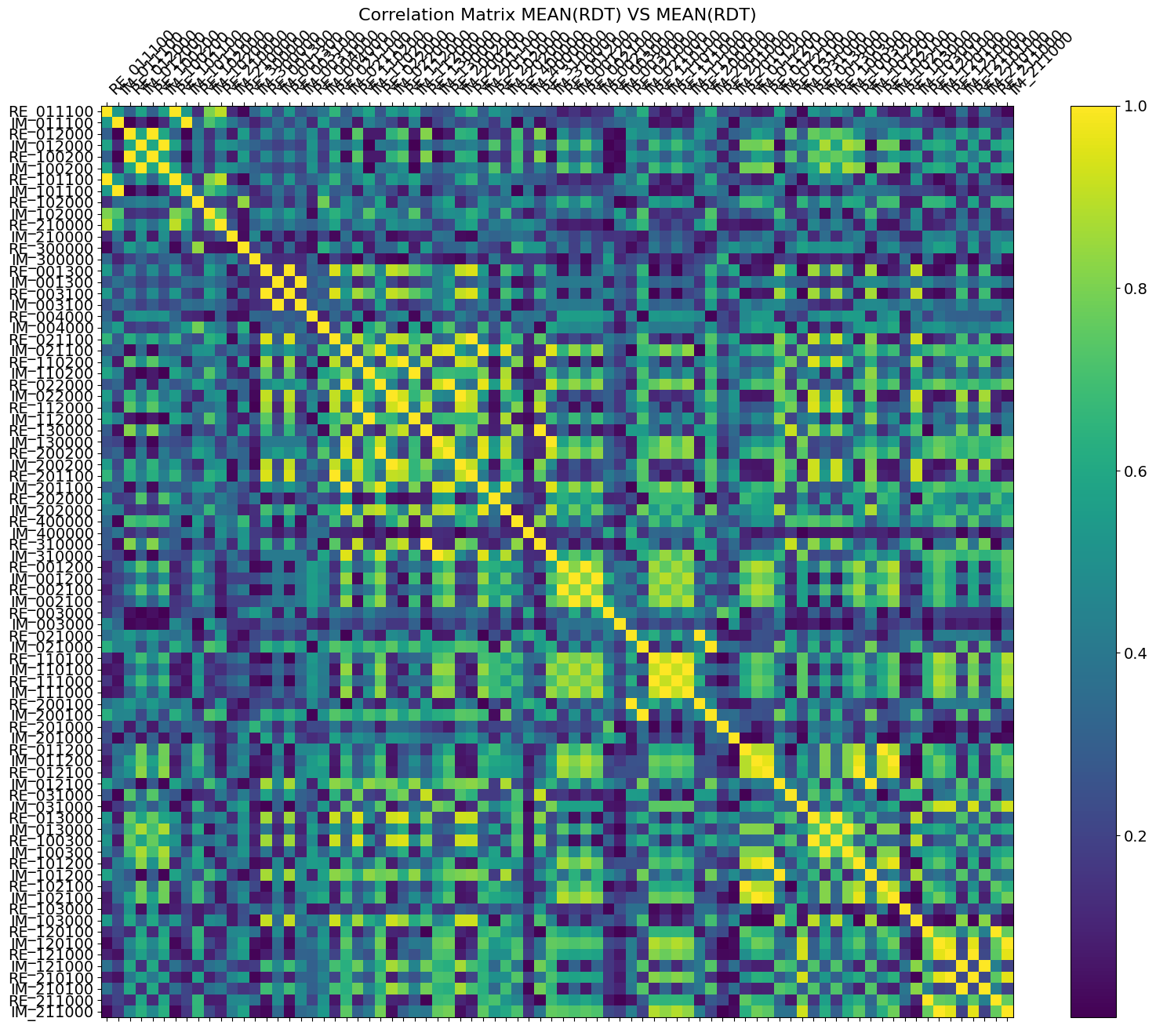
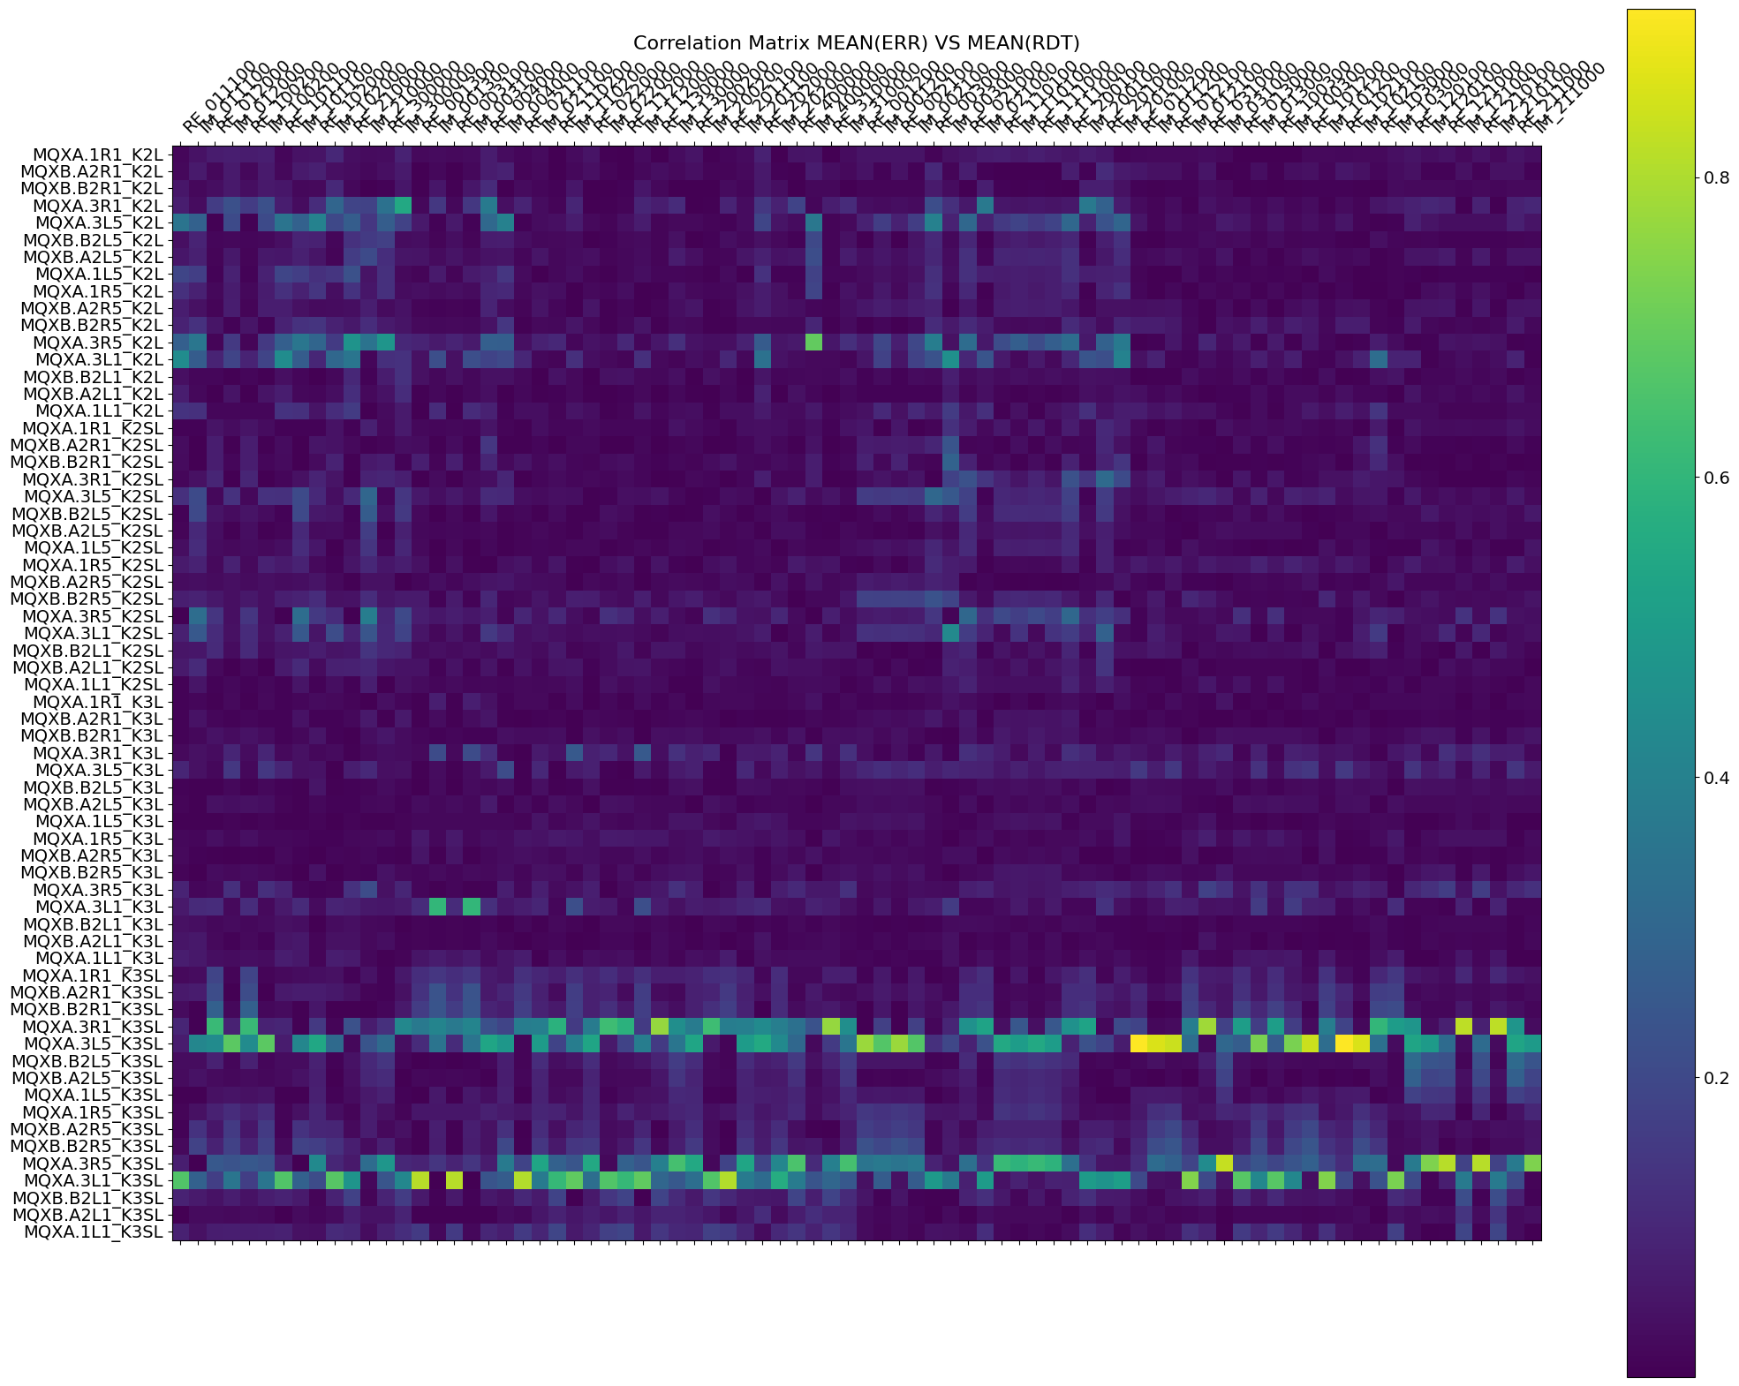
Backup Slides
Correlation Matrix with xing angle setup

Slide 30
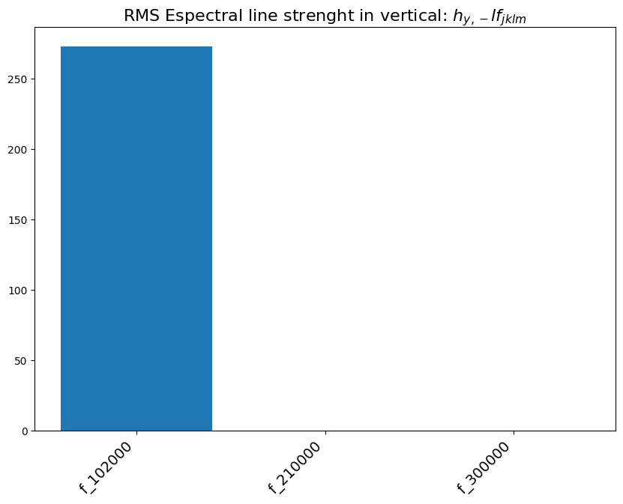
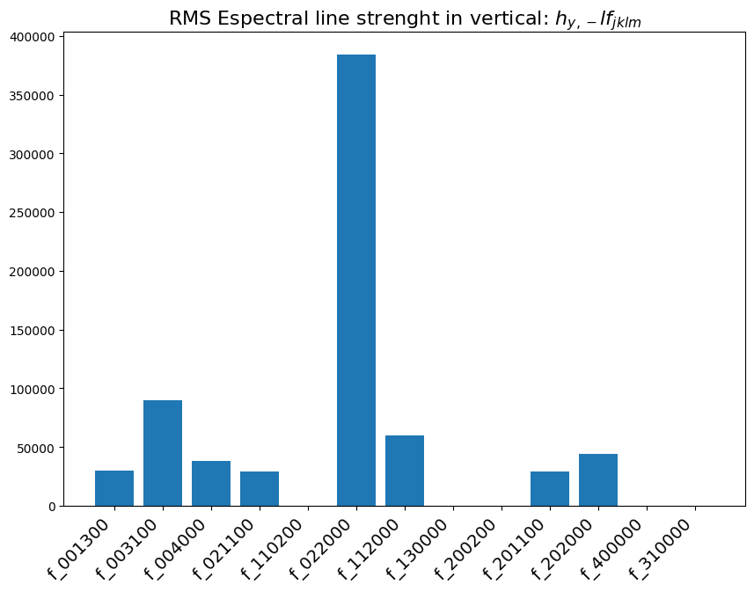
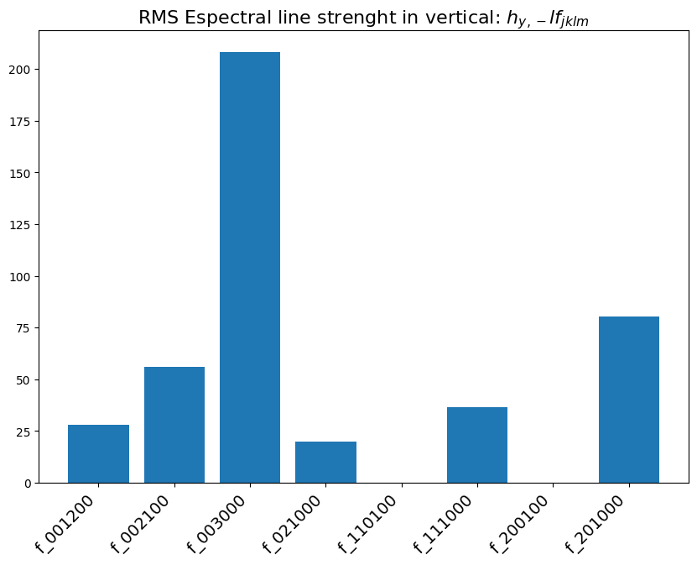
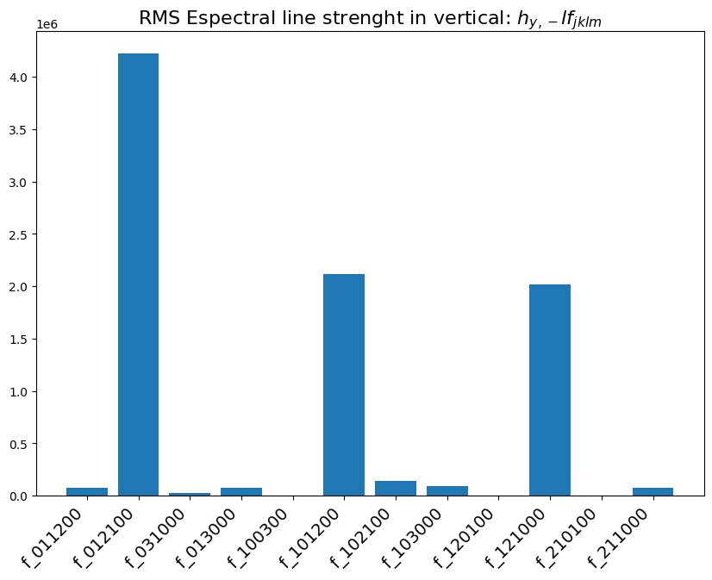
Backup Slides
RMS Spectral line strength in the vertical plane

Slide 31




Backup Slides
RMS Spectral line strength in the horizontal plane

