Slide 1


SCHNEIDER ELECTRIC’S
TRAINEE PROGRAM
Software Development Challenge
Gutiérrez Vázquez, Alejandro

Slide 2

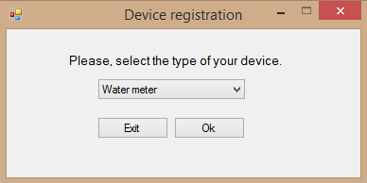
FIRST COMMENTS
.NET Framework 4.8
Newest version
Applications forms:
- intuitive approach
Visually more atractive
Pop-up errors warnings
Notes:
This is an example of a Text Slide. Reference the different layout options in the Slide Master (under the View tab) for different variations. Remember, our new Brand Guidelines call for clean and simple messages and design. Reference the PowerPoint Guidelines on the Brand Book for tips and useful information on creating effective presentations.

Slide 3
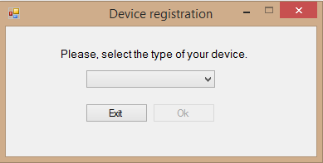
SELECTING THE DEVICE’S TYPE
Ok button disabled until a type is selected.
Each “combobox” has a function associated and you can add more options only adding them to a string.
Notes:
This is an example of a Text Slide. Reference the different layout options in the Slide Master (under the View tab) for different variations. Remember, our new Brand Guidelines call for clean and simple messages and design. Reference the PowerPoint Guidelines on the Brand Book for tips and useful information on creating effective presentations.

Slide 4
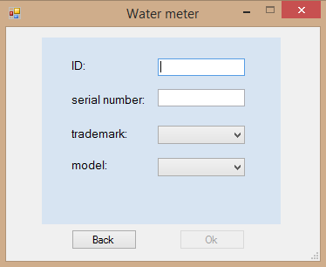
ENTERING DEVICE’S PARAMETERS
The parameters have to be introduced in a group of textbox and combobox
Easy to manage errors and incorrect inputs by the user.
Notes:
This is an example of a Text Slide. Reference the different layout options in the Slide Master (under the View tab) for different variations. Remember, our new Brand Guidelines call for clean and simple messages and design. Reference the PowerPoint Guidelines on the Brand Book for tips and useful information on creating effective presentations.

Slide 5
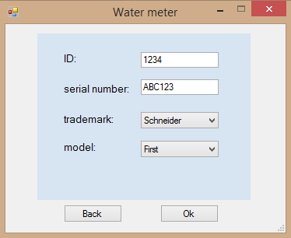
ENTERING DEVICE’S PARAMETERS
Parameters’s format:
ID: Number with 4 digits
Serial number: combination of 6 letters or digits
Trademark and model to be chosen from a group of options
Easy to achieve using forms events and errorProvider
Notes:
This is an example of a Text Slide. Reference the different layout options in the Slide Master (under the View tab) for different variations. Remember, our new Brand Guidelines call for clean and simple messages and design. Reference the PowerPoint Guidelines on the Brand Book for tips and useful information on creating effective presentations.

Slide 6
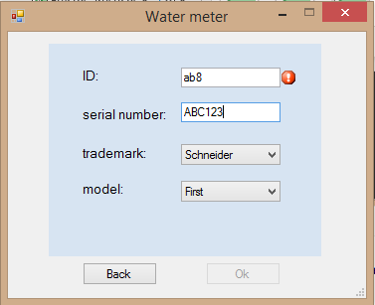
ENTERING DEVICE’S PARAMETERS
The error messages helps the user to fix his mistakes.
Registration can’t be finished without entering the parameters correctly.
Notes:
This is an example of a Text Slide. Reference the different layout options in the Slide Master (under the View tab) for different variations. Remember, our new Brand Guidelines call for clean and simple messages and design. Reference the PowerPoint Guidelines on the Brand Book for tips and useful information on creating effective presentations.

Slide 7
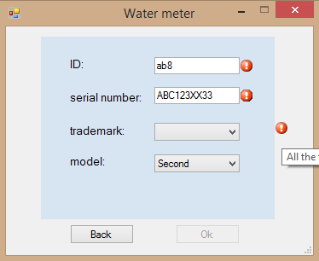
ENTERING DEVICE’S PARAMETERS
Registration can’t be finished without entering the parameters correctly.
Notes:
This is an example of a Text Slide. Reference the different layout options in the Slide Master (under the View tab) for different variations. Remember, our new Brand Guidelines call for clean and simple messages and design. Reference the PowerPoint Guidelines on the Brand Book for tips and useful information on creating effective presentations.

Slide 8
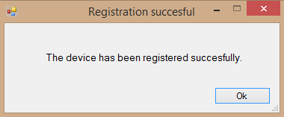
FINISHING THE REGISTRATION
Save_var(): get the values introduced by the user and save them.
Validate(): Checks if the device is already registered.
Register_device(): Write the device’s parameters in a file .txt.
Notes:
This is an example of a Text Slide. Reference the different layout options in the Slide Master (under the View tab) for different variations. Remember, our new Brand Guidelines call for clean and simple messages and design. Reference the PowerPoint Guidelines on the Brand Book for tips and useful information on creating effective presentations.

Slide 9
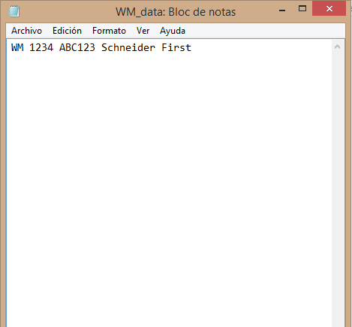
FINISHING THE REGISTRATION
Save_var(): get the values introduced by the user and save them.
Validate(): Checks if the device is already registered.
Register_device(): Write the device’s parameters in a file .txt.
Notes:
This is an example of a Text Slide. Reference the different layout options in the Slide Master (under the View tab) for different variations. Remember, our new Brand Guidelines call for clean and simple messages and design. Reference the PowerPoint Guidelines on the Brand Book for tips and useful information on creating effective presentations.

Slide 10
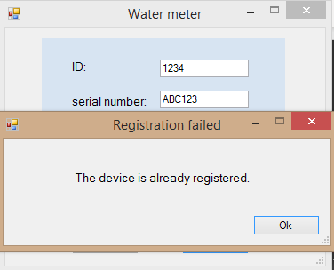
FINISHING THE REGISTRATION
If the ID or serial number introduced are already in the file the aplication will show an error message.
Notes:
This is an example of a Text Slide. Reference the different layout options in the Slide Master (under the View tab) for different variations. Remember, our new Brand Guidelines call for clean and simple messages and design. Reference the PowerPoint Guidelines on the Brand Book for tips and useful information on creating effective presentations.

Slide 11
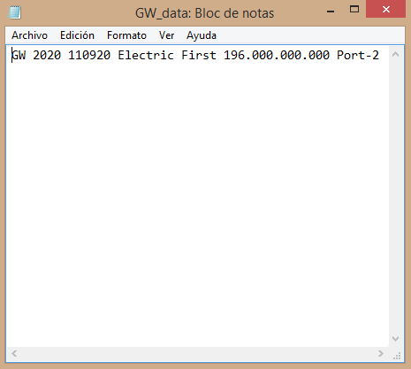
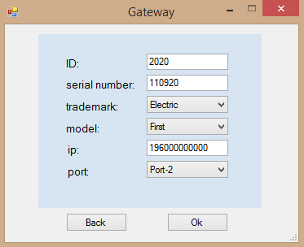
ALL THE 3 DEVICES SUPPORTED
Notes:
This is an example of a Text Slide. Reference the different layout options in the Slide Master (under the View tab) for different variations. Remember, our new Brand Guidelines call for clean and simple messages and design. Reference the PowerPoint Guidelines on the Brand Book for tips and useful information on creating effective presentations.

Slide 12
Notes:
Closing slide

