Slide 1
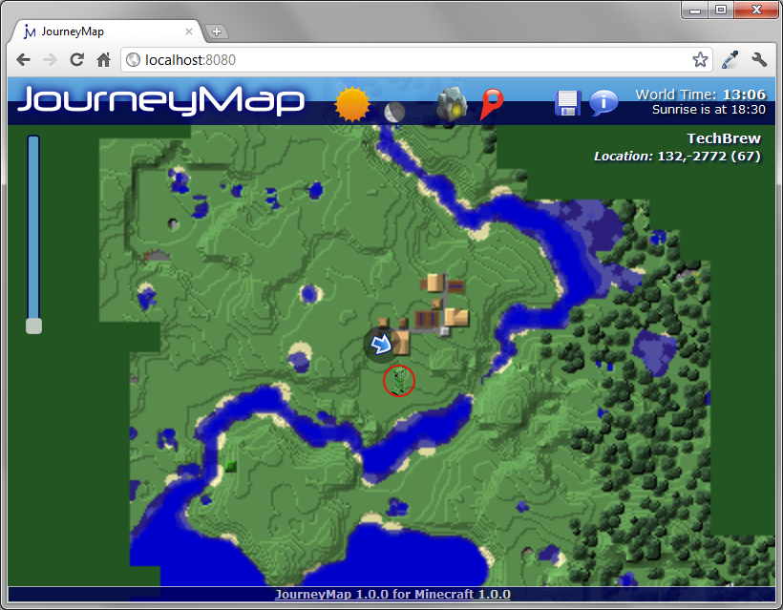
Moonlight
Mode
Toggle “Follow Me”
Daylight
Mode
Save Map Image
Show
Caves
Game Name & Location
Zoom
Slider
Nearby
Monster
Unexplored
Area
Your Position & Heading

