Slide 1
Value-Agnostic Conversational Semantic Parsing
Anthony Platanios, Adam Pauls, Subhro Roy, Yuchen Zhang, Alex Kyte, Alan Guo, Sam Thomson, Jayant Krishnamurthy, Jason Wolfe, Jacob Andreas, Dan Klein

Slide 2
Semantic Parsing / Program Synthesis
UTTERANCE
PROGRAM
What is 1 + 2 + 3?
parsing1
+(x = +(x = 1, y = 2), y = 3))
PRIOR WORK
OUR WORK
Naïve Seq2Seq
[Dong & Lapata 2016]
+ ( x = + ( x = 1 , y = 2 ) , y = 3 ) )
[0] +(x = , y = )
1: Number
_: Number
2: Number
_: Number
[1] +(x = , y = )
[0]: Number
3: Number
_: Number
_: Number
Top-Down Parsing
[Krishnamurthy et al. 2017, Dong & Lapata 2016, 2018]
+(x = _: Number, y = _: Number)
+(x = _: Number, y = _: Number)
1
2
3
Hiding values after generating them.
Bottom-Up Parsing
[Misra & Artzi 2016, Rubin & Berant 2020, Odena 2020]
[0] 1
[1] 2
[2] +(x = [0], y = [1])
[3] 3
[4] +(x = [2], y = [3])

Slide 3
Conversational Semantic Parsing
USER UTTERANCE
PREVIOUS PROGRAM
Can you delete my event called holiday shopping?
delete(
find(
Constraint[Event](
subject = ~=("holiday shopping")
)
)
)
parsing
AGENT UTTERANCE
I can’t find an event with that name.
execution
USER UTTERANCE
PREDICTED PROGRAM
Oh, it’s just called shopping day . It may be at two.
revise(
oldLoc = Constraint[Event](),
rootLoc = Constraint[Any](),
new = Constraint[Event](
subject = ~=("shopping day"),
start = Time(hour = 2, meridiem = PM)
)
)
parsing1

Slide 4


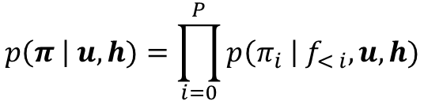


Proposed Method
Model
PREDICTED PROGRAM
ENTITY PROPOSERS
USER UTTERANCE
revise(
oldLoc = Constraint[Event](),
rootLoc = Constraint[Any](),
new = Constraint[Event](
subject = ~=("shopping day"),
start = Time(hour = 2, meridiem = PM)
)
)
Month.May
Number(2)
Oh, it’s just called shopping day . It may be at two.
Annotate spans with potential values.
LINEARIZED REPRESENTATION
MODEL
This is the representation predicted by the proposed model.
We propose the following factorization:
$$π_{0}$$
function invocation
$$p\left(π \right| u, h)=\prod_{i=0}^{P}{p\left(π_{i} \right| f_{< i}, u, h)}$$
We have 4 types of argument values
[0] Constraint[Event]()
[1] Constraint[Any]()
[2] ~=(value = "shopping day")
[3] Time(hour = 2 , meridiem = PM )
[4] Constraint[Event](subject = [2], start = [3])
[5] revise(oldLoc = [0], rootLoc = [1], new = [4])
copy
entity
program
constant
utterance
reference
dialogue history
Only depends on the past sequence of functions and not the complete function invocations (i.e., no argument values).
function
argument
value
$$f_{5}$$
$$a_{51}$$
$$v_{51}$$

Slide 5



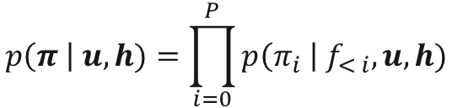

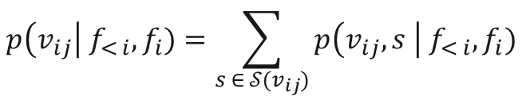

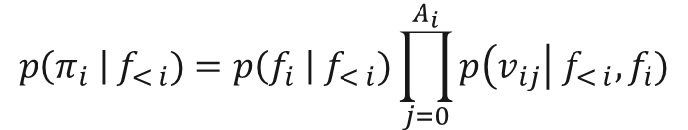


Proposed Method
Model / Encoder
Model / Decoder
$$p\left(π \right| u, h)=\prod_{i=0}^{P}{p\left(π_{i} \right| f_{< i}, u, h)}$$
$$p\left(π_{i} \right| f_{< i})=p\left(f_{i} \right| f_{< i})\prod_{j=0}^{A_{i}}{p\left(v_{ij}\right| f_{< i}, f_{i})}$$
neural encoder-decoder architecture
function scoring
argument value scoring
ENCODER
Reduce the dependence on the dialogue history using meta-computation operators [SM et al., 2020].
Encode a stripped-down version of the dialogue history.
The independence assumptions help improve both efficiency (and latency) and generalization accuracy.
DECODER
Function Scoring: Autoregressive Transformer with a function signature embedding component.
UTTERANCE ENCODER
Argument Value Scoring: We have four kinds of argument sources: references, constants, copies, and entities.
CURRENT USER UTTERANCE
embed
$$u$$
transformer
We marginalize over the sources of each value:
$$H_{utt}$$
PREVIOUS USER UTTERANCE
PREVIOUS PROGRAM
HISTORY TYPES
history
Can you delete my event called holiday shopping ?
delete(
find(
Constraint[Event](
subject = ~=("holiday shopping")
)
)
)
String
Constraint[String]
Constraint[Event]
Event
Unit
EventNotFoundError
types extractor
encoder
$$p\left(v_{ij}\right| f_{< i}, f_{i})=\sum_{s ∈ 𝒮(v_{ij})}{p\left(v_{ij},s \right| f_{< i}, f_{i})}$$
$$h$$
parsing
decoder
utterance
HISTORY ENCODER
$$u$$
AGENT UTTERANCE
embed
I can’t find an event with that name .
K
V
Q
+
decoder
$$h$$
$$T$$
attention
$$H_{enc}$$
execution

Slide 6

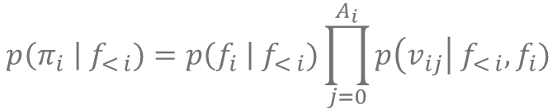





Proposed Method
Model / Decoder
Argument Value Scoring
$$p\left(π_{i} \right| f_{< i})=p\left(f_{i} \right| f_{< i})\prod_{j=0}^{A_{i}}{p\left(v_{ij}\right| f_{< i}, f_{i})}$$
$$H_{utt}$$
$$H_{dec}$$
...
called
shopping
day
...
[0] Constraint[Event]()
[1] Constraint[Any]()
[2] ~=(value = "shopping day")
[3] Time(hour = 2 , meridiem = PM)
...
function scoring
argument value scoring
The independence assumptions help improve both efficiency (and latency) and generalization accuracy.
DECODER
Function Scoring: Autoregressive Transformer with a function signature embedding component.
reference logits
$$=φ^{reference}({\hat{h}}_{dec}^{k})$$
learned constant value embeddings
Argument Value Scoring: We have four kinds of argument sources: references, constants, copies, and entities.
constant logits
$$=φ^{constant}(c^{k})$$
learned linear function
We marginalize over the sources of each value:
copy logits
$$=φ^{{copy}_{start}}\left(h_{utt}^{k_{start}}\right)+φ^{{copy}_{end}}(h_{utt}^{k_{end}})$$
entity logits
$$=φ^{{entity}_{start}}\left(h_{utt}^{k_{start}}\right)+φ^{{entity}_{end}}(h_{utt}^{k_{end}})$$
$$p\left(v_{ij}\right| f_{< i}, f_{i})=\sum_{s ∈ 𝒮(v_{ij})}{p\left(v_{ij},s \right| f_{< i}, f_{i})}$$
The span copy mechanism avoids the otherwise quadratic memory cost while only copying contiguous spans directly!

Slide 7
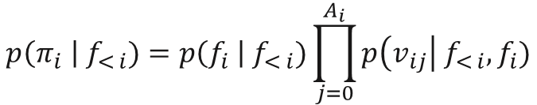


Proposed Method
Model
$$p\left(π \right| u, h)=\prod_{i=0}^{P}{p\left(π_{i} \right| f_{< i}, u, h)}$$
$$p\left(π_{i} \right| f_{< i})=p\left(f_{i} \right| f_{< i})\prod_{j=0}^{A_{i}}{p\left(v_{ij}\right| f_{< i}, f_{i})}$$
neural encoder-decoder architecture
function scoring
argument value scoring
ENCODER
Reduce the dependence on the dialogue history using meta-computation operators [SM et al., 2020].
Encode a stripped-down version of the dialogue history.
The independence assumptions help improve both efficiency (and latency) and generalization accuracy.
DECODER
Function Scoring: Autoregressive Transformer with a function signature embedding component.
Argument Value Scoring: We have four kinds of argument sources: references, constants, copies, and entities.
history
types extractor
encoder
function scoring
$$h$$
decoder
program
argument value scoring
$$π$$
utterance
$$u$$
references
constants
copies
entities

Slide 8
Experiments
Results
Datasets
CONVERSATIONAL SEMANTIC PARSING
SMCalFlow [SM et al., 2020]: 33k training dialogues.
TreeDST [Cheng et al., 2020]: 19k training dialogues.

Slide 9
Experiments
Ablations
We also ran some ablation experiments to determine the impact of each decision:
The less the training data, the larger the impact of our modeling decisions.

Slide 10
Experiments
Takeaways
Our independence assumptions, value hiding, and stripped-down dialogue history representation resulted in:
Significant accuracy gains
Improved training speed (~10x faster training than Seq2Seq baseline)
Lower prediction latency (~10x lower latency than Seq2Seq baseline)
Span copies and entity proposers help significantly in the low data regime.
Also ran experiments on traditional non-contextual semantic parsing datasets and got similar results to current state-of-the-art:

Slide 11
Thank You!

Slide 12
Semantic Parsing / Program Synthesis
UTTERANCE
PROGRAM
What is 1 + 2 + 3?
parsing1
+(x = +(x = 1, y = 2), y = 3))
PRIOR WORK
OUR WORK
[0] +(x = , y = )
1: Number
_: Number
2: Number
Naïve Seq2Seq
[Dong & Lapata 2016]
+ ( x = + ( x = 1 , y = 2 ) , y = 3 ) )
_: Number
[1] +(x = , y = )
[0]: Number
3: Number
sequence of 20 dependent decisions
_: Number
_: Number
sequence of 3 dependent decisions
Top-Down Parsing
[Krishnamurthy et al. 2017, Dong & Lapata 2016, 2018]
+(x = _: Number, y = _: Number)
+(x = _: Number, y = _: Number)
1
2
3
Hiding values after generating them.
Shorter dependent action sequences.
sequence of 5 dependent decisions
Bottom-Up Parsing
[Misra & Artzi 2016, Rubin & Berant 2020, Odena 2020]
[0] 1
[1] 2
[2] +(x = [0], y = [1])
[3] 3
[4] +(x = [2], y = [3])
sequence of 5 dependent decisions

Slide 13
Proposed Method
Independence Assumptions
UTTERANCE
PROGRAM
What is 1 + 2 + 3?
parsing1
+(x = +(x = 1, y = 2), y = 3))
PRIOR WORK
OUR WORK
[0] +(x = , y = )
Naïve Seq2Seq
[Dong & Lapata 2016]
+ ( x = + ( x = 1 , y = 2 ) , y = 3 ) )
1: Number
2: Number
[1] +(x = , y = )
sequence of 20 dependent decisions
[0]: Number
3: Number
sequence of 3 dependent decisions
[0] +(x = _: Number, y = _: Number)
+
(
x
=
+
(
x
=
1
,
1
2
y
=
2
)
,
y
=
3
)
)
[1] +(x = _: Number, y = _: Number)
[0]
3
longest path = 20 dependent decisions
longest path = 3 dependent decisions

Slide 14
Proposed Method
Model / Encoder
$$p\left(π \right| u, h)=\prod_{i=0}^{P}{p\left(π_{i} \right| f_{< i}, u, h)}$$
neural encoder-decoder architecture
ENCODER
Reduce the dependence on the dialogue history using meta-computation operators [SM et al., 2020]. E.g.:
Only contains information that is mentioned in the current user utterance.
CURRENT PROGRAM with revision
revise(
oldLoc = Constraint[Event](),
rootLoc = RoleConstraint(start),
new = Time(hour = 3, meridiem = PM)
)
CURRENT USER UTTERANCE
It actually starts at 3pm.
Contains information that is not mentioned in the current user utterance.
PREVIOUS PROGRAM
CURRENT PROGRAM without revision
delete(find(
Constraint[Event](
subject = ~=("holiday shopping"),
start = Time(hour = 2, meridiem = PM),
end = Time(hour = 5, meridiem = PM)
)
))
delete(find(
Constraint[Event](
subject = ~=("holiday shopping"),
start = Time(hour = 3, meridiem = PM),
end = Time(hour = 5, meridiem = PM)
)
))

Slide 15


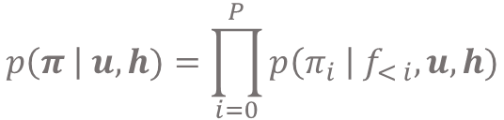
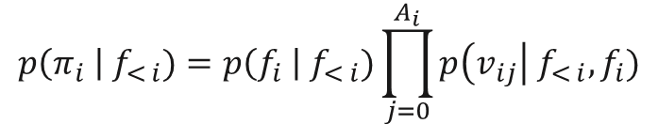
Proposed Method
Model / Decoder
$$p\left(π \right| u, h)=\prod_{i=0}^{P}{p\left(π_{i} \right| f_{< i}, u, h)}$$
$$p\left(π_{i} \right| f_{< i})=p\left(f_{i} \right| f_{< i})\prod_{j=0}^{A_{i}}{p\left(v_{ij}\right| f_{< i}, f_{i})}$$
neural encoder-decoder architecture
function scoring
ENCODER
Reduce the dependence on the dialogue history using meta-computation operators [SM et al., 2020].
Encode a stripped-down version of the dialogue history.
The independence assumptions help improve both efficiency (and latency) and generalization accuracy.
DECODER
Function Scoring: Autoregressive Transformer with a function signature embedding component.
FUNCTION SIGNATURE
Book[Flight](from: City, to: City): Booking[Flight]
name
type
argument
argument
type
history
types extractor
$$h$$
encoder
from: City
decoder
name
type
utterance
$$u$$
+
pooling
+
+
function embedding
argument embedding
FUNCTION EMBEDDER
ARGUMENT EMBEDDER

Slide 16



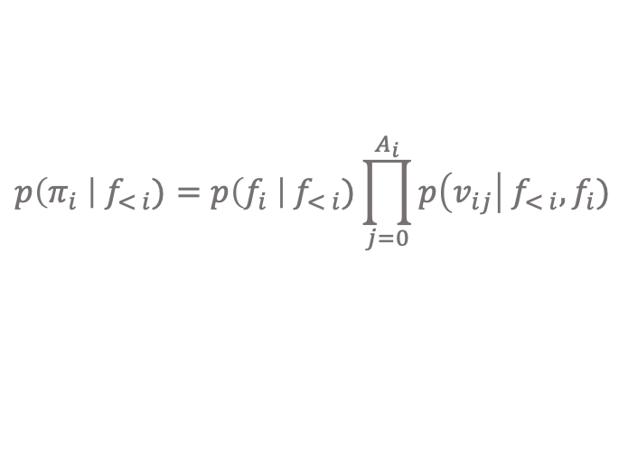





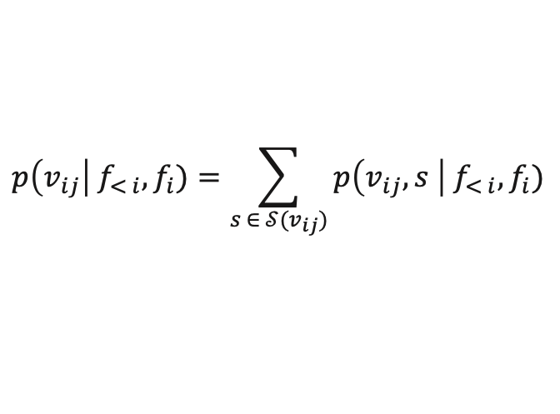
Proposed Method
Model / Decoder
Argument Value Scoring
model parameters
$$p\left(π_{i} \right| f_{< i})=p\left(f_{i} \right| f_{< i})\prod_{j=0}^{A_{i}}{p\left(v_{ij}\right| f_{< i}, f_{i})}$$
We use the following scoring function:
$$φ^{kind}(\tilde{v})={\tilde{v}}^{⊤}\left(h_{dec}^{i,a_{ij}}+w_{a_{ij}}^{kind} \right)+b_{a_{ij}}^{kind}$$
function scoring
argument value scoring
The independence assumptions help improve both efficiency (and latency) and generalization accuracy.
$$h_{dec}^{i,a_{ij}}≜{\hat{h}}_{dec}^{i}⨀\tanh\left(f_{i}+a_{ij}\right)$$
conditioned decoder state
DECODER
$$H_{utt}$$
$$H_{dec}$$
...
called
shopping
day
...
[0] Constraint[Event]()
[1] Constraint[Any]()
[2] ~=(value = "shopping day")
[3] Time(hour = 2 , meridiem = PM)
...
Function Scoring: Autoregressive Transformer with a function signature embedding component.
Argument Value Scoring: We have four kinds of argument sources: references, constants, copies, and entities.
We marginalize over the sources of each value:
reference logits
$$=φ^{reference}({\hat{h}}_{dec}^{k})$$
$$p\left(v_{ij}\right| f_{< i}, f_{i})=\sum_{s ∈ 𝒮(v_{ij})}{p\left(v_{ij},s \right| f_{< i}, f_{i})}$$
learned constant value embeddings
constant logits
$$=φ^{constant}(c^{k})$$
copy logits
$$=φ^{{copy}_{start}}\left(h_{utt}^{k_{start}}\right)+φ^{{copy}_{end}}(h_{utt}^{k_{end}})$$
entity logits
$$=φ^{{entity}_{start}}\left(h_{utt}^{k_{start}}\right)+φ^{{entity}_{end}}(h_{utt}^{k_{end}})$$
The span copy mechanism avoids the otherwise quadratic memory cost while only copying contiguous spans directly!

