Slide 1
U
Q₁
Q₂
EGP₀
k₁₂
F₀₁Q₁(GV)
x₁
k_{b1}
k_{a1}
x₂
k_{b2}
I
k_{a2}
x₃
k_{b3}
k_{a3}

Slide 2
slow channel
ku
Q_{1a}
Q₂
k_{a1}
LD_{a}
k_{a1}
fast channel
(1-k)u
Q_{1b}
Q₃
k_{a2}
plasma
insulin
LD_{b}
k_{e}

Slide 3
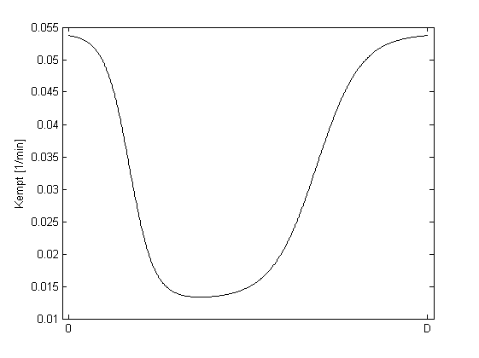
kmax
K_{empt} [min⁻¹]
(kmax-kmin)/2
kmin
c·D
b·D

Slide 4
S₁
S₂
I
u(t)
t_{maxI}
t_{maxI}
k_{e}

