Slide 1
Transport Comparison
Alyssa Blackburn
Marie Hilliard
Alejandro Parraguez
Notes:
redesign

Slide 2
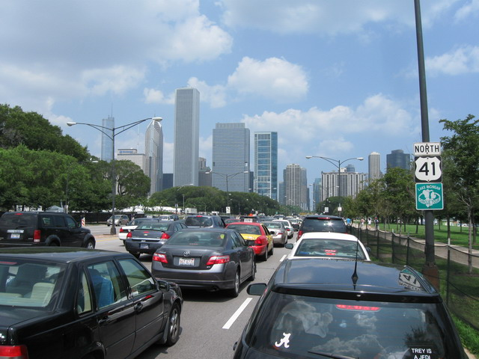
Project Goal
To create a website that compares cost and travel time estimates for different modes of transportation
If 5 people are traveling, is an uber, taxi or public transport cheaper?
Which mode of transport will be fastest?
Notes:
Say what else here?

Slide 3
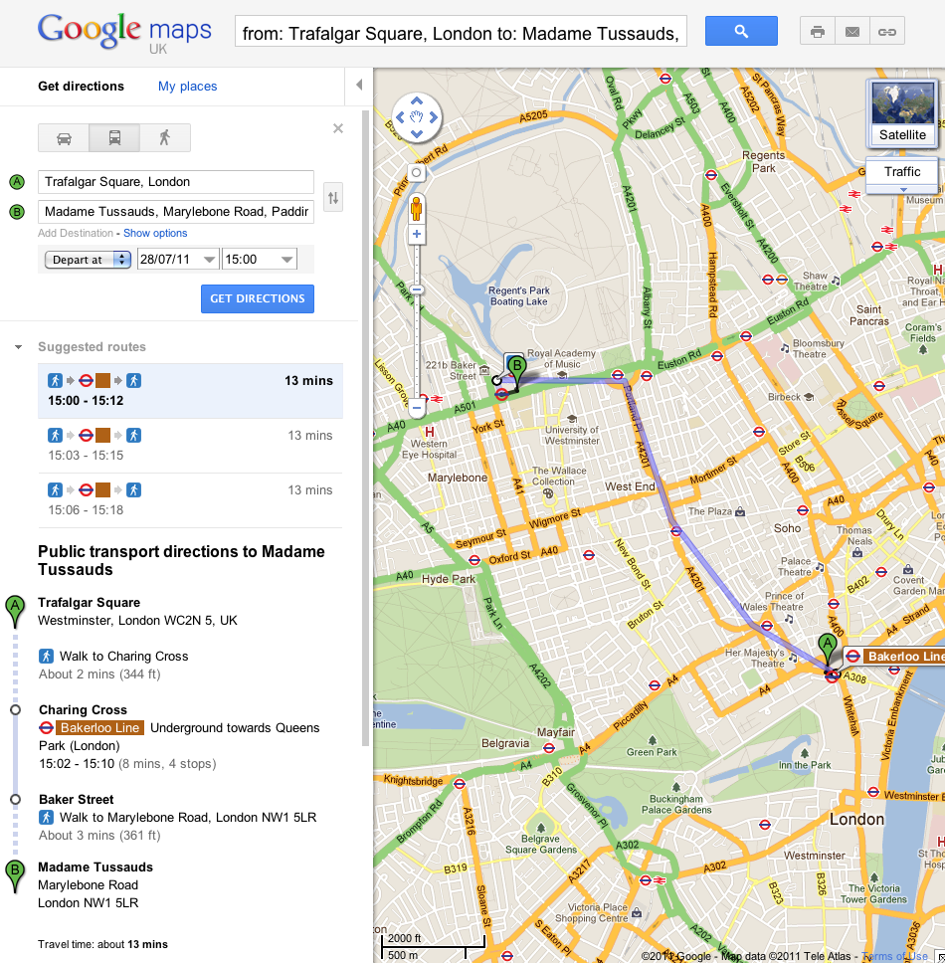
Part 1: Travel Time and Cost Estimates
Use Google Maps Directions API
Get lat/long coordinates
Use car trip distance and time estimate with standard taxi fare to estimate cost
Use number legs and type of transit in each leg with standard public transportation costs to calculate the total cost
Use Uber API
Determine estimated cost and trip duration

Slide 4
Part 2: Website
Use Django to build a website for users
Tell us:
Public Transport:
Cost: $8.25
Time: 1 hour 03 min
Show me directions!
Start Location:
Taxi:
Cost: $33
Time: 40 min
Destination:
Uber:
Cost: $28
Time: 37 min
How many travelers:
Cost: $7.99
Time: 1 hour 03 min
Show me closest bike station!
Divvy Bikes:

Slide 5
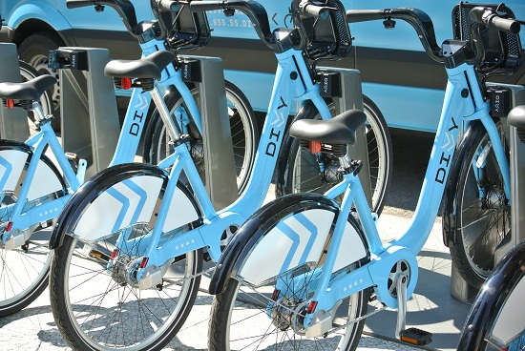
Part 3: Divvy Bikes estimate
Use Divvy Bikes API
Get coordinates for the nearest bike station that has available bikes
Get coordinates for the bike station closest to the destination
Use Google Maps API
Determine the walking time between bike stations and trip start and destination
Determine estimated biking time between stations
Notes:
https://github.com/iandees/divvyapiapi

Slide 6




Review of New Tools Used
Google Maps API
Uber API
Django
Divvy Bikes API

Slide 7
Timeline
Travel Time and Cost:
Alyssa and Marie
Feb. 9
Website:
Alyssa and Alejandro
Feb. 25
5th Week
6th Week
7th Week
8th Week
9th Week
10th Week
Uber:
Marie and Alejandro
Feb. 12
Divvy:
Marie and Alyssa
Mar. 1

