Slide 1
Fare Compare Chicago
Alyssa Blackburn
Marie Hilliard
Alejandro Parraguez
Notes:
redesign

Slide 2
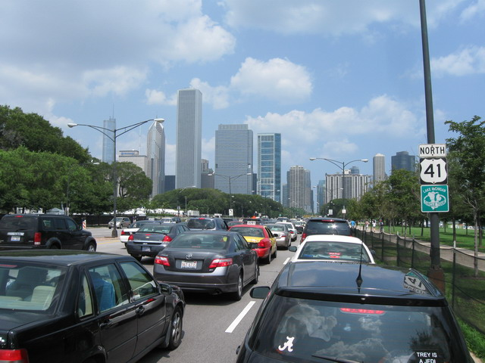
Project Goal
To create a website that compares cost and travel time estimates for different modes of transportation
If 5 people are traveling, is an uber, taxi or public transport cheaper?
Which mode of transport will be fastest?
Notes:
Say what else here?

Slide 3
Project Design
Website Front Page
HTML Template
Django Code
HTML Template
Backend
Website Response Page

Slide 4
Backend Design
Divvy Bikes API
Google Embed Map API
Google Directions API
UBER API
APIs
Google Geocode API
Request
Response
Request
Request
Response
Request
Response
Response
Response
Request
Request
Response
UBER
Biking
Public Transit
Driving
Python Code
Taxi
JSON File
City Fares

Slide 5
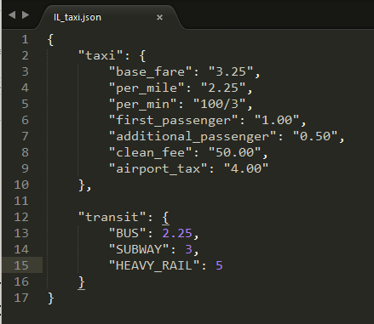
Interesting Aspects
City is Modulized:
JSON text file records the taxi and public transit fare information for a city
City name and JSON file are passed into python code
Possible to expand to multiple cities
Use 5 APIs
Did not have to store any data (in SQL tables, ect.)
All information is real-time

Slide 6
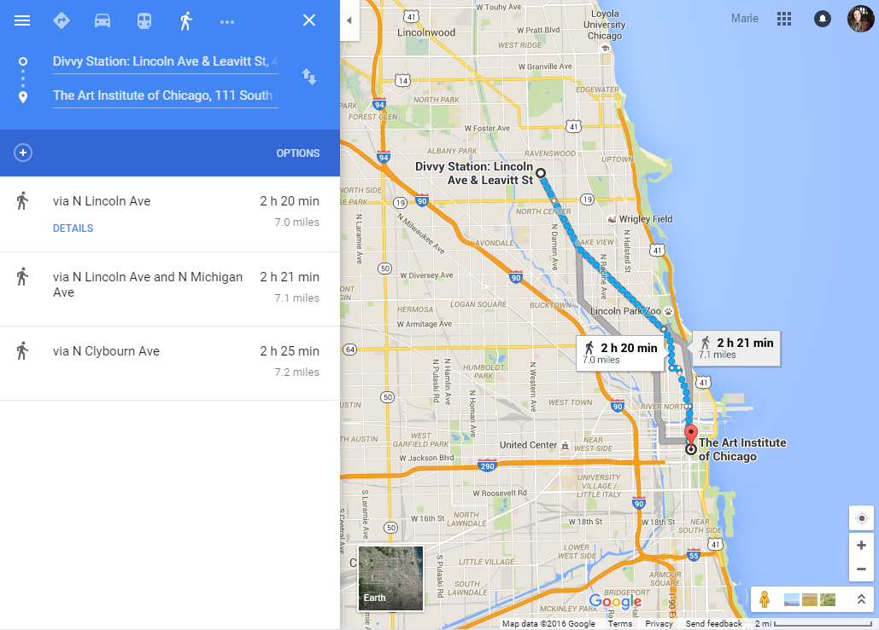
Challenges: Divvy Bike Stations
Divvy data would require unnecessary and costly computation
Divvy data contains locations of all bike stations
To find closest for directions, we would have to calculate the Euclidian distance between the start/end points and each location
Searching for Divvy Stations with Google API returns wrong station

Slide 7
Challenges: Passenger Capacity
Service | Maximum Passengers
uberX | 4
uberBLACK | 4
uberXL | 6
uberSUV | 6
uberSELECT | 4
How many passengers can travel together?
Unlimited for public transportation and biking
Taxis and ubers have capacity limits
Limit the number of passengers on the first page
Only return uber options which can carry all passengers

Slide 8
Project Demonstration

