Slide 1
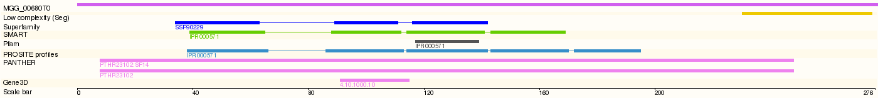
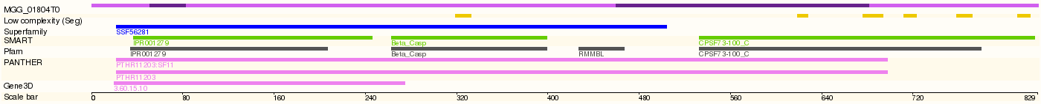
MGG_00739T0
MGG_01676T0
MGG_00680T0
MGG_01804T0

Slide 2
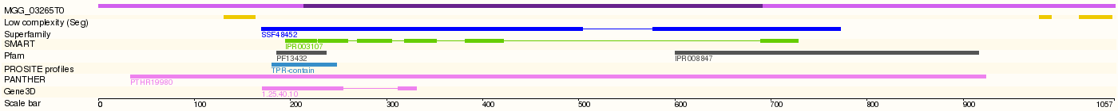
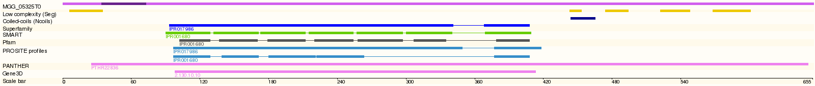
MGG_02741T0
MGG_03265T0
MGG_03704T0
MGG_05325T0

Slide 3
MGG_06313T0
MGG_06570T0
MGG_06881T0
MGG_07252T0

Slide 4
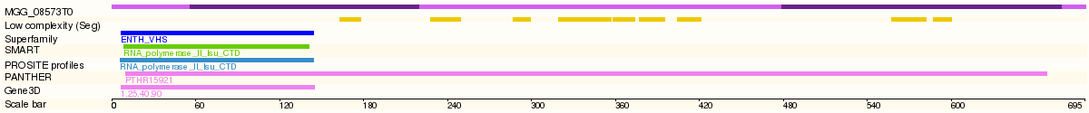
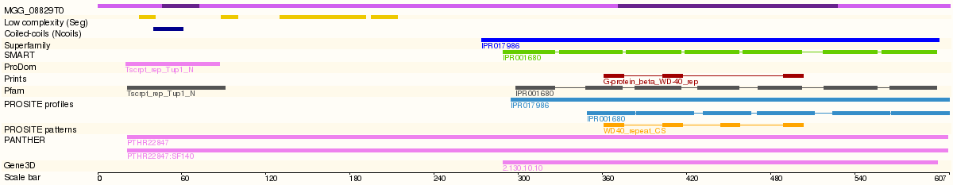
MGG_08573T0
MGG_08804T0
MGG_08829T0

Slide 5
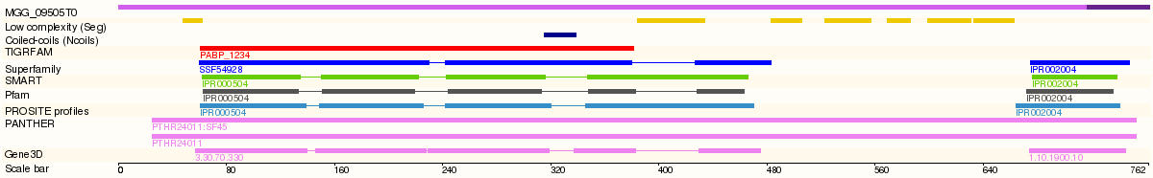
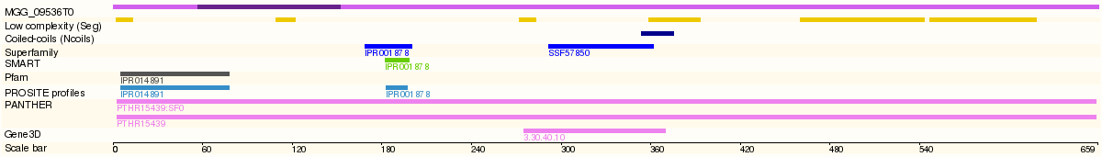
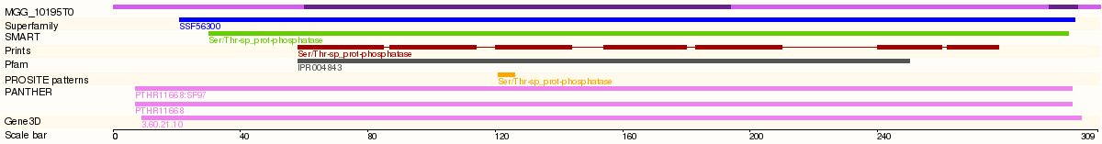
MGG_09505T0
MGG_09536T0
MGG_10195T0

Slide 6
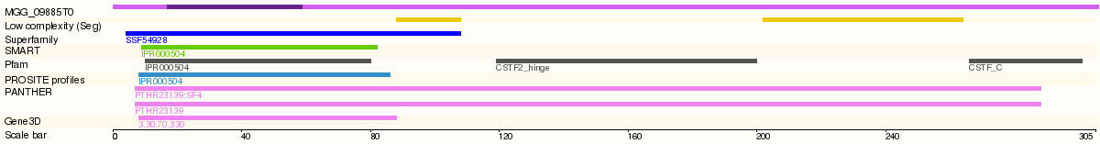
MGG_10820T0
MGG_14293T0
MGG_09885T0

Slide 7
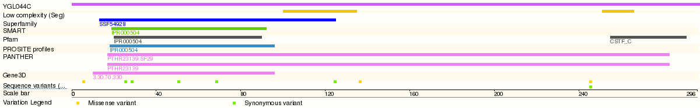
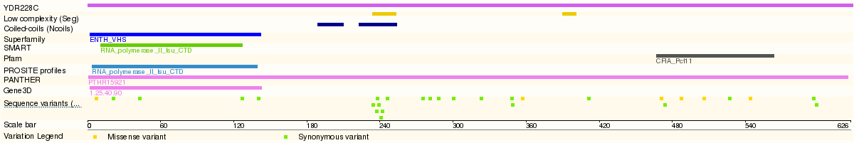
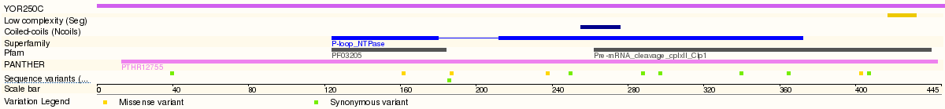
Rna15
Pcf11
Clp1

Slide 8
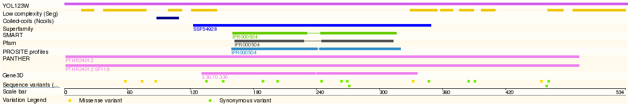
Ssu72
Hrp1
Ref2

Slide 9
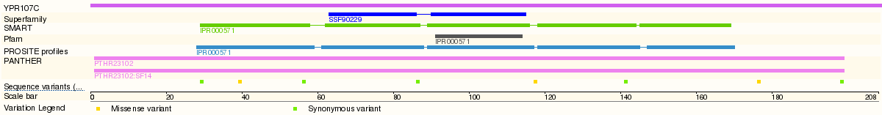
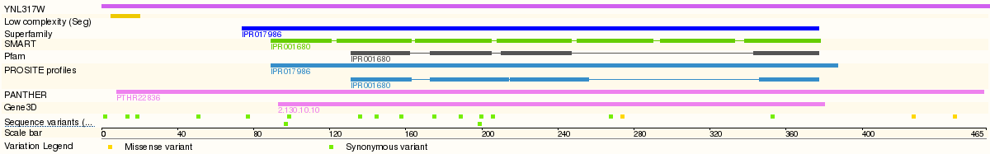
Fip1
Yth1
Pfs2

Slide 10
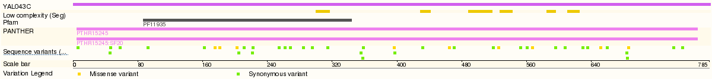
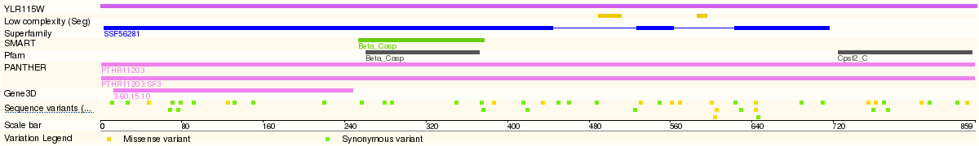
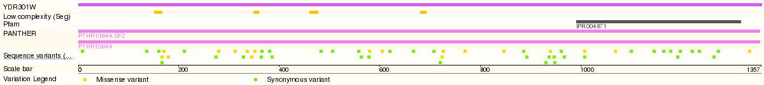
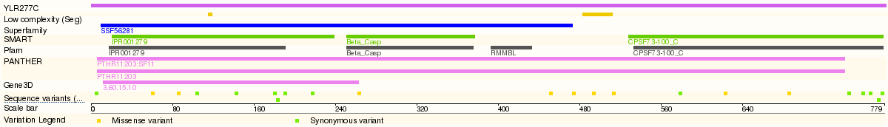
Pta1
Ydh1_Ctf2
Yhh1_Ctf1
Ysh1

Slide 11
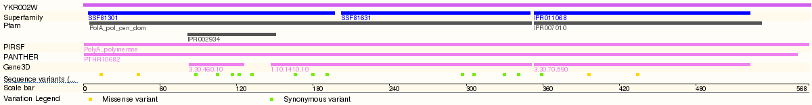
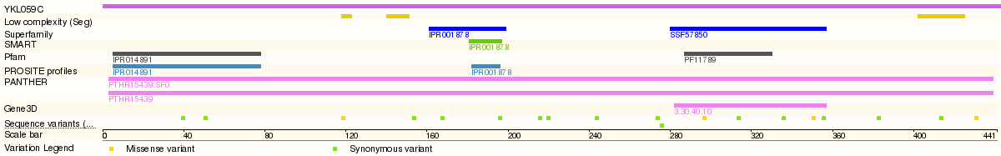
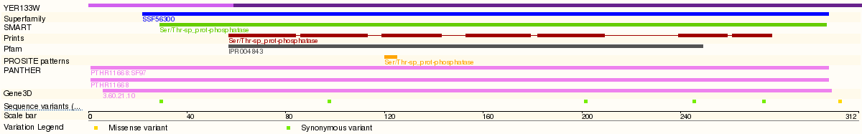
Pap1
Mpe1
Glc7

Slide 12
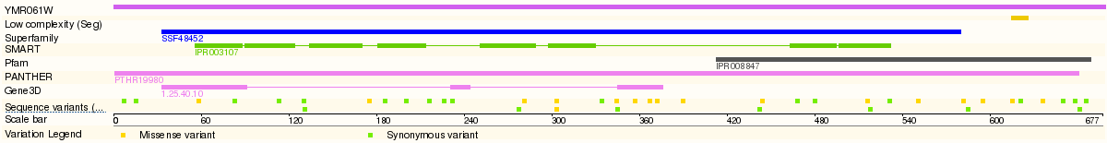
Rna14

