Slide 1






A New Parallelization Approach in Deep Learning Using CPU/GPU Architectures for Memory Optimization
AUTHOR: LUIS ALEJANDRO TORRES NIÑO
YEAR: 2023
DIRECTED BY:
CARLOS JAIME BARRIOS HERNÁNDEZ
YVES DENNEULIN
ESCUELA DE INGENIERÍA DE SISTEMAS
DOCTORADO EN CIENCIAS DE LA COMPUTACIÓN
LABORATOIRE D'INFORMATIQUE DE GRENOBLE

Slide 2
01
STATEMENT OF
THE PROBLEM

Slide 3
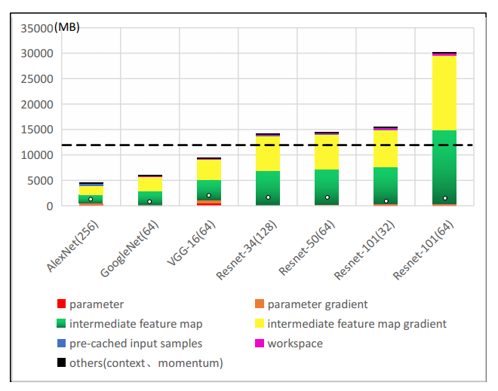
01_ STATEMENT OF THE PROBLEM
The deep learning model training algorithm requires a significant amount of memory that often exceeds the capabilities of the GPU and, in some cases, even the memory of the CPU.
What is the problem?
The need to have increasingly efficient computational resources with better performance, among which are greater processing capacity and memory available for the execution of the training of these models.
Notes:
When we talk about training deep neural networks, we always have in mind that this process is carried out on GPU.
The problem arises when the model is larger than the memory capacity of the GPU, or the training algorithm requires more memory than is available on one device.
Due to this situation, we need to have increasingly efficient computational resources with better performance, greater processing, and greater memory available for the execution of the training of these models.
To solve this problem appeared new methods to train the model, such as Model Parallelism, Data Parallelism, and Pipeline Parallelism.
However, these methods could require increasingly specialized hardware that doesn’t reduce the memory footprint on GPU and only distributes the model or the training algorithm between devices.
In summary, the problem is that to train a model larger than the available memory in one device, we need to distribute the model among multiple devices with different techniques or use host memory to try to reduce the memory footprint on the GPU.
However, these techniques require expensive hardware or advanced programming techniques.
Always leaving aside the CPU.

Slide 4
02
PURPOSE OF THE
STUDY

Slide 5
02_PURPOSE OF THE STUDY
General Objetive
Propose a method of parallelization of the Deep Learning training algorithm by distributing the workload between the CPU and the GPU to reduce the memory footprint present in these devices without loss of accuracy and performance.
Notes:
The main objective of this research is to propose “A method of parallelization of the Deep Learning training algorithm by distributing the workload between the CPU and the GPU to reduce the memory footprint present in these devices without loss of accuracy and performance”.

Slide 6
02_ PURPOSE OF THE STUDY
Specific Objetives
01
02
03
Analyze the training memory footprint of some of the most common deep learning models in CPU versus GPU and determine the factors that significantly impact different hardware architectures.
Evaluate the power consumption, training execution times, and accuracy of selected models in both CPU and GPU and determine whether instruction sets such as AVX on Intel CPUs allow similar results between the two architectures.
Design an asynchronous method to execute the training distributed between the CPU and the GPU reducing waiting times during the forward pass and backward pass balancing workloads.
Notes:
To achieve the general objective, we proposed five specific objectives:
Analyze the training memory footprint of some of the most common deep learning models in CPU Vs. GPU and determine the factors that impact different hardware architectures.
Evaluate the power consumption, training execution times, and accuracy of selected models in both CPU and GPU and determine whether instruction sets such as AVX on Intel CPUs allow similar results between the two architectures.
Design an asynchronous method to execute the training distributed between the CPU and the GPU, reducing waiting times during the forward pass and backward pass balancing workloads.

Slide 7
02_ PURPOSE OF THE STUDY
Specific Objetives
04
05
Evaluate the Stochastic Weighted Average method in the new parallelization method and determine if it can help reduce the memory footprint, increase or maintain model accuracy, and allow it to increase the batch size using during training.
Perform the evaluation of the parallelization method by measuring the resources consumed (memory, CPU, GPU), power consumption, execution time, and accuracy in different Deep Learning models.
Notes:
Evaluate the stochastic weighted average method in the new parallelization method and determine if it can help reduce the memory footprint, increase or maintain model accuracy, and allow it to increase the batch size using during training.
Perform the evaluation of the parallelization method by measuring the resources consumed (memory, CPU, GPU), power consumption, execution time, and accuracy in different Deep Learning models.

Slide 8
03
RESEARCH QUESTIONS

Slide 9
Is it possible to optimize memory usage in training deep neural network models by distributing or parallelizing the Pipeline between the CPU and the GPU?
02_ RESEARCH QUESTIONS
By distributing the pipeline between the CPU and GPU, can better results be obtained in training times while maintaining the accuracy of the model?
RESEARCH
QUESTIONS
By having more storage capacity in the CPU memory, is it possible to increase the size of the input batch and thus improve training efficiency?
Does using the CPU and GPU simultaneously during training involve more or less energy cost when comparing training time Vs. Accuracy Vs. Power Consumption?
Notes:
In this section, we discuss the research questions raised about memory constraints in deep neural network training.
The first is:
Is it possible to optimize memory usage in training deep neural network models by distributing or parallelizing the Pipeline between the CPU and the GPU?
By distributing the pipeline between the CPU and GPU, can better results be obtained in training times while maintaining the accuracy of the model?
By having more storage capacity in the CPU memory, is it possible to increase the size of the input batch and thus improve training efficiency?
Does using the CPU and GPU simultaneously during training involve more or less energy cost when comparing training time Vs. Accuracy Vs. Power Consumption?

Slide 10
04
THEORETICAL FRAMEWORK
Notes:
In this section, we explain the backpropagation algorithm, the three parallelization techniques that are used in deep learning, we explain how the stochastic weighted average and the CPU offloading work, and finally explain something about PAPI, which will be used to measure the power consumption.

Slide 11

06_ THEORETICAL FRAMEWORK
NEURON – BASIC UNIT
Update parameters
W_{j} b_{j}
Error
X_{j}
$$Σ$$
Y_{j} Actual Output
Loss Function
Inputs
Y_{j} Desired Output
Y_{j}
Notes:
Neuron is the basic unit in a neural network.
The idea with respect to how neuron work is simple.
We multiply each input with a respective weight and we add all results.
This output is the input to the function called the activation function , this function adds nonlinearity to our neuron.
And this fact is important because it is the reason why neural networks can be to adapt to different environments.
Now, we consider this simple neuron how to the most basic neural network, and to train it, we used the Backpropagation Algorithm.
To do this, the output of the neural network is the input to the function called the Loss function or the error function.
In this function, we calculate the error between the desired output and the actual output.
This error is propagated to the weights, and after that, we update the neural network with the new values.

Slide 12
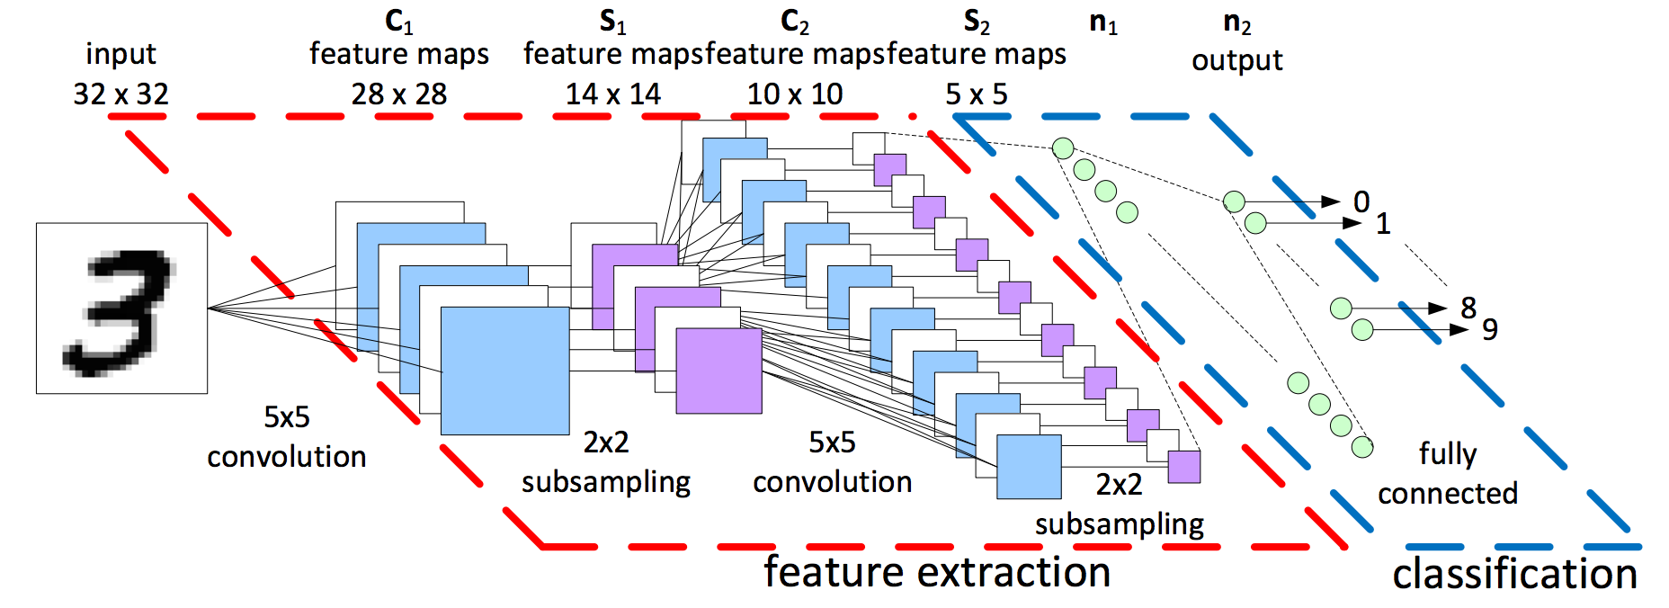
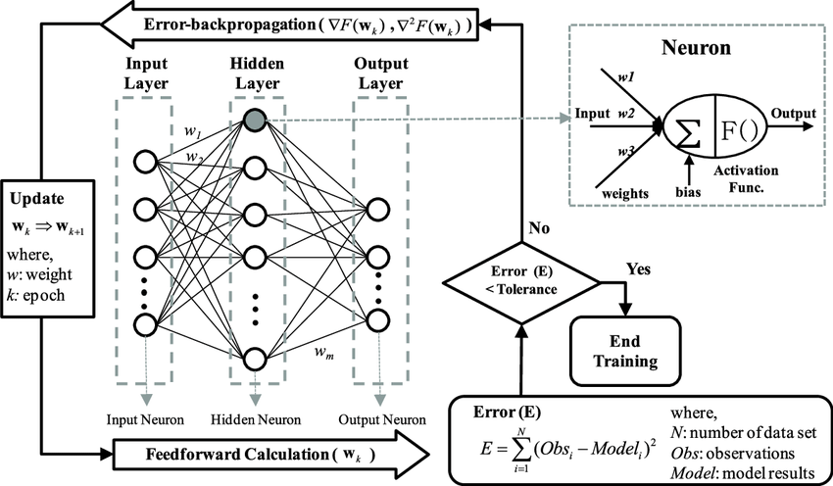
06_ THEORETICAL FRAMEWORK
BACKPROPAGATION
Notes:
Now, What is the Backpropagation Algorithm?
In simple words, it’s the algorithm that allows to adjust of the weights.
This is divided into two phases: Forward Pass and Backward Pass.
In the first phase, the data cross each layer, where each layer is made up of multiple neurons. The outputs of the neurons of the layer before are the inputs of all neurons in the next layer, and so on.
In the second phase,
The output of the network is the input to the Lost Function. We calculate de error and propagate it to each weight of the network. That idea is to decrease the final error and to do this, we used partial derivatives and the chain rule.
To carry out the Backpropagation Algorithm, weight, inputs and the activations of each neuron must be kept in the memory. These data are necessary to calculate the gradients and update the weights.
This is why memory is a big problem when we train deep neural networks.
With respect to CNN, the training is similar, the only different is the network learn the different filters on each convolutional layer instead of learning the weights in the neurons.

Slide 13
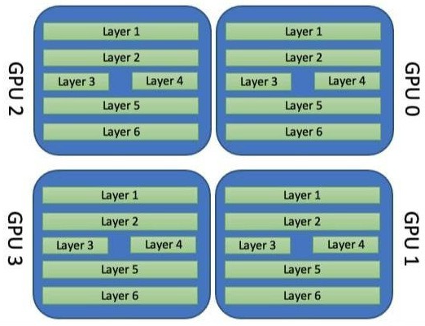
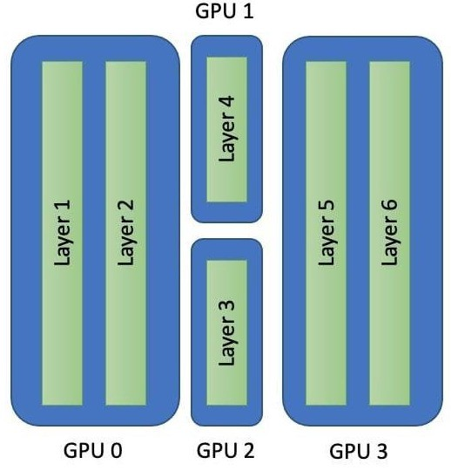
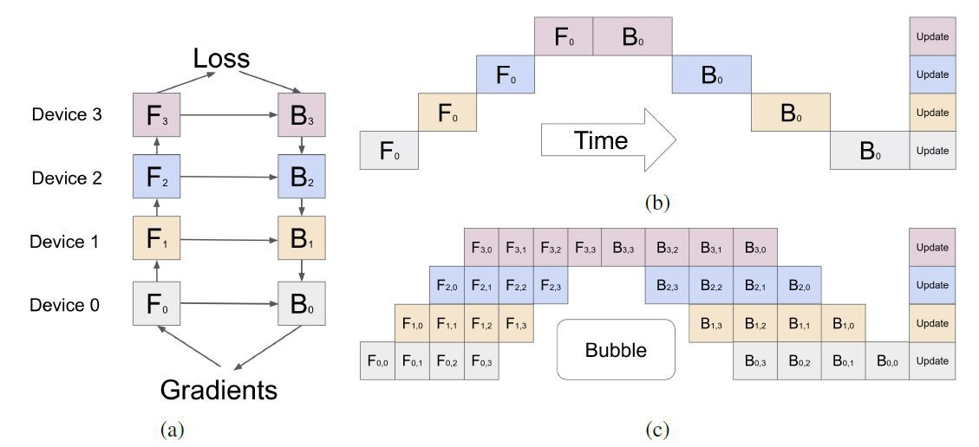
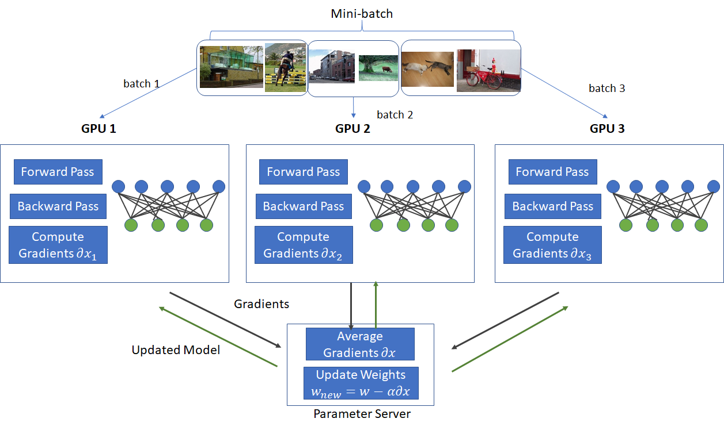
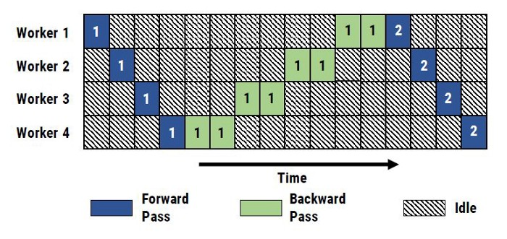
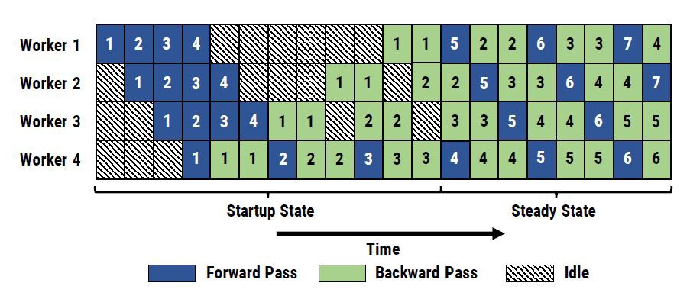
06_ THEORETICAL FRAMEWORK
DATA PARALLELISM
MODEL PARALLELISM
PIPELINE PARALLELISM
Notes:
DATA PARALLELISM
In this methodology, we copy the model to each GPU.
The forward pass and the backward pass are done in each GPU with different mini-batches.
We obtain N matrices of gradients. Finally, we average these matrices and update the weights of the model on each GPU.
This methodology is useful when the model can be stored in the memory of each GPU, but the remaining memory does not support large batches and we have a big dataset to train our model.
Data parallelism shows a new problem, what if the model cannot be stored on one GPU?
--------------------------------------
MODEL PARALLELISM
In this methodology, we distributed the model between the GPUs.
This distribution is made according to the number of layers in the model and the density of each layer.
We have a limitation in this methodology, and it is the number of the layers. If we have 4 layers, the maximum number of GPUs is 4.
This methodology presents a problem with training times and the use of computational resources.
While the data is being processed on one GPU, the others are idle.
--------------------------------------
PIPELINE PARALLELISM
In this methodology we use micro-batches. Each microbatch is sent to the GPU when this is idle.
In this example, we have 4 microbatches, so 4 different models.
In this part, this methodology is similar to the data parallelism, we get the matrices of gradients to the end of the last backward pass, we average these gradients and update the weights of the model.
This methodology reduce the idle times present in the Model Parallelism.
The problem with this methodology is not a standard in the frameworks and each model require its own implementation.

Slide 14
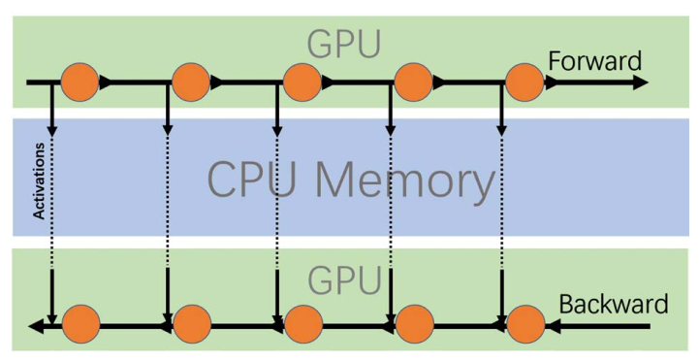
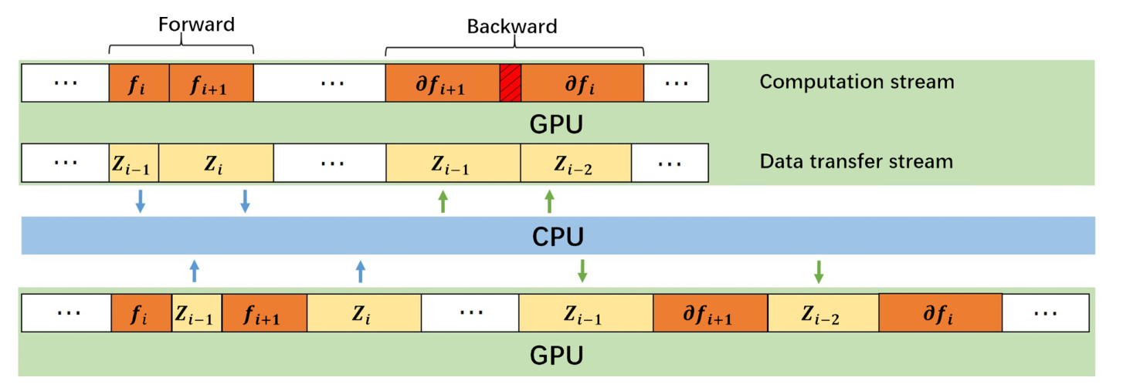
06_ THEORETICAL FRAMEWORK
CPU OFFLOADING
Notes:
CPU-OFFLOADING
In this methodology, we offload the activations from the GPU memory to the CPU memory.
With this, we reduce the memory footprint on the GPU caused by the Backpropagation Algorithm.
The problem with this methodology is the bottleneck in the PCI bus caused by the high traffic in these communications.

Slide 15
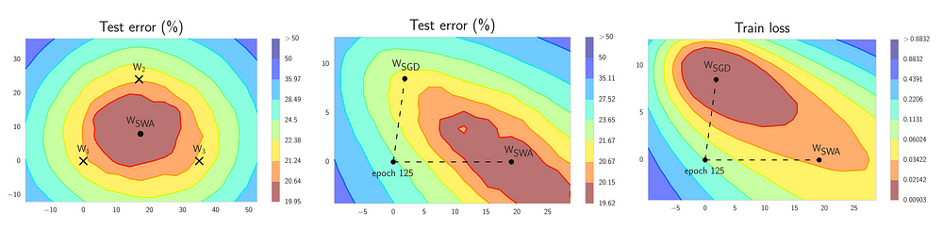
06_ THEORETICAL FRAMEWORK
STOCHASTIC WEIGHT AVERAGE
Notes:
STOCHASTIC WEIGHT AVERAGE
In this method, we average N matrices of weights of N models.
When we talk about Data Parallelism, we obtained N matrices of gradients; in this method, we finished the backpropagation algorithm in each model and average its matrices of weights.
According to the results of the paper, this method reduces the training times because it helps to reach the point of convergence more quickly.
------------------------------------------------------------------------------------------------------------------------
This is important in this research because we distribute the workload between the CPU and the GPU.
So, we will have times when the GPU is idle, and to solve this situation, we send other micro-batch to the GPU, in a similar way to the pipeline parallelism.
It’s possible that this method helps us to reduce the delay times caused by the CPU during training.

Slide 16

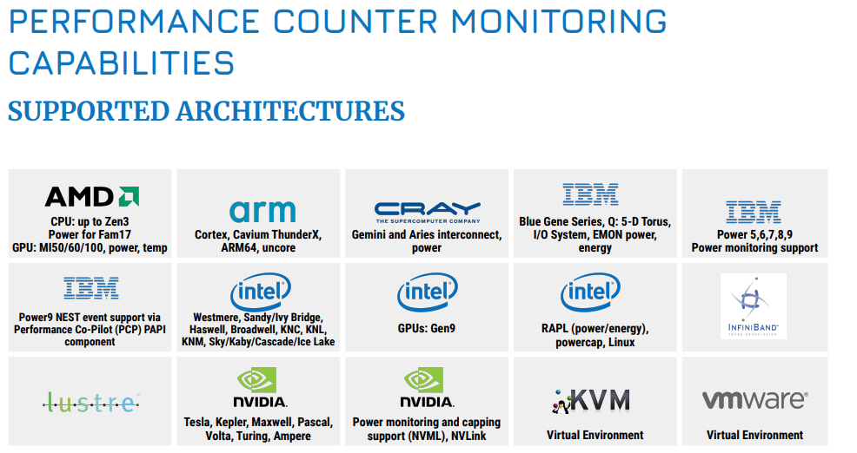
06_ THEORETICAL FRAMEWORK
ENERGY AND POWER CONSUMPTION
Hardware Performance Counters
They are performance counters that use specialized registers to measure the performance of various aspects of a microprocessor.
These provide application developers with information to help improve code sections and optimize performance.
Notes:
When we talk about Deep Learning Training, we must consider the power consumption due to the intensive use of GPUs.
To do this, we used Hardware Performance Counters
PAPI
PAPI (Performance Application Programming Interface) is a library that provides an interface to work with the counters found in the system,
such as CPUs, GPUs, on-/off-chip Memory, Interconnects, I/O system, File System, Energy/Power, etc.
These counters and PAPI will be used to measure and evaluate energy consumption and other aspects of this project.

Slide 17
05
LIMITATIONS
&
DELIMITATIONS

Slide 18
08_ LIMITATIONS & DELIMITATIONS
LIMITATIONS
Architectures with limited PCI bandwidth
Intel AVX 512 4th Generation
DELIMITATIONS
Deep Neural Networks – CNN
One server
Intel and NVIDIA Architectures
Notes:
Regarding the limitations we have:
We will work with architectures with limited PCI bandwidth (PCI Express 4 or 5) and over Intel architectures without AVX 512 4th generation.
About delimitations, we have:
We work over deep neural networks, including only multilayer perceptron and some tests over convolutional neural networks
Therefore, we will limit ourselves to a single server.
And finally, we use only the architectures of Intel and NVIDIA.

Slide 19

Thanks
AUTHOR: LUIS ALEJANDRO TORRES NIÑO
YEAR: 2023
DIRECTED BY:
CARLOS JAIME BARRIOS HERNÁNDEZ
YVES DENNEULIN
ESCUELA DE INGENIERÍA DE SISTEMAS
DOCTORADO EN CIENCIAS DE LA COMPUTACIÓN

Slide 20
00
COMPUTATIONAL RESOURCE CONSUMPTION IN CNN
Notes:
Actual State of the investigation.

Slide 21
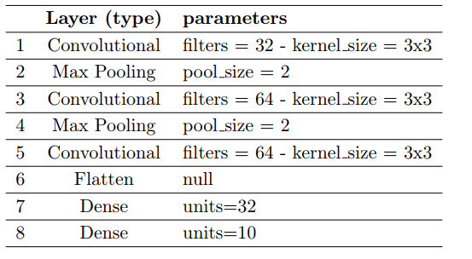
06_ THEORETICAL FRAMEWORK
Tool for Characterizing the Resources Consumed
Monitor
pynvml library
psutil libray
GPU Usage
Device Memory Used
PCIe Bus Interaction
CPU Utilization
Memory Used
Dense
Convolutional
Flatten
Max Pooling
…
Convolutional Neural Network

Slide 22
06_ THEORETICAL FRAMEWORK
Experimental Environment
 | FELIX – SC3 | Chifflot – Grid5K
Processor | 4 Intel(R) Xeon(R) CPU X7560 at 2.27GHz processors 64 cores in total | 2 Intel(R) Xeon(R) Gold 6126 at 2.60GHz processors with 48 cores in total
Memory | 125 GB | 192 GB
GPU | 2 x Nvidia GeForce GTX TITAN X cards each with 12 GB of memory | 2 x Nvidia Tesla P100 cards each with 16 GB of memory
 | GTX TITAN X | TESLA P100 | TESLA P100
 | Engine Specs
Architecture | Maxwell | Pascal
CUDA Cores | 3072 | 3584
Base Clock (MHz) | 1000 | 1189
Boost Clock (MHz) | 1075 | 1328
 | Memory Specs
Memory clock (MHz) | 1752.5 | 715
Memory clock – effective (MHz) | 7010 | 1430
Memory size (GB) | 12 | 16
Memory type | GDDR5 | HBM2
Memory Interface Width | 384-bit | 4096-bit
Memory Bandwidth (GB/sec) | 336.5 | 732

Slide 23
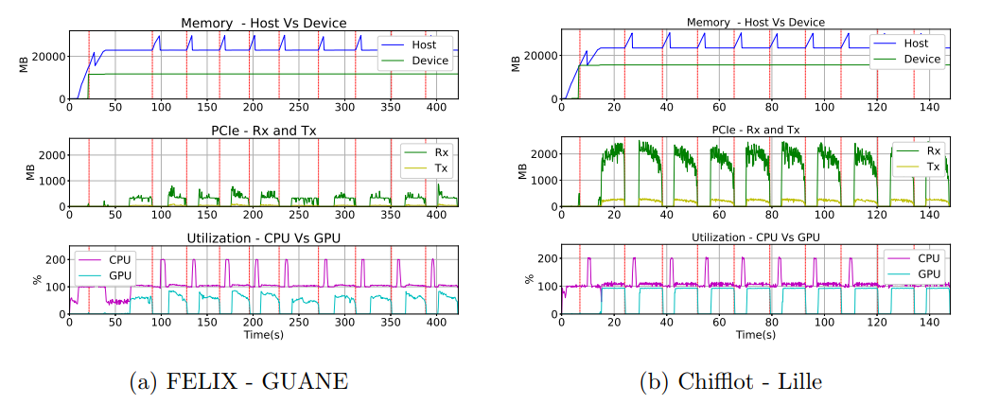
06_ THEORETICAL FRAMEWORK
Evaluation and Results - TensorFlow

Slide 24
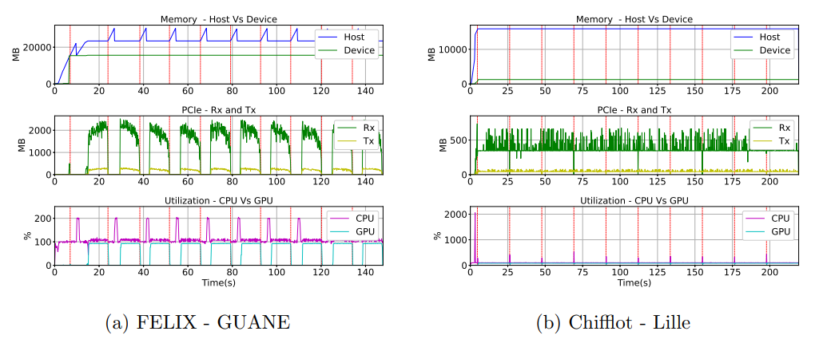
06_ THEORETICAL FRAMEWORK
Evaluation and Results - PyTorch

Slide 25
00
MATRIX MULTIPLICATION PERFORMANCE ANALYSIS USING AVX
AND CUDA PROGRAMMING MODELS

Slide 26
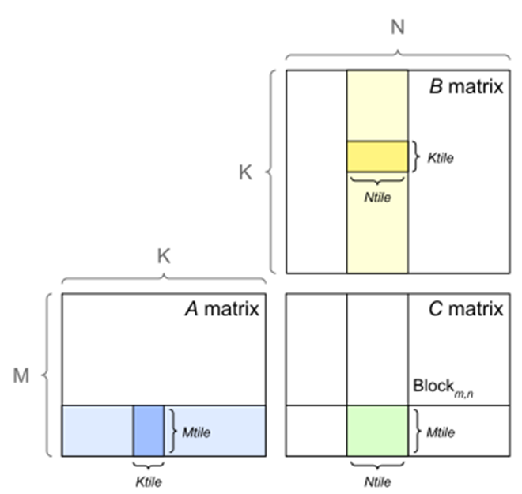
06_ THEORETICAL FRAMEWORK
TILED MATRIX MULTIPLICATION - SGEMM
$C=αAB + βC$

Slide 27
06_ THEORETICAL FRAMEWORK
Experimental Environment
Server Type | Processor | Memory | GPU
Dell PowerEdge C6420 | 2 Xeon Gold 6130 (Skylake, 2.10GHz, 16 cores/CPU) | 192 GiB | - | OpenMP, AVX2, AVX512
Dell PowerEdge R7525 | 2 AMD EPYC 7452(Zen 2, 32 cores/CPU) | 128 GiB | NVIDIA A100-PCIE-40GB | Cuda, CuBLAS

Slide 28
06_ THEORETICAL FRAMEWORK
RESULTS
Times obtained when evaluating matrix multiplication by implementing SGEMM in CUDA and using the cublasSgemm() method of cuBLAS.

Slide 29
06_ THEORETICAL FRAMEWORK
RESULTS
Times were obtained from matrix multiplication using OpenMP, AVX2, AVX512, and CUDA. The times obtained for OpenMP were consistently higher than the others, presenting more considerable and significant differences as the matrix size grew.

Slide 30
06_ THEORETICAL FRAMEWORK
RESULTS
The computation times of matrix multiplication in AVX2, AVX512, and CUDA. For matrices larger than 256x256, there is a significant increase in the implementation with AVX512.
Processing times - AVX2 Vs AVX512 Vs CUDA

