Slide 1
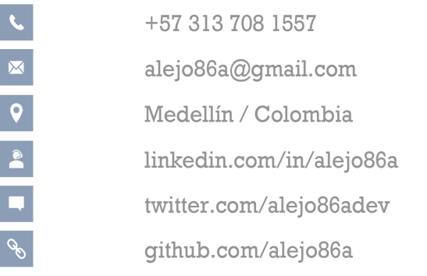
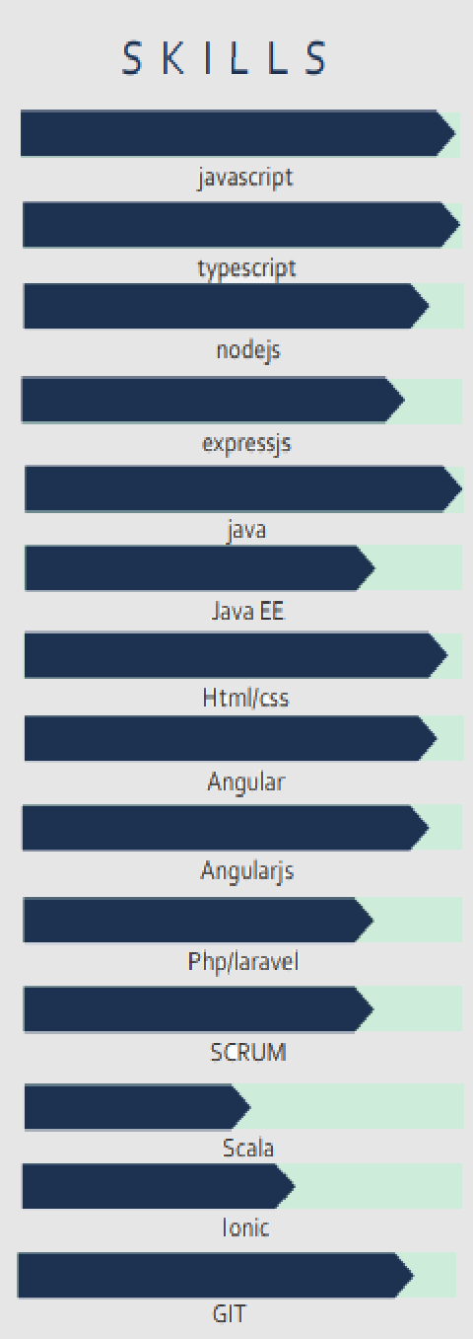
Alejandro Berrío Marín
B a c k e n d d e v e l o p e r
A B O U T M E
Entrepreneurship lover from my own personal projects to my work experience. Obsessed with meeting goals quickly under the principles of quality, extensibility, security, reusability, and code readability
I am a developer passionate about new technologies who loves to learn all kinds of technologies in a self-taught way.
E X P E R I E N C E
C E R T I F I C A T E S
IBM Cloud basics on platzi (2018)
Basic of architecture, micro services and artificial intelligence as well as the installation and IBM cloud application deployment.
Publicis Global Delivery (prodigious)
Senior Principal Software Engineer/ San Francisco,California / 2021-2022
Backend development mainly with nodejs and other technologies such as java and react.
working in internals projects at knex, springboot, react, strapi, azure.
talent interviewer with nodejs profile.
Interview new candidates for the position of senior software engineer in nodejs.
SCALA intensive course (2018)
Dictated by seven4n.
Jenkins CI and DevOps (2017)
Master Jenkins Build and Test Automation in 2 Hours. Hand-on DevOps, CICD, Jenkins Pipeline, Jenkins on AWS.
BairesDevSoftware
Development Engineer / San Francisco,
California / 2021
outsourcing and software development company that allowed me to be part of two interesting projects
Instructure: as a backend developer in nodejs .
waitr app: as a backend developer in nodejs and devops.
Call for discovery of apps.co (2016)
Which I was a finalist and I acquired Marketing insights, customer discovery, and some talks on software development mainly in doing a quick MVP.
Rapicredit
software engeneer / Bogotá, Colombia / 2020-2021
fintech startup in charge of making small loans to unbanked people.
Startup weekend Medellín
“INTERNET OF THINGS” (2015)
Event of entrepreneurship in which for 3 days of continuous work in the city of Medellín the aim was to develop an innovative idea within an interdisciplinary team.
Development frontend with angular in charge of implementing the best practices in the development.
Development backend creation of endpoint with java spring boot and the drools rule manager.
Fintech challenge (2015)
Event of bank entrepreneurship in which for 3 days of continuous work in the city of Bogota the aim was to develop an innovative idea within an interdisciplinary team.
E D U C A T I O N
Systems Engineering
ITM (Instituto Tecnológico Metropolitano)
7° semester (actual)
Application development course for IOS (2013)
Dictated by arunovo and rutaN.
Intermediate backend developer
Rappi S.A.S./Bogota, Colombia/2018-2020
Diploma Leadership in an age of disruption
CSUN (California State University Northridge)
2022
Development of rappiPay an alternative to send, receive money or pay without using a bank card.
OTHER EXPERIENCE
Freelancer
Freelancer/Colombia/ 2012-2016
Develop web pages in HTML and CSS to promote and show small products and services of small companies.
Diploma course in advance architecture with microservices and devops
UdeA (Universidad de Antioquia)
2018
Development consultant
SETI S.A.S./Medellín, Colombia/2016-2020
Full stack developer in the following projects:
Develop a platform for the management of proposals, company commercials, sales and follow up projects. This project was developed in Angular, Java EE and Oracle.
Platform for the quote and sale of car insurance and company insurance developed in GuideWire, Angular and Scala.
Design and layout.
Logo construction and photo editing.
Deploy and maintain the website in time.
Systems Engineering
UdeA (Universidad de Antioquia)
8° semester (in pause)
•
Founder and CEO
Peiname.co/Colombia/ 2016
Systems Technique
SENA (Servicio Nacional de Aprendizaje)
2011
Founder of my own start up.
Marketing.
Customer discovery.
MVP development (android and ios app).

