Slide 1
Presentation of the web page
The project is called Natours
It is a website for a company that offers tours in the nature
So lets take a look at the web page
The whole web page was made with pure CSS

Slide 2
Quick presentation of the HTML code

Slide 3
Now I’m gonna tell you the most relevant stuff of the project

Slide 4

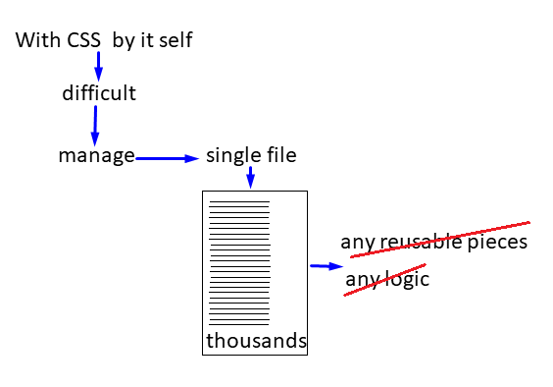
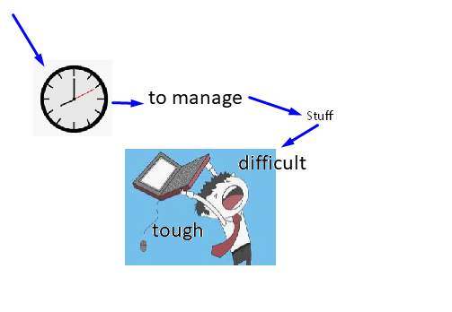
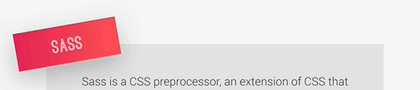
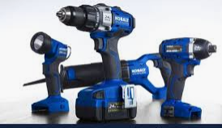
In some
That’s what I am using SASS
Gives to CSS
distribute
the whole code
organize
and easy way

Slide 5
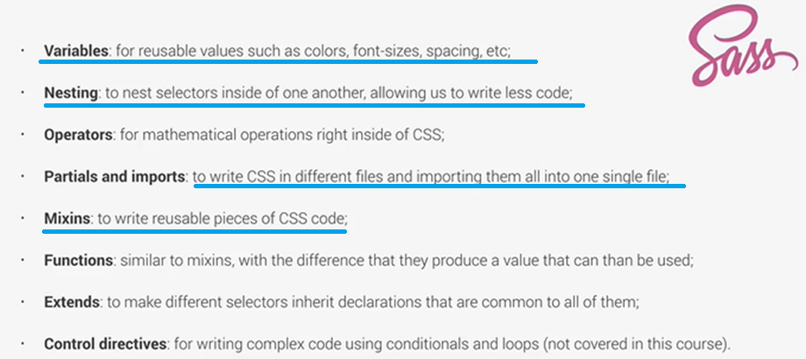

Slide 6
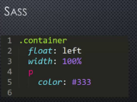
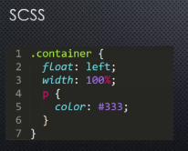
Talking about syntaxis, there are actually to ways of type of SASS,
The differences are the way are typed
The one that I am using in this project is SCSS which stands for sassy(fresh) CSS
permit the use of nesting

Slide 7

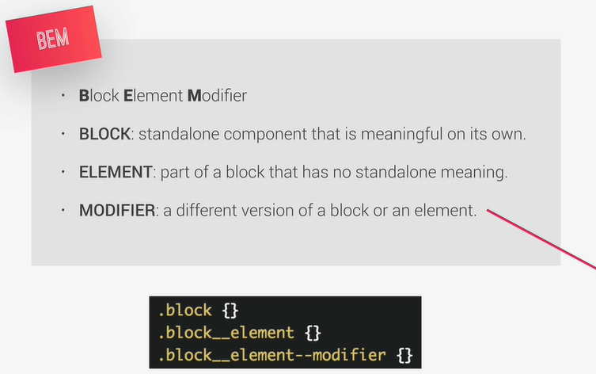
BEM

Slide 8
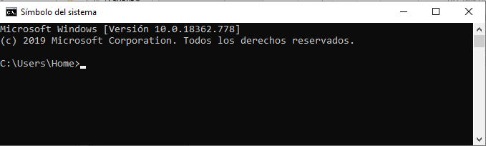
NOW,
The browser only understands CSS pure code, so it is necessary to convert SASS into pure CSS code and for that I am using NPM
Node Package Manager, I compile SASS locally by using

Slide 9
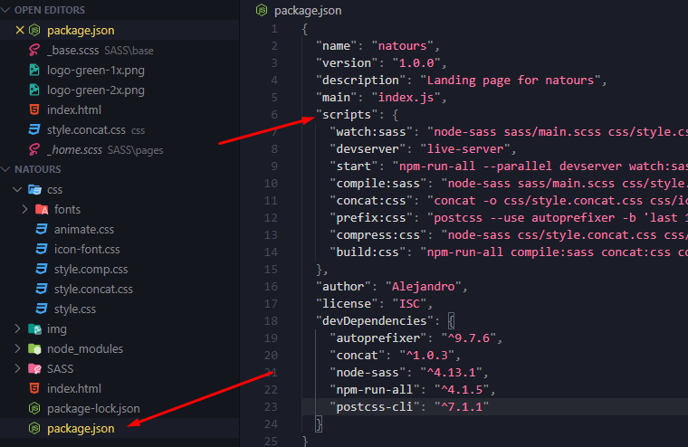
Firstable package.json
Run

Slide 10
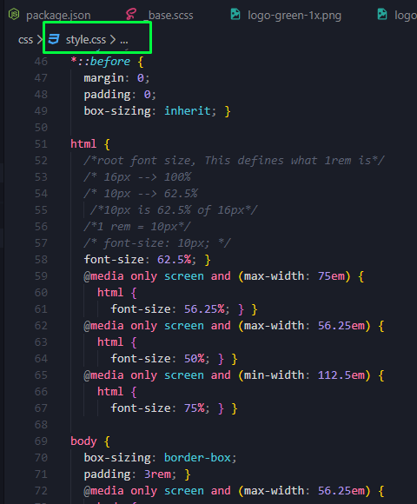
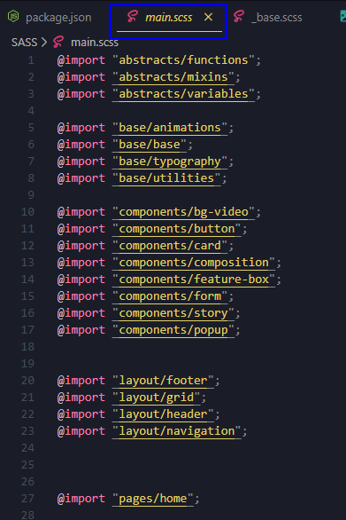
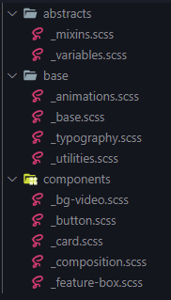

Slide 11

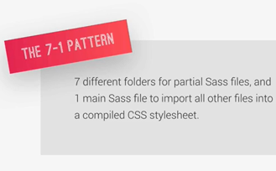
ABSTRACT: Code that doesn’t go to any CSS such as:
Variables
Mixins
BASE: Put the basic definitions
COMPONENTS: One file for each component
LAYOUT: Define the layout of the project
PAGES: Styles for specific pages
THEMES: If want to implement different visual themes
Vendors: where all third party CSS goes

Slide 12
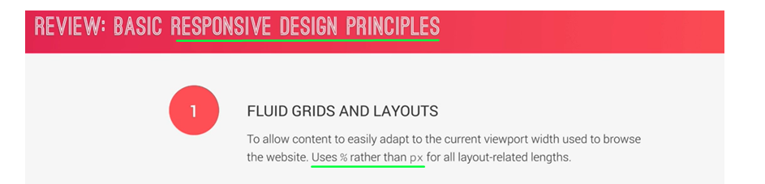

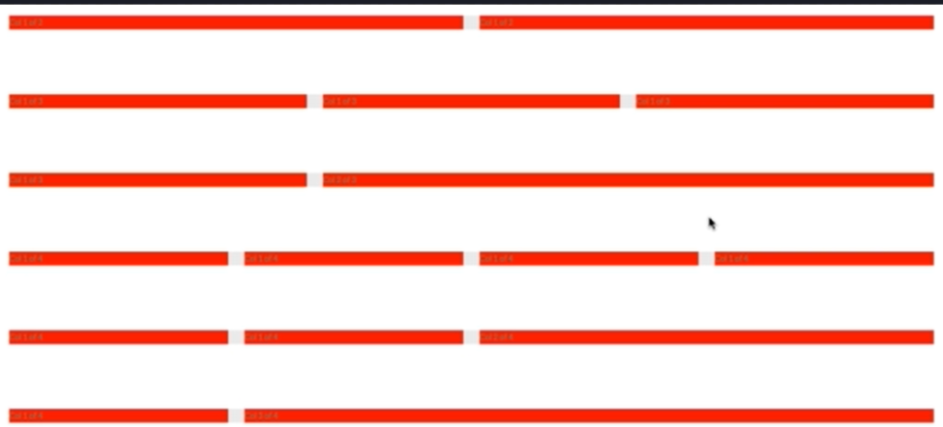
Grid system

Slide 13
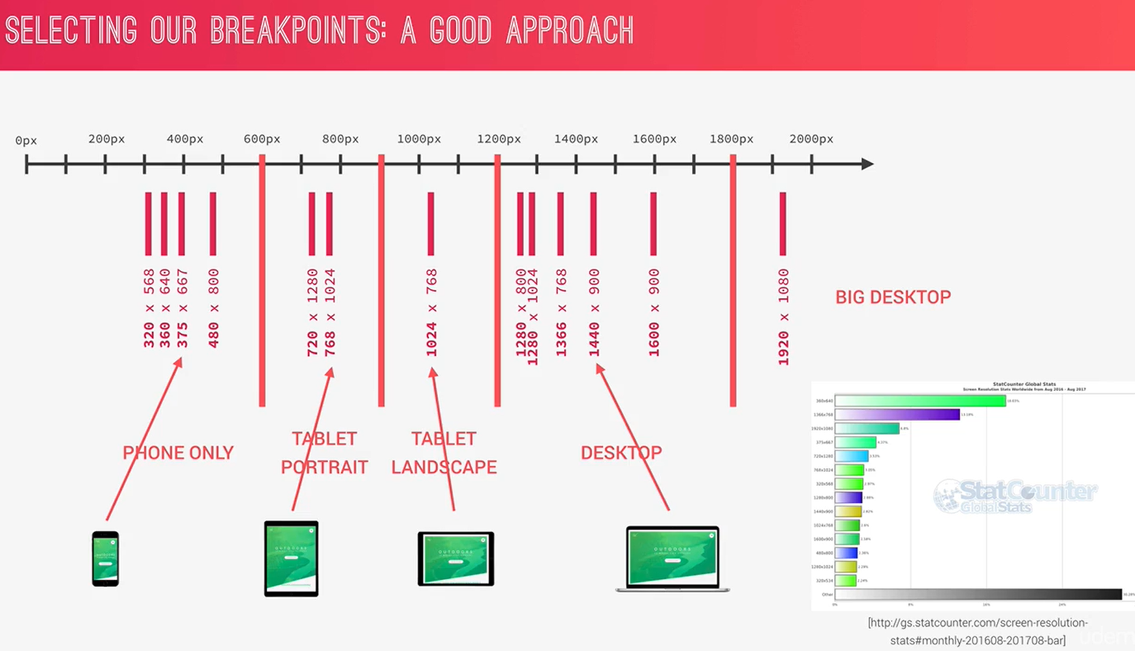

Slide 14

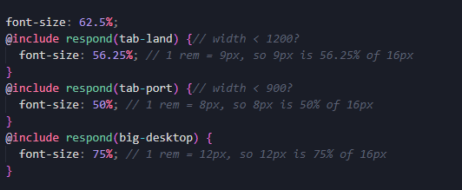
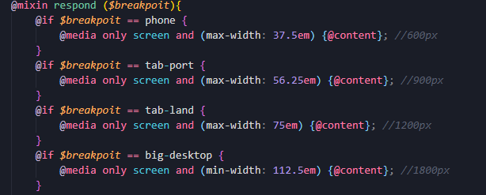
Mixins
MEDIA QUERY MANAGER
1 REM OR 1 EM = FONT SIZE FROM THE BROWSER 16PX
USE EM INSTEAD OF REM THEY TEND T FAIL IN BROWSERS

Slide 15
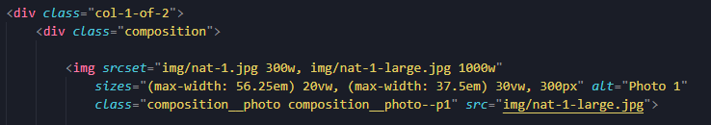
Responsive images in HTML

Slide 16
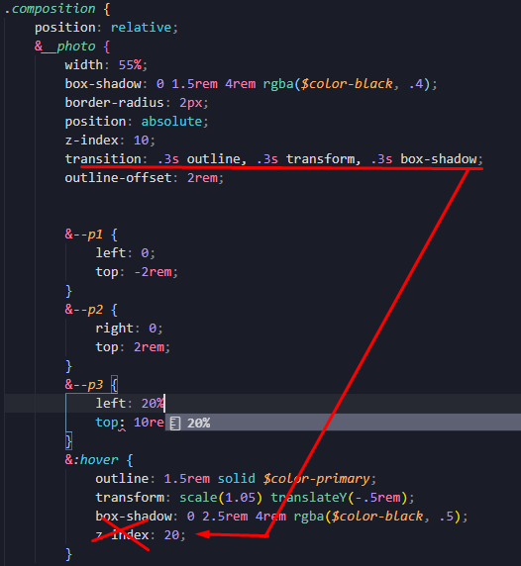
Asi arregle el tema del efecto que no me gustama en el cambio de los index

Slide 17
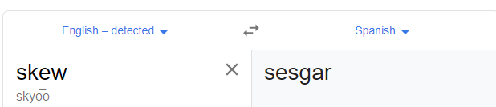
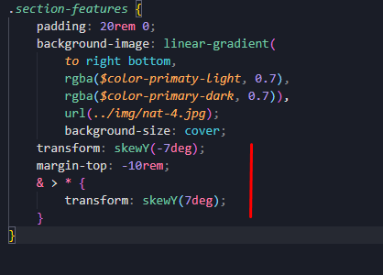
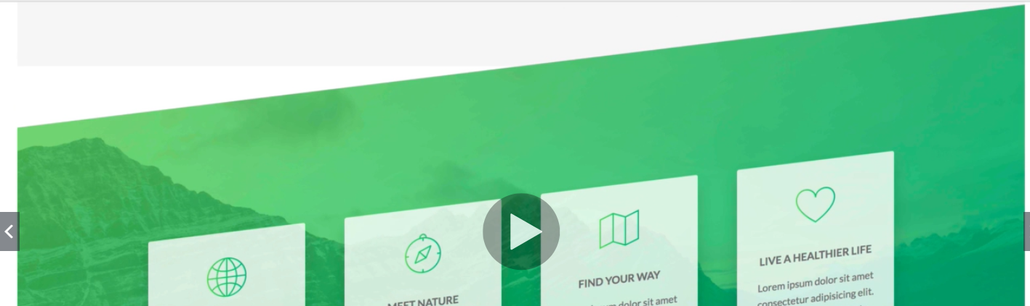
Section features
Icon fonts are vectors that no matters how much you zoom in or zoom out you always will see them with a good definition

Slide 18
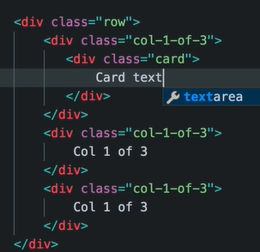

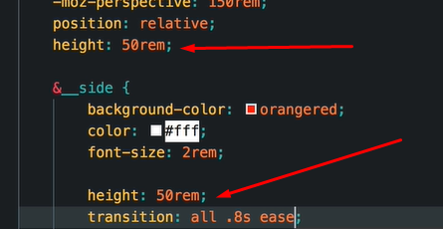
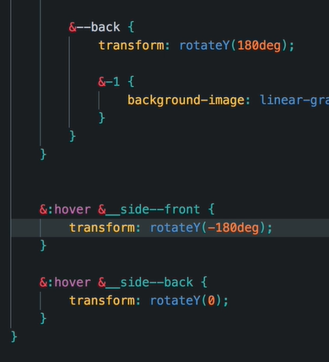
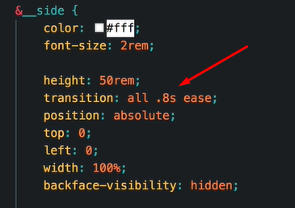
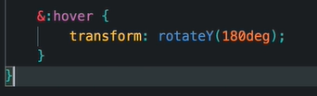
Tours Section
1. Set it into the Grid system
3. Perspective to make the effect looks nice
5. Set its out height
4. Set the position on Y of both faces
6. Animation
2. Rotate on Y axis

Slide 19
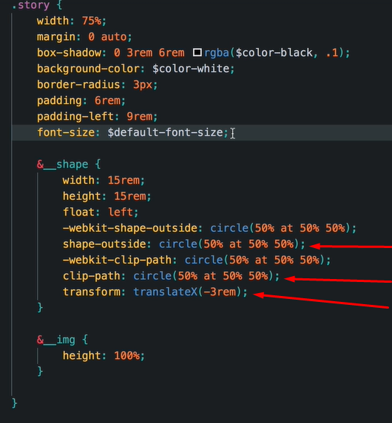
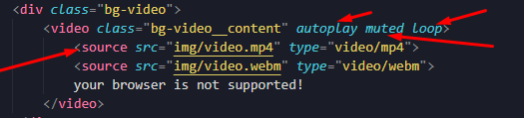
stories Section
Out side shape
Shape of the circle it self
To don’t type any padding

Slide 20
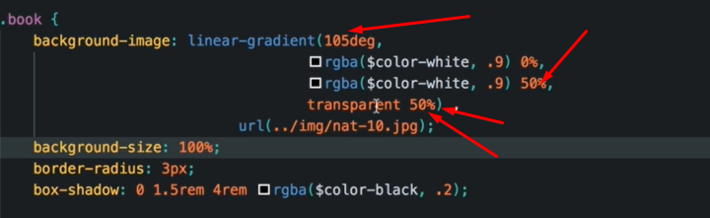

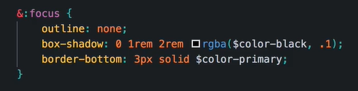
Book Section

Slide 21


In the layout the webpage can be found different components
Because they have couple of advantages such as:

Slide 22
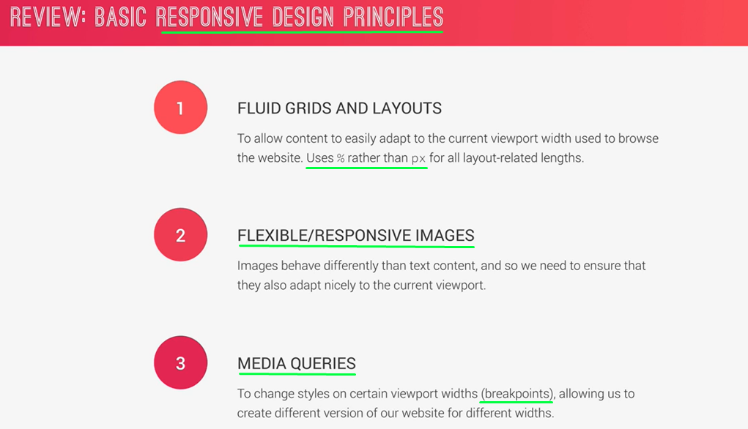

Slide 23
Graceful degradation

Slide 24
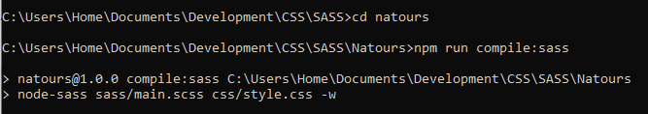
Correr sass en consola

