Slide 1
Trillo
It is a booking app where the idea is that a user can book a hotel, flight, car and tours, this is the user interface, the hotel overview
Set the background pink color

Slide 2
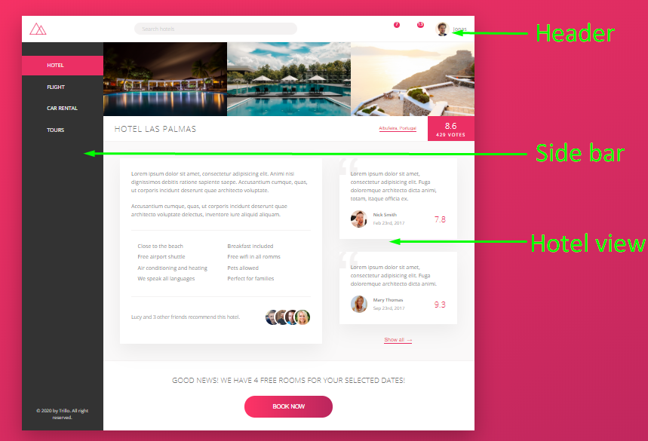
Container
Content

Slide 3
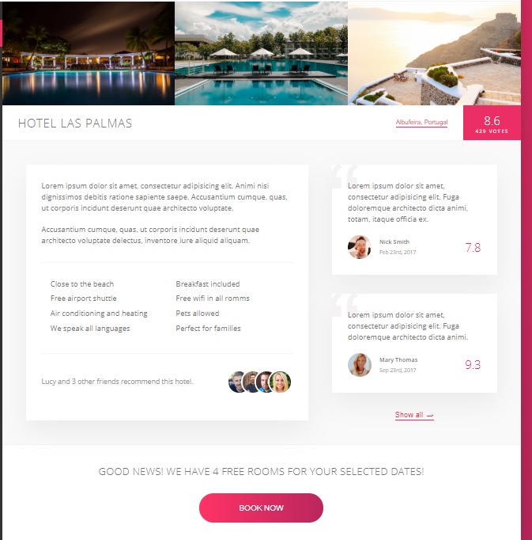
Gallery
Overview
Review
Cta

Slide 4



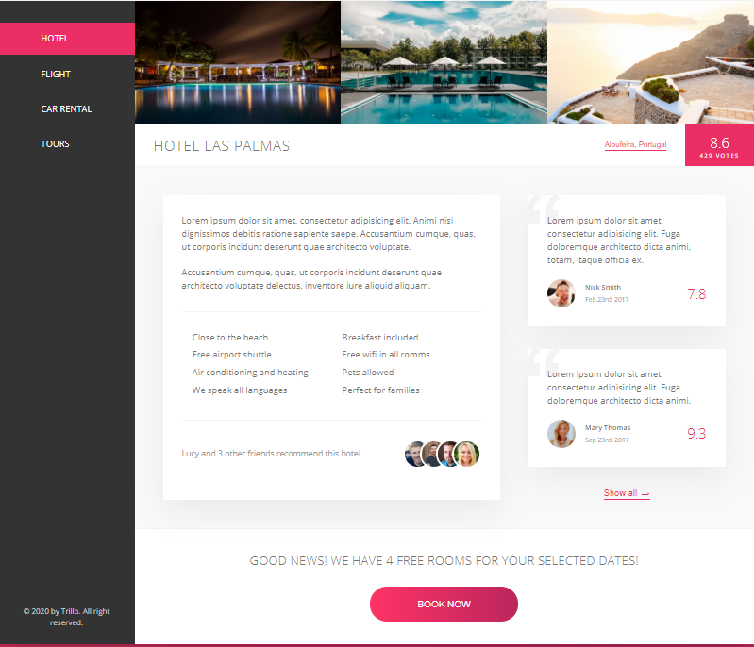
Content
Side Bar
Hotel view

Slide 5


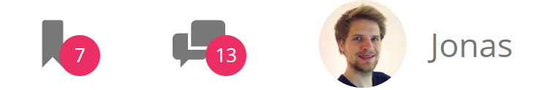




Parent: header
Search
User nav
Logo
Parent: header
Parent: Search
Input
Button
Icon box
Icon box
Nav-user

Slide 6
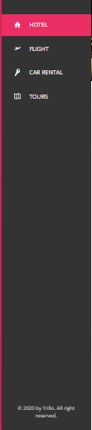
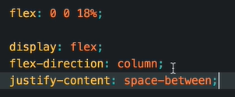


Parent: sidebar
ul
legal

Slide 7
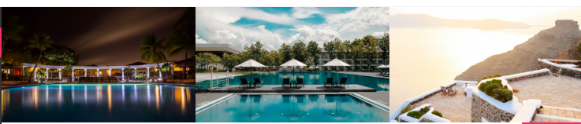
Parent: gallery

Slide 8


Parent: overview
heading
stars
location
raiting

Slide 9
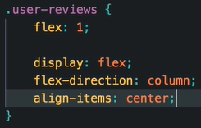
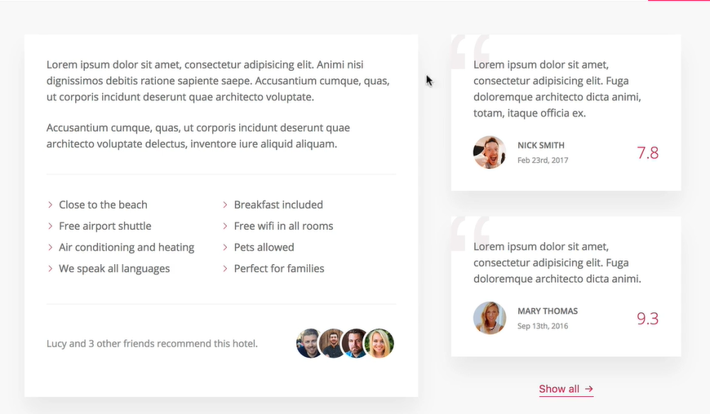


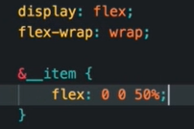
Parent: detail
Description
reviews
user
List
recommend

Slide 10
Responsive Design

Slide 11
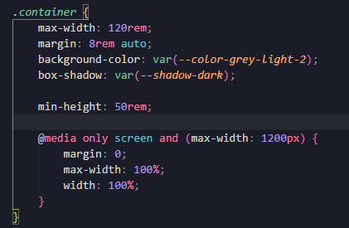

Slide 12

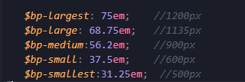
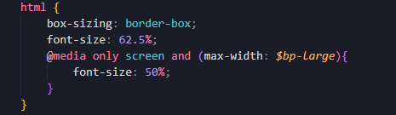

Slide 13
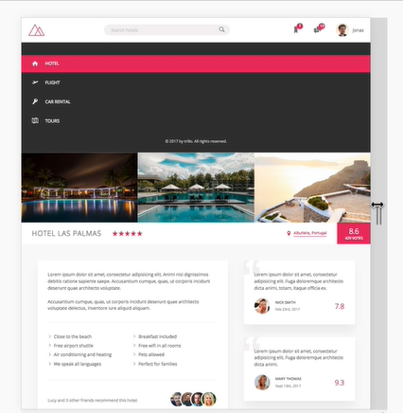
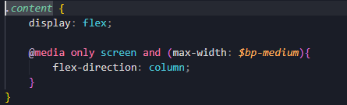

Slide 14

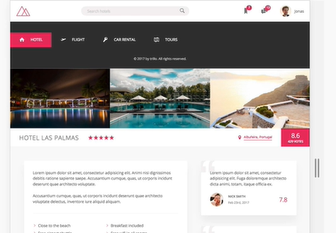

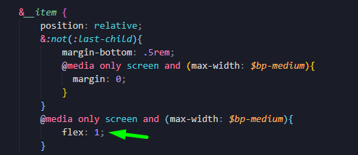

Slide 15
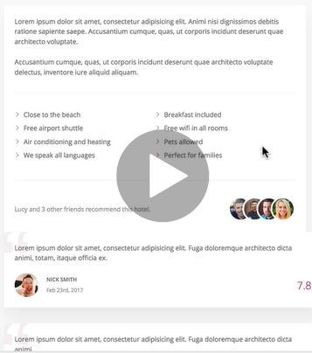
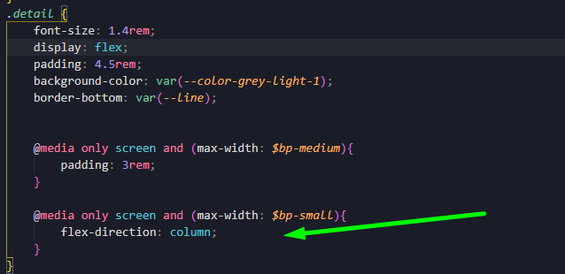

Slide 16
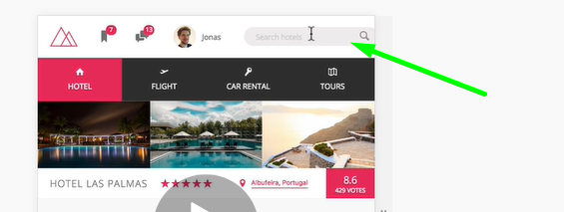
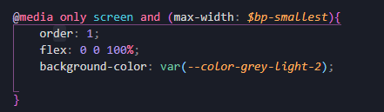
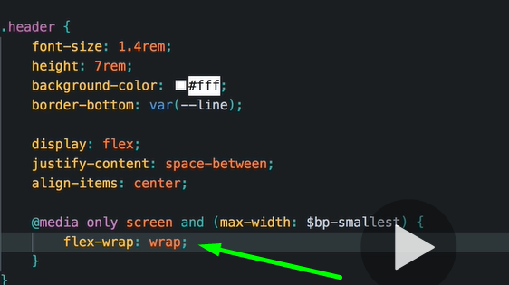

Slide 19
SVG
Scalable Vector Graphics
As s best practice
They can be seen only in the web server

