Slide 1

PRESENTACIÓN TÉCNICA
*para los que le saben
MÉTODO(logia)

Slide 2
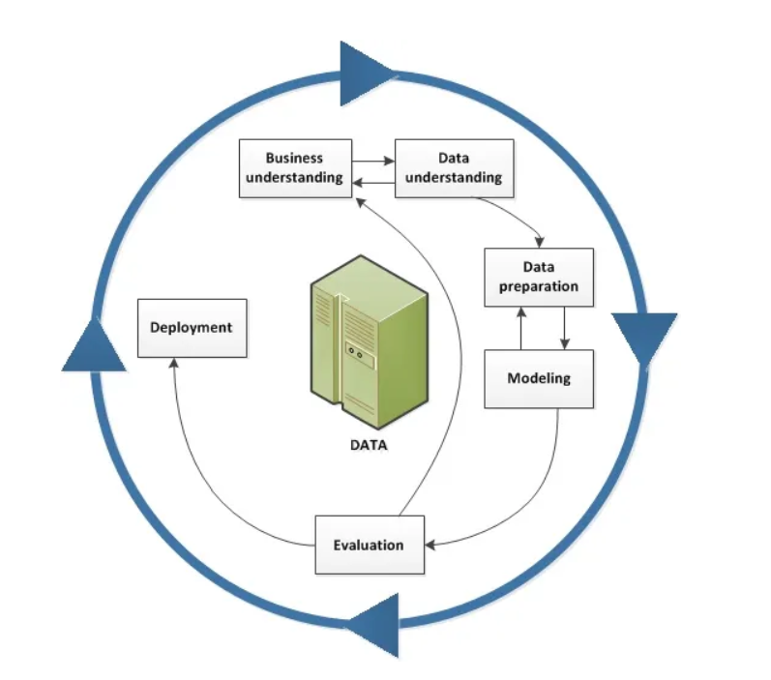

Slide 3
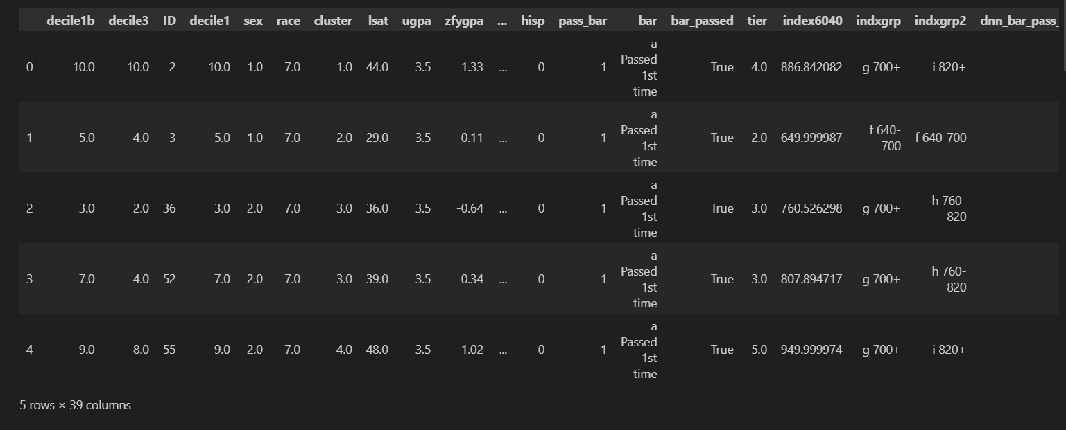
PRESENTACIÓN TÉCNICA
*para los que le saben
DE DATOS Y MODELO(s)
Datos originales: Wightman, L. F. (1998). LSAC National Longitudinal Bar Passage Study. LSAC Research Report Series. Law School Admission Council.
Target: Datos nominales [1/0]
Features: Datos nominales, continuos, discretos y ordinales.
Librerías:
pandas==2.2.2
matplotlib==3.9.0
seaborn==0.13.2
numpy==1.26.4
sklearn==1.5.0
imblearn==0.12.3
pickle==4.0
yaml==6.0.2

Slide 5
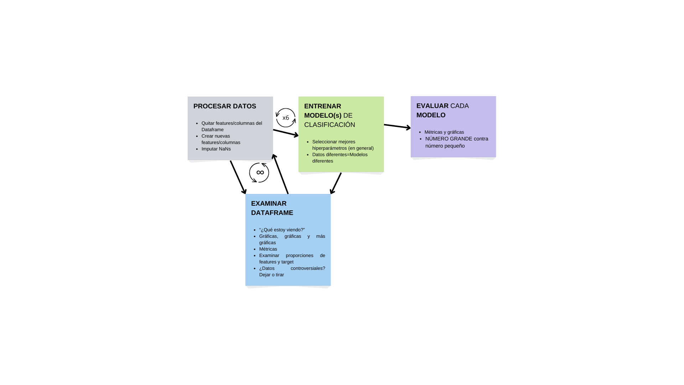
DE DATOS Y MODELO(s)
METODO(logia)

Slide 6
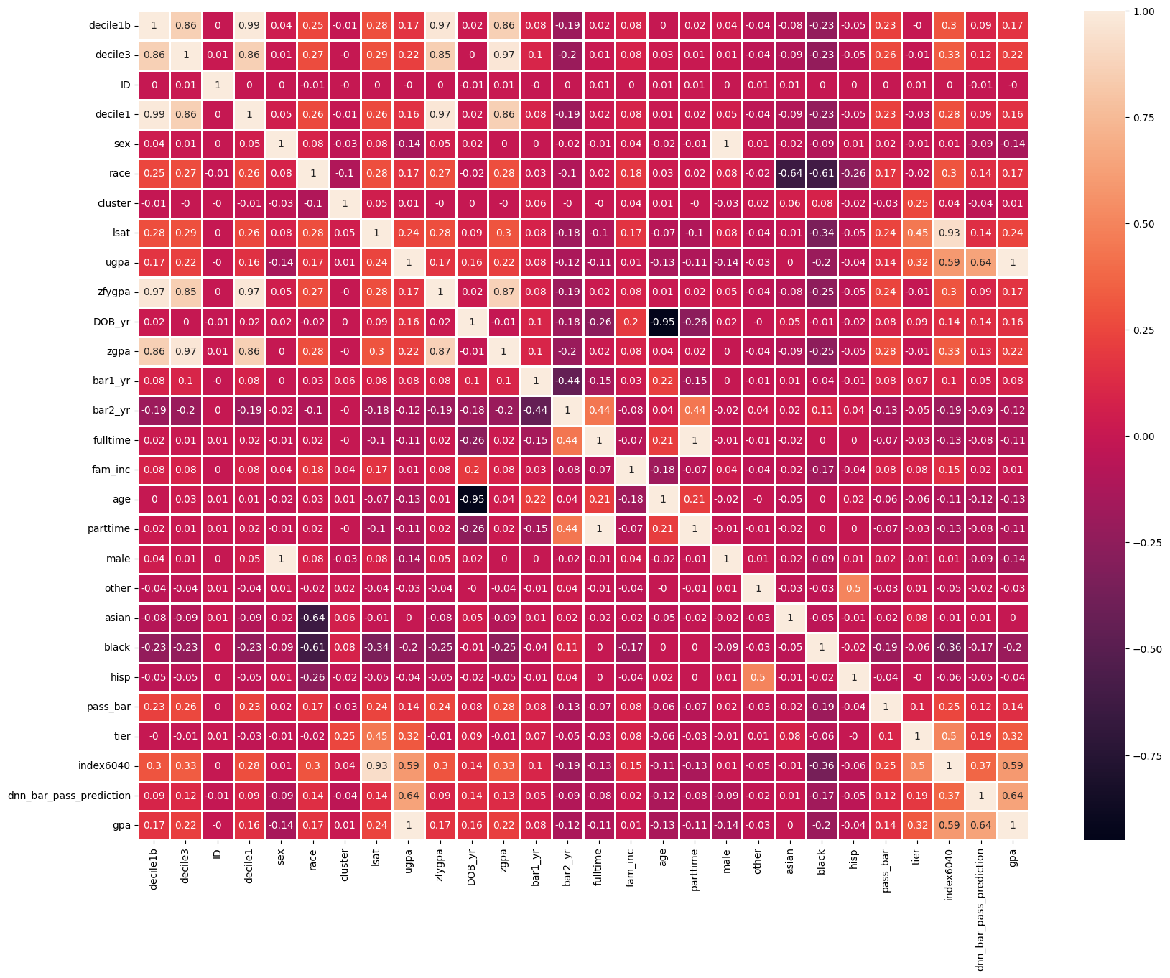
DE DATOS Y MODELO(s)
(DEMASIADOS) DATOS
22407 filas × 39 columnas
Muchas features
NaNs y nulls
Desbalanceo en target (Oversampling)
Train/Test (con y sin datos controversiales, y ambos con y sin oversampling)

Slide 7
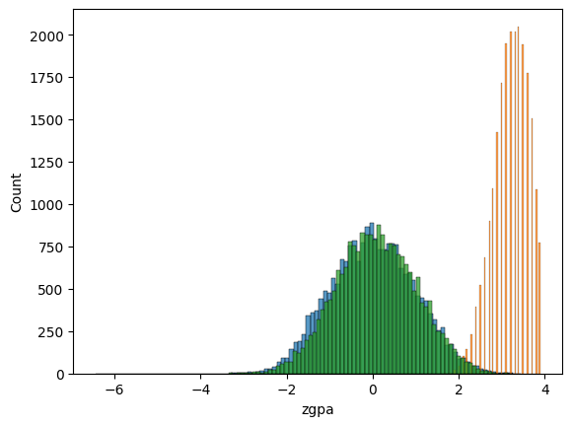
FEATURES
UGPA (GPA)
ZGPA
ZFYGPA
(…)

Slide 8
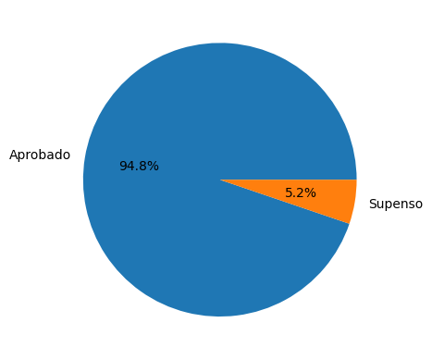
TARGET

Slide 9
Features numéricas: | Features no numéricas:
decile1b | grad
decile3 | bar1
ID | bar2
decile1 | gender
sex | race1
race | race2
cluster | Dropout
lsat | bar
ugpa | indxgrp
zfygpa | indxgrp2
DOB_yr
zgpa
bar1_yr
bar2_yr
fulltime
fam_inc
age
+ dnn_bar_pass_prediction: The LSAT prediction from the DNN model.
+ gender: Gender of the student.
+ lsat: LSAT score received by the student.
+ race: Race of the student.
+ ugpa: A student's undergraduate GPA.
+ pass_bar: - Ground truth label indicating whether or not the student eventually passed a bar.
+ bar_passed - I added a boolean target column for convenience, of whether someone passed the bar at any point
FEATURES

Slide 10
+ dnn_bar_pass_prediction: The LSAT prediction from the DNN model.
+ gender: Gender of the student.
+ lsat: LSAT score received by the student.
+ race: Race of the student.
+ ugpa: A student's undergraduate GPA.
+ pass_bar: - Ground truth label indicating whether or not the student eventually passed a bar.
+ bar_passed - I added a boolean target column for convenience, of whether someone passed the bar at any point
Features numéricas: | Features no numéricas:
partime | grad
male | bar1
other | bar2
asian | gender
black | race1
hisp | race2
pass_bar | Dropout
bar_passed (BOOL) | bar
tier | indxgrp
index6040 | indxgrp2
dnn_bar_pass_prediction
gpa

Slide 12
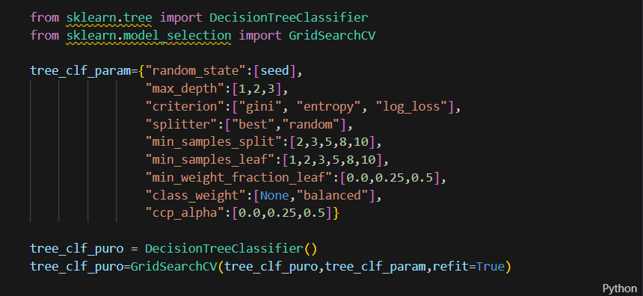
MODELOS
Árbol de decisión
Forest
Regresión Logística
SVC
KNN
KMeans
MÉTODO(logia)

Slide 14
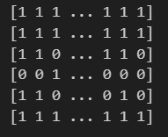
RESULTADOS Y EVALUACIÓN
Mejores modelos:
Tree
Reg. Log.
KNN
MÉTODO(logia)

Slide 15
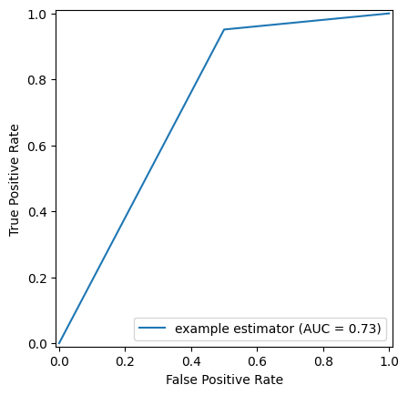
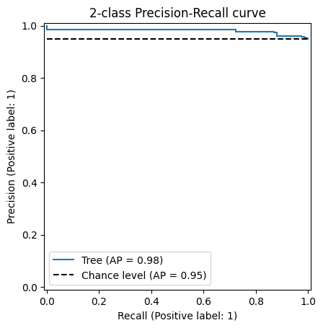
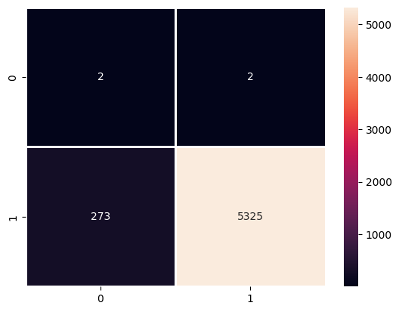
EVALUACIÓN
Mejores modelos:
Forest
Reg. Log.
KNN
Métricas:
1.
AUC: 0.7781149589432346
F1-Score:0.8694190566235949
Precision Score: 0.7767974469682748
Recall Score: 0.987118320610687
ROC-AUC Score: 0.5719279546315846
Specificity: 0.15673758865248227
2.
AUC: 0.9503748661192432
F1-Score:0.9745327958959326
Precision Score: 0.9984982166322508
Recall Score: 0.9516908212560387
ROC-AUC Score: 0.6681531029357116
Specificity: 0.38461538461538464
3.
AUC: 0.978246539222149
F1-Score:0.9780439121756487
Precision Score: 0.95703125
Recall Score: 1.0
ROC-AUC Score: 0.9789002557544757
Specificity: 0.9578005115089514
MÉTODO(logia)

Slide 16
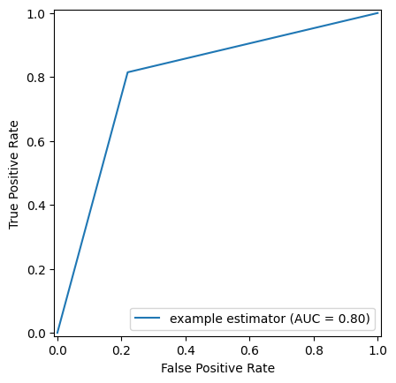
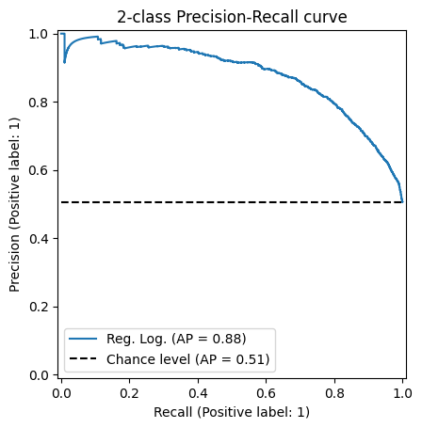
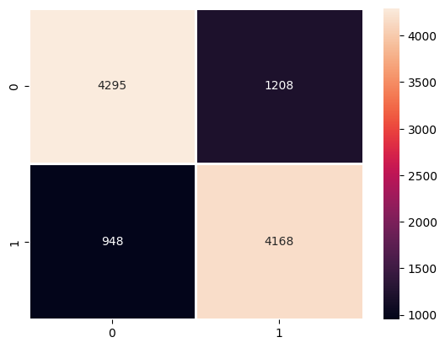
EVALUACIÓN
Métricas:
1.
AUC: 0.7781149589432346
F1-Score:0.8694190566235949
Precision Score: 0.7767974469682748
Recall Score: 0.987118320610687
ROC-AUC Score: 0.5719279546315846
Specificity: 0.15673758865248227
2.
AUC: 0.9503748661192432
F1-Score:0.9745327958959326
Precision Score: 0.9984982166322508
Recall Score: 0.9516908212560387
ROC-AUC Score: 0.6681531029357116
Specificity: 0.38461538461538464
3.
AUC: 0.978246539222149
F1-Score:0.9780439121756487
Precision Score: 0.95703125
Recall Score: 1.0
ROC-AUC Score: 0.9789002557544757
Specificity: 0.9578005115089514
MÉTODO(logia)

Slide 17
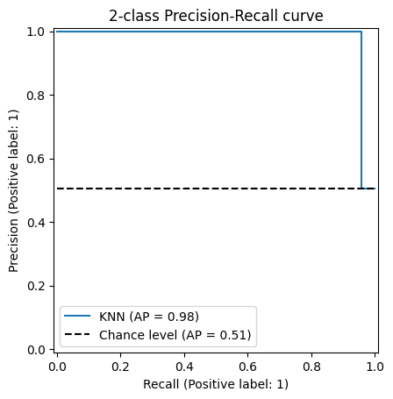
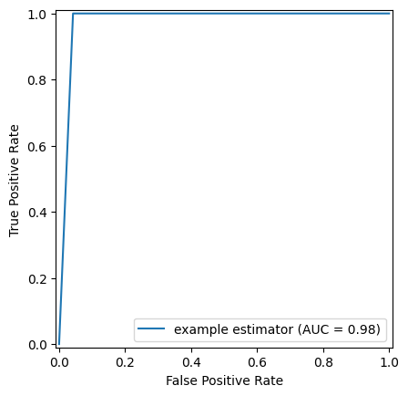
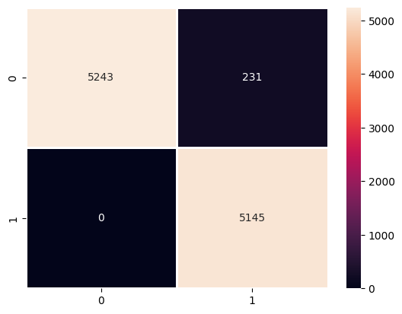
EVALUACIÓN
Métricas:
1.
AUC: 0.7781149589432346
F1-Score:0.8694190566235949
Precision Score: 0.7767974469682748
Recall Score: 0.987118320610687
ROC-AUC Score: 0.5719279546315846
Specificity: 0.15673758865248227
2.
AUC: 0.9503748661192432
F1-Score:0.9745327958959326
Precision Score: 0.9984982166322508
Recall Score: 0.9516908212560387
ROC-AUC Score: 0.6681531029357116
Specificity: 0.38461538461538464
3.
AUC: 0.978246539222149
F1-Score:0.9780439121756487
Precision Score: 0.95703125
Recall Score: 1.0
ROC-AUC Score: 0.9789002557544757
Specificity: 0.9578005115089514
MÉTODO(logia)

Slide 19

PRESENTACIÓN BUSSINES
MÉTODO(logia)

Slide 20



RESULTADOS Y EVALUACIÓN
¿CÓMO SACO DINERO DE ESTO?
Métricas:
1.
AUC: 0.7781149589432346
F1-Score:0.8694190566235949
Precision Score: 0.7767974469682748
Recall Score: 0.987118320610687
ROC-AUC Score: 0.5719279546315846
Specificity: 0.15673758865248227
2.
AUC: 0.9503748661192432
F1-Score:0.9745327958959326
Precision Score: 0.9984982166322508
Recall Score: 0.9516908212560387
ROC-AUC Score: 0.6681531029357116
Specificity: 0.38461538461538464
3.
AUC: 0.978246539222149
F1-Score:0.9780439121756487
Precision Score: 0.95703125
Recall Score: 1.0
ROC-AUC Score: 0.9789002557544757
Specificity: 0.9578005115089514
Contexto: Departamentos de RR.HH. de empresas que requieran empleados con profesiones que requieran un examen habilitante y apuntarse a Colegios Profesionales (arquitectos, abogados, algunos ingenieros, médicos, etc.)
Aplicable también a profesionales del ámbito público que estén dispuestos a compartir sus notas en oposiciones (profesores, por ejemplo).
MÉTODO(logia)

Slide 21

¿DINERO? EL TUYO
Problemas RESUELTOS:
Datos Controversiales
Problemas a RESOLVER:
Extrapolación a otras industrias = Más datos
Complejidad de la realidad
MÉTODO(logia)

