Slide 1
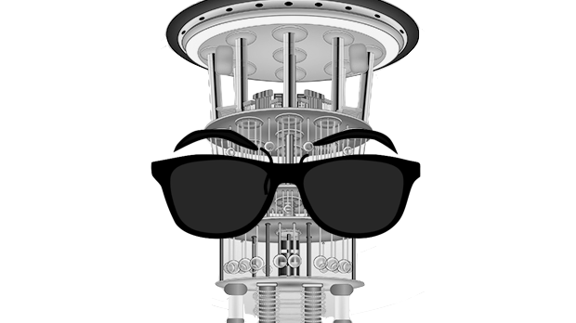

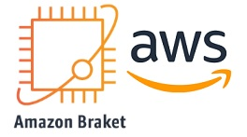
Quantum pathfinder: the vehicle routing optimal solver
Alejandro Montañez
Alberto Maldonado
Team Avocados
Amazon Braket challenge

Slide 2
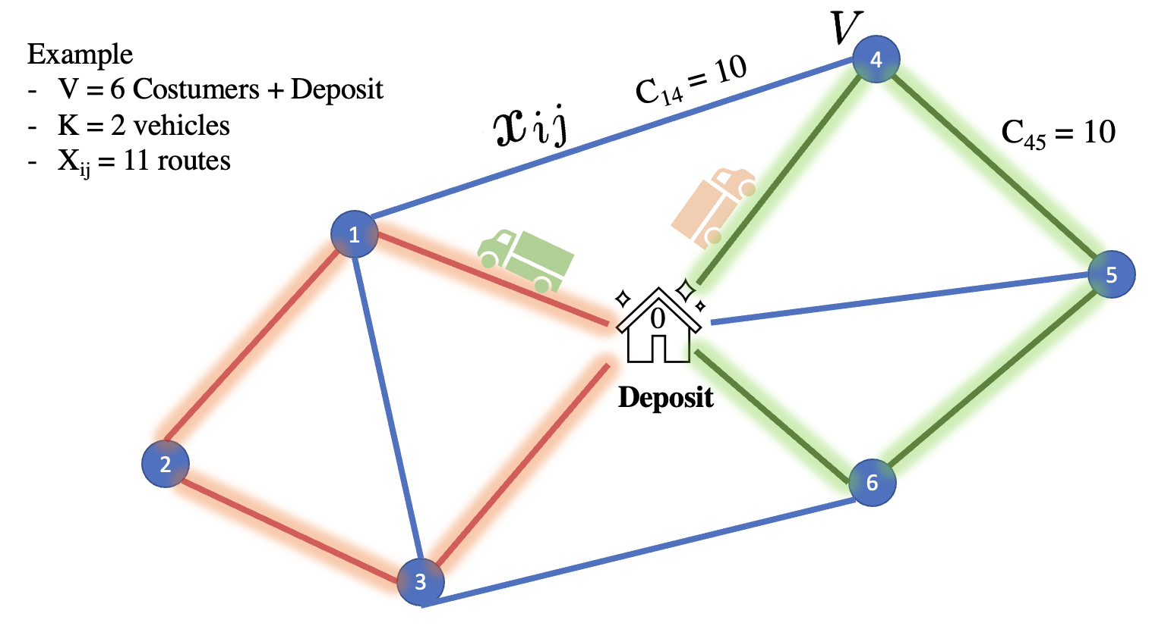
Objective
Quantum pathfinder is an optimization tool designed to find the optimal set of routes for a number of vehicles to traverse in order to deliver to a given set of customers. Quantum Pathfinder uses a quadratic unconstrained binary optimization (QUBO) representation of the well-known problem of the Vehicle Routing Problem VRP and solves it using the Quantum Approximate Optimization Algorithm (QAOA). We compare the results using QAOA and CPLEX a classical solver.
Present a new tool for encoding CPLEX problems into Braket and Pennylane .

Slide 3
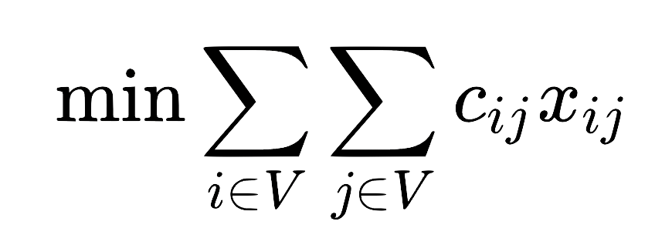
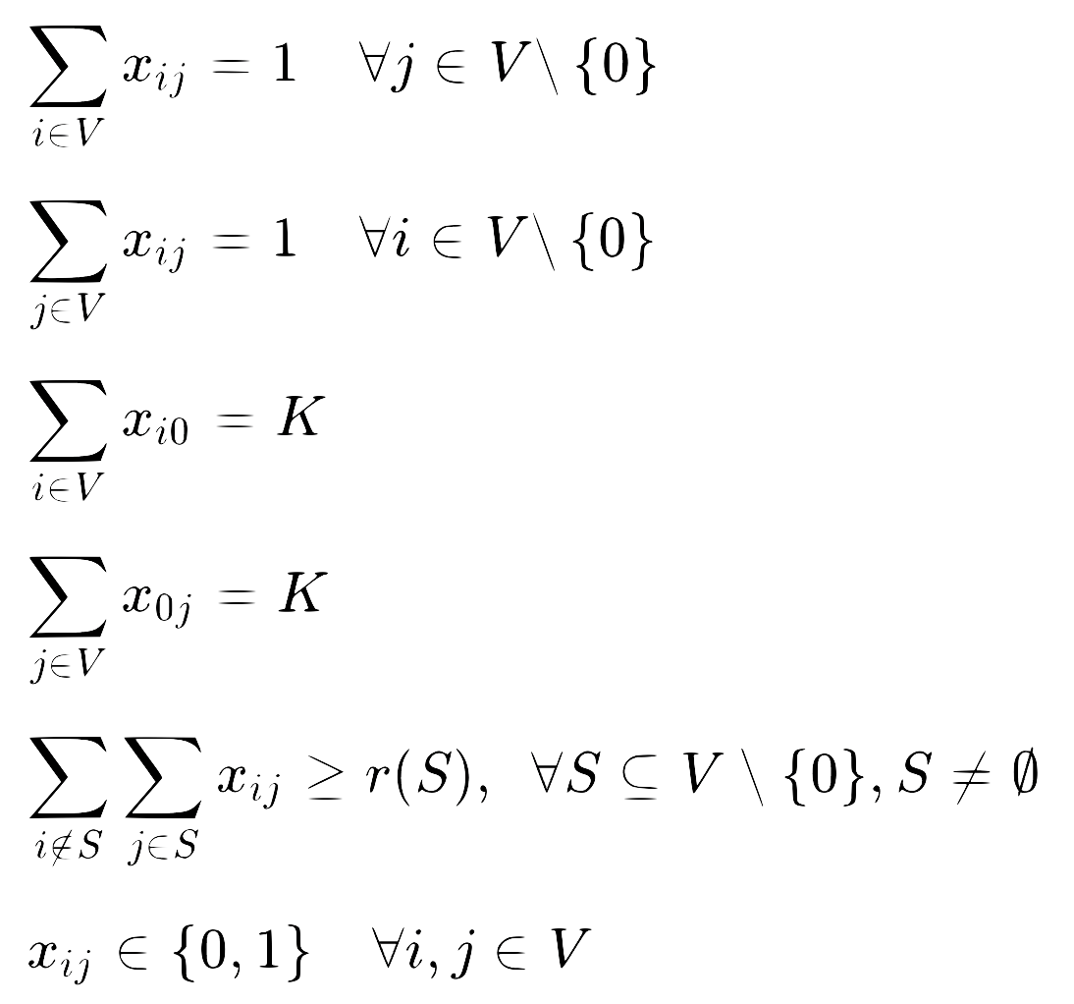
Cost Function
Constraints
Ensure one route entering company i and leaving company j
Constraints associated with K vehicles leaving the deposit and returning to it.
Cost of going from company i to company j
Binary variable 1 if route i, j is considered in the solution
Nodes that represent the companies
Impose the routes must be connected

Slide 4
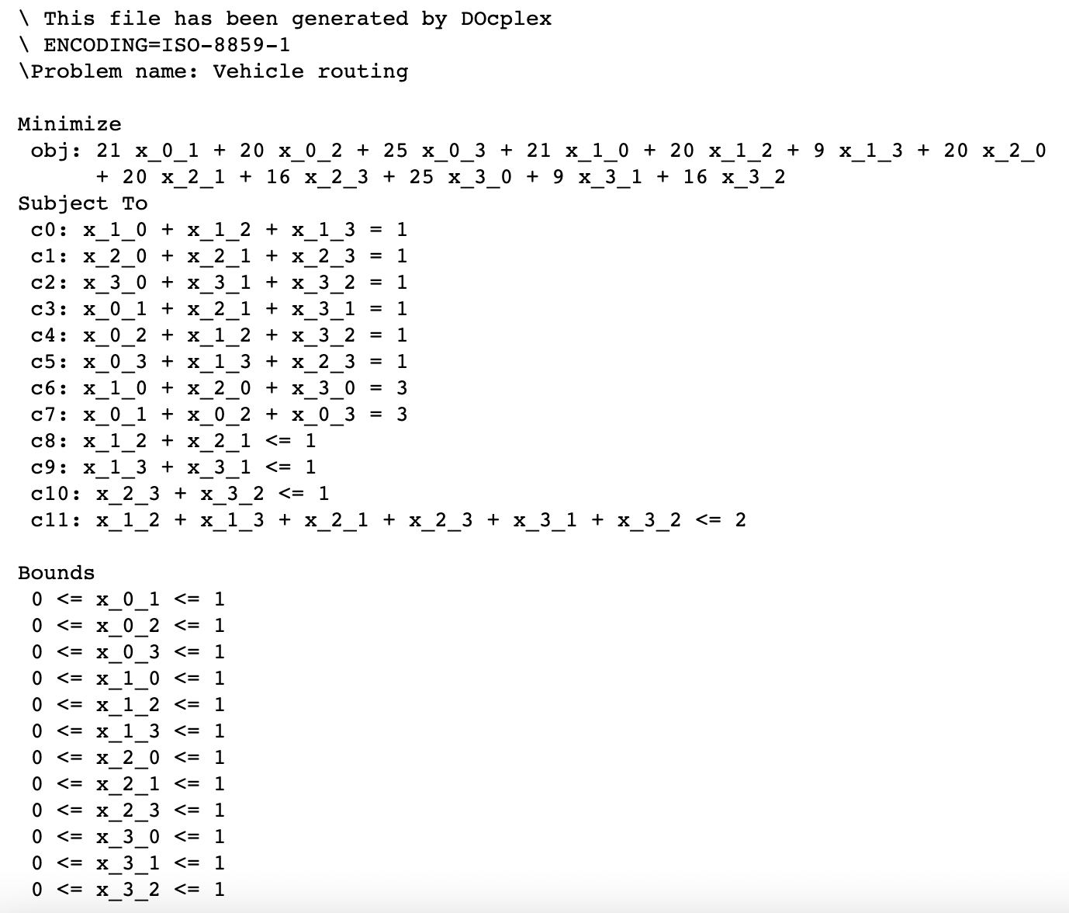
Encoding the problem in DOcplex

Slide 5
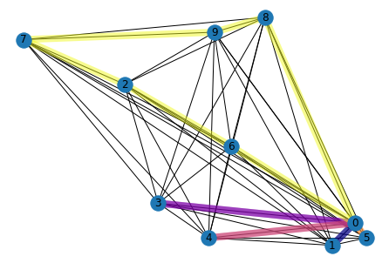
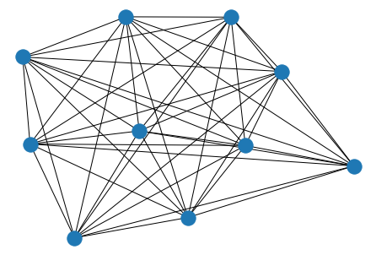
Vehicle Routing problem Solution
Vehicle Routing problem as a graph
Solving using the QAOA function and COBYLA
Quadratic Program using CPLEX
We created a function to translate the quadratic program to a circuit in Pennylane.

Slide 6
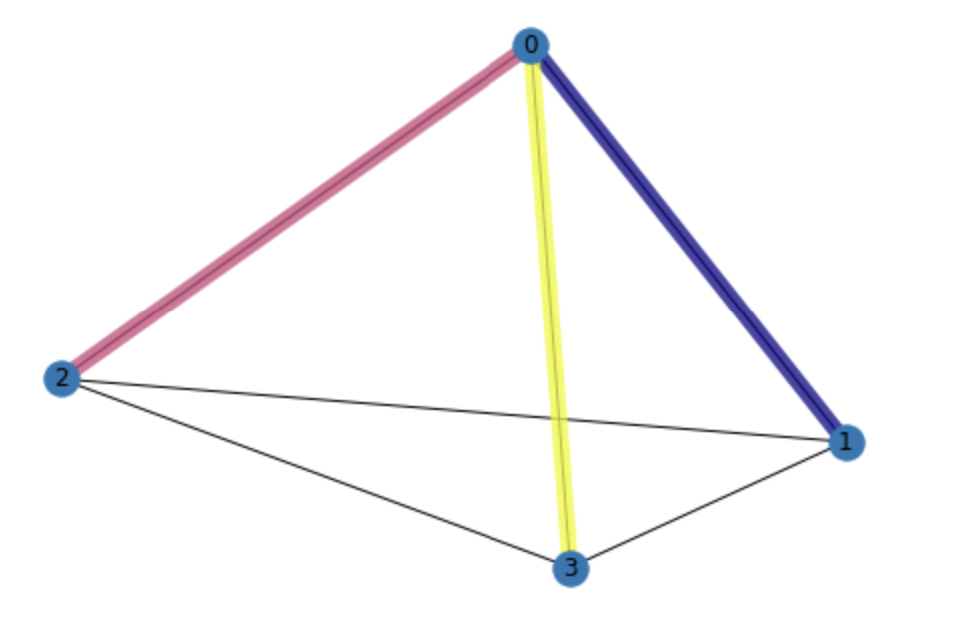
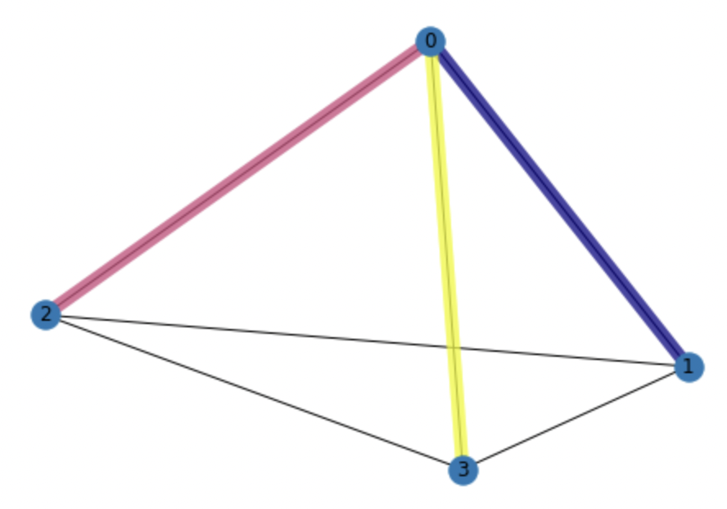
Solution using CPLEX
Solution using QAOA and COBYLA
12 is the number of qubits to encode this problem with 3 costumers and 1 deposit using 3 vehicles

Slide 7
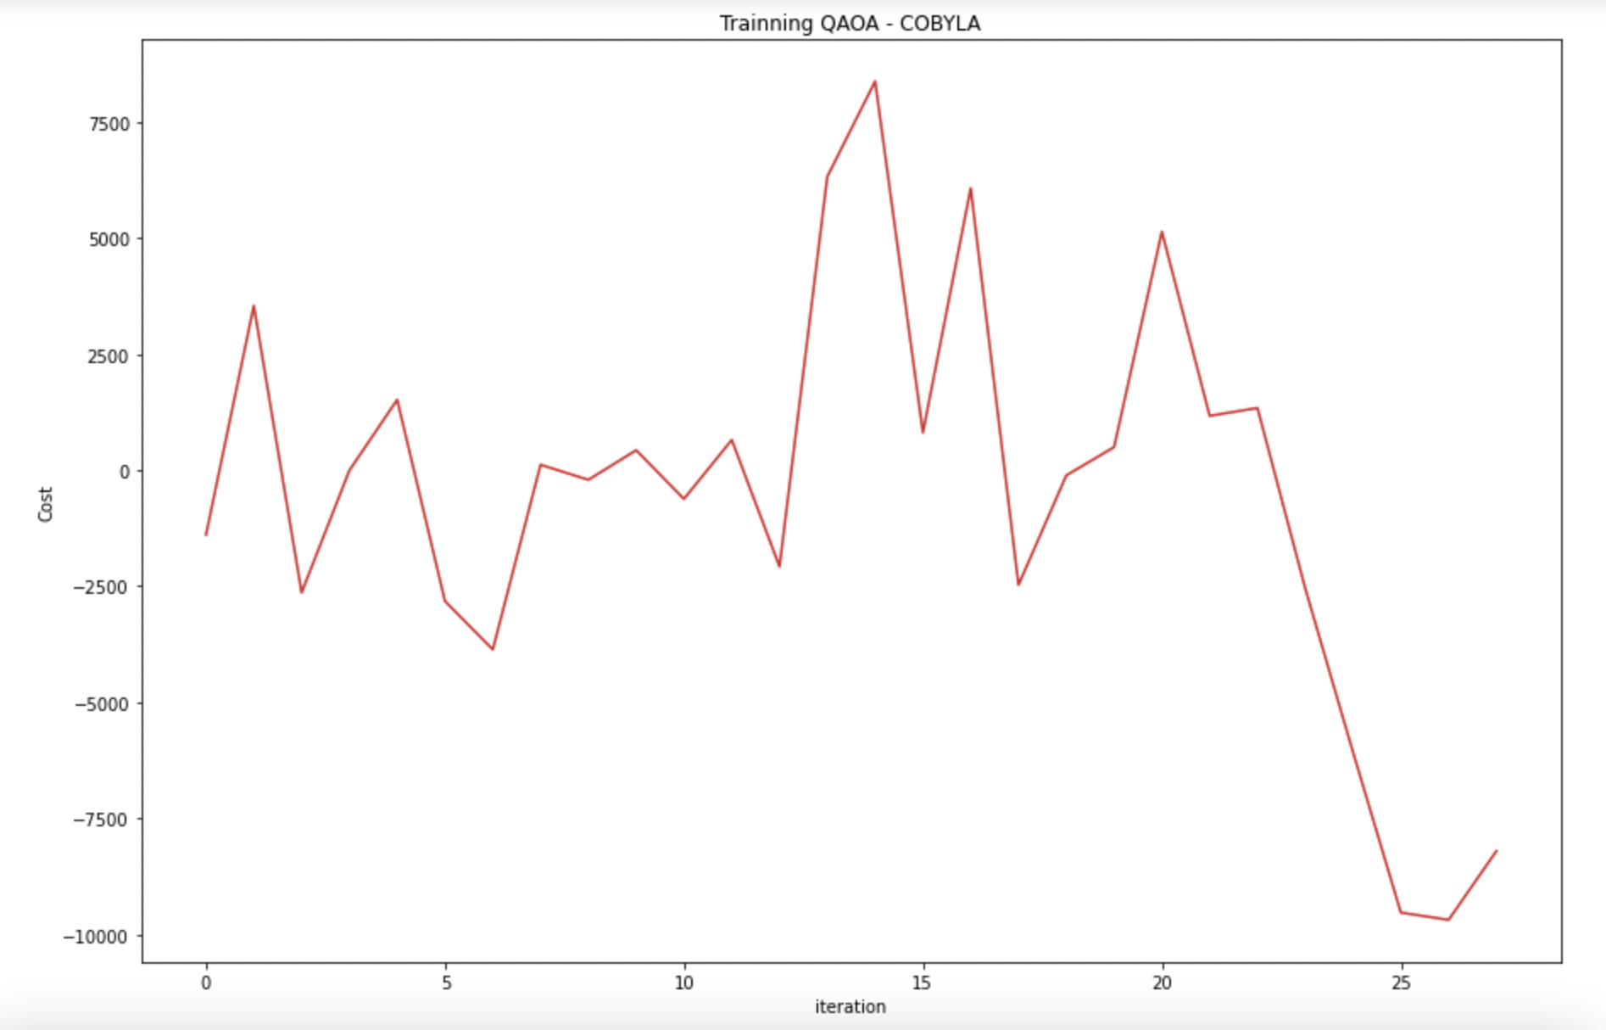
Cost function training
Repetitions of the mixer and the encoding Hamiltonian p = 1

Slide 8
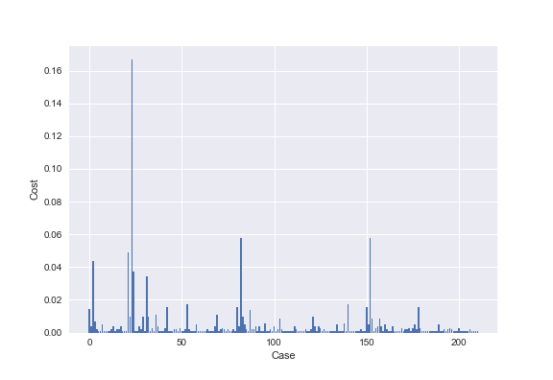
AWS solution – Pennylane QAOA encoding

Slide 9
Conclusions
The QAOA algorithm gives the same solution as CPLEX for the problem proposed which means that the QAOA is getting the optimal solution for this problem.
The Pennylane solution needs an improvement to classify the correct solution. However, we create a function that combines a model from CPLEX QuadraticProgram and Pennylane. This tool will be helpful for an easier user interface to encode QUBO problems.
Future work involves using real devices in AWS with error mitigation (mitiq).

