Slide 1
RL methods in practice
Alekh Agarwal

Slide 2
Recap
In the last lecture we saw:
Markov Decision Processes
Value iteration methods for known MDPs
RMAX algorithm for unknown MDPs
Crucial assumption: Number of states is small

Slide 3
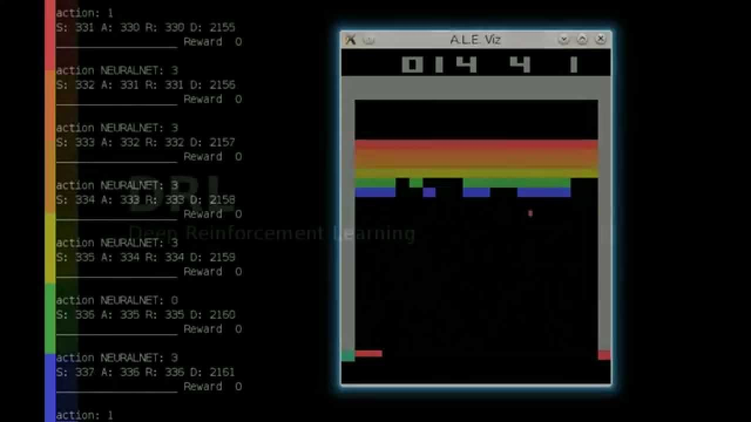

From theory to practice
Agent receives high-dimensional observations
Want policies: observations $↦$ action
Observation as state does not scale
Want policies and value functions to generalize across related observations

Slide 4
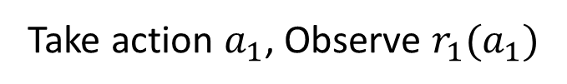
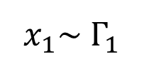
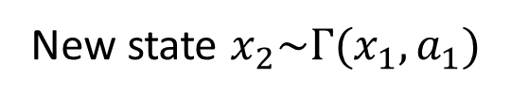
Markov Decision Processes (MDPs)
$x_{1}\sim Γ_{1}$
Take action $a_{1}$, Observe $r_{1}(a_{1})$
New state $x_{2}\sim Γ(x_{1},a_{1})$
Challenge: Allow large number of unique states $x$

Slide 5
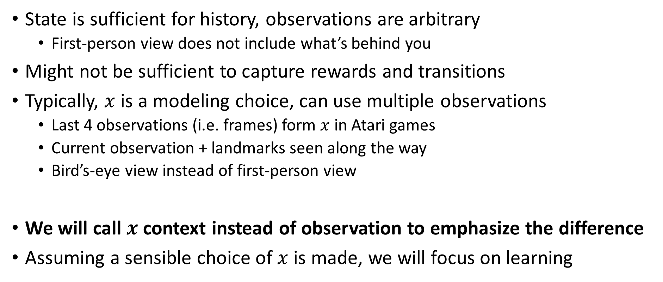
From observations to states
State is sufficient for history, observations are arbitrary
First-person view does not include what’s behind you
Might not be sufficient to capture rewards and transitions
Typically, $x$ is a modeling choice, can use multiple observations
Last 4 observations (i.e. frames) form $x$ in Atari games
Current observation + landmarks seen along the way
Bird’s-eye view instead of first-person view
We will call $x$ context instead of observation to emphasize the difference
Assuming a sensible choice of $x$ is made, we will focus on learning

Slide 6
Two broad paradigms
Value function approximation
Policy improvement/search

Slide 7

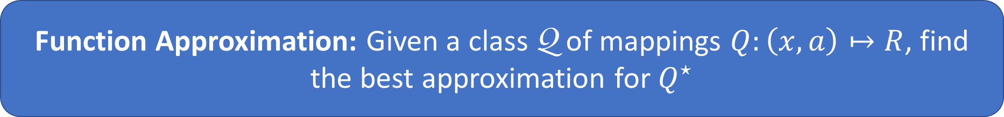
Value Function Approximation
Agent receives context $x$.
Find a function of $(x,a)$ similar to the optimal value function $Q^{⋆}$
Intuition: Pick $\text{Q}$ such that similar $x^{′}s$ get similar predictions
Function Approximation: Given a class $\text{Q}$ of mappings $Q:\left(x,a\right)↦R$, find the best approximation for $Q^{⋆}$

Slide 8
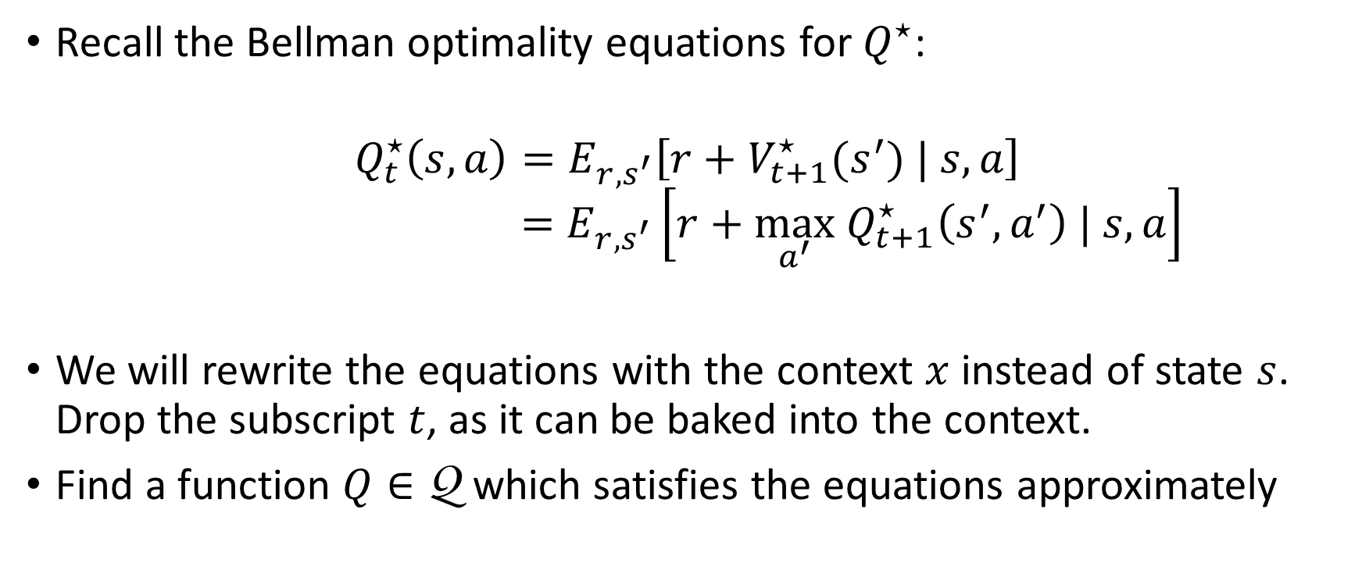
Quality of approximation
Recall the Bellman optimality equations for $Q^{⋆}$:
$$Q_{t}^{⋆}\left(s,a\right)=E_{r,s^{′}}\left[r+V_{t+1}^{⋆}(s^{′}) | s,a\right]$$
$$=E_{r,s^{′}}\left[r+\max_{a^{′}} Q_{t+1}^{⋆}\left(s^{′},a^{′}\right) | s,a\right]$$
We will rewrite the equations with the context $x$ instead of state $s$. Drop the subscript $t$, as it can be baked into the context.
Find a function $Q∈\text{Q}$ which satisfies the equations approximately

Slide 9
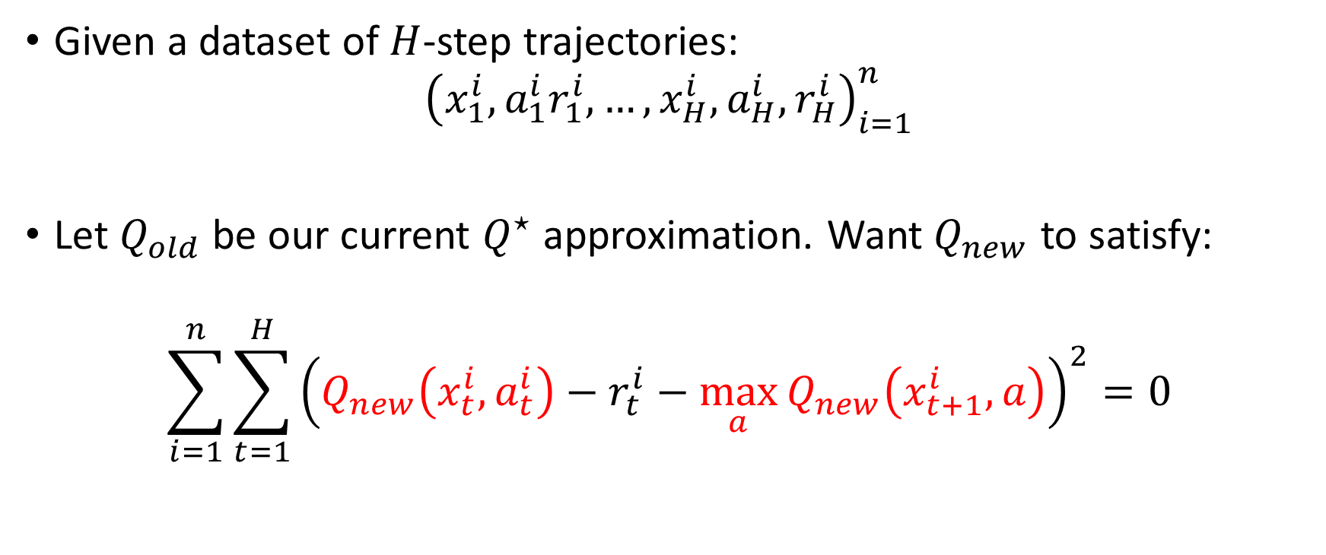
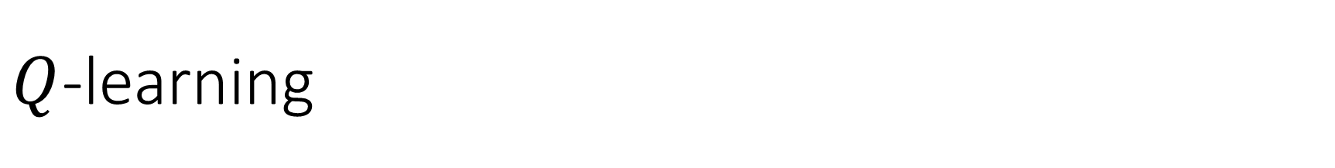
$Q$-learning
Given a dataset of $H$-step trajectories:
$${\left(x_{1}^{i},a_{1}^{i}r_{1}^{i},…,x_{H}^{i}, a_{H}^{i},r_{H}^{i}\right)}_{i=1}^{n}$$
Let $Q_{old}$ be our current $Q^{⋆}$ approximation. Want $Q_{new}$ to satisfy:
$$\sum_{i=1}^{n}{\sum_{t=1}^{H}{{\left(Q_{new}\left(x_{t}^{i},a_{t}^{i}\right)−r_{t}^{i}−\max_{a}{Q_{new}\left(x_{t+1}^{i},a\right)}\right)}^{2}}}=0$$

Slide 10
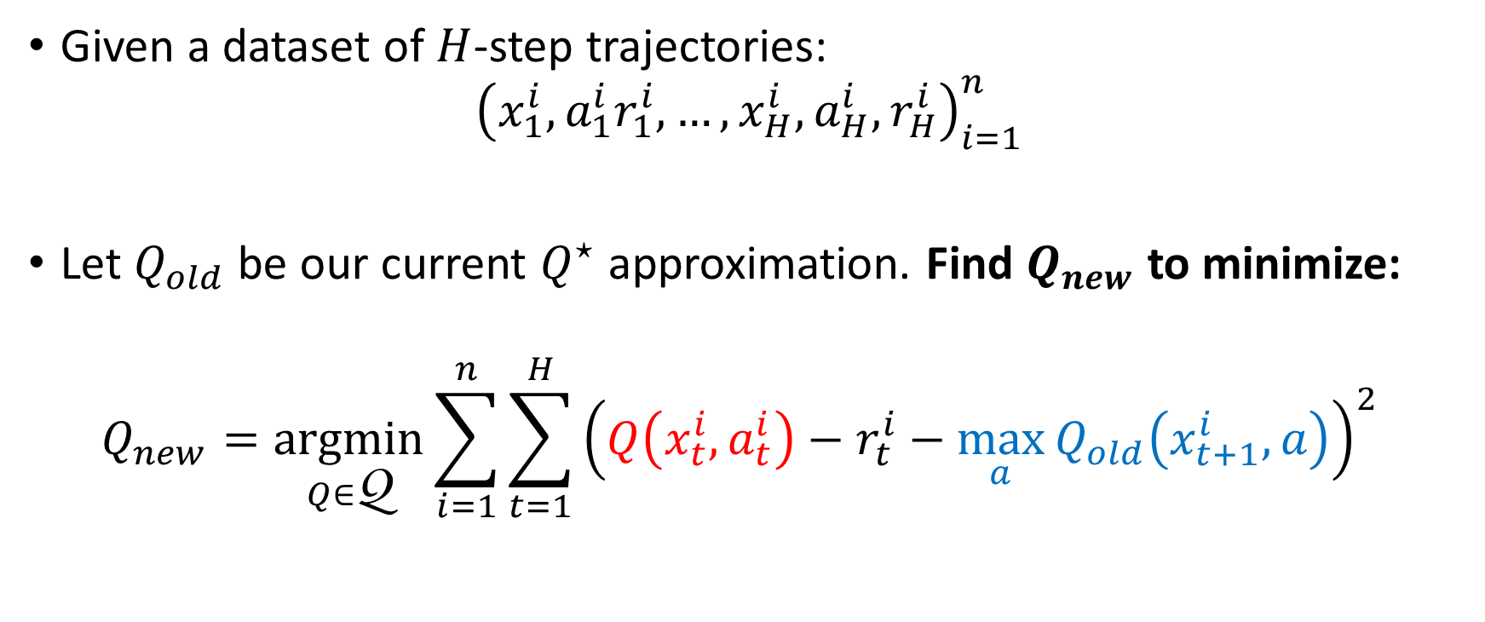
$Q$-learning
Given a dataset of $H$-step trajectories:
$${\left(x_{1}^{i},a_{1}^{i}r_{1}^{i},…,x_{H}^{i}, a_{H}^{i},r_{H}^{i}\right)}_{i=1}^{n}$$
Let $Q_{old}$ be our current $Q^{⋆}$ approximation. Find $Q_{new}$ to minimize:
$$Q_{new}=\underset{Q∈\text{Q}}{argmin}{\sum_{i=1}^{n}{\sum_{t=1}^{H}{{\left(Q\left(x_{t}^{i},a_{t}^{i}\right)−r_{t}^{i}−\max_{a}{Q_{old}\left(x_{t+1}^{i},a\right)}\right)}^{2}}} }$$

Slide 11
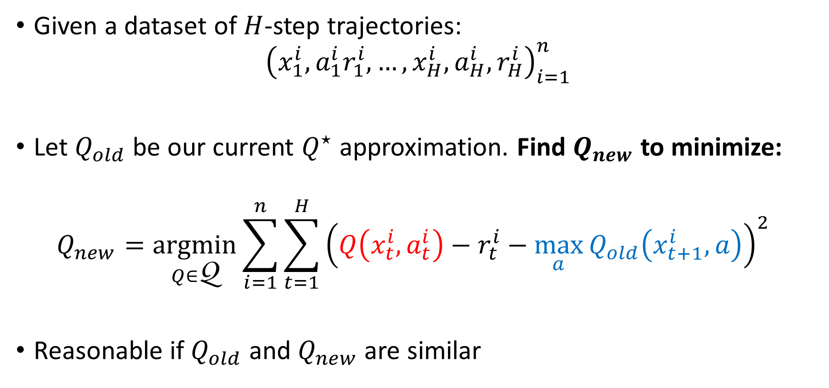
$Q$-learning
Given a dataset of $H$-step trajectories:
$${\left(x_{1}^{i},a_{1}^{i}r_{1}^{i},…,x_{H}^{i}, a_{H}^{i},r_{H}^{i}\right)}_{i=1}^{n}$$
Let $Q_{old}$ be our current $Q^{⋆}$ approximation. Find $Q_{new}$ to minimize:
$$Q_{new}=\underset{Q∈\text{Q}}{argmin}{\sum_{i=1}^{n}{\sum_{t=1}^{H}{{\left(Q\left(x_{t}^{i},a_{t}^{i}\right)−r_{t}^{i}−\max_{a}{Q_{old}\left(x_{t+1}^{i},a\right)}\right)}^{2}}} }$$
Reasonable if $Q_{old}$ and $Q_{new}$ are similar

Slide 12
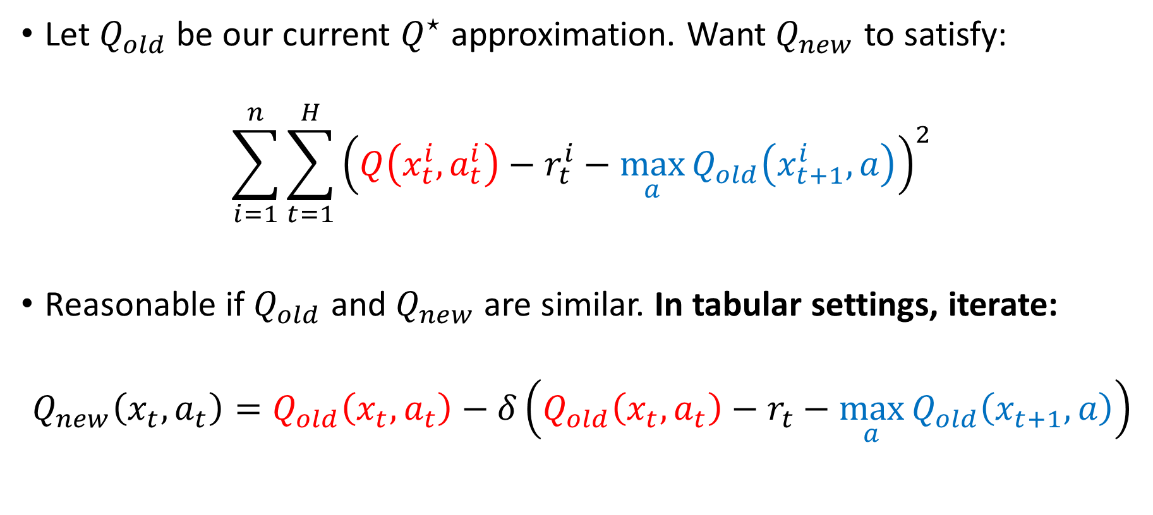
$Q$-learning
Let $Q_{old}$ be our current $Q^{⋆}$ approximation. Want $Q_{new}$ to satisfy:
$$\sum_{i=1}^{n}{\sum_{t=1}^{H}{{\left(Q\left(x_{t}^{i},a_{t}^{i}\right)−r_{t}^{i}−\max_{a}{Q_{old}\left(x_{t+1}^{i},a\right)}\right)}^{2}}}$$
Reasonable if $Q_{old}$ and $Q_{new}$ are similar. In tabular settings, iterate:
$$Q_{new}\left(x_{t},a_{t}\right)=Q_{old}\left(x_{t},a_{t}\right)−δ\left(Q_{old}\left(x_{t},a_{t}\right)−r_{t}−\max_{a}{Q_{old}\left(x_{t+1},a\right)}\right)$$

Slide 13
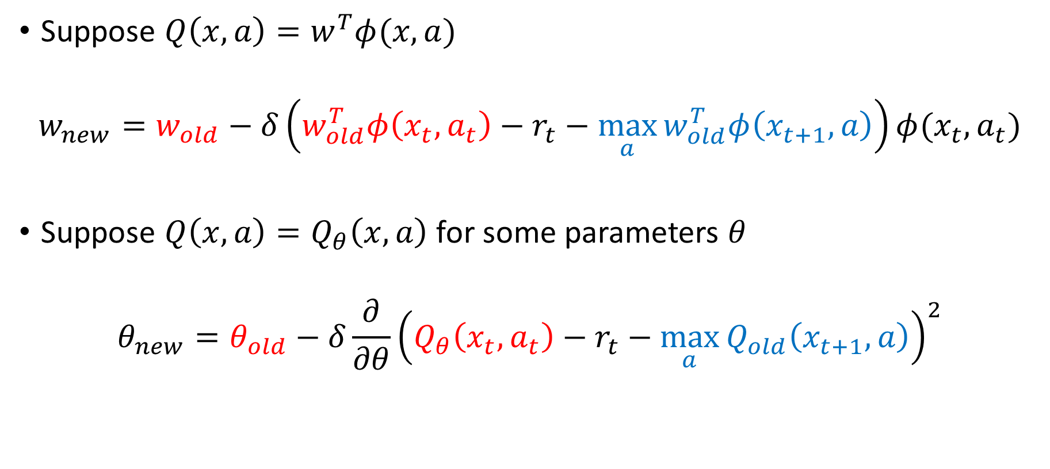
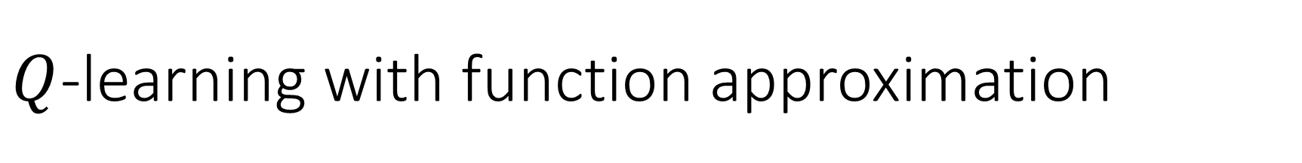
$Q$-learning with function approximation
Suppose $Q\left(x,a\right)=w^{T}φ(x,a)$
$$w_{new}=w_{old}−δ\left(w_{old}^{T}φ\left(x_{t},a_{t}\right)−r_{t}−\max_{a}{w_{old}^{T}φ\left(x_{t+1},a\right)}\right)φ(x_{t},a_{t})$$
Suppose $Q\left(x,a\right)=Q_{θ}\left(x,a\right)$ for some parameters $θ$
$$θ_{new}=θ_{old}−δ\frac{∂}{∂θ}{\left(Q_{θ}\left(x_{t},a_{t}\right)−r_{t}−\max_{a}{Q_{old}\left(x_{t+1},a\right)}\right)}^{2}$$

Slide 14
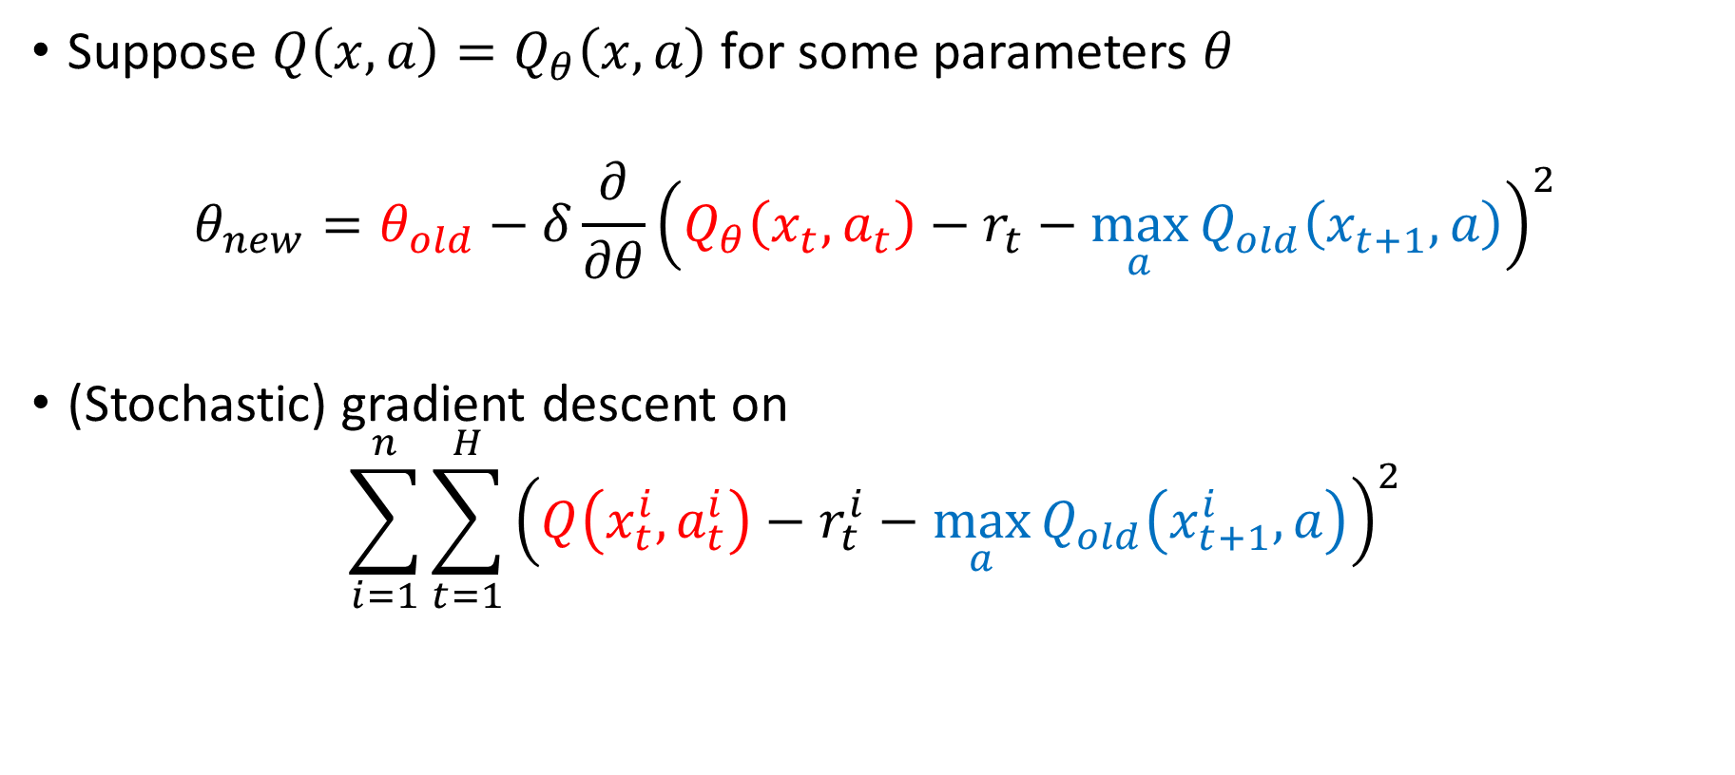
$Q$-learning with function approximation
Suppose $Q\left(x,a\right)=Q_{θ}\left(x,a\right)$ for some parameters $θ$
$$θ_{new}=θ_{old}−δ\frac{∂}{∂θ}{\left(Q_{θ}\left(x_{t},a_{t}\right)−r_{t}−\max_{a}{Q_{old}\left(x_{t+1},a\right)}\right)}^{2}$$
(Stochastic) gradient descent on
$$\sum_{i=1}^{n}{\sum_{t=1}^{H}{{\left(Q\left(x_{t}^{i},a_{t}^{i}\right)−r_{t}^{i}−\max_{a}{Q_{old}\left(x_{t+1}^{i},a\right)}\right)}^{2}}}$$

Slide 15
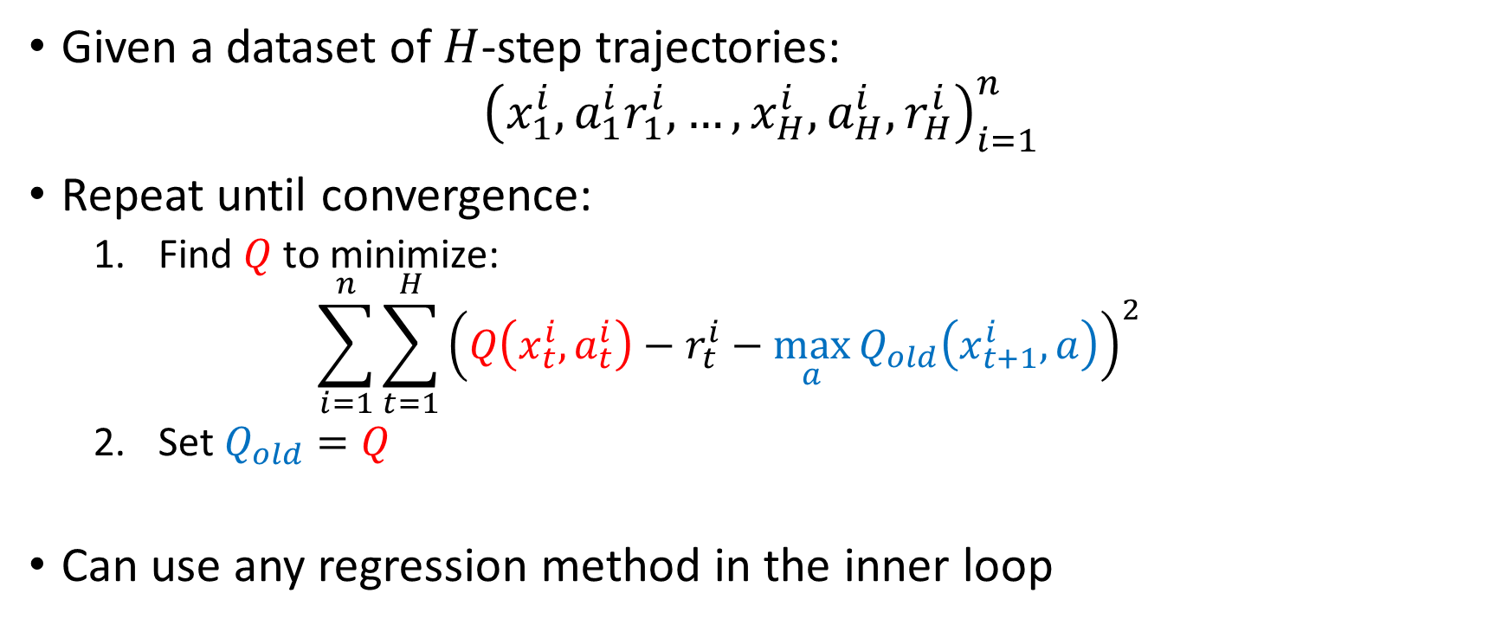

Fitted $Q$-Iteration ($FQI$)
Given a dataset of $H$-step trajectories:
$${\left(x_{1}^{i},a_{1}^{i}r_{1}^{i},…,x_{H}^{i}, a_{H}^{i},r_{H}^{i}\right)}_{i=1}^{n}$$
Repeat until convergence:
Find $Q$ to minimize:
$$\sum_{i=1}^{n}{\sum_{t=1}^{H}{{\left(Q\left(x_{t}^{i},a_{t}^{i}\right)−r_{t}^{i}−\max_{a}{Q_{old}\left(x_{t+1}^{i},a\right)}\right)}^{2}}}$$
Set $Q_{old}=Q$
Can use any regression method in the inner loop

Slide 16
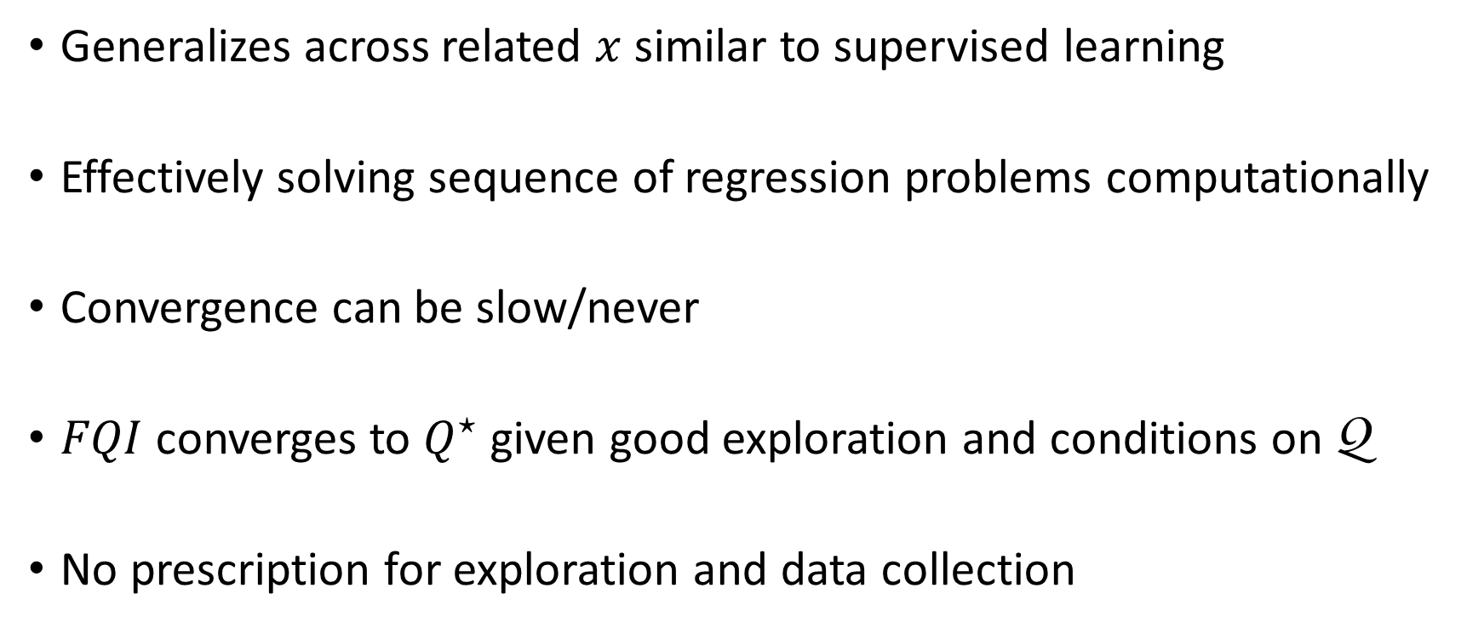
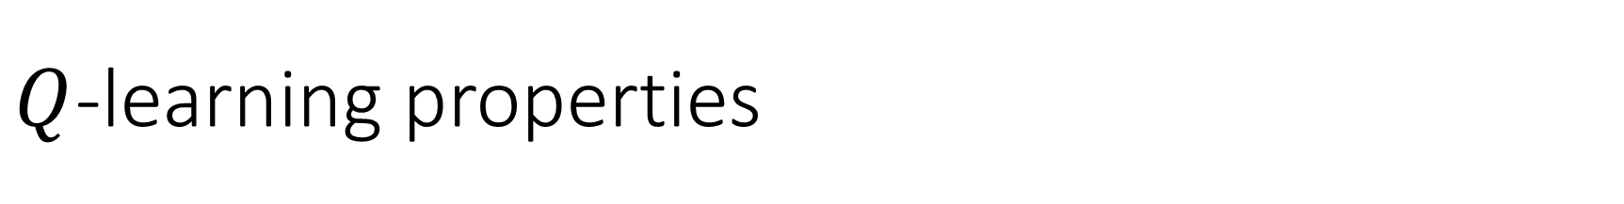
$Q$-learning properties
Generalizes across related $x$ similar to supervised learning
Effectively solving sequence of regression problems computationally
Convergence can be slow/never
$FQI$ converges to $Q^{⋆}$ given good exploration and conditions on $\text{Q}$
No prescription for exploration and data collection

Slide 17
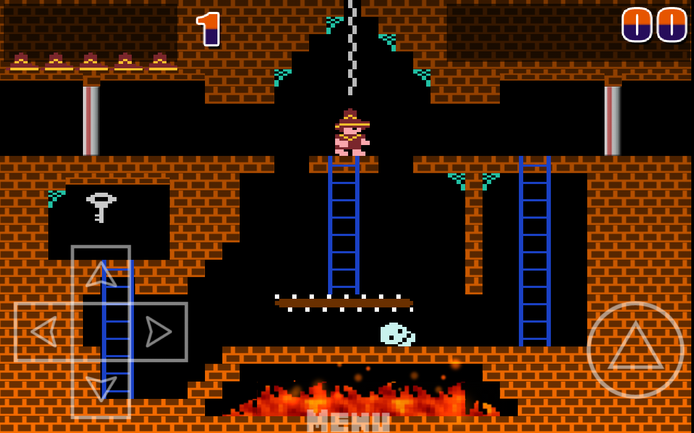
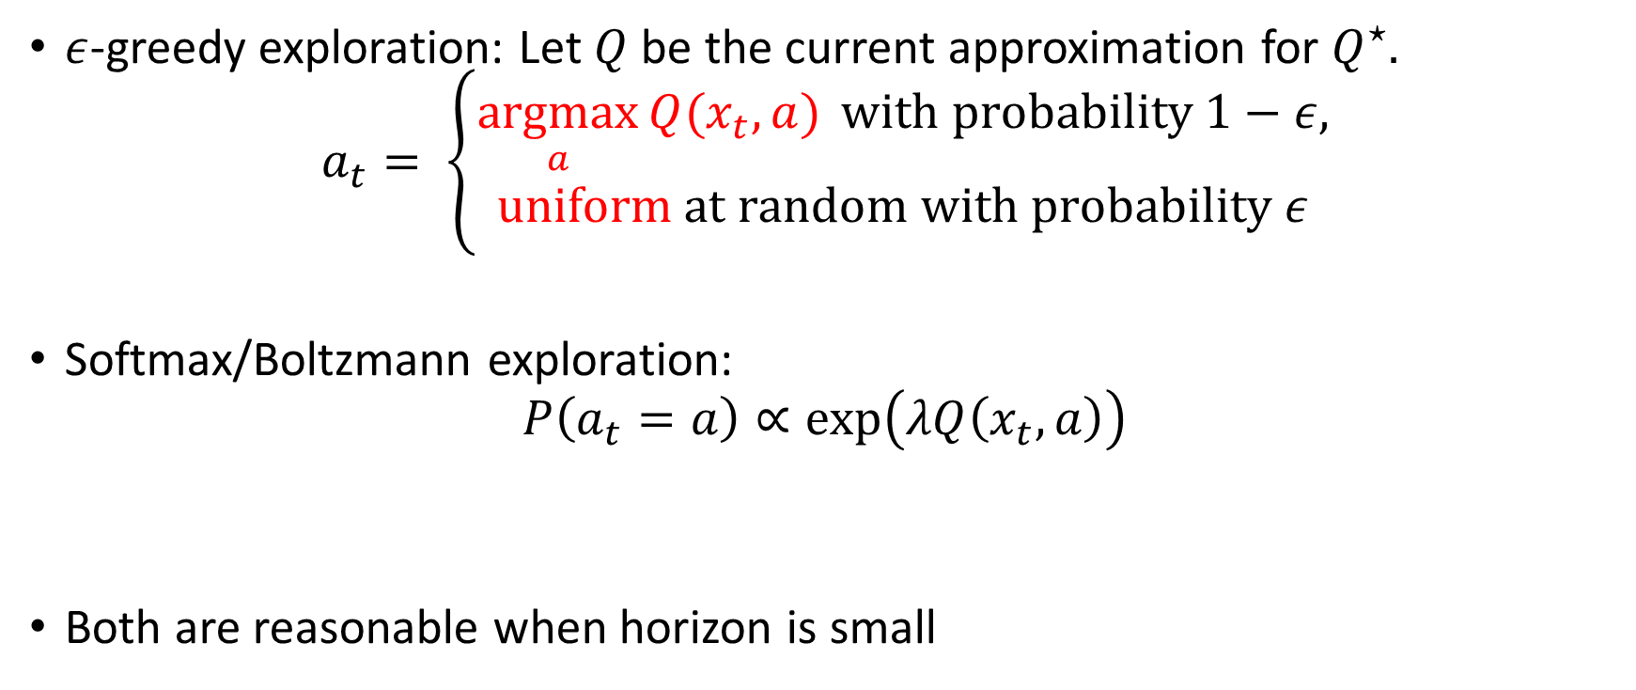
How to explore
$ε$-greedy exploration: Let $Q$ be the current approximation for $Q^{⋆}.$
$$a_{t}= \left\{\begin{aligned}\underset{a}{argmax}{Q(x_{t},a)} \text{with} \text{probability} 1−ε, \\ \text{uniform} \text{at} \text{random} \text{with} \text{probability} ε\end{aligned}\right.$$
Softmax/Boltzmann exploration:
$$P\left(a_{t}=a\right)∝\exp\left(λQ\left(x_{t}, a\right)\right)$$
Both are reasonable when horizon is small

Slide 18
Ensemble exploration
Structure of optimal exploration in contextual bandits
Create an ensemble of candidate optimal policies
Randomize amongst their chosen actions
e.g.: EXP4, ILTCB, Thompson Sampling,…
Adapts to arbitrary policy/value-function classes
Can we extend this idea to RL?

Slide 19
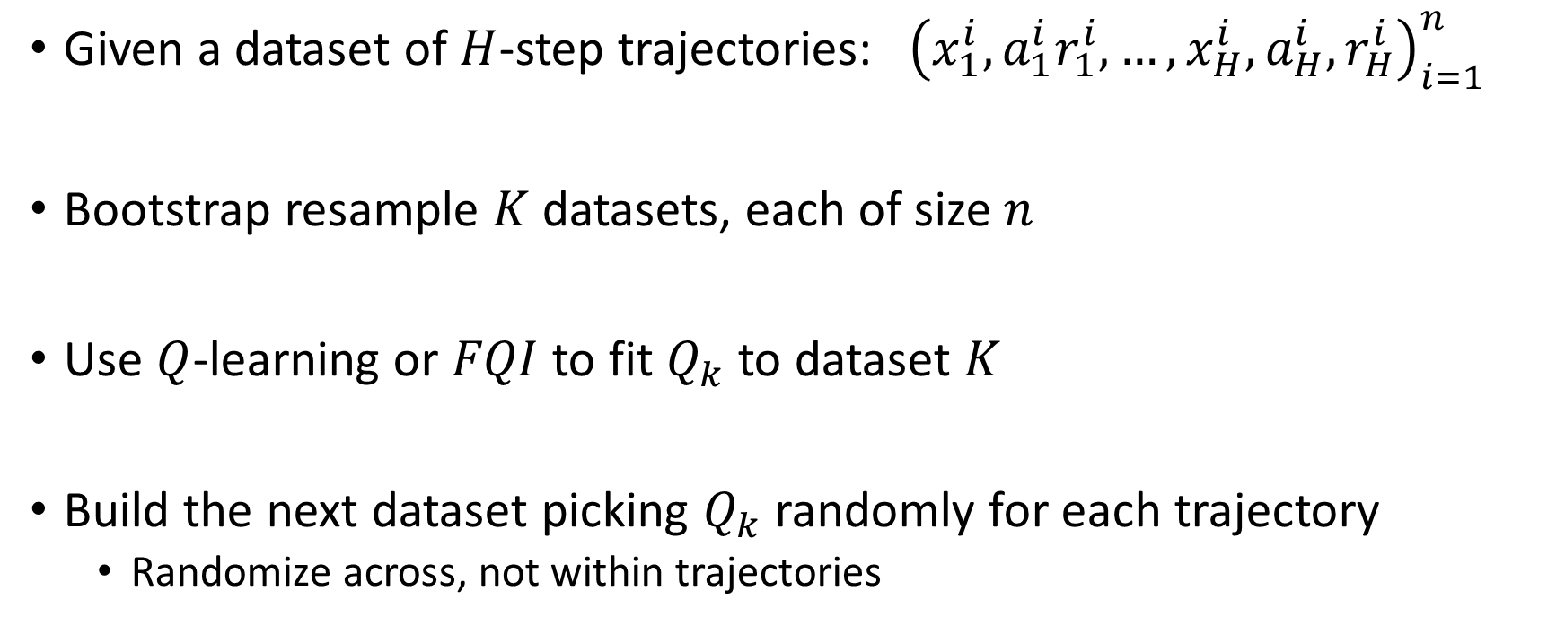

Bootstrapped $Q$-learning (Osband et al., 2016)
Given a dataset of $H$-step trajectories: ${\left(x_{1}^{i},a_{1}^{i}r_{1}^{i},…,x_{H}^{i}, a_{H}^{i},r_{H}^{i}\right)}_{i=1}^{n}$
Bootstrap resample $K$ datasets, each of size $n$
Use $Q$-learning or $FQI$ to fit $Q_{k}$ to dataset $K$
Build the next dataset picking $Q_{k}$ randomly for each trajectory
Randomize across, not within trajectories

Slide 20
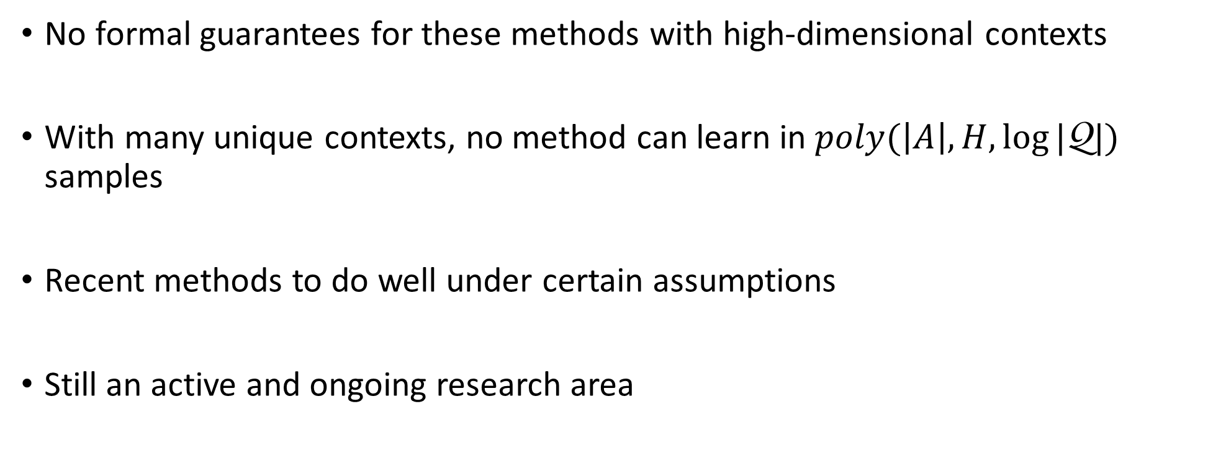
Exploration in RL
No formal guarantees for these methods with high-dimensional contexts
With many unique contexts, no method can learn in $poly(\left|A\right|,H,\log{|\text{Q}|})$ samples
Recent methods to do well under certain assumptions
Still an active and ongoing research area

Slide 21
Two broad paradigms
Value function approximation
Policy improvement/search

Slide 22
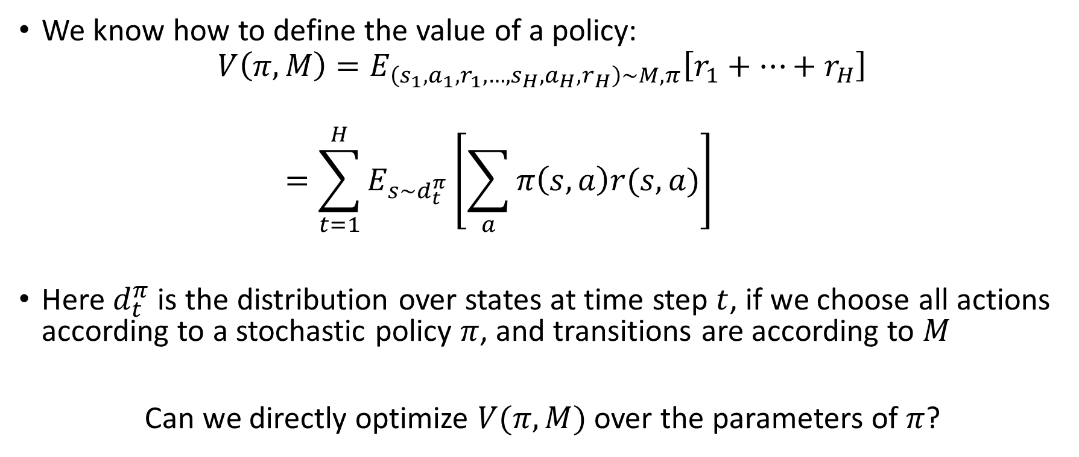
Policy search
We know how to define the value of a policy:
$$V\left(π,M\right)=E_{\left(s_{1},a_{1},r_{1},…,s_{H}, a_{H}, r_{H}\right)∼M,π}\left[r_{1}+…+r_{H}\right]$$
$$=\sum_{t=1}^{H}{E_{s∼d_{t}^{π}}\left[\sum_{a}{π\left(s,a\right)r(s,a)}\right]}$$
Here $d_{t}^{π}$ is the distribution over states at time step $t$, if we choose all actions according to a stochastic policy $π$, and transitions are according to $M$
Can we directly optimize $V(π,M)$ over the parameters of $π$?

Slide 23
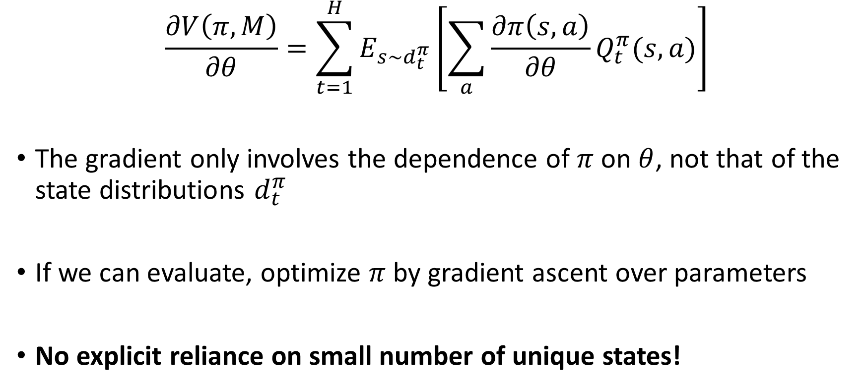
Policy Gradient (Sutton et al., 2000)
$$\frac{∂V\left(π,M\right)}{∂θ}=\sum_{t=1}^{H}{E_{s∼d_{t}^{π}}\left[\sum_{a}{\frac{∂π\left(s,a\right)}{∂θ}Q_{t}^{π}(s,a)}\right]}$$
The gradient only involves the dependence of $π$ on $θ$, not that of the state distributions $d_{t}^{π}$
If we can evaluate, optimize $π$ by gradient ascent over parameters
No explicit reliance on small number of unique states!

Slide 24
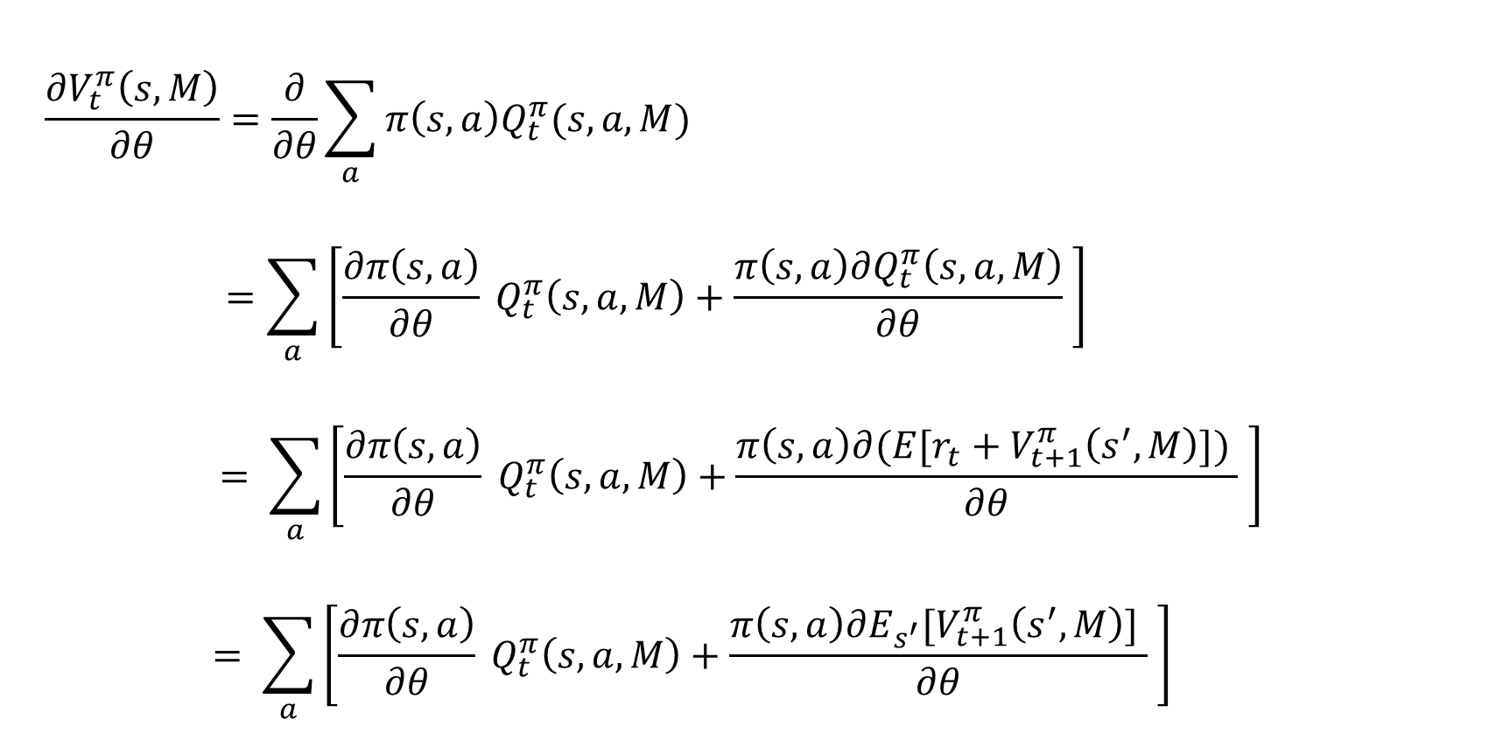
Proof sketch
$$\frac{∂V_{t}^{π}\left(s,M\right)}{∂θ}=\frac{∂}{∂θ}\sum_{a}{π\left(s,a\right)Q_{t}^{π}(s,a,M)}$$
$$=\sum_{a}{\left[\frac{∂π\left(s,a\right)}{∂θ} Q_{t}^{π}\left(s,a,M\right)+\frac{π\left(s,a\right)∂Q_{t}^{π}\left(s,a,M\right)}{∂θ} \right]}$$
$$= \sum_{a}{\left[\frac{∂π\left(s,a\right)}{∂θ} Q_{t}^{π}\left(s,a,M\right)+\frac{π\left(s,a\right)∂{(E[r_{t}+V}_{t+1}^{π}\left(s^{′},M\right)]) }{∂θ} \right]}$$
$$= \sum_{a}{\left[\frac{∂π\left(s,a\right)}{∂θ} Q_{t}^{π}\left(s,a,M\right)+\frac{π\left(s,a\right)∂{E_{s^{′}}[V}_{t+1}^{π}\left(s^{′},M\right)] }{∂θ} \right]}$$

Slide 25
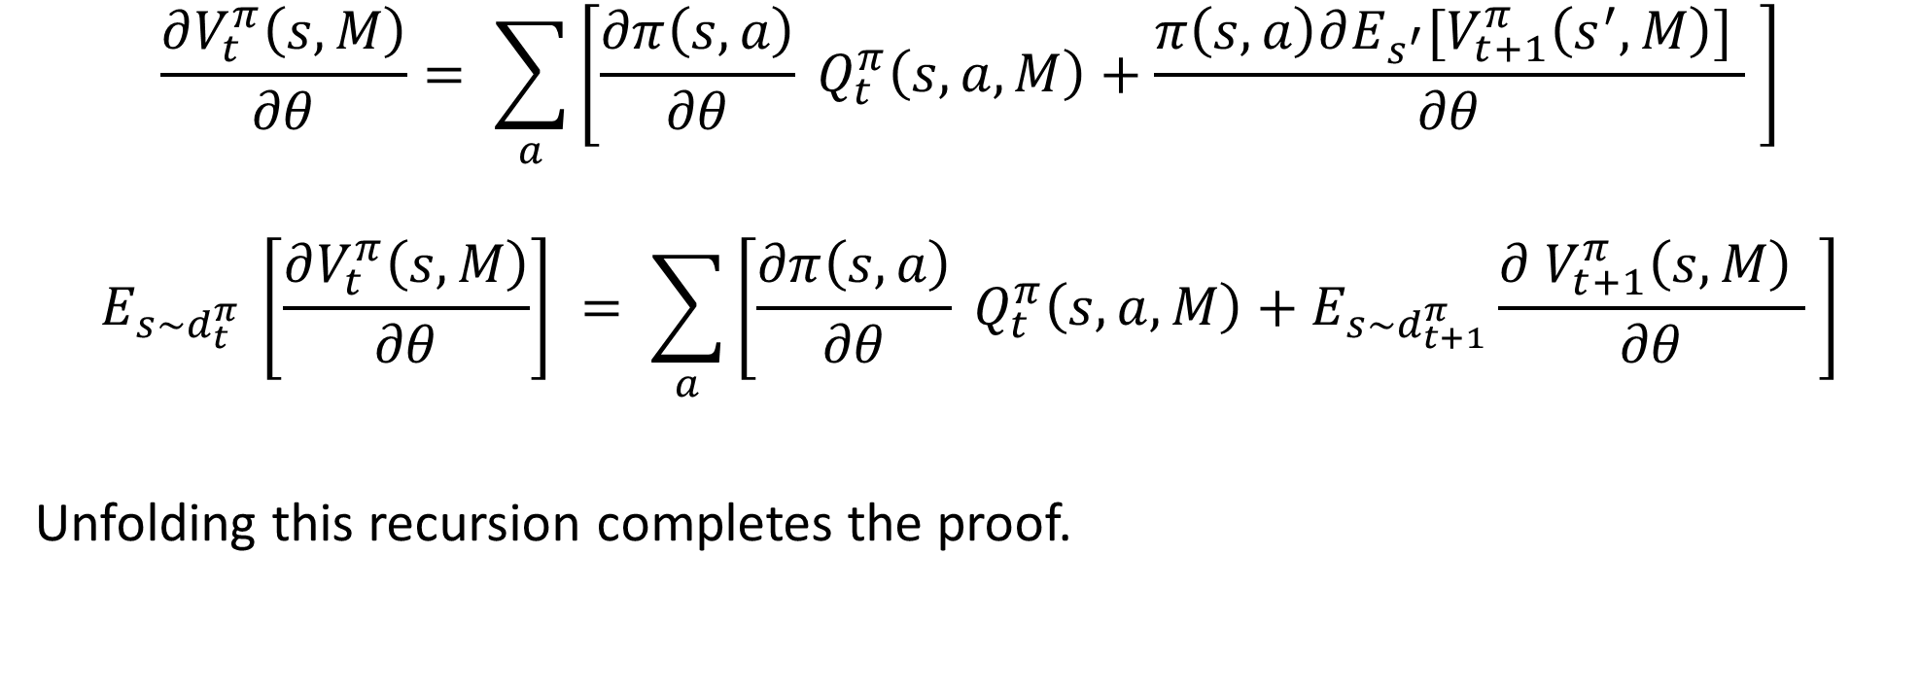
Proof sketch (contd.)
$$\frac{∂V_{t}^{π}\left(s,M\right)}{∂θ}= \sum_{a}{\left[\frac{∂π\left(s,a\right)}{∂θ} Q_{t}^{π}\left(s,a,M\right)+\frac{π\left(s,a\right)∂{E_{s^{′}}[V}_{t+1}^{π}\left(s^{′},M\right)] }{∂θ} \right]}$$
$$E_{s∼d_{t}^{π} }\left[\frac{∂V_{t}^{π}\left(s,M\right)}{∂θ}\right] = \sum_{a}{\left[\frac{∂π\left(s,a\right)}{∂θ} Q_{t}^{π}\left(s,a,M\right)+E_{s∼d_{t+1}^{π}}\frac{∂{ V}_{t+1}^{π}\left(s,M\right) }{∂θ} \right]}$$
Unfolding this recursion completes the proof.

Slide 26

Evaluating policy gradients
$$\frac{∂V\left(π,M\right)}{∂θ}=\sum_{t=1}^{H}{E_{s∼d_{t}^{π}}\left[\sum_{a}{\frac{∂π\left(s,a\right)}{∂θ}Q_{t}^{π}(s,a)}\right]}$$
Take $t$ steps according to $π$, gives state $s∼d_{t}^{π}$

Slide 27

Evaluating policy gradients
$$\frac{∂V\left(π,M\right)}{∂θ}=\sum_{t=1}^{H}{E_{s∼d_{t}^{π}}\left[\sum_{a}{\frac{∂π\left(s,a\right)}{∂θ}Q_{t}^{π}(s,a)}\right]}$$
Take $t$ steps according to $π$, gives state $s∼d_{t}^{π}$
Choose a random action $a$ in state $s$. Compute derivative of $π(s,a)$

Slide 28
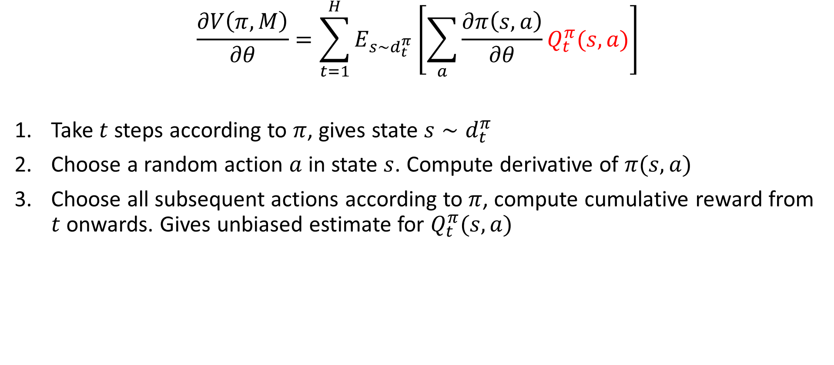
Evaluating policy gradients
$$\frac{∂V\left(π,M\right)}{∂θ}=\sum_{t=1}^{H}{E_{s∼d_{t}^{π}}\left[\sum_{a}{\frac{∂π\left(s,a\right)}{∂θ}Q_{t}^{π}(s,a)}\right]}$$
Take $t$ steps according to $π$, gives state $s∼d_{t}^{π}$
Choose a random action $a$ in state $s$. Compute derivative of $π(s,a)$
Choose all subsequent actions according to $π$, compute cumulative reward from $t$ onwards. Gives unbiased estimate for $Q_{t}^{π}(s,a)$

Slide 29
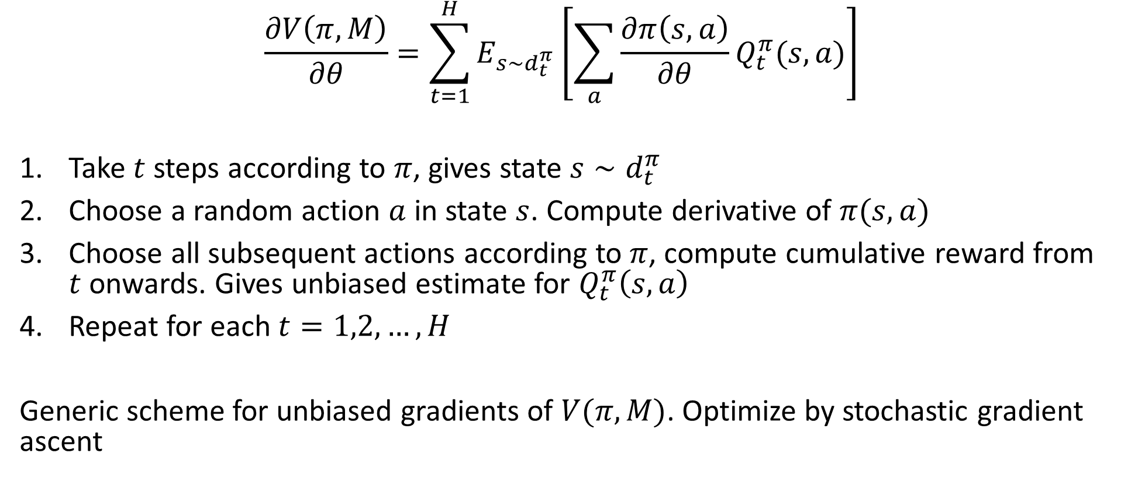
Evaluating policy gradients
$$\frac{∂V\left(π,M\right)}{∂θ}=\sum_{t=1}^{H}{E_{s∼d_{t}^{π}}\left[\sum_{a}{\frac{∂π\left(s,a\right)}{∂θ}Q_{t}^{π}(s,a)}\right]}$$
Take $t$ steps according to $π$, gives state $s∼d_{t}^{π}$
Choose a random action $a$ in state $s$. Compute derivative of $π(s,a)$
Choose all subsequent actions according to $π$, compute cumulative reward from $t$ onwards. Gives unbiased estimate for $Q_{t}^{π}\left(s,a\right)$
Repeat for each $t=1,2,…,H$
Generic scheme for unbiased gradients of $V(π,M)$. Optimize by stochastic gradient ascent

Slide 30
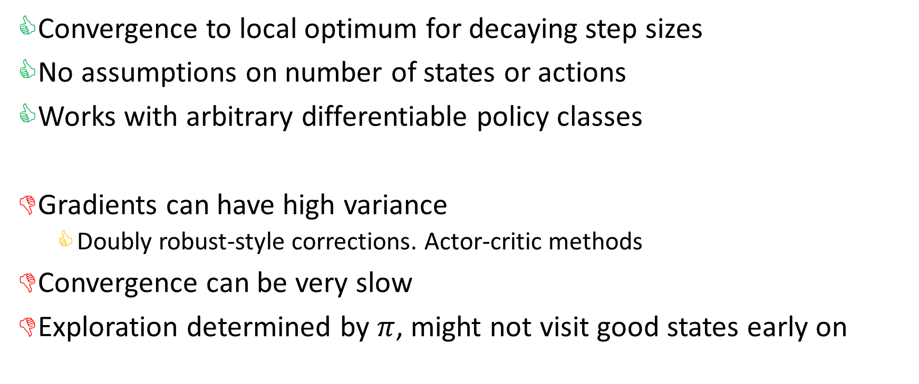
Policy gradient properties
Convergence to local optimum for decaying step sizes
No assumptions on number of states or actions
Works with arbitrary differentiable policy classes
Gradients can have high variance
Doubly robust-style corrections. Actor-critic methods
Convergence can be very slow
Exploration determined by $π$, might not visit good states early on

Slide 31
Policy Improvement
Policy gradient struggles from a poor initialization
Suppose we have access to an expert at training time
Algorithm can query the expert’s actions at any state/context
Wants to find a policy at least as good as the expert
Evaluated without expert’s help at test time

Slide 32





A general template
Deviations
Roll-in = Roll-out = $π$ for policy gradient
Given an expert policy $μ$ at training time, what are better choices?
Roll-out
$$t=H$$
$$t$$
$$s$$
$$t=1$$
Roll-in

Slide 33

Behavior cloning
Deviations
Roll-in = Roll-out = $μ$
Train a policy to minimize $E_{s∼d^{μ}}[1\left(π\left(s\right)≠μ\left(s\right))\right]$
Roll-out
$$t=H$$
$$t$$
$$s$$
$$t=1$$
Roll-in

Slide 34
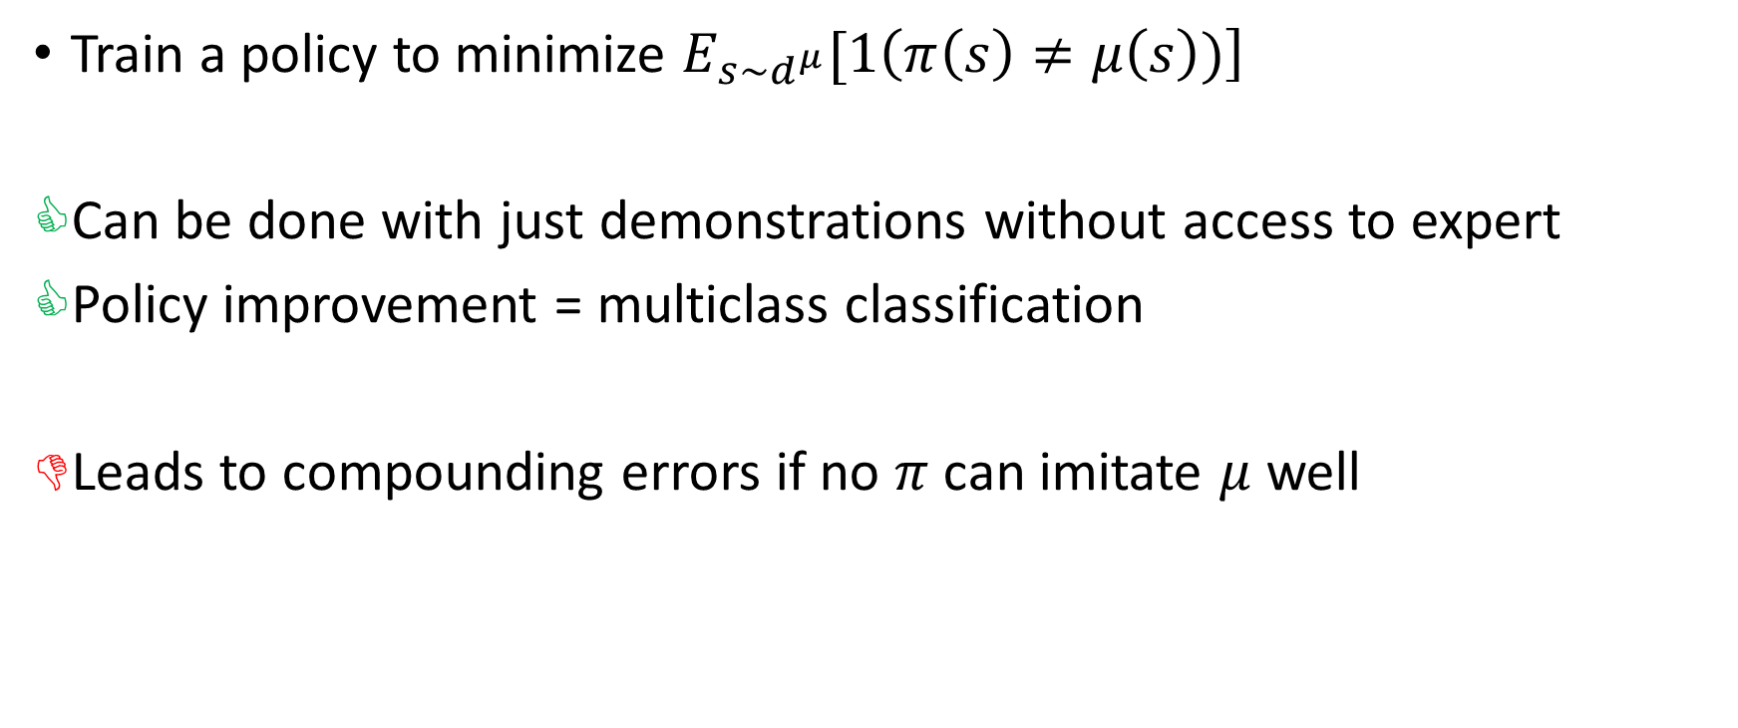
Behavior cloning
Train a policy to minimize $E_{s∼d^{μ}}[1\left(π\left(s\right)≠μ\left(s\right))\right]$
Can be done with just demonstrations without access to expert
Policy improvement = multiclass classification
Leads to compounding errors if no $π$ can imitate $μ$ well

Slide 35








Compounding errors
$μ$ takes actions in red. Rewards only in leaf nodes.
If $π$ makes mistake at root, no information on how to act in $s_{2}$
$$s_{1}$$
$$s_{2}$$
$$s_{3}$$
$$s_{4}$$
$$s_{5}$$
$$s_{6}$$
$$s_{7}$$
1
0
0
1

Slide 36

AggreVaTe (Ross and Bagnell, 2014)
Deviations
Roll-in = $π$, Roll-out = $μ$
Train a policy to minimize $E_{s∼d^{π}}\left[Q^{μ}\left(s,π\left(s\right)\right)\right]$
Roll-out
$$t=H$$
$$t$$
$$s$$
$$t=1$$
Roll-in

Slide 37
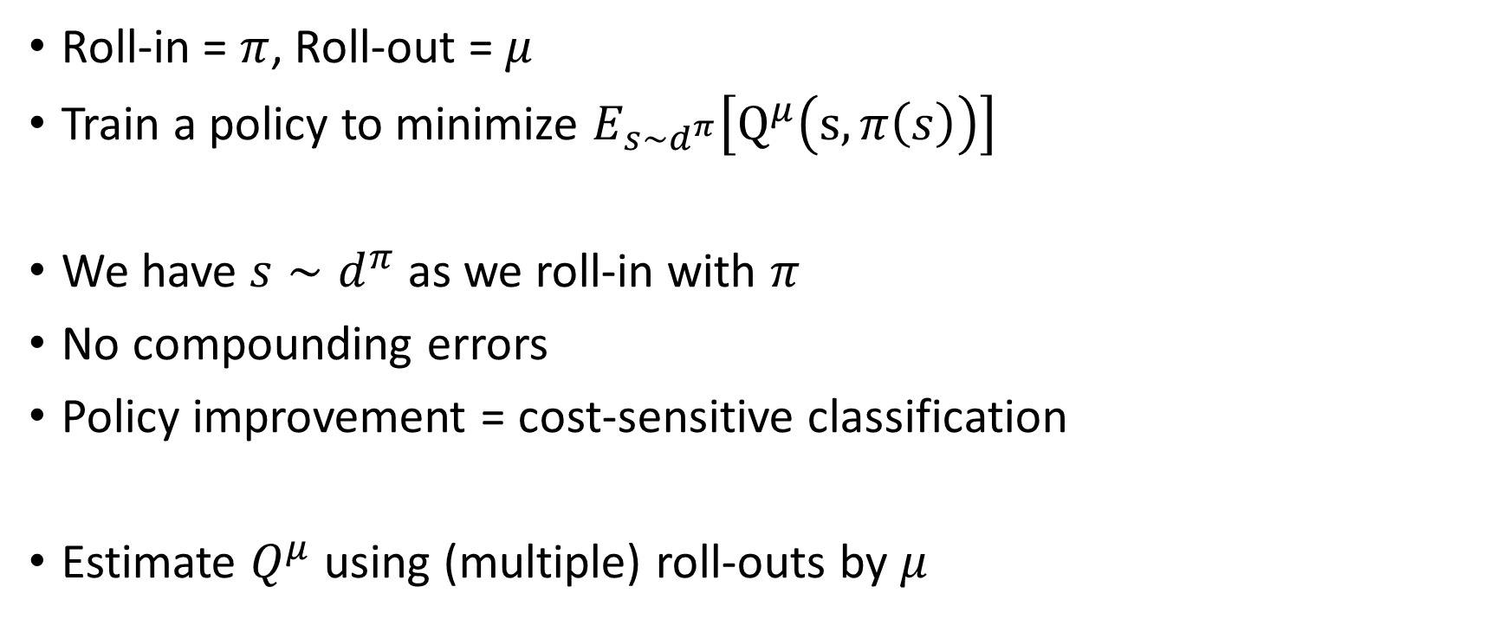
AggreVaTe (Ross and Bagnell, 2014)
Roll-in = $π$, Roll-out = $μ$
Train a policy to minimize $E_{s∼d^{π}}\left[Q^{μ}\left(s,π\left(s\right)\right)\right]$
We have $s∼d^{π}$ as we roll-in with $π$
No compounding errors
Policy improvement = cost-sensitive classification
Estimate $Q^{μ}$ using (multiple) roll-outs by $μ$

Slide 38

Compounding errors revisited
$μ$ takes actions in red. Rewards only in leaf nodes.
If $π$ minimizes cost, indifferent at root.
Roll-in with $μ$ means no training in $s_{2}$. Fixed by roll-in with $π$
$$s_{1}$$
$$s_{2}$$
$$s_{3}$$
$$s_{4}$$
$$s_{5}$$
$$s_{6}$$
$$s_{7}$$
1
0
0
1

Slide 39
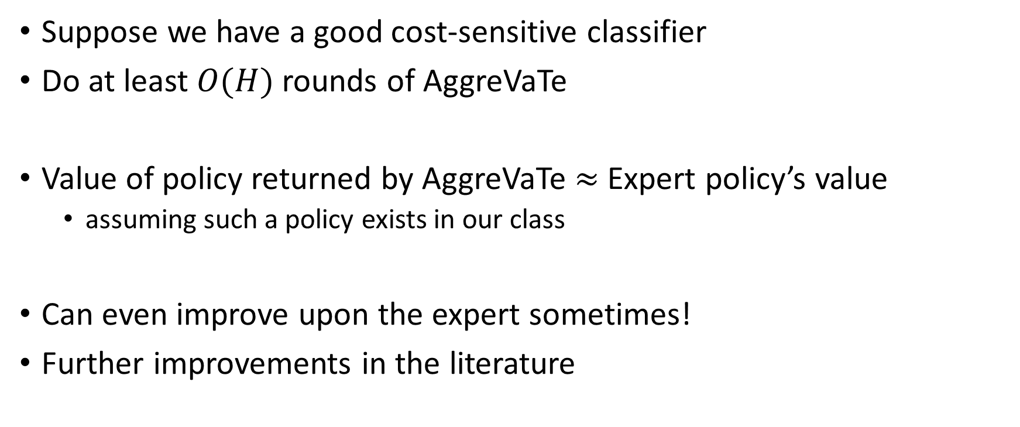
AggreVaTe theory
Suppose we have a good cost-sensitive classifier
Do at least $O(H)$ rounds of AggreVaTe
Value of policy returned by AggreVaTe $≈$ Expert policy’s value
assuming such a policy exists in our class
Can even improve upon the expert sometimes!
Further improvements in the literature

Slide 40
Policy search overview
No expert
Policy gradient, TRPO, Actor-critic variants
Expert dataset
Behavior cloning
Expert policy
AggreVaTe and improvements

Slide 41
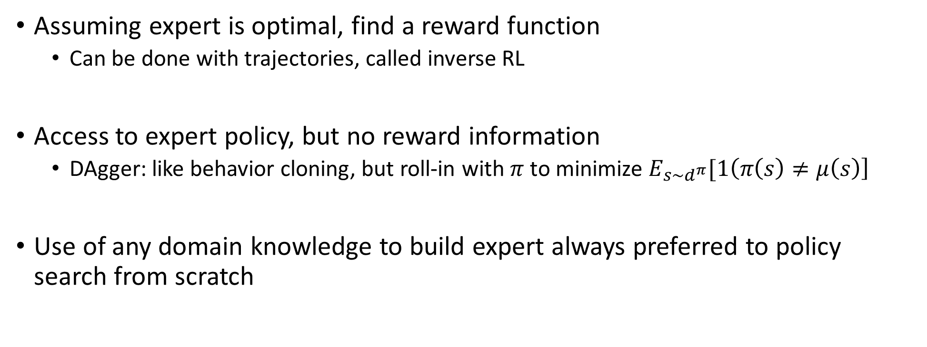
Other ways of using expert
Assuming expert is optimal, find a reward function
Can be done with trajectories, called inverse RL
Access to expert policy, but no reward information
DAgger: like behavior cloning, but roll-in with $π$ to minimize $E_{s∼d^{π}}[1\left(π\left(s\right)≠μ\left(s\right)\right]$
Use of any domain knowledge to build expert always preferred to policy search from scratch

Slide 42
Some practical issues
All algorithms we saw today require exponentially many trajectories for hard problems
Typical data requirements still quite large, unless strong expert
Better exploration will help
Long-horizon problems still data intensive

Slide 43
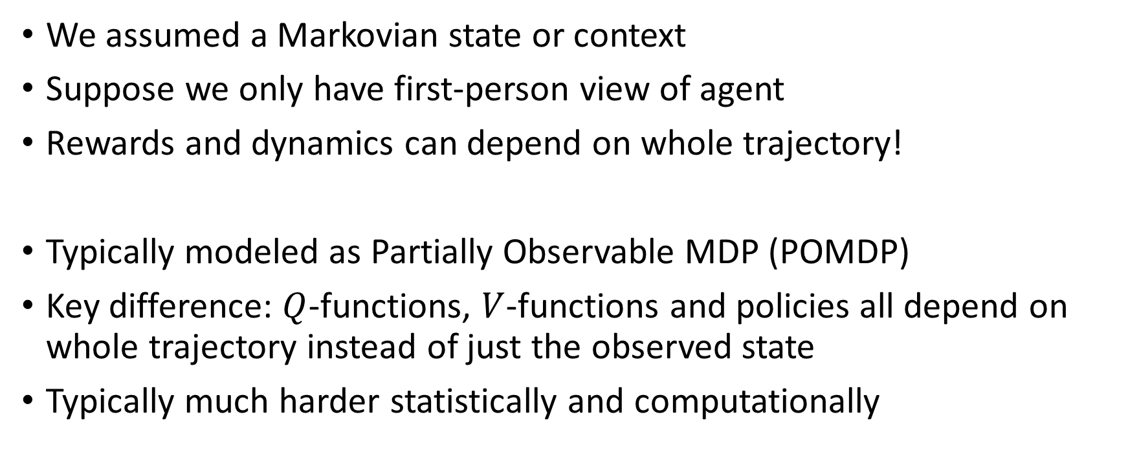
Partial Observability
We assumed a Markovian state or context
Suppose we only have first-person view of agent
Rewards and dynamics can depend on whole trajectory!
Typically modeled as Partially Observable MDP (POMDP)
Key difference: $Q$-functions, $V$-functions and policies all depend on whole trajectory instead of just the observed state
Typically much harder statistically and computationally

Slide 44
Hierarchical RL
Long-horizon problems are hard
Can benefit if trajectories have repeated sub-patterns or sub-tasks
First learn how to do sub-tasks well, compose to solve original problem
Many formalisms:
Options
General value functions
RL with sub-goals

