Slide 1
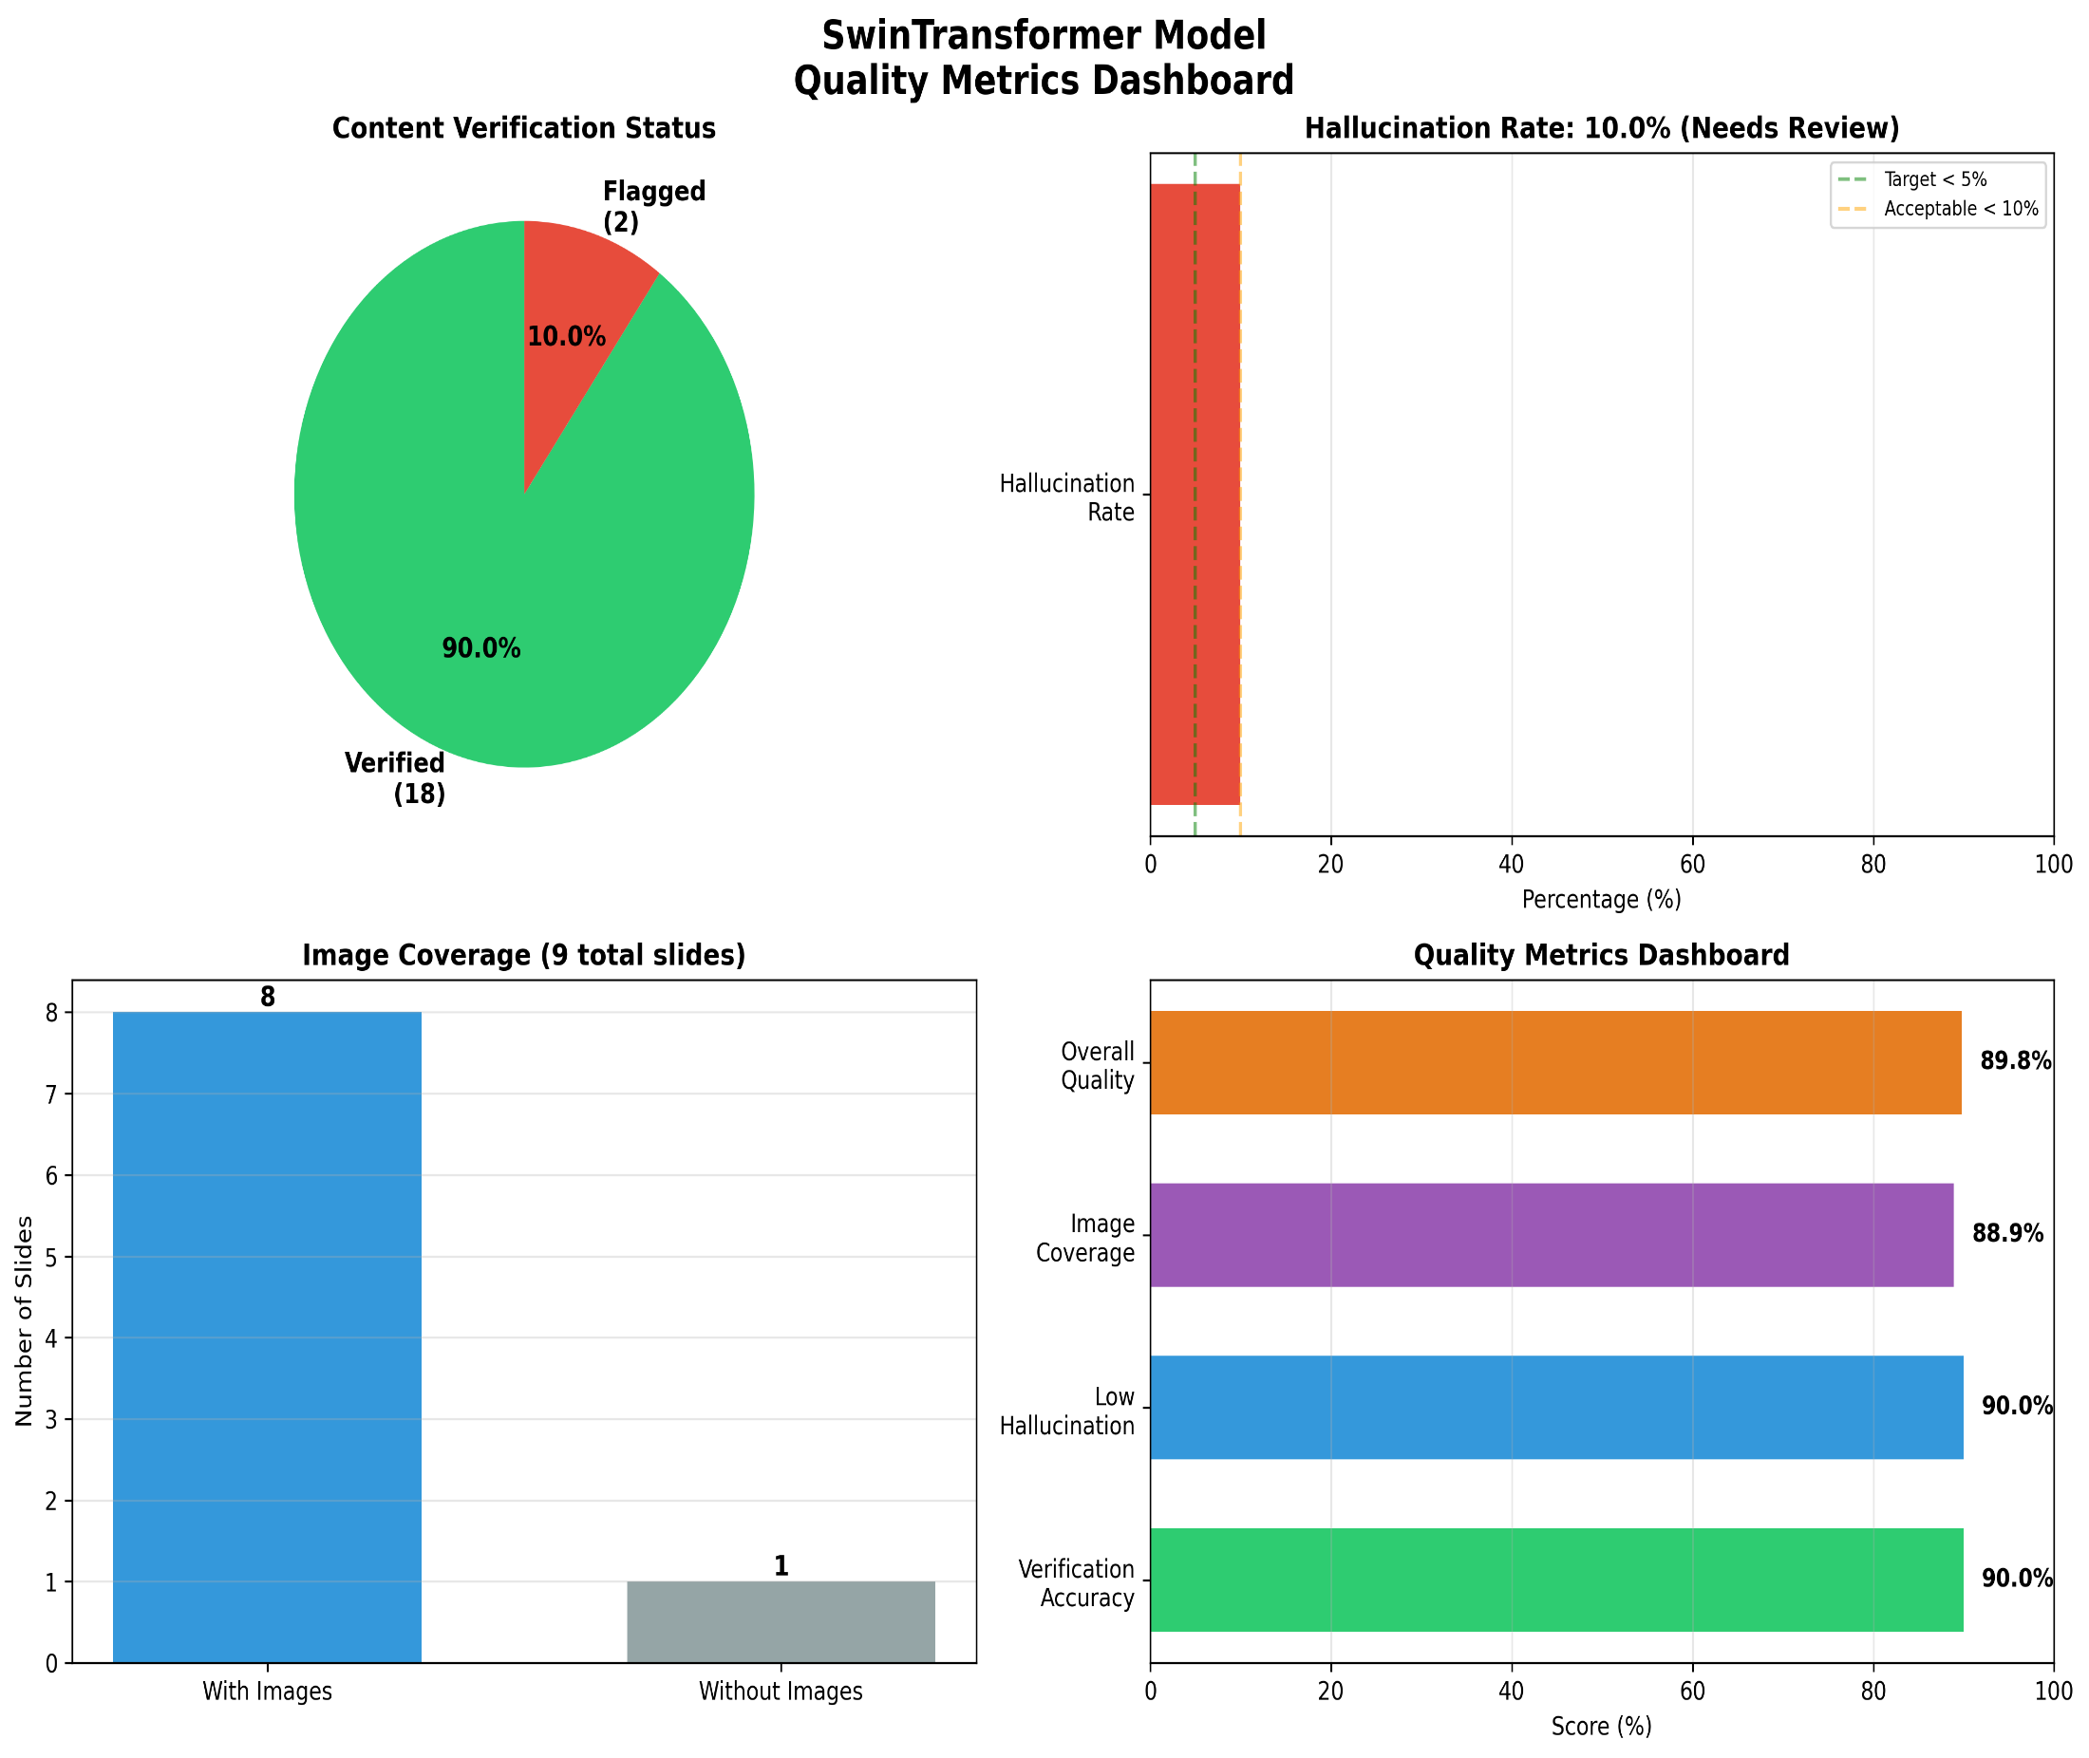
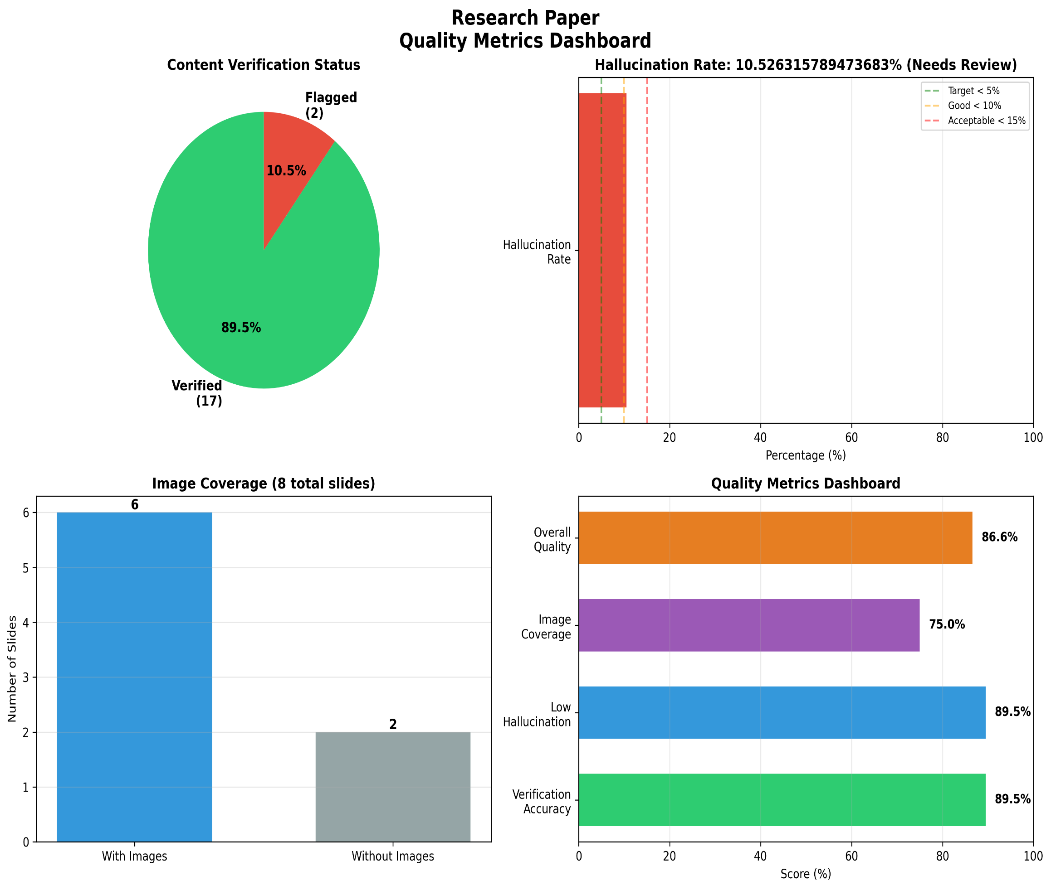
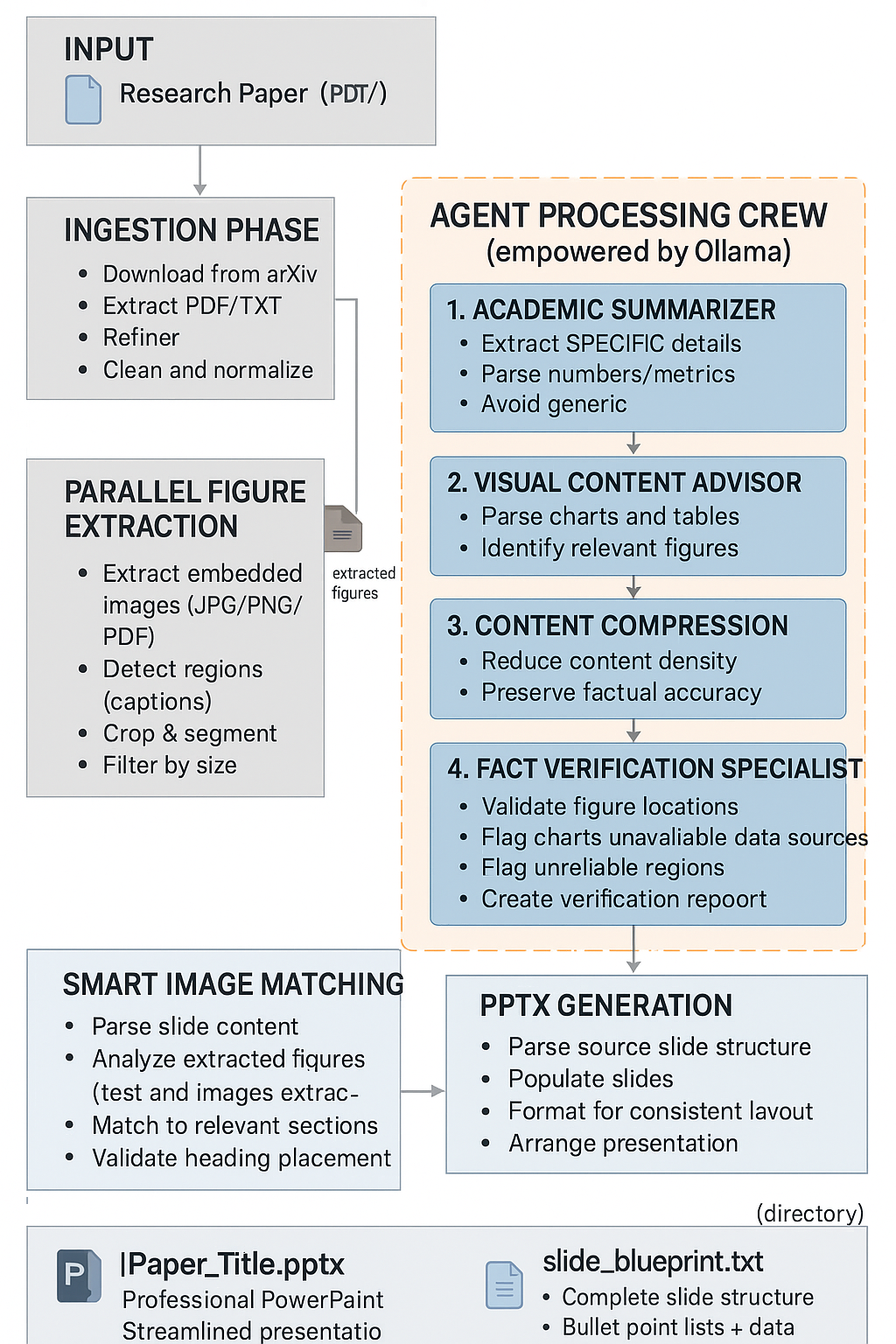
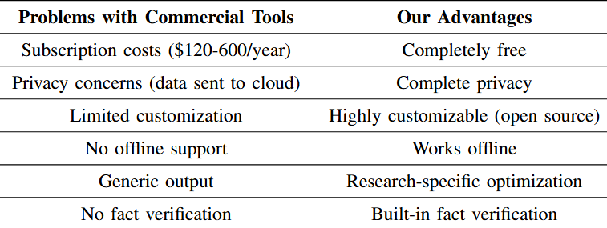
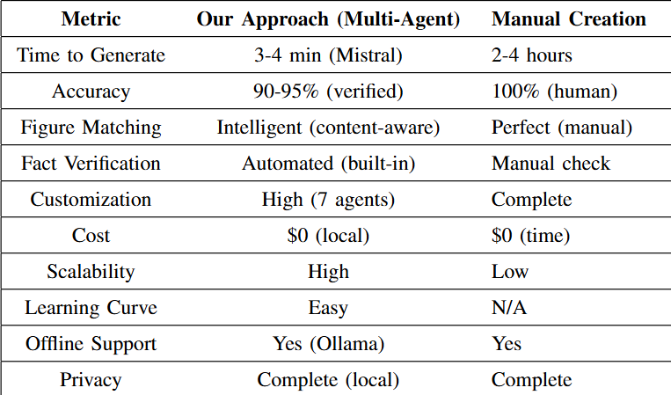
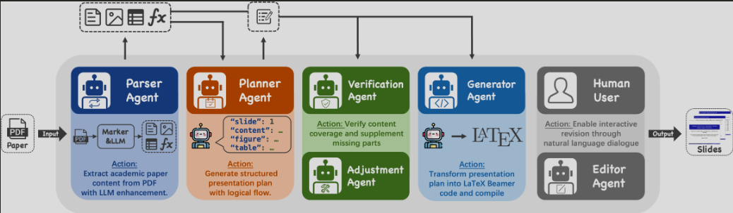
Slide Deck : Multi-Agent Framework for Automated Presentation Generator
Abstract
Methodology
Results
Conclusion
The project introduces an automated multi-agent system that converts research papers into clean, accurate presentation slides.
The system uses a multi-agent pipeline that parses research papers, extracts key ideas and visuals, and verifies their correctness. A generation agent then transforms the refined content into coherent, slide-ready material, ensuring relevance and clarity in the final presentation.
Key Findings
95% reduction in manual effort
10x faster than manual slide creation
85-90%+ accuracy with fact verification
Intelligent figure matching
Multi-agent collaboration
Introduction
This project automates the transformation of research papers into structured, accurate slide decks using a coordinated multi-agent pipeline for text extraction, verification, and figure retrieval.

