Slide 1

R.R INSTITUTE OF MODERN TECHNOLOGY
Team Members : Alekh Gautam, Ayan Kumar , Aman Upadhyay
Course : BTECH
Batch : CSE
Group : Tech 1(c)
Guided By : Raghav Ranjan Sir
GitHub Link : https://github.com/alekhgautam1/Scientific-Calculator

Slide 2

SCIENTIFIC CALCULATOR IN JAVA
A GUI-Based Scientific Calculator Using Java Swing
JAVA SWING & AWT

Slide 3

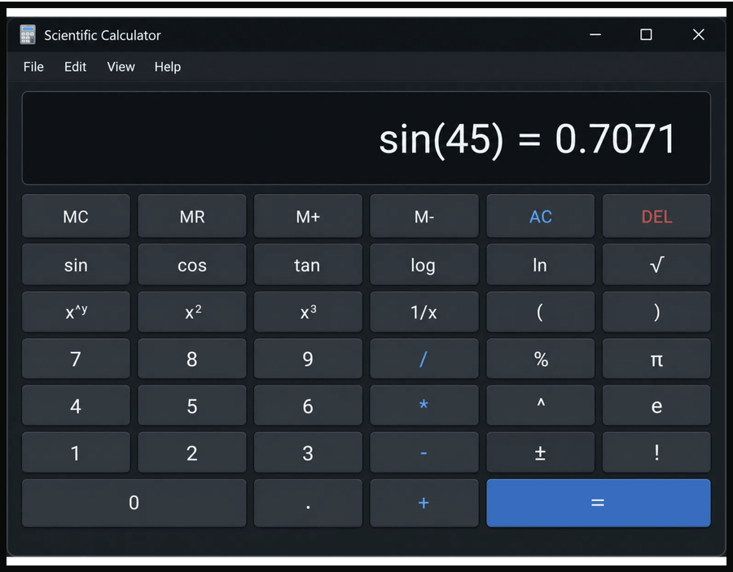
What is a Scientific Calculator?
A scientific calculator goes beyond basic arithmetic to handle functions used in engineering, physics, and higher mathematics.
It offers operations like trigonometry, logarithms, exponentiation, and factorial.
Implementing one in Java demonstrates OOP, GUI event handling, and expression evaluation.

Slide 4






Key Features
BASIC ARITHMETIC
SCIENTIFIC FUNCTIONS
ADVANCED OPERATIONS
Addition, subtraction, multiplication, and division operations.
sin, cos, tan, log, ln, sqrt, cbrt, and exponentiation (pow).
Factorial (!), percentage (%), absolute value (|x|), and reciprocal (1/x).
INVERSE TRIGONOMETRY
MEMORY FUNCTIONS
EXPRESSION EVALUATION
Memory Clear (MC), Memory Recall (MR), Memory Add (M+), Memory Subtract (M-).
arcsin, arccos, and arctan functions for complex calculations.
Supports nested parentheses and proper operator precedence handling.

Slide 5





Core Technologies
Key Java packages and concepts used to build a responsive scientific calculator.
JAVAX.SWING
JAVA.AWT
JAVA.AWT.EVENT
JFrame, JButton, JTextField, JPanel for UI.
Layout managers, fonts, colors, graphics.
ActionEvent and ActionListener for interactions.
JAVA.LANG.MATH
EXCEPTION HANDLING
THREADING
Math functions: sqrt, sin, cos, log, pow.
Use SwingUtilities.invokeLater for GUI tasks.
try-catch to manage invalid inputs and domain errors.

Slide 6

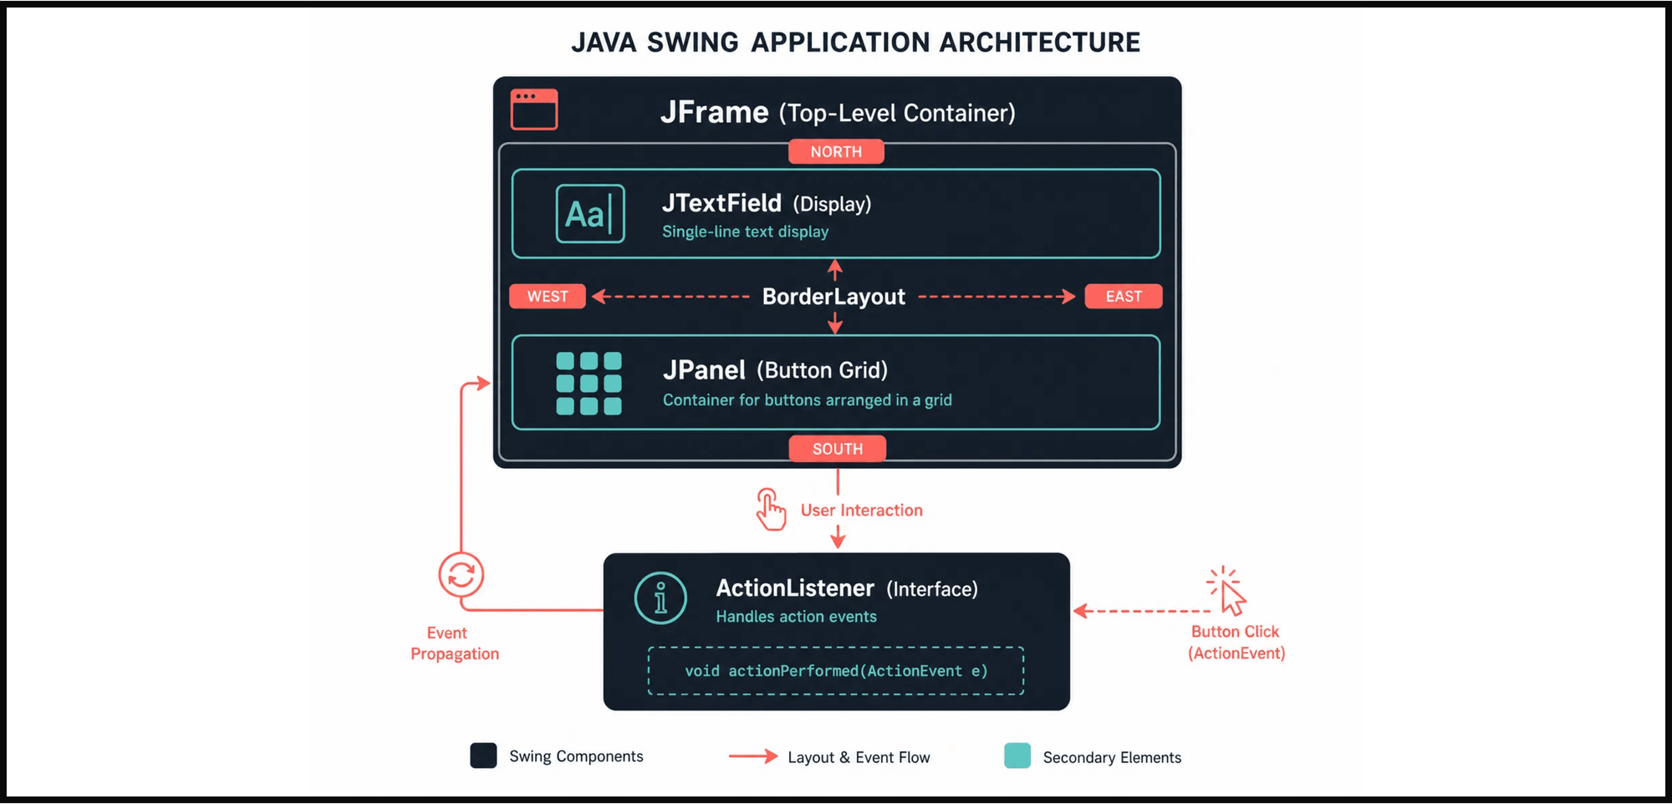
Architecture and Design Pattern

Slide 7

Implementation — Step 1
01
IDE & JDK Setup
// Imports & Class
Use Eclipse or IntelliJ; JDK
import javax.swing.*; import java.awt.*; import java.awt.event.*;
8+.
02
Import Packages
public class ScientificCalculator extends JFrame implements ActionListener {
Import GUI and event
private JTextField display; private JPanel buttonPanel;
packages.
03
Define Main Class
// Constructor
Create a class extending
public ScientificCalculator() { setTitle("Scientific Calculator"); setDefaultCloseOperation(JFrame.EXIT_ON_CLOSE); setLayout(new BorderLayout()); }
JFrame.
04
Constructor Setup
Initialize frame title and
}
layout.
05
TextField Configuration
Add a non-editable, right-
aligned JTextField.

Slide 8
Building the GUI
1. BUTTON ARRAY
2. JPANEL LAYOUT
3. ACTION LISTENERS
String[] labels = {"1","2","3","/","4","5","6","*","7","8","9","-","0",".","=","+","sin","cos","tan","log"};
JPanel panel = new JPanel();
panel.setLayout(new GridLayout(5,4,3,3));
for (String label : labels) { JButton btn = new JButton(label); btn.setFont(new Font("Arial",1,18)); btn.addActionListener(this); panel.add(btn); }
add(panel, BorderLayout.CENTER);
Use GridLayout (e.g., 7x4) to arrange buttons uniformly.
Register each button with addActionListener to handle clicks.
Define labels for digits, operators, scientific functions and memory keys.
5. PANEL ADDITION
4. BUTTON STYLING
Place the button panel in CENTER and display in NORTH.
Apply consistent fonts and colors for a cohesive look.

Slide 9
Step 3: Event Handling Logic
The actionPerformed() method is the heart of the calculator's logic, capturing every user interaction.
public void actionPerformed(ActionEvent e) {
String s = e.getActionCommand();
// Digit or decimal input
Digit Input: When a number or decimal button is pressed, the character is appended to the current expression string for display.
if ((s.charAt(0) >= '0' && s.charAt(0) <= '9') || s.charAt(0) == '.') {
str2 = str2 + s;
field.setText(str + str1 + str2);
}
Operator Buttons: Store the selected operator and manage operand strings for sequential calculations.
// Scientific functions
else if (s.equals("sin")) {
double val = Double.parseDouble(str2);
field.setText("sin(" + val + ") = " + Math.sin(Math.toRadians(val)));
Scientific Functions: Buttons like sin, cos, sqrt, log, and ! directly evaluate the current display value.
}
...
}

Slide 10
Recursive Descent Parsing
PARSER CLASS STRUCTURE
PARSEEXPRESSION()
private double parseExpression() { double x = parseTerm(); while (true) { if (eat('+')) x += parseTerm(); else if (eat('-')) x -= parseTerm(); else return x; } }
Handles addition and subtraction (lowest precedence) in a loop over parsed terms.
Nested
ExpressionParser keeps
a position pointer
private double parseFactor() { if (eat('(')) { double x = parseExpression(); eat(')'); return x; } else if (isDigit(ch)) return parseNumber(); else if (isLetter(ch)) { /* handle sqrt, sin, etc. */ } }
pos
and current char
ch
to
traverse the input.
PARSETERM()
PARSEFACTOR()
Handles multiplication, division, and exponentiation at higher precedence.
Handles parentheses, numbers, and unary functions; calls recursively for nested parentheses.
FUNCTION HANDLING
Recognizes identifiers (sqrt, sin, cos, log) and applies the corresponding Math methods to parsed values.

Slide 11
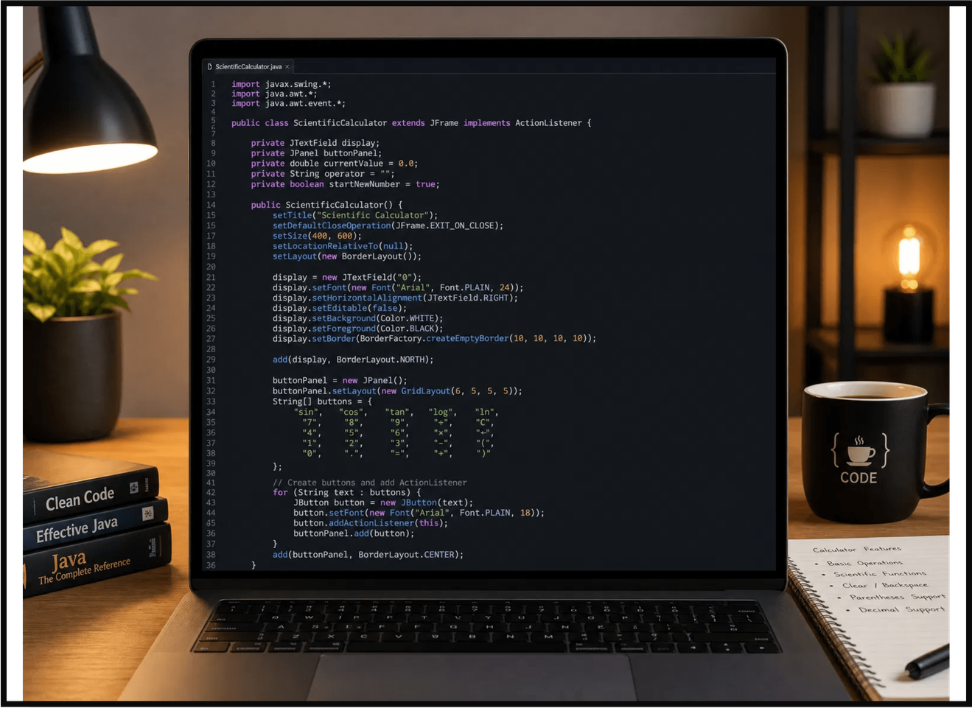
Complete Code Sample
IMPORTS & CLASS
Import necessary packages and define the main class extending JFrame.
CONSTRUCTOR
Initialize GUI components, layout managers, and button panels.
MAIN METHOD
Entry point using SwingUtilities.invokeLater for thread safety.

Slide 12
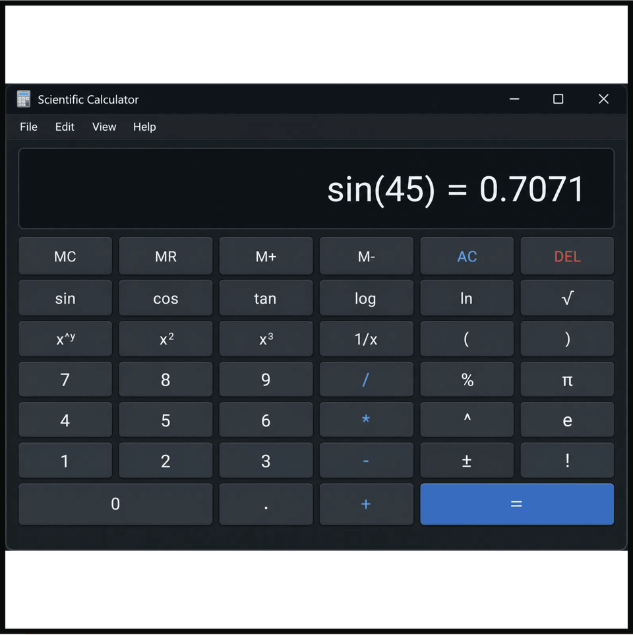





User Experience
DISPLAY AREA
A large, readable text field at the top shows the current expression and computed result.
BUTTON LAYOUT
Scientific functions arranged on top rows, numbers and basic operators in the center.
COLOR CODING
Different colors for number buttons, operator buttons, and scientific functions improve usability.
INPUT FLOW
Users type expressions naturally — digits build the number, operators chain operations.
ERROR FEEDBACK
Invalid operations (e.g., log of negative number) show clear error messages instead of crashing.

Slide 13






Key Takeaways
OOP MASTERY
GUI DEVELOPMENT
Demonstrates class inheritance (JFrame), interface implementation (ActionListener), and encapsulation.
Practical experience with Swing components, layout managers, and event-driven programming.
ALGORITHMIC THINKING
REAL-WORLD RELEVANCE
Expression parsing teaches recursive descent parsing and operator precedence handling.
Calculator applications are used in education, engineering tools, financial software, and scientific research.
EXTENSIBILITY
CAREER VALUE
The project can be enhanced with graph plotting, unit conversion, history tracking, or keyboard input support.
This project is a strong portfolio piece for Java developers, showcasing both UI design and algorithmic skills.

Slide 14


