Slide 1
Investment company Analysis
By Alekhya

Slide 2
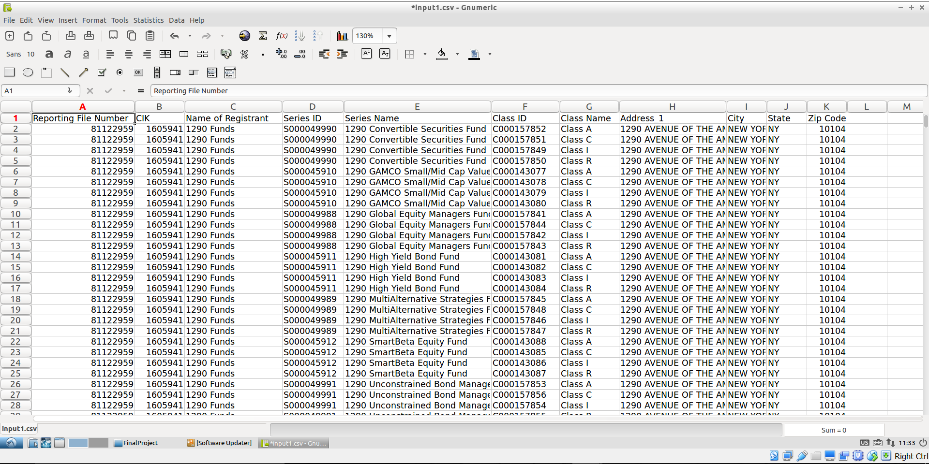
Input File
Input file consist of investment company names, registration number, series and class they belong to.

Slide 3
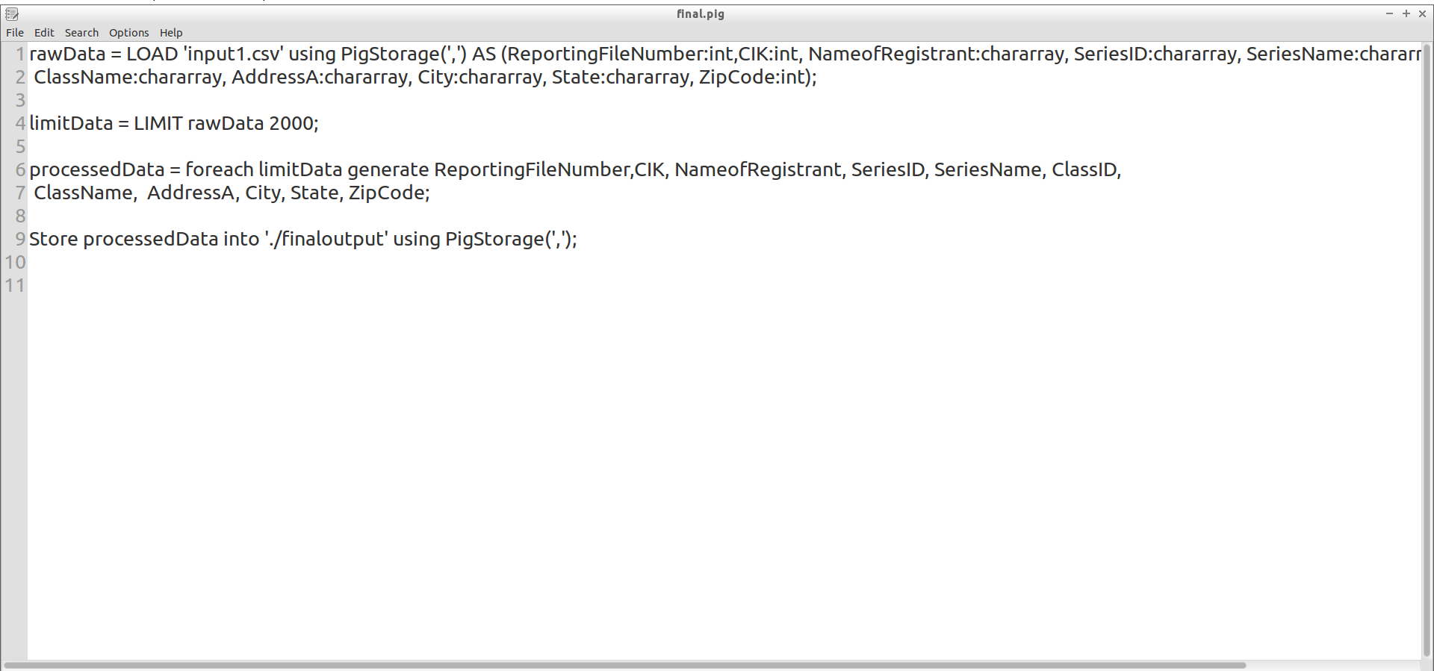
Pig Script
Limiting data to 2000 rows.
Choosing limited fields
Reporting File Number
Name of Registrant
CIK
SeriesID
Series Name
ClassID
Class Name
Address
City
State
Zip Code

Slide 4
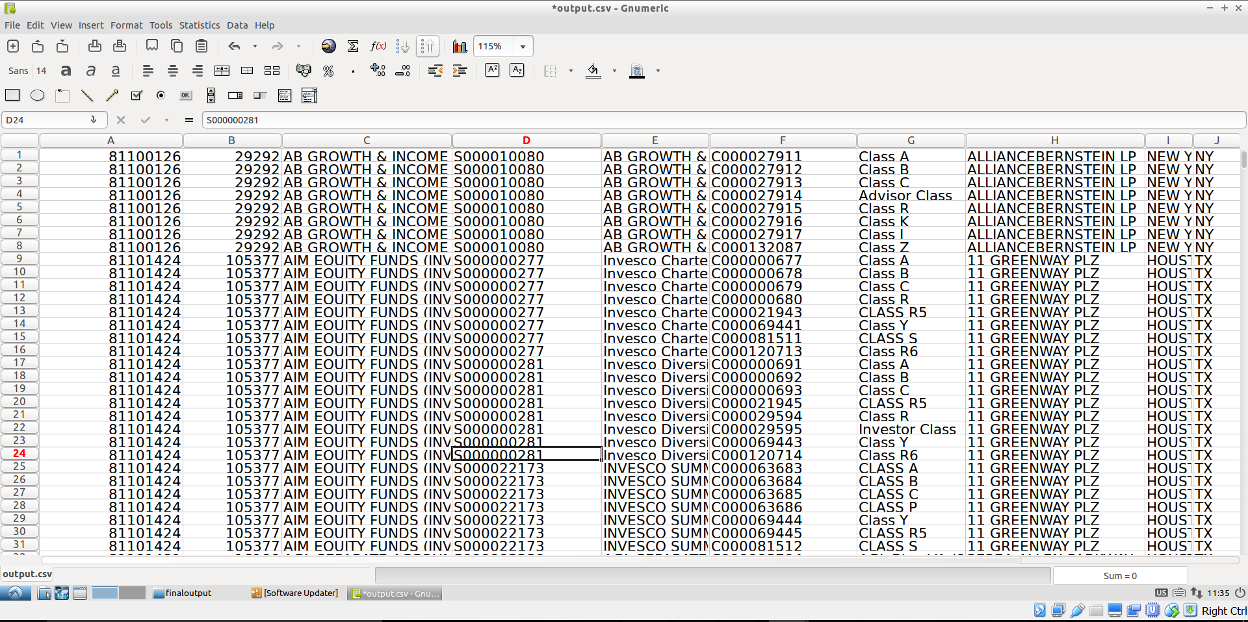
Pig output

Slide 5
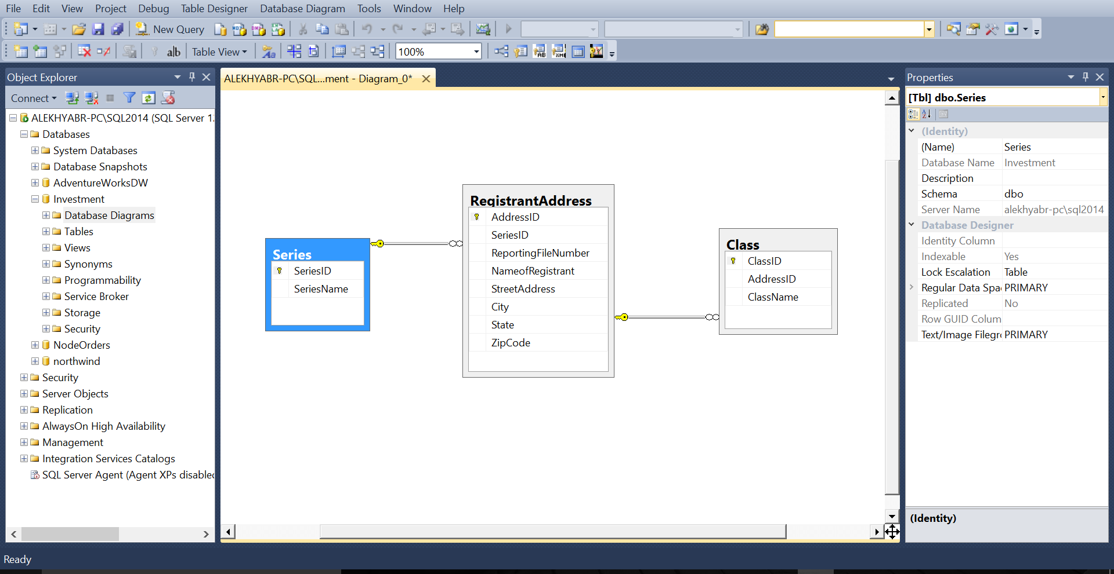
Database diagram
Relationships
Registrant Address and Class has 1:m relationship
Series and Registrant Address has 1:m relationship

Slide 6
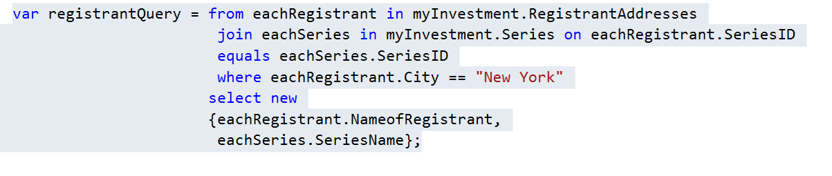
Linq Query
List the names of registrant and there series that are available in New York.

Slide 7
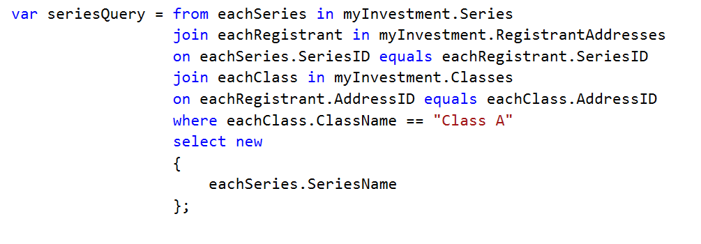
Linq query
List the series names that are classified under Class A

Slide 8
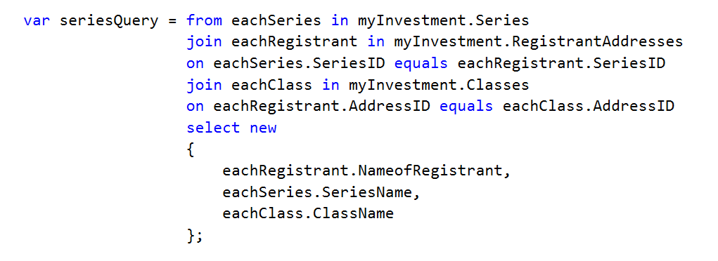
Linq query
List the names of the registrant and series and classes they belong to

Slide 9
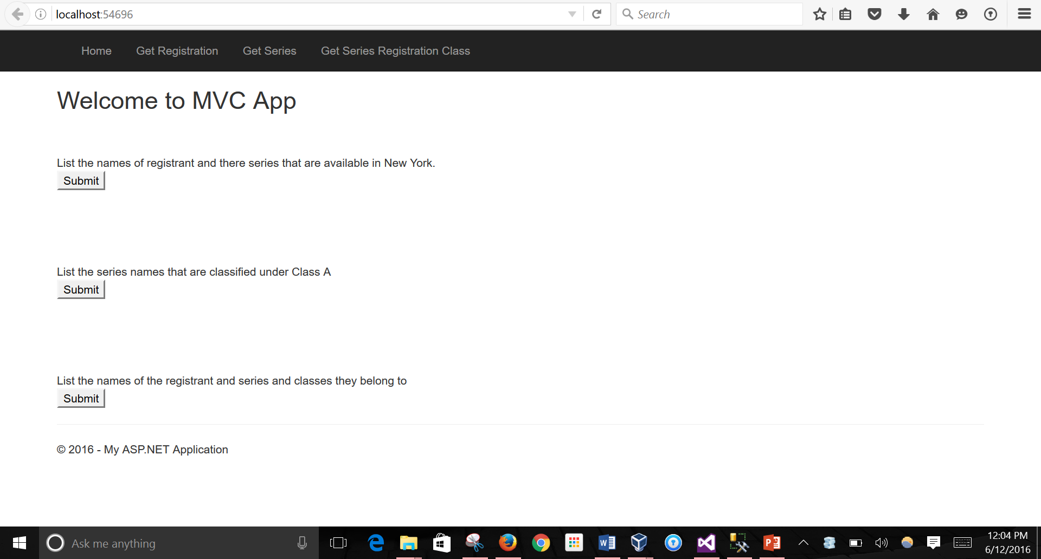
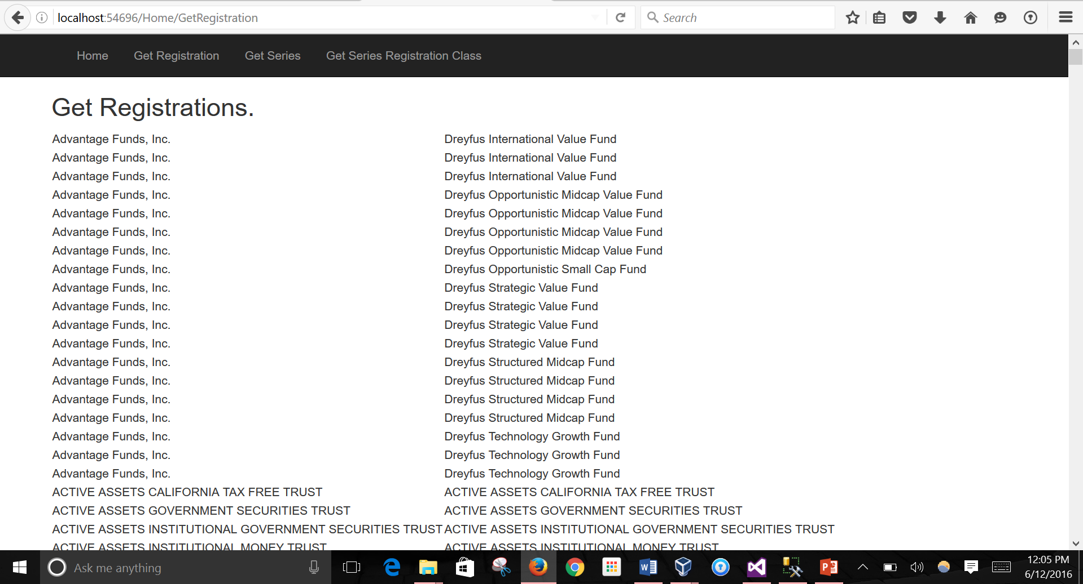
output

Slide 10
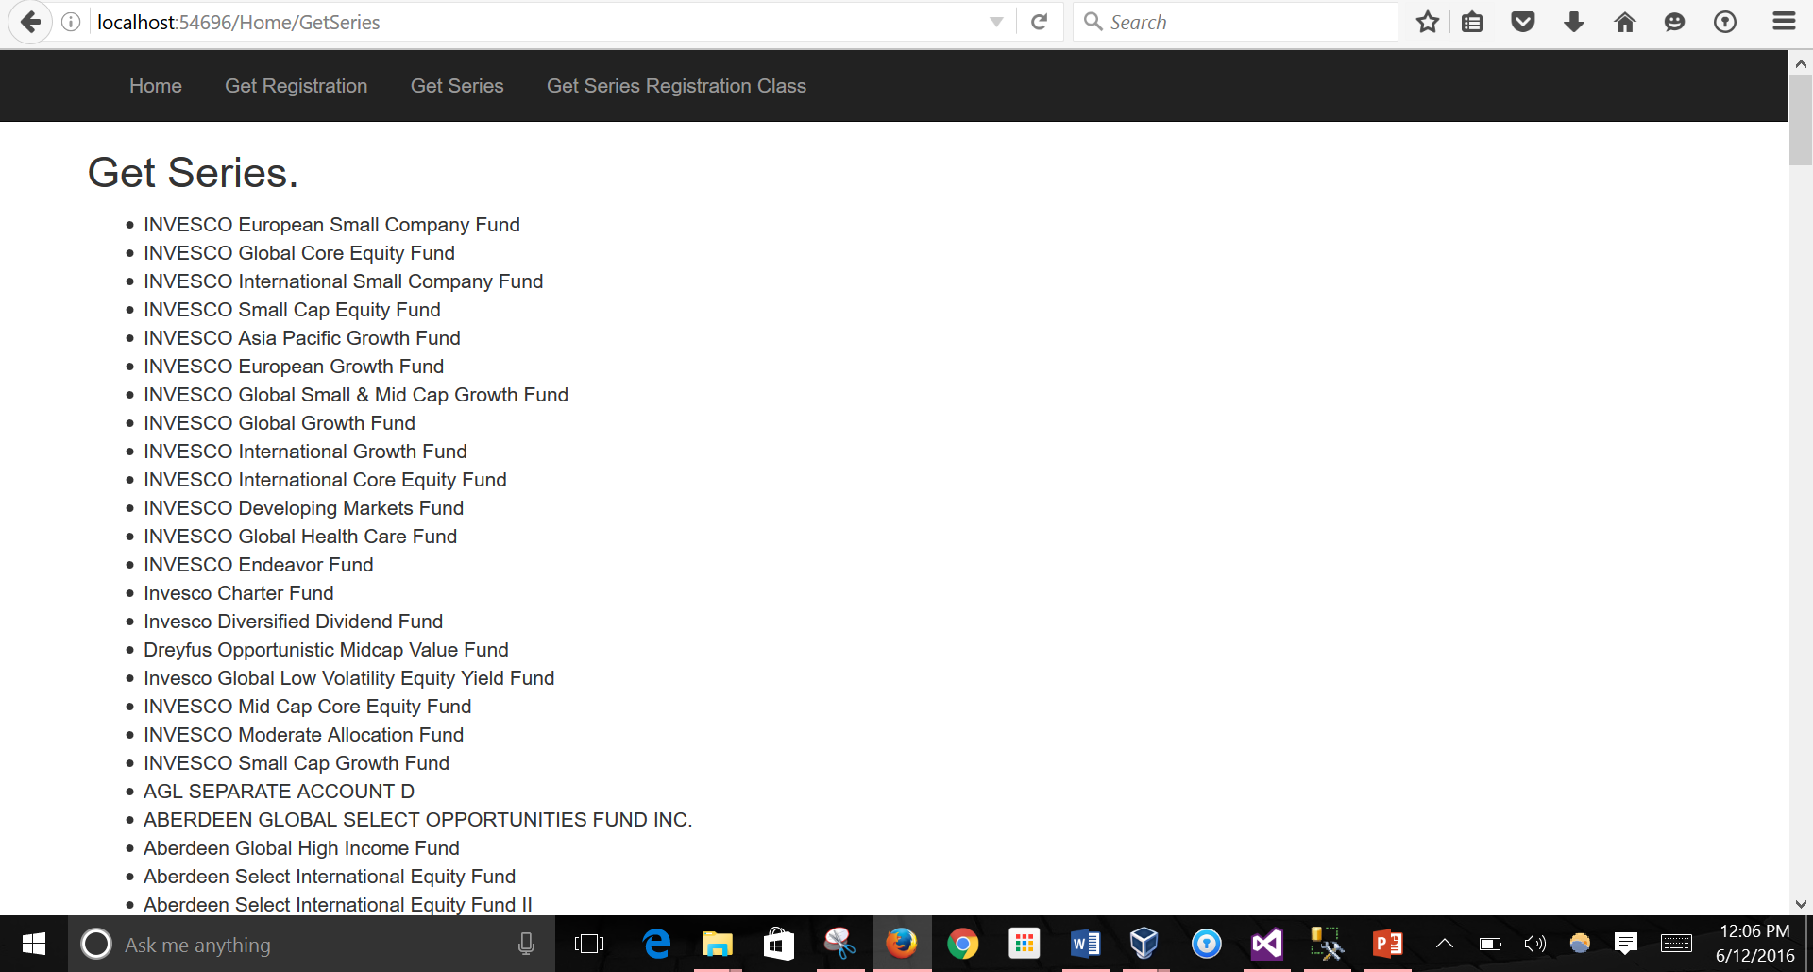
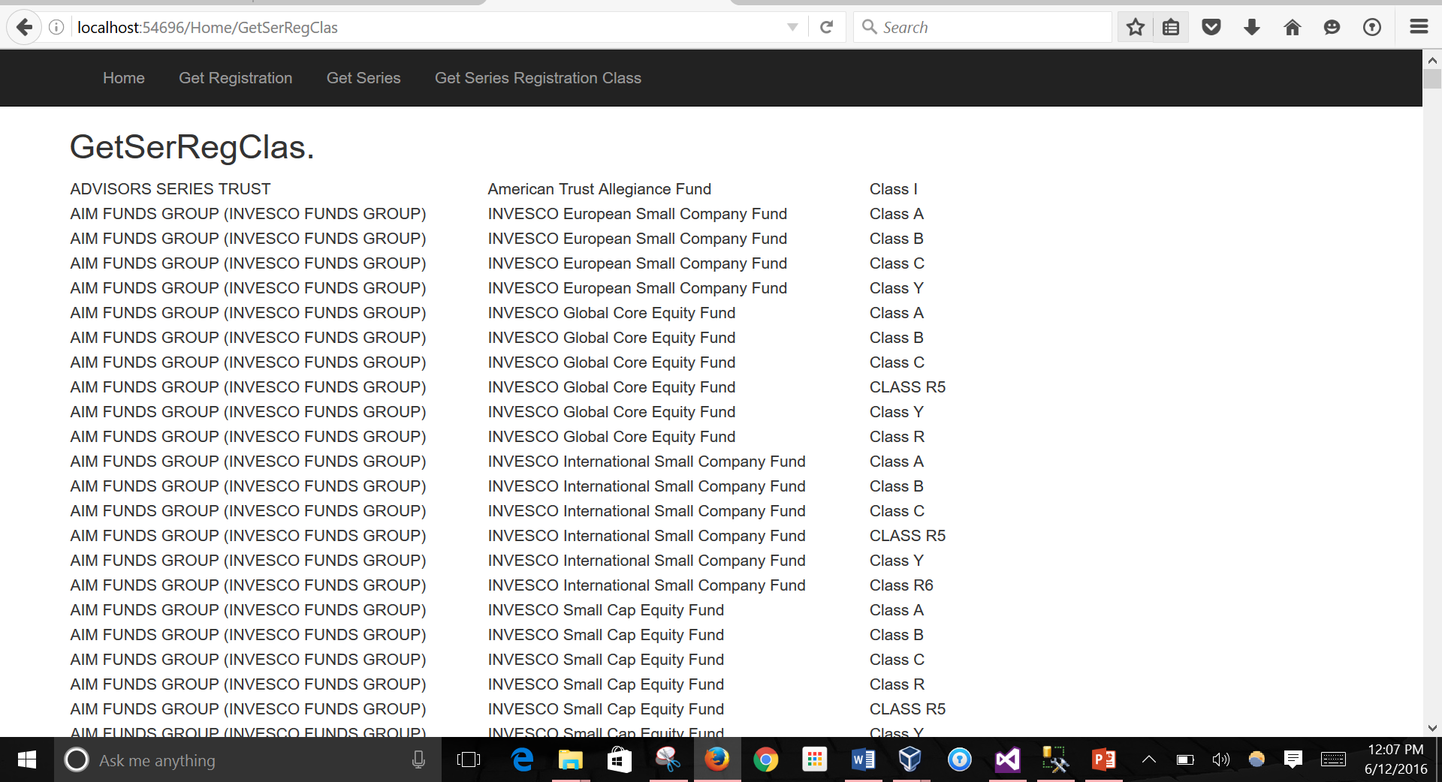
Output

