Slide 1
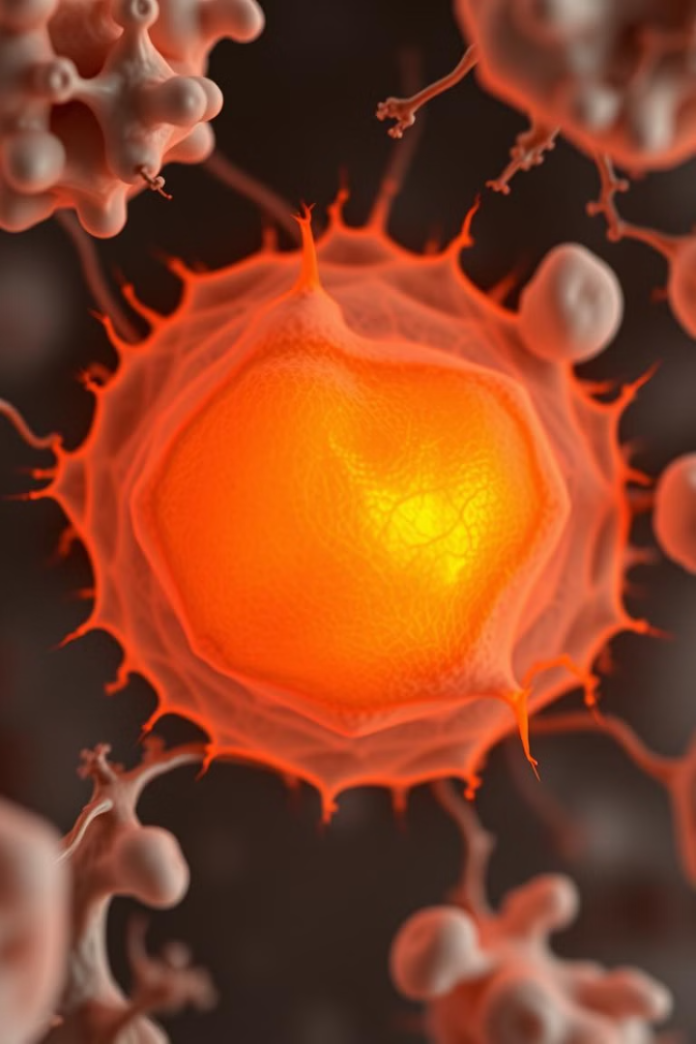
Explainable Deep Learning for Breast Cancer Classification
Article Link Authors : Marcello Di Giammarco, Camilla Vitulli, Simone Cirnelli, Benedetta Masone, Antonella Santone, Mario Cesarelli, Fabio Martinelli, Francesco Mercaldo

Slide 2
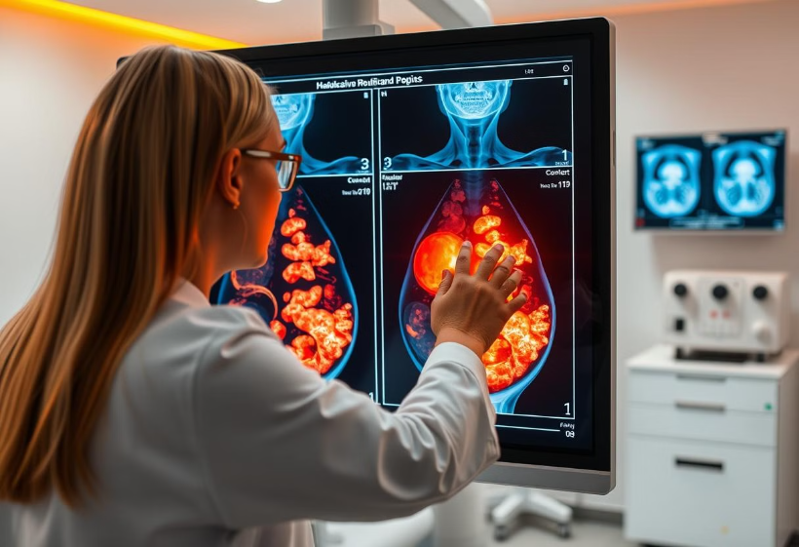
Motivation
This presentation explores explainable AI in breast cancer diagnosis. Early detection is crucial, and deep learning shows promise, offering new avenues for precision and speed. However, transparency is key for trust and clinical adoption. We'll delve into a framework for building accurate, interpretable models that enhance understanding and confidence in AI-driven diagnoses.

Slide 3
Problem Statement:
Traditional methods of breast cancer diagnosis can be subjective and time-consuming.
Distinguishing between benign and malignant tumors is crucial for effective therapy.
The challenge is to develop a Deep Learning model that is both accurate and provides visual explanations for its predictions, helping clinicians understand why a certain diagnosis is made.
Accurate localization of cancerous regions is essential for treatment planning.

Slide 4
Objectives:
Develop a deep learning model for breast cancer classification using ultrasound images.
Achieve high accuracy in distinguishing between benign and malignant tumors.
Implement explainability techniques to visualize and understand the model's decision-making process.
Evaluate and compare different model architectures for both performance and explainability.
Find the neural network that can optimally discriminate a benign from a malignant tumor by examining US images of breast cancer.
Provide visual explanations about the location of regions of interest (ROIs) and specific image areas.

Slide 5



Methodology:
Model Architecture
Breast Cancer Datasets
Class Activation Mapping (CAM)
Standard_CNN, ALEX_NET, GoogLeNet, VGG_16 and VMC_NET.
Ultrasound Breast Images for Breast Cancer from Kaggle website, Breast Ultrasound Images(BUSI) dataset
Employ Grad-CAM and Score-CAM to generate visual explanations, highlighting key regions.

Slide 6



Results:
Metrics Used
Loss, Accuracy, Precision, Recall, F-measure, and AUC.
Results
The study reports on tests performed, and the resultant evaluation metrics for a number of network architectures. VMC_NET and Standard_CNN networks reported good results in quantitative terms for various test conditions relating to number of epochs, batch size, learning rate, and image size.
Qualitative Findings
The CAM visualizations provided insights into which regions of the ultrasound images were most important for the model's classification decisions.

Slide 7

References:
Explainable Deep Learning for Breast Cancer Classification and Localization. https://doi.org/10.1145/3702237
Summary Link : https://drive.google.com/file/d/1Ym6VizJZKn9u47D0i1cjDGECk-YDclv7/view?usp=drive_link
Dataset https://www.kaggle.com/datasets/vuppalaadithyasairam/ultrasound-breast-images-for-breast-cancer

Slide 8
Thank You
Alekhya Aluri 700773355

