Slide 1

MOURI Tech Pvt Limited
INTENSIVE TRAINING PROGRAM - 2019
GLOBAL ENTERPRISE SOLUTIONS
1

Slide 2
AGENDA

Slide 3
Sub Topics with Objective
MOURI Tech Overview
Success Journey

Slide 4

Introduction to Java Programming Language

Slide 5
Chapter 1: Introduction
The Java Programming Language
Program Development
Object-Oriented Programming

Slide 6
Java
A programming language specifies the words and symbols that we can use to write a program
A programming language employs a set of rules that dictate how the words and symbols can be put together to form valid program statements
The Java programming language was created by Sun Microsystems, Inc.
It was introduced in 1995 and it's popularity has grown quickly since

Slide 7
Java programming Language
Some buzzwords for Java
“Write Once, Run Anywhere”
Simple
Object oriented
Distributed
Multithreaded
Dynamic
Architecture neutral
Portable
High performance
Robust
Secure

Slide 8
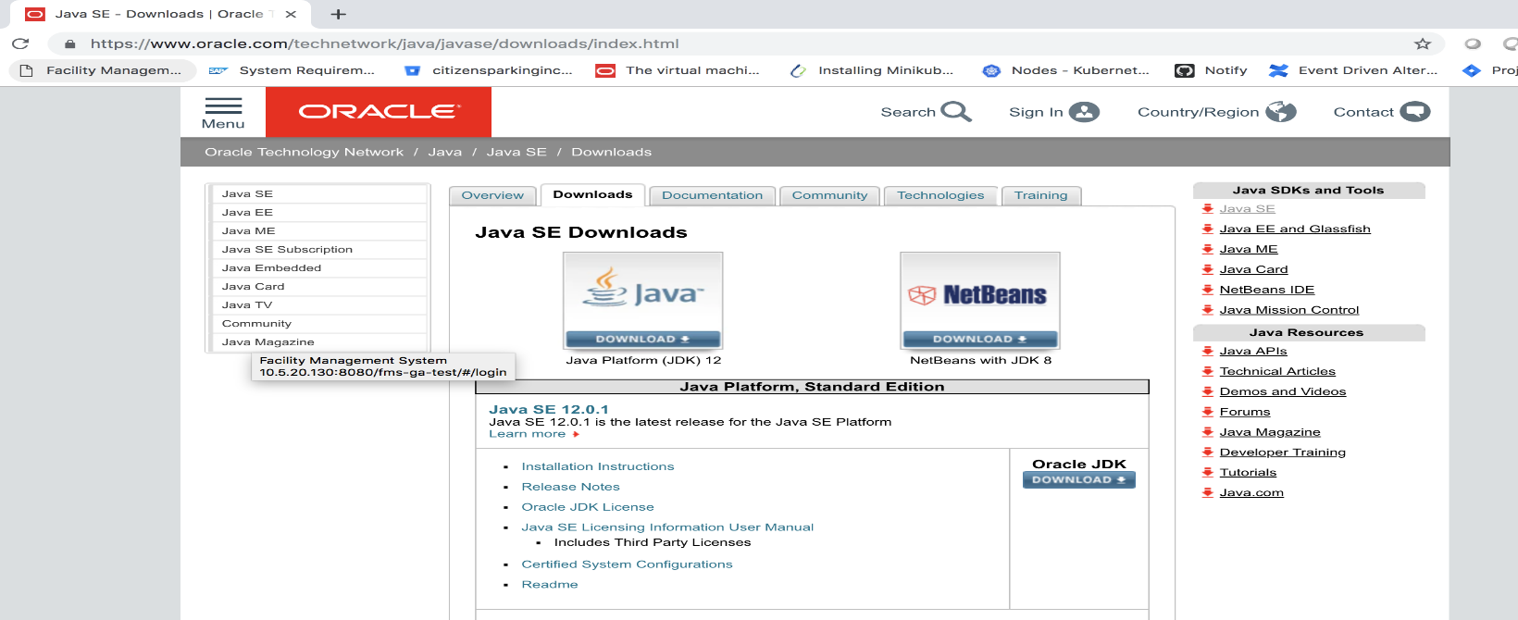
Installing Java in your machine (1)
Downloading Java Development Kit (JDK) from Oracle
Java Runtime Environment (JRE) is usually included in the JDK installation file.

Slide 9
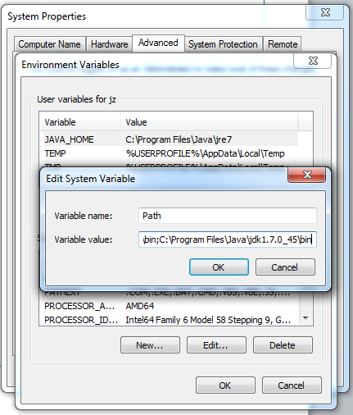
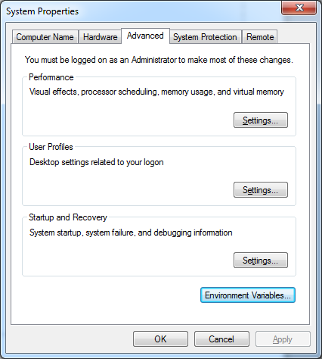
Installing Java in your machine (2)
Setting JAVA_HOME (Windows):
E.g., C:\Program Files\Java\jdk1.7.0_45
Setting path and classpath

Slide 10
Java Program Structure
In the Java programming language:
A program is made up of one or more classes
A class contains one or more methods
A method contains program statements
These terms will be explored in detail throughout the course
A Java application always contains a method called main

Slide 11
Lincoln.java
public class Lincoln
{
//-----------------------------------------------------------------
// Prints a presidential quote.
//-----------------------------------------------------------------
public static void main (String[] args)
{
System.out.println ("A quote by Abraham Lincoln:");
System.out.println ("Whatever you are, be a good one.");
}
}

Slide 12
Java Program Structure
// comments about the class
public class MyProgram
{
}
class header
class body
Comments can be placed almost anywhere

Slide 13
Java Program Structure
// comments about the class
public class MyProgram
{
}
// comments about the method
public static void main (String[] args)
{
}
method header
method body

Slide 14
Comments
Comments in a program are called inline documentation
They should be included to explain the purpose of the program and describe processing steps
They do not affect how a program works
Java comments can take three forms:
// this comment runs to the end of the line
/* this comment runs to the terminating
symbol, even across line breaks */
/** this is a javadoc comment */

Slide 15
Outline
The Java Programming Language
Program Development
Object-Oriented Programming

Slide 16
Program Development
The mechanics of developing a program include several activities
writing the program in a specific programming language (such as Java)
translating the program into a form that the computer can execute
investigating and fixing various types of errors that can occur
Software tools can be used to help with all parts of this process

Slide 17
Programming Languages
Each type of CPU executes only a particular machine language
A program must be translated into machine language before it can be executed
A compiler is a software tool which translates source code into a specific target language
Often, that target language is the machine language for a particular CPU type
The Java approach is somewhat different

Slide 18
Java Translation
The Java compiler translates Java source code into a special representation called bytecode
Java bytecode is not the machine language for any traditional CPU
Another software tool, called an interpreter, translates bytecode into machine language and executes it
Therefore the Java compiler is not tied to any particular machine
Java is considered to be architecture-neutral

Slide 19
Java Translation
Java source
code
Java
bytecode
Java
compiler
Bytecode
interpreter
Bytecode
compiler
Machine
code

Slide 20
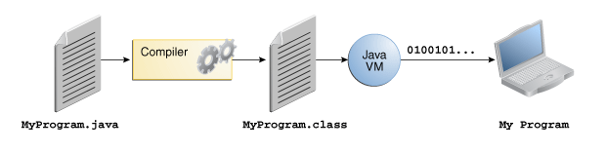
Java Development Process
.java => .class => JVM execution

Slide 21
Development Environments
There are many programs that support the development of Java software, including:
Sun Java Development Kit (JDK)
Sun NetBeans
IBM Eclipse
Borland JBuilder
MetroWerks CodeWarrior
BlueJ
jGRASP
Though the details of these environments differ, the basic compilation and execution process is essentially the same

Slide 22
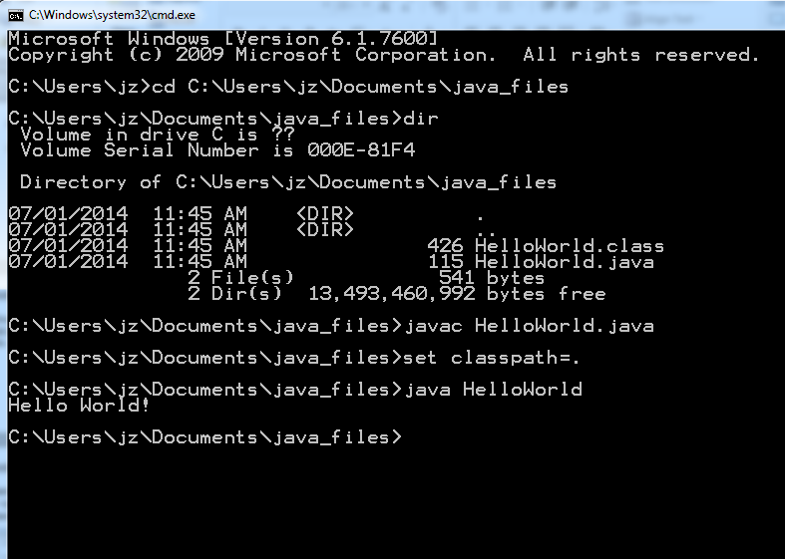
Compile .java File into a .class File (Command Line)

Slide 23
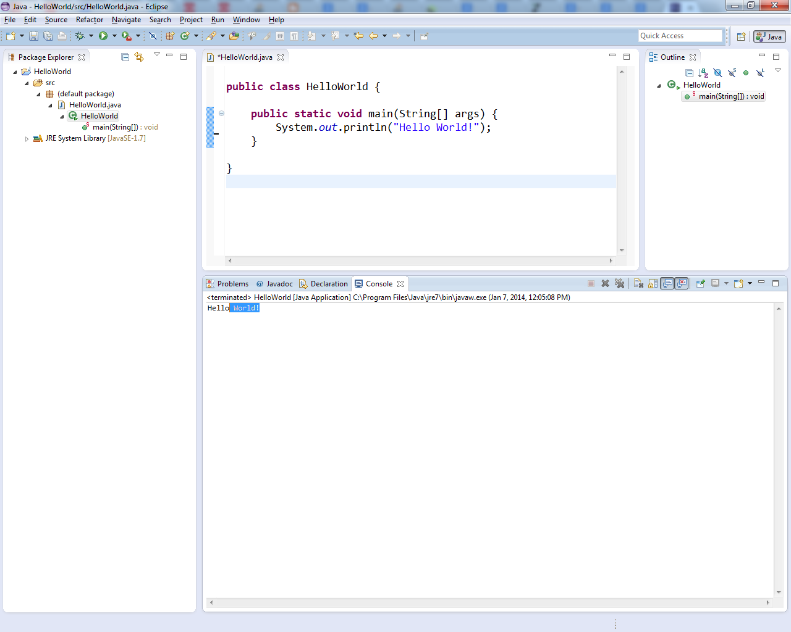
Running HelloWorld in Eclipse IDE

Slide 24
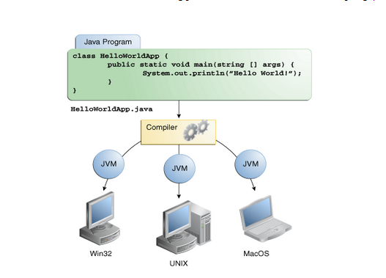
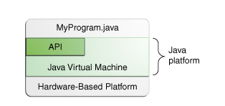
Java platform

Slide 25
Syntax and Semantics
The syntax rules of a language define how we can put together symbols, reserved words, and identifiers to make a valid program
The semantics of a program statement define what that statement means (its purpose or role in a program)
A program that is syntactically correct is not necessarily logically (semantically) correct
A program will always do what we tell it to do, not what we meant to tell it to do

Slide 26
Primitive Data Types
Primitive Data Types: byte, short, int, long, float, double, boolean, char
Arrays are also a class
long [] a = new long[5];
You can get the length by visiting the length field of array object a, like this: a.length
String class is very commonly used to represents character strings, for example
String s1 = “Hello ”, s2 = “Wolrd!”;
String s3 = s1 + s2;

Slide 27
Primitive Data Types
Data type | Range of values
byte | -128 .. 127 (8 bits)
short | -32,768 .. 32,767 (16 bits)
int | -2,147,483,648 .. 2,147,483,647 (32 bits)
long | -9,223,372,036,854,775,808 .. ... (64 bits)
float | +/-10⁻³⁸ to +/-10⁺³⁸ and 0, about 6 digits precision
double | +/-10⁻³⁰⁸ to +/-10⁺³⁰⁸ and 0, about 15 digits precision
char | Unicode characters (generally 16 bits per char)
boolean | True or false

Slide 28
Declaring Variables
int n = 1;
char ch = ‘A’;
String s = “Hello”;
long L = 100000;
boolean done = false;
final double pi = 3.14159265358979323846;
char [] a = new char[3];
int square;
square = n * n;
double cube = n * (double)square;
Can generally declare local variables where they are initialized
All variables get a safe initial value anyway (zero/null)

Slide 29
Operators
++,-- Auto increment/decrement
+,- Unary plus/minus
*,/ Multiplication/division
% Modulus
+,- Addition/subtraction

Slide 30
Operators
subscript [ ], call ( ), member access .
pre/post-increment ++ --, boolean complement !, bitwise complement ~, unary + -, type cast (type), object creation new
* / %
binary + - (+ also concatenates strings)
signed shift << >>, unsigned shift >>>
comparison < <= > >=, class test instanceof
equality comparison == !=
bitwise and &
bitwise or |

Slide 31
Operators
logical (sequential) and &&
logical (sequential) or ||
conditional cond ? true-expr : false-expr
assignment =, compound assignment += -= *= /= <<= >>= >>>= &= |=

Slide 32
Type Compatibility and Conversion
Widening conversion:
In operations on mixed-type operands, the numeric type of the smaller range is converted to the numeric type of the larger range
In an assignment, a numeric type of smaller range can be assigned to a numeric type of larger range
byte to short to int to long
int kind to float to double

Slide 33
Referencing and Creating Objects
You can declare reference variables
They reference objects of specified types
Two reference variables can reference the same object
The new operator creates an instance of a class
A constructor executes when a new object is created
Example: String greeting = ″hello″;

Slide 34
Java Control Statements
A group of statements executed in order is written
{ stmt1; stmt2; ...; stmtN; }
The statements execute in the order 1, 2, ..., N
Control statements alter this sequential flow of execution
A conditional statement lets us choose which statement will be executed next
Therefore they are sometimes called selection statements
Conditional statements give us the power to make basic decisions
The Java conditional statements are the:
if statement
if-else statement
switch statement

Slide 35
The if Statement
The if statement has the following syntax:
if is a Java
reserved word
if ( condition )
statement;
If the condition is true, the statement is executed.
If it is false, the statement is skipped.

Slide 36
Logic of an if statement
condition
evaluated
true
false
statement

Slide 37
Boolean Expressions
A condition often uses one of Java's equality operators or relational operators, which all return boolean results:
== equal to
!= not equal to
< less than
> greater than
<= less than or equal to
>= greater than or equal to
Note the difference between the equality operator (==) and the assignment operator (=)

Slide 38
Age.java
…
public static void main (String[] args)
{
final int MINOR = 21;
Scanner scan = new Scanner (System.in);
System.out.print ("Enter your age: ");
int age = scan.nextInt();
System.out.println ("You entered: " + age);
if (age < MINOR)
System.out.println ("Youth is a wonderful thing. "
+ "Enjoy.");
System.out.println ("Age is a state of mind.");
}
}

Slide 39
Age.java Output
----jGRASP exec: java Age
Enter your age: 12
You entered: 12
Youth is a wonderful thing. Enjoy.
Age is a state of mind.
----jGRASP: operation complete.
----jGRASP exec: java Age
Enter your age: 100
You entered: 100
Age is a state of mind.
----jGRASP: operation complete.

Slide 40
Indentation
The statement controlled by the if statement is indented to indicate that relationship
The use of a consistent indentation style makes a program easier to read and understand
Although it makes no difference to the compiler, proper indentation is crucial
"Always code as if the person who ends up maintaining your code will be a violent psychopath who knows where you live."
-- Martin Golding

Slide 41
The if Statement
What do the following statements do?
if (top >= MAXIMUM)
top = 0;
Sets top to zero if the current value of top is greater than or equal to the value of MAXIMUM
if (total != stock + warehouse)
inventoryError = true;
Sets a flag to true if the value of total is not equal to the sum of stock and warehouse
The precedence of the arithmetic operators is higher than the precedence of the equality and relational operators

Slide 42
Logical Operators
Boolean expressions can also use the following logical operators:
! Logical NOT
&& Logical AND
|| Logical OR
They all take boolean operands and produce boolean results
Logical NOT is a unary operator (it operates on one operand)
Logical AND and logical OR are binary operators (each operates on two operands)

Slide 43
Logical NOT
The logical NOT operation is also called logical negation or logical complement
If some boolean condition a is true, then !a is false; if a is false, then !a is true
Logical expressions can be shown using a truth table
a | !a
true | false
false | true

Slide 44
Logical AND and Logical OR
The logical AND expression
a && b
is true if both a and b are true, and false otherwise
The logical OR expression
a || b
is true if a or b or both are true, and false otherwise

Slide 45
Logical Operators
Expressions that use logical operators can form complex conditions
if (total < MAX+5 && !found)
System.out.println ("Processing…");
All logical operators have lower precedence than the relational operators
Logical NOT has higher precedence than logical AND and logical OR

Slide 46
Logical Operators
A truth table shows all possible true-false combinations of the terms
Since && and || each have two operands, there are four possible combinations of conditions a and b
a | b | a && b | a || b
true | true | true | true
true | false | false | true
false | true | false | true
false | false | false | false

Slide 47
Boolean Expressions
Specific expressions can be evaluated using truth tables
total < MAX | found | !found | total < MAX && !found
false | false | true | false
false | true | false | false
true | false | true | true
true | true | false | false

Slide 48
The if-else Statement
An else clause can be added to an if statement to make an if-else statement
if ( condition )
statement1;
else
statement2;
If the condition is true, statement1 is executed; if the condition is false, statement2 is executed
One or the other will be executed, but not both

Slide 49
Logic of an if-else statement
condition
evaluated
true
false
statement1
statement2

Slide 50
else if drift
String grdStr;
if (grade >= 90)
grdStr = “A”;
else
if (grade >= 80)
grdStr = “B”;
else
if (grade >= 70)
grdStr = “C”;
else
if (grade >= 60)
grdStr = “D”;
else
grdStr = “F”;
String grdStr;
if (grade >= 90)
grdStr = “A”;
else if (grade >= 80)
grdStr = “B”;
else if (grade >= 70)
grdStr = “C”;
else if (grade >= 60)
grdStr = “D”;
else
grdStr = “F”;

Slide 51
Indentation Revisited
Remember that indentation is for the human reader, and is ignored by the computer
if (total > MAX)
System.out.println ("Error!!");
errorCount++;
Despite what is implied by the indentation, the increment will occur whether the condition is true or not

Slide 52
Importance of Curly Braces
Print “We have a problem” if examGrade < 60
Print “We have a real problem” if examGrade < 60 and quizGrade < 10
Print “Ok” if examGrade >= 60
int examGrade, quizGrade;
if (examGrade < 60)
System.out.println(“We have a problem”);
if (quizGrade < 10)
System.out.println(“We have a real problem”);
else
System.out.println(“Ok”);

Slide 53
The switch Statement
The switch statement provides another way to decide which statement to execute next
The switch statement evaluates an expression, then attempts to match the result to one of several possible cases
Each case contains a value and a list of statements
The flow of control transfers to statement associated with the first case value that matches

Slide 54
The switch Statement
The general syntax of a switch statement is:
switch
and
case
are
reserved
words
switch ( expression )
{
case value1 :
statement-list1
case value2 :
statement-list2
case value3 :
statement-list3
case ...
}
If expression
matches value2,
control jumps
to here

Slide 55
The switch Statement
Often a break statement is used as the last statement in each case's statement list
A break statement causes control to transfer to the end of the switch statement
If a break statement is not used, the flow of control will continue into the next case
Sometimes this may be appropriate, but often we want to execute only the statements associated with one case

Slide 56
The switch Statement
An example of a switch statement:
switch (option)
{
case 'A':
aCount++;
break;
case 'B':
bCount++;
break;
case 'C':
cCount++;
break;
}

Slide 57
The switch Statement
A switch statement can have an optional default case
The default case has no associated value and simply uses the reserved word default
If the default case is present, control will transfer to it if no other case value matches
If there is no default case, and no other value matches, control falls through to the statement after the switch

Slide 58
The switch Statement
The expression of a switch statement must result in an integral type, meaning an int or a char
It cannot be a boolean value, a floating point value (float or double), or another integer type
The implicit boolean condition in a switch statement is equality
You cannot perform relational checks with a switch statement

Slide 59
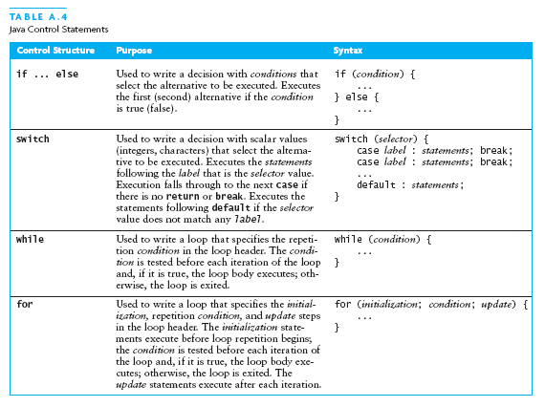
Java Control Statements (continued)

Slide 60
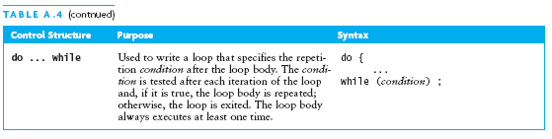
Java Control Statements (continued)

Slide 61
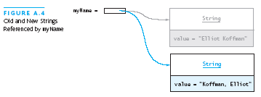
The String Class
The String class defines a data type that is used to store a sequence of characters
You cannot modify a String object
If you attempt to do so, Java will create a new object that contains the modified character sequence

Slide 62
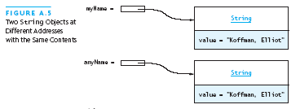

Comparing Objects
You can’t use the relational or equality operators to compare the values stored in strings (or other objects)
(You will compare the pointers, not the objects!)

Slide 63
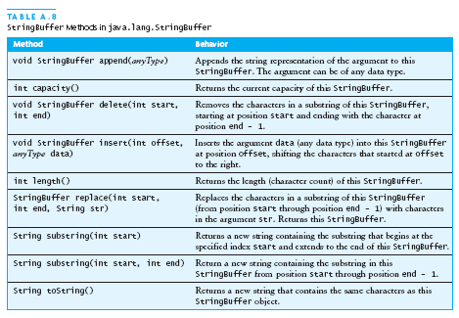
The StringBuffer Class
Stores character sequences
Unlike a String object, you can change the contents of a StringBuffer object

Slide 64
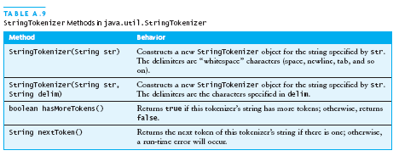
StringTokenizer Class
We often need to process individual pieces, or tokens, of a String

Slide 65
Alternate Ways to Split a String
Use the split method of String:
String[] = s.split(“\\s”);
// see class Pattern in java.util.regex
Use a StreamTokenizer (in java.io)

Slide 66
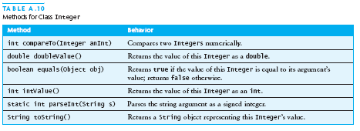
Wrapper Classes for Primitive Types
Sometimes we need to process primitive-type data as objects
Java provides a set of classes called wrapper classes whose objects contain primitive-type values: Float, Double, Integer, Boolean, Character, etc.

Slide 67
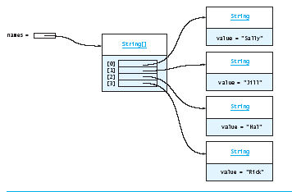
Arrays
In Java, an array is also an object
Arrays are objects that help us organize large amounts of information
The elements are indexes and are referenced using the form arrayvar[subscript]

Slide 68
Outline
Declaring and Using Arrays
Arrays of Objects
Two-Dimensional Arrays
Variable Length Parameter Lists

Slide 69
Arrays
An array is an ordered list of values
The entire array
has a single name
Each value has a numeric index
0 1 2 3 4 5 6 7 8 9
scores
79 87 94 82 67 98 87 81 74 91
An array of size N is indexed from zero to N-1
This array holds 10 values that are indexed from 0 to 9

Slide 70
Arrays
A particular value in an array is referenced using the array name followed by the index in brackets
For example, the expression
scores[2]
refers to the value 94 (the 3rd value in the array)
That expression represents a place to store a single integer and can be used wherever an integer variable can be used

Slide 71
Arrays
For example, an array element can be assigned a value, printed, or used in a calculation:
scores[2] = 89;
scores[first] = scores[first] + 2;
mean = (scores[0] + scores[1])/2;
System.out.println ("Top = " + scores[5]);

Slide 72
Arrays
The values held in an array are called array elements
An array stores multiple values of the same type – the element type
The element type can be a primitive type or an object reference
Therefore, we can create an array of integers, an array of characters, an array of String objects, an array of Coin objects, etc.
In Java, the array itself is an object that must be instantiated

Slide 73
Arrays
Another way to depict the scores array:
scores
79
87
94
82
67
98
87
81
74
91

Slide 74
Arrays
Using arrays
System.out.println(x[0]);
x[3] = 25.0;
sum = x[0] + x[1];
sum = sum + x[2];
x[3] = x[3] + 1.0;
x[2] = x[0] + x[1];
System.out.println(x[7]);
int i = 5;
System.out.println(i + “\t” + x[i]);
System.out.println(x[i+1]);
System.out.println(x[i+i]);
System.out.println(x[2*i-4]);
x[i] = x[i+1];
x[i-1] = x[i];
x[i] – 1 = x[i-1];
Output
1
2
3
4
5
6
x[0] | 16.0
x[1] | 12.0
x[2] | 6.0
x[3] | 8.0
x[4] | 2.5
x[5] | 12.0
x[6] | 14.0
x[7] | -54.5
sum
i

Slide 75
Declaring Arrays
The scores array could be declared as follows:
int[] scores = new int[10];
The type of the variable scores is int[] (an array of integers)
Note that the array type does not specify its size, but each object of that type has a specific size
The reference variable scores is set to a new array object that can hold 10 integers

Slide 76
Decalring Arrays
Some other examples of array declarations:
float[] prices = new float[500];
boolean[] flags;
flags = new boolean[20];
char[] codes = new char[1750];

Slide 77
Separating Declaration and Allocation
Declaration and allocation as separate lines
double[] grades;
grades = new double[50];
first statement declares the array
second statement allocates the array
Example – Ask user for size of array
double [] grades;
Scanner scan = new Scanner(System.in);

Slide 78
Using Arrays
The iterator version of the for loop can be used when processing array elements
for (int score : scores)
System.out.println (score);
This is only appropriate when processing all array elements from top (lowest index) to bottom (highest index)
See BasicArray.java (page 372)

Slide 79
BasicArray.java
//----------------------------------------------------------
// Creates an array, fills it with various integer values,
// modifies one value, then prints them out.
//----------------------------------------------------------
public static void main (String[] args)
{
final int LIMIT = 15, MULTIPLE = 10;
int[] list = new int[LIMIT];
// Initialize the array values
for (int index = 0; index < LIMIT; index++)
list[index] = index * MULTIPLE;
list[5] = 999; // change one array value
// Print the array values
for (int value : list)
System.out.print (value + " ");
}

Slide 80
Bounds Checking
Once an array is created, it has a fixed size
An index used in an array reference must specify a valid element
That is, the index value must be in range 0 to N-1
The Java interpreter throws an ArrayIndexOutOfBoundsException if an array index is out of bounds
This is called automatic bounds checking

Slide 81
Bounds Checking
For example, if the array codes can hold 100 values, it can be indexed using only the numbers 0 to 99
If the value of count is 100, then the following reference will cause an exception to be thrown:
System.out.println (codes[count]);
It’s common to introduce off-by-one errors when using arrays
problem
for (int index=0; index <= 100; index++)
codes[index] = index*50 + epsilon;

Slide 82
Alternate Array Syntax
The brackets of the array type can be associated with the element type or with the name of the array
Therefore the following two declarations are equivalent:
float[] prices;
float prices[];
The first format generally is more readable and should be used

Slide 83
Initializer Lists
An initializer list can be used to instantiate and fill an array in one step
The values are delimited by braces and separated by commas
Examples:
int[] units = {147, 323, 89, 933, 540,
269, 97, 114, 298, 476};
char[] letterGrades = {'A', 'B', 'C', 'D', ’F'};

Slide 84
Initializer Lists
Note that when an initializer list is used:
the new operator is not used
no size value is specified
The size of the array is determined by the number of items in the initializer list
An initializer list can be used only in the array declaration

Slide 85
Outline
Declaring and Using Arrays
Arrays of Objects
Two-Dimensional Arrays
Variable Length Parameter Lists

Slide 86
Arrays of Objects
The elements of an array can be object references
The following declaration reserves space to store 5 references to String objects
String[] words = new String[5];
It does NOT create the String objects themselves
Initially an array of objects holds null references
Each object stored in an array must be instantiated separately

Slide 87
Arrays of Objects
The words array when initially declared:
words
-
-
-
-
-
At this point, the following reference would throw a NullPointerException:
System.out.println (words[0]);

Slide 88
Outline
Declaring and Using Arrays
Arrays of Objects
Two-Dimensional Arrays
Variable Length Parameter Lists

Slide 89
Two-Dimensional Arrays
A one-dimensional array stores a list of elements
A two-dimensional array can be thought of as a table of elements, with rows and columns
one
dimension
two
dimensions

Slide 90
Two-Dimensional Arrays
To be precise, in Java a two-dimensional array is an array of arrays
A two-dimensional array is declared by specifying the size of each dimension separately:
int[][] scores = new int[12][50];
A array element is referenced using two index values:
value = scores[3][6]
The array stored in one row can be specified using one index

Slide 91
SodaSurvey.java
//----------------------------------------------------------
// Determines and prints the average of each row (soda) and
// each column (respondent) of the survey scores.
//----------------------------------------------------------
public static void main (String[] args)
{
int[][] scores = { {3, 4, 5, 2, 1, 4, 3, 2, 4, 4},
{2, 4, 3, 4, 3, 3, 2, 1, 2, 2},
{3, 5, 4, 5, 5, 3, 2, 5, 5, 5},
{1, 1, 1, 3, 1, 2, 1, 3, 2, 4} };
final int SODAS = scores.length;
final int PEOPLE = scores[0].length;
int[] sodaSum = new int[SODAS];
int[] personSum = new int[PEOPLE];
for (int soda=0; soda < SODAS; soda++)
for (int person=0; person < PEOPLE; person++)
{
sodaSum[soda] += scores[soda][person];
personSum[person] += scores[soda][person];
}

Slide 92
SodaSurvey.java
DecimalFormat fmt = new DecimalFormat ("0.#");
System.out.println ("Averages:\n");
for (int soda=0; soda < SODAS; soda++)
System.out.println ("Soda #" + (soda+1) + ": " +
fmt.format ((float)sodaSum[soda]/PEOPLE));
System.out.println ();
for (int person =0; person < PEOPLE; person++)
System.out.println ("Person #" + (person+1) + ": " +
fmt.format ((float)personSum[person]/SODAS));
}
}

Slide 93
Multidimensional Arrays
An array can have many dimensions – if it has more than one dimension, it is called a multidimensional array
Each dimension subdivides the previous one into the specified number of elements
Each dimension has its own length constant
Because each dimension is an array of array references, the arrays within one dimension can be of different lengths
these are sometimes called ragged arrays

Slide 94
Exercise 1
Write a code fragment that calculates the product of all the entries on the main diagonal of a square array of doubles called numbers.

Slide 95
Exercise 2
Write a code fragment that calculates the product of all the entries on the skew diagonal of a square array of doubles called numbers (the skew diagonal is the one from the lower left corner to the upper right corner).
(0,3)
(1,2)
(2,1)
(3,0)

Slide 96
Exercise 3
Write a code fragment that copies the lower right quarter of a 20 by 10 int array called arr into an array called copy. You may assume that arr has already been declared and initialized, but write the statements that declare and initialize copy. copy should be a 10 by 5 array.
arr
copy

Slide 97
Outline
Declaring and Using Arrays
Arrays of Objects
Two-Dimensional Arrays
Variable Length Parameter Lists

Slide 98
Variable Length Parameter Lists
Suppose we wanted to create a method that processed a different amount of data from one invocation to the next
For example, let's define a method called average that returns the average of a set of integer parameters
// one call to average three values
mean1 = average (42, 69, 37);
// another call to average seven values
mean2 = average (35, 43, 93, 23, 40, 21, 75);

Slide 99
Variable Length Parameter Lists
We could define overloaded versions of the average method
Downside: we'd need a separate version of the method for each parameter count
We could define the method to accept an array of integers
Downside: we'd have to create the array and store the integers prior to calling the method each time
Instead, Java provides a convenient way to create variable length parameter lists

Slide 100
Variable Length Parameter Lists
Using special syntax in the formal parameter list, we can define a method to accept any number of parameters of the same type
For each call, the parameters are automatically put into an array for easy processing in the method
Indicates a variable length parameter list
public double average (int ... list)
{
// whatever
}
element
type
array
name

Slide 101
Variable Length Parameter Lists
public double average (int ... list)
{
double result = 0.0;
if (list.length != 0)
{
int sum = 0;
for (int num : list)
sum += num;
result = (double)num / list.length;
}
return result;
}

Slide 102
Objects
identity – unique identification of an object
attributes – data/state
services – methods/operations
supported by the object
within objects responsibility to provide these services to other clients
Empoyee emp = new Employee();

Slide 103
Class
“type”
object is an instance of class
class groups similar objects
same (structure of) attributes
same services
object holds values of its class’s attributes

Slide 104
Classes
A class can contain data declarations and method declarations
int size, weight;
char category;
Data declarations
Method declarations

Slide 105
Classes
The values of the data define the state of an object created from the class
The functionality of the methods define the behaviors of the object
For our Die class, we might declare an integer that represents the current value showing on the face
One of the methods would “roll” the die by setting that value to a random number between one and six

Slide 106
Classes
We’ll want to design the Die class with other data and methods to make it a versatile and reusable resource
Any given program will not necessarily use all aspects of a given class
See RollingDice.java
See Die.java

Slide 107
RollingDice.java
public class RollingDice
{
//----------------------------------------------------------
// Creates two Die objects and rolls them several times.
//----------------------------------------------------------
public static void main (String[] args)
{
Die die1, die2;
int sum;
die1 = new Die();
die2 = new Die();
die1.roll();
die2.roll();
System.out.println ("Die One: " + die1 + ", Die Two: " +die2);
die1.roll();
die2.setFaceValue(4);
System.out.println ("Die One: " + die1 + ", Die Two: " +
die2);
sum = die1.getFaceValue() + die2.getFaceValue();
System.out.println ("Sum: " + sum);
sum = die1.roll() + die2.roll();
System.out.println ("Die One: " + die1 + ", Die Two: " +die2);
System.out.println ("New sum: " + sum);
}
}

Slide 108
Die.java
public class Die
{
private final int MAX = 6; // maximum face value
private int faceValue; // current value showing on the die
// Constructor: Sets the initial face value.
public Die() {
faceValue = 1;
}
// Rolls the die and returns the result.
public int roll() {
faceValue = (int)(Math.random() * MAX) + 1;
return faceValue;
}
// Face value mutator.
public void setFaceValue (int value) {
faceValue = value;
}
// Face value accessor.
public int getFaceValue() {
return faceValue;
}
// Returns a string representation of this die.
public String toString() {
String result = Integer.toString(faceValue);
return result;
}
}

Slide 109
The Die Class
The Die class contains two data values
a constant MAX that represents the maximum face value
an integer faceValue that represents the current face value
The roll method uses the random method of the Math class to determine a new face value
There are also methods to explicitly set and retrieve the current face value at any time

Slide 110
Constructors
As mentioned previously, a constructor is a special method that is used to set up an object when it is initially created
A constructor has the same name as the class
The Die constructor is used to set the initial face value of each new die object to one
We examine constructors in more detail later in this chapter

Slide 111
Data Scope
The scope of data is the area in a program in which that data can be referenced (used)
Data declared at the class level can be referenced by all methods in that class
Data declared within a method can be used only in that method
Data declared within a method is called local data
In the Die class, the variable result is declared inside the toString method -- it is local to that method and cannot be referenced anywhere else

Slide 112
Instance Data
The faceValue variable in the Die class is called instance data because each instance (object) that is created has its own version of it
A class declares the type of the data, but it does not reserve any memory space for it
Every time a Die object is created, a new faceValue variable is created as well
The objects of a class share the method definitions, but each object has its own data space
That's the only way two objects can have different states

Slide 113
Instance Data
We can depict the two Die objects from the RollingDice program as follows:
die1
faceValue
5
die2
faceValue
2
Each object maintains its own faceValue variable, and thus its own state

Slide 114
UML Diagrams
UML stands for the Unified Modeling Language
UML diagrams show relationships among classes and objects
A UML class diagram consists of one or more classes, each with sections for the class name, attributes (data), and operations (methods)
Lines between classes represent associations
A dotted arrow shows that one class uses the other (calls its methods)

Slide 115
UML Class Diagrams
A UML class diagram for the RollingDice program:
RollingDice
Die
faceValue : int
main (args : String[]) : void
roll() : int
setFaceValue (int value) : void
getFaceValue() : int
toString() : String

Slide 116
Encapsulation
We can take one of two views of an object:
internal - the details of the variables and methods of the class that defines it
external - the services that an object provides and how the object interacts with the rest of the system
From the external view, an object is an encapsulated entity, providing a set of specific services
These services define the interface to the object

Slide 117
Encapsulation
One object (called the client) may use another object for the services it provides
The client of an object may request its services (call its methods), but it should not have to be aware of how those services are accomplished
Any changes to the object's state (its variables) should be made by that object's methods
We should make it difficult, if not impossible, for a client to access an object’s variables directly
That is, an object should be self-governing

Slide 118
Encapsulation
An encapsulated object can be thought of as a black box -- its inner workings are hidden from the client
The client invokes the interface methods of the object, which manages the instance data
Client
Methods
Data

Slide 119
Visibility Modifiers
In Java, we accomplish encapsulation through the appropriate use of visibility modifiers
A modifier is a Java reserved word that specifies particular characteristics of a method or data
We've used the final modifier to define constants
Java has three visibility modifiers: public, protected, and private
The protected modifier involves inheritance, which we will discuss later

Slide 120
Visibility Modifiers
Members of a class that are declared with public visibility can be referenced anywhere
Members of a class that are declared with private visibility can be referenced only within that class
Members declared without a visibility modifier have default visibility and can be referenced by any class in the same package

Slide 121
Visibility Modifiers
Public variables violate encapsulation because they allow the client to “reach in” and modify the values directly
Therefore instance variables should not be declared with public visibility
It is acceptable to give a constant public visibility, which allows it to be used outside of the class
Public constants do not violate encapsulation because, although the client can access it, its value cannot be changed

Slide 122
Visibility Modifiers
Methods that provide the object's services are declared with public visibility so that they can be invoked by clients
Public methods are also called service methods
A method created simply to assist a service method is called a support method
Since a support method is not intended to be called by a client, it should not be declared with public visibility

Slide 123
Visibility Modifiers
public
private
Violate
encapsulation
Enforce
encapsulation
Variables
Support other
methods in the
class
Provide services
to clients
Methods

Slide 124
Accessors and Mutators
Because instance data is private, a class usually provides services to access and modify data values
An accessor method returns the current value of a variable
A mutator method changes the value of a variable
The names of accessor and mutator methods take the form getX and setX, respectively, where X is the name of the value
They are sometimes called “getters” and “setters”

Slide 125
Mutator Restrictions
The use of mutators gives the class designer the ability to restrict a client’s options to modify an object’s state
A mutator is often designed so that the values of variables can be set only within particular limits
For example, the setFaceValue mutator of the Die class should have restricted the value to the valid range (1 to MAX)
We’ll see in Chapter 5 how such restrictions can be implemented

Slide 126
Method Declarations
Let’s now examine method declarations in more detail
A method declaration specifies the code that will be executed when the method is invoked (called)
When a method is invoked, the flow of control jumps to the method and executes its code
When complete, the flow returns to the place where the method was called and continues
The invocation may or may not return a value, depending on how the method is defined

Slide 127
Method Control Flow
If the called method is in the same class, only the method name is needed
compute
myMethod
myMethod();

Slide 128
Method Control Flow
The called method is often part of another class or object
main
doIt
helpMe
obj.doIt();
helpMe();

Slide 129
Method Header
A method declaration begins with a method header
char calc (int num1, int num2, String message)
method
name
parameter list
return
type
The parameter list specifies the type
and name of each parameter
The name of a parameter in the method
declaration is called a formal parameter

Slide 130
Method Body
The method header is followed by the method body
char calc (int num1, int num2, String message)
{
int sum = num1 + num2;
char result = message.charAt (sum);
return result;
}
sum and result
are local data
They are created each time the method is called, and are destroyed when it finishes executing
The return expression
must be consistent with
the return type

Slide 131
The return Statement
The return type of a method indicates the type of value that the method sends back to the calling location
A method that does not return a value has a void return type
A return statement specifies the value that will be returned
return expression;
Its expression must conform to the return type

Slide 132
Parameters
When a method is called, the actual parameters in the invocation are copied into the formal parameters in the method header
ch = obj.calc (25, count, "Hello");
char calc (int num1, int num2, String message)
{
int sum = num1 + num2;
char result = message.charAt (sum);
return result;
}

Slide 133
Local Data
As we’ve seen, local variables can be declared inside a method
The formal parameters of a method create automatic local variables when the method is invoked
When the method finishes, all local variables are destroyed (including the formal parameters)
Keep in mind that instance variables, declared at the class level, exists as long as the object exists

Slide 134
Bank Account Example
Let’s look at another example that demonstrates the implementation details of classes and methods
We’ll represent a bank account by a class named Account
It’s state can include the account number, the current balance, and the name of the owner
An account’s behaviors (or services) include deposits and withdrawals, and adding interest

Slide 135
Driver Programs
A driver program drives the use of other, more interesting parts of a program
Driver programs are often used to test other parts of the software
The Transactions class contains a main method that drives the use of the Account class, exercising its services
See Transactions.java
See Account.java

Slide 136
Transactions.java
public class Transactions
{
//----------------------------------------------------------
// Creates some bank accounts and requests various
// services.
//----------------------------------------------------------
public static void main (String[] args)
{
Account acct1 = new Account ("Ted Murphy", 72354, 102.56);
Account acct2 = new Account ("Jane Smith", 69713, 40.00);
Account acct3 = new Account ("Edward Demsey", 93757, 759.32);
acct1.deposit (25.85);
double smithBalance = acct2.deposit (500.00);
System.out.println ("Smith balance after deposit: " +smithBalance);
System.out.println ("Smith balance after withdrawal: " + acct2.withdraw (430.75, 1.50));
acct1.addInterest();
acct2.addInterest();
acct3.addInterest();
System.out.println ();
System.out.println (acct1);
System.out.println (acct2);
System.out.println (acct3);
}
}

Slide 137
Account.java
import java.text.NumberFormat;
public class Account
{
private final double RATE = 0.035; // interest rate of 3.5%
private long acctNumber;
private double balance;
private String name;
//----------------------------------------------------------
// Sets up the account by defining its owner, account
// number, and initial balance.
//----------------------------------------------------------
public Account (String owner, long account, double initial) {
name = owner;
acctNumber = account;
balance = initial;
}
// Deposits the specified amount into the account. Returns
// the new balance.
public double deposit (double amount) {
balance = balance + amount;
return balance;
}

Slide 138
Account.java
// Sets up the account by defining its owner, account
// number, and initial balance.
public Account (String owner, long account, double initial) {
name = owner;
acctNumber = account;
balance = initial;
}
// Deposits the specified amount into the account. Returns
// the new balance.
public double deposit (double amount) {
balance = balance + amount;
return balance;
}
// Withdraws the specified amount from the account and
// applies the fee. Returns the new balance.
public double withdraw (double amount, double fee) {
balance = balance - amount - fee;
return balance;
}
// Adds interest to the account and returns the new
// balance.
public double addInterest ()
{
balance += (balance * RATE);
return balance;
}

Slide 139
Account.java
//----------------------------------------------------------
// Returns the current balance of the account.
//----------------------------------------------------------
public double getBalance ()
{
return balance;
}
//----------------------------------------------------------
// Returns a one-line description of the account as a
// string.
//----------------------------------------------------------
public String toString ()
{
NumberFormat fmt = NumberFormat.getCurrencyInstance();
return (acctNumber + "\t" + name + "\t" +
fmt.format(balance));
}
}

Slide 140
Bank Account Example
acct1
acctNumber
72354
balance
102.56
name
“Ted Murphy”
acct2
acctNumber
69713
balance
40.00
name
“Jane Smith”

Slide 141
Bank Account Example
There are some improvements that can be made to the Account class
Formal getters and setters could have been defined for all data
The design of some methods could also be more robust, such as verifying that the amount parameter to the withdraw method is positive

Slide 142
Constructors Revisited
Note that a constructor has no return type specified in the method header, not even void
A common error is to put a return type on a constructor, which makes it a “regular” method that happens to have the same name as the class
The programmer does not have to define a constructor for a class
Each class has a default constructor that accepts no parameters

Slide 143
Static
Member data - Same data is used for all the instances (objects) of some Class.
Assignment performed
on the first access to the
Class.
Only one instance of ‘x’
exists in memory
Class A {
public int y = 0;
public static int x_ = 1;
};
A a = new A();
A b = new A();
System.out.println(b.x_);
a.x_ = 5;
System.out.println(b.x_);
A.x_ = 10;
System.out.println(b.x_);
Output:
1
5
10

Slide 144
Static
Member function
Static member function can access only static members
Static member function can be called without an instance.
Class TeaPot {
private static int numOfTP = 0;
private Color myColor_;
public TeaPot(Color c) {
myColor_ = c;
numOfTP++;
}
public static int howManyTeaPots()
{ return numOfTP; }
// error :
public static Color getColor()
{ return myColor_; }
}

Slide 145
Static
Block
Code that is executed in the first reference to the class.
Several static blocks can exist in the same class ( Execution order is by the appearance order in the class definition ).
Only static members can be accessed.
class RandomGenerator {
private static int seed_;
static {
int t = System.getTime() % 100;
seed_ = System.getTime();
while(t-- > 0)
seed_ = getNextNumber(seed_);
}
}
}

Slide 146
Exercise
Design and implement a class called Box that contains instance data that represents the height, width, and depth of the box. Also include a boolean variable called full as instance data that represents if the box is full or not.
Define three Box constructors
no arguments and creates the unit box
one argument and creates a cube of that size
three arguments to accept and initialize the height, width, and depth of the box in that order
Each newly created Box is empty (the constructor should initialize full to false).
Other methods
Include a toString method that returns a one-line description of the box.
Include accessors (getter) and mutators (setter) methods for all instance data.
Include calculation of the volume of the box

Slide 147
Identifiers
Identifiers are the words a programmer uses in a program
An identifier can be made up of letters, digits, the underscore character ( _ ), and the dollar sign
Identifiers cannot begin with a digit
Java is case sensitive - Total, total, and TOTAL are different identifiers
By convention, programmers use different case styles for different types of identifiers, such as
title case for class names - Lincoln
upper case for constants - MAXIMUM

Slide 148
Reserved Words
The Java reserved words:
abstract
assert
boolean
break
byte
case
catch
char
class
const
continue
default
do
double
else
enum
extends
false
final
finally
float
for
goto
if
implements
import
instanceof
int
interface
long
native
new
null
package
private
protected
public
return
short
static
strictfp
super
switch
synchronized
this
throw
throws
transient
true
try
void
volatile
while

Slide 149
White Space
Spaces, blank lines, and tabs are called white space
White space is used to separate words and symbols in a program
Extra white space is ignored
A valid Java program can be formatted many ways
Programs should be formatted to enhance readability, using consistent indentation

Slide 150
Errors
A program can have three types of errors
The compiler will find syntax errors and other basic problems (compile-time errors)
If compile-time errors exist, an executable version of the program is not created
A problem can occur during program execution, such as trying to divide by zero, which causes a program to terminate abnormally (run-time errors)
A program may run, but produce incorrect results, perhaps using an incorrect formula (logical errors)

Slide 151
Basic Program Development
Edit and
save program
errors
Compile program
Execute program and
evaluate results

Slide 152
Outline
The Java Programming Language
Program Development
Object-Oriented Programming

Slide 153
Problem Solving
The purpose of writing a program is to solve a problem
Solving a problem consists of multiple activities:
Understand the problem
Design a solution
Consider alternatives and refine the solution
Implement the solution
Test the solution
These activities are not purely linear – they overlap and interact

Slide 154
Problem Solving
The key to designing a solution is breaking it down into manageable pieces
When writing software, we design separate pieces that are responsible for certain parts of the solution
An object-oriented approach lends itself to this kind of solution decomposition
We will dissect our solutions into pieces called objects and classes

Slide 155
Packages
Java code has hierarchical structure.
The environment variable CLASSPATH contains the directory names of the roots.
Every Object belongs to a package ( ‘package’ keyword)
Object full name contains the name full name of the package containing it.

Slide 156
Access Control
public member (function/data)
Can be called/modified from outside.
protected
Can be called/modified from derived classes
private
Can be called/modified only from the current class
default ( if no access modifier stated )
Usually referred to as “Friendly”.
Can be called/modified/instantiated from the same package

Slide 157
Inheritance
Inheritance is a mechanism wherein a new class is derived from an existing class. In Java, classes may inherit or acquire the properties and methods of other classes.
A class derived from another class is called a subclass, whereas the class from which a subclass is derived is called a superclass or parent class.
A subclass can have only one superclass, whereas a superclass may have one or more subclasses.
The inheritance mechanism is very useful in code reuse.
For example, a vehicle is a superclass and a car is a subclass. The car (subclass) inherits all of the vehicle’s properties.

Slide 158
Inheritance
class Base {
Base(){}
Base(int i) {}
protected void foo() {…}
}
class Derived extends Base {
Derived() {}
protected void foo() {…}
Derived(int i) {
super(i);
…
super.foo();
}
}
Base
Derived

Slide 159
Inheritance
In Java, all methods are virtual :
class Base {
void foo() {
System.out.println(“Base”);
}
}
class Derived extends Base {
void foo() {
System.out.println(“Derived”);
}
}
public class Test {
public static void main(String[] args) {
Base b = new Derived();
b.foo(); // Derived.foo() will be activated
}
}

Slide 160
Types of Inheritance in Java
Single Inheritance :
In single inheritance, subclasses inherit the features of one superclass. In image below, the class A serves as a base class for the derived class B.
Multilevel Inheritance :
In Multilevel Inheritance, a derived class will be inheriting a base class and as well as the derived class also act as the base class to other class.
Hierarchical Inheritance :
In Hierarchical Inheritance, one class serves as a superclass (base class) for more than one sub class.
Multiple Inheritance (Through Interfaces) :
In Multiple inheritance ,one class can have more than one superclass and inherit features from all parent classes.
Please note that Java does not support multiple inheritance with classes. In java, we can achieve multiple inheritance only through Interfaces.

Slide 161
Why does Java not support Multiple Inheritance
To reduce complexity and ambiguity, Java does not allow Multiple Inheritance using classes. Let us explain the ambiguity with an example.
Say, there is a class A having a method display() and class B having another method display(). A third class C, extends both A and B and as per the concept of inheritance, is able to access both the display() methods of A and B. Now, when creating an object of C and calling the display() method, the compiler will not be able to discern which display method to call as both classes A and B have a method having the same name and are extended by class C.
Class A () {
public void display () {
//some code
}
}
class B () {
public void display () {
//some code
}
}
class C extends A,B () ( Not supported in Java ){
public static void main (){
C obj = new C ();
obj.display(); ( Ambiguity between display() of class A and display of class B)
}
}
In order to prevent this ambiguity, Java does not allow multiple inheritance between classes and throws a compile-time error when multiple inheritance is attempted.
Note: Java, however, simulates Multiple Inheritance by using Interfaces.

Slide 162
Polymorphism
Inheritance creates an “is a” relation:
For example, if B inherits from A, than we say that “B is also an A”.
Implications are:
access rights (Java forbids reducing access rights) - derived class can receive all the messages that the base class can.
behavior
precondition and postcondition

Slide 163
Abstraction
Abstraction is a process of hiding the implementation details from the user. Оnly the functionality will be provided to the user.
Abstraction is achieved using abstract classes and interfaces.
NOTE:
An abstract class is not required to have an abstract method in it.
But any class that has an abstract method in it or that does
not provide an implementation for any abstract methods declared
in its superclasses must be declared as an abstract class.

Slide 164
Abstract - Example
package java.lang;
public abstract class Shape {
public abstract void draw();
public void move(int x, int y) {
setColor(BackGroundColor);
draw();
setCenter(x,y);
setColor(ForeGroundColor);
draw();
}
}
package java.lang;
public class Circle extends Shape {
public void draw() {
// draw the circle ...
}
}

Slide 165
Abstract classes and Abstract methods
An abstract class is a class that is declared with abstract keyword.
An abstract method is a method that is declared without an implementation.
An abstract class may or may not have all abstract methods. Some of them can be concrete methods
A method defined abstract must always be redefined in the subclass,thus making overriding compulsory OR either make subclass itself abstract.
Any class that contains one or more abstract methods must also be declared with abstract keyword.
There can be no object of an abstract class.That is, an abstract class can not be directly instantiated with the new operator.
An abstract class can have parametrized constructors and default constructor is always present in an abstract class.

Slide 166
Use of abstract class and methods
When we want to define a superclass that declares the structure of a given abstraction without providing a complete implementation of every method. (i.e., sometimes we will want to create a superclass that only defines a generalization form that will be shared by all of its subclasses, leaving it to each subclass to fill in the details)

Slide 167
Interface
Interfaces are useful for the following:
Capturing similarities among unrelated classes without artificially forcing a class relationship.
Declaring methods that one or more classes are expected to implement.
Revealing an object's programming interface without revealing its class.

Slide 168
Interface
abstract “class”
Helps defining a “usage contract” between classes
All methods are public
Java’s compensation for removing the multiple inheritance. You can “inherit” as many interfaces as you want.
Interfaces specify what a class must do and not how. It is the blueprint of the class.
Interface do not have implementation of any method.
To declare an interface, use interface keyword.
It is used to provide total abstraction. That means all the methods in interface are declared with empty body and are public and all fields are public, static and final by default.
A class that implement interface must implement all the methods declared in the interface. To implement interface use implements keyword.

Slide 169
Interface - syntax
interface <interface_name> {
// declare constant fields
// declare methods that abstract
// by default.
}

Slide 170
Interface
interface IChef {
void cook(Food food);
}
interface BabyKicker {
void kickTheBaby(Baby);
}
interface SouthParkCharacter {
void curse();
}
class Chef implements IChef, SouthParkCharacter {
// overridden methods MUST be public
// can you tell why ?
public void curse() { … }
public void cook(Food f) { … }
}

Slide 171
Polymorphism
Polymorphism in Java is a concept by which we can perform a single action in different ways.
Greek words: poly and morphs. The word "poly" means many and "morphs" means forms. So polymorphism means many forms.
There are two types of polymorphism in Java:
compile-time polymorphism
runtime polymorphism.
We can perform polymorphism in java by method overloading and method overriding.

Slide 172
Runtime polymorphism
Runtime Polymorphism is nothing but method overriding in java.If subclass is having same method as base class then it is known as method overriding Or in another word, If subclass provides specific implementation to any method which is present in its one of parents classes then it is known as method overriding.
Runtime polymorphism can't be achieved by data members.
In this example, we are creating two classes Bike and Splendor. Splendor class extends Bike class and overrides its run() method. We are calling the run method by the reference variable of Parent class. Since it refers to the subclass object and subclass method overrides the Parent class method, the subclass method is invoked at runtime.
Since method invocation is determined by the JVM not compiler, it is known as runtime polymorphism.

Slide 173
Runtime polymorphism - Example
class Bike{
int speedlimit=100;
void run(){System.out.println("running");}
}
class Splendor extends Bike{
int speedlimit=90;
void run(){System.out.println("running safely with 60km");}
public static void main(String args[]){
Bike b = new Splendor();//upcasting
b.run();
System.out.println(b.speedlimit);
}
}
Output:
running safely with 60km.
100

Slide 174
Compile time Polymorphism
Compile time Polymorphism is nothing but method overloading in java. You can define various methods with same name but different method arguments.
public class MethodOverloadingExample {
public void method1(int a) {
System.out.println("Integer: "+a);
}
public void method1(double b) {
System.out.println("Double "+b);
}
public void method1(int a, int b) {
System.out.println("Integer a and b:"+a+" "+b);
}
public static void main(String args[]) {
MethodOverloadingExample moe=new MethodOverloadingExample();
moe.method1(20);
moe.method1(30.0);
moe.method1(20, 30);
}
}
Output:
Integer: 20
Double 30.0
Integer a and b:20 30

Slide 175
ENUMS
Enumerations represents a group of named constants in a programming language.Examples include natural enumerated types (like the planets, days of the week, colors, directions, etc.). Enums are used when there are all known possible values at compile time, such as choices on a menu, rounding modes, command line flags, etc. It is not necessary that the set of constants in an enum type stay fixed for all time.
In Java (from 1.5), enums are represented using enum data type. In Java, we can also add variables, methods and constructors to it. The main objective of enum is to define our own data types(i.e.,Enumerated Data Types).

Slide 176
Decalration of Enums
Declaration of enum in java :Enum declaration can be done outside a Class or inside a Class but not inside a Method.below is the example how a enum is declared:
Example:
enum Color{
RED,
GREEN,
YELLOW;
}
Public Class test{
Public static void main(String args[]){
Color c=Color.RED;
System.out.println(c);
}

Slide 177
Enum declaration contd..
We can also declare enum inside a class:
Public class test{
enum Color{
RED,GREEN,YELLOW;
}
Public static void main(String args[]){
Color c=Color.RED;
System.out.println(c);
}

Slide 178
Important features of Enum
Every enum internally implemented by using Class
Internally the enum color in the above example Color is converted as below:
class Color{
public static final Color RED =new Color();
public static final Color GREEN =new Color();
public static final Color YELLOW =new Color();
}
Every enum constant represents an object of type enum.

Slide 179
Enum using a switch statement
Below is the example how enum is used in a switch statement :
import java.util.Scanner;
// An Enum class
enum color
{
RED,GREEN, YELLOW;
}
// Driver class that contains an object of "day" and
// main().
public class Test
{
Color color;
// Constructor
public Test(Color color)
{
this.color = color;
}
// Prints a line about Color using switch
public void colorIsLike()
{
switch (color)
{
case RED:
System.out.println(" print the color red ");
break;
case GREEN:
System.out.println("print the color green");
break;
case YELLOW:
System.out.println("pritn the color yellow");
break;
default:
System.out.println("print nothing");
break;
}
}
// main method
public static void main(String[] args)
{
String str = "RED";
Test t1 = new Test(Color.valueOf(str));
t1.colorIsLike();
}
}

Slide 180
Enum and Inheritance
All enums implicitly extend java.lang.Enum class. As a class can only extend oneparent in Java, so an enum cannot extend anything else.
toString() method is overridden in java.lang.Enum class,which returns enum constant name.
enum can implement many interfaces.
values(), ordinal() and valueOf() methods :
These methods are present inside java.lang.Enum.
values() method can be used to return all values present inside enum.
Order is important in enums.By using ordinal() method, each enum constant index can be found, just like array index.
valueOf() method returns the enum constant of the specified string value, if exists.

Slide 181
Enum and constructor
enum can contain constructor and it is executed separately for each enum constant at the time of enum class loading.
We can’t create enum objects explicitly and hence we can’t invoke enum constructor directly
enum can contain concrete methods only, no any abstract methods will be allowed.

Slide 182
Collections
Collection/container
object that groups multiple elements
used to store, retrieve, manipulate, communicate aggregate data
Iterator - object used for traversing a collection and selectively remove elements
Generics – implementation is parametric in the type of elements

Slide 183
Java Collection Framework
Goal: Implement reusable data-structures and functionality
Collection interfaces - manipulate collections independently of representation details
Collection implementations - reusable data structures
List<String> list = new ArrayList<String>(c);
Algorithms - reusable functionality
computations on objects that implement collection interfaces
e.g., searching, sorting
polymorphic: the same method can be used on many different implementations of the appropriate collection interface

Slide 184
Collection Interfaces
Collection
Map
Set
List
Queue
Sorted Map
SortedSet

Slide 185
Collection Interface
Basic Operations
int size();
boolean isEmpty();
boolean contains(Object element);
boolean add(E element);
boolean remove(Object element);
Iterator iterator();
Bulk Operations
boolean containsAll(Collection<?> c);
boolean addAll(Collection<? extends E> c);
boolean removeAll(Collection<?> c);
boolean retainAll(Collection<?> c);
void clear();
Array Operations
Object[] toArray(); <T> T[] toArray(T[] a); }

Slide 186
General Purpose Implementations
Collection
Map
Set
List
Queue
Sorted Map
SortedSet
HashSet
TreeSet
ArrayList
LinkedList
TreeMap
HashMap
List<String> list1 = new ArrayList<String>(c);
List<String> list2 = new LinkedList<String>(c);

Slide 187
final
final member data Constant member
final member function The method can’t be overridden.
final class ‘Base’ is final, thus it can’t be extended
final class Base {
final int i=5;
final void foo() {
i=10;
//what will the compiler say about this?
}
}
class Derived extends Base { // Error
// another foo ...
void foo() {
}
}

Slide 188

Java Threading

Slide 189
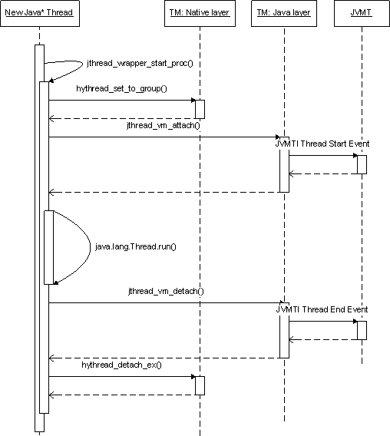
Java Threading
A thread is a thread of execution in a program [6]
JVM allows an application to have multiple threads running concurrently.
Apache Harmony example:

Slide 190
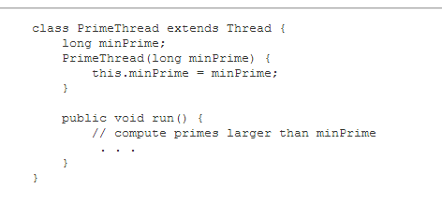

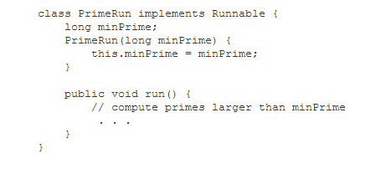

Two ways to do threading
Extends Thread class
Implements Runnable interface

Slide 191
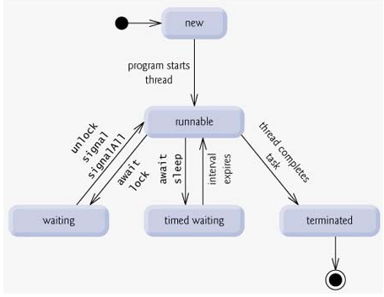
Thread lifecycle

Slide 192
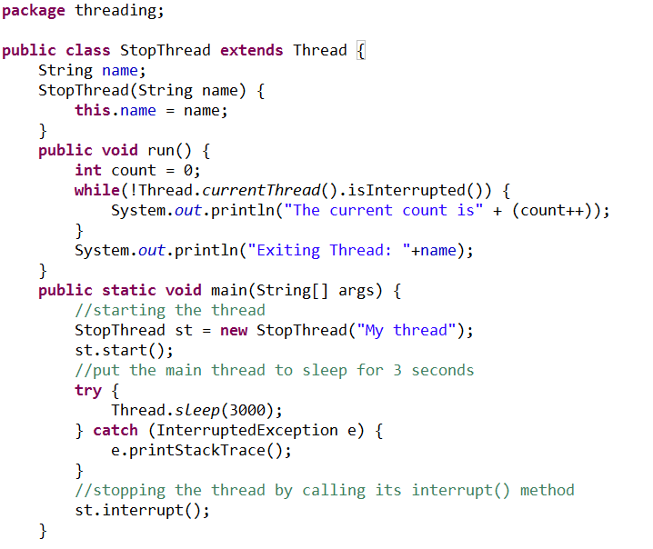
How to stop a Thread
Using Thread.interrupt() method:

Slide 193
Java Synchronization

Slide 194
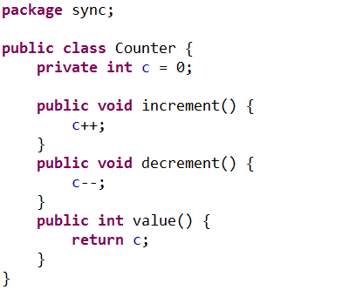
Thread Interference (1)
Increment operation is translated to multiple steps by the virtual machine :
Retrieve the current value of c.
Increment the retrieved value by 1.
Store the incremented value back in c.

Slide 195
Thread Interference (2)
Assume we have 2 threads, A and B.
A increments c, and B decrements c.
Thread A and B runs together.
One possible order of the low-level steps:
Thread A: Retrieve c.
Thread B: Retrieve c.
Thread A: Increment retrieved value; result is 1.
Thread B: Decrement retrieved value; result is -1.
Thread A: Store result in c; c is now 1.
Thread B: Store result in c; c is now -1.
Is the result correct?
What if the thread A and B are bank transactions?

Slide 196
Problem Root Cause
Threads are visiting one field (resource) at the same time.
Multiple steps of an operation
No enforced “happen-before” relationship

Slide 197
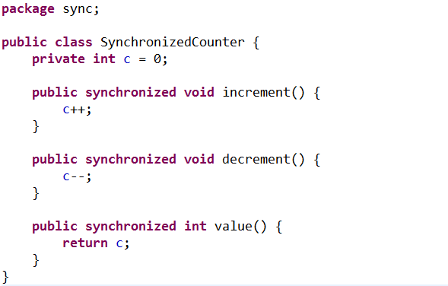
Solution: synchronized method
Example: http://docs.oracle.com/javase/tutorial/essential/concurrency/syncmeth.html

Slide 198
synchronized method
Enforce the ‘happen-before’ relationship in the method level.
Either one of the below instance will happen. But result is always 0, which is correct.
Thread A: Retrieve c.
Thread A: Increment retrieved value; result is 1.
Thread A: Store result in c; c is now 1.
Thread B: Retrieve c.
Thread B: Decrement retrieved value; result is 0.
Thread B: Store result in c; c is now 0.
Thread B: Retrieve c.
Thread B: Decrement retrieved value; result is -1.
Thread B: Store result in c; c is now -1.
Thread A: Retrieve c.
Thread A: Increment retrieved value; result is 0.
Thread A: Store result in c; c is now 0.
OR

Slide 199
synchronized statements (1)
Every object has an intrinsic lock associated with it
Primitive types (e.g., int, char) do not have intrinsic locks.
We can combine object intrinsic locks and synchronized keyword to create fine-grained synchronization control.

Slide 200
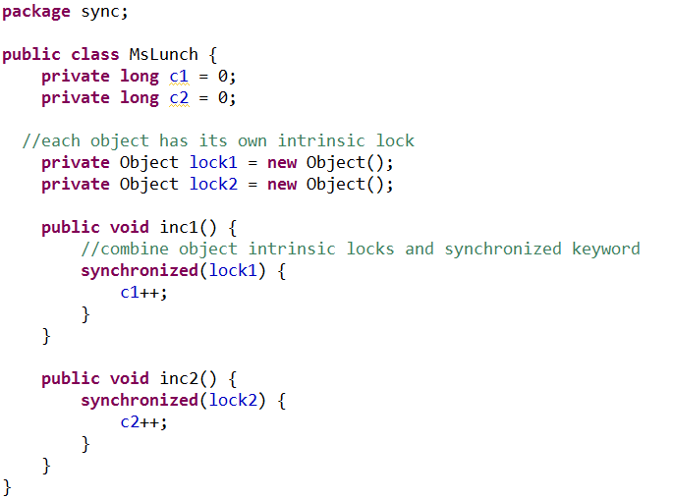
synchronized statements (2)
http://docs.oracle.com/javase/tutorial/essential/concurrency/locksync.html

Slide 201
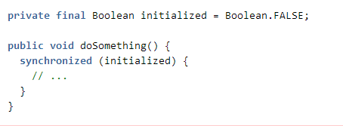
synchronized statement hazards (1)
Boolean has only two instances of Boolean
If another thread also synchronizes on the same Boolean instance, like this:
private final Boolean someLock = Boolean.FALSE;
The lock will be reused.
The system might be deadlock or unresponsive.
It is hard to detect this type of bugs!
More examples:
https://www.securecoding.cert.org/confluence/display/java/LCK01-J.+Do+not+synchronize+on+objects+that+may+be+reused

Slide 202
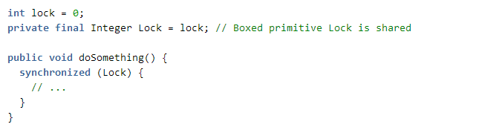
synchronized statement hazards (2)
Another example of the wrong way of using locks:
What will happen another thread also synchronizes on an integer instance with the 0 integer value?
https://www.securecoding.cert.org/confluence/display/java/LCK01-J.+Do+not+synchronize+on+objects+that+may+be+reused

Slide 203
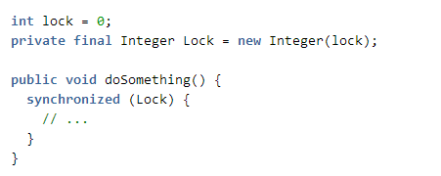
synchronized statement hazards (3)
Correct way of using locks: using new to instantiate an object
https://www.securecoding.cert.org/confluence/display/java/LCK01-J.+Do+not+synchronize+on+objects+that+may+be+reused

Slide 204
IO - Introduction
Definition
Stream is a flow of data
characters read from a file
bytes written to the network
…
Philosophy
All streams in the world are basically the same.
Streams can be divided (as the name “IO” suggests) to Input and Output streams.
Implementation
Incoming flow of data (characters) implements “Reader” (InputStream for bytes)
Outgoing flow of data (characters) implements “Writer” (OutputStream for bytes –eg. Images, sounds etc.)

Slide 205
Input/Output using Streams
An InputStream is a sequence of characters representing program input data
An OutputStream is a sequence of characters representing program output
The console keyboard stream is System.in
The console window is associated with System.out

Slide 206
Opening and Using Files: Reading Input
import java.io.*;
public static void main (String[] args) {
// open an input stream (**exceptions!)
BufferedReader rdr =
new BufferedReader(
new FileReader(args[0]));
// read a line of input
String line = rdr.readLine();
// see if at end of file
if (line == null) { ... }

Slide 207
Opening and Using Files: Reading Input (2)
// using input with StringTokenizer
StringTokenizer sTok =
new StringTokenizer (line);
while (sTok.hasMoreElements()) {
String token = sTok.nextToken();
...;
}
// when done, always close a stream/reader
rdr.close();

Slide 208
Alternate Ways to Split a String
Use the split method of String:
String[] = s.split(“\\s”);
// see class Pattern in java.util.regex
Use a StreamTokenizer (in java.io)

Slide 209
Opening and Using Files: Writing Output
// open a print stream (**exceptions!)
PrintStream ps = new PrintStream(args[0]);
// ways to write output
ps.print(“Hello”); // a string
ps.print(i+3); // an integer
ps.println(“ and goodbye.”); // with NL
ps.printf(“%2d %12d%n”, i, 1<<i); // like C
ps.format(“%2d %12d%n”, i, 1<<i); // same
// closing output streams is very important!
ps.close();

Slide 210

Debugging
203

Slide 211
Debugging Java in Eclipse (1)
Debugging means “run a program interactively while watching the source code and the variables during the execution.” [5]
Set breakpoints to stop the program at the middle of execution
Eclipse has a Debug Mode

Slide 212
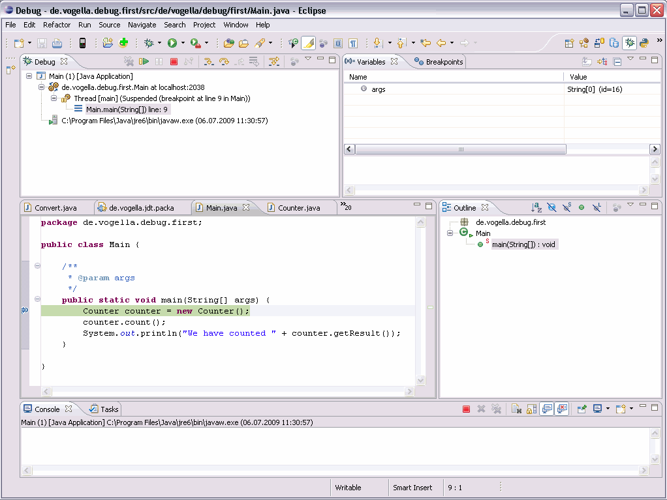
Debugging Java in Eclipse(2)
Image courtesy: http://www.vogella.com/tutorials/EclipseDebugging/images/xdebugstart20.gif.pagespeed.ic.SqCELlNeCm.png

Slide 213

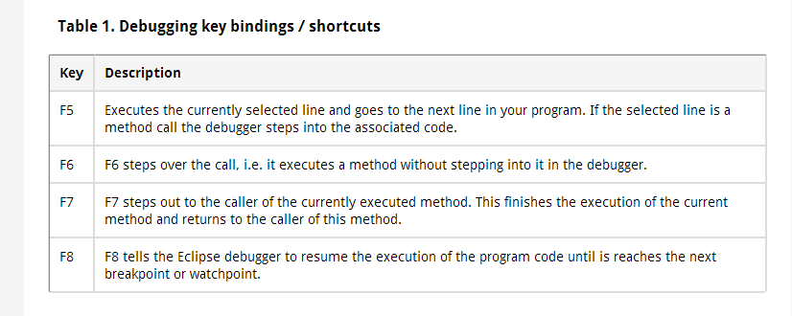
Debugging Java in Eclipse(3)
Table courtesy: http://www.vogella.com/tutorials/EclipseDebugging/article.html

Slide 214
Java latest features(Java 7,8, 9)

Slide 215
Java Lambda expressions
Lambda Expressions provides a concise way to represent one method interface using an expression. It helps to iterate, filter and extract data from collection.
The Lambda expression is used to provide the implementation of an interface which has functional interface. It saves a lot of code. In case of lambda expression, we don't need to define the method again for providing the implementation. Here, we just write the implementation code.

Slide 216
Java Lambda expressions - Example
Functional Interface
Lambda expression provides implementation of functional interface. An interface which has only one abstract method is called functional interface. Java provides an anotation @FunctionalInterface, which is used to declare an interface as functional interface.
Java Lambda Expression Syntax
(argument-list) -> {body}
Example:
@FunctionalInterface //It is optional
interface Drawable{
public void draw();
}
public class LambdaExpressionExample2 {
public static void main(String[] args) {
int width=10;
//with lambda
Drawable d2=()->{
System.out.println("Drawing "+width);
};
d2.draw();
}
}

Slide 217
Functional Interfaces
An Interface that contains exactly one abstract method is known as functional interface. It can have any number of default, static methods but can contain only one abstract method. It can also declare methods of object class.
A functional interface can extends another interface only when it does not have any abstract method.
Example:
interface sayable{
void say(String msg); // abstract method
}
@FunctionalInterface
interface Doable extends sayable{
// Invalid '@FunctionalInterface' annotation; Doable is not a functional interface
void doIt();
}

Slide 218
Stream API
We can use stream to filter, collect, print, and convert from one data structure to other etc. Stream does not store elements. It simply conveys elements from a source such as a data structure, an array, or an I/O channel, through a pipeline of computational operations.
Operations performed on a stream does not modify it's source. For example, filtering a Stream obtained from a collection produces a new Stream without the filtered elements, rather than removing elements from the source collection. We can use stream by importing java.util.stream package
In the following examples, we have apply various operations with the help of stream.
import java.util.*;
import java.util.stream.Collectors;
class Product{
int id;
String name;
float price;
public Product(int id, String name, float price) {
this.id = id;
this.name = name;
this.price = price;
}
}

Slide 219
Streams API – cont..
public class JavaStreamExample {
public static void main(String[] args) {
List<Product> productsList = new ArrayList<Product>();
//Adding Products
productsList.add(new Product(1,"HP Laptop",25000f));
productsList.add(new Product(2,"Dell Laptop",30000f));
productsList.add(new Product(3,"Lenevo Laptop",28000f));
productsList.add(new Product(4,"Sony Laptop",28000f));
productsList.add(new Product(5,"Apple Laptop",90000f));
List<Float> productPriceList2 =productsList.stream()
.filter(p -> p.price > 30000)// filtering data
.map(p->p.price) // fetching price
.collect(Collectors.toList()); // collecting as list
System.out.println(productPriceList2);
}
}

Slide 220
Streams API- cont..
In the following example, we are using filter() method. Here, you can see code is optimized and very concise.
import java.util.*;
class Product{
int id;
String name;
float price;
public Product(int id, String name, float price) {
this.id = id;
this.name = name;
this.price = price;
}
}
public class JavaStreamExample {
public static void main(String[] args) {
List<Product> productsList = new ArrayList<Product>();
//Adding Products
productsList.add(new Product(1,"HP Laptop",25000f));
productsList.add(new Product(2,"Dell Laptop",30000f));
productsList.add(new Product(3,"Lenevo Laptop",28000f));
productsList.add(new Product(4,"Sony Laptop",28000f));
productsList.add(new Product(5,"Apple Laptop",90000f));
// This is more compact approach for filtering data
productsList.stream()
.filter(product -> product.price == 30000)
.forEach(product -> System.out.println(product.name));
}
}

Slide 221
Java Default Methods
Java provides a facility to create default methods inside the interface. Methods which are defined inside the interface and tagged with default are known as default methods. These methods are non-abstract methods.
Java Default Method Example:
interface Sayable{
// Default method
default void say(){
System.out.println("Hello, this is default method");
}
// Abstract method
void sayMore(String msg);
}
public class DefaultMethods implements Sayable{
public void sayMore(String msg){ // implementing abstract method
System.out.println(msg);
}
public static void main(String[] args) {
DefaultMethods dm = new DefaultMethods();
dm.say(); // calling default method
dm.sayMore("Work is worship"); // calling abstract method
}
}

Slide 222
Java ForEach Loo
Java provides a new method forEach() to iterate the elements. It is defined in Iterable and Stream interface. It is a default method defined in the Iterable interface. Collection classes which extends Iterable interface can use forEach loop to iterate elements.
This method takes a single parameter which is a functional interface. So, you can pass lambda expression as an argument.
Example:
List<String> gamesList = new ArrayList<String>();
gamesList.add("Football");
gamesList.add("Cricket");
gamesList.add("Chess");
gamesList.add("Hocky");
System.out.println("------------Iterating by passing lambda expression--------------"); gamesList.forEach(games -> System.out.println(games));

Slide 223
Java StringJoiner
Java added a new final class StringJoiner in java.util package. It is used to construct a sequence of characters separated by a delimiter. Now, you can create string by passing delimiters like comma(,), hyphen(-) etc. You can also pass prefix and suffix to the char sequence.
Example:
StringJoiner joinNames = new StringJoiner(","); // passing comma(,) as delimiter
// Adding values to StringJoiner
joinNames.add("Rahul");
joinNames.add("Raju");
joinNames.add("Peter");
joinNames.add("Raheem");
System.out.println(joinNames);
Output:
Rahul,Raju,Peter,Raheem

Slide 224
Base64 Encode and Decode
Java provides a class Base64 to deal with encryption. You can encrypt and decrypt your data by using provided methods. You need to import java.util.Base64 in your source file to use its methods.
Basic Encoding and Decoding:
It uses the Base64 alphabet specified by Java in RFC 4648 and RFC 2045 for encoding and decoding operations. The encoder does not add any line separator character. The decoder rejects data that contains characters outside the base64 alphabet.
// Getting encoder
Base64.Encoder encoder = Base64.getUrlEncoder();

Slide 225
Java Collectors
Collectors is a final class that extends Object class. It provides reduction operations, such as accumulating elements into collections, summarizing elements according to various criteria, etc
Example:
List<Float> productPriceList = productsList.stream()
.map(x->x.price) // fetching price
.collect(Collectors.toList()); // collecting as list
System.out.println(productPriceList);

Slide 226
Java 9 Private Interface Methods
We can create private methods inside an interface. Interface allows us to declare private methods that help to share common code between non-abstract methods.
Before Java 9, creating private methods inside an interface cause a compile time error.
Example:
interface Sayable{
default void say() {
saySomething();
}
// Private method inside interface
private void saySomething() {
System.out.println("Hello... I'm private method");
}
}

Slide 227
Java 9 Factory methods
Java 9 Collection library includes static factory methods for List, Set and Map interface. These methods are useful to create small number of collection.
Example for List:
List<String> list = List.of("Java","JavaFX","Spring","Hibernate","JSP");
for(String l:list) {
System.out.println(l);
}
Example for Map:
Map<Integer,String> map = Map.of(101,"JavaFX",102,"Hibernate",103,"Spring MVC");
for(Map.Entry<Integer, String> m : map.entrySet()){
System.out.println(m.getKey()+" "+m.getValue());
}

Slide 228
Java 9 Underscore
In earlier versions of Java, underscore can be used as identifier and to create variable name also. But in Java 9 release, underscore is a keyword and can't be used as an identifier or variable name.
If we use the underscore character ("_") as an identifier, our source code can no longer be compiled.

Slide 229
Catch Multiple Exceptions
Java allows you to catch multiple type exceptions in a single catch block. It was introduced in Java 7 and helps to optimize code.
You can use vertical bar (|) to separate multiple exceptions in catch block.
catch(Exception | ArithmeticException | ArrayIndexOutOfBoundsException e)

Slide 230
Type Inference
In Java 7, Java provides improved compiler which is enough smart to infer the type of generic instance. Now, you can replace the type arguments with an empty set of type parameters (<>). This pair of angle brackets is informally called the diamond.
The following approach is used in Java 6 and prior version.
List<Integer> list = new List<Integer>();
Now, you can use the following new approach introduced in Java 7.
List<Integer> list = new List<>(); // Here, we just used diamond

Slide 231

Exception Handling
224

Slide 232
Errors
Syntax errors arise because the rules of the language have not been followed. They are detected by the compiler.
Runtime errors occur while the program is running if the environment detects an operation that is impossible to carry out.
Logic errors occur when a program doesn't perform the way it was intended to.

Slide 233
Runtime Errors

Slide 234
Catch Runtime Errors

Slide 235
Exception Classes

Slide 236
System Errors
System errors are thrown by JVM and represented in the Error class. The Error class describes internal system errors. Such errors rarely occur. If one does, there is little you can do beyond notifying the user and trying to terminate the program gracefully.

Slide 237
Exceptions
Exception describes errors caused by your program and external circumstances. These errors can be caught and handled by your program.

Slide 238
Runtime Exceptions
RuntimeException is caused by programming errors, such as bad casting, accessing an out-of-bounds array, and numeric errors.

Slide 239
Checked Exceptions vs. Unchecked Exceptions
RuntimeException, Error and their subclasses are known as unchecked exceptions. All other exceptions are known as checked exceptions, meaning that the compiler forces the programmer to check and deal with the exceptions.

Slide 240
Unchecked Exceptions
In most cases, unchecked exceptions reflect programming logic errors that are not recoverable. For example, a NullPointerException is thrown if you access an object through a reference variable before an object is assigned to it; an IndexOutOfBoundsException is thrown if you access an element in an array outside the bounds of the array. These are the logic errors that should be corrected in the program. Unchecked exceptions can occur anywhere in the program. To avoid cumbersome overuse of try-catch blocks, Java does not mandate you to write code to catch unchecked exceptions.

Slide 241
Checked or Unchecked Exceptions

Slide 242
Declaring, Throwing, and Catching Exceptions

Slide 243
Declaring Exceptions
Every method must state the types of checked exceptions it might throw. This is known as declaring exceptions.
public void myMethod()
throws IOException
public void myMethod()
throws IOException, OtherException

Slide 244
Throwing Exceptions
When the program detects an error, the program can create an instance of an appropriate exception type and throw it. This is known as throwing an exception. Here is an example,
throw new TheException();
TheException ex = new TheException(); throw ex;

Slide 245
Throwing Exceptions Example
/** Set a new radius */
public void setRadius(double newRadius)
throws IllegalArgumentException {
if (newRadius >= 0)
radius = newRadius;
else
throw new IllegalArgumentException(
"Radius cannot be negative");
}

Slide 246
Catching Exceptions
try {
statements; // Statements that may throw exceptions
}
catch (Exception1 exVar1) {
handler for exception1;
}
catch (Exception2 exVar2) {
handler for exception2;
}
...
catch (ExceptionN exVar3) {
handler for exceptionN;
}

Slide 247
Catching Exceptions

Slide 248
Catch or Declare Checked Exceptions
Java forces you to deal with checked exceptions. If a method declares a checked exception (i.e., an exception other than Error or RuntimeException), you must invoke it in a try-catch block or declare to throw the exception in the calling method. For example, suppose that method p1 invokes method p2 and p2 may throw a checked exception (e.g., IOException), you have to write the code as shown in (a) or (b).

Slide 249
Rethrowing Exceptions
try {
statements;
}
catch(TheException ex) {
perform operations before exits;
throw ex;
}

Slide 250
The finally Clause
try {
statements;
}
catch(TheException ex) {
handling ex;
}
finally {
finalStatements;
}

Slide 251
Cautions When Using Exceptions
Exception handling separates error-handling code from normal programming tasks, thus making programs easier to read and to modify. Be aware, however, that exception handling usually requires more time and resources because it requires instantiating a new exception object, rolling back the call stack, and propagating the errors to the calling methods.

Slide 252
When to Throw Exceptions
An exception occurs in a method. If you want the exception to be processed by its caller, you should create an exception object and throw it. If you can handle the exception in the method where it occurs, there is no need to throw it.

Slide 253
Suggested Materials for Reference
https://docs.oracle.com/javase/tutorial/

Slide 254
Closing - Questions
Campus Drive
Questions

