Slide 1
MEDIATOR

Slide 2
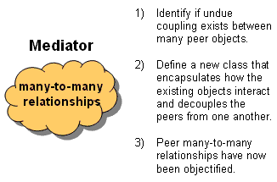
Definition
Mediator pattern is used to reduce communication complexity between multiple objects or classes.
This pattern provides a mediator class which normally handles all the communications between different classes and supports easy maintenance of the code by loose coupling.
Define an object that encapsulates how a set of objects interact. Mediator promotes loose coupling by keeping objects from referring to each other explicitly, and it lets you vary their interaction independently.
Design an intermediary to decouple many peers.
Promote the many-to-many relationships between interacting peers to "full object status".

Slide 3
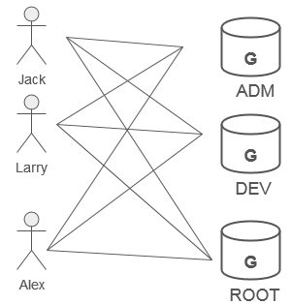
Discussion
Consider that 3 users are connected to 3 groups.
If we were to model this in software, we could decide to have User objects coupled to Group objects, and Group objects coupled to User objects.
Then when changes occur, both classes and all their instances would be affected.
An alternate approach would be to introduce "an additional level of indirection" - take the mapping of users to groups and groups to users, and make it an abstraction unto itself.
ADV: many mappings can easily be maintained and manipulated simultaneously

Slide 4
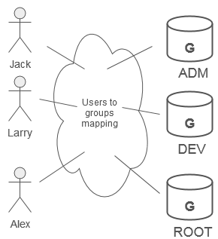
The mediator object:
encapsulates all interconnections, acts as the hub of communication
is responsible for controlling and coordinating the interactions of its clients
and promotes loose coupling by keeping objects from referring to each other explicitly.
The Mediator pattern promotes a "many-to-many relationship network" to "full object status".
Modelling the inter-relationships with an object enhances encapsulation, and allows the behavior of those inter-relationships to be modified or extended through subclassing.

Slide 5
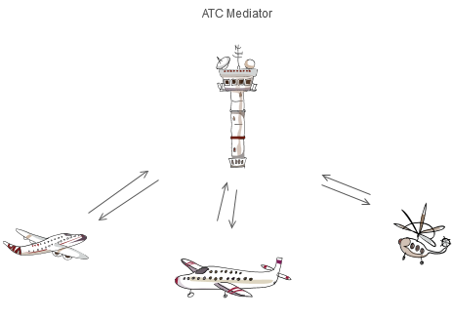
Example
The Mediator defines an object that controls how a set of objects interact.
Loose coupling between colleague objects is achieved by having colleagues communicate with the Mediator, rather than with each other.
The control tower at a controlled airport demonstrates this pattern very well.
The pilots of the planes approaching or departing the terminal area communicate with the tower rather than explicitly communicating with one another.
The constraints on who can take off or land are enforced by the tower.

Slide 6
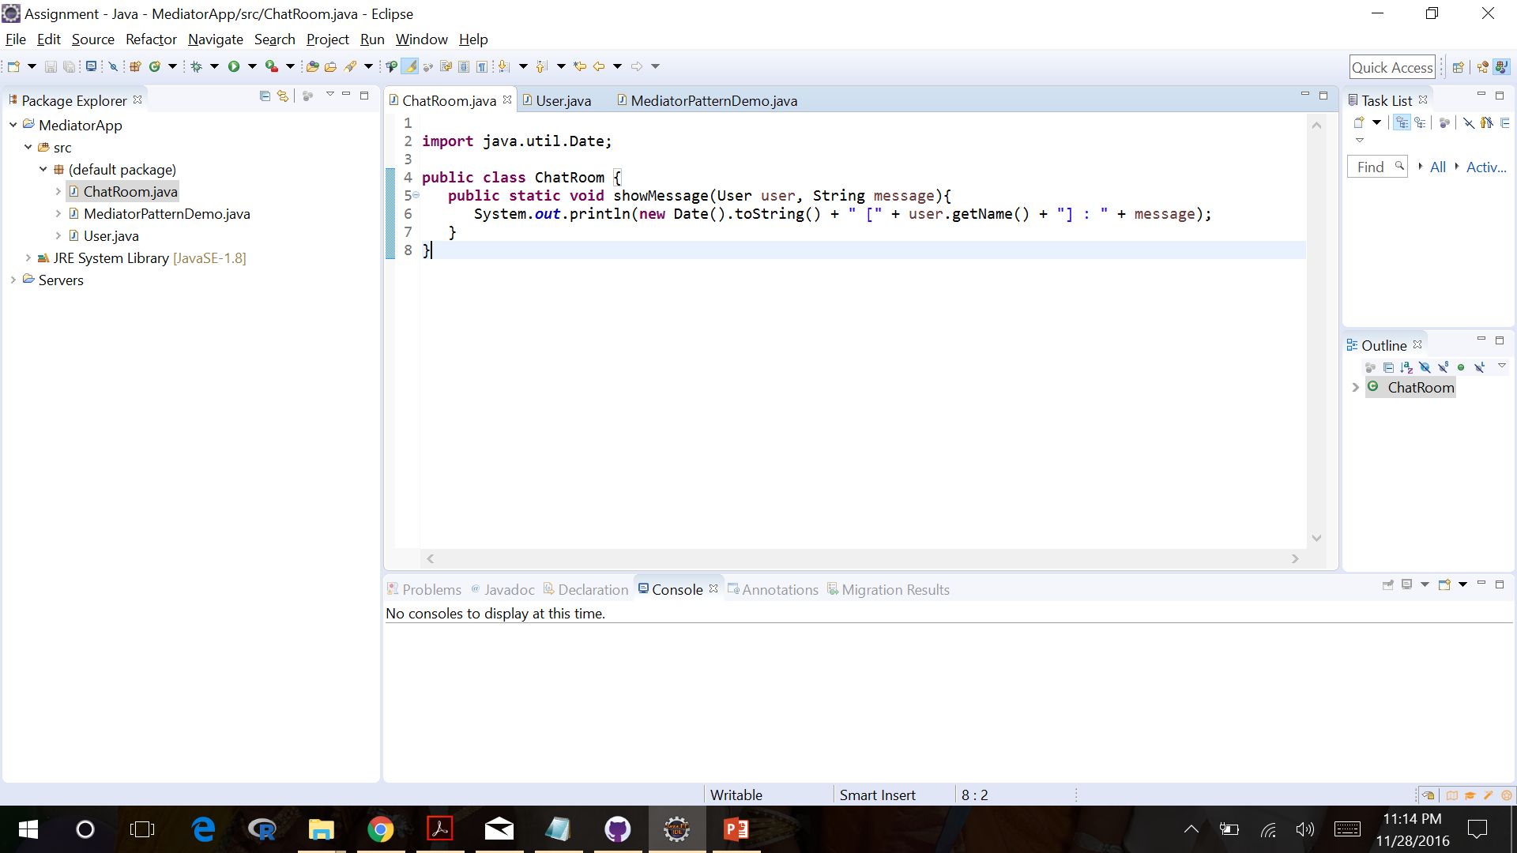
Example Code

Slide 7
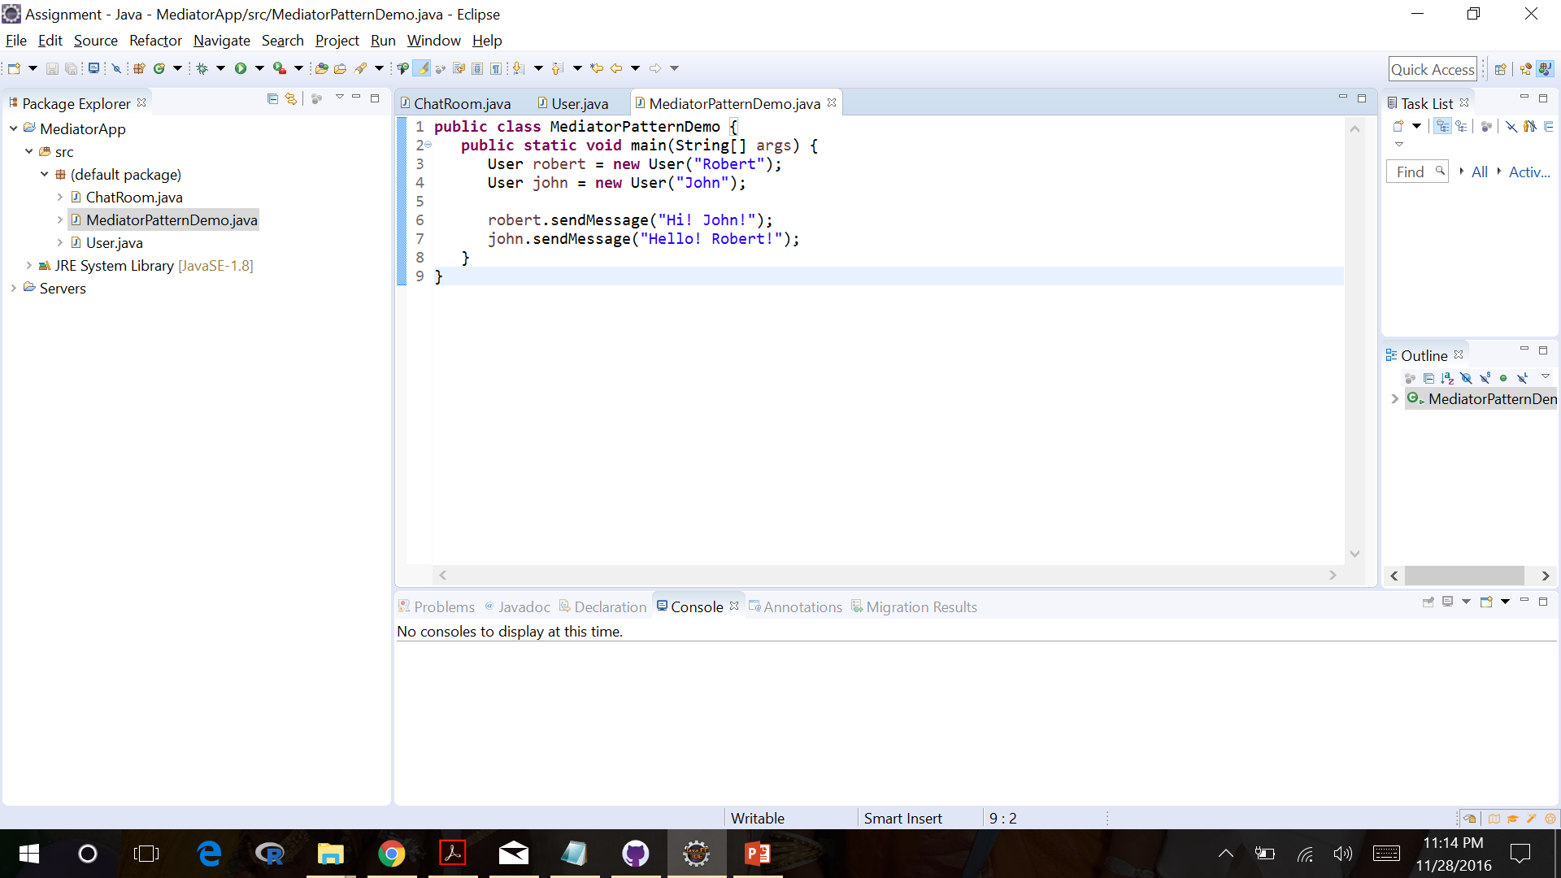

Slide 8
