Slide 1
INTELLIGENT TRANSPARENT SOFTWARE ECOSYSTEMS
Alekhya Polavarapu(43)
Sita ratna deepika lalam(24)
Avinash Penti(42)
Harsha Kumar raja Golla(15)

Slide 2
What does it mean?
These type of software ecosystems will support rapid development of innovative products, besides helping developers manage risk and issuing them early warnings of looming failures.

Slide 3
Contnd..
The combination of distributed version control and social-media features that create transparent environments, which adds transformative intelligent services. This idea is called as intelligent transparency.

Slide 4
Scenario: Big tax data
Imagine that in 2020 the IRS announces it will release an anonymized version of its tax return database.
Intelligent software assurance and monitoring(ISAM)
-- It applies analytics to the database and identifies the best candidate ensembles

Slide 5
Ongoing Vigilance
Another primary risk of reliance on open source components is that ensemble elements becomes incompatible as new versions comes.
ISAM provider issues notifications of suggested changes which allows a peek into projects future.

Slide 6
Enhancing Transparency with Analytics

Slide 7
Definition of transparency:
“accurate observability, of an organization’s low level activities, routines, behaviors, output, and performance.”
Transparent environments:
easily fork and manipulate code, examine all commits and comments.
ADV:
developers can easily find and monitor code.
DISADV:
transparency can present developers with overwhelming amounts of information.

Slide 8
Intelligently transparent environments
quality attributes of a component(like durability and responsiveness) – are not directly observable.
Signals – time consuming, laborious.
commit velocity,
Number of test cases
Intelligently transparent environments
enhances inference speed and accuracy
can quickly summarize the information developers want to see.

Slide 9
Intelligent Transparency
Help developers discover interesting changes.
Example: Tech Angels’ Gemnasium
help identify changes that encourage further actions
such as breaking interface changes or new useful features.
It notifies users of updates and security vulnerabilities in their dependencies
can take appropriate action without constantly monitoring changes.

Slide 10
Information Overload
Problem - notification clutter.
Approaches to filter important messages.
YooHoo
NeedFeed
YooHoo identifies those changes that break binary compatibility in library code—a mere 7 percent of all changes.
NeedFeed uses code ownership and past code changes to identify relevant changes.

Slide 11
Contd…
ISAM for developers and users can help them decide:
where to implement new functionality,
what projects and APIs to use,
how to avoid disrupting users, and
what activity in other repositories requires immediate attention.
These analyses will produce additional notifications and reports that ISAM can provide in the longer run.

Slide 12
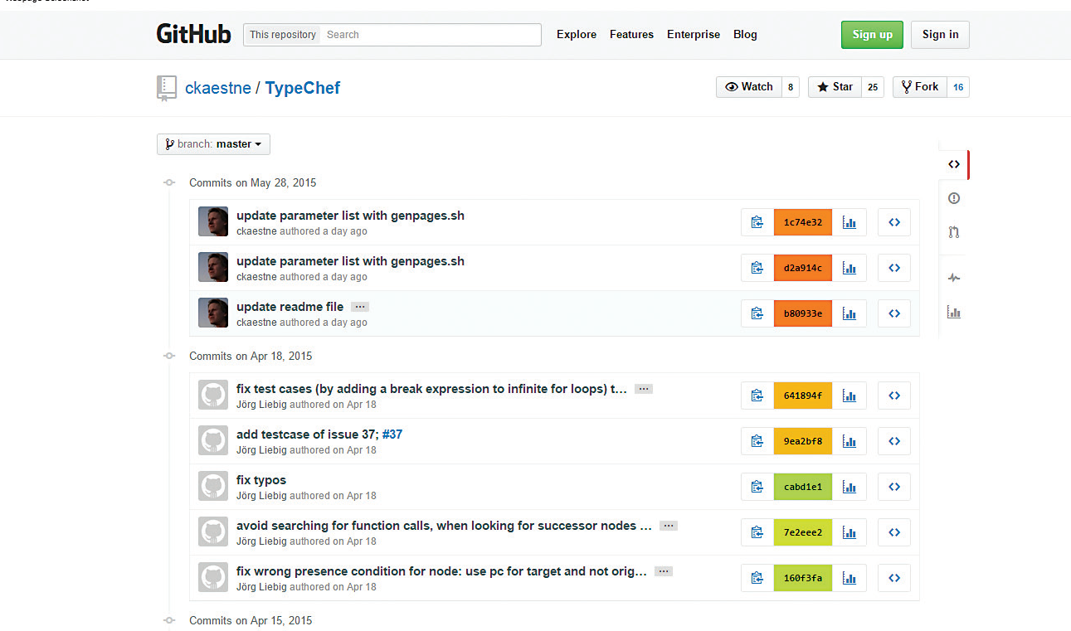

Slide 13
Analyzing Runtime Data to Provide Monitoring :
Color coding to highlight commits in a GitHub repository
Unpredictable failures and security threats.
If developers can observe that a component is widely used in diverse contexts and has become stable, they’ll regard it as trustworthy.

Slide 14
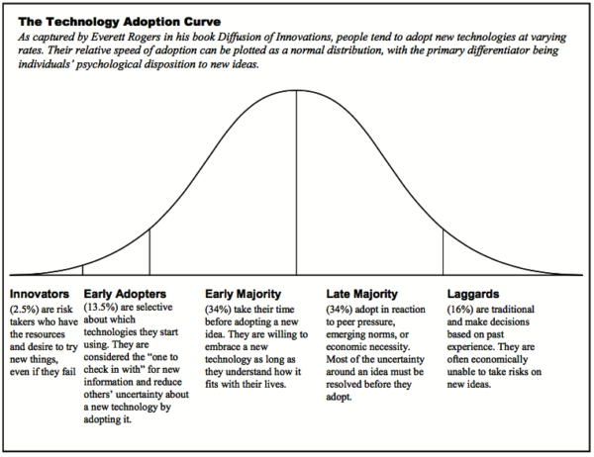
Adoption curve

Slide 15
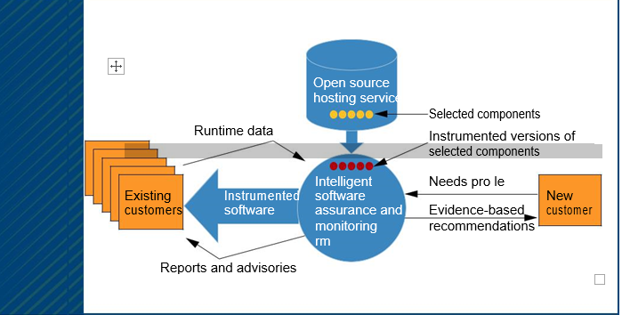
How ISAM works ?

Slide 16
ISAM providers will deliver evidence-based component recommendations.
These versions will send usage data back to the providers.
Using data supplied by existing customers, they’ll also issue a range of early warnings as customer applications and open source components evolve.

Slide 17
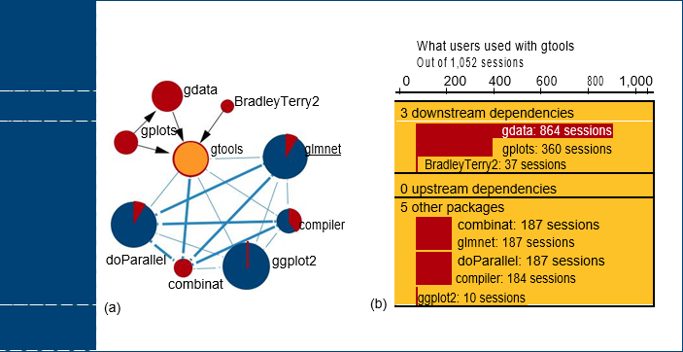
Visualizing run-time data :

Slide 18
Contd..
The graph view (see Figure 3a) shows which other packages the gtools package depends on (the solid lines)
Package dependencies and the frequency with which the packages are called in a set of runs.
Runtime data poses potential privacy issues, but they might well be surmountable.

Slide 19
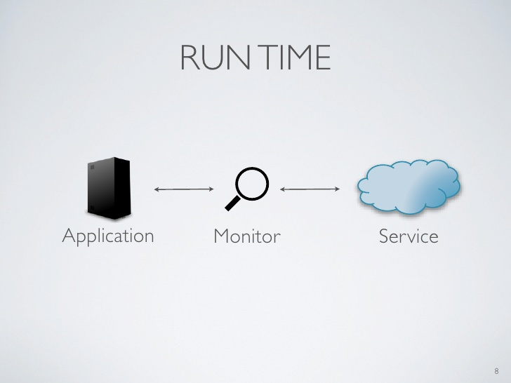
RUNTIME MONITORING
ISAM customers agree to use instrumented software versions and provide their runtime data and test results

Slide 20
What ISAM Does?
ISAM providers will develop proprietary algorithms
Make custom assessment reports
Reports Updated Frequently
Customers will benefit from these reports
ISAM makes the basic data public so that it benefits the overall ecosystem

Slide 21
Advantages and Disadvantages
Open software ecosystems have rich source of libraries, frameworks, and code
But require time and effort to evaluate
Make the user dependent on someone else’s code making it uncertain.
ISAM providers will support well-informed choices
ISAM issues timely warnings
Thus software quality will improve and the development becomes
Predictable
Cheaper
Faster

Slide 22


Slide 23


