Slide 1
PB PROJECT
BHAVESH VEERAMACHANENI
ALEKHYA POLAVARAPU
MONICA NADAKUDITI
YAMINI

Slide 2
Downloaded the tweets
Extract the needed data from tweets downloaded(filtering)
Store the filtered output data in HDFS
Run the word count program on the filtered output.

Slide 3
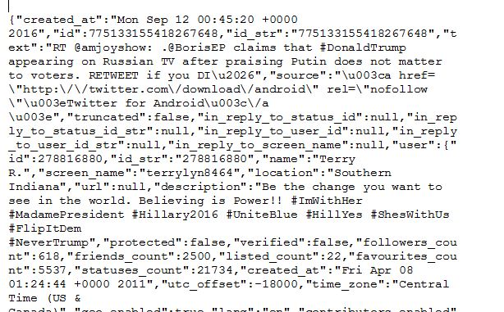
DOWNLOADING TWEETS
First we need to have twitter developer account to download the tweets.
After downloading the tweets, have access to certain tokens and insert them in the “tweetsfromtwitter.py” program and run it.
This produces the output in the terminal which we can copy into a text document. The output will be in the JSON format.

Slide 4
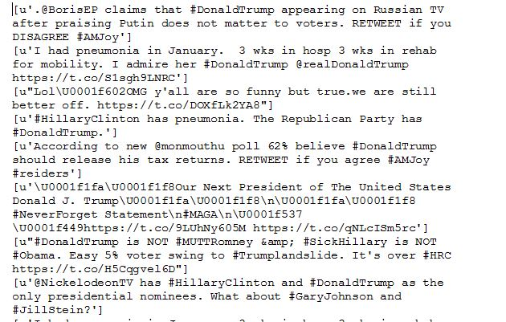
FILTERING THE DATA
After downloading the twitter data, now we need to extract the required data that is to be processed.
We write a program “tweetsfilterprgm.py” program to extract the required data.
This creates the output in the given “.txt” file.
Here we extracted tweets, tweet-id, hashtag, etc.
Sample for the filtered data.

Slide 5
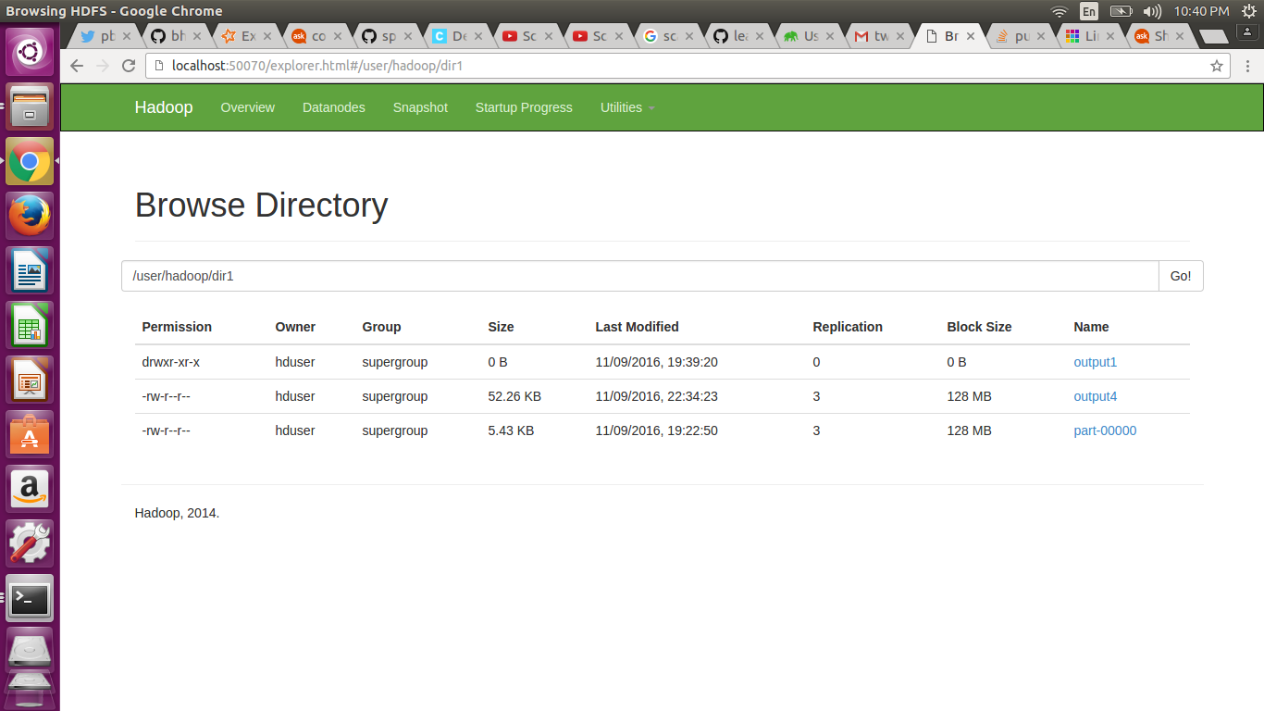
STORING IN HDFS AND PROGRAM RUNNING
After having the required data, we need to move the data into hdfs to process the data.
The command for moving the data
“hadoop fs -put “input-path” “output-path” ”
Now we run the wordcount program on the given data using mapreduce environment.
The ouput cannot be seen in the filebrowser but can be seen through the interface provided by the Hadoop.

Slide 6
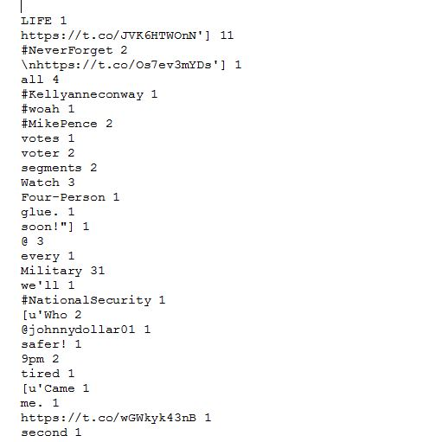
Sample output

Slide 7
DATA FRAMES
This query returns user name and location whose friends count is greater than 100.
“val s1 = sqlContext.sql("SELECT user.name as name, user.location as loc from tweetsdata where user.friends_count > 100")”
The second data frame query is used for join query. Here, it searches for the tags in hash_tag.json file and matches with the tags in the twitter_data file and produce a join table.
“select hash1.tag,count(tweetsdata.text) as count from tweetsdata join hash1 on tweetsdata.text like concat ('%',hash1.tag,'%') group by hash1.tag order by count desc limit 10”

Slide 8
RDD’s
Here, using RDD we count the number of tweets posted on Donald trump and Hilary Clinton.
“val dt=datafile.filter(text => text.contains("#DonaldTrump")).count()”
“val hc=datafile.filter(text => text.contains("#HillaryClinton")).count()”
Here in second RDD query, we retrieve the count of the number of people who tweeted using twitter website and also count of the number of people who posted using twitter mobile application.
“val tw=datafile.filter(text => text.contains("twitter.com")).count()” “val tm=datafile.filter(text => text.contains("mobile.twitter.com")).count()”
PUBLIC API:
using public API we returned 20 most recent tweets favourited by the user.
“val statuses = twitter.getFavourites()”

Slide 9
WEB USER INTERFACE
Built a user interface that enables the user to select one of your five queries and displays the results for the selected query in their corresponding visualization like Google maps, bar chart, pie chart, line graph and table format.
Also, it is a fully automated interaction.
Languages used: html, css , javascript, Sql
Software used: intellji, Webstrom, scala, hadoop

Slide 10
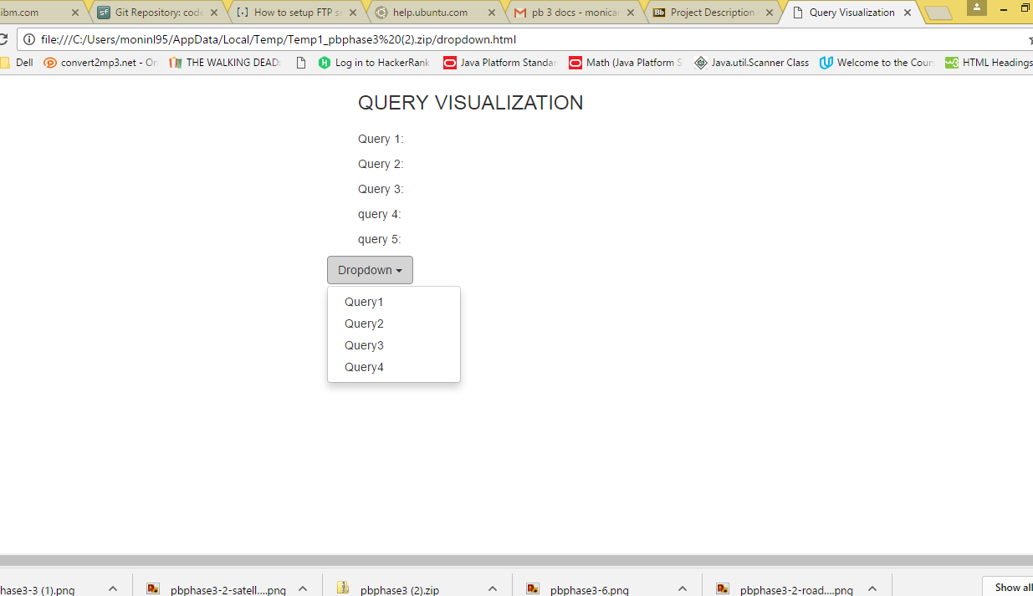
This is the home page of the user interface that enables the user to select queries from the dropdown box. By selecting the particular query, it navigates to its corresponding page.

Slide 11
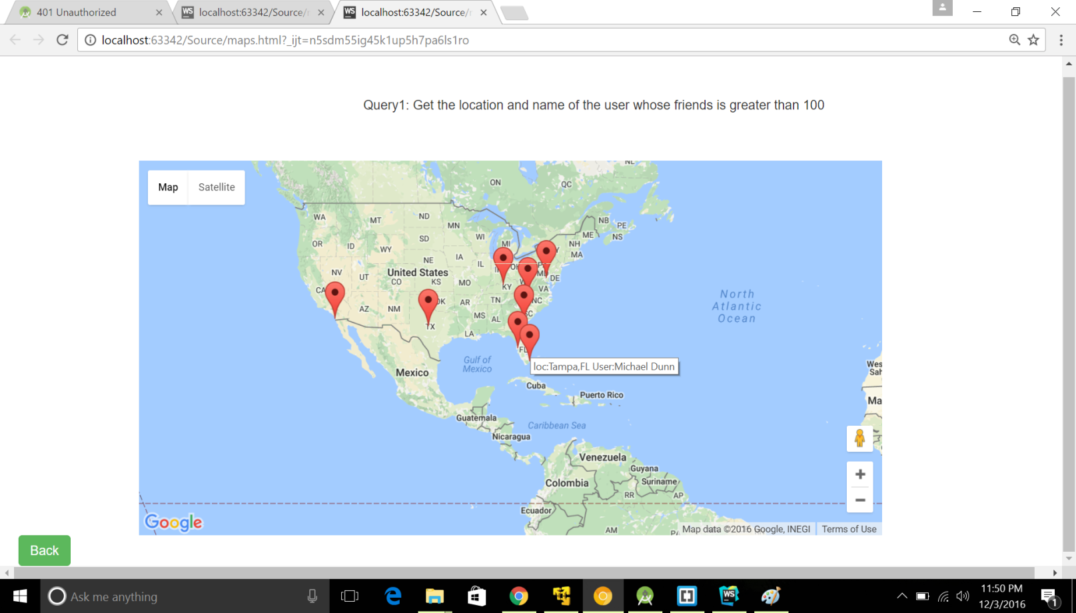
Query 1:We used Google maps API to display the location and name of the user who has friends more than 100 in two different views- Map and Satellite view.

Slide 12
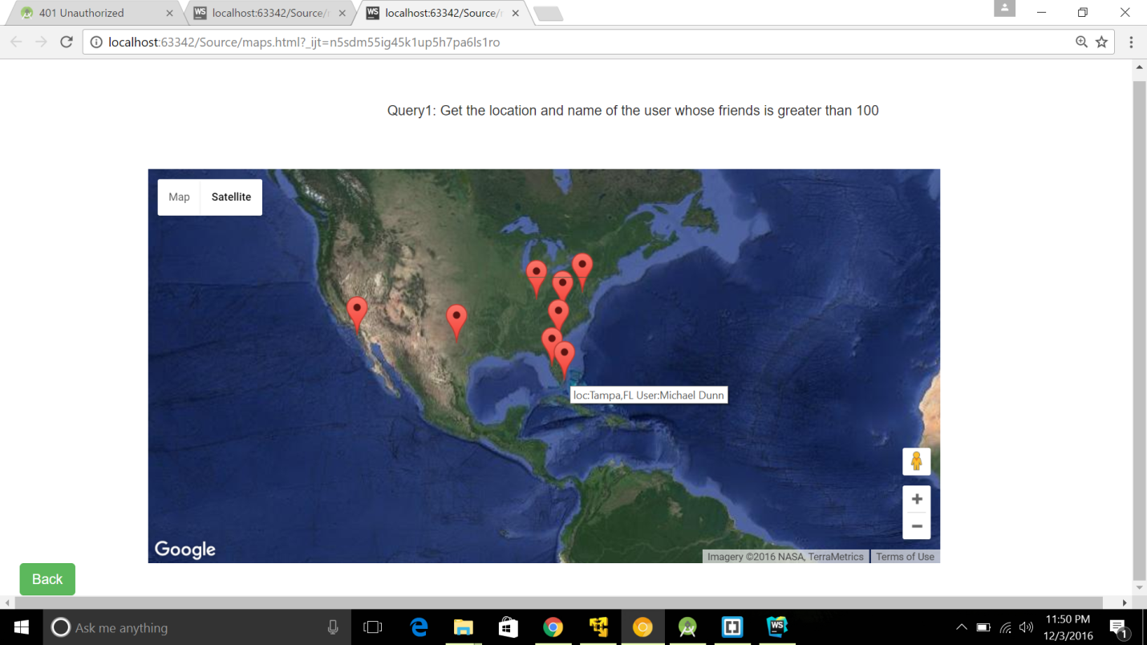

Slide 13
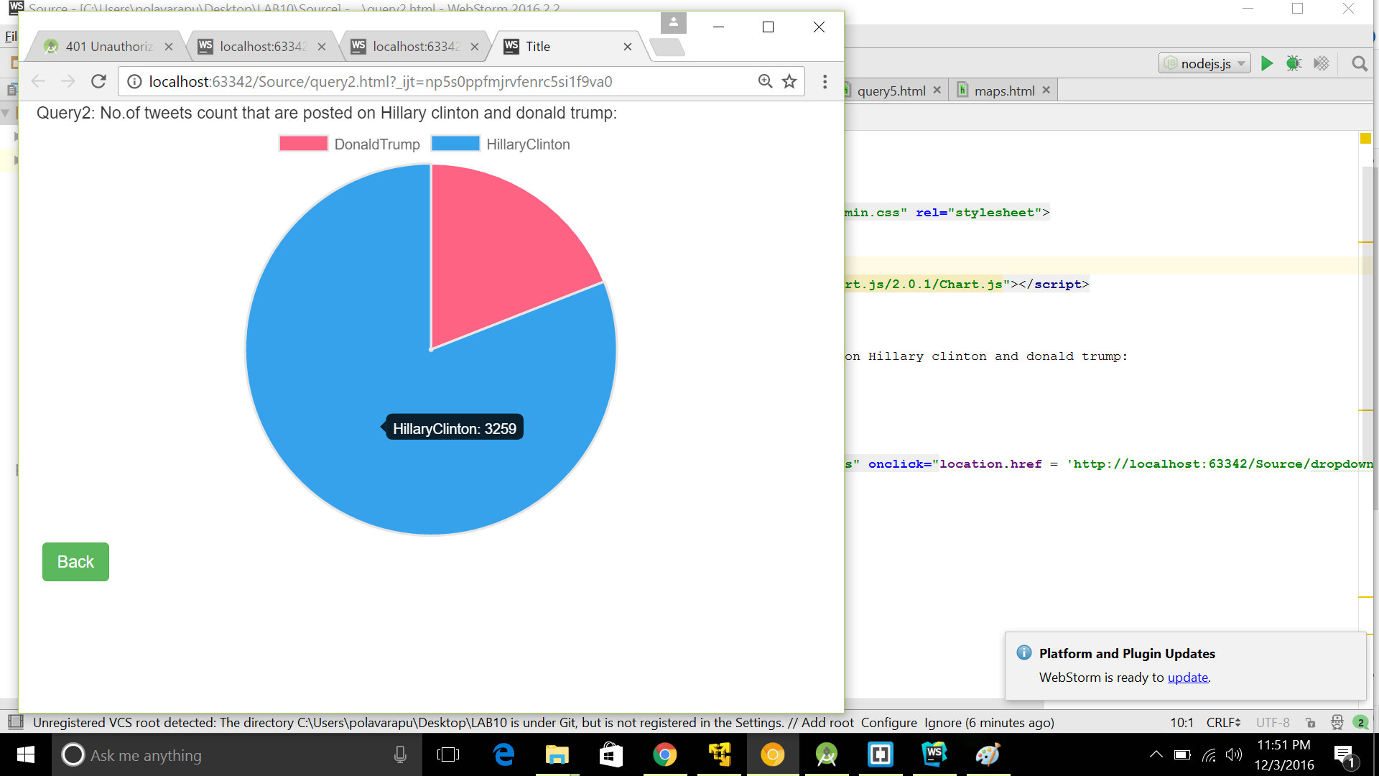
Query2: This query uses pie chart visualization to count the number of tweets posted on both Hillary Clinton and Donald Trump.

Slide 14
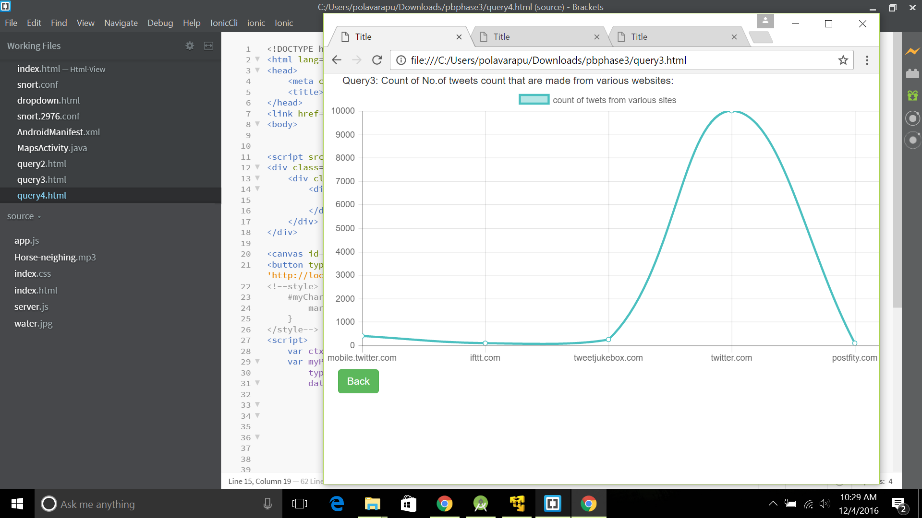
Query 3: This query displays the count of number of tweets that are made from various websites using line graph representation.

Slide 15
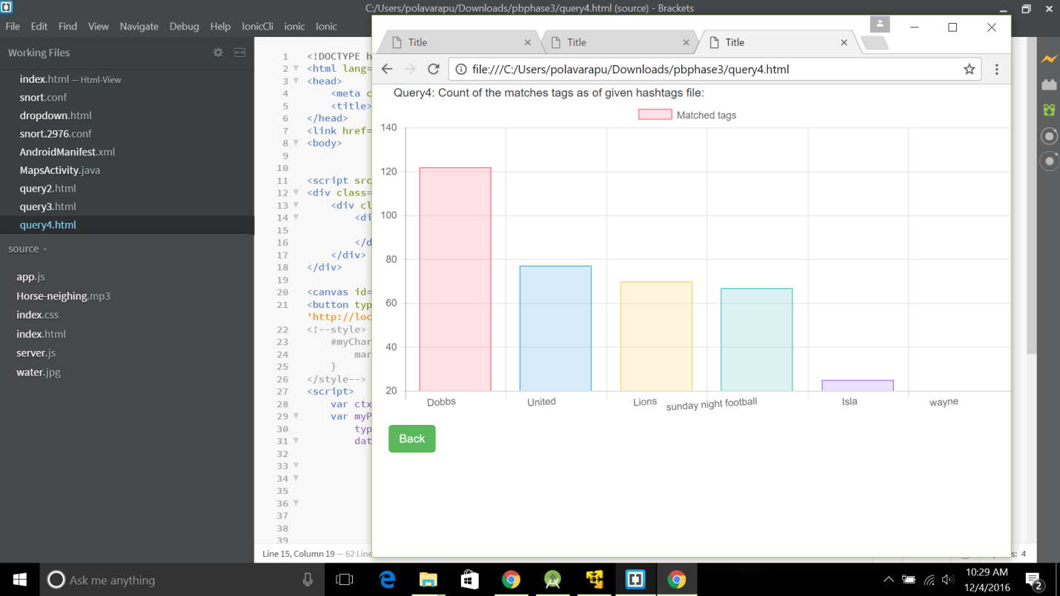
Query 4: This query displays the count of the matched tags corresponding to the given hashtags file using bar graph representation.

Slide 16
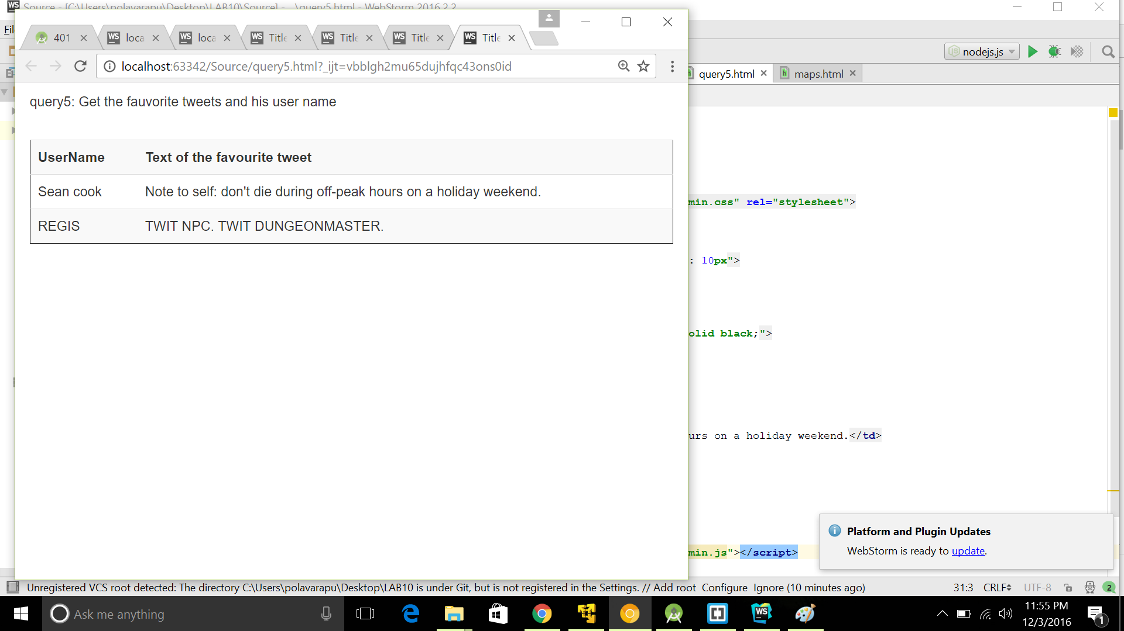
Query 5: This query displays the favorite tweets and corresponding user name using non graphical visualization.

