Slide 1
Analysis of twitter data-Donald Trump
BHAVESH VEERAMACHANENI
Alekhya PolavaRAPU
MONICA NADAKUDITI
YAMINI NUVVULA

Slide 2
Introduction
Collected the twitter data from twitter API using python language
Analyzation is performed on the collected data using scala-plugins and loading spark libraries in Intellij Idea IDE
Implemented the visualization of the analyzed data in Html , javascript and chart.js cdn

Slide 3
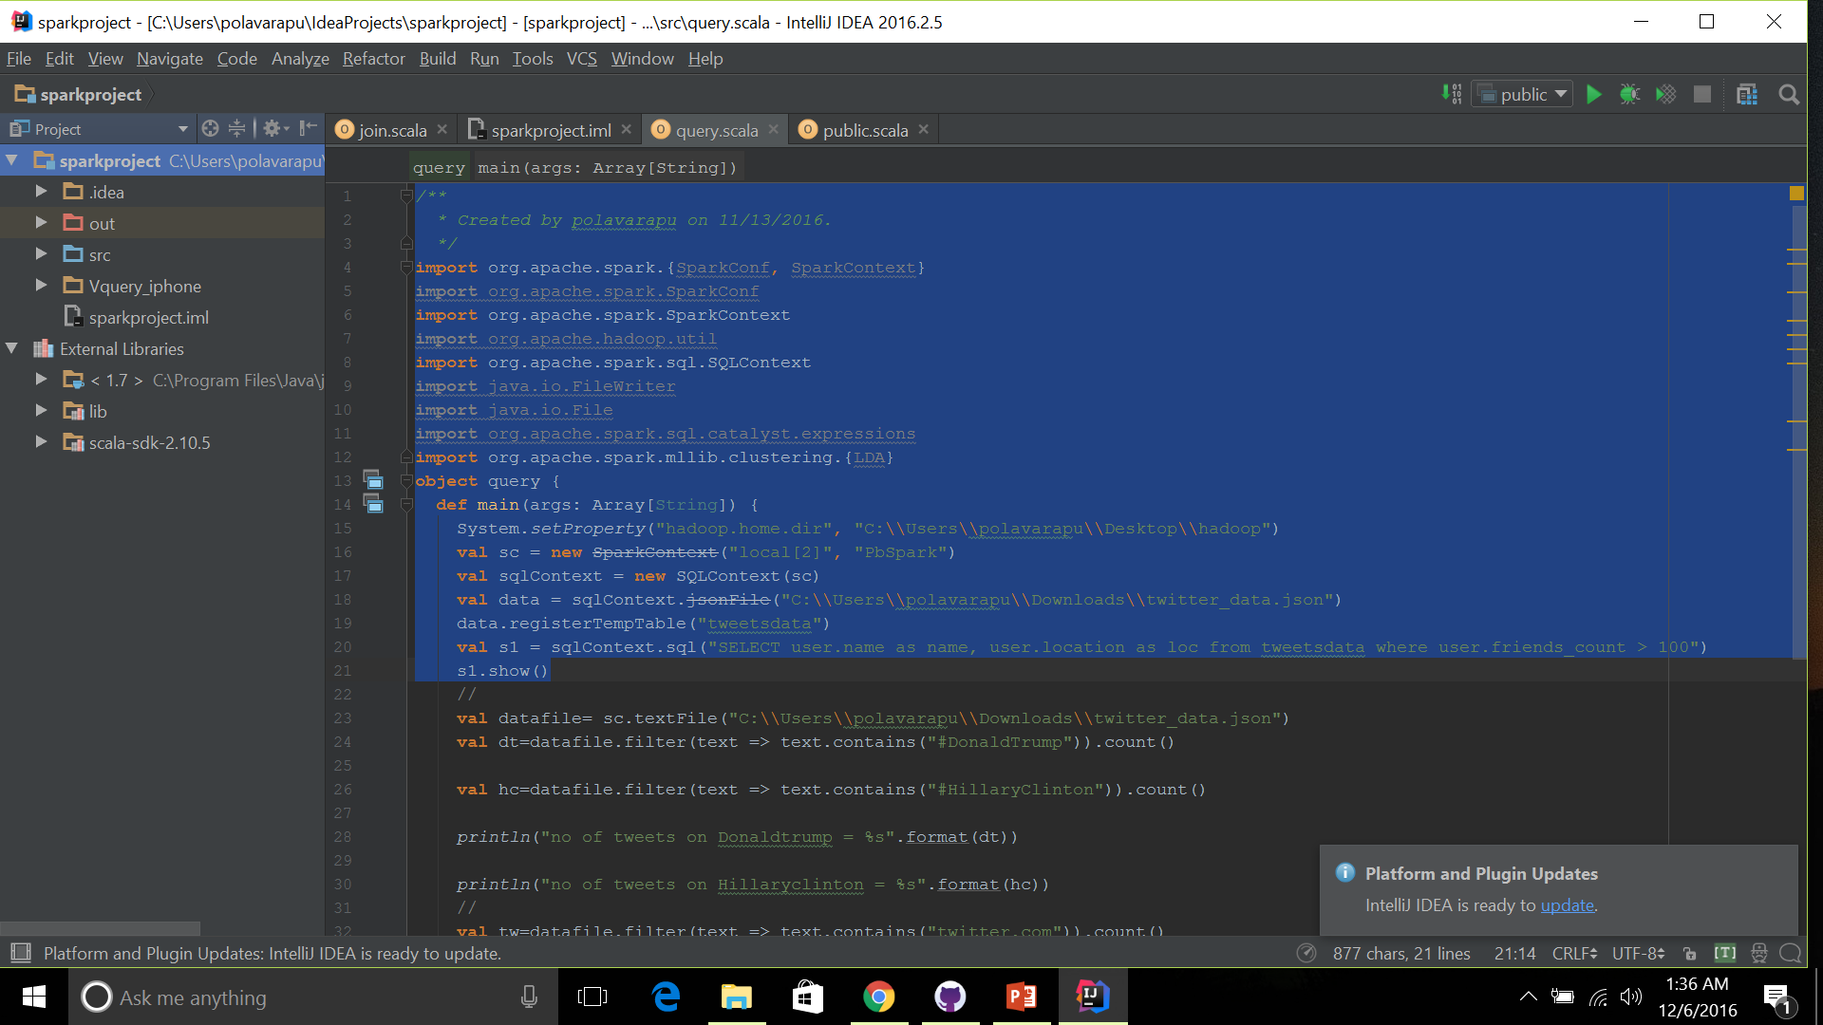
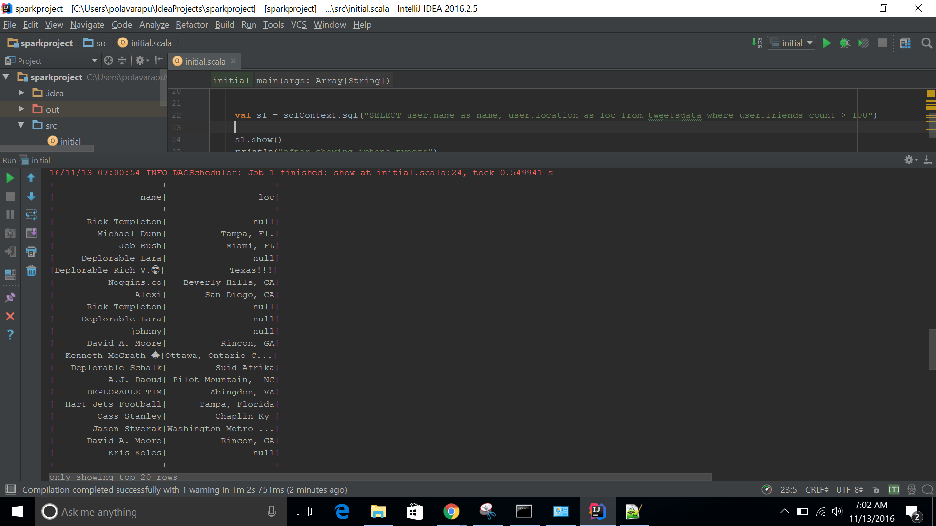
Query-1: Get the username and location of the person who tweeted on Donald trump

Slide 4
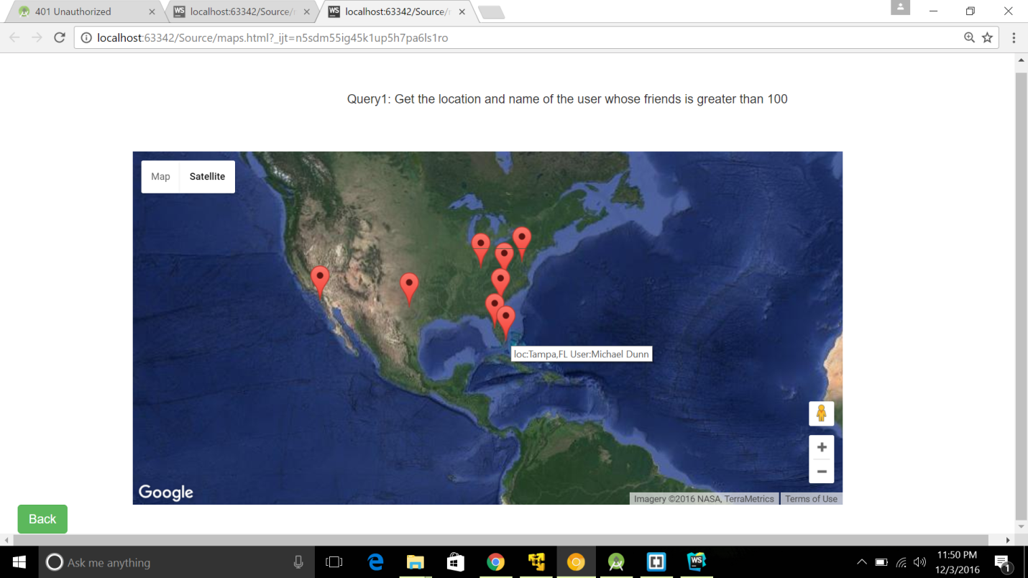
Visualization of the Query result on maps

Slide 5
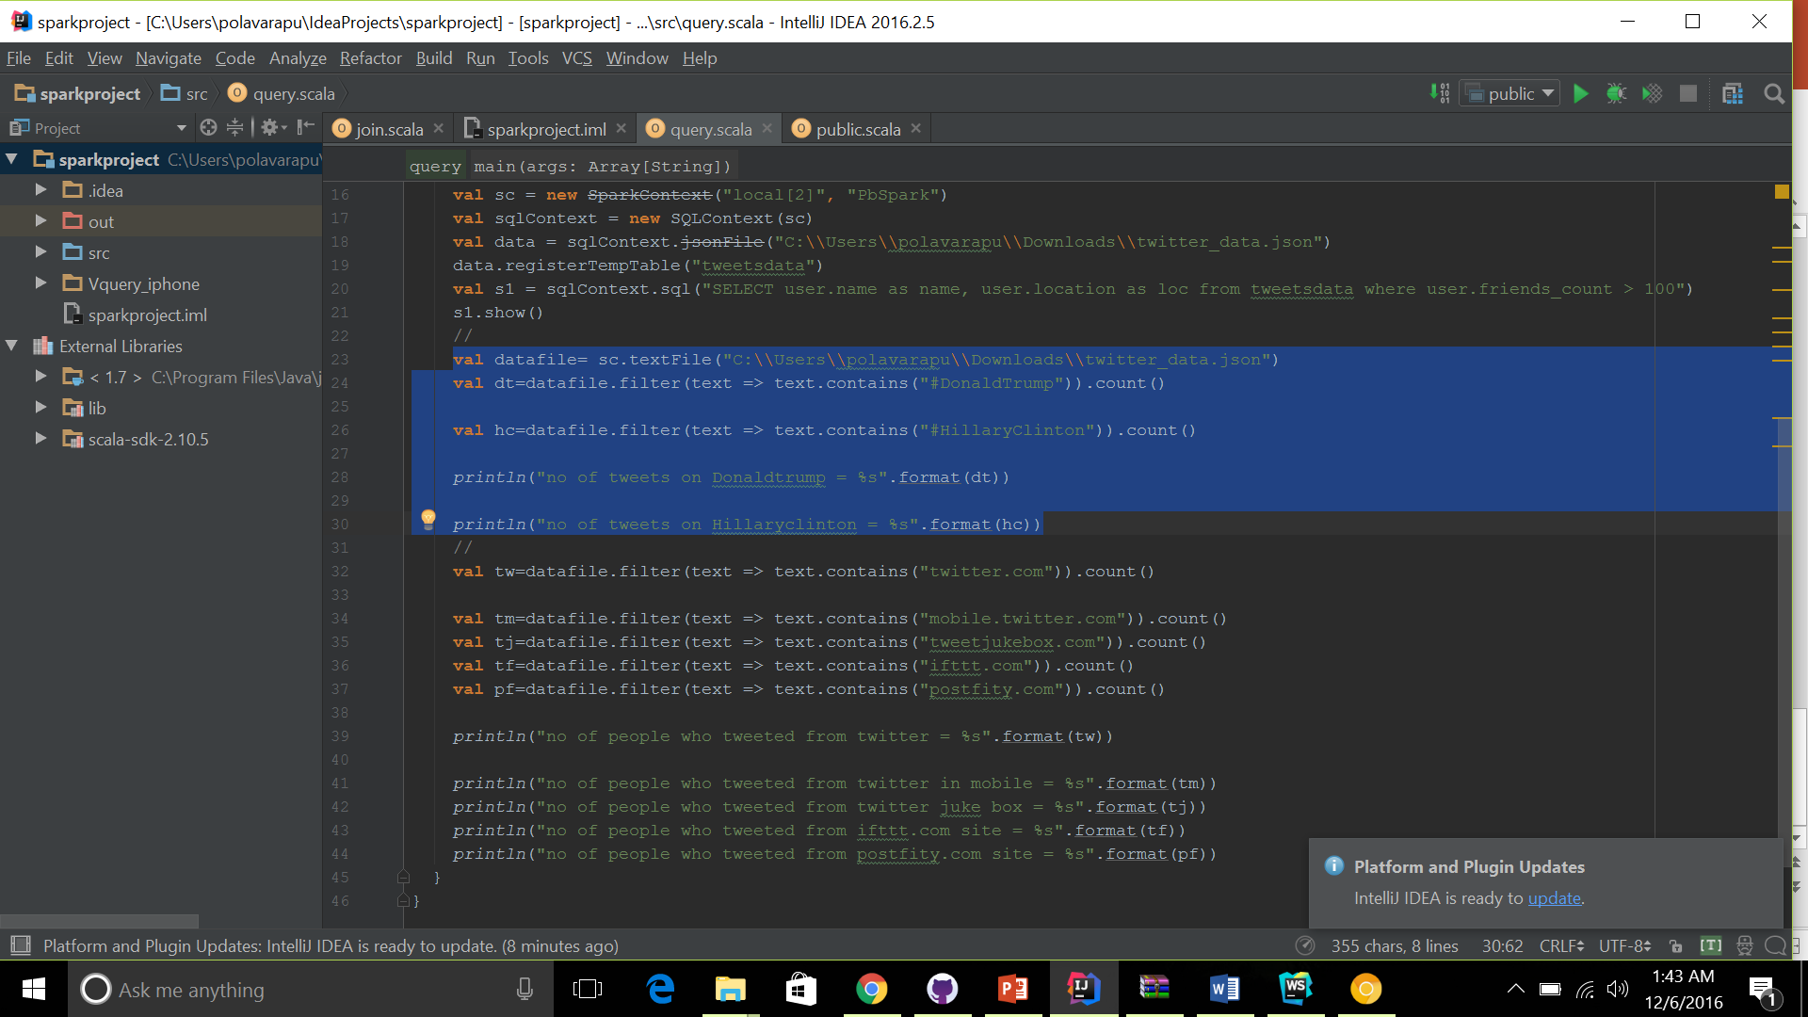
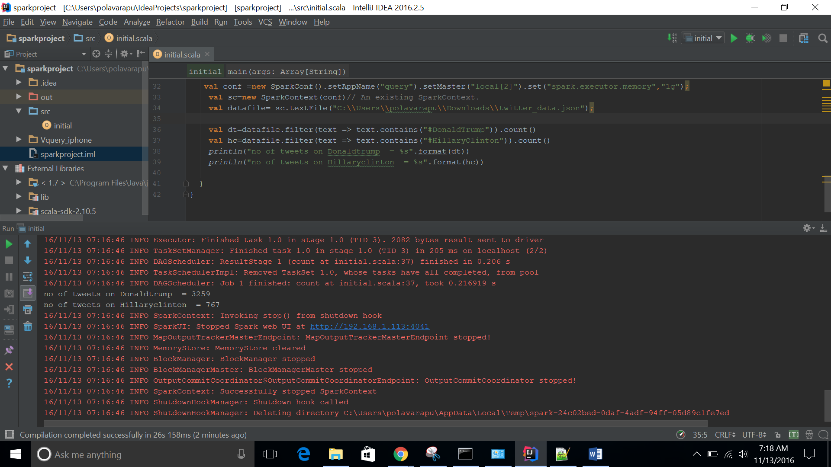
Query:2 Count of the tweets on Donald trump and Hillary clinton

Slide 6
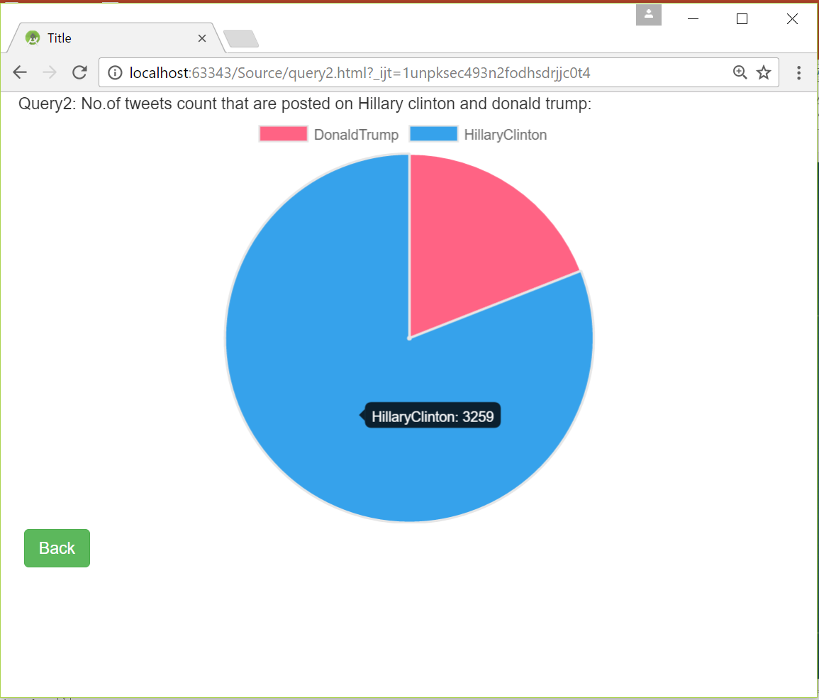
Query 2 Visualization

Slide 7
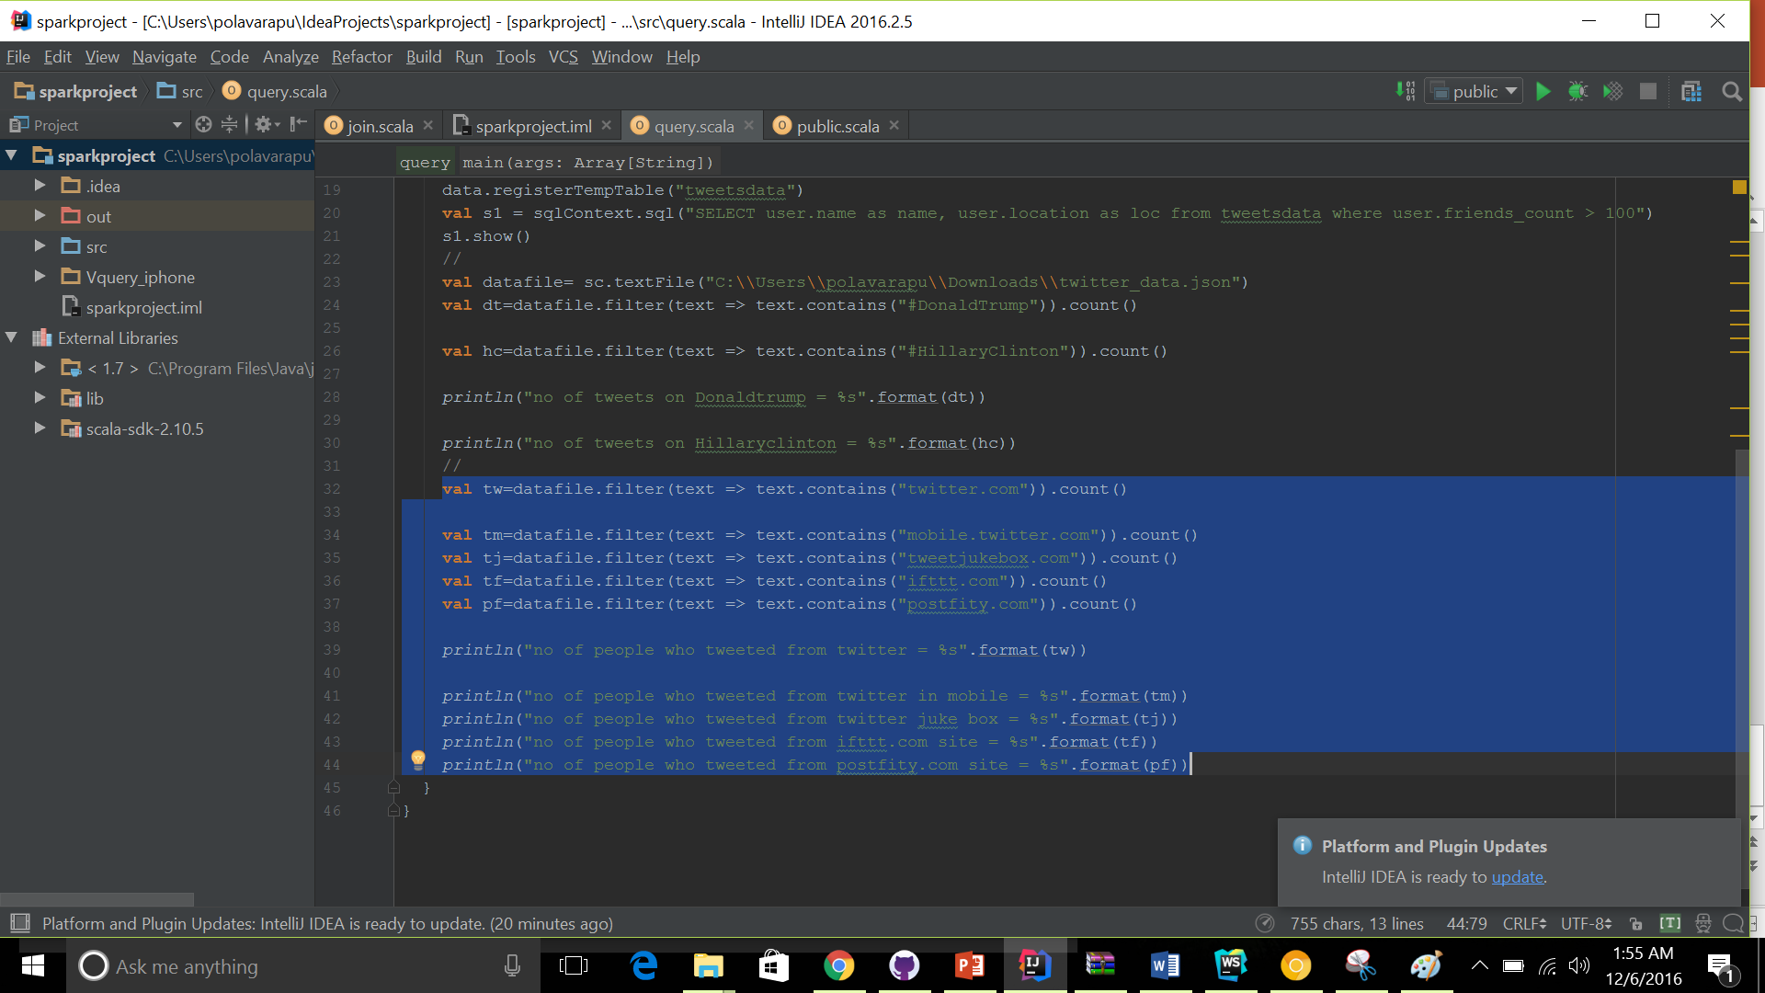
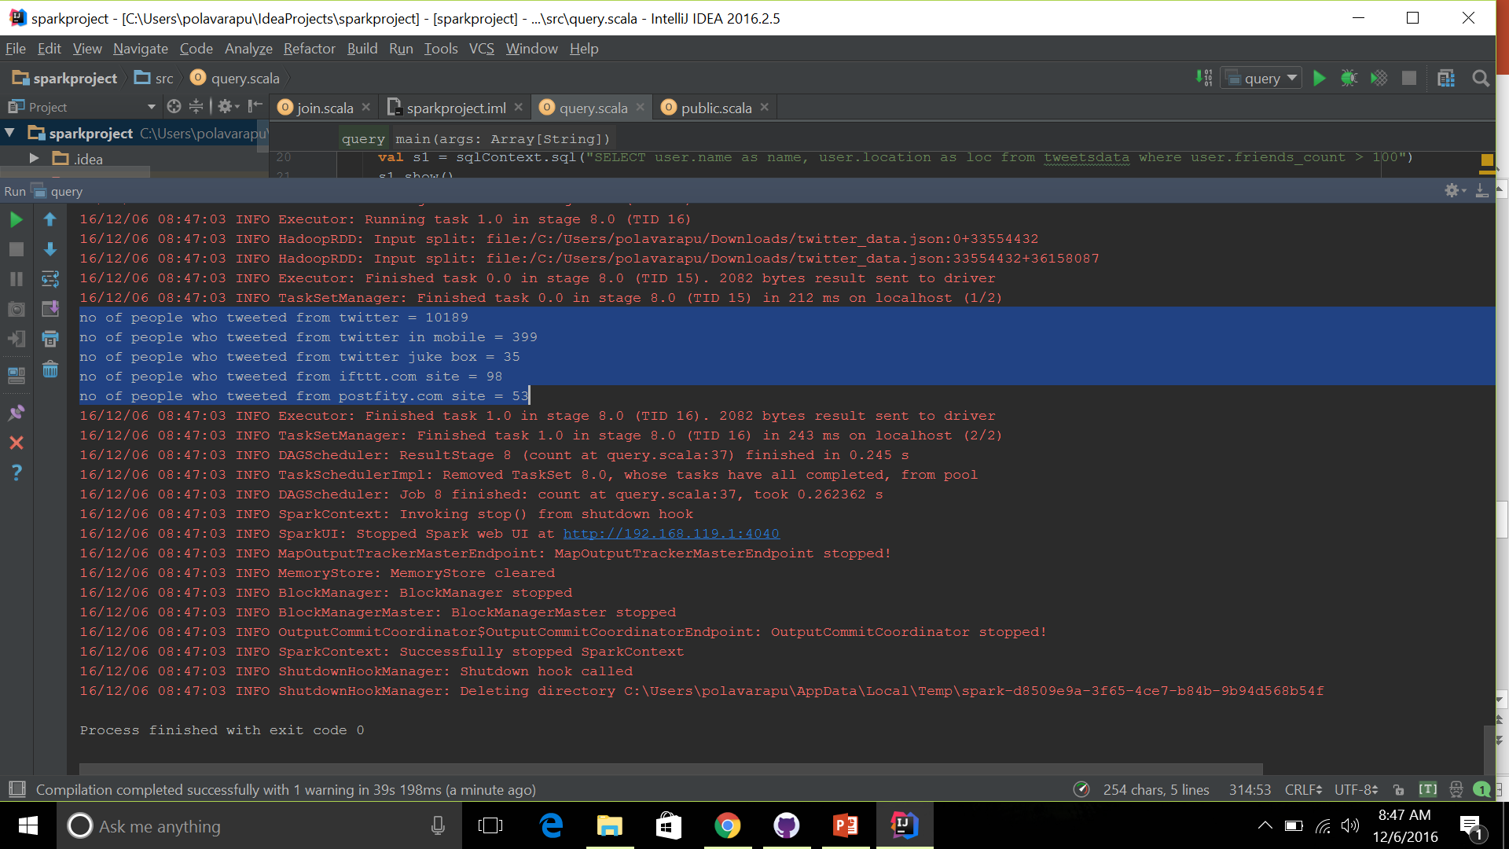
Query:3 count of tweets that are made from various websites

Slide 8
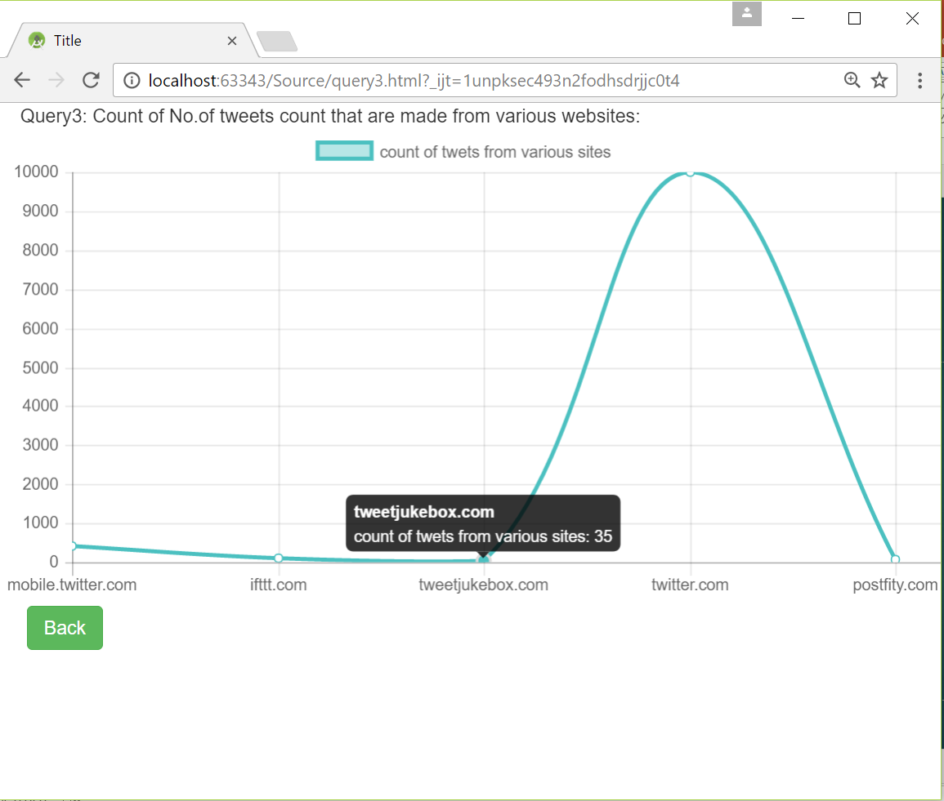
Query 3 visualization

Slide 9
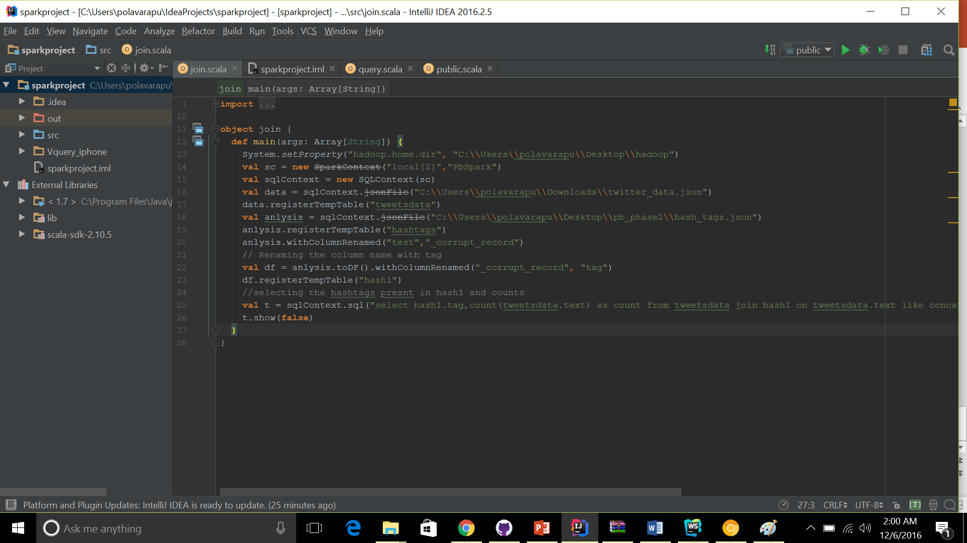
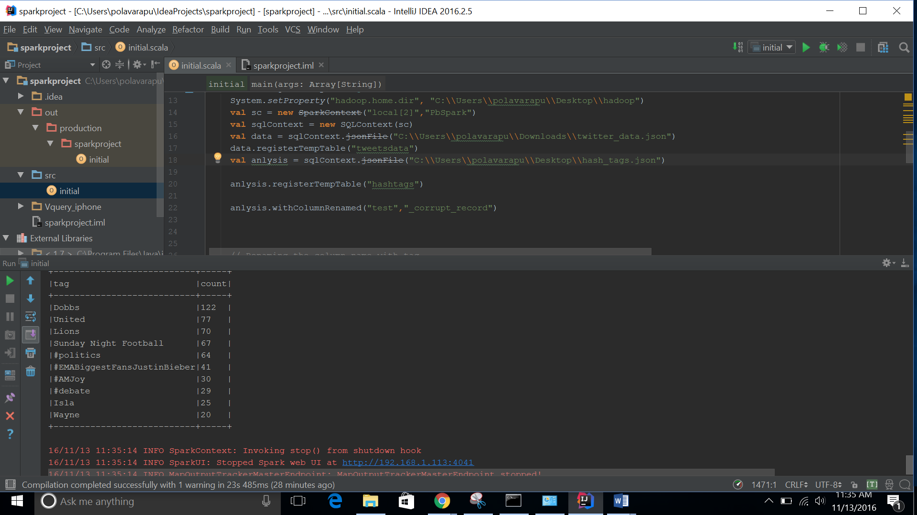
Query:4 count of the matched hash tags

Slide 10
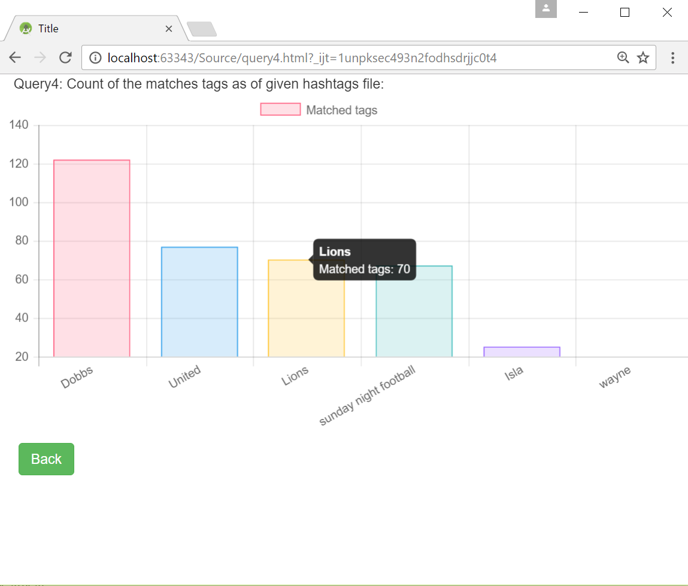
Query 4 Visualization

Slide 11
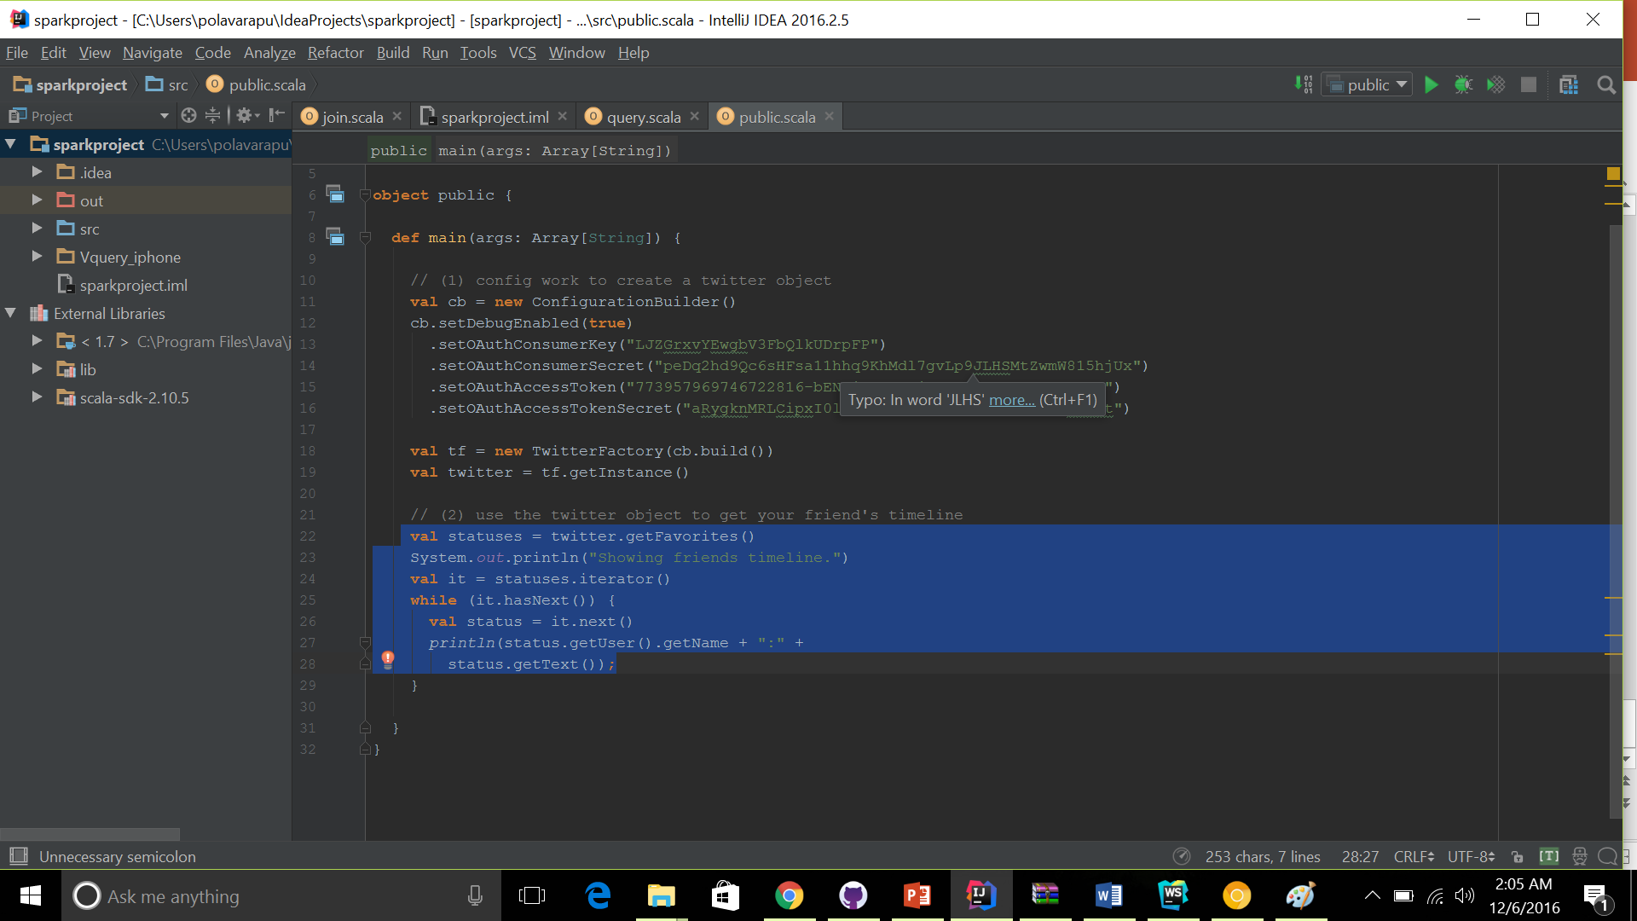
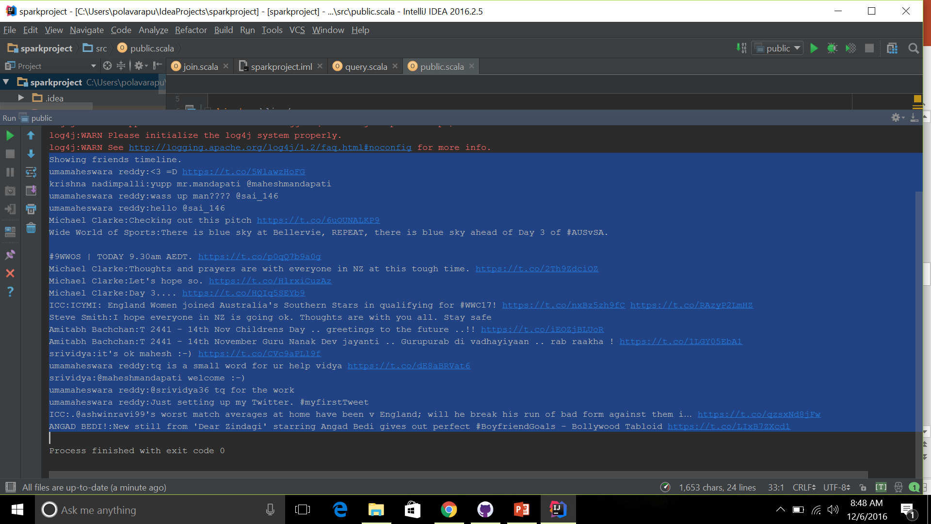
Query:5 In this query we implemented getfavourites() public API to retrieve the favorited tweets of an authenticated user

Slide 12
THANKYOU

Slide 13
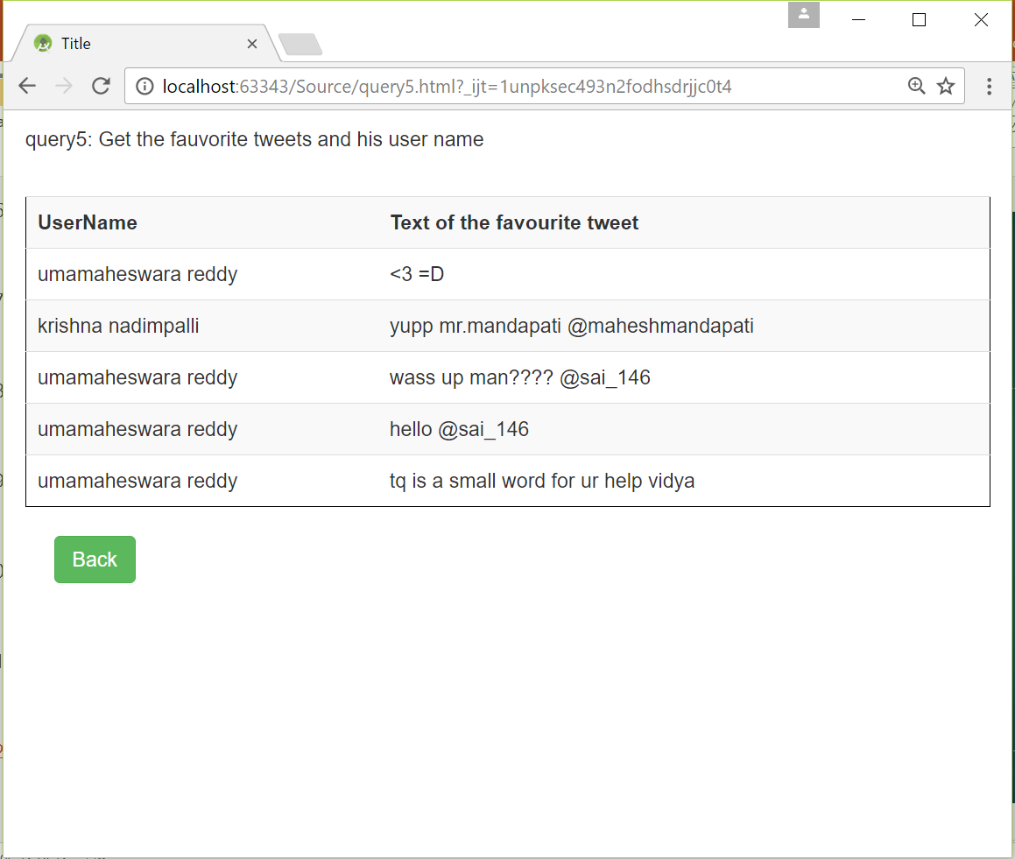
Query 5 visualization

