Slide 1
Object detection with voice over
TO HELP VISUALLY IMPAIRED PEOPLE

Slide 2
Team guide
Mrs. T. Aruna ( Ph. D )

Slide 3
Team members
R . Alekhya
G . Vandana
P . Jabili Sree
M . Prathyusha

Slide 4
TABLE OF CONTENT
1.AIM
2. ABSTRACT
3. PROBLEM STATEMENT
4. MOTIVATION
5.ARCHITECTURE
6. SRS TABLE
7. UML DIAGRAMS
8.DATA SET
9.INPUT SCREENS
10.OUTPUT SCREENS

Slide 5
AIM
To produce a device that can detect obstacles and produce a voice over about the object detected and help the visually impaired persons to have a safe way to move in closer environment.

Slide 6
ABSTRACT
Developing a tool for the visually impaired people is not a recently problem .
But developing a computer aided tool is a still developing area.
As object recognition technology has developed recently, various technologies have been applied to autonomous vehicles, robots and industrial facilities .
However, the benefits of these technologies are not reaching the visually impaired , who need it the most . This project proposed an object detection system for the blind using deep learning technologies. Furthermore, a voice guidance technique is used to inform sight impaired persons as to the location of objects. The object recognition deep learning model utilizes the You Only Look Once (YOLO) algorithm and a voice announcement is synthesized using text-to-speech (TTS) to make it easier for the blind to get information about the objects. As a result , it implements an efficient object-detection system that helps the blind find a object in a specific space without help of others.

Slide 7
PROBLEM STATEMENT
Visually impaired individuals will face many difficulties and onof the common difficulties is when they involve in self-navigating at an environment which is strange for them. In fact, physical movement is one of the biggest challenges for them. Besides that, while they travel around or walking at a crowded corridor, it may pose great difficulty. One of the existing problems for visually impaired individuals to travel in a corridor is that they cannot detect either they need to turn left or turn right when reached to the end of the corridor by using only the walking stick. According to Saaid M.F [7], to walk at the corridor, the visually impaired individuals must find the border of the sidewalk at the corridor and then use their walking stick to define their current location. The reason why the visually impaired individuals do that is because they cannot forecast the obstacle which is far from them while they only can use the walking stick to detect the area around them

Slide 8
MOTIVATION
I want to use my platform to give a bit of motivation and determination to other blind and vision impaired young people.

Slide 9
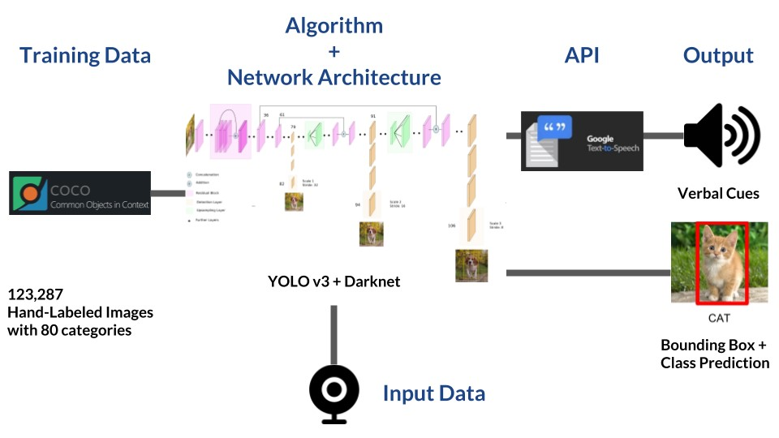
ARCHITECTURE

Slide 10
Software requirement specification TABLE
S.NO | REQUIREMENTS | REQUIREMENTS NUMBERS | ESSENTIAL OR DESIRABLE | DESCRIPTION
1 | Camera(on/off) | RS1 | Essential | The camera will identify all the objects.
2 | COCO Data Set | RS2 | Essential | It is used for object recognition.
3 | Object Detection | RS3 | Essential | It will say what the object is and identify the object.
4 | Voice Over | RS4 | Essential | It tells the object name.

Slide 11
Uml DIAGRAMs
USE CASE DIAGRAM
A use case diagram is a Unified Modelling Language (UML) is a type of behavioural diagram defined by and created from Use-case analysis. Its purpose is to present a graphical overview of the functionality provided by a system in terms of actors, their goals (represented as use cases), and any dependencies between those use cases
1.Used to gather requirements of a system.
2.Used to get an outside view of a system.
3.Identify external and internal factors influencing the system.
4.Show the interacting among the requirements are actors.

Slide 12
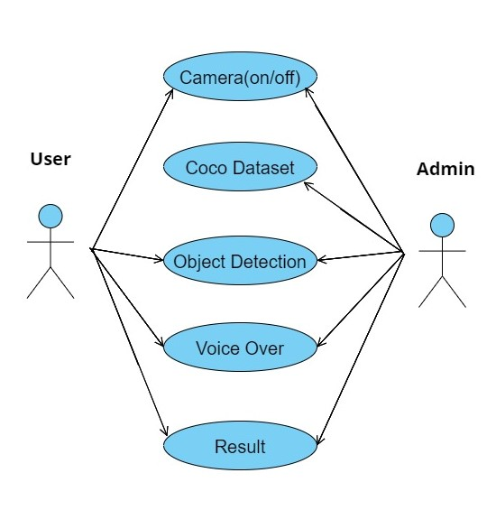

Slide 13
Activity Diagram
An activity diagram visually presents a series of actions or flow of control in a system similar to a flowchart or a data flow diagrams. Activity diagrams are often used in business process modelling. They can also describe the steps in a use case diagram. Activities modelled can be sequential and concurrent. In both cases an activity diagram will have a beginning (an initial state) and an end (a final state). In between there are ways to depict activities, flows, decisions, and time events and more.

Slide 14
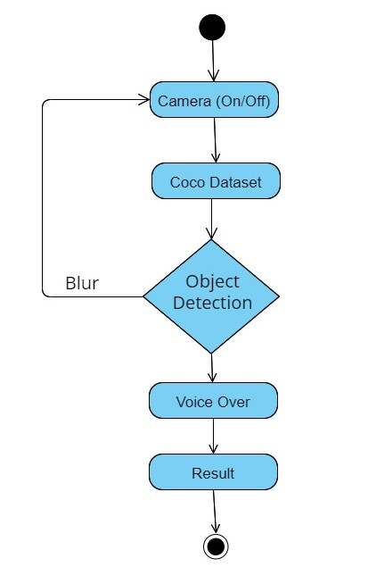

Slide 15
State Chart Diagram
A State chart diagram describes a state machine. State machine can be defined as a machine which defines different states of an object and these states are controlled by external or internal events. As the State chart diagram defines the states, it is used to model the lifetime of an object. State chart diagram describes the flow of control from one state to another state. States are defined as a condition in which an object exists and it changes when some event is triggered. The most important purpose of a state chart diagram is to model the lifetime of an object from creation to termination

Slide 16
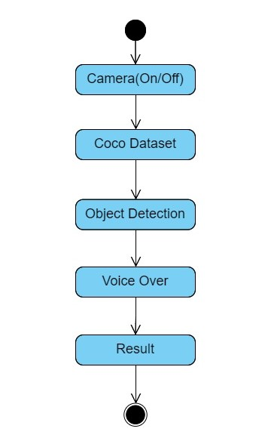

Slide 17
Sequence diagram
Sequence diagrams are probably the most important UML diagrams among not only the computer science community but also design - level models for business application development. Lately they have become popular in depicting business processes, because of their visually self- explanatory nature

Slide 18
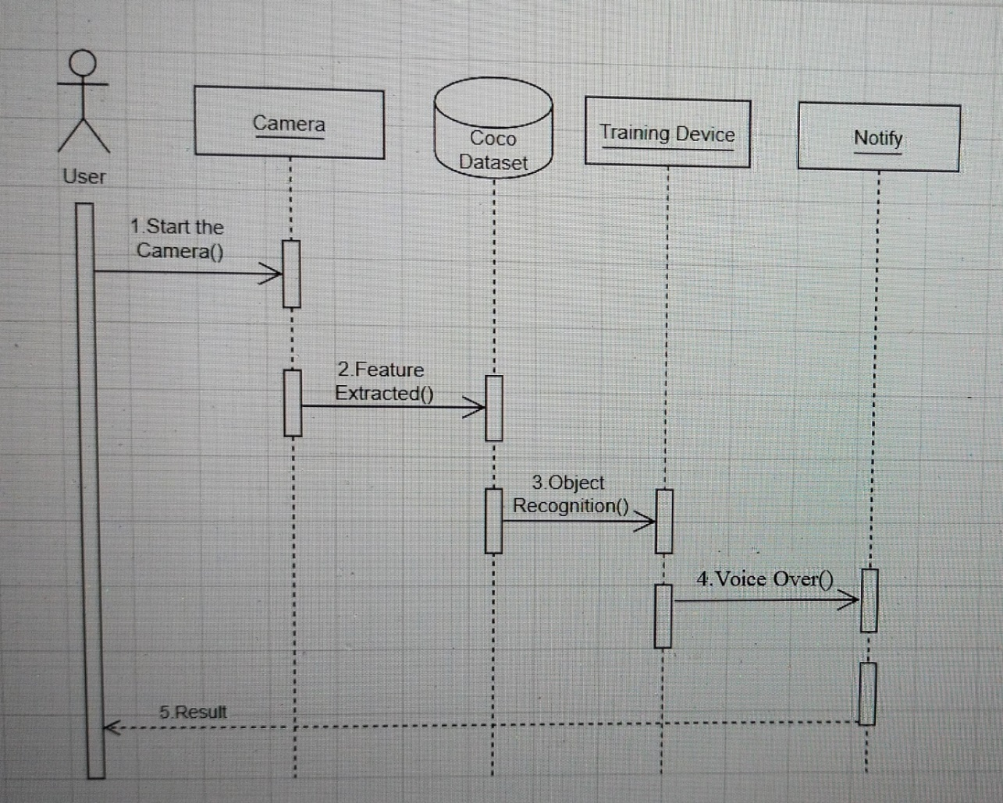

Slide 19
DATASET
S.NO | X | Y | W | H | IMAGE
1 | 36 | 92 | 33 | 61 | data/IMG_20210104_230447291.jpg
2 | 183 | 88 | 93 | 60 | data/IMG_20210104_230447291.jpg
3 | 47 | 75 | 44 | 86 | data/IMG_20210104 _230800476.jpg
4 | 192 | 80 | 104 | 62 | data/IMG_20210104 _230800476.jpg
5 | 83 | 95 | 25 | 48 | data/IMG_20210104 _231127922.jpg
6 | 153 | 91 | 66 | 45 | data/IMG_20210104 _231127922.jpg
7 | 53 | 86 | 30 | 56 | data/IMG_20210104 _231314528.jpg
8 | 134 | 87 | 72 | 48 | data/IMG_20210104 _231314528.jpg
9 | 16 | 65 | 43 | 90 | data/IMG_20210104 _231330048.jpg
10 | 154 | 77 | 88 | 57 | data/IMG_20210104 _231330048.jpg
11 | 4 | 73 | 57 | 107 | data/IMG_20210104 _231346592.jpg
12 | 186 | 91 | 104 | 64 | data/IMG_20210104 _231346592.jpg
13 | 137 | 77 | 69 | 48 | data/IMG_20210104 _231401065.jpg
14 | 58 | 79 | 27 | 54 | data/IMG_20210104 _231401065.jpg
15 | 141 | 75 | 74 | 53 | data/IMG_20210104 _231416685.jpg

Slide 20
YOLO ALOGRITHM
YOLO Stands for ‘YOU ONLY LOOK ONCE.
YOLO algorithm gives a much better performance on all the parameters.
The YOLO algorithm works by dividing the image into N grids, each having an equal dimensional region of S x S.
This is one of the best algorithms for object detection.
YOLO is a state-of-the-art object detection algorithm that is incredibly fast and accurate.
YOLO is one such real-time Object detection algorithms.

Slide 21
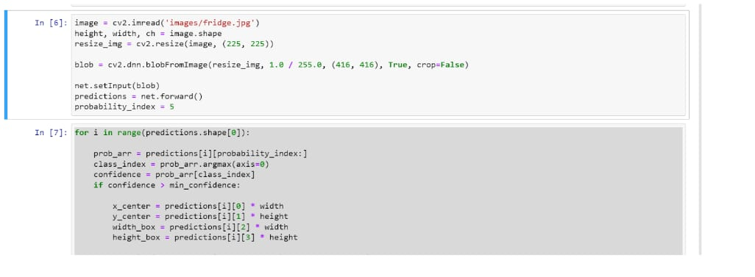
INPUT SCREENS

Slide 22
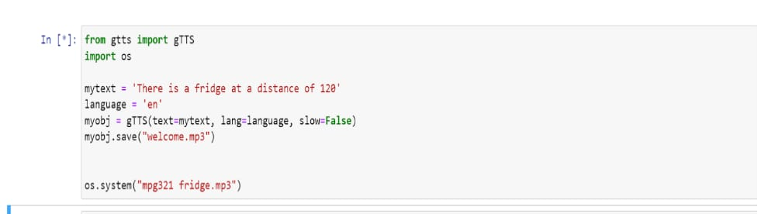
VOICE CODE

Slide 23
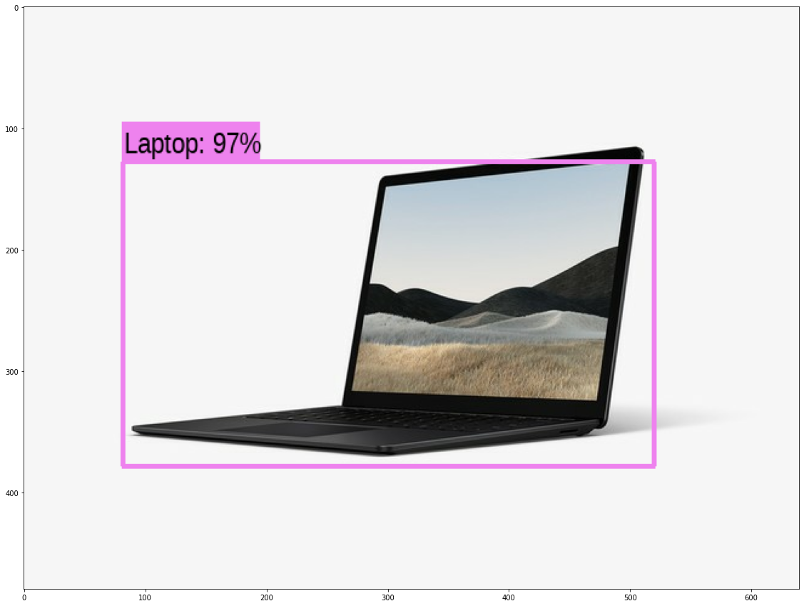
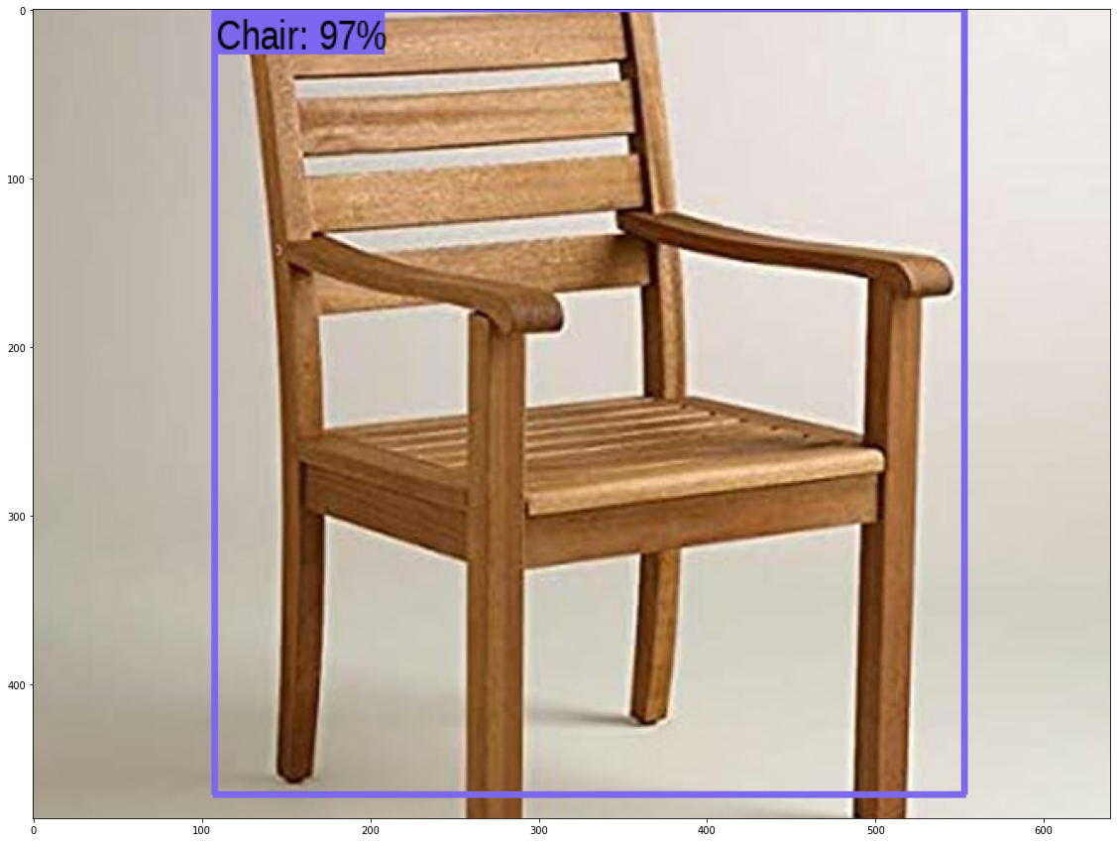
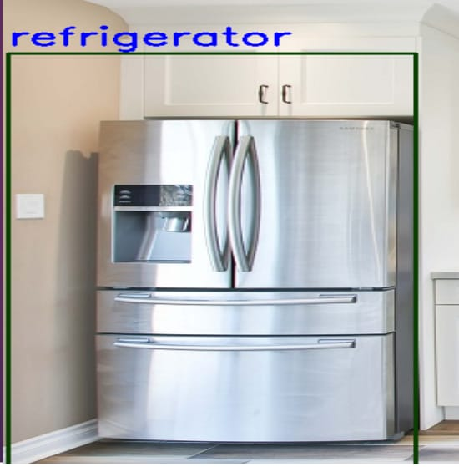
OUTPUT SCREEN

Slide 24
CONCLUSION
Develop the object detection system with the help of deep learning algorithm such as YOLO and estimate the position of object with help of same.
This system provides the voice guidance for visually impaired people. This system is solely designed to help the blind people effectively.

