Slide 1
Home Automation and Automatic Plant Watering System

Slide 2
TEAM GUIDE
Mrs.T.Renuka

Slide 3
R . Alekhya
G . Vandana
P . Jabili Sree
M . Prathyusha
Team members

Slide 4
TABLE OF CONTENT
1.ABSTRACT
2. INTRODUCTION
3. MOTIVATION
4. PROBLEM STATEMENT
5.REQUIREMENT ANALYSIS
6.UML DIAGRAMS

Slide 5
Introduction
Now-a-days everything is based on technology. According to the growth of technology human life is being attracted by the technology. So, in this scenario we decided to build a project which is useful to the human life. iN our project with which we can control the home appliances both manually and voice control, and Automatic plant watering system

Slide 6
ABSTRACT
The Internet of Things (IoT) conceptualizes the idea of remotely connecting and monitoring real
World objects (things) through the Internet . When it comes to our house. this concept can be
Apply incorporated to make it smarter , safer and automated . Automation is the technology by
which a process is performed with minimum human efforts. Automation or automatic control is the
use of discrete control systems for operating equipment. This project presents the complete
design of an IoT based sensing and monitoring system with voice for smart home and automatic
planting system. The selected platform is very flexible and user-friendly. The sensing of different
variables inside the house is conducted using the NodeMCU-ESP8266 microcontroller board,
Which allows Realtime data sensing, processing and uploading/downloading to/from the BYLNK
cloud server.

Slide 7
MOTIVATION
The main motive of this system is to control the home appliances and electronic devices with the help of a supervisory system. The supervisory system is designed in such a way that everyone can access it. Home computerization brings about a more astute home and is utilized to give a higher and more beneficial way of life. The magnificence of a home computerization framework is that it is very versatile, adaptable and its abilities are constrained just by our creative ability. With the IOT unrest practically around the bend, it's about time that we move towards boundless selection of such a prototype.

Slide 8
PROBLEM STATEMENT
Home automation refers to control the home appliances by using computer technology. Computer Systems enables From remote control of lighting through to complex micro-controller or computer based networks with various degrees of intelligence and automation. Home automation provides security, energy efficiency and ease of use hence, it is adopted more. It also provides remote interface to home appliances to provide control and monitoring on a web browser.

Slide 9
SOFTWARE REQUIREMENT SPECIFICATION TABLE
S.NO | SOFTWARE REQUIREMENT | REQUIREMENT NUMBER | ESSENTIAL OR DESIRABLE | DESCRIPTION
1 | BYLNK | RS1 | Essential | It is used to control Arduino, nodemcu via internet
2 | IFTTT | RS2 | Essential | A predefined action happens automatically when it is triggered by changes that occur with an environment.
3 | Google Assistance | RS3 | Essential | We want to control the devices with our voice, we are using google assistance.
4 | Alexa | RS4 | Essential | We want to control the devices with our voice, we are using Alexa.

Slide 10
HARDWARE REQURIMENT
SDDGAFEAFT
NODEMCU
8 CHANNEL RELAY
BREAD BOARD
JUMPER WIRES

Slide 11
UML DIAGRAMS
Class diagram is a static diagram .it represent the static view of an application. Class diagram describes the attributes and operations of a class .
USE CASE DIAGRAM
A use case Diagram is used to represent the dynamic behavior of as system.
COLLABORATION
DIAGRAM
A Collaboration Diagram is an Illustration of the relationships and interactions among software objects in the UML.
ACTIVITY DIAGRAM
Activity Diagram describe the flow of control in a system .so it consists of activities and links. The flow can be sequential, concurrent or branched
A Sequence Diagram is an interaction diagram deals with some sequence, which are the sequence of message flowing from one object to another .
SEQUENCE DIAGRAM
CLASS
DIAGRAM

Slide 12
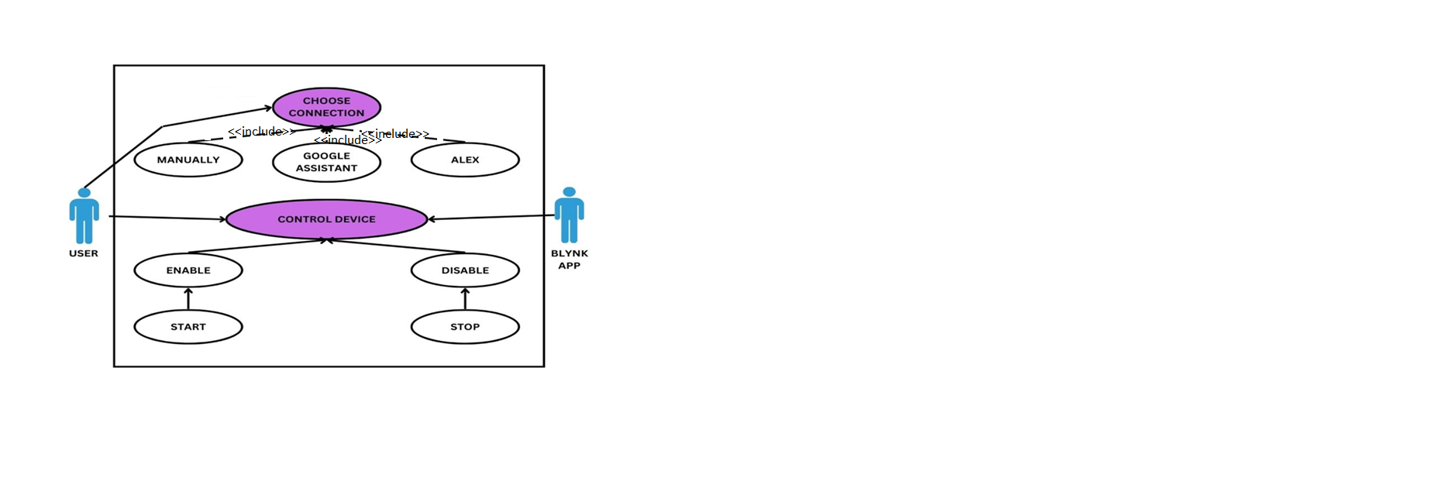
USE CASE DIAGRAM

Slide 13
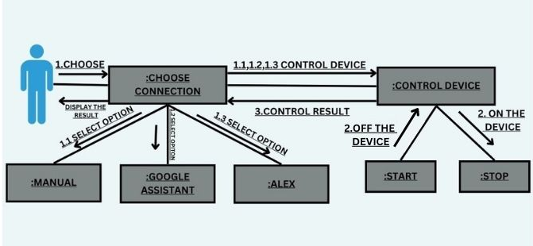
COLLABRATION DIAGRAM

Slide 14
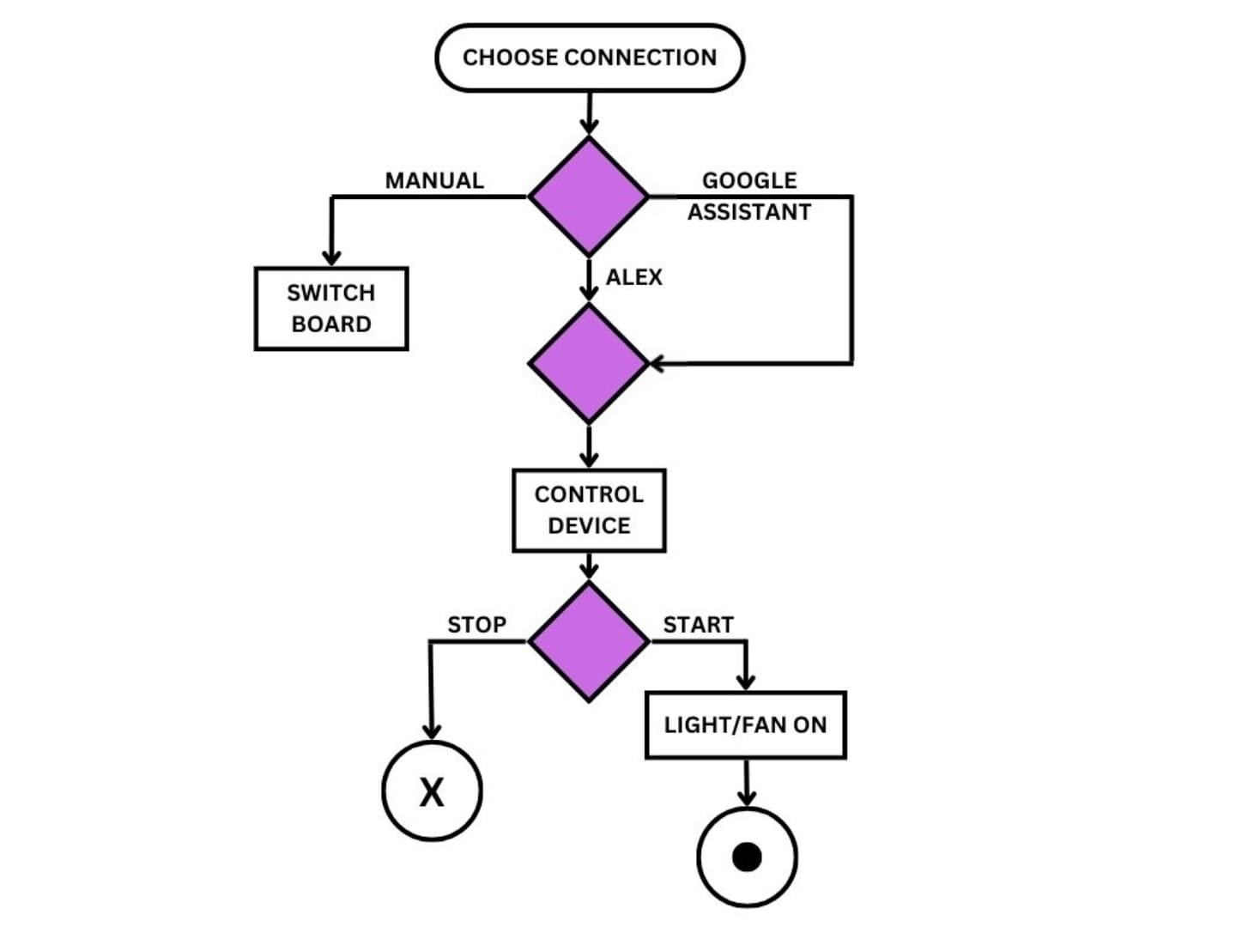
ACTIVITY DIAGRAM

Slide 15
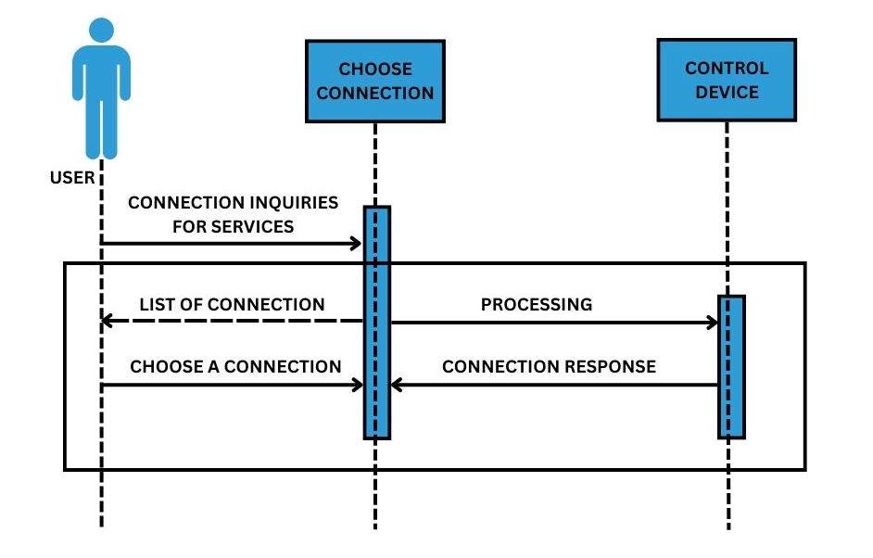
SEQUENCE DIAGRAM

Slide 16
CLASS DIAGRAM

Slide 17
Thank you

