Slide 1
Fine-Tuning

Slide 2
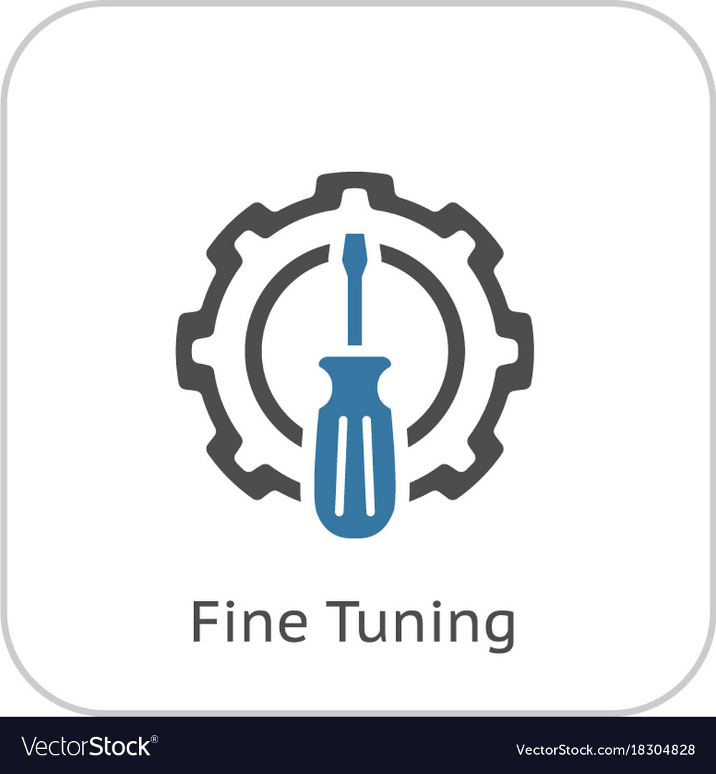
What is Fine-Tuning
Fine-tuning is a technique used to adapt a pre-trained LLM to a specific task.
It involves further training the LLM on a smaller, more focused dataset relevant to the desired task.
Excels in its ability to adapt an LLM’s behaviour to specific
nuances, tones, or terminologies
Why it is needed
It is efficient
Effective
Ecnomical

Slide 3
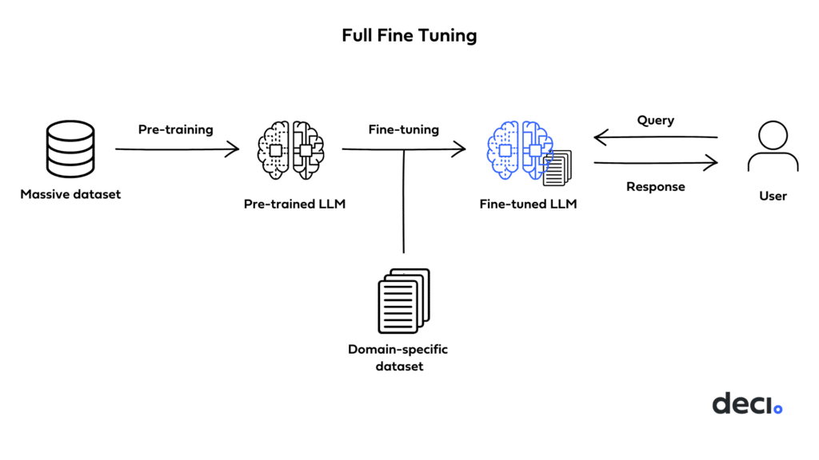
PROCESS OF FINE-TUNING
Initial-Finetuning
Dataset Selection
Adjusting Parameters
Evaluation

Slide 4
REQUIREMENTS:
Requirements | Data Set Resources | Learning Resources
Python 3.10.12 | Hugging Face | Open AI Docs
openai == 0.28.0 | LLM Datahub(Github) | Youtube
Openai playground account

Slide 5
Examples:
Banking Chatbot
Personalized Content creator

Slide 6
DEMO

