Slide 1
RAG

Slide 2
What is RAG: RAG (Retriever-Augmented Generation) combines pre-trained LLMS with information retrieval systems using retrieved documents as context to craft a response. WHY WE NEED IT
Integrates the power of retrieval (or searching) into LLM text generation
Retrieves relevant information from knowledge sources before generating a response (databases, documents, etc.)
Ideal for applications that require access to external data sources

Slide 3
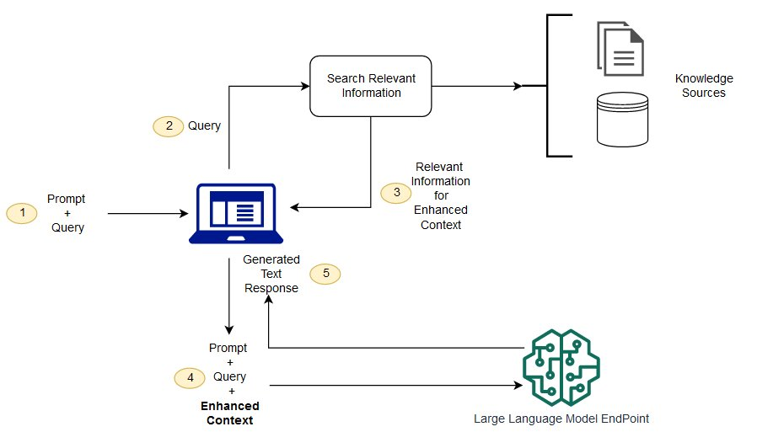
ARCHITECTURE OF RAG:

Slide 4
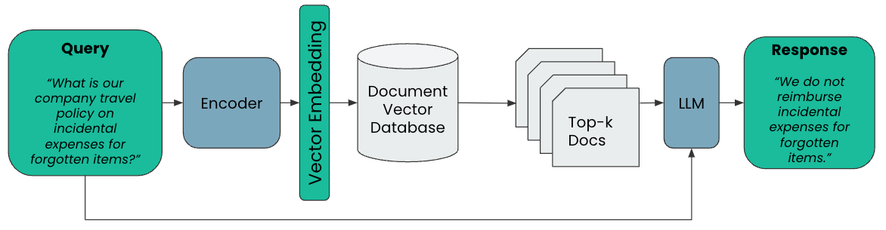
Vector Embedding Architecture

Slide 5
LANGCHAIN
It is a framework designed to simplify the creation of applications using large language models. As a language model integration framework.
Its use-cases largely overlap with those of language models in general, including document analysis and summarization, chatbots, and code analysis.

Slide 6
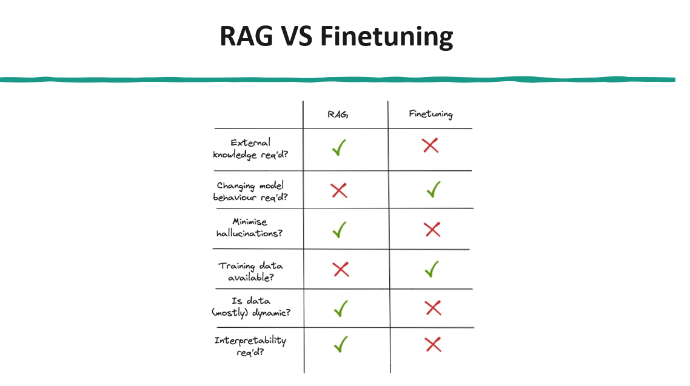

Slide 7
REQUIREMENTS
Requirements | Data Set Resources | Learning Resources
Python 3.10.12 | Hugging Face | Open AI Docs
openai == 0.28.0 | LLM Datahub(Github) | langchain
Ubuntu |  | RAG
langchain == 0.0.284
faiss-cpu == 1.7.4
tiktoken

Slide 8
DEMO

