Slide 2
Summary of paper
What is on farm research: it is a research conducted on the working farm. Conducted on a small part of the farm but uses plots large enough to allow for the use of standard field equipment and practical data collection
In On-farm research, farmers participate in identifying problems and its priorities, managing experiment and evaluating results
The objective of On-farm research is to identify existing inputs or practices that might help to solve major problems of many farmers in a defined study area
As there are many variables used during the data collection ,so to perform the data analysis without loosing the accuracy of the data Principal component analysis (PCA) is performed
PCA is a statistical technique in data analysis. It is used to compress higher dimensional dataset to lower dimensional ones. PCA allows the use of variables which are not measured in the same units for example elevation, concentration of nutrient, temperature and pH, making it an ideal tool for on-farm research data analysis
Different type of field researches:
Small plot research
On-station research
On-Farm research

Slide 3
Why ON-Farm research
On-farm research gives high quality results regarding the suitability of the investigated technological innovations under small, medium, and large-scale farming conditions.
On-farm research leads to more appropriate site-specific technology and aid faster adoption.
Since farmers are the adopters and often the innovators of new farming techniques, it would therefore be unwise to undertake farm-based research without involving farmers in the research process as much as possible.
Using accepted methods of on-farm testing, farmers can achieve experimental precision comparable to those of intensive university research trials.
On-farm research broadens the range of validity of conclusions beyond the narrow confines of a research institute
Stages of On Farm research:
Diagnosis
Planning
Experimentation
Assessment/Evaluation of results
Recommendation and Diffusion

Slide 4
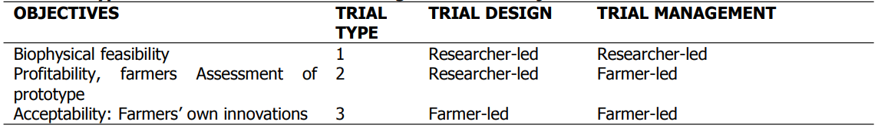
Types of ON Farm Research
On-farm research differs according to the chosen objective, the selected location, the type of design used and the degree of farmer involvement into:
Measurements Of ON-Farm experimental
There are 3 types of ON-Farm experiments:
Measurement of the types that are taken on in-station trails.
Measurement that are taken the Plot level
Measurement of Farmer opinions

Slide 5
Analysis ON-Farm data
Analysis can be done in 3 ways depending upon the experimental and the survey data:
Analysis of Questionnaire data
Analysis of Plot data
Combination of above 2 analysis data using the results from interviews to understand the variation in yield type data
During the data analysis we should consider the following steps:
Split the data up into subsets
Omit particular plots
Pay close attention to comments made about individual plots
Use additional information, both at the farmer level and at the plot level
In the absence of within-farm replication, use treatment contrasts at the farm level to investigate the farm by treatment interaction, or investigate the interaction using the additional farmer information
report on, and possibly follow up on, particular farmers who show interesting results

Slide 6
Principal component analysis (PCA) basics
PCA is a mathematical procedure that uses an orthogonal transformation to convert a set of observations of possibly correlated variables into a set of values of linearly uncorrelated variables called principal components
This transformation is defined in such a way that the first principal component has the largest possible variance (that is, accounts for as much of the variability in the data as possible), and each succeeding component in turn has the highest variance possible under the constraint that it be orthogonal to the preceding components
PCA can be done by eigenvalue decomposition of a data covariance matrix or singular value decomposition of data matrix; usually after mean centering (and normalizing or using Z-score) the data matrix for each attributes

Slide 7
Applications OF PCA
PCA as a multivariate technique can be use in analyzing relationships among several quantitative variables.
PCA can be used to analyze variables that are measured on different units.
PCA provides information about the relative importance of each variable in characterizing the objects.
PCA is used to reduce the number of variables of the data set but retain most of the original variability in the data. A small number of these new variables will usually be sufficient to describe the observational objects

Slide 8
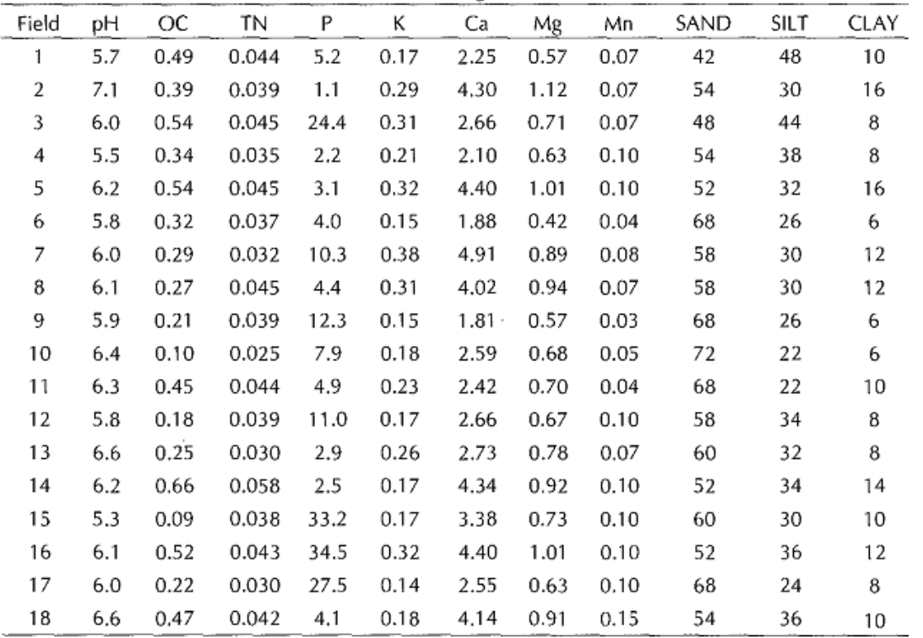
Calculation of PCA IN Paper
Chemical and textural properties were measured on soil from 18 farmers’ fields in Yamrat, Bauchi State, Nigeria
The questions which arise are:
which soil properties are correlated (relationship)
2. which soil properties contribute most to the overall variance in soil characteristics
3. How the number of variables can be reduced without losing too much information.

Slide 9
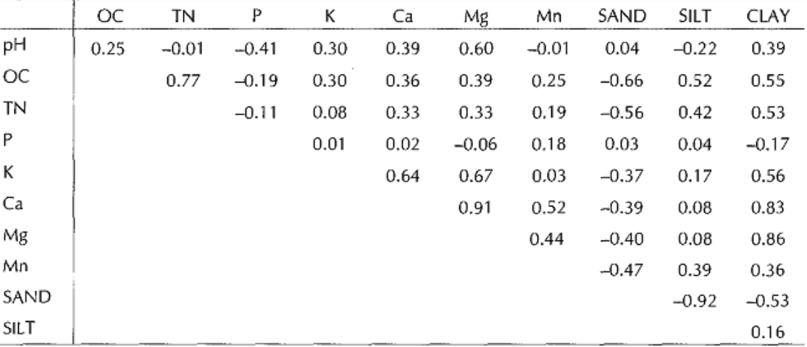
The next step is to compute correlation among the soil characteristics in order to reveal relationships between variables . This provides an insight into the relationship between the variables. In this case, a positive correlation is seen between soil Clay, Ca and Mg contents for the soil in these fields

Slide 10
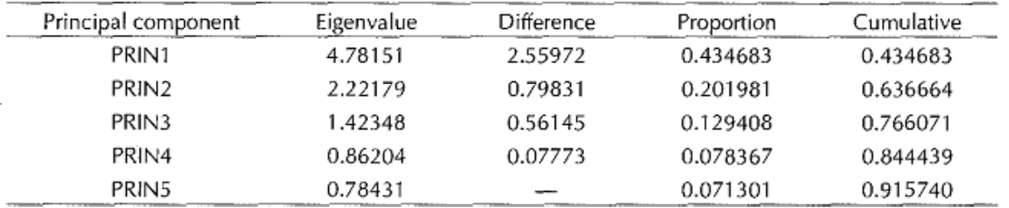
Eigen-values of the Correlation Matrix and the Proportion and Total of Variance Explained by the Five Largest Principal Components
Principal component 1 (PRIN 1) explains 43.4 % of the overall variance, PRIN 2, PRIN 3,PRIN 4, PRIN 5 contribute an additional 20.2 %, 12.9 %, 7.8 % and 7.1 % respectively. All five principal components together in this case explain 91.4 % of the overall variance

Slide 11
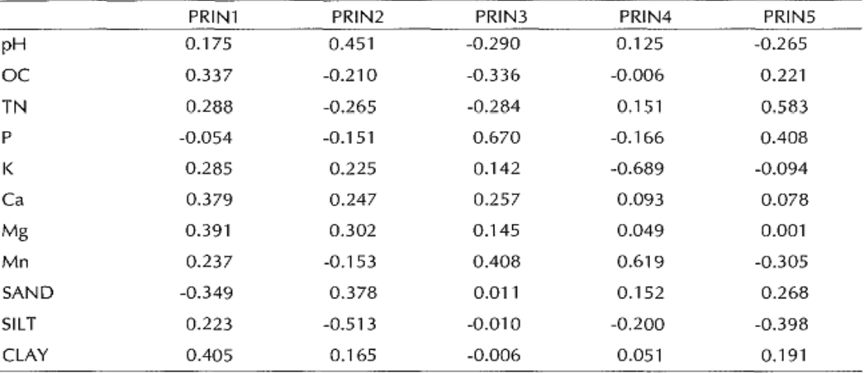
Eigenvectors of principal components representing a linear combination of the original variables
PRIN 1 is most strongly affected by the soil clay content and the Ca and Mg content, which were seen to be correlated earlier on. PRIN 2 is most strongly associated with soil pH and soil silt content.
PRIN 3 is closely related to soil P.

Slide 12
Conclusion
AS in On-Farm research we have a lot of variables, so PCA is used for reducing a number of observed variables into a smaller number of variables that account for most of the variance in the data set.
As PCA allowed the variables which are not measured in the same units such as elevation, concentration of nutrients, temperature, pH, and so on, therefore making it a good tool for ON-Farm research analysis

