Slide 1

MongoDB
SEMOS ACADEMY

Slide 2

What is it?
MongoDB is an open source NoSQL database management program. NoSQL (Not only SQL) is used as an alternative to traditional relational databases. NoSQL databases are quite useful for working with large sets of distributed data.
MongoDB is a tool that can manage document-oriented information, store or retrieve information.
MongoDB is used for high-volume data storage, helping organizations store large amounts of data while still performing rapidly. Organizations also use MongoDB for its ad-hoc queries, indexing, load balancing, aggregation, server-side JavaScript execution and other features.

Slide 3
Features of MongoDB
MongoDB stores data in flexible, JSON-like documents, meaning fields can vary from document to document and data structure can be changed over time
The document model maps to the objects in your application code, making data easy to work with
Ad hoc queries, indexing, and real time aggregation provide powerful ways to access and analyze your data
MongoDB is a distributed database at its core, so high availability, horizontal scaling, and geographic distribution are built in and easy to use
MongoDB is free to use

Slide 4
JSON and BSON
JSON
Text-based open standar for data interchange
JSON = JavaScript Object Notation
Derived from JavaScript scripting language
Filename: *.json
BSON
It is binary-encoded serialization of JSON documents

Slide 5
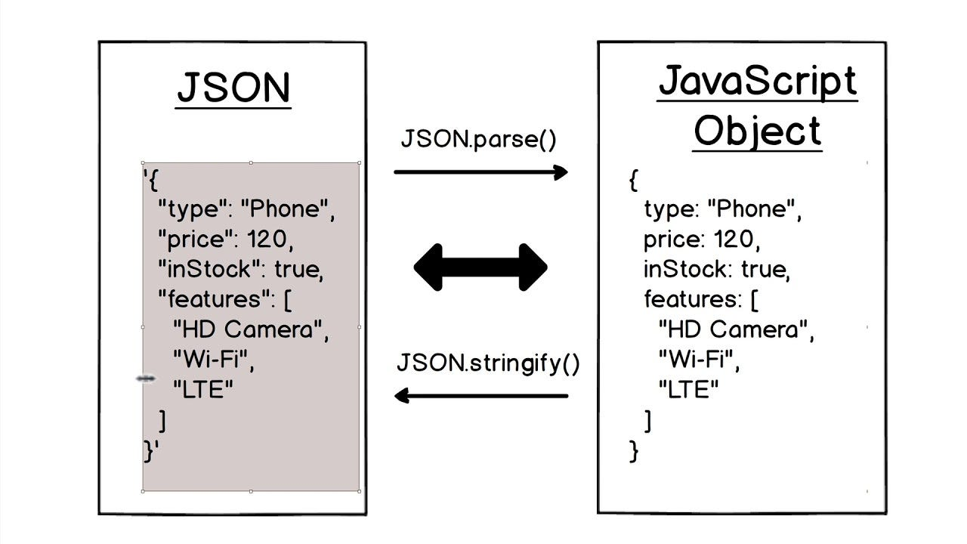

Slide 6
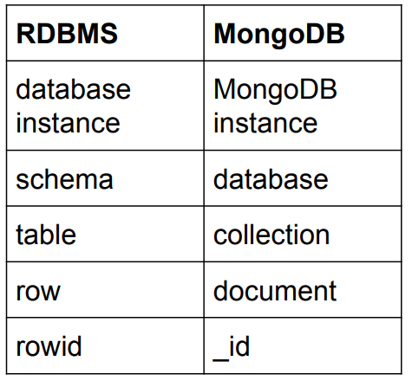

Terminology
Each JSON document:
Belongs to collection
Has a field _id
Unique with the collection
Each collection:
Belongs to a “database”

Slide 7
Databases
MongoDB groups collections into databases
A single instance of MongoDB can host several databases
Each database groups together zero or more collections
A database has its own permissions, users and role and each database is stored in separate files on disk
A good rule is storing all data for single application in the same database

Slide 8
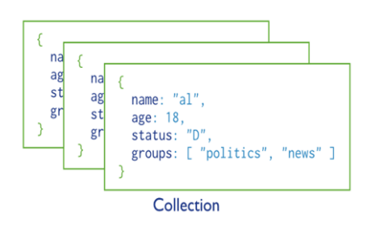
Collections
A collection is a group of related documents
Collections can be thought of as the analog to a tables in relational databases
Collections have dynamic schemas

Slide 9
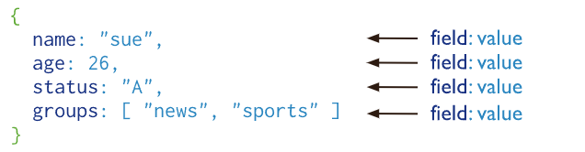
Document
Documents in MongoDB consist of a set of key-value pairs, representing data in a JSON-like format, and are used to store information within collections.
Attributes within MongoDB documents are individual fields, each with a name and a corresponding value, and can include various data types such as strings, numbers, arrays, and nested documents.

Slide 10
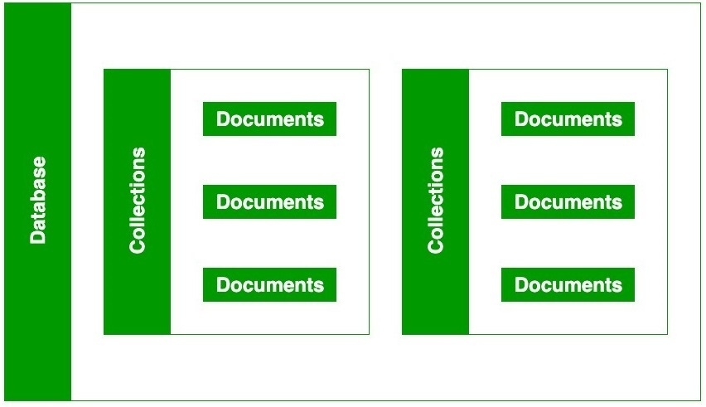

Slide 11
Data Modeling in MongoDB
Data modeling is a crucial aspect of designing a database system.
In MongoDB, two primary approaches are used for structuring data:
Embedding
Referencing
Effective data modeling in MongoDB allows you to tailor your database structure to the specific needs and requirements of your applications.

Slide 12
Embedding Documents
Denormalized schema
Embedding documents involves nesting one document within another document.
Manipulate related data in a single operation
Disadvantages:
Documents may grow significantly during the time
Imapcts both read/write performance

Slide 13
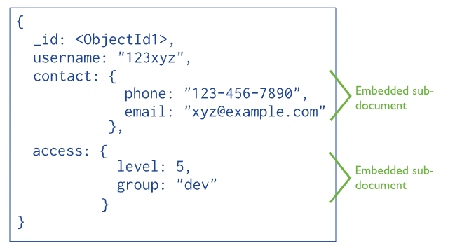

Slide 14
Referencing Documents
Normalization of the schema
Referencing documents involves one document referring to another using a unique identifier, often the _id field.
More flexibility than embedding
Disadvantages:
Can require more roundtrips to the server

Slide 15
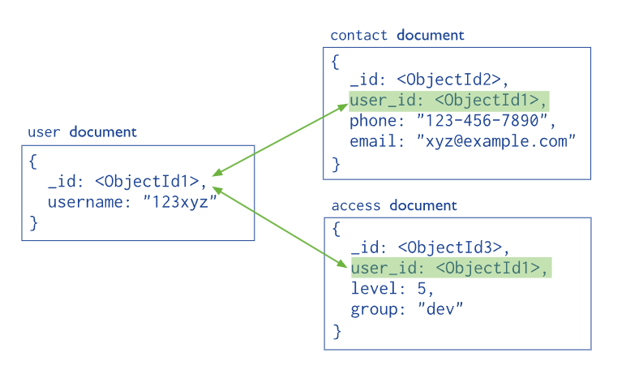

Slide 16
Conclusion
In conclusion, MongoDB stands as a dynamic and powerful NoSQL database, offering remarkable advantages in flexibility, scalability, and performance
Its support for flexible schema, robust querying, and efficient data storage, along with a vibrant community, makes MongoDB a leading choice for modern data-driven applications.

Slide 17
THANK YOU !

