Slide 1

Node.js
SEMOS ACADEMY

Slide 2
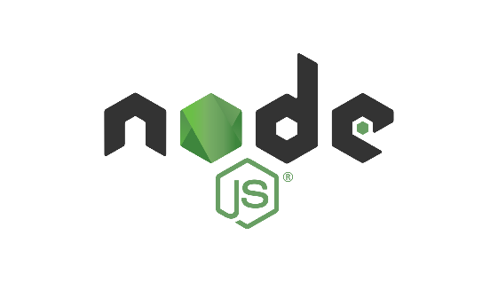
BRIEF HISTORY OF NODEJS
It all began in 2009, when Ryan Dahl created the first version of Node.js. He wanted to create a fast and lightweight runtime environment for JavaScript, and he chose to use the Google Chrome V8 JavaScript engine as the foundation for Node.js.
One of the most notable was the release of the Node Package Manager (NPM) in 2010.
NPM is a command-line interface that makes it easy to install and manage packages (i.e., reusable pieces of code) for Node.js applications. This made it much easier for developers to share and reuse code, and it helped to fuel the growth of the Node.js ecosystem.
another big milestone in the history of Node.js was the creation of the Node.js Foundation in 2015
The Node.js Foundation is a non-profit organization that promotes the growth and adoption of Node.js, and it’s supported by major companies like Microsoft, IBM, PayPal, and Intel.

Slide 3
What is Node.js?
Node.js is open-source: This means that the source doe for Node.js is publicly available. And it’s maintained by contributors from all over the world.
Node.js is cross-platform: Node.js is not dependent on any operating system software. It can work on Linux, macOS, or Windows.
Node.js is a JavaScript runtime environment: When you write JavaScript code in your text editor, that code cannot perform any takes unless you execute it and to run that code you need a runtime environment

Slide 4

Features of Node.js
Asynchronous event driven I/O helps concurrent request handling
Node uses the V8 JavaScript Runtime engine, the one witch is used by Google Chrome.
Handling of concurrent request
The Node.js library used JavaScript
There are an active and vibrant community for the Node.js framework.
Building highly scalable server-side application.
Node.js allows you to run JavaScript on the server.

Slide 5
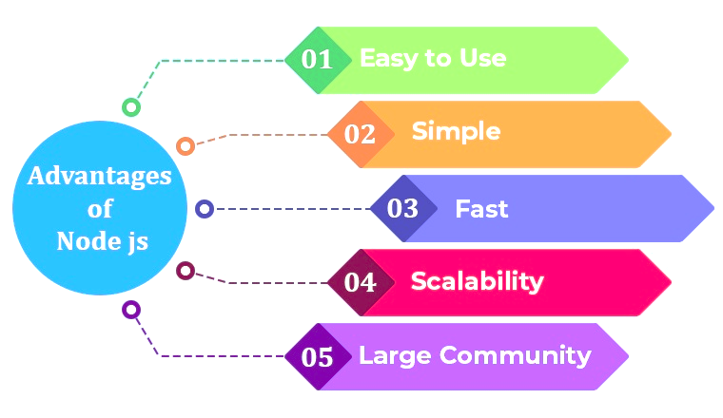

Slide 6
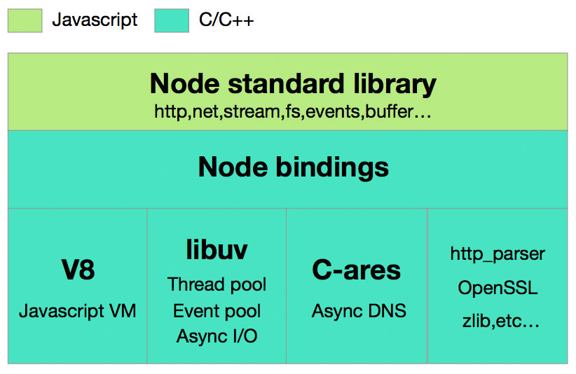
Node.js Architecture

Slide 7
Node.js Process Model
Node.js runs in a single process and the application code runs in a single thread.
User request to web application will be handled by a single thread
All the I/O work or long running job is performed asynchronously for a particular request.
So this single thread doesn’t have to wait for the request to complete and is free to handle the next request.
When asynchronous I/O work completes then it process the request further and sends the response
An event loop is constantly watching for the events to be raised for an asynchronous job and executing callback function when the job completes.
Internally, Node.js uses libuv for the event loop which in turn uses internal C++ thread pool to provide asynchronous I/O.
Node.js process model increases the performance and scalability with a few caveats.
Node.js is not fit for an application which performs CPU-intensive operations like image processing or other heavy computation work because it takes time to process a request and thereby blocks the single thread.

Slide 8
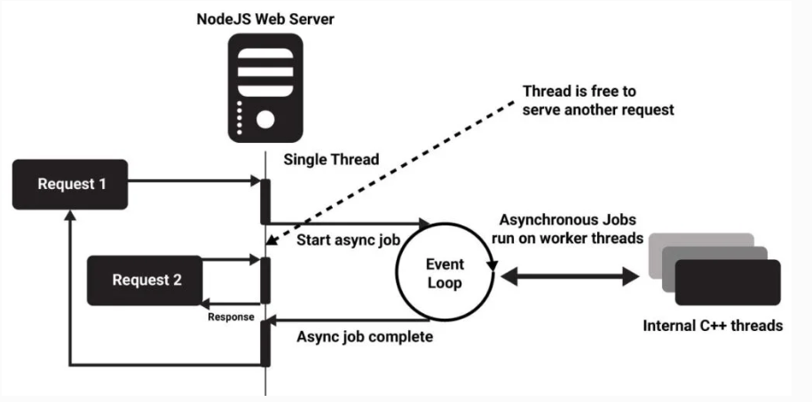
Node.js Process Model

Slide 9
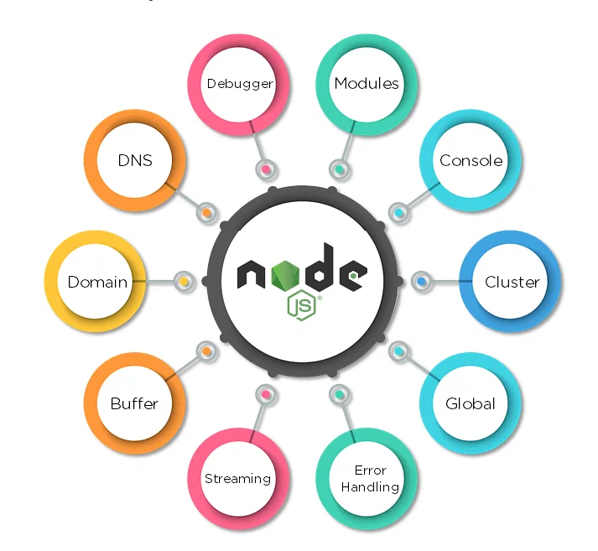

Slide 10
What can you do with Node.js?
You can create an HTTP server.
You can create a TCP server.
You can create DNS server.
You can create Static File Server.
You can create a Web Chat Application.
You can create Online games.
Node.js can also be used for collaboration tools or anything which sends update to the user in real-time.

Slide 11
List of Popular Node.js libraries
Express: minimal, flexible Node.js web application framework for building robust and scalable web applications.
Socket.io: real-time communication library that enables bidirectional, event-driven communication between clients and servers.
Mongoose: An Object Data Modeling (ODM) library for MongoDB, making it easier to work with MongoDB in Node.js applications.
Jest: JavaScript testing framework that provides a simple and powerful way to write and run tests for your code.
Cors: middleware for Express.js that enables Cross-Origin Resource Sharing, allowing secure data exchange between different domains in web applications.
Express-jwt: authentication middleware for Node.js that simplifies user authentication and authorization in web applications.
Multer: middleware for handling file uploads in Node.js applications with ease
NodeMailer: Node.js module for sending email messages using a simple and customizable API.
Sequelize: promise-based Node.js ORM (Object-Relational Mapping) for working with relational databases like MySQL, PostgreSQL, and SQLite.
Morgan: middleware for logging HTTP requests and responses in Node.js applications.
Dotenv: zero-dependency module that loads environment variables from a .env file into Node.js applications, making it easier to manage configuration settings.

Slide 12

Global Companies using Node.js
Netflix
PayPal
Trello
Uber
GoDaddy
Linkedin
Mozilla
Walmart
eBay
NASA – Node.js Helps Even in Space

Slide 13
Conclusion
In conclusion, Node.js is a powerful and versatile runtime environment for building server-side applications. Its non-blocking, event-driven architecture, along with a vast ecosystem of libraries and frameworks, has made it a popular choice for web developers. With Node.js, you can develop scalable, high-performance applications, handle real-time communication, and easily build APIs and microservices.
Node.js is also well-suited for modern web development trends, such as serverless computing, single-page applications, and microservices architecture. Its community-driven development and extensive package ecosystem on npm provide a wealth of tools and resources to streamline development.
As you dive into Node.js, you'll find that its flexibility and performance can empower you to create innovative solutions, whether you're building web servers, APIs, real-time applications, or any other server-side projects

Slide 14
Thank You

