Slide 1
Universal Web Parser
Aleksei Rziankin 2025

Slide 2
A Software-as-a-Service (SaaS) platform that runs your Kotlin scripts on schedule - complete with helper APIs for web parsing.
Main features:
Dynamic scripting
Compile and run Kotlin scripts on the fly - adjust parsing logic anytime without redeploying.
Real-time feedback
Live WebSocket updates deliver compilation errors, logs, and UI updates instantly.
Structured output
Access parsed data as clean JSON objects through REST endpoints.

Slide 3
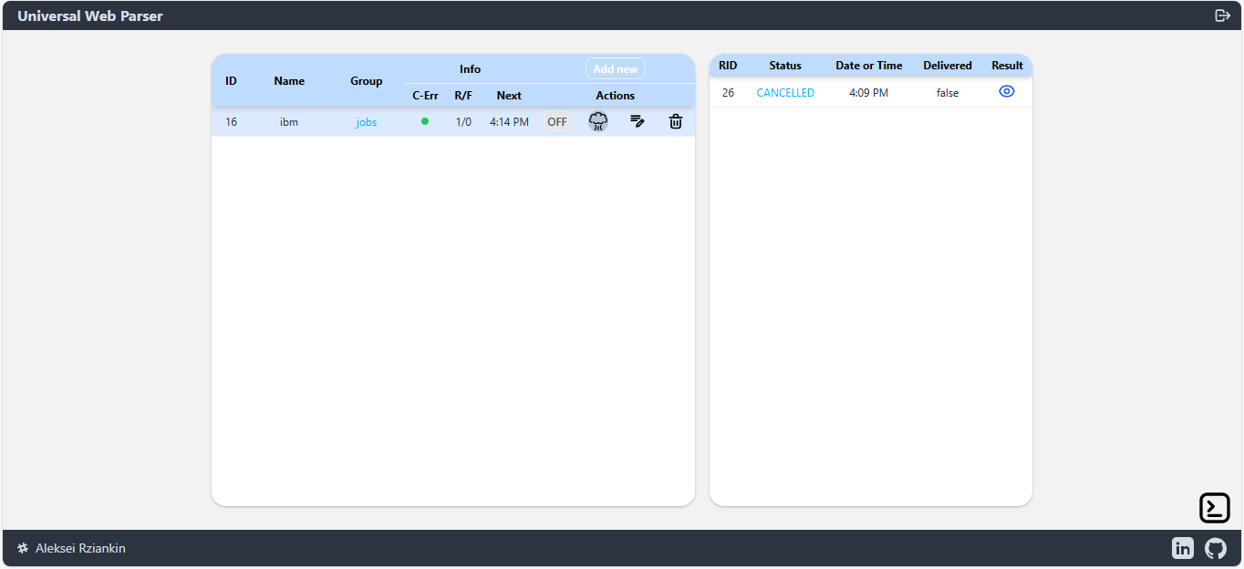
Dashboard
Compilation status
Kill, Edit, Delete
results
available scripts
web console

Slide 4
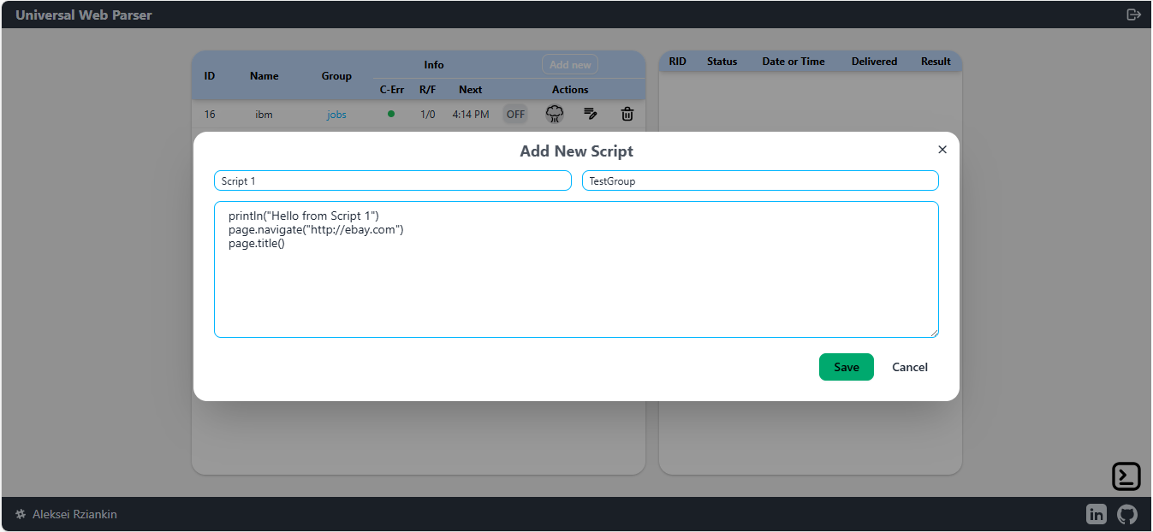
Create new script

Slide 5
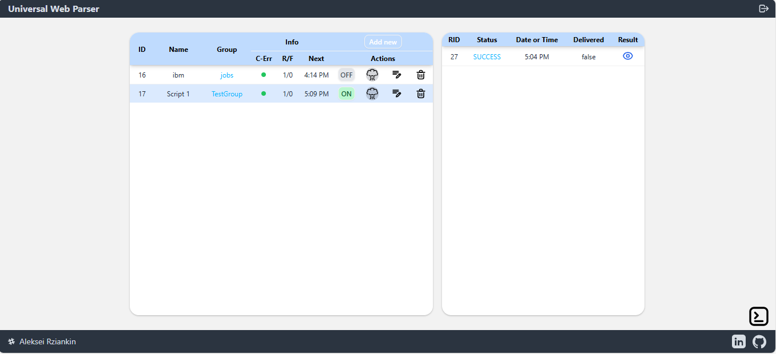
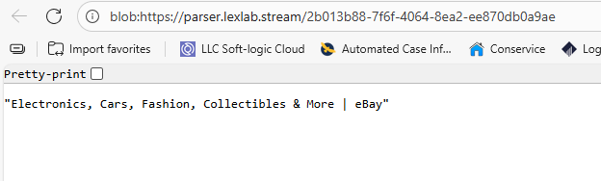
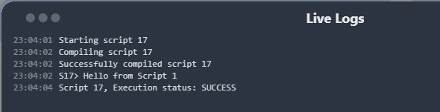
Monitoring

Slide 6
Script API
Each script has access to the following API, managed by the Parser:
println(Any) – Outputs any object to the web console.
page – A ready-to-use Playwright Page instance. Autosaves cookies and sessions.
store – Provides access to state:
fun load(): MutableMap<String, String> – Reads the map from disk.
fun save(map: Map<String, String>) – Saves the map to disk.
val memoryMap: MutableMap<String, Any> – A singleton in-memory map.
fun isThrottled(url: String, hours: Int): Boolean – Returns true on the first invocation,
then false until the specified time has passed.

Slide 7
The End

