Slide 1
8x/Es3
Using the information you spent the last lesson compiling on a country of your choice, make a physical leaflet advising someone on how to spend their holiday in that country.

Slide 2
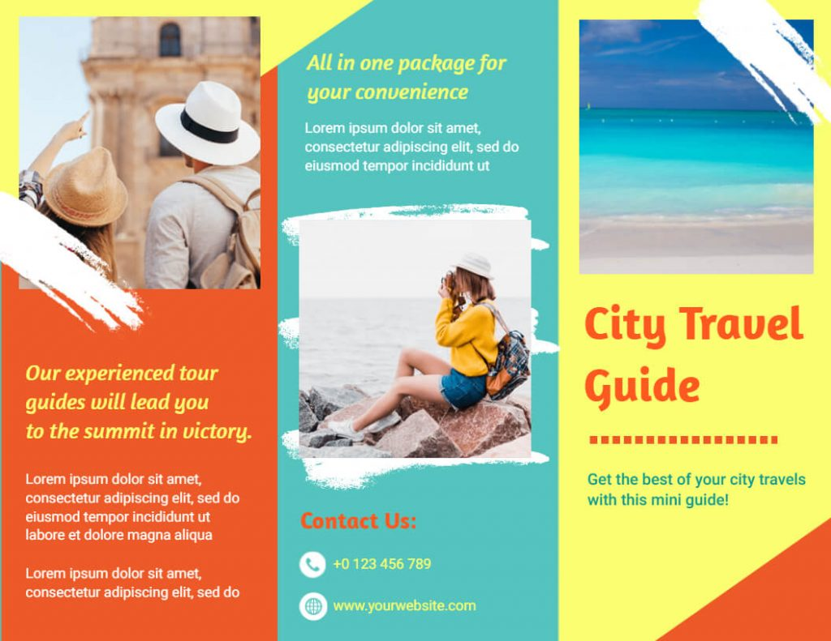

Slide 3
What to include in your leaflet
1. Destination Name + Eye-Catching Title
E.g. “Discover the Magic of Paris!” or “Adventure Awaits in New Zealand!”
Use bold fonts and bright colors.
2. Images or Illustrations
Photos or drawings of famous landmarks, food, nature, or people.
E.g. Eiffel Tower, beaches, wildlife.
3. Short Introduction
A few exciting sentences about the place.
Example: “Paris is the city of lights and love. Explore amazing food, art, and history!”
4. Top Attractions
A bullet point list or short paragraphs.
3–5 key places or activities:
Famous landmarks (e.g. Big Ben, Great Wall of China)
Museums or theme parks
Natural wonders (e.g. beaches, volcanoes)
Local activities (e.g. surfing, hiking, shopping)
5. Fun Facts
Include 2–3 interesting or unusual facts about the place.
“Did you know the Eiffel Tower gets repainted every 7 years?”
“New Zealand has more sheep than people!”
6. Food and Culture
Mention popular local dishes or customs.
“Try fresh sushi in Japan!”
“In Spain, people take a nap in the afternoon called a siesta.”
7. Weather / Best Time to Visit
A small box or section with:
Typical weather
Best months to travel
8. How to Get There
Simple info on transport (plane, train, boat).
You could add a mini map.
9. Who It’s For
Families? Adventurers? Nature lovers?
Helps make it personal: “Perfect for beach lovers!”
10. Contact / Travel Info (Optional)
A fake phone number or travel website if it’s part of a project.

