Slide 1
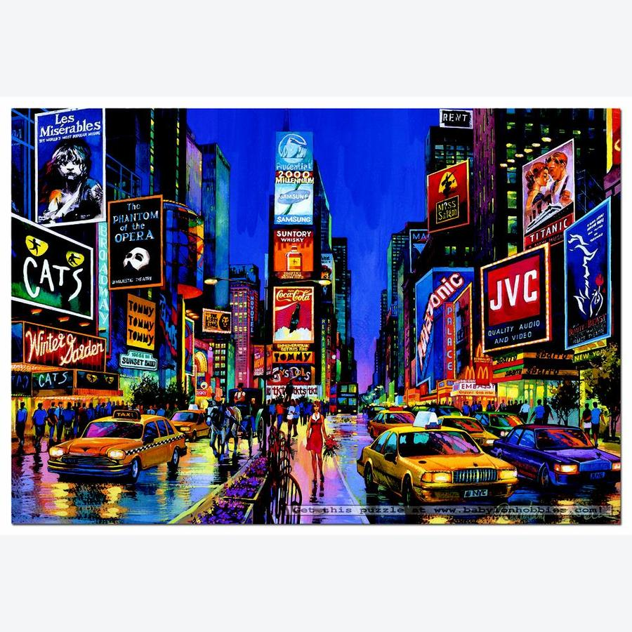
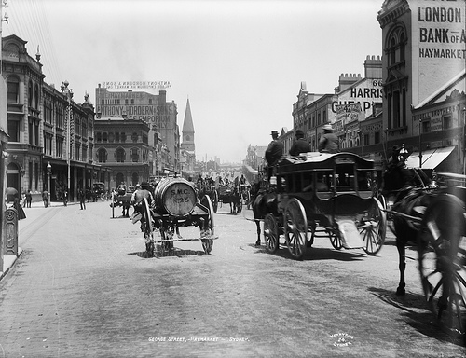
Starter Activity:
Why do we use more oil than 100 years ago? Try to come up with 10 reasons and write them down
2 minutes

Slide 2
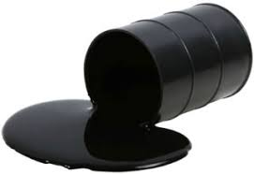
Title:
Oil as a resource.
.
Learning question: (Learning Objective)
Why is oil so important?
LO3: To identify the key facts about oil and the Middle East.
Learning outcome:
LO1: To locate the world’s major oil reserves.
LO2: To explain what we use oil for.

Slide 3
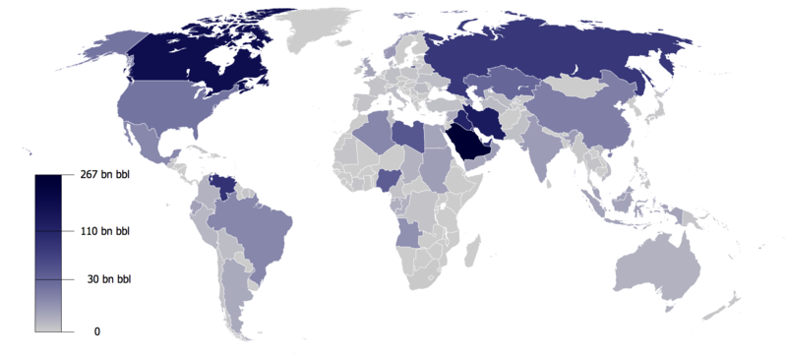
LO1: To locate where the world’s major oil reserves are located.
TASK: In a couple of sentences, Describe where oil is found in the world. Use an atlas if you need to, to help you. Use evidence (numbers) from the image below
Success criteria:
Refer to specific countries
Continents
Use the key make sure you include the figures.
BBL = barrels of oil
Challenge:
Can you link how much oil countries have with how rich they are? Explain using examples.
Sentence starters :
Countries with the most oil are……….. with ……billion barrels of oil.
Countries with the least oil are………. with………billion barrels of oil.
Notes:
Use next slide to for enlarged map

Slide 4
BN - Billion
BBL = barrels of oil

Slide 5
Learning Check: To locate where the world’s major oil reserves are located.
WAGOLL (what a good one looks like) check what yours is compared to this and make some edits/improvements in green pen
T: The distribution of oil is fairly evenly spread out with oil found in most continents.
E: Countries with the most oil are Canada and Saudi Arabia with 267 billion barrels of oil, in the northern hemisphere. Next we have Iran, Iraq and Venezuela with approximately 110 billion barrels of oil.
E: Countries with least amount of oil are for example in South America, Chile, Bolivia and Uruguay with 0 barrels of oil and in Africa, Namibia, Botswana and Zimbabwe also have zero barrels of oil.

Slide 6

Title:
Oil as a resource.
Learning question: (Learning Objective)
How can water cause conflict?
LO3: To identify the key facts about oil and the Middle East.
Learning outcome:
LO1: To locate the world’s major oil reserves.
LO2: To explain what we use oil for.

Slide 7
LO2: To explain what we use oil for.
https://www.youtube.com/watch?v=UPAqfTNiais
Petrol for cars | Diesel for cars, lorries and ships | Aviation fuel for planes | Credit cards | Plastic bags
Hair brushes | Anti-freeze | Motorcycle Helmets | Carpets | Telephones
Brake fluid | Boats | Glue | Toilet Seats | Shampoo
Household paint | Detergent | Bowls | Fertiliser | Explosives
Car tyres | Artificial turf | Football boots | Lipstick | Weed killer
Parachutes | Umbrellas | Food wrappers | Shower curtains | Waterproof coats
Artifical limbs | Roads | Bubble wrap | Drinks bottles | Toothbrushes
Life jackets | Fishing line | Tennis rackets | Roller blades | Eye glasses
Lunch boxes | Flower pots | Toys | Car seats | Insulation
Nail polish | Hair spray | Medicines | Insect repellant | Golf balls
TASK:
On your handout, rank 10 of these on a scale of
1- the most important
10-least important.
Then…
State why you have made your decision.
Help: which ones could we live without and which ones could we not live without? Explain your thoughts.
EXT:
Why do you think oil is so important to people today?

Slide 8
Title:
Oil as a resource.
Learning question: (Learning Objective)
How can water cause conflict?
LO1: To locate the world’s major oil reserves.
LO3: To identify the key facts about oil and the Middle East.
Learning outcome:
LO2: To explain what we use oil for.

Slide 9
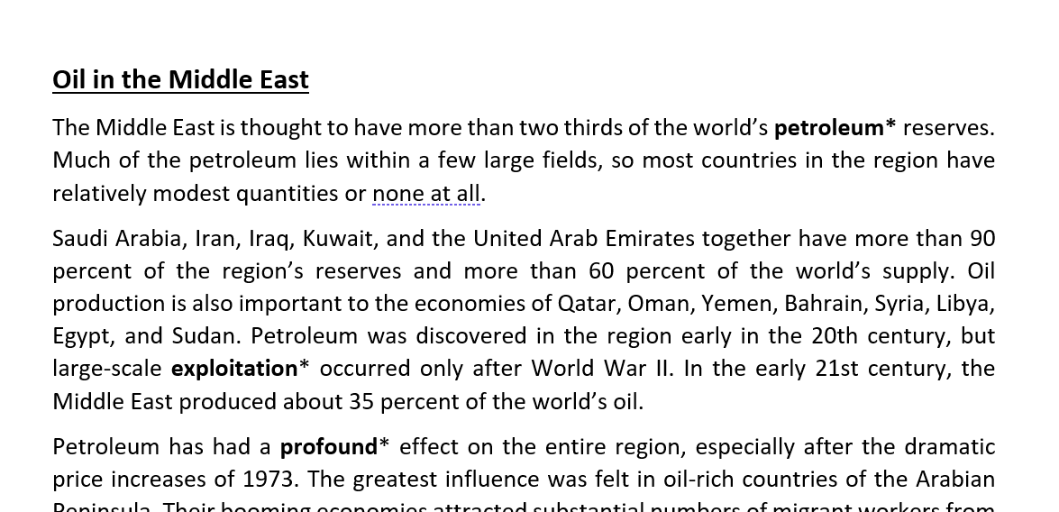
Now read the word document attached to satchel one - about Oil in the Middle East.
When finished reading, do the questions on the next slide.

Slide 10
LO3: To identify the key facts about oil and the Middle East.
TASK:
use the article you have just read (the word document) to oanswer the below questions (in full sentences):
What percentage of the world’s oil reserves are found in this region?
Which countries make up this total?
Who are other main producers of oil in the region?
When was the oil discovered?
What have all the countries dne to diversify their economies?
EXT: Research 5 facts about oil in Saudi Arabia and/or Iraq.
5 minutes
Notes:
Add 5 min timer

Slide 11
Learning check: To identify the key facts about oil and the Middle East.
TASK:
Check your answers:
What percentage of the world’s oil reserves are found in this region?
Which countries make up this total?
Who are other main producers of oil in the region?
When was the oil discovered?
What have all the countries done to diversify their economies?
60%
Saudi Arabia, Iran, Iraq, Kuwait & UAE.
Qatar, Oman, Yemen, Bahrain, Syria, Libya, Egypt, and Sudan
Early 20th Century
Industrialised

Slide 12
Title:
Oil as a resource.
Learning question: (Learning Objective)
How can water cause conflict?
LO3: To identify the key facts about oil and the Middle East.
Learning outcome:
LO1: To locate the world’s major oil reserves.
LO2: To explain what we use oil for.

Slide 13
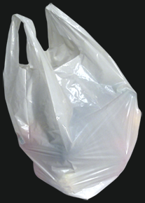
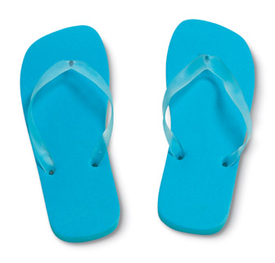
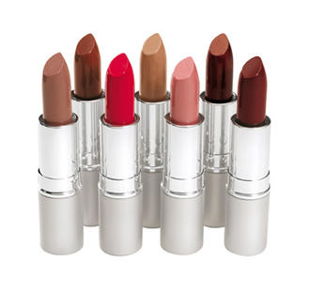
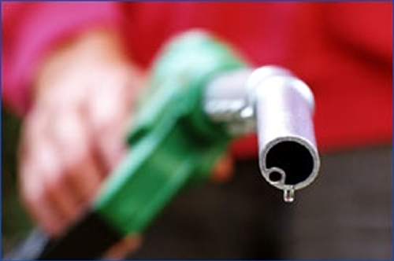
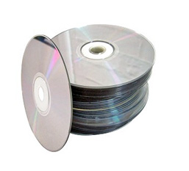
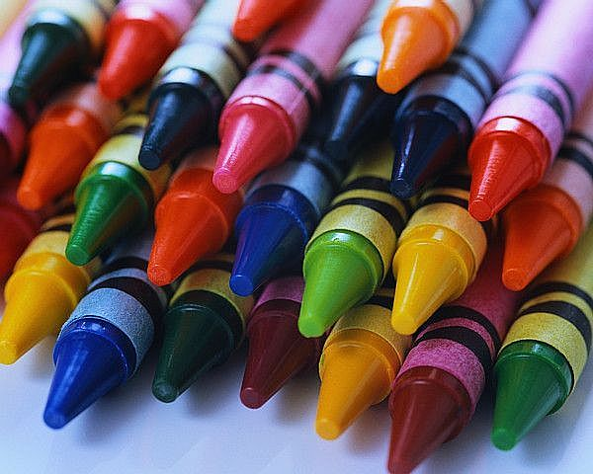
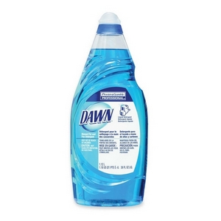
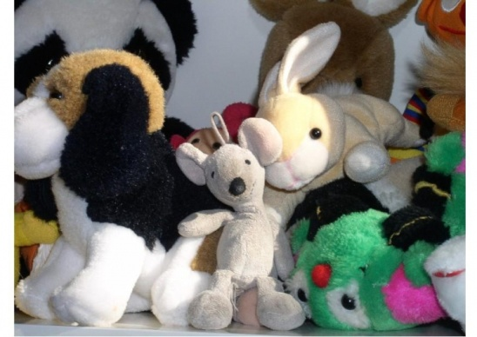
Plenary
TASK: What links all these photos?

Slide 14
Petrol for cars | Diesel for cars, lorries and ships | Aviation fuel for planes | Credit cards | Plastic bags
Hair brushes | Anti-freeze | Motorcycle Helmets | Carpets | Telephones
Brake fluid | Boats | Glue | Toilet Seats | Shampoo
Household paint | Detergent | Bowls | Fertiliser | Explosives
Car tyres | Artificial turf | Football boots | Lipstick | Weed killer
Parachutes | Umbrellas | Food wrappers | Shower curtains | Waterproof coats
Artifical limbs | Roads | Bubble wrap | Drinks bottles | Toothbrushes
Life jackets | Fishing line | Tennis rackets | Roller blades | Eye glasses
Lunch boxes | Flower pots | Toys | Car seats | Insulation
Nail polish | Hair spray | Medicines | Insect repellant | Golf balls
Petrol for cars | Diesel for cars, lorries and ships | Aviation fuel for planes | Credit cards | Plastic bags
Hair brushes | Anti-freeze | Motorcycle Helmets | Carpets | Telephones
Brake fluid | Boats | Glue | Toilet Seats | Shampoo
Household paint | Detergent | Bowls | Fertiliser | Explosives
Car tyres | Artificial turf | Football boots | Lipstick | Weed killer
Parachutes | Umbrellas | Food wrappers | Shower curtains | Waterproof coats
Artifical limbs | Roads | Bubble wrap | Drinks bottles | Toothbrushes
Life jackets | Fishing line | Tennis rackets | Roller blades | Eye glasses
Lunch boxes | Flower pots | Toys | Car seats | Insulation
Nail polish | Hair spray | Medicines | Insect repellant | Golf balls
Notes:
1 per student

