Slide 1
Assessment 1: How useful is Source A to a historian studying the significance of the Scientific Revolution on Europe? [8 marks]
Recap knowledge
Plan a practice question together and highlight model answer
Revise for assessment.

Slide 2
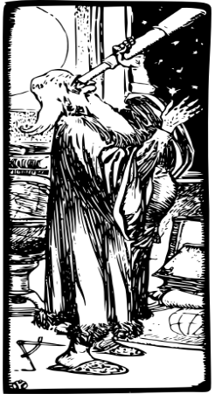


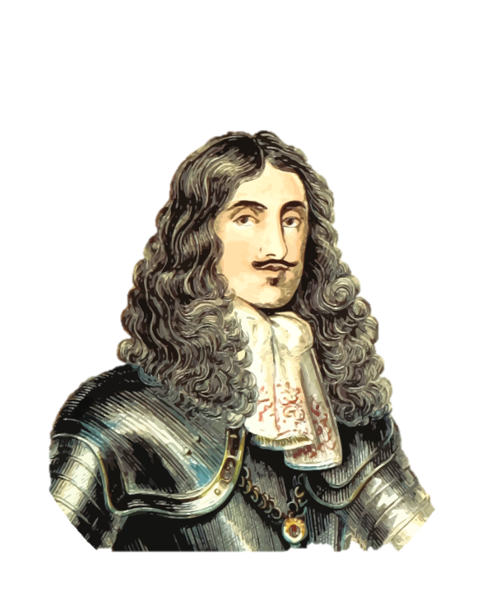
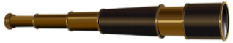
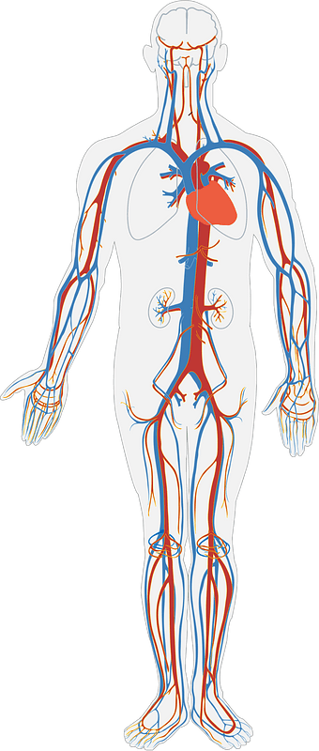
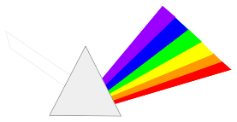
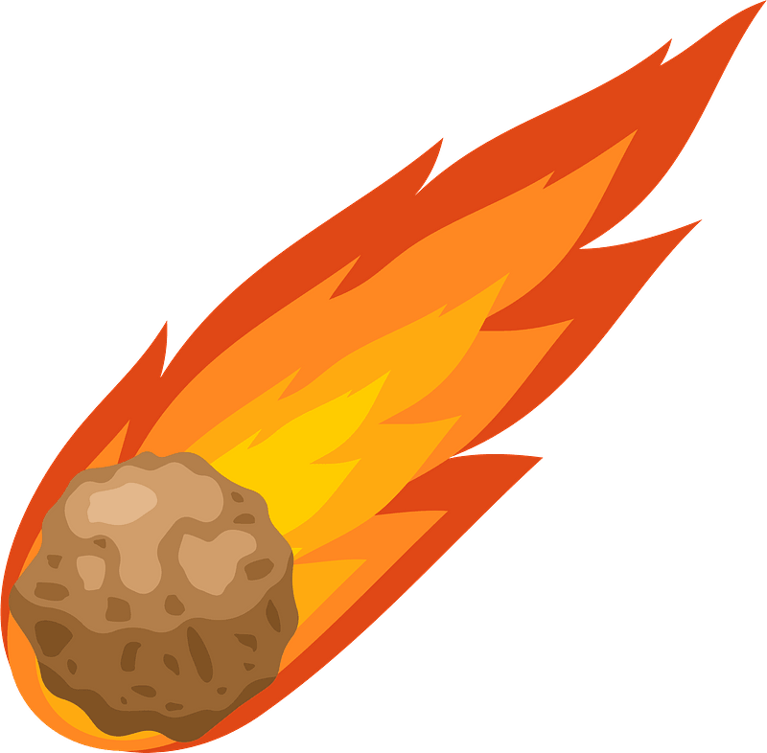

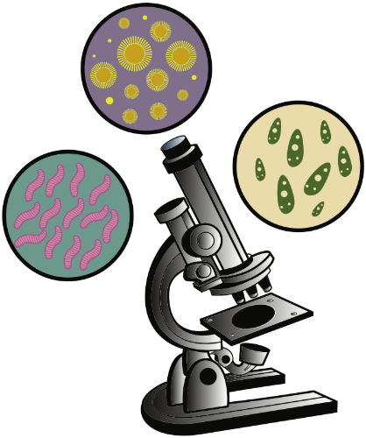
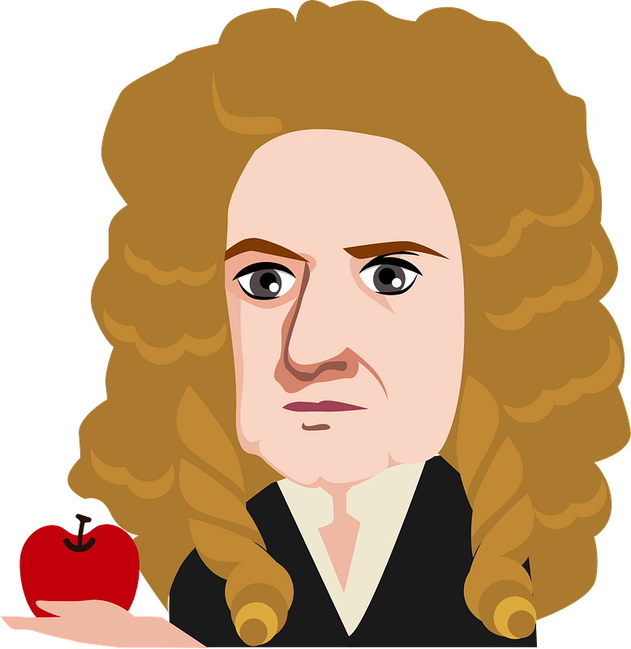
1543
Polish astronomer, Nicolaus Copernicus used mathematics and observation to prove that planets revolved around the Sun and not the Earth. He also proved that the Moon moves around the Earth.
1543
An Italian doctor, Andreas Vesalius published the first books which showed accurate drawings of the muscles, blood vessels and bones in the human body. He used the bodies of executed criminals which he had stolen from local
cemeteries.
1575
Ambroise Paré was a surgeon in the French army. He discovered that using bandages and soothing ointments could treat wounds and prevent deadly infections. Before this, boiling oil was used on open wounds and soldiers died from blood loss.
1609
An Italian called Galileo Galilei designed and built the first effective telescope which was powerful enough to see planets such as Mars and Venus for the first time. However, when he said he could prove that the Earth revolved around the Sun, the Church rejected his ideas and made him deny his theory in public!
1620
British politician and scientist Francis Bacon created a new way to study and learn about the world. Rather than simply discuss ideas with other scientists until they all agreed, Bacon believed a person needed to experiment to find out new facts. He inspired others such as Isaac Newton.
1662
King Charles II also wanted more breakthroughs in the study of the human body. He went against the wishes of the Church and increased the number of dead bodies for doctors to study. The bodies were all from executed criminals.
1662
King Charles II was keen to promote new scientific discoveries. He formed the Royal Society. This became a place for modern scientists to discuss their new ideas and carry out experiments. The group still meet today.
1661
Englishman, Robert Boyle proved that air is essential for both breathing and burning. As a scientist, he proved that a much larger number of substances made up the Earth. Before Boyle, most people believed the world was made of only four elements – earth, air, fire and water. Boyle is now referred to as the ‘Father of Modern Chemistry’.
1657
Englishman, Christopher Wren was a Professor of Astronomy as well as the famous designer of St Paul’s Cathedral in London. Rather than work alone, he believed that more discoveries could be made if scientists worked together. He began to regularly meet with other scientists and
mathematicians.
1628
Until now, doctors believed that the liver helped circulate blood around the body. English doctor, William Harvey experimented on human bodies to prove that the heart acted like a pump to circulate blood around the body.
1676
Dutchman, Leeuwenhoek developed powerful microscopes from which images of tiny particles could be seen for the first time, including the first image of bacteria – the main cause of illness and disease.
1686
Englishman, Isaac Newton discovered a force called gravity. He proved that it was gravity which kept the Moon orbiting around Earth and that kept objects and humans on the Earth.
1686
Isaac Newton published his famous book called Principia. In it, he used a prism to show the seven main colours of the spectrum. He helped scientists all over the world understand how light works in the universe.
1705
Astronomer Edmund Halley discovered that the same comet orbited the Earth every 75 years. The comet became known as Halley’s Comet. It was last seen in 1986 and is due to appear next in 2061!
1717
Lady Mary Wortley Montagu experimented with smallpox vaccinations to stop a person catching the deadly disease. Her experiments were so successful that King George I had his own grandchildren vaccinated.
Notes:
William Harvey Arms - https://creativecommons.org/licenses/by-sa/2.0/ - https://www.flickr.com/photos/liverpoolhls/10826089793

Slide 3
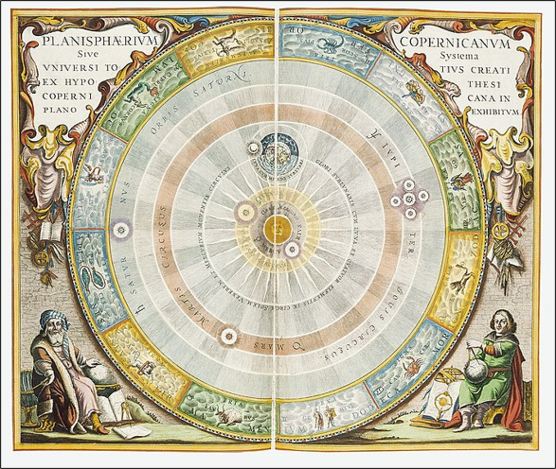
How useful is Source A to a historian studying the significance of the Scientific Revolution on Europe? [8 marks]
D | Describe key features
E | Explain meaning (inference)
E | Evidence/examples
P | Provenance details
ER | Explain what provenance reveals.
An image published in Nicolaus Copernicus’ famous book On the Revolutions of the Heavenly Spheres published in 1543. It was widely circulated across Europe.

Slide 4
How useful is Source A to a historian studying the significance of the Scientific Revolution on Europe? [8 marks]
1.Describe key features … Source A shows …
2. Explain meaning (inference) … This suggests that …
3. Evidence/examples … This is useful because I know that …
4. Provenance details … The source was …
5. Explain what the provenance reveals … This is useful because it shows, demonstrates, highlights …
6. Decide how useful (judgement) … To conclude, Source A is useful because …
An image published in Nicolaus Copernicus’ famous book On the Revolutions of the Heavenly Spheres published in 1543. It was widely circulated across Europe.

Slide 5
How useful is Source A to a historian studying the significance of the Scientific Revolution on Europe? [8 marks]
1.Describe key features … Source A shows a diagram of the universe with the Sun in the centre and all the planets, including Earth, orbiting around it in circles. It includes the names of the planets like Mars, Venus and Saturn, and the outer ring shows the zodiac signs.
2. Explain meaning (inference) … This suggests that the person who made this image believed in the idea that the Sun, not the Earth, is at the centre of the universe. It also shows that people were beginning to question older beliefs.
3. Evidence/examples … This is useful because I know that before this, most people believed that the Earth was in the centre. This was until Polish astronomer, Nicolaus Copernicus used mathematics and observation to prove that planets revolved around the Sun and not the Earth. He also proved that the moon moves around the Earth. This image shows a clear change in thinking during the Scientific Revolution.
4. Provenance details … The source was published in 1543 by Nicolaus Copernicus in a book called On the Revolutions of the Heavenly Spheres. It was shared across Europe at the time.
5. Explain what the provenance reveals … This is useful because it shows how new ideas were being spread during the Renaissance, especially through books and printing. It demonstrates that scientists like Copernicus were challenging the Church’s teachings using evidence and observation.
6. Decide how useful (judgement) … To conclude, Source A is useful because it helps us understand how the Copernicus’ idea was presented and shared during the 1500s. It also shows how science was starting to become more important than religious tradition.
An image published in Nicolaus Copernicus’ famous book On the Revolutions of the Heavenly Spheres published in 1543. It was widely circulated across Europe.

Slide 6
How useful is Source A to a historian studying the significance of the Scientific Revolution on Europe?
[8 marks]
D | Describe key features
E | Explain meaning (inference)
E | Evidence/examples
P | Provenance details
ER | Explain what provenance reveals
Source A shows a diagram of the universe with the Sun in the centre and all the planets, including Earth, orbiting around it in circles. It includes the names of the planets like Mars, Venus and Saturn, and the outer ring shows the zodiac signs. This suggests that the person who made this image believed in the idea that the Sun, not the Earth, is at the centre of the universe. It also shows that people were beginning to question older beliefs. This is useful because I know that before this, most people believed that the Earth was in the centre. This was until Polish astronomer, Nicolaus Copernicus used mathematics and observation to prove that planets revolved around the Sun and not the Earth. He also proved that the moon moves around the Earth. This image shows a clear change in thinking during the Scientific Revolution. The source was published in 1543 by Nicolaus Copernicus in a book called On the Revolutions of the Heavenly Spheres. It was shared across Europe at the time. This is useful because it shows how new ideas were being spread during the Renaissance, especially through books and printing. It demonstrates that scientists like Copernicus were challenging the Church’s teachings using evidence and observation. To conclude, Source A is useful because it helps us understand how the Copernicus’ idea was presented and shared during the 1500s. It also shows how science was starting to become more important than religious tradition.
Notes:
model

Slide 7
How useful is Source A to a historian studying the significance of the Scientific Revolution on Europe?
[8 marks]
D | Describe key features
E | Explain meaning (inference)
E | Evidence/examples
P | Provenance details
ER | Explain what provenance reveals
Source A shows a diagram of the universe with the Sun in the centre and all the planets, including Earth, orbiting around it in circles. It includes the names of the planets like Mars, Venus and Saturn, and the outer ring shows the zodiac signs. This suggests that the person who made this image believed in the idea that the Sun, not the Earth, is at the centre of the universe. It also shows that people were beginning to question older beliefs. This is useful because I know that before this, most people believed that the Earth was in the centre. This was until Polish astronomer, Nicolaus Copernicus used mathematics and observation to prove that planets revolved around the Sun and not the Earth. He also proved that the moon moves around the Earth. This image shows a clear change in thinking during the Scientific Revolution. The source was published in 1543 by Nicolaus Copernicus in a book called On the Revolutions of the Heavenly Spheres. It was shared across Europe at the time. This is useful because it shows how new ideas were being spread during the Renaissance, especially through books and printing. It demonstrates that scientists like Copernicus were challenging the Church’s teachings using evidence and observation. To conclude, Source A is useful because it helps us understand how the Copernicus’ idea was presented and shared during the 1500s. It also shows how science was starting to become more important than religious tradition.
Notes:
model

Slide 8
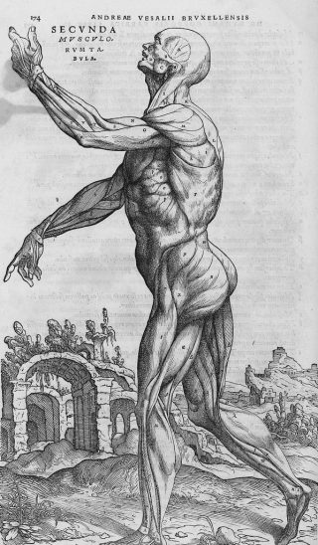
How useful is Source A to a historian studying the significance of the Scientific Revolution on Europe? [8 marks]
A drawing from Andreas Vesalius' book, The Fabric of the Human Body, published in 1543. It was the first book that contained accurate drawings of the human body based on extensive dissections.
D | Describe key features
E | Explain meaning (inference)
E | Evidence/examples
P | Provenance details
ER | Explain what provenance reveals

Slide 9
A drawing from Andreas Vesalius' book, The Fabric of the Human Body, published in 1543. It was the first book that contained accurate drawings of the human body based on extensive dissections.

Slide 10
How useful is Source A to a historian studying the significance of the Scientific Revolution on Europe? [8 marks]
1.Describe key features … Source A shows …
2. Explain meaning (inference) … This suggests that …
3. Evidence/examples … This is useful because I know that …
4. Provenance details … The source was …
5. Explain what the provenance reveals … This is useful because it shows, demonstrates, highlights …
6. Decide how useful (judgement) … To conclude, Source A is useful because …
A drawing from Andreas Vesalius' book, The Fabric of the Human Body, published in 1543. It was the first book that contained accurate drawings of the human body based on extensive dissections.

Slide 11
How useful is Source A to a historian studying the significance of the Scientific Revolution on Europe? (8 marks)
Level Awarded: |  | Student Feedback: (add in green)
AO1=Knowledge & Understanding: How well do you know your topic, and can you explain what happened in history? AO2= How well can you understand, explain and judge historical sources?
Level 1 – Emerging (1-2marks) | Level 2 – Developing (3-4 marks) | Level 3 – Secure (5-6 marks) | Level 4 – Mastered (7-8 marks)
Says something very simple about what the source shows. May copy part of the source or describe the picture/text without explaining. Shows little knowledge of the Scientific Revolution or its impacts. Does not explain if the source is useful or why. | Describes what the source shows and gives a basic opinion on its usefulness. Uses a small amount of knowledge about the Scientific Revolution. Mentions who made the source or when, but doesn’t explain how that affects usefulness. Gives a limited judgement. | Explains what the source shows or suggests and how that links to impacts of the Scientific Revolution. Uses own knowledge to support or question what the source says. Mentions who made the source and when, and begins to explain if it’s reliable. Gives a reasoned opinion on how useful the source is. | Confidently explains the message or purpose of the source. Uses accurate and specific knowledge to show how the source helps explain the impacts of the Scientific Revolution. Evaluates the source’s reliability by discussing the author, date, and possible bias. Makes a balanced judgement: how useful is it overall, and what else would a historian need?
To improve? Say what the source is about and who made it. Start to use your own knowledge to say if the source is true or not. Use phrases like “This is useful because…” or “This doesn’t tell us…” | To improve: Add more knowledge to support what the source is showing. Think about when the source was made and whether the person who made it might be biased. Begin to explain what the source leaves out or what it doesn’t tell us. | To Improve: Make clear links between the source and what historians already know about the impacts. Use terms like trustworthy, biased, limited, supportive. Show both what the source is useful for and what it might miss out. | To improve: Use detailed knowledge of key impacts. Evaluate the provenance clearly (who, when, why?) and how that affects usefulness. Explain both the value of the source and its limitations, and support your conclusion with evidence.

