Slide 1



INTRODUCTION

Slide 2
Team Members
Introduction/Background: Siying Chen
Query 1: Jinhui Liu
Query 2: Aleksander Sekowski
Query 3: Adrian Marroquin
Query 4: Fereshteh Mamaghani

Slide 3
Dataset Details
Name: Pain Pills in the USA
Size: 12GB subset from 74GB
Source: https://www.kaggle.com/paultimothymooney/pain-pills-in-the-usa
Github: https://github.com/aleksUIX/CIS5200-team5

Slide 4

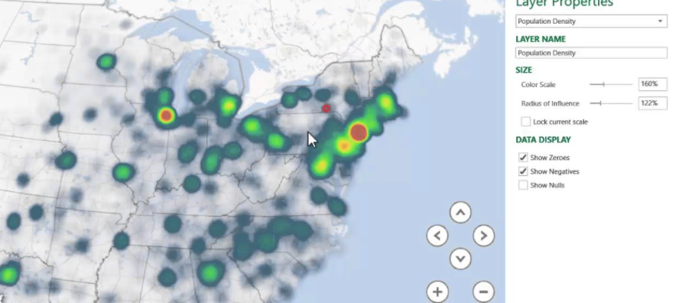


FLOWCHART OF DATA ANALYSIS
Download data from ARCOS
Use Spatial-Temporal diagrams, pie charts and other graphs to visualize the insights
Fix and Edit data details in Microsoft Excel
Uploaded the tsv file into HDFS
Create tables and relations using Hive and Pig
Output new file in ‘CSV’ or ‘TSV’ format to local hard drive

Slide 5
ARCOS
ARCOS Defined :
The Automation of Reports and Consolidated Orders System (ARCOS) is the automated system developed by DEA to monitor selected controlled substances.
Authority for ARCOS

Slide 6

Specifications
Cluster version: 20.3.3-20
Cluster number of nodes:3
Memory size: 180 GB RAM
Storage: 960 GB
CPU speed: 12 OCPUs

