Slide 1
Основи рачунарске технике 2
Пројекат

Slide 2
Основи рачунарске технике 2
Пројекат – INTR блок

Slide 3
Инструкција | IR_{23..18}
SUB | 0011 11b
ADD | 0011 10b
ST | 0011 01b
LD | 0011 00b
Инструкција | IR_{23..16} | IR_{15..8} | IR_{7..0} | Дужина
JSR | 0010 0001b | млађи бајт | старији бајт | 3B
JMP | 0010 0000b | млађи бајт | старији бајт | 3B
JLEQ | 0001 0001b | млађи бајт | старији бајт | 3B
BLSS | 0001 0000b | померај | / | 2B
RTI | 0000 0010b | / | / | 1B
RTS | 0000 0001b | / | / | 1B
HALT | 0000 0000b | / | / | 1B
Адресирања | IR_{17..16} | IR_{15..8} | IR_{7..0} | Дужина
regindpom | 11b | PPPP PRRRb | / | 2B
regind | 10b | XXXX XRRRb | / | 2B
memdir | 01b | млађи бајт | старији бајт | 3B
immed | 00b | податак | / | 2B
 | Нижа адреса | Виша адреса
Адреса | млађи | старији

Slide 4
INTR
INTR
INTR
0
INTR
0
1
1
prekid
0
prekid
0
IF
IF
1
1

Slide 5
MAR_{15..0} <= SP_{15..0}
MDR_{7..0} <= PC_{15..8}
SP_{15..0} <= SP_{15..0} - 1
mxMAR0, mxMAR1, ldMAR,
decSP, mxMDR1, ldMDR
MEM[MAR_{15..0}] <= MDR_{7..0}
wrMEM
FCBUS
0
FCBUS
0
1
1
MAR_{15..0} <= SP_{15..0}
MDR_{7..0} <= PC_{7..0}
SP_{15..0} <= SP_{15..0} - 1
mxMAR0, mxMAR1, ldMAR,
decSP, mxMDR0, mxMDR1, ldMDR
MEM[MAR_{15..0}] <= MDR_{7..0}
wrMEM
FCBUS
0
FCBUS
0
1
1

Slide 6
MAR_{15..0} <= SP_{15..0}
MDR_{7..0} <= PSW_{7..0}
SP_{15..0} <= SP_{15..0} - 1
mxMAR0, mxMAR1, ldMAR,
decSP, mxMDR2, ldMDR
MEM[MAR_{15..0}] <= MDR_{7..0}
wrMEM
FCBUS
0
FCBUS
0
1
1
BR_{1..0} <= UEXT_{1..0}
ldBR
MAR_{15..0} <= IVTP_{15..0}+IVTDSP_{15..0}
mxMAR2, ldMAR
MDR_{7..0} <= MEM[MAR_{15..0}]
rdMEM, ldMDR
FCBUS
0
FCBUS
0
1
1

Slide 7
MAR_{15..0} <= MAR_{15..0}+1,
DWL_{7..0} <= MDR_{7..0}
incMAR, ldDWL
MDR_{7..0} <= MEM[MAR_{15..0}]
rdMEM, ldMDR
FCBUS
0
FCBUS
0
1
1
DWH_{7..0} <= MDR_{7..0}
ldDWH
PC_{15..0} <= DW_{15..0}
ldPC, mxPC1
IF
IF
FETCH <= 1, INTR <= 0
stFETCH, clINTR
EXEC
EXEC

Slide 8
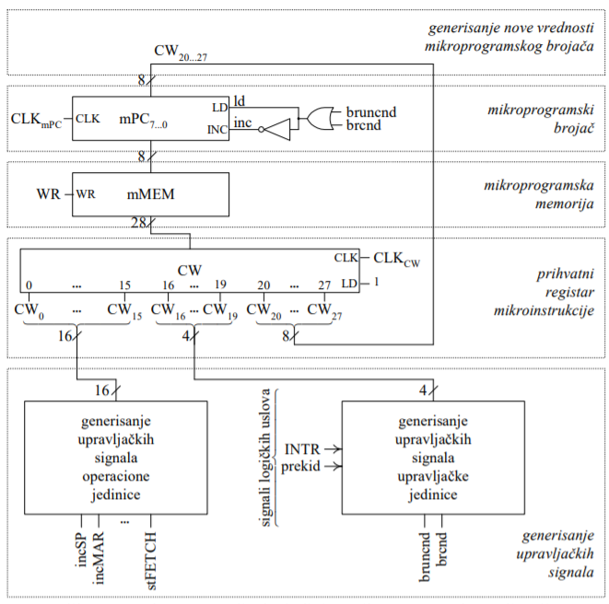
Управљачка јединица

Slide 9
step00 br(if notINTR then step00)
step01 br(if notprekid then step)
INTR
INTR
0
1
prekid
0
IF
1

Slide 10
step00 br(if notINTR then step00)
step01 br(if notprekid then step)
step02 mxMAR0, mxMAR1, ldMAR, decSP, mxMDR1, ldMDR
step03 wrMEM,
br(if notFCBUS then step03)
step04 mxMAR0, mxMAR1, ldMAR, decSP, mxMDR0, mxMDR1, ldMDR
step05 wrMEM,
br(if notFCBUS then step05)
mxMAR0, mxMAR1, ldMAR,
decSP, mxMDR1, ldMDR
wrMEM
FCBUS
0
1
mxMAR0, mxMAR1, ldMAR,
decSP, mxMDR0, mxMDR1, ldMDR
wrMEM
FCBUS
0
1

Slide 11
step00 br(if notINTR then step00)
step01 br(if notprekid then step)
step02 mxMAR0, mxMAR1, ldMAR, decSP, mxMDR1, ldMDR
step03 wrMEM,
br(if notFCBUS then step03)
step04 mxMAR0, mxMAR1, ldMAR, decSP, mxMDR0, mxMDR1, ldMDR
step05 wrMEM,
br(if notFCBUS then step05)
step06 mxMAR0, mxMAR1, ldMAR, decSP, mxMDR2, ldMDR
step07 wrMEM,
br(if notFCBUS then step07)
step08 ldBR
step09 mxMAR2, ldMAR
step0A rdMEM, ldMDR
br(if notFCBUS then step0A)
mxMAR0, mxMAR1, ldMAR,
decSP, mxMDR2, ldMDR
wrMEM
FCBUS
0
1
ldBR
mxMAR2, ldMAR
rdMEM, ldMDR
FCBUS
0
1

Slide 12
step0B incMAR, ldDWL
step0C rdMEM, ldMDR
br(if notFCBUS then step0C)
step0D ldDWH
step0E ldPC, mxPC1
step0F stFETCH, clINTR
incMAR, ldDWL
rdMEM, ldMDR
FCBUS
0
1
ldDWH
ldPC, mxPC1
IF
stFETCH, clINTR
EXEC

Slide 13
step00 br(if notINTR then step00)
step01 br(if notprekid then step0F)
step02 mxMAR0, mxMAR1, ldMAR, decSP, mxMDR1, ldMDR
step03 wrMEM,
br(if notFCBUS then step03)
step04 mxMAR0, mxMAR1, ldMAR, decSP, mxMDR0, mxMDR1, ldMDR
step05 wrMEM,
br(if notFCBUS then step05)
step06 mxMAR0, mxMAR1, ldMAR, decSP, mxMDR2, ldMDR
step07 wrMEM,
br(if notFCBUS then step07)
step08 ldBR
step09 mxMAR2, ldMAR
step0A rdMEM, ldMDR
br(if notFCBUS then step0A)
0 | 1 | 2 | 3
mxMAR0 | mxMAR1 | ldMAR | decSP
4 | 5 | 6 | 7
mxMDR1 | ldMDR | wrMEM | mxMDR0
8 | 9 | 10 | 11
mxMDR2 | ldBR | mxMAR2 | rdMEM
12 | 13 | 14 | 15
16 | 17 | 18 | 19
20 | 21 | 22 | 23

Slide 14
step0B incMAR, ldDWL
step0C rdMEM, ldMDR
br(if notFCBUS then step0C)
step0D ldDWH
step0E ldPC, mxPC1
step0F stFETCH, clINTR
0 | 1 | 2 | 3
mxMAR0 | mxMAR1 | ldMAR | decSP
4 | 5 | 6 | 7
mxMDR1 | ldMDR | wrMEM | mxMDR0
8 | 9 | 10 | 11
mxMDR2 | ldBR | mxMAR2 | rdMEM
12 | 13 | 14 | 15
incMAR | ldDWL | ldDWH | ldPC
16 | 17 | 18 | 19
mxPC1 | stFETCH | clINTR
20 | 21 | 22 | 23

Slide 15
Сигнал безусловног скока | CC
bruncnd | 1
Сигнал условног скока | CC | Сигнал услова
brnotINTR | 2 | INTR
brnotprekid | 3 | prekid
brnotFCBUS | 4 | FCBUS

Slide 16
0 | 1 | 2 | 3
mxMAR0 | mxMAR1 | ldMAR | decSP
4 | 5 | 6 | 7
mxMDR1 | ldMDR | wrMEM | mxMDR0
8 | 9 | 10 | 11
mxMDR2 | ldBR | mxMAR2 | rdMEM
12 | 13 | 14 | 15
incMAR | ldDWL | ldDWH | ldPC
16 | 17 | 18 | 19
mxPC1 | stFETCH | clINTR | cc
20 | 21 | 22 | 23
cc |  | ba
24 | 25
ba

Slide 17
step00 br(if notINTR then step00)
step01 br(if notprekid then step0F)
step02 mxMAR0, mxMAR1, ldMAR, decSP, mxMDR1, ldMDR
step03 wrMEM,
br(if notFCBUS then step03)
step04 mxMAR0, mxMAR1, ldMAR, decSP, mxMDR0, mxMDR1, ldMDR
step05 wrMEM,
br(if notFCBUS then step05)
step06 mxMAR0, mxMAR1, ldMAR, decSP, mxMDR2, ldMDR
step07 wrMEM,
br(if notFCBUS then step07)
step08 ldBR
step09 mxMAR2, ldMAR
step0A rdMEM, ldMDR
br(if notFCBUS then step0A)
step0B incMAR, ldDWL
step0C rdMEM, ldMDR
br(if notFCBUS then step0C)
step0D ldDWH
step0E ldPC, mxPC1
step0F stFETCH, clINTR

