Slide 1
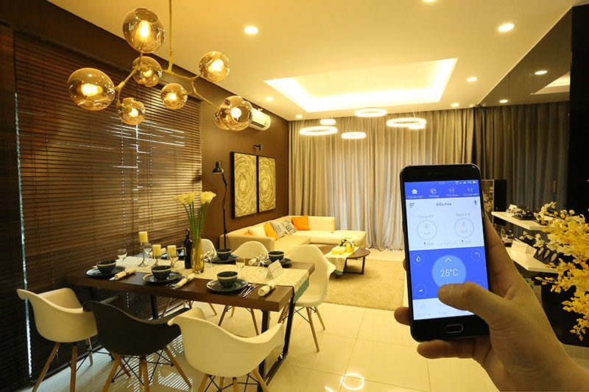
IoTHome

Slide 2
At the end of the day, it isn’t where I came from. Maybe home is somewhere I’m going and never have been before. ― Warsan Shire

Slide 3
Table of contents
What is IoTHome?
Motivation
Project goals
Participants
Project plan
Budget
Questions?

Slide 4
IoTHome
Smart home system using the Internet of Things
Call: H2020-IOT-2017 R&I on IoT integration and platforms
Project start date: 1.7.2018.
Project end date: 1.6.2021.

Slide 5
Motivation
Development of smarter application and services
Open IoT ecosystem and platforms
Integration and cooperation of different platforms and devices

Slide 6
Project goals
Easier human life
More eficient energy consumption
Easier security control

Slide 7
Participants
ETF Belgrade
Serbia
Schneider Electric
Serbia
Aegis Defence Services
Hungary
Miele
Czech Republic
ETH Warsaw
Poland
Vinci
Romania

Slide 8

Project plan

Slide 9
WorkPackages
Preparation
Implementation
QA & review
WP1 Market analysis
WP2 User requirements analysis
WP3 System design
WP4 Architecture modeling
WP5 Software implementation
WP6 Software integration
WP7 System testing
WP8 Promotion and marketing
WP9 Evaluation and dissimination
WP10 Project management

Slide 10

Important milestones
End of analysis
Start of implementation
End of integration
End of testing
End of marketing
End of project

Slide 11
Basic architecture
Home
appliances
Central
Unit
Android
Desktop
IOS

Slide 12

System functionality
User login
Add a home device
Change the state of device
Add house mode
Chose house mode
Edit mode of house
Security and engergy consumption alerts

Slide 13
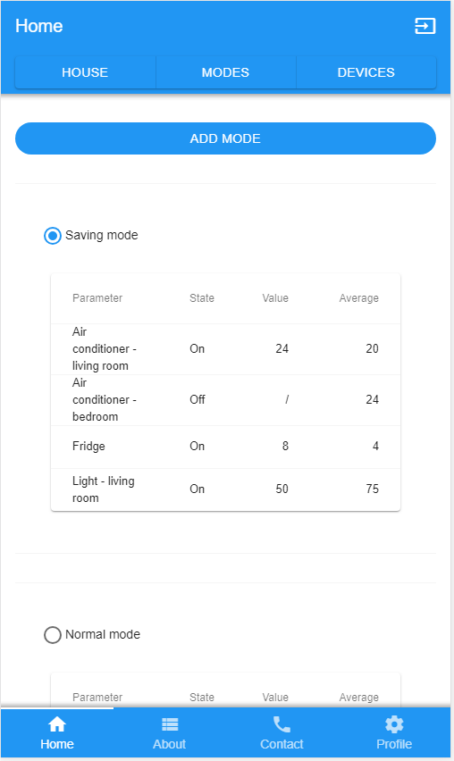
ANDROID PROJECT
Place your screenshot here

Slide 14
762,070
Total grant requested from the EU

Slide 15
Budget
NAME OF EXPENSE | AMOUNT
Staff costs | 252 470
Equipment costs | 170 000
Travel costs | 65 500 + 224 000
Outsorcing | 50 000
 | 762 070

Slide 16

Authors:
Aleksandra Todorovic
0333/2014
Aleksa Marusic
0129/2015

Slide 17
Questions?

