Slide 1



Chair for Applied Software Engineering
Prof. Dr. Bernd Brügge
Applied Machine Learning
Food waste due to inefficient food consumption
Aleksandar Aleksandrov

Slide 2
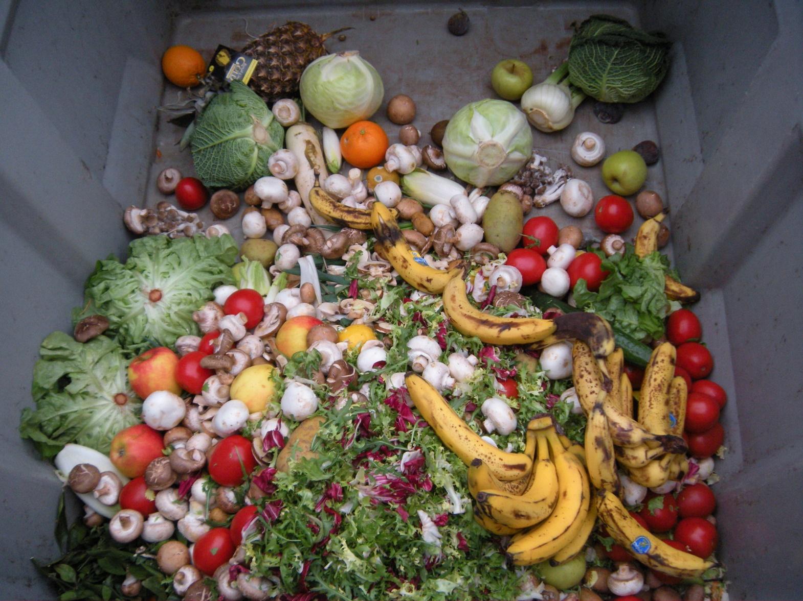
Problem Statement
Problem: Food waste due to inefficient food consumption
Hard facts:
~7.5B people
>0.8B malnourished people ^{[1]}
Food production for >12.5B people ^{[3]}
Only 1/3 of produced food is being consumed ^{[1]}
>100 kg food waste per end consumer on average per year (developed countries) ^{[2]}
Direct correlation to two of the sustainability goals ^{[1]}

Slide 3
Problem Statement – Causes & Solutions
Some causes of the problem: ^{[2]}
Poor Planning
Inefficient food production
Inefficient food usage
Overconsumption
Solution: Optimize eating habits by providing a easy-to-use recipe recommendation system based on visual identification of available ingredients

Slide 4
Related Work
Implemented solutions:
Recipe recommendation by visual identification of ingredients @IJIM ^{[4]}
Recipe discovery based on ingredients using kNN @IRJET ^{[10]}
Generating recipes based on ingredients with LSTM @Stanford ^{[9]}
Available Datasets
Recipe Datasets:
Meal-MasterTM Recipe Dataset ^{[11]}
Image Datasets:
Freiburg Groceries Dataset ^{[5]}
Grozi-120 (in situ and in vitro) ^{[6]}

Slide 5
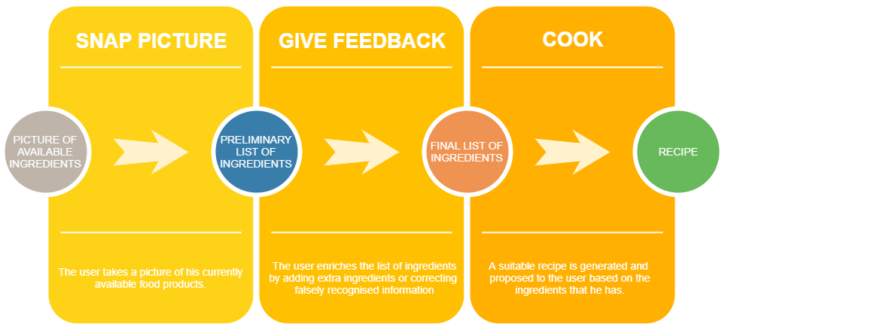
Expected Outcome - Workflow

Slide 6
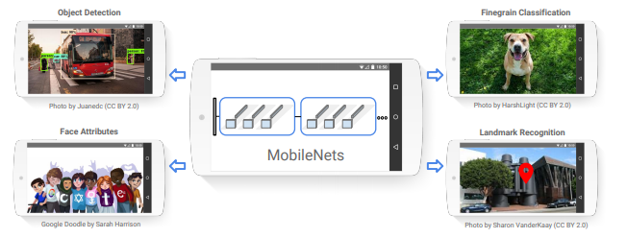

Expected Outcome – Tech side
CNN for ingredients detection (MobileNets)
R-CNN/YOLO for multi-object detection
kNN or RNN for recipe recommendation
Packaged as an Android Application consisting of 3-4 views with TF Lite for the integration of ML models
Source:[7]
Source: [8]

Slide 7
Expected Outcome – Acceptance criteria
Research:
Define the problem and identify it‘s causes
Get familiar with implemented solutions and identify room for improvement
Search for state-of-the-art solutions for problems of similar solution and identify cross-over components
Technical side:
Train a sufficiently good CNN model
Train a sufficiently good recipe recommendation model
Develop a multi-view Android application with integrated models
[Optional] Deploy the Android application to the Google Play Store

Slide 8
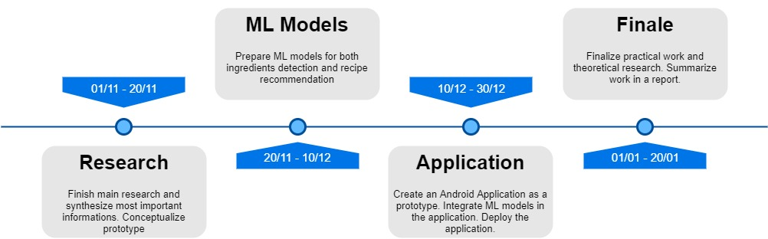
Time Schedule

Slide 9
References
United Nations, About the Sustainable Development Goals, 2019. URL https://www.un.org/sustainabledevelopment/sustainable-development-goals/
Jenny Gustavsson, Jenny, Cederberg, Christel, Sonesson, Ulf, Ulf, van Otterdijk, Robert, Meybeck, Alexandre. “Global Food Losses and Food Waste: Extent, Causes and Prevention”, 2011. URL http://www.fao.org/3/mb060e/mb060e.pdf
Wikipedia, Lebensmittelvergeudung --- Wikipedia{,} Die freie Enzyklopädie, 2019. URL https://de.wikipedia.org/wiki/Lebensmittelvergeudung
Yanai, Keiji, Takuma Maruyama, and Yoshiyuki Kawano. "A Cooking Recipe Recommendation System with Visual Recognition of Food Ingredients." International Journal of Interactive Mobile Technologies (iJIM) 8.2 (2014): 28-34.
Jund, Philipp, et al. "The freiburg groceries dataset." arXiv preprint arXiv:1611.05799 (2016).
Merler, Michele, Carolina Galleguillos, and Serge Belongie. "Recognizing groceries in situ using in vitro training data." 2007 IEEE Conference on Computer Vision and Pattern Recognition. IEEE, 2007.
Android logo, 2019. URL https://developer.android.com/distribute/marketing-tools/brand-guidelines?hl=de
Howard, Andrew G., et al. "Mobilenets: Efficient convolutional neural networks for mobile vision applications." arXiv preprint arXiv:1704.04861 (2017).
Willis, Angelica, Elbert Lin, and Brian Zhang. "Forage: Optimizing Food Use With Machine Learning Generated Recipes.“
Praveen, S., Prithivi Raj, M.V., Poovarasan, R., Thiruvenkadam, V., Kavinkumar, M. “Discovery of Recipes Based on Ingredients using Machine Learning” IRJET, Volume 06, Issue 02, 2019
Meal-Master. Now you’re cooking! recipe software, 2013. URL http://www.ffts.com/

