Slide 1
All 41 size bins

Slide 2
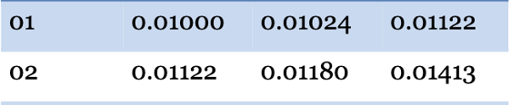
Size Bin 1 and 2 combined

Slide 3
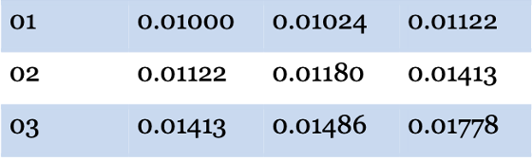
Size Bin 1, 2 and 3 combined

Slide 4
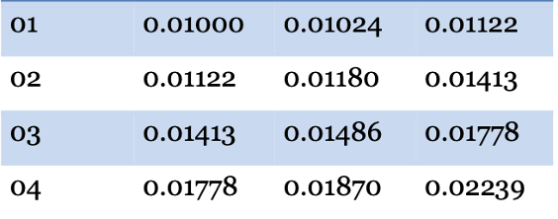
Size Bin 1, 2, 3 and 4 combined

Slide 5
