Slide 1
School management system database
Aleksandar Đukić 2018202931
Notes:
Be specific and direct in the title. Use the subtitle to give the specific context of the speech.
-The goal should be to capture the audience’s attention which can be done with a quote, a startling statistic, or fact. It is not necessary to include this attention getter on the slide.

Slide 2
School management system database
CONTENT
Project description
ERD
Assumptions and procedural rules
CRUD
Data sample
Mapping and creating tables
Queries
Form and report examples
List of values
Conclusion
Notes:
Use the background points to post details that are not common knowledge, or that the audience will need to understand the context of the speech.
-Do not read these main points from the PowerPoint, instead elaborate on these points during the speech.

Slide 3
We interact with databases every day, consciously or unconsciously.
Notes:
Dedicate this entire slide to the thesis statement. It is the reason the speech is being given. Use this time to reveal the three main points of the speech (slides 4,5,6) as an overview for the direction of the speech:
-[type main point #1 here]
-[type main point #2 here]
-[type main point #3 here]
Make sure to transition to the first main point and the next slide.

Slide 4
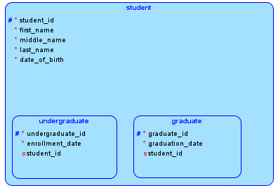
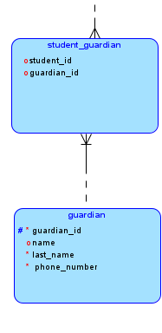
Project description
The school stores information about students
Information like name (first, middle and last), date of birth, date when students enrolled and graduated
Information about parents (guardians) is stored as well
Student can have more than one guardian, each of them has a name and contact info
Notes:
The title of main point #1 should be clear and concise. Each piece of evidence should be summarised for clarity and cited correctly. Do not simply read the pieces of evidence, but elaborate where needed.
[type notes for elaboration here]
Make sure to transition to main point #2 and the next slide.

Slide 5
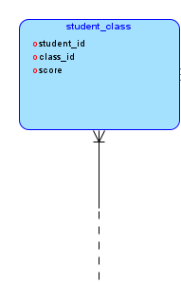
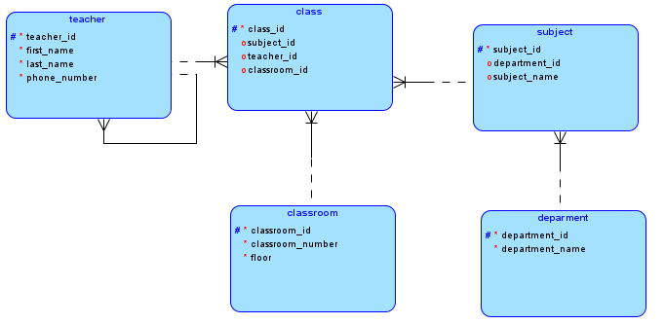
Project description
Students are part of classes and can be in more than one class at a time
Class has subjects, teacher and classroom
Each subject belongs to department
Teachers are stored in the system, they have names and contact info
Classroom has a number and it is located on a specific floor
Students are graded in each class, this score is stored for each class
Notes:
The title of main point #2 should be clear and concise. Each piece of evidence should be summarised for clarity and cited correctly. Do not simply read the pieces of evidence, but elaborate where needed.
[type notes for elaboration here]
Make sure to transition to main point #3 and the next slide.

Slide 6
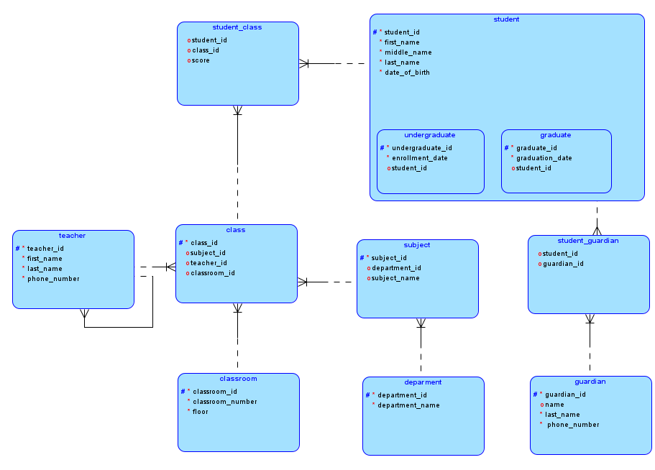
ERD
Notes:
The title of main point #3 should be clear and concise. Each piece of evidence should be summarised for clarity and cited correctly. Do not simply read the pieces of evidence, but elaborate where needed.
[type notes for elaboration here]
Make sure to transition to the counter-argument and the next slide.

Slide 7
Assumptions and procedural rules
Student can have one or more guardians
Guardians can have one or more students
Student can be only undergraduate or graduate
Student can be in more than one class at a time
Class has subject, teacher and classroom
Teacher can be supervisor to other teachers (principal, dean)
Department can have many subjects
Notes:
The counterargument should be the most common argument against the topic. The goal for this slide is to address the counterargument in such a way as to actually strengthen the original topic. Make sure to address each piece of evidence against the topic. As you address each piece of evidence elaborate on the text found on the slide. Remember to transition to the final slide, the action step.

Slide 8
CRUD
CREATE | Student enrollment and teacher employment
READ | Student, guardian and teacher information
UPDATE | Student, guardian and teacher information
DELETE | Graduated students and former professors data
Notes:
The title of main point #3 should be clear and concise. Each piece of evidence should be summarised for clarity and cited correctly. Do not simply read the pieces of evidence, but elaborate where needed.
[type notes for elaboration here]
Make sure to transition to the counter-argument and the next slide.

Slide 9
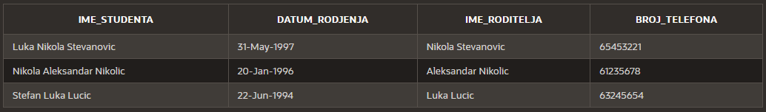
Data sample

Slide 10
Mapping and creating tables
UNDERGRADUATE
PK | UNDERGRADUATE_ID | *
 | ENROLLMENT_DATE | *
FK | STUDENT_ID | *
STUDENT
PK | STUDENT_ID | *
 | FIRST_NAME | *
 | MIDDLE_NAME | *
 | LAST_NAME | *
 | DATE_OF_BIRTH | *
GRADUATE
PK | GRADUATE_ID | *
 | GRADUATION_DATE | *
FK | STUDENT_ID | *

Slide 11
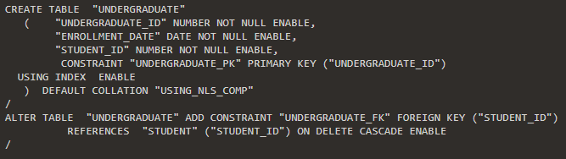
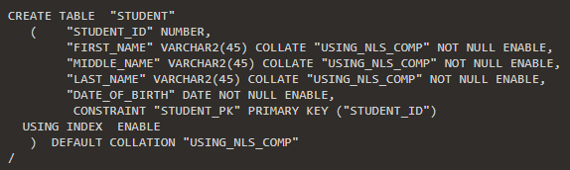
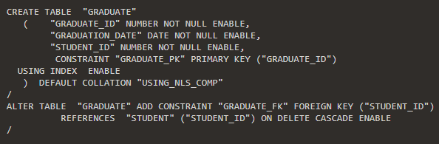
Mapping and creating tables

Slide 12
Mapping and creating tables
STUDENT_GUARDIAN
FK | STUDENT_ID | *
FK | GUARDIAN_ID | *
GUARDIAN
PK | GUARDIAN_ID | *
 | FIRST_NAME | *
 | LAST_NAME | *
 | PHONE_NUMBER | *

Slide 13
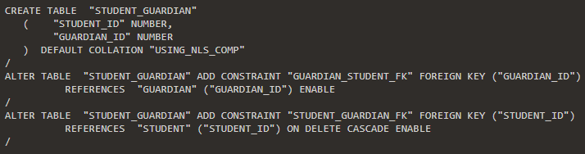
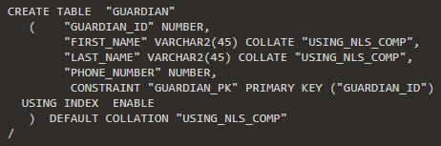
Mapping and creating tables

Slide 14
Mapping and creating tables
STUDENT_CLASS
FK | STUDENT_ID | *
FK | CLASS_ID | *
 | SCORE

Slide 15
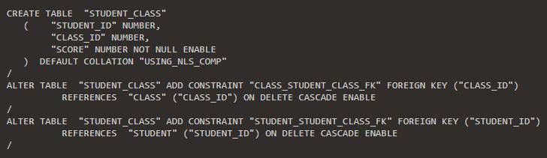
Mapping and creating tables

Slide 16
Mapping and creating tables
CLASS
PK | CLASS_ID | *
FK | SUBJECT_ID | *
FK | TEACHER_ID | *
FK | CLASSROOM_ID | *
TEACHER
PK | TEACHER_ID | *
 | FIRST_NAME | *
 | LAST_NAME | *
 | PHONE_NUMBER | *
CLASSROOM
PK | CLASSROOM_ID | *
 | CLASSROOM_NUMBER | *
 | FLOOR | *

Slide 17
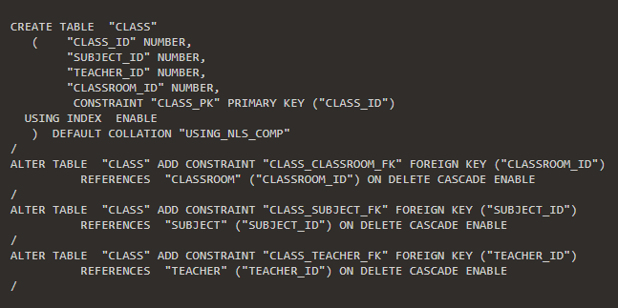
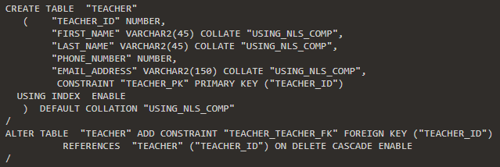
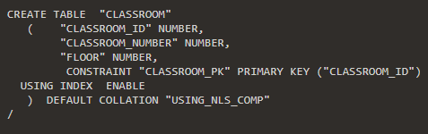
Mapping and creating tables

Slide 18
Mapping and creating tables
SUBJECT
PK | SUBJECT_ID | *
 | SUBJECT_NAME | *
FK | DEPARTMENT_ID | *
DEPARTMENT
PK | DEPARTMENT_ID | *
 | DEPARTMENT_NAME | *

Slide 19
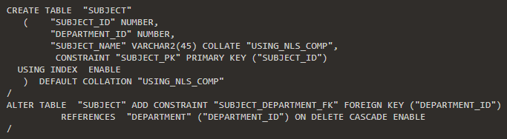
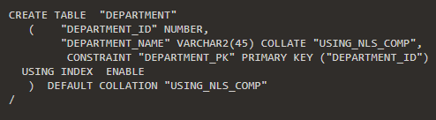
Mapping and creating tables

Slide 20
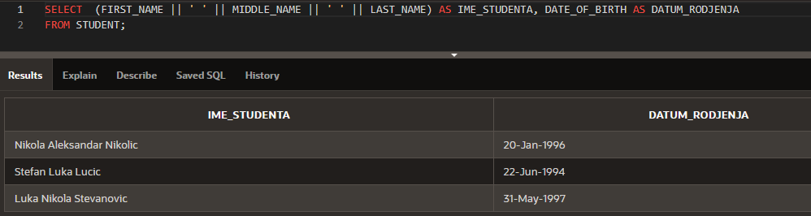
Queries

Slide 21
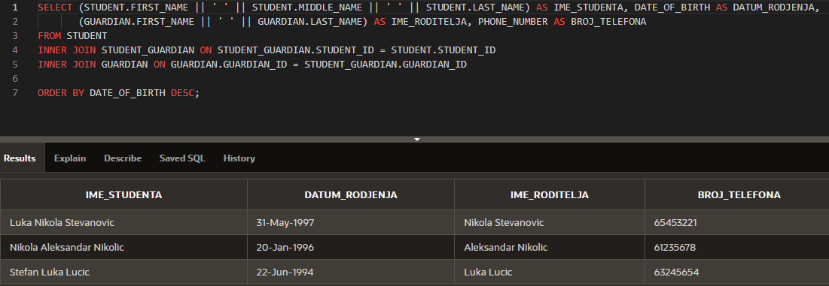
Queries

Slide 22
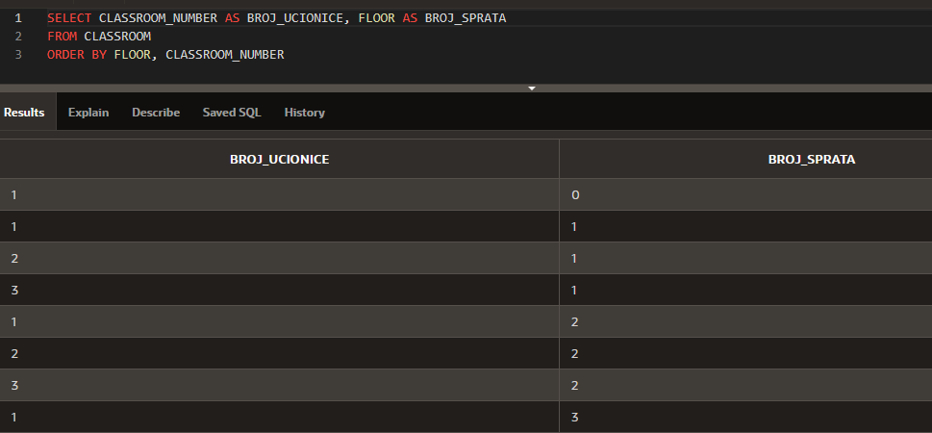
Queries

Slide 23
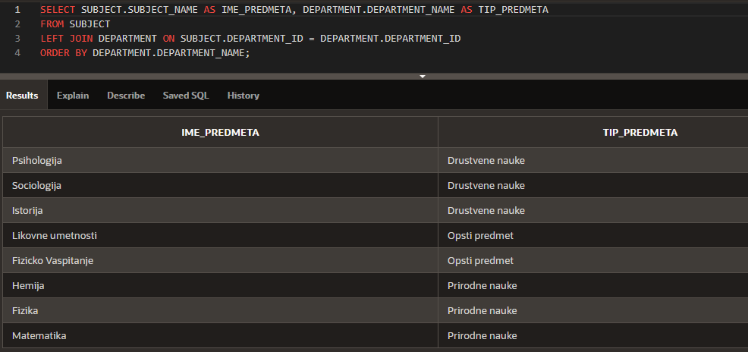
Queries

Slide 24
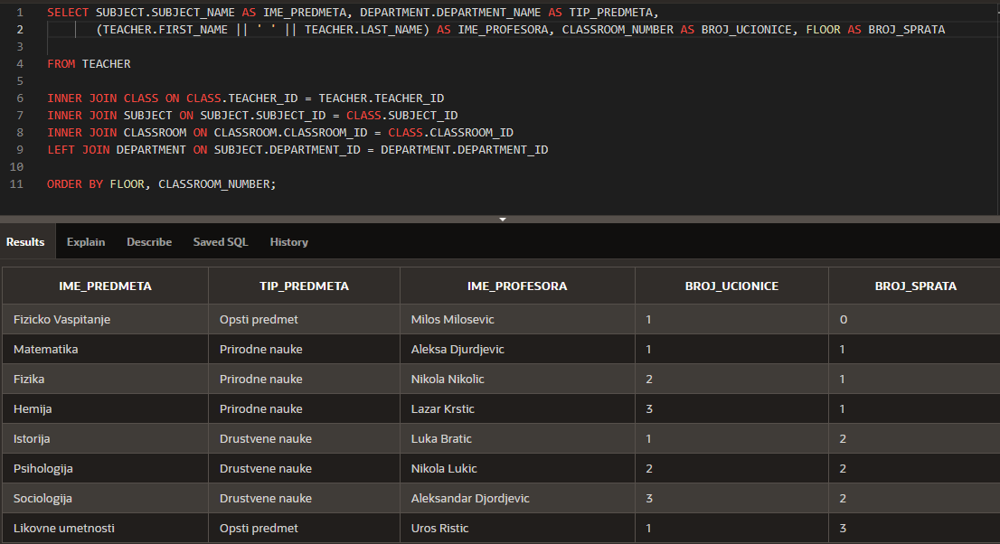
Queries

Slide 25
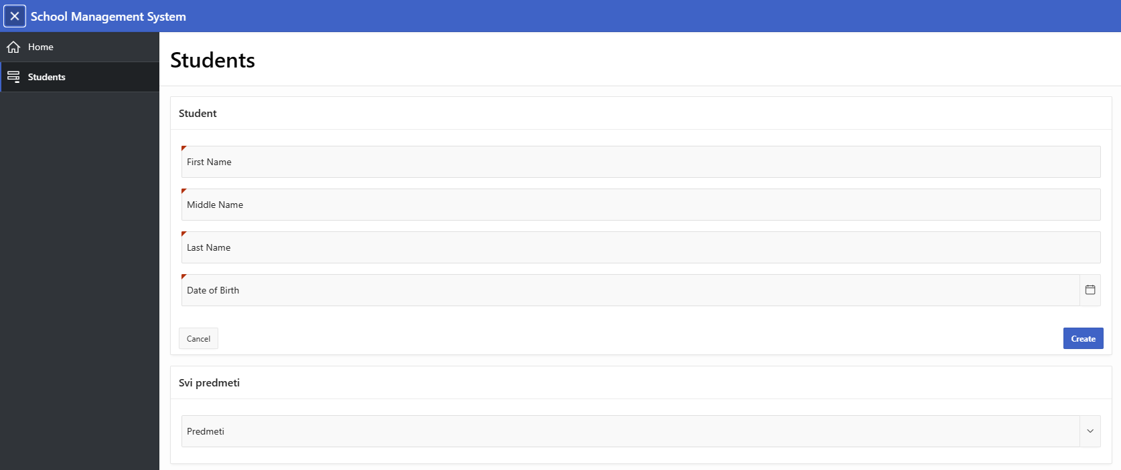
Form example

Slide 26
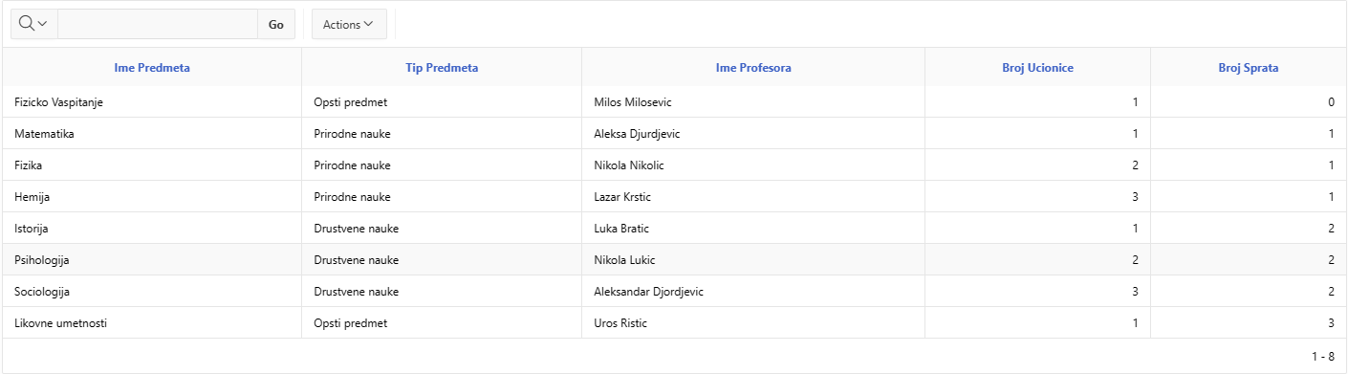
Report example

Slide 27
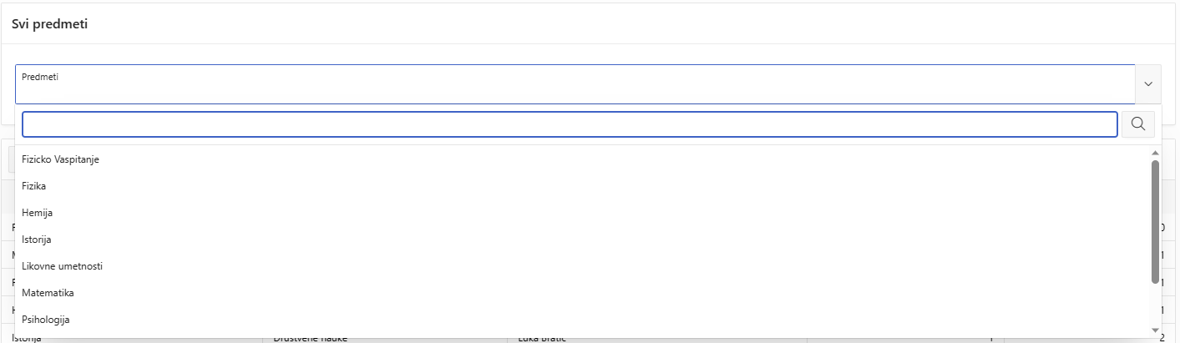
List of values

Slide 28
Databases are changing over time. That is because they grow alongside businesses or other projects they were intended for. The version of database shown in this presentation is just the tip of the iceberg in terms of the potential that can be achieved with this project. Depending on the establishment that would utilize a database like this, features such as terms for classes, periods of school year, tracking student year level and grading system could be implemented.
Conclusion
Notes:
The action step is what the audience is supposed to do or think about the topic. It should be one sentence that is written clearly and with much thought. It may also be the thesis statement restated as an action. The goal of this slide is to leave the audience with a clear message as to what they are to do or think at the end of the speech. It may be a good idea to end with a powerful quote or image.

Slide 29
References
Oracle Academy presentations and lessons
DD Database design learner
DP Database Programming with SQL Learner
ADFo Application Development Foundations Learner
W3Schools SQL Tutorial (w3schools.com)
Database Star
Notes:
The action step is what the audience is supposed to do or think about the topic. It should be one sentence that is written clearly and with much thought. It may also be the thesis statement restated as an action. The goal of this slide is to leave the audience with a clear message as to what they are to do or think at the end of the speech. It may be a good idea to end with a powerful quote or image.

