Slide 1
CluedIn Fundamentals: Defining record uniqueness
Strategies for handling missing or empty values in properties used to generate primary and additional identifiers

Slide 2
How to deal with empty values in primary identifier
How to deal with empty values in additional identifiers
Training agenda
How to deal with Null or N/A values in identifiers
Demo of strategies for defining record uniqueness

Slide 3
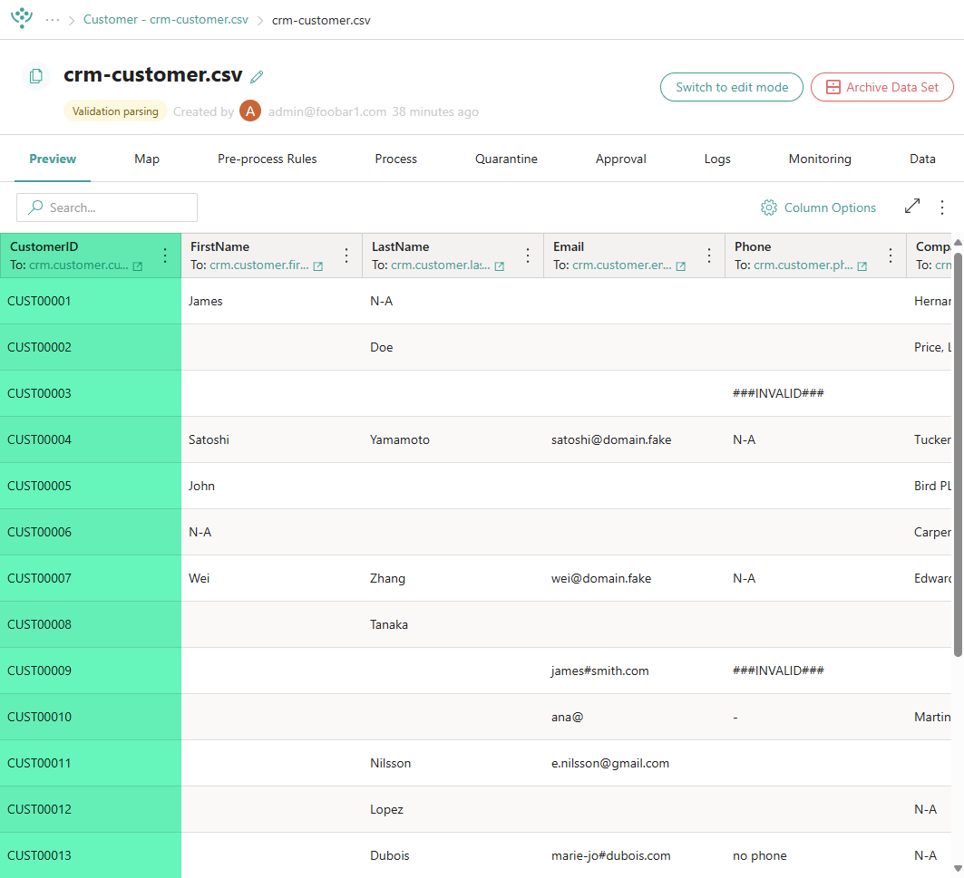

Previously, we worked with training files that included the CustomerID property, which served as a unique identifier for each record.
How do we define uniqueness when records contain missing ID values or don’t have suitable properties to establish it?
How to define record uniqueness?

Slide 4



Key takeaway
If two or more records share the same identifier (primary or additional), they will be merged into one golden record.
Why unique identifiers are important
Best practice
Always use valid, unique identifiers to ensure correct matching and avoid unintended merges.

Slide 5
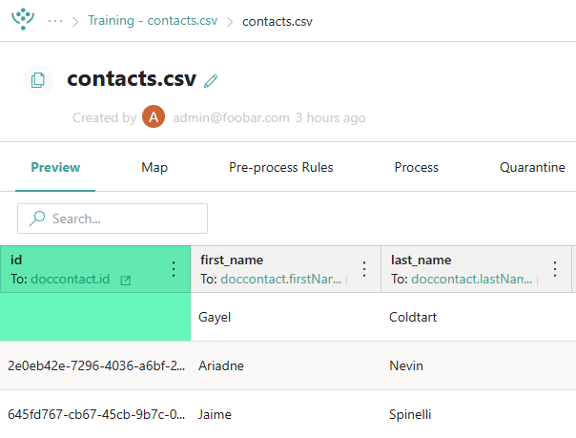


What happens when the property used to generate the primary identifier is empty?
If the selected property is empty, CluedIn generates a hash code as a fallback to represent the record’s uniqueness.
If your data set contains many records with empty values, using hash codes can lead to incorrect merges and negatively affect data quality.

Slide 6
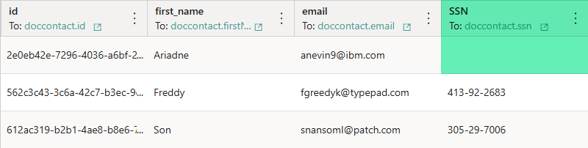
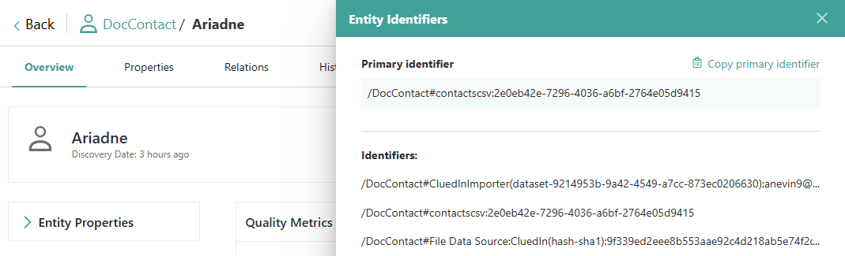
What happens when the property used to generate additional identifiers is empty?
If a property used for generating an additional identifier is empty, CluedIn will simply ignore it, and no additional identifier will be created from that property.
Unlike primary identifiers, additional identifiers are optional, and there is no fallback mechanism like a hash code for missing values.

Slide 7
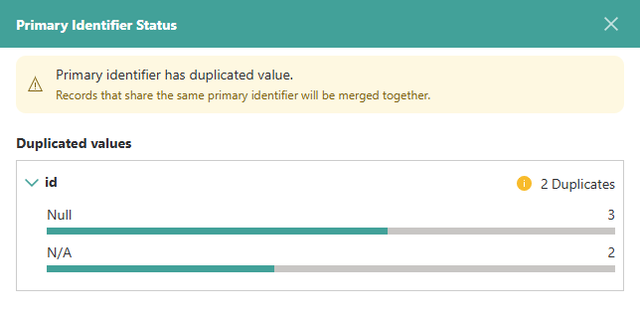
How to handle Null or N/A values when defining the primary identifier?
When multiple records have a Null or N/A value in the field used for generating the primary identifier, CluedIn treats them as duplicates and merges them into a single golden record.
To avoid incorrect merges, apply a property rule to convert Null or N/A into empty values, triggering hash-based identifiers.

Slide 8
DEMO: Defining record uniqueness in case of empty, Null, and N/A values

Slide 9
Demo summary
You’ve seen how to:
Handle empty values when generating primary identifiers
Handle empty values when generating additional identifiers
Handle Null and N/A values when generating primary identifiers
Outcome:
You now understand how CluedIn handles various scenarios related to primary and additional identifiers.
Important:
You do not need to replicate this process yourself, as the training files from the previous sessions are not suitable. This demonstration is intended to illustrate the concept.

Slide 10
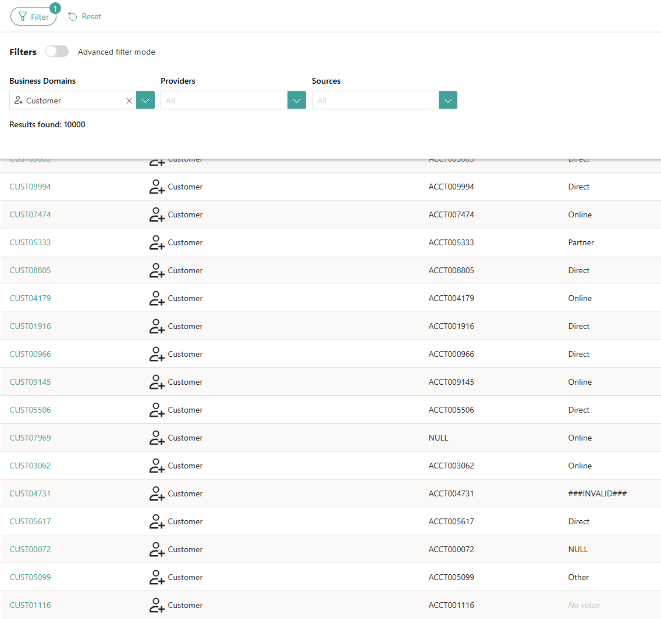


Learn more about primary and additional identifiers in our documentation portal.
Next session: Using the edit mode to identify and fix issues directly in the data set.
What’s next?

