Slide 1
Page: 1
biogeosciences, 7, 1505–1514, 2010 www.biogeoscients.net/7/1505/2010/ doi:10.5194/bg-7-1505-2010 . current and future CO2 emissions from drained peatlands in Southeast

Slide 2
Page: 1
opical peatlands in Southeast Asia store at least 42 000 million metric tonnes of soil carbon . carbon dioxide (CO2) emissions caused by decomposition of drained peatland were between 355 Mt .

Slide 3
Page: 1
peat- land drainage in Southeast Asia contributes the equivalent of 1.3% to 3.1% of current global CO2 emissions from the combustion of fossil fuel . if current peatland development and management practices continue, these emissions are pre-dicted to continue for decades .

Slide 4
Page: 1
human intervention has major impacts on peatland hydrology unless appropriate water management is implemented . lowland peatlands in Southeast Asia cover 27.1 million hectares (Mha) of which over 22.5 Mha are in Indonesia .

Slide 5

Page: 1 Image: 1

Slide 6

Page: 1 Image: 2

Slide 7
Page: 2
peat accumulation from vegetation over thousands of years Stream channel 5 to 50 km 1 to 20 m Drainage: • Water tables lowered . most peat carbon above drainage limit released to the atmosphere .

Slide 8
Page: 2
ead concession-based and illegal logging has resulted in peat drainage through construction of logging canals which leads to increased risk of fire . domestic and international interest in using palm oil as a source of biofuel has contributed to further deforestation and

Slide 9
Page: 2
carbon emissions from drained tropical peatlands (other than from fires) have received limited attention in analyses of emissions from land use, land use change and forestry .

Slide 10
Page: 2
there is relatively little information on CO2 emissions from drained peatlands in the tropics . the analysis is based on data for peatland area, thickness and carbon con- tent, and on rates of deforestation and drainage .

Slide 11
Page: 3
forest cover on peatland in the year 2000 (GLC 2000 land cover data; Bartholom e and Belward 2000), in Indonesia, Malaysia and Brunei . the required information is addressed step-by-step below .

Slide 12
Page: 3
peat thickness data for Sumatra, Kalimantan and Papua (Indonesia) were obtained from wetlands International (2003, 2004) which provides maps of peat area in 6 thickness ranges (0.5 m, 0.5–

Slide 13
Page: 3
location and area of drained peatlands in the year 2000 was derived from the global land cover 2000 map (Bartholom e and Belward, 2005) of the sixteen land cover cate- gories, those that occurred on peat were divided into four

Slide 14
Page: 3
mixed croplands will always be 100% drained . drainage impacts extend far enough (1 to 3 km) to affect most or all un- productive areas in such mosaic landscapes .

Slide 15
Page: 3
drained area, groundwater depth and unit CO2 emissions in drainage classes on tropical lowland peatland in Southeast Asia . estimates of minimum, likely and maximum possible drainage intensity are given .

Slide 16
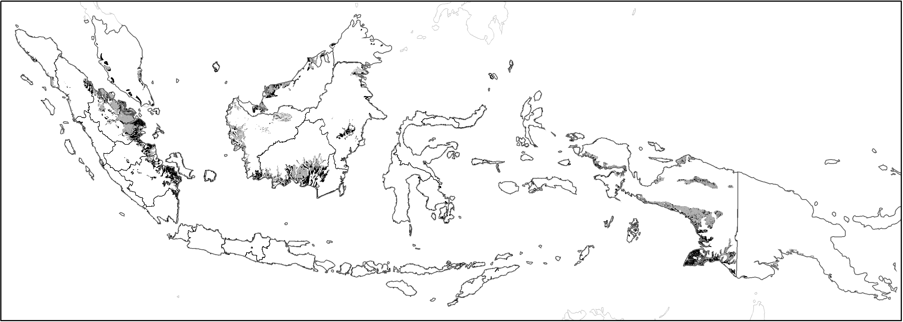
Page: 3 Image: 1

Slide 17
Page: 3 Image: 2

Slide 18
Page: 4
arge croplands, including plantations t ha -1y -1 73 86 100 (calculated from 1, 2 and 3) mixed cropland / shrubland: small-scale agriculture . recently cleared & burnt areas .

Slide 19
Page: 4
global forest watch / world Res. Inst. annual change over the period 1985 - 2000 % area % areas % region % zone % %area % zones % regions %/y Total Indonesia 225234 4 2 6 3 24 27

Slide 20
Page: 4
1 -1.3 Malaysia 20431 2 1 2 7 32 39 7 36 4 15 54 78* -1.8* Peninsular 5990 0 1 1 4 47 50 13 37 0 0 37 78 * -2.8* Sabah 1718 8 2 10 3

Slide 21
Page: 4 Table: 1
1. Drained area | Large croplands, including plantations | % | 100 100 | nan | 100.0
(within land use class) | Mixed cropland / shrubland: small-scale agriculture | % | 75 88 | nan | 100.0
nan | Shrubland; recently cleared & burnt areas | % | 25 50 | nan | 75.0
nan | nan | nan | 2 | nan | nan
2. Groundwater depth | Large croplands, including plantations Lowland peatland area (km | nan | 0m.8)0 0.95 | nan | 1.1
(within land use class) | Mixed cropland / shrubland; small-scale agriculture | m | 0.40 0.60 | nan | 0.8
nan | Shrubland; recently cleared & burnt areas Mosaics & Shmrub Cover, s0h.r2u5b compo0ne.3n3t | nan | nan | nan | 0.4
nan | nan | dominant, mainly evergreen | nan | nan | nan
3. Apply relation between groundwater depth and CO2 emission: 91 t/ha/y CO2 emission per m depth | nan | nan | nan | nan | nan
nan | Shrub cover, mainly deciduous, (Dry or | nan | nan | nan | nan
-14. Result: unit CO2 emission | Large croplands, including plantations | -1 t ha | y 73 bur8n6t) | nan | 100.0
(calculated from 1, 2 and 3) | Mixed cropland / shrubland: small-scale agriculture | -1t ha -1 | y 27 48 | nan | 73.0
nan | nan | -1 | -1 | nan | nan
nan | Shrubland; recently cleared & burnt areas | t ha | yTotal shru6bland + bu1rn5t | nan | 27.0

Slide 22
Page: 4 Table: 2
Original GLC 2000 class: 6 8 total 2 9 | total | 12 Total mix1 cropland 4+ shrub (s5mall-sctaolteal | nan | 1985 85-'00
nan | nan | nan | agr.) | Global Annual
nan | nan | nan | nan | Forest change
nan | nan | nan | nan | Watch / over the
nan | nan | Cultivated and managed, non irrigated | nan | World period
nan | nan | nan | (mixed) | Res. Inst. 1985 -
nan | nan | nan | nan | 2000
nan | nan | Tree cover, broadleaved, evergreen, closed | nan | nan
nan | nan | and closed to open | nan | nan
nan | nan | Tree cover, regularly flooded, Mangrove | nan | nan
nan | nan | Tree cover, regularly flooded, Swamp | nan | nan
% area % area %area % area % area | %area | % area % area % area % area | % area | % area %/y
Total Indonesia 225234 4 2 6 3 24 | 27 | 5 27 4 | 30 61 | 81 -1.3
Kalimantan 58379 15 4 19 2 17 | 19 | 3 3T0otal fore2st (includ2i7ng logge5d8) | nan | 87 -1.9
Central Kalimantan 30951 19 2 21 2 15 | 18 | 3 33 1 | 24 57 | 90 -2.2
East Kalimantan 6655 22 19 40 0 9 | 9 | 5 29 4 | 11 44 | 85 -2.8
West Kalimantan 17569 5 1 6 2 17 | 19 | 1 28 3 | 43 74 | 92 -1.2
South Kalimantan 3204 15 3 18 6 45 | 51 | 14 14 0 | 4 18 | 41 -1.6
Sumatra 69317 0 1 1 3 34 | 37 | 10 14 2 | 35 52 | 78 -1.8
D.I. Aceh 2613 0 0 0 4 28 | 32 | 8 37 0 | 22 59 | 87 -1.8
North Sumatera 3467 0 2 2 3 39 | 42 | 20 20 1 | 16 36 | 76 -2.6
Riau 38365 0 1 1 2 24 | 26 | 7 14 3 | 49 66 | 87 -1.4
Jambi 7076 0 1 1 3 38 | 40 | 17 9 0 | 33 42 | 67 -1.7
South Sumatera 14015 0 1 1 4 57 | 61 | 12 11 1 | 14 26 | 66 -2.6
West Sumatera 2096 0 5 5 4 42 | 46 | 11 24 0 | 13 38 | 69 -2.1
Papua 75543 0 1 1 4 20 | 25 | 1 36 9 | 27 72 | 80 -0.5
Other Indonesia~ 21995 4 2 6 3 24 | 27 | 5 27 4 | 30 61 | 81 -1.3
Malaysia 20431 2 1 2 7 32 | 39 | 7 36 4 | 15 54 | 78* -1.8*
Peninsular 5990 0 1 1 4 47 | 50 | 13 37 0 | 0 37 | 78* -2.8*
Sabah 1718 8 2 10 3 28 | 31 | 17 21 21 | 2 43 | 86* -2.9*
Sarawak 12723 2 1 2 9 26 | 35 | 4 38 3 | 23 64 | 76* -1.1*
Brunei 646 3 1 4 1 9 | 10 | 2 39 6 | 39 85 | 85* -0.2*
Papua N. Guinea 25680 0 1 1 4 32 | 36 | 3 38 5 | 19 62 | 80* -1.3*
SE ASIA 271991 4 2 5 4 26 | 29 | 5 29 4 | 28 61 | 81* -1.3*
~ Land use distribution for 'Other Indonesia' assumed equal to Total Indonesia. | nan | nan | nan | nan
* 1985 forest cover outside Indonesia is visually estimated from map. | nan | nan | nan | nan

Slide 23
Page: 5
unpublished data collected by authors in water management projects in central Kalimantan (Hooijer et al., 2008a), Jambi and Riau . common practice is to keep average water tables always below 0.7 m, but they are often as deep as

Slide 24
Page: 5
the defor- estation rate in peatlands over this period was 1.3% y1 for Indonesia . similar rates apply to other countries in Southeast Asia included in this analysis .

Slide 25
Page: 5
linear relation between groundwater depth in peatland and CO2 emission caused by peat decomposition . the line has been fitted through published measurements in agricultural areas . measures in forest and unproductive degraded peatlands are excluded .

Slide 26
Page: 5
udy is CO2 gas emission monitoring in relation to water depth . the second is long term monitoring of peat subsidence in drained peatlands . it is combined with peat car- bon content and bulk density measurements .

Slide 27
Page: 5
the increase in emis-sions is caused by progressive drainage of an increased peatland area . the stepwise pattern of this decrease is ex- plained by the discrete peat thickness data available .

Slide 28
Page: 6
peatland drained to 0.95 m depth on average for 88% of the area emits 48 t CO2 ha1 y1 on average . emissions calculated for the total area of each class within each country and region .

Slide 29
Page: 6
as, and burnt and degraded agricultural areas) emits 15 t CO2 ha1 y1 and 8.5 Mha (67%) was affected by moderately in- tensive drainage for small-scale agriculture.

Slide 30
Page: 6
2.2 Mha (16%) had been recently cleared or burnt . estimated total drained peatland area for 2006 of 11.1 Mha (9.5 Mha– 12.7 Mha)

Slide 31
Page: 6
emissions expected to peak at 745 Mt y1 in 2015, followed by a steady decline over sub- sequent decades as peat deposits become in- creasingly depleted . by 2030, emission is pro-jected to decline to a likely

Slide 32
Page: 6
CO2 emissions from drained peats in Southeast Asia 1511 and 16.1 and 15.0 t CO2 ha1 y1 for arable cultivation . these fluxes are at the lower end of the emission range .

Slide 33
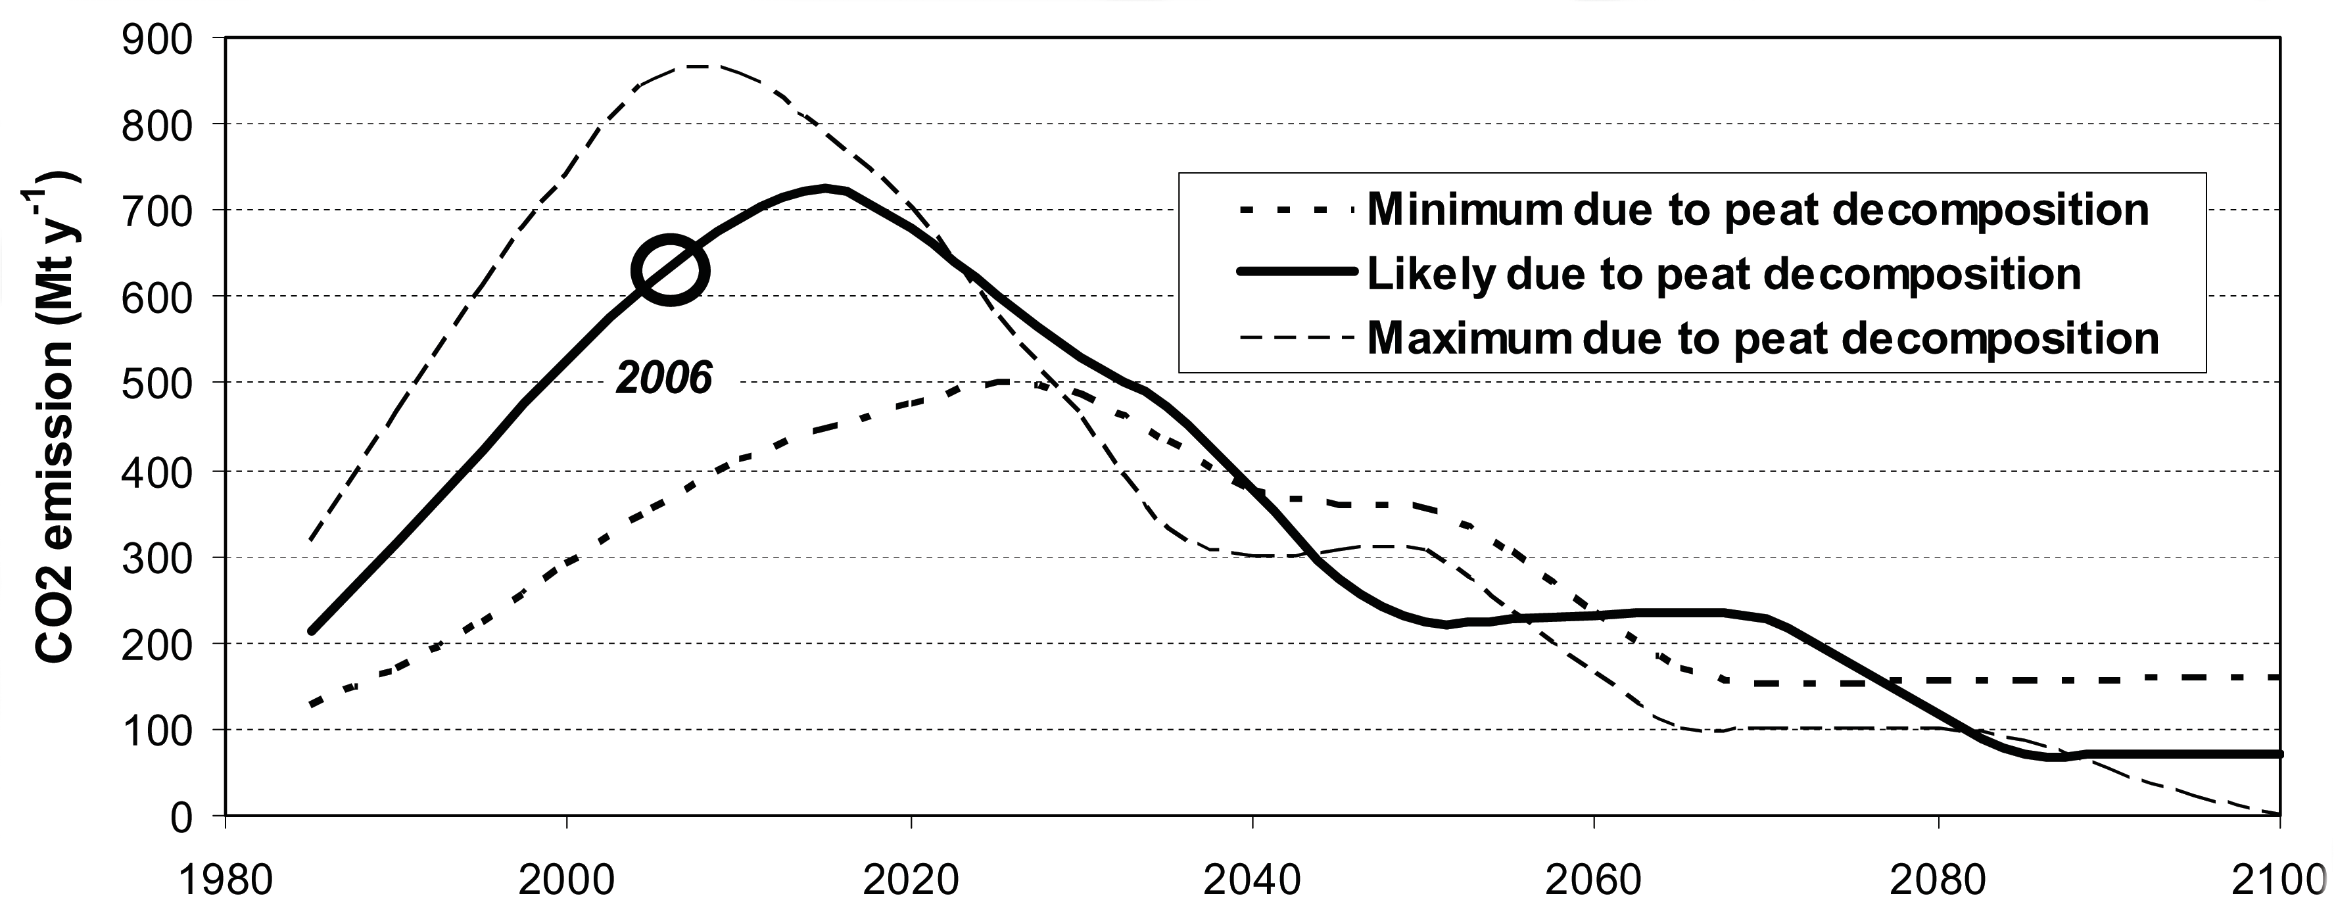
Page: 6 Image: 1

Slide 34
Page: 7
average annual fire emissions is estimated to be at least 1400 Mt y1 CO2 for 1997–2006 . infrequent emissions caused by peat decom- position and peatland fires are of similar magnitude .

Slide 35
Page: 7
peat decomposition and peat- land fires make large contributions to global car- bon dioxide emissions . conservation of remaining pristine forested tropical peatlands and reha-bilitation of degraded ones make them potentially easier to manage .

Slide 36
Page: 7
7 of 11 models agree on decreased rainfall during the dry seasons in a number of peatland regions of Southeast Asia (Li et al., 2007), 9 agree on greater interannual variability in dry season rainfall . these changes are strongest and most consistent for southern Sum

Slide 37
Page: 7
peatland is listed in national soil and land use inventories . peat soils are Histosols but their definition varies from country to country . some classifications adopt a minimum organic matter of 65% . others specify an organic content of only 35%

Slide 38
Page: 7
peat carbon content is obtained by com- bining the area of peatland with the bulk density of and car- bon concentration in peat . carbon densities be- tween 24 kg C m3 .

Slide 39
Page: 7
the study was de-rived from the GLC 2000 global land cover classification (Bartholom e and Belward, 2005) for ex- ample, areas in Papua (Indonesia) are classified as “mixed crop

Slide 40
Page: 7 Table: 1
long-term context that includes climate change (in addition to | tration of 60% (Wösten et al., 2001; Rieley et al., 2008) both
land use change). An analysis of climate projections to 2100 | of which vary greatly across the surface of tropical peatland
shows that 7 of 11 models agree on decreased rainfall during | and in peat profiles (Page et al., 2004). Carbon densities be-
the dry seasons in a number of peatland regions of Southeast | tween 24 kg C m−3 and up to 95 kg C m−3 have been reported

Slide 41
Page: 8
percentages of peatland drained within the drainage classes are conservative estimates derived from surveys car- ried out in Indonesia . it is assumed that the situation in other countries in Southeast Asia is similar but it is not certain whether this indeed exists .

Slide 42
Page: 8
it is common to find water tables well below one metre from the surface in oil palm and pulp wood plantations . there is a need for an extensive system of groundwater depth monitoring in the range of tropical peatland types .

Slide 43
Page: 8
peatland drainage systems in abandoned peatlands continue to draw down water levels for decades, because no funding is available for canal blocking . peat subsidence monitoring can be difficult to interpret .

Slide 44
Page: 8
monitoring of peat subsidence and peat carbon content provides a more direct and accurate measurement of net carbon loss . subsidence measurements account for lateral export of particulate and dissolved or- ganic matter into rivers and canals .

Slide 45
Page: 8
nship is con- sidered the best estimate currently available for determining CO2 emissions at water table depths between 0.5 and 1 m . it covers the range of the most common groundwater depths in the study region .

Slide 46
Page: 8
ion on nitrous oxide (N2O) emissions in peatlands re- quires new continued measurements, particularly in agricul- tural areas with nitrogen inputs . the original assessment was funded from internal deltares | Delft

Slide 47
Page: 8 Table: 1

Slide 48
Page: 9
this assessment is a contribution to a synthesis effort on the vulnerabilities of tropical peatlands carried out under the auspices of the Global Car- bon Project . the global car- bon project was a joint project of the Earth System Science Partnership .

Slide 49
Page: 9
canadell, J. G., Le Qu er e, C., Raupach, M. R., Field, C, B., Buiten- huis, E. T., Ciais, P., Gillet

Slide 50
Page: 9
esia: Bogor, Indonesia: Forest Watch Indonesia, and Washington DC: Global Forest Watch, 2002 . Hooijer, A.: Hydrological assessment of forest plantation impacts on tropical forested peatlands .

Slide 51
Page: 9
deltares.nl, 2006. Hooijer, A., Van der Vat, M., Prinsen, G., Vernimmen, R., Brinkman, J. J., and Zijl, F.: Hydrology of

Slide 52
Page: 9
carbon balance in managed tropical peat in central Kalimantan, in: Proceedings of the 12th International Peat Congress, Tampere 6-11.6.2004 .

Slide 53
Page: 9
atlands, geophys. Lett., 34, L01403, doi:10.1029/2006GL028364, 2007. Melling, L., Hatano, R., and Goh, K. J.: Climate impacts of peatland

Slide 54
Page: 10
Rieley, J. O. and Page, S. E., Samara Pub- lishing, Cardigan, 55–72, 1997 . the amount of carbon released from peat and forest fires in Indonesia .

Slide 55
Page: 10
Silvius, M. J. and Taufik, A. W.: Conservation and Land Use of Kimaam Island .

Slide 56
Page: 10
wetlands international: Maps of peatland distribution and carbon content in Sumatera, 2000–2002, 2004 . W osten, J. H. M., Ismail, A. B., and Van Wijk, L. M

Slide 57
Page: 10
biogeosciences, 7, 1505–1514, 2010 www.biogeoscientifics.net/7/1505/2010/ .

Slide 58
Page: 10 Table: 1
in four domed ombrogenous peat deposits, Indonesia, in: Biodi- | nan | 1491, 2007. | nan | nan | nan | nan | nan | nan | nan | nan
versity and sustainability in peatlands – Proceedings of the In- | nan | Ueda, S., Go, C.-S. U., Yoshioka, T., Yoshida, N., Wada, E., Miya- | nan | nan | nan | nan | nan | nan | nan | nan
ternational Symposium on Tropical Peatlands, Palangka Raya, | nan | jima, T., Sugimoto, A., Boontanon N., Vijarnsorn, P., and Boon- | nan | nan | nan | nan | nan | nan | nan | nan
Indonesia, edited by: Rieley, J. O. and Page, S. E., Samara Pub- | nan | prakub, S.: | Dynamics of dissolved O2, CO2, CH4, and N2O in | nan | nan | nan | nan | nan | nan | nan
lishing, Cardigan, 55–72, 1997. | nan | a tropical coastal swamp in southern Thailand, Biogeochemistry, | nan | nan | nan | nan | nan | nan | nan | nan
Page, S. E., Rieley, J. O., Shotyk, O. W., and Weiss, D.: Interde- | nan | 49, 191–215, 2000. | nan | nan | nan | nan | nan | nan | nan | nan
pendence of peat and vegetation in a tropical peat swamp forest, | nan | Van der Werf, G. R., Dempewolf, J., Trigg, S. N., Randerson, J. T., | nan | nan | nan | nan | nan | nan | nan | nan
Phil. Trans. R. Soc. Lond, B 345, 1885–1897, 1999. | nan | Kasibhatla, P. S., Gigio, L., Murdiyarso, D., Peters, W., Morton, | nan | nan | nan | nan | nan | nan | nan | nan
Page, S. E., Siegert, F., Rieley, J. O., Boehm, H. V., Jaya, A., and | nan | D. C., Collatz, G. J., Dolman, A. J., and DeFries, R. S.: Climate | nan | nan | nan | nan | nan | nan | nan | nan
Limin, S.: The amount of carbon released from peat and forest | nan | regulation of fire emissions and deforestation in equatorial Asia, | nan | nan | nan | nan | nan | nan | nan | nan
fires in Indonesia during 1997, Nature, 420, 61–65, 2002. | nan | PNAS, 105, 20350–20355, 2008. | nan | nan | nan | nan | nan | nan | nan | nan
Rieley, J. O., Wüst, R. A. J., Jauhiainen, J., Page, S. E., Ritzema, | nan | Wetlands International: | nan | nan | Maps of peatland distribution and carbon | nan | nan | nan | nan | nan
H., Wösten, H., Hooijer, A., Siegert, F., Limin, S., Vasander, | nan | content in Sumatera, 1990–2002, 2003. | nan | nan | nan | nan | nan | nan | nan | nan
H., and Stahlhut, M.: Tropical Peatlands, Carbon stores, Carbon | nan | Wetlands International: | nan | nan | Maps of peatland distribution and carbon | nan | nan | nan | nan | nan
Gas Emissions and Contribution to Climate Change Processes, | nan | content in Kalimantan, 2000–2002, 2004. | nan | nan | nan | nan | nan | nan | nan | nan
in: Peatlands and Climate Change, edited by: Strack, M., Inter- | nan | Wösten, J. H. M., Ismail, A. B., and Van Wijk, A. L. M.: Peat sub- | nan | nan | nan | nan | nan | nan | nan | nan
national Peat Society, Jyväskylä, Finland, 148–181, 2008. | nan | sidence and its practical implications: | nan | nan | nan | nan | a case study in Malaysia, | nan | nan | nan
Shimada, S., Takahashi, H., Haraguchi, A., and Kaneko, M.: The | nan | Geoderma, 78, 25–36, 1997. | nan | nan | nan | nan | nan | nan | nan | nan
carbon content characteristics of tropical peats in Central Kali- | nan | Wösten, J. H. M. and Ritzema, H. P.: Land and water management | nan | nan | nan | nan | nan | nan | nan | nan
mantan, Indonesia: estimating their spatial variability in density, | nan | options for peatland development in Sarawak, Malaysia, Interna- | nan | nan | nan | nan | nan | nan | nan | nan
Biogeochemistry, 53, 249–267, 2001. | nan | tional Peat Journal 11, 59–66, 2001. | nan | nan | nan | nan | nan | nan | nan | nan
Silvius, M. J. and Taufik, A. W.: Conservation and Land Use of | nan | Wösten, J. | H. M., | Van | den | Berg, J., | Van Eijk, | P., | Gevers, | G. J.
Kimaam Island, A survey report and compilation of existing in- | nan | M., Giesen, W. B. J. T., Hooijer, A., Idris, A., Leenman, P. H., | nan | nan | nan | nan | nan | nan | nan | nan
formation, PHPA/AWB Bogor, 1990. | nan | Satriadi Rais Dipa, Siderius, C., Silvius, M. J., Suryadiputra, N., | nan | nan | nan | nan | nan | nan | nan | nan
Silvius, M. J. and Giesen, W.: Integration of Conservation and | nan | and Wibisono, I. W.: | nan | nan | Interrelationships between Hydrology and | nan | nan | nan | nan | nan
Land-Use Development of Swamp Forest of East Sumatra, in: | nan | Ecology in Fire Degraded Tropical Peat Swamp Forests, | nan | nan | nan | nan | nan | nan | Int. J. | nan

