Slide 1
Page: 1
1.0 15.57 145.157 0.008 0.0127 0.0163 20.083 0.3489 0.1214 0.000185 1.2 81.48 145.162 0.033 0.0518 0.1308 21.861 0.3365 0.1223 0.0017

Slide 2
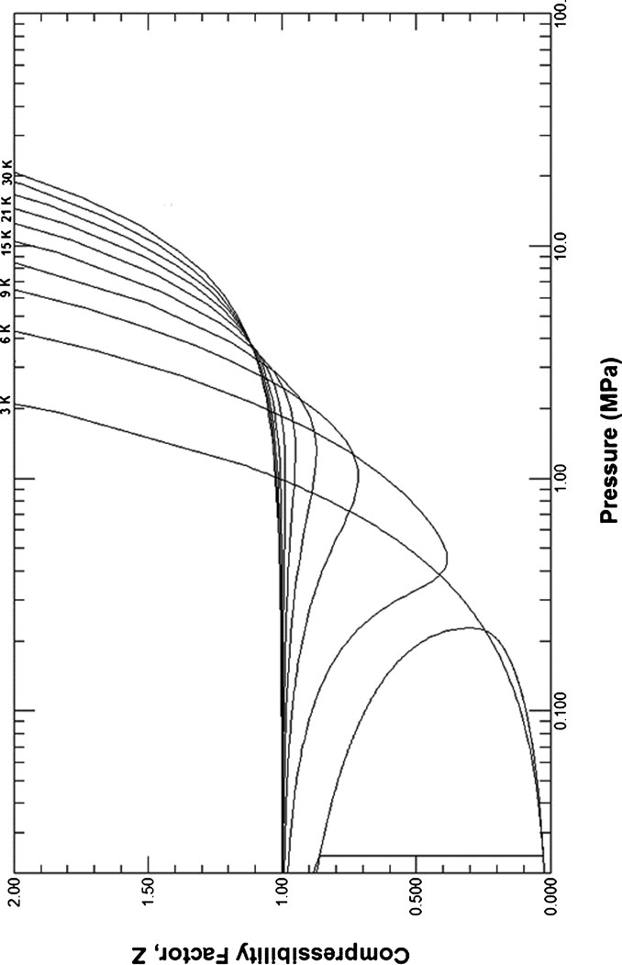
Page: 2 Image: 1

Slide 3
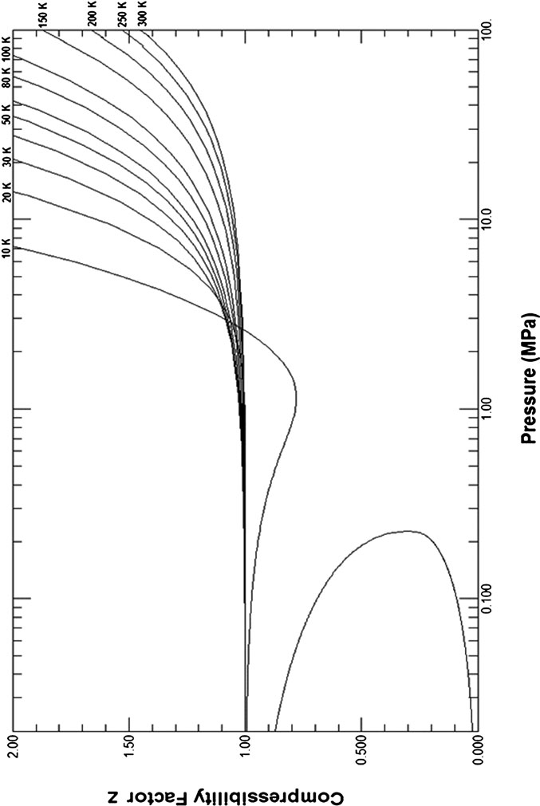
Page: 3 Image: 1

Slide 4
Page: 5
5.15 146.150 1.251 3.0900 1.6380 22.461 0.2865 0.1424 0.010264 2.60404 13.630 2.4 8,354.10 145.494 1.828 3.6780 1.8860 22.623 0.2700 0.1

Slide 5
Page: 5
3.07087 18.754 4.6 141,930.40 116.339 24.489 12.3100 4.0180 17.829 0.0506 0.9831 0.351500 2.95366 18.843 4.8 167,429.50 110.162 3

Slide 6
Page: 5 Table: 1
1.2 | 81.48 | 145.162 | 0.033 | 0.0518 | 0.051 | 21.024 | 0.3439 | 0.1219 | 0.000579 | nan | nan
1.4 | 282.00 | 145.199 | 0.098 | 0.1579 | 0.1308 | 21.861 | 0.3365 | 0.1223 | 0.001738 | nan | nan
1.6 | 746.36 | 145.278 | 0.23 | 0.3923 | 0.2839 | 22.533 | 0.3268 | 0.1254 | 0.003211 | nan | nan
1.8 | 1,638.41 | 145.416 | 0.455 | 0.8422 | 0.5437 | 22.977 | 0.3151 | 0.1284 | 0.005283 | nan | nan
2.0 | 3,129.26 | 145.654 | 0.794 | 1.642 | 0.9578 | 23.046 | 0.3016 | 0.1341 | 0.00996 | nan | nan
2.1768 | 5,041.80 | 146.15 | 1.192 | 2.949 | 1.574 | 22.796 | 0.288 | 0.1466 | 0.05106 | nan | nan
2.2 | 5,335.15 | 146.15 | 1.251 | 3.09 | 1.638 | 22.461 | 0.2865 | 0.1424 | 0.010264 | 2.60404 | 13.63
2.4 | 8,354.10 | 145.494 | 1.828 | 3.678 | 1.886 | 22.623 | 0.27 | 0.147 | 0.03319 | 3.04356 | 14.5
2.6 | 12,372.07 | 144.429 | 2.549 | 4.161 | 2.068 | 22.906 | 0.2522 | 0.1589 | 0.04573 | 3.28415 | 15.265
2.8 | 17,551.76 | 143.035 | 3.433 | 4.662 | 2.24 | 23.132 | 0.2334 | 0.1756 | 0.05789 | 3.44756 | 15.946
3.0 | 24,047.07 | 141.354 | 4.499 | 5.195 | 2.408 | 23.255 | 0.2138 | 0.194 | 0.07003 | 3.5687 | 16.55
3.2 | 32,009.97 | 139.442 | 5.767 | 5.787 | 2.581 | 23.265 | 0.1935 | 0.2162 | 0.08268 | 3.63809 | 17.087
3.4 | 41,594.70 | 137.267 | 7.267 | 6.448 | 2.76 | 23.146 | 0.1728 | 0.2449 | 0.09697 | 3.61874 | 17.548
3.6 | 52,956.31 | 134.813 | 9.033 | 7.183 | 2.946 | 22.87 | 0.1518 | 0.2826 | 0.1138 | 3.4719 | 17.937
3.8 | 66,247.39 | 132.05 | 11.111 | 7.998 | 3.14 | 22.406 | 0.1309 | 0.3337 | 0.13487 | 3.37654 | 18.247
4.0 | 81,619.69 | 128.929 | 13.564 | 8.899 | 3.34 | 21.724 | 0.1101 | 0.4053 | 0.16222 | 3.28009 | 18.481
4.2 | 99,233.46 | 125.372 | 16.487 | 9.901 | 3.551 | 20.79 | 0.0896 | 0.5112 | 0.20005 | 3.17862 | 18.644
4.4 | 119,269.30 | 121.252 | 20.035 | 11.02 | 3.774 | 19.537 | 0.0697 | 0.6803 | 0.2566 | 3.07087 | 18.754
4.6 | 141,930.40 | 116.339 | 24.489 | 12.31 | 4.018 | 17.829 | 0.0506 | 0.9831 | 0.3515 | 2.95366 | 18.843
4.8 | 167,429.50 | 110.162 | 30.445 | 13.84 | 4.296 | 15.397 | 0.0324 | 1.384 | 0.54437 | 2.81969 | 18.973
5.0 | 196,003.90 | 100.89 | 39.327 | 15.92 | 4.664 | 11.726 | 0.0153 | 4.153 | 1.2072 | 2.63572 | 19.3
5.1953 | 227,462.30 | 69.641 | 69.641 | 21.95 | 5.768 | 0.0 | 0.0 | nan | nan | nan | nan

Slide 7
Page: 6
8.952 3.318 4.396 2.495 3.327 18.624 4.2 125.40 9.902 3.550 5.161 2.547 3.181 18.651 Tsvp 14 4.2163 16.533 31.81 8.510 9.

Slide 8
Page: 6
18.6 17.52 5.250 3.121 3.582 26.198 22 2.187 129.1 18.02 5.240 3.122 3.808 27.792 24 2.003 139.6 18.48 5.232 3.120 4.025 29.333 26 1.848 150.0

Slide 9
Page: 6 Table: 1
1.0 146.90 | nan | 0.697 | 0.016 | 0.102 | 0.102 | nan
1.2 146.90 | nan | 0.737 | 0.051 | 0.322 | 0.322 | nan
1.4 146.90 | nan | 0.843 | 0.132 | 0.787 | 0.787 | nan
1.6 147.00 | nan | 1.075 | 0.287 | 1.614 | 1.612 | nan
1.8 147.20 | nan | 1.522 | 0.548 | 2.959 | 2.953 | nan
2.0 147.50 | nan | 2.319 | 0.966 | 5.249 | 5.227 | nan
Tl 1⁄4 2.168 148.00 | nan | 3.56 | 1.56 | 27.88 | 25.67 | nan
2.2 148.00 | nan | 3.719 | 1.631 | 3.777 | 3.765 | 2.715 13.859
2.4 147.40 | nan | 4.257 | 1.866 | 2.282 | 2.173 | 3.140 14.746
2.6 146.30 | nan | 4.696 | 2.042 | 2.233 | 2.029 | 3.364 15.529
2.8 145.00 | nan | 5.147 | 2.209 | 2.308 | 1.978 | 3.515 16.226
3.0 143.30 | nan | 5.623 | 2.373 | 2.496 | 2.017 | 3.634 16.844
3.2 141.40 | nan | 6.15 | 2.543 | 2.784 | 2.135 | 3.715 17.383
3.4 139.10 | nan | 6.739 | 2.721 | 3.108 | 2.253 | 3.718 17.838
3.6 136.50 | nan | 7.395 | 2.909 | 3.463 | 2.353 | 3.585 18.204
3.8 133.50 | nan | 8.128 | 3.107 | 3.874 | 2.432 | 3.456 18.469
4.0 129.90 | nan | 8.952 | 3.318 | 4.396 | 2.495 | 3.327 18.624
4.2 125.40 | nan | 9.902 | 3.55 | 5.161 | 2.547 | 3.181 18.651
Tsvp 1⁄4 4.2163 125.01 | nan | 9.987 | 3.57 | 5.243 | 2.551 | 3.168 18.648
Tsvp 1⁄4 4.2163 16.533 | nan | 31.81 | 8.51 | 9.015 | 3.24 | 1.241 9.004
4.4 14.940 | nan | 32.37 | 8.872 | 8.056 | 3.217 | 1.274 9.275
4.6 13.640 | nan | 33.92 | 9.215 | 7.436 | 3.194 | 1.312 9.586
4.8 12.620 | nan | 35.36 | 9.523 | 7.027 | 3.175 | 1.350 9.901
5.0 11.780 | nan | 36.74 | 9.803 | 6.735 | 3.159 | 1.389 10.216
5.2 11.070 | nan | 38.06 | 10.06 | 6.517 | 3.146 | 0.000 10.528
6 9.028 | nan | 43.05 | 10.96 | 6.011 | 3.12 | 1.579 11.736
7 7.426 | nan | 48.89 | 11.86 | 5.724 | 3.111 | 1.761 13.161
8 6.344 | nan | 54.54 | 12.61 | 5.575 | 3.111 | 1.935 14.491
9 5.555 | nan | 60.06 | 13.26 | 5.485 | 3.113 | 2.100 15.729
10 4.949 | nan | 65.52 | 13.84 | 5.426 | 3.115 | 2.258 16.889
12 4.074 | nan | 76.29 | 14.82 | 5.353 | 3.118 | 2.557 19.025
14 3.468 | nan | 86.95 | 15.64 | 5.31 | 3.12 | 2.835 20.983
16 3.023 | nan | 97.54 | 16.35 | 5.282 | 3.12 | 3.097 22.811
18 2.680 | nan | 108.1 | 16.97 | 5.264 | 3.121 | 3.345 24.543
20 2.408 | nan | 118.6 | 17.52 | 5.25 | 3.121 | 3.582 26.198
22 2.187 | nan | 129.1 | 18.02 | 5.24 | 3.121 | 3.808 27.792
24 2.003 | nan | 139.6 | 18.48 | 5.232 | 3.12 | 4.025 29.333
26 1.848 | nan | 150.0 | 18.9 | 5.226 | 3.12 | 4.235 30.831
28 1.716 | nan | 160.5 | 19.28 | 5.221 | 3.12 | 4.437 32.290
30 1.601 | nan | 170.9 | 19.64 | 5.218 | 3.12 | 4.634 33.716
40 1.200 | nan | 223.0 | 21.14 | 5.206 | 3.119 | 5.542 40.444
50 0.961 | nan | 275.0 | 22.3 | 5.201 | 3.118 | 6.360 46.678
60 0.801 | nan | 327.0 | 23.25 | 5.198 | 3.118 | 7.116 52.552
70 0.686 | nan | 379.0 | 24.05 | 5.196 | 3.117 | 7.827 58.149

Slide 10
Page: 7
738 2.175 2.209 1.918 3.613 16.590 3.0 145.70 6.192 2.332 2.387 1.966 3.733 17.247 3.2 143.90 6.695 2.494 2.653 2.087 3.8

Slide 11
Page: 7
482.9 25.36 5.195 3.117 9.152 68.697 100 0.481 534.9 25.91 5.194 5.117 9.778 73.713 125 0.385 664.7 27.07 5.294 3.116 11.090 85.663 150

Slide 12
Page: 7 Table: 1
80 | nan | 0.601 | 431.0 | 24.75 | 5.195 | 3.117 | 8.503 63.518
90 | nan | 0.534 | 482.9 | 25.36 | 5.195 | 3.117 | 9.152 68.697
100 | nan | 0.481 | 534.9 | 25.91 | 5.194 | 3.117 | 9.778 73.713
125 | nan | 0.385 | 664.7 | 27.07 | 5.194 | 3.116 | 11.090 85.663
150 | nan | 0.321 | 794.6 | 28.01 | 5.193 | 3.116 | 12.500 96.937
175 | nan | 0.275 | 924.4 | 28.81 | 5.193 | 3.116 | 13.850 107.679
200 | nan | 0.241 | 1,054 | 29.51 | 5.193 | 3.116 | 15.140 117.982
225 | nan | 0.214 | 1,184 | 30.12 | 5.193 | 3.116 | 16.390 127.917
250 | nan | 0.193 | 1,314 | 30.66 | 5.193 | 3.116 | 17.600 137.535
275 | nan | 0.175 | 1,444 | 31.16 | 5.193 | 3.116 | 18.780 146.877
300 | nan | 0.16 | 1,574 | 31.61 | 5.193 | 3.116 | 19.930 155.973

Slide 13
Page: 7 Table: 2
1.0 148.50 | nan | 1.374 | 0.016 | 0.104 | 0.104 | nan
1.2 148.50 | nan | 1.414 | 0.052 | 0.328 | 0.328 | nan
1.4 148.50 | nan | 1.522 | 0.134 | 0.797 | 0.796 | nan
1.6 148.60 | nan | 1.757 | 0.29 | 1.631 | 1.628 | nan
1.8 148.90 | nan | 2.208 | 0.554 | 2.99 | 2.979 | nan
2.0 149.30 | nan | 3.015 | 0.977 | 5.323 | 5.285 | nan
Tl 1⁄4 2.158 149.90 | nan | 4.185 | 1.537 | 25.01 | 22.86 | nan
2.2 149.90 | nan | 4.375 | 1.625 | 3.419 | 3.406 | 2.846 14.135
2.4 149.30 | nan | 4.885 | 1.847 | 2.195 | 2.097 | 3.260 15.048
2.6 148.30 | nan | 5.306 | 2.016 | 2.153 | 1.972 | 3.471 15.860
2.8 147.10 | nan | 5.738 | 2.175 | 2.209 | 1.918 | 3.613 16.590
3.0 145.70 | nan | 6.192 | 2.332 | 2.387 | 1.966 | 3.733 17.247
3.2 143.90 | nan | 6.695 | 2.494 | 2.653 | 2.087 | 3.834 17.830
3.4 141.90 | nan | 7.255 | 2.664 | 2.943 | 2.209 | 3.881 18.337
3.6 139.70 | nan | 7.874 | 2.841 | 3.246 | 2.31 | 3.809 18.710
3.8 137.10 | nan | 8.555 | 3.025 | 3.57 | 2.39 | 3.675 19.053
4.0 134.10 | nan | 9.305 | 3.217 | 3.94 | 2.451 | 3.557 19.304
4.2 130.70 | nan | 10.14 | 3.42 | 4.395 | 2.499 | 3.432 19.459
4.4 126.60 | nan | 11.07 | 3.638 | 5.014 | 2.54 | 3.298 19.512
4.6 121.60 | nan | 12.16 | 3.88 | 5.984 | 2.579 | 3.147 19.470
4.8 114.80 | nan | 13.53 | 4.17 | 7.942 | 2.623 | 2.964 19.352
5.0 102.80 | nan | 15.68 | 4.608 | 16.58 | 2.696 | 2.683 19.294
Tsvp 1⁄4 5.0356 98.60 | nan | 16.387 | 4.749 | 24.548 | 2.722 | 2.593 19.439
Tsvp 1⁄4 5.0356 40.36 | nan | 27.842 | 7.023 | 34.804 | 3.04 | 1.721 14.136
5.2 32.030 | nan | 31.14 | 7.669 | 14.29 | 3.081 | 1.670 12.791
6 21.260 | nan | 38.84 | 9.057 | 7.737 | 3.096 | 1.734 12.768
7 16.260 | nan | 45.85 | 10.14 | 6.519 | 3.095 | 1.882 13.834
8 13.450 | nan | 52.11 | 10.98 | 6.064 | 3.1 | 2.036 15.040

Slide 14
Page: 8
1 1.976 1.830 3.852 17.424 2.8 152.50 7.513 2.095 1.993 1.774 3.962 18.236 3.0 151.40 7.920 2.235 2.151 1.839 4.075 18.982 3.2

Slide 15
Page: 8
19 7.843 58.242 80 1.199 431.200 23.310 5.198 3.118 8.518 63.608 90 1.066 483.200 23.920 5.197 3.118 9.165 68.785 100 0.960 535.100 24.470

Slide 16
Page: 8 Table: 1
9 | 11.56 | nan | 58.050 | 11.68 | 5.828 | 3.106 | 2.188 16.203
10 | 10.18 | nan | 63.800 | 12.28 | 5.685 | 3.112 | 2.337 17.308
12 | 8.271 | nan | 74.990 | 13.3 | 5.52 | 3.119 | 2.622 19.368
14 | 6.994 | nan | 85.930 | 14.15 | 5.429 | 3.123 | 2.891 21.274
16 | 6.071 | nan | 96.720 | 14.87 | 5.372 | 3.125 | 3.146 23.066
18 | 5.37 | nan | 107.400 | 15.5 | 5.334 | 3.125 | 3.389 24.769
20 | 4.818 | nan | 118.100 | 16.06 | 5.306 | 3.125 | 3.621 26.403
22 | 4.371 | nan | 128.700 | 16.56 | 5.286 | 3.125 | 3.844 27.979
24 | 4.001 | nan | 139.200 | 17.02 | 5.271 | 3.125 | 4.059 29.507
26 | 3.69 | nan | 149.700 | 17.44 | 5.259 | 3.124 | 4.266 30.993
28 | 3.424 | nan | 160.300 | 17.83 | 5.249 | 3.124 | 4.467 32.443
30 | 3.194 | nan | 170.700 | 18.19 | 5.242 | 3.124 | 4.661 33.861
40 | 2.395 | nan | 223.000 | 19.7 | 5.219 | 3.122 | 5.564 40.563
50 | 1.916 | nan | 275.200 | 20.86 | 5.209 | 3.12 | 6.379 46.783
60 | 1.598 | nan | 327.200 | 21.81 | 5.203 | 3.119 | 7.134 52.650
70 | 1.37 | nan | 379.200 | 22.61 | 5.2 | 3.119 | 7.843 58.242
80 | 1.199 | nan | 431.200 | 23.31 | 5.198 | 3.118 | 8.518 63.608
90 | 1.066 | nan | 483.200 | 23.92 | 5.197 | 3.118 | 9.165 68.785
100 | 0.96 | nan | 535.100 | 24.47 | 5.196 | 3.118 | 9.791 73.799
125 | 0.768 | nan | 665.000 | 25.63 | 5.194 | 3.117 | 11.100 85.746
150 | 0.641 | nan | 794.900 | 26.57 | 5.194 | 3.117 | 12.510 97.019
175 | 0.549 | nan | 924.700 | 27.37 | 5.193 | 3.117 | 13.860 107.759
200 | 0.481 | nan | 1,055.000 | 28.07 | 5.193 | 3.116 | 15.150 118.062
225 | 0.427 | nan | 1,184.000 | 28.68 | 5.193 | 3.116 | 16.400 127.996
250 | 0.385 | nan | 1,314.000 | 29.23 | 5.193 | 3.116 | 17.610 137.614
275 | 0.35 | nan | 1,444.000 | 29.72 | 5.193 | 3.116 | 18.790 146.955
300 | 0.321 | nan | 1,574.000 | 30.17 | 5.193 | 3.116 | 19.930 156.050

Slide 17
Page: 8 Table: 2
1.0 152.80 | 3.365 | 0.016 0.109 0.109
1.2 152.80 | 3.407 | 0.054 0.346 0.346
1.4 152.90 | 3.52 | 0.140 0.838 0.836
1.6 153.10 | 3.767 | 0.304 1.705 1.697
1.8 153.40 | 4.238 | 0.579 3.117 3.088
2.0 154.00 | 5.081 | 1.021 5.604 5.510
Tl 1⁄4 2.127 154.80 | 6.024 | 1.477 39.540 30.460
2.2 154.80 | 6.301 | 1.605 2.696 2.681 3.308 15.561
2.4 154.20 | 6.743 | 1.798 1.985 1.900 3.685 16.538
2.6 153.50 | 7.125 | 1.951 1.976 1.830 3.852 17.424
2.8 152.50 | 7.513 | 2.095 1.993 1.774 3.962 18.236
3.0 151.40 | 7.92 | 2.235 2.151 1.839 4.075 18.982
3.2 150.10 | 8.373 | 2.381 2.385 1.972 4.209 19.665

Slide 18
Page: 9
53.4.6 135.40 12.880 3.531 4.104 2.470 3.797 21.655 4.8 132.40 13.730 3.712 4.440 2.497 3.685 21.789 5.0 129.00 14.660 3.901 4.846 2.523

Slide 19
Page: 9
968 327.800 19.900 5.218 3.125 7.185 53.005 70 3.405 379.900 20.710 5.210 3.123 7.890 58.568 80 2.982 432.000 21.400 5.205 3.122 8.561 63.914 90

Slide 20
Page: 9 Table: 1
T(K) | r(kg/m ) h(kJ/kg) | s(kJ/kg K) Cp(kJ/kg K) Cv(kJ/kg K) m(mPa s) k(mW/m K)
3.4 | 148.50 8.874 | 2.533 2.629 2.101 4.338 20.283
3.6 | 146.80 9.424 | 2.690 2.864 2.208 4.387 19.937
3.8 | 145.00 10.020 | 2.851 3.093 2.291 4.244 20.421
4.0 | 142.90 10.660 | 3.016 3.321 2.354 4.133 20.836
4.2 | 140.60 11.350 | 3.183 3.558 2.402 4.020 21.180
4.4 | 138.10 12.090 | 3.355 3.815 2.439 3.909 21.453
4.6 | 135.40 12.880 | 3.531 4.104 2.470 3.797 21.655
4.8 | 132.40 13.730 | 3.712 4.440 2.497 3.685 21.789
5.0 | 129.00 14.660 | 3.901 4.846 2.523 3.573 21.861
5.2 | 125.20 15.680 | 4.101 5.354 2.548 3.458 21.879
6 | 102.10 21.420 | 5.121 10.040 2.689 2.942 21.179
7 | 59.44 33.930 | 7.047 11.650 2.946 2.443 17.870
8 | 41.34 43.780 | 8.366 8.505 3.031 2.412 17.670
9 | 32.87 51.560 | 9.285 7.241 3.068 2.488 18.308
10 | 27.76 58.470 | 10.010 6.635 3.090 2.592 19.111
12 | 21.60 71.080 | 11.160 6.065 3.116 2.824 20.810
14 | 17.89 82.920 | 12.080 5.796 3.129 3.061 22.495
16 | 15.35 94.340 | 12.840 5.641 3.135 3.294 24.131
18 | 13.49 105.500 | 13.500 5.541 3.137 3.520 25.717
20 | 12.05 116.500 | 14.080 5.472 3.138 3.740 27.259
22 | 10.90 127.400 | 14.600 5.422 3.138 3.952 28.762
24 | 9.957 138.200 | 15.070 5.384 3.137 4.159 30.229
26 | 9.171 149.000 | 15.500 5.354 3.137 4.359 31.664
28 | 8.503 159.600 | 15.890 5.331 3.136 4.554 33.071
30 | 7.929 170.300 | 16.260 5.312 3.135 4.744 34.452
40 | 5.940 223.100 | 17.780 5.257 3.130 5.631 41.030
50 | 4.756 275.500 | 18.950 5.231 3.127 6.437 47.180
60 | 3.968 327.800 | 19.900 5.218 3.125 7.185 53.005
70 | 3.405 379.900 | 20.710 5.210 3.123 7.890 58.568
80 | 2.982 432.000 | 21.400 5.205 3.122 8.561 63.914
90 | 2.653 484.000 | 22.010 5.202 3.121 9.206 69.077
100 | 2.390 536.000 | 22.560 5.199 3.120 9.829 74.080
125 | 1.914 665.900 | 23.720 5.196 3.119 11.130 86.010
150 | 1.597 795.800 | 24.670 5.195 3.118 12.540 97.272
175 | 1.370 925.700 | 25.470 5.194 3.118 13.880 108.005
200 | 1.199 1,056.000 | 26.160 5.193 3.117 15.170 118.303
225 | 1.066 1,185.000 | 26.780 5.193 3.117 16.420 128.233
250 | 0.960 1,315.000 | 27.320 5.193 3.117 17.620 137.847
275 | 0.873 1,445.000 | 27.820 5.193 3.117 18.800 147.184
300 | 0.801 1,575.000 | 28.270 5.193 3.117 19.940 0.156

Slide 21
Page: 10
80 8.471 1.128 6.538 6.243 Tl 14 2.068 161.40 9.020 1.398 39.200 25.520 2.2 160.0 9.388 1.571 2.026 2.003 4.215 15.604 2.4 160.80

Slide 22
Page: 10
61.35 50.42 8.023 7.819 3.013 3.066 22.888 12 45.58 65.06 9.361 6.898 3.094 3.172 23.747 14 36.76 78.28 10.38 6.370 3.128

Slide 23
Page: 10 Table: 1
T(K) | r(kg/m ) h(kJ/kg) | s(kJ/kg K) Cp(kJ/kg K) Cv(kJ/kg K) m(mPa s) k(mW/m K)
1.0 | 158.70 6.578 | 0.020 0.133 0.133
1.2 | 158.80 6.627 | 0.064 0.393 0.391
1.4 | 159.00 6.753 | 0.160 0.919 0.911
1.6 | 159.30 7.021 | 0.338 1.842 1.820
1.8 | 159.80 7.530 | 0.636 3.384 3.320
2.0 | 160.80 8.471 | 1.128 6.538 6.243
Tl 1⁄4 2.068 161.40 | 9.020 | 1.398 39.200 25.520
2.2 | 161.40 9.388 | 1.571 2.026 2.003 4.215 15.604
2.4 | 160.80 9.753 | 1.730 1.730 1.652 4.497 16.671
2.6 | 160.20 10.09 | 1.868 1.777 1.661 4.569 17.655
2.8 | 159.60 10.44 | 1.997 1.761 1.602 4.607 18.574
3.0 | 158.70 10.80 | 2.121 1.900 1.683 4.689 19.433
3.2 | 157.70 11.20 | 2.250 2.115 1.829 4.842 20.234
3.4 | 156.50 11.64 | 2.385 2.331 1.967 5.039 20.978
3.6 | 155.30 12.13 | 2.524 2.530 2.082 5.217 21.508
3.8 | 153.90 12.65 | 2.665 2.712 2.171 5.090 22.134
4.0 | 152.40 13.21 | 2.809 2.882 2.238 4.962 22.698
4.2 | 150.80 13.81 | 2.954 3.045 2.290 4.837 23.203
4.4 | 149.10 14.43 | 3.099 3.206 2.330 4.716 23.648
4.6 | 147.30 15.09 | 3.245 3.369 2.363 4.599 24.033
4.8 | 145.40 15.78 | 3.392 3.539 2.391 4.487 24.360
5.0 | 143.30 16.51 | 3.540 3.718 2.416 4.379 24.631
5.2 | 141.10 17.27 | 3.690 3.909 2.439 4.276 24.848
6 | 130.90 20.75 | 4.311 4.849 2.531 3.901 25.217
7 | 114.10 26.41 | 5.180 6.584 2.659 3.506 24.643
8 | 93.31 33.93 | 6.181 8.248 2.806 3.215 23.462
9 | 74.62 42.33 | 7.170 8.341 2.932 3.083 22.862
10 | 61.35 50.42 | 8.023 7.819 3.013 3.066 22.888
12 | 45.58 65.06 | 9.361 6.898 3.094 3.172 23.747
14 | 36.76 78.28 | 10.38 6.370 3.128 3.345 24.974
16 | 31.07 90.68 | 11.21 6.060 3.145 3.537 26.308
18 | 27.04 102.6 | 11.91 5.863 3.153 3.735 27.671
20 | 24.02 114.2 | 12.52 5.728 3.156 3.933 29.039
22 | 21.65 125.5 | 13.06 5.631 3.157 4.129 30.399
24 | 19.73 136.7 | 13.55 5.558 3.156 4.322 31.747
26 | 18.14 147.8 | 13.99 5.502 3.155 4.512 33.081
28 | 16.81 158.7 | 14.40 5.458 3.153 4.698 34.401
30 | 15.66 169.6 | 14.77 5.422 3.152 4.880 35.706
40 | 11.72 223.2 | 16.32 5.316 3.143 5.740 42.014
50 | 9.397 276.1 | 17.50 5.268 3.137 6.531 48.003
60 | 7.850 328.7 | 18.45 5.242 3.133 7.269 53.721
70 | 6.743 381.0 | 19.26 5.226 3.130 7.967 59.211
80 | 5.912 433.2 | 19.96 5.217 3.128 8.633 64.504
90 | 5.264 485.3 | 20.57 5.210 3.126 9.273 69.627
100 | 4.745 537.4 | 21.12 5.206 3.125 9.892 74.600
125 | 3.806 667.5 | 22.28 5.199 3.122 11.190 86.478

Slide 24
Page: 11
k(mW/m K) 1.0 163.80 9.685 0.028 0.169 0.168 1.2 164.00 9.744 0.080 0.448 0.445 1.4 164.20 9.883 0.187 1.007 0.996

Slide 25
Page: 11
4.953 27.023 6 143.00 22.48 3.992 4.040 2.462 4.548 27.904 7 131.70 26.96 4.681 4.952 2.584 4.152 28.124 8 118.50 32.44

Slide 26
Page: 11
Helium Appendix A2.7 Pressure 2.0 MPa T(K) r(kg/m3) h(kJ/kg) Cp(kj/kg K) m(mPa s) k(mW/m K) Cv

Slide 27
Page: 11 Table: 1
150 | nan | 3.178 | 797.4 | 23.23 5.196 3.121 12.590 97.709
175 | nan | 2.728 | 927.3 | 24.03 5.195 3.120 13.930 108.421
200 | nan | 2.39 | 1,057.0 | 24.72 5.194 3.119 15.210 118.704
225 | nan | 2.126 | 1,187.0 | 25.34 5.193 3.119 16.450 128.623
250 | nan | 1.915 | 1,317.0 | 25.88 5.193 3.118 17.650 138.228
275 | nan | 1.742 | 1,447.0 | 26.38 5.192 3.118 18.820 147.558
300 | nan | 1.597 | 1,576.0 | 26.83 5.192 3.118 19.960 156.645

Slide 28
Page: 11 Table: 2
3 | nan
T(K) r(kg/m ) h(kJ/kg) | s(kJ/kg K) Cp(kJ/kg K) Cv(kJ/kg K) m(mPa s) k(mW/m K)
1.0 163.80 9.685 | 0.028 0.169 0.168
1.2 164.00 9.744 | 0.080 0.448 0.445
1.4 164.20 9.883 | 0.187 1.007 0.996
1.6 164.60 10.18 | 0.380 2.012 1.973
1.8 165.30 10.74 | 0.710 3.818 3.669
2.0 166.80 11.89 | 1.310 10.310 8.875
Tl 1⁄4 2.003 166.90 11.92 | 1.326 31.620 18.990
2.2 166.80 12.36 | 1.536 1.654 1.624 5.198 16.101
2.4 166.30 12.67 | 1.673 1.586 1.515 5.335 17.249
2.6 165.70 12.99 | 1.803 1.634 1.540 5.276 18.317
2.8 165.20 13.31 | 1.924 1.593 1.471 5.228 19.324
3.0 164.40 13.64 | 2.037 1.730 1.565 5.277 20.275
3.2 163.60 14.01 | 2.155 1.935 1.718 5.448 21.172
3.4 162.70 14.42 | 2.279 2.138 1.862 5.702 22.012
3.6 161.70 14.86 | 2.406 2.322 1.981 5.993 22.792
3.8 160.50 15.34 | 2.536 2.486 2.074 5.903 23.519
4.0 159.40 15.85 | 2.668 2.634 2.146 5.748 24.188
4.2 158.10 16.40 | 2.800 2.773 2.201 5.600 24.800
4.4 156.70 16.96 | 2.932 2.905 2.245 5.457 25.354
4.6 155.30 17.56 | 3.064 3.035 2.281 5.321 25.852
4.8 153.80 18.18 | 3.196 3.166 2.311 5.192 26.295
5.0 152.20 18.82 | 3.328 3.299 2.339 5.070 26.685
5.2 150.50 19.50 | 3.460 3.436 2.365 4.953 27.023
6 143.00 22.48 | 3.992 4.040 2.462 4.548 27.904
7 131.70 26.96 | 4.681 4.952 2.584 4.152 28.124
8 118.50 32.44 | 5.411 6.006 2.706 3.858 27.677
9 103.90 38.93 | 6.175 6.925 2.821 3.655 27.024
10 89.98 46.11 | 6.930 7.337 2.922 3.546 26.587
12 68.77 60.71 | 8.262 7.145 3.054 3.524 26.683
14 55.39 74.56 | 9.330 6.713 3.117 3.626 27.478
16 46.58 87.62 | 10.20 6.369 3.148 3.776 28.535
18 40.37 100.10 | 10.94 6.121 3.163 3.945 29.698
20 35.75 112.20 | 11.57 5.943 3.170 4.122 30.909
22 32.15 123.90 | 12.13 5.812 3.172 4.302 32.140

Slide 29
Page: 12
0.09 2.929 2.819 2.209 6.025E-06 27.403 4.8 160.20 20.67 3.051 2.933 2.242 5.874E- 06 27.934 5.0 158.90 21.26 3.1

Slide 30
Page: 12
5.192 3.119 17.680 138.602 275 2.606 1,448.00 25.54 5.192 4.119 19.980 157.003 Appendix A2.6 .

Slide 31
Page: 12 Table: 1
T(K) | r(kg/m ) h(kJ/kg) | s(kJ/kg K) Cp(kJ/kg K) Cv(kJ/kg K) m(mPa s) k(mW/m K)
24 | 29.26 135.40 | 12.63 5.711 3.172 4.482 33.378
26 | 26.88 146.80 | 13.09 5.634 3.171 4.661 34.618
28 | 24.88 158.00 | 13.50 5.572 3.169 4.838 35.854
30 | 23.18 169.10 | 13.89 5.522 3.167 5.012 37.085
40 | 17.36 223.40 | 15.45 5.372 3.156 5.847 43.119
50 | 13.93 276.80 | 16.64 5.303 3.148 6.624 48.930
60 | 11.65 329.60 | 17.60 5.265 3.141 7.352 54.526
70 | 10.02 382.10 | 18.41 5.242 3.137 8.043 59.928
80 | 8.792 434.50 | 19.11 5.228 3.133 8.704 65.156
90 | 7.834 486.70 | 19.73 5.219 3.131 9.339 70.228
100 | 7.066 538.80 | 20.28 5.212 3.129 9.955 75.161
125 | 5.677 669.00 | 21.44 5.203 3.125 11.240 86.971
150 | 4.745 799.00 | 22.39 5.198 3.123 12.640 98.159
175 | 4.076 928.90 | 23.19 5.195 3.122 13.970 108.842
200 | 3.572 1,059.00 | 23.88 5.194 3.121 15.250 119.105
225 | 3.179 1,189.00 | 24.49 5.193 3.120 16.480 129.009
250 | 2.864 1,318.00 | 25.04 5.192 3.119 17.680 138.602
275 | 2.606 1,448.00 | 25.54 5.192 3.119 18.840 147.923
300 | 2.391 1,578.00 | 25.99 5.192 3.119 19.980 157.003

Slide 32
Page: 12 Table: 2
3 | nan | nan
T(K) r(kg/m ) h(kJ/kg) s(kJ/kg K) | Cp(kJ/kg K) Cv(kJ/kg K) m(mPa s) | k(mW/m K)
1.0 168.40 12.70 0.035 | 0.198 0.197 | nan
1.2 168.50 12.77 0.095 | 0.503 0.500 | nan
1.4 168.70 12.92 0.214 | 1.126 1.112 | nan
1.6 169.20 13.25 0.433 | 2.290 2.218 | nan
1.8 170.20 13.91 0.817 | 4.570 4.216 | nan
Tl 1⁄4 1.932 171.60 14.74 1.258 | 31.000 15.730 | nan
2.0 171.80 14.92 1.351 | 1.926 1.926 5.664E-06 | 15.358
2.2 171.50 15.24 1.502 | 1.429 1.394 6.172E-06 | 16.654
2.4 171.00 15.52 1.624 | 1.511 1.447 6.111E-06 | 17.875
2.6 170.40 15.83 1.751 | 1.525 1.446 5.904E-06 | 19.021
2.8 169.90 16.14 1.867 | 1.463 1.367 5.776E-06 | 20.107
3.0 169.30 16.44 1.972 | 1.602 1.471 5.817E-06 | 21.139
3.2 168.50 16.78 2.082 | 1.799 1.627 6.035E-06 | 22.118
3.4 167.80 17.16 2.197 | 1.993 1.774 6.364E-06 | 23.043
3.6 166.90 17.58 2.316 | 2.167 1.895 6.774E-06 | 23.911
3.8 166.00 18.03 2.437 | 2.321 1.991 6.720E-06 | 24.723
4.0 164.90 18.51 2.560 | 2.459 2.065 6.534E-06 | 25.478
4.2 163.90 19.01 2.683 | 2.585 2.123 6.355E-06 | 26.176
4.4 162.70 19.54 2.806 | 2.704 2.170 6.186E-06 | 26.817
4.6 161.50 20.09 2.929 | 2.819 2.209 6.025E-06 | 27.403
4.8 160.20 20.67 3.051 | 2.933 2.242 5.874E-06 | 27.934
5.0 158.90 21.26 3.173 | 3.047 2.273 5.730E-06 | 28.412

Slide 33
Page: 13
.184 4.975E-06 37.313 30 30.47 168.60 13.250 5.609 3.181 5.142 E-06 38.480 40 22.84 223.70 14.830 5.424 3.168 5.953E- 06 44.2

Slide 34
Page: 13
0.107 0.569 0.566 1.4 172.80 15.890 0.244 1.304 1.280 1.6 173.50 16.280 0.501 2.734 2.583 1.8 175.00 17.090 0.976 5.937 5.042 Tl 14

Slide 35
Page: 13 Table: 1
5.2 157.50 | 21.89 | 3.295 | 3.163 2.301 5.596E-06 28.839
6 151.30 | 24.61 | 3.781 | 3.652 2.408 5.131E-06 30.080
7 142.30 | 28.59 | 4.394 | 4.333 2.539 4.690E-06 30.754
8 132.10 | 33.29 | 5.021 | 5.074 2.662 4.367E-06 30.738
9 120.90 | 38.74 | 5.662 | 5.814 2.773 4.137E-06 30.345
10 109.30 | 44.88 | 6.307 | 6.420 2.870 3.985E-06 29.875
12 88.17 | 58.35 | 7.534 | 6.892 3.016 3.866E-06 29.463
14 72.39 | 72.05 | 8.59 | 6.766 3.101 3.902E-06 29.847
16 61.22 | 85.34 | 9.478 | 6.517 3.146 4.010E-06 30.649
18 53.13 | 98.14 | 10.23 | 6.288 3.169 4.150E-06 31.639
20 47.04 | 110.50 | 10.88 | 6.101 3.180 4.307E-06 32.717
22 42.29 | 122.60 | 11.46 | 5.954 3.185 4.471E-06 33.841
24 38.48 | 134.40 | 11.97 | 5.838 3.186 4.638E-06 34.989
26 35.34 | 145.90 | 12.43 | 5.745 3.186 4.807E-06 36.148
28 32.71 | 157.30 | 12.86 | 5.671 3.184 4.975E-06 37.313
30 30.47 | 168.60 | 13.25 | 5.609 3.181 5.142E-06 38.480
40 22.84 | 223.70 | 14.83 | 5.424 3.168 5.953E-06 44.265
50 18.35 | 277.40 | 16.03 | 5.335 3.157 6.715E-06 49.905
60 15.37 | 330.50 | 17.0 | 5.287 3.149 7.435E-06 55.378
70 13.23 | 383.20 | 17.81 | 5.258 3.143 8.119E-06 60.687
80 11.62 | 435.70 | 18.51 | 5.239 3.139 8.774E-06 65.844
90 10.36 | 488.00 | 19.13 | 5.227 3.136 9.405E-06 70.860
100 9.355 | 540.30 | 19.68 | 5.218 3.133 1.002E-05 75.749
125 7.526 | 670.50 | 20.84 | 5.206 3.128 1.129E-05 87.480
150 6.296 | 800.60 | 21.79 | 5.199 3.126 1.268E-05 98.618
175 5.412 | 930.50 | 22.59 | 5.196 3.124 1.401E-05 109.267
200 4.746 | 1,060.0 | 23.29 | 5.194 3.122 1.528E-05 119.505
225 4.226 | 1,190.0 | 23.9 | 5.193 3.121 1.651E-05 129.391
250 3.809 | 1,320.0 | 24.44 | 5.192 3.120 1.770E-05 138.971
275 3.466 | 1,450.0 | 24.94 | 5.192 3.120 1.886E-05 148.281
300 3.180 | 1,580.0 | 25.39 | 5.192 3.119 2.000E-05 157.352

Slide 36
Page: 13 Table: 2
3 | nan
T(K) r(kg/m ) h(kJ/kg) | s(kJ/kg K) Cp(kJ/kg K) Cv(kJ/kg K) m(mPa s) k(mW/m K)
1.0 172.50 15.640 | 0.041 0.220 0.220
1.2 172.60 15.720 | 0.107 0.569 0.566
1.4 172.80 15.890 | 0.244 1.304 1.280
1.6 173.50 16.280 | 0.501 2.734 2.583
1.8 175.00 17.090 | 0.976 5.937 5.042
Tl 1⁄4 1.855 175.90 17.500 | 1.195 29.960 12.640
2.0 176.00 17.780 | 1.342 1.412 1.404 6.878 15.783
2.2 175.70 18.040 | 1.468 1.287 1.248 7.050 17.147
2.4 175.10 18.300 | 1.582 1.465 1.405 6.757 18.438
2.6 174.60 18.620 | 1.708 1.441 1.373 6.412 19.656

Slide 37
Page: 14
788 4.8 165.60 23.180 2.936 2.762 2.179 6.555 29.393 5.0 164.40 23.740 3.051 2.866 2.213 6.387 29.945 5.2 163.20 24.330 3.165

Slide 38
Page: 14
73 3.150 8.193 61.469 80 14.40 436.90 18.05 5.250 3.145 8.843 66.553 90 12.86 489.40 18.66 5.235 3.140 9.470 71.512 100 11.61 541.70 19.22 5.224 3.

Slide 39
Page: 14 Table: 1
T(K) | r(kg/m ) h(kJ/kg) | s(kJ/kg K) Cp(kJ/kg K) Cv(kJ/kg K) m(mPa s) k(mW/m K)
2.8 | 174.00 18.920 | 1.821 1.365 1.287 6.243 20.816
3.0 | 173.50 19.200 | 1.919 1.501 1.393 6.329 21.923
3.2 | 172.80 19.520 | 2.022 1.690 1.549 6.645 22.977
3.4 | 172.10 19.880 | 2.130 1.877 1.696 7.088 23.977
3.6 | 171.40 20.270 | 2.242 2.044 1.818 7.608 24.921
3.8 | 170.60 20.690 | 2.357 2.191 1.915 7.557 25.808
4.0 | 169.70 21.140 | 2.473 2.321 1.992 7.334 26.639
4.2 | 168.70 21.620 | 2.589 2.440 2.052 7.122 27.412
4.4 | 167.70 22.120 | 2.705 2.551 2.102 6.922 28.128
4.6 | 166.70 22.640 | 2.821 2.657 2.143 6.733 28.788
4.8 | 165.60 23.180 | 2.936 2.762 2.179 6.555 29.393
5.0 | 164.40 23.740 | 3.051 2.866 2.213 6.387 29.945
5.2 | 163.20 24.330 | 3.165 2.971 2.244 6.230 30.445
6 | 157.80 26.880 | 3.620 3.405 2.361 5.693 31.974
7 | 150.10 30.570 | 4.188 3.984 2.501 5.189 32.991
8 | 141.60 34.850 | 4.759 4.588 2.631 4.824 33.280
9 | 132.30 39.740 | 5.335 5.189 2.746 4.562 33.115
10 | 122.50 45.210 | 5.911 5.740 2.843 4.379 32.743
12 | 103.30 57.520 | 7.030 6.461 2.992 4.194 32.111
14 | 87.03 70.680 | 8.044 6.627 3.087 4.171 32.122
16 | 74.51 83.850 | 8.924 6.528 3.142 4.239 32.657
18 | 65.02 96.750 | 9.684 6.362 3.173 4.351 33.473
20 | 57.72 109.30 | 10.35 6.198 3.189 4.487 34.430
22 | 51.97 121.60 | 10.93 6.055 3.196 4.636 35.461
24 | 47.32 133.50 | 11.45 5.935 3.199 4.791 36.531
26 | 43.49 145.30 | 11.92 5.836 3.199 4.950 37.624
28 | 40.27 156.90 | 12.35 5.753 3.197 5.110 38.730
30 | 37.52 168.30 | 12.75 5.685 3.195 5.270 39.843
40 | 28.16 224.00 | 14.35 5.471 3.179 6.057 45.413
50 | 22.66 278.10 | 15.56 5.366 3.167 6.806 50.897
60 | 19.00 331.40 | 16.53 5.308 3.157 7.516 56.251
70 | 16.38 384.30 | 17.34 5.273 3.150 8.193 61.469
80 | 14.40 436.90 | 18.05 5.250 3.145 8.843 66.553
90 | 12.86 489.40 | 18.66 5.235 3.140 9.470 71.512
100 | 11.61 541.70 | 19.22 5.224 3.137 10.080 76.354
125 | 9.353 672.10 | 20.38 5.209 3.132 11.350 88.000
150 | 7.832 802.20 | 21.33 5.201 3.128 12.730 99.083
175 | 6.738 932.10 | 22.13 5.197 3.126 14.050 109.694
200 | 5.911 1,062.00 | 22.82 5.194 3.124 15.320 119.905
225 | 5.266 1,192.00 | 23.43 5.193 3.123 16.540 129.770
250 | 4.747 1,322.00 | 23.98 5.192 3.122 17.730 139.334
275 | 4.322 1,451.00 | 24.48 5.192 3.121 18.880 148.633
300 | 3.966 1,581.00 | 24.93 5.191 3.120 20.010 157.693

Slide 40
Page: 15
0.50 700.32 661.55 625.36 575.38 502.50 453.88 1.48 909.64 891.23 853.58 804.33 754.62 688.14 592.62 522.84 1.5 1,104.84 1,08

Slide 41
Page: 15
8,038.89 7,703.03 7,170.71 6,278.62 4,652.08 3,123.42 1,541.29 382.86 1.78 8,896.31 8,498.36 7,879.58 6,827.27 4,880.66 3,112.

Slide 42
Page: 15 Table: 1
(K) | SVP | 0.1 MPa | 0.25 MPa | 0.5 MPa | 1 MPa | 1.5 MPa | 2 MPa | 2.5 MPa
1.4 | 396.88 | 389.91 | 374.74 | 356.23 | 343.23 | 322.94 | 291.98 | 279.18
1.42 | 492.09 | 483.16 | 464.00 | 440.23 | 421.71 | 394.09 | 352.60 | 331.46
1.44 | 607.04 | 595.63 | 571.54 | 541.13 | 515.08 | 477.78 | 422.59 | 389.82
1.46 | 745.02 | 730.50 | 700.32 | 661.55 | 625.36 | 575.38 | 502.50 | 453.88
1.48 | 909.64 | 891.23 | 853.58 | 804.33 | 754.62 | 688.14 | 592.62 | 522.84
1.5 | 1,104.84 | 1,081.57 | 1,034.78 | 972.45 | 904.87 | 817.11 | 692.86 | 595.36
1.52 | 1,334.81 | 1,305.52 | 1,247.60 | 1,169.02 | 1,078.03 | 963.05 | 802.68 | 669.54
1.54 | 1,603.96 | 1,567.21 | 1,495.81 | 1,397.13 | 1,275.74 | 1,126.23 | 920.88 | 742.74
1.56 | 1,916.77 | 1,870.84 | 1,783.17 | 1,659.73 | 1,499.25 | 1,306.30 | 1,045.52 | 811.63
1.58 | 2,277.66 | 2,220.49 | 2,113.27 | 1,959.50 | 1,749.17 | 1,502.09 | 1,173.75 | 872.13
1.6 | 2,690.81 | 2,619.91 | 2,489.35 | 2,298.61 | 2,025.27 | 1,711.38 | 1,301.68 | 919.55
1.62 | 3,159.86 | 3,072.31 | 2,914.01 | 2,678.47 | 2,326.23 | 1,930.69 | 1,424.35 | 948.79
1.64 | 3,687.69 | 3,580.03 | 3,388.95 | 3,099.42 | 2,649.33 | 2,155.11 | 1,535.63 | 954.68
1.66 | 4,275.95 | 4,144.16 | 3,914.56 | 3,560.40 | 2,990.12 | 2,378.07 | 1,628.42 | 932.58
1.68 | 4,924.68 | 4,764.10 | 4,489.55 | 4,058.54 | 3,342.20 | 2,591.24 | 1,694.78 | 879.06
1.7 | 5,631.79 | 5,437.10 | 5,110.43 | 4,588.75 | 3,696.87 | 2,784.58 | 1,726.45 | 792.94
1.72 | 6,392.53 | 6,157.71 | 5,771.08 | 5,143.29 | 4,042.96 | 2,946.41 | 1,715.47 | 676.33
1.74 | 7,198.86 | 6,917.20 | 6,462.18 | 5,711.32 | 4,366.75 | 3,063.84 | 1,655.15 | 535.73
1.76 | 8,038.89 | 7,703.03 | 7,170.71 | 6,278.62 | 4,652.08 | 3,123.42 | 1,541.29 | 382.86
1.78 | 8,896.31 | 8,498.36 | 7,879.58 | 6,827.27 | 4,880.66 | 3,112.10 | 1,373.74 | 234.57
1.8 | 9,749.90 | 9,281.59 | 8,567.29 | 7,335.65 | 5,032.79 | 3,018.70 | 1,157.98 | 111.09
1.82 | 10,573.23 | 10,026.21 | 9,207.86 | 7,778.62 | 5,088.44 | 2,835.73 | 906.67 | 31.12
1.84 | 11,334.63 | 10,700.85 | 9,771.03 | 8,128.11 | 5,028.94 | 2,561.60 | 640.58 | 1.49
1.86 | 11,997.49 | 11,269.75 | 10,222.94 | 8,354.22 | 4,839.10 | 2,203.13 | 388.07 | nan
1.88 | 12,521.14 | 11,693.80 | 10,527.32 | 8,426.88 | 4,510.05 | 1,777.95 | 181.76 | nan
1.9 | 12,862.33 | 11,932.24 | 10,647.41 | 8,318.24 | 4,042.50 | 1,316.21 | 50.37 | nan
1.92 | 12,977.62 | 11,945.21 | 10,548.69 | 8,005.91 | 3,450.25 | 860.57 | 2.39 | nan
1.94 | 12,826.67 | 11,697.28 | 10,202.53 | 7,476.91 | 2,763.44 | 462.82 | nan | nan
1.96 | 12,376.63 | 11,161.98 | 9,590.84 | 6,732.33 | 2,030.59 | 174.52 | nan | nan

Slide 43
Page: 16
1,500.03 6,257.67 4,805.26 2,371.58 41.55 2.06 5,763.86 4,612.16 3,344.14 1,347.17 0.00 2.08 4,002.59 3,024.66 2,009.69 572.35

Slide 44
Page: 16 Table: 1
(K) | SVP | 0.1 MPa | 0.25 MPa | 0.5 MPa | 1 MPa | 1.5 MPa | 2 MPa | 2.5 MPa
1.98 | 11,607.65 | 10,327.35 | 8,711.42 | 5,792.32 | 1,317.94 | 27.72 | nan | nan
2 | 10,519.24 | 9,202.22 | 7,583.96 | 4,700.74 | 703.69 | 0.00 | nan | nan
2.02 | 9,137.17 | 7,822.67 | 6,255.61 | 3,528.19 | 263.46 | nan | nan | nan
2.04 | 7,520.03 | 6,257.67 | 4,805.26 | 2,371.58 | 41.55 | nan | nan | nan
2.06 | 5,763.86 | 4,612.16 | 3,344.14 | 1,347.17 | 0.00 | nan | nan | nan
2.08 | 4,002.59 | 3,024.66 | 2,009.69 | 572.35 | nan | nan | nan | nan
2.1 | 2,400.26 | 1,655.30 | 947.80 | 129.50 | nan | nan | nan | nan
2.12 | 1,129.61 | 657.73 | 276.12 | 1.99 | nan | nan | nan | nan
2.14 | 328.41 | 125.60 | 18.18 | nan | nan | nan | nan | nan
2.16 | 21.57 | 0.35 | nan | nan | nan | nan | nan | nan

Slide 45
Page: 17
pressure P is in MPa 452 Appendix 5 T-S Diagrams in He II Region Helium T–S diagram showing isobars crossing l-line . pressure P represents 'l-point' and pressure 'p' is in kJ

Slide 46
Page: 17 Table: 1
1.2 | 21.35 | nan | nan | nan | 3.08 | nan | nan | nan
1.22 | 20.35 | nan | nan | nan | 4.03 | nan | nan | nan
1.26 | 18.67 | nan | nan | nan | 6.77 | nan | nan | nan
1.28 | 17.97 | nan | nan | nan | 8.67 | nan | nan | nan
1.3 | 17.35 | nan | nan | nan | 11.03 | nan | nan | nan
1.32 | 16.8 | nan | nan | nan | 13.94 | nan | nan | nan
1.34 | 16.33 | nan | nan | nan | 17.47 | nan | nan | nan
1.36 | 15.91 | nan | nan | nan | 21.77 | nan | nan | nan
1.38 | 15.54 | nan | nan | nan | 26.96 | nan | nan | nan
1.4 | 15.22 | nan | nan | nan | 33.18 | nan | nan | nan
1.44 | 14.7 | nan | nan | nan | 49.30 | nan | nan | nan
1.46 | 14.48 | nan | nan | nan | 59.71 | nan | nan | nan
1.48 | 14.3 | nan | nan | nan | 71.88 | nan | nan | nan
1.5 | 14.13 | nan | nan | nan | 86.16 | nan | nan | nan
1.52 | 13.99 | nan | nan | nan | 102.85 | nan | nan | nan
1.54 | 13.86 | nan | nan | nan | 122.20 | nan | nan | nan
1.56 | 13.74 | nan | nan | nan | 144.94 | nan | nan | nan
1.6 | 13.54 | nan | nan | nan | 201.08 | nan | nan | nan
1.62 | 13.45 | nan | nan | nan | 235.78 | nan | nan | nan
1.64 | 13.37 | nan | nan | nan | 275.56 | nan | nan | nan
1.66 | 13.29 | nan | nan | nan | 321.19 | nan | nan | nan
1.68 | 13.22 | nan | nan | nan | 373.07 | nan | nan | nan
1.7 | 13.16 | nan | nan | nan | 432.22 | nan | nan | nan
1.72 | 13.11 | nan | nan | nan | 499.82 | nan | nan | nan
1.74 | 13.06 | nan | nan | nan | 576.22 | nan | nan | nan
1.76 | 13.03 | nan | nan | nan | 661.50 | nan | nan | nan
1.78 | 13.0 | nan | nan | nan | 758.24 | nan | nan | nan
1.8 | 13.0 | nan | nan | nan | 865.32 | nan | nan | nan
1.82 | 13.02 | nan | nan | nan | 984.22 | nan | nan | nan
1.84 | 13.05 | nan | nan | nan | 1,118.40 | nan | nan | nan

Slide 47
Page: 18 Table: 1
T(K) | mn(10 | nan | Pa.s) | g(T) (W/m K) | 10.0 | nan
1.86 | 13.12 | nan | nan | 1,263.00 | nan | nan
1.88 | 13.22 | nan | nan | 1,420.90 | nan | nan
1.90 | 13.36 | nan | nan | 1,591.30 | nan | nan
1.92 | 13.54 | nan | nan | 1,775.30 | nan | nan
1.94 | 13.78 | nan | nan | 1,972.20 | nan | nan
1.96 | 14.07 | nan | nan | 2,178.60 | nan | nan
1.98 | 14.44 | nan | nan | 2,391.80 | nan | nan
2.00 | 14.88 | nan | nan | 2,617.60 | nan | nan
2.02 | 15.40 | nan | nan | 2,846.10 | nan | nan
2.04 | 16.03 | nan | nan | 3,075.70 | nan | nan
2.06 | 16.77 | nan | nan | 3,310.70 | nan | nan
2.10 | 18.67 | nan | nan | 3,777.20 | nan | nan
2.12 | 19.87 | nan | nan | 3,999.40 | nan | nan
2.14 | 21.29 | nan | nan | 4,229.60 | nan | nan
2.16 | 23.03 | nan | nan | 4,456.50 | nan | nan
2.18 | 25.25 | nan | nan | 4,677.10 | nan | nan

Slide 48
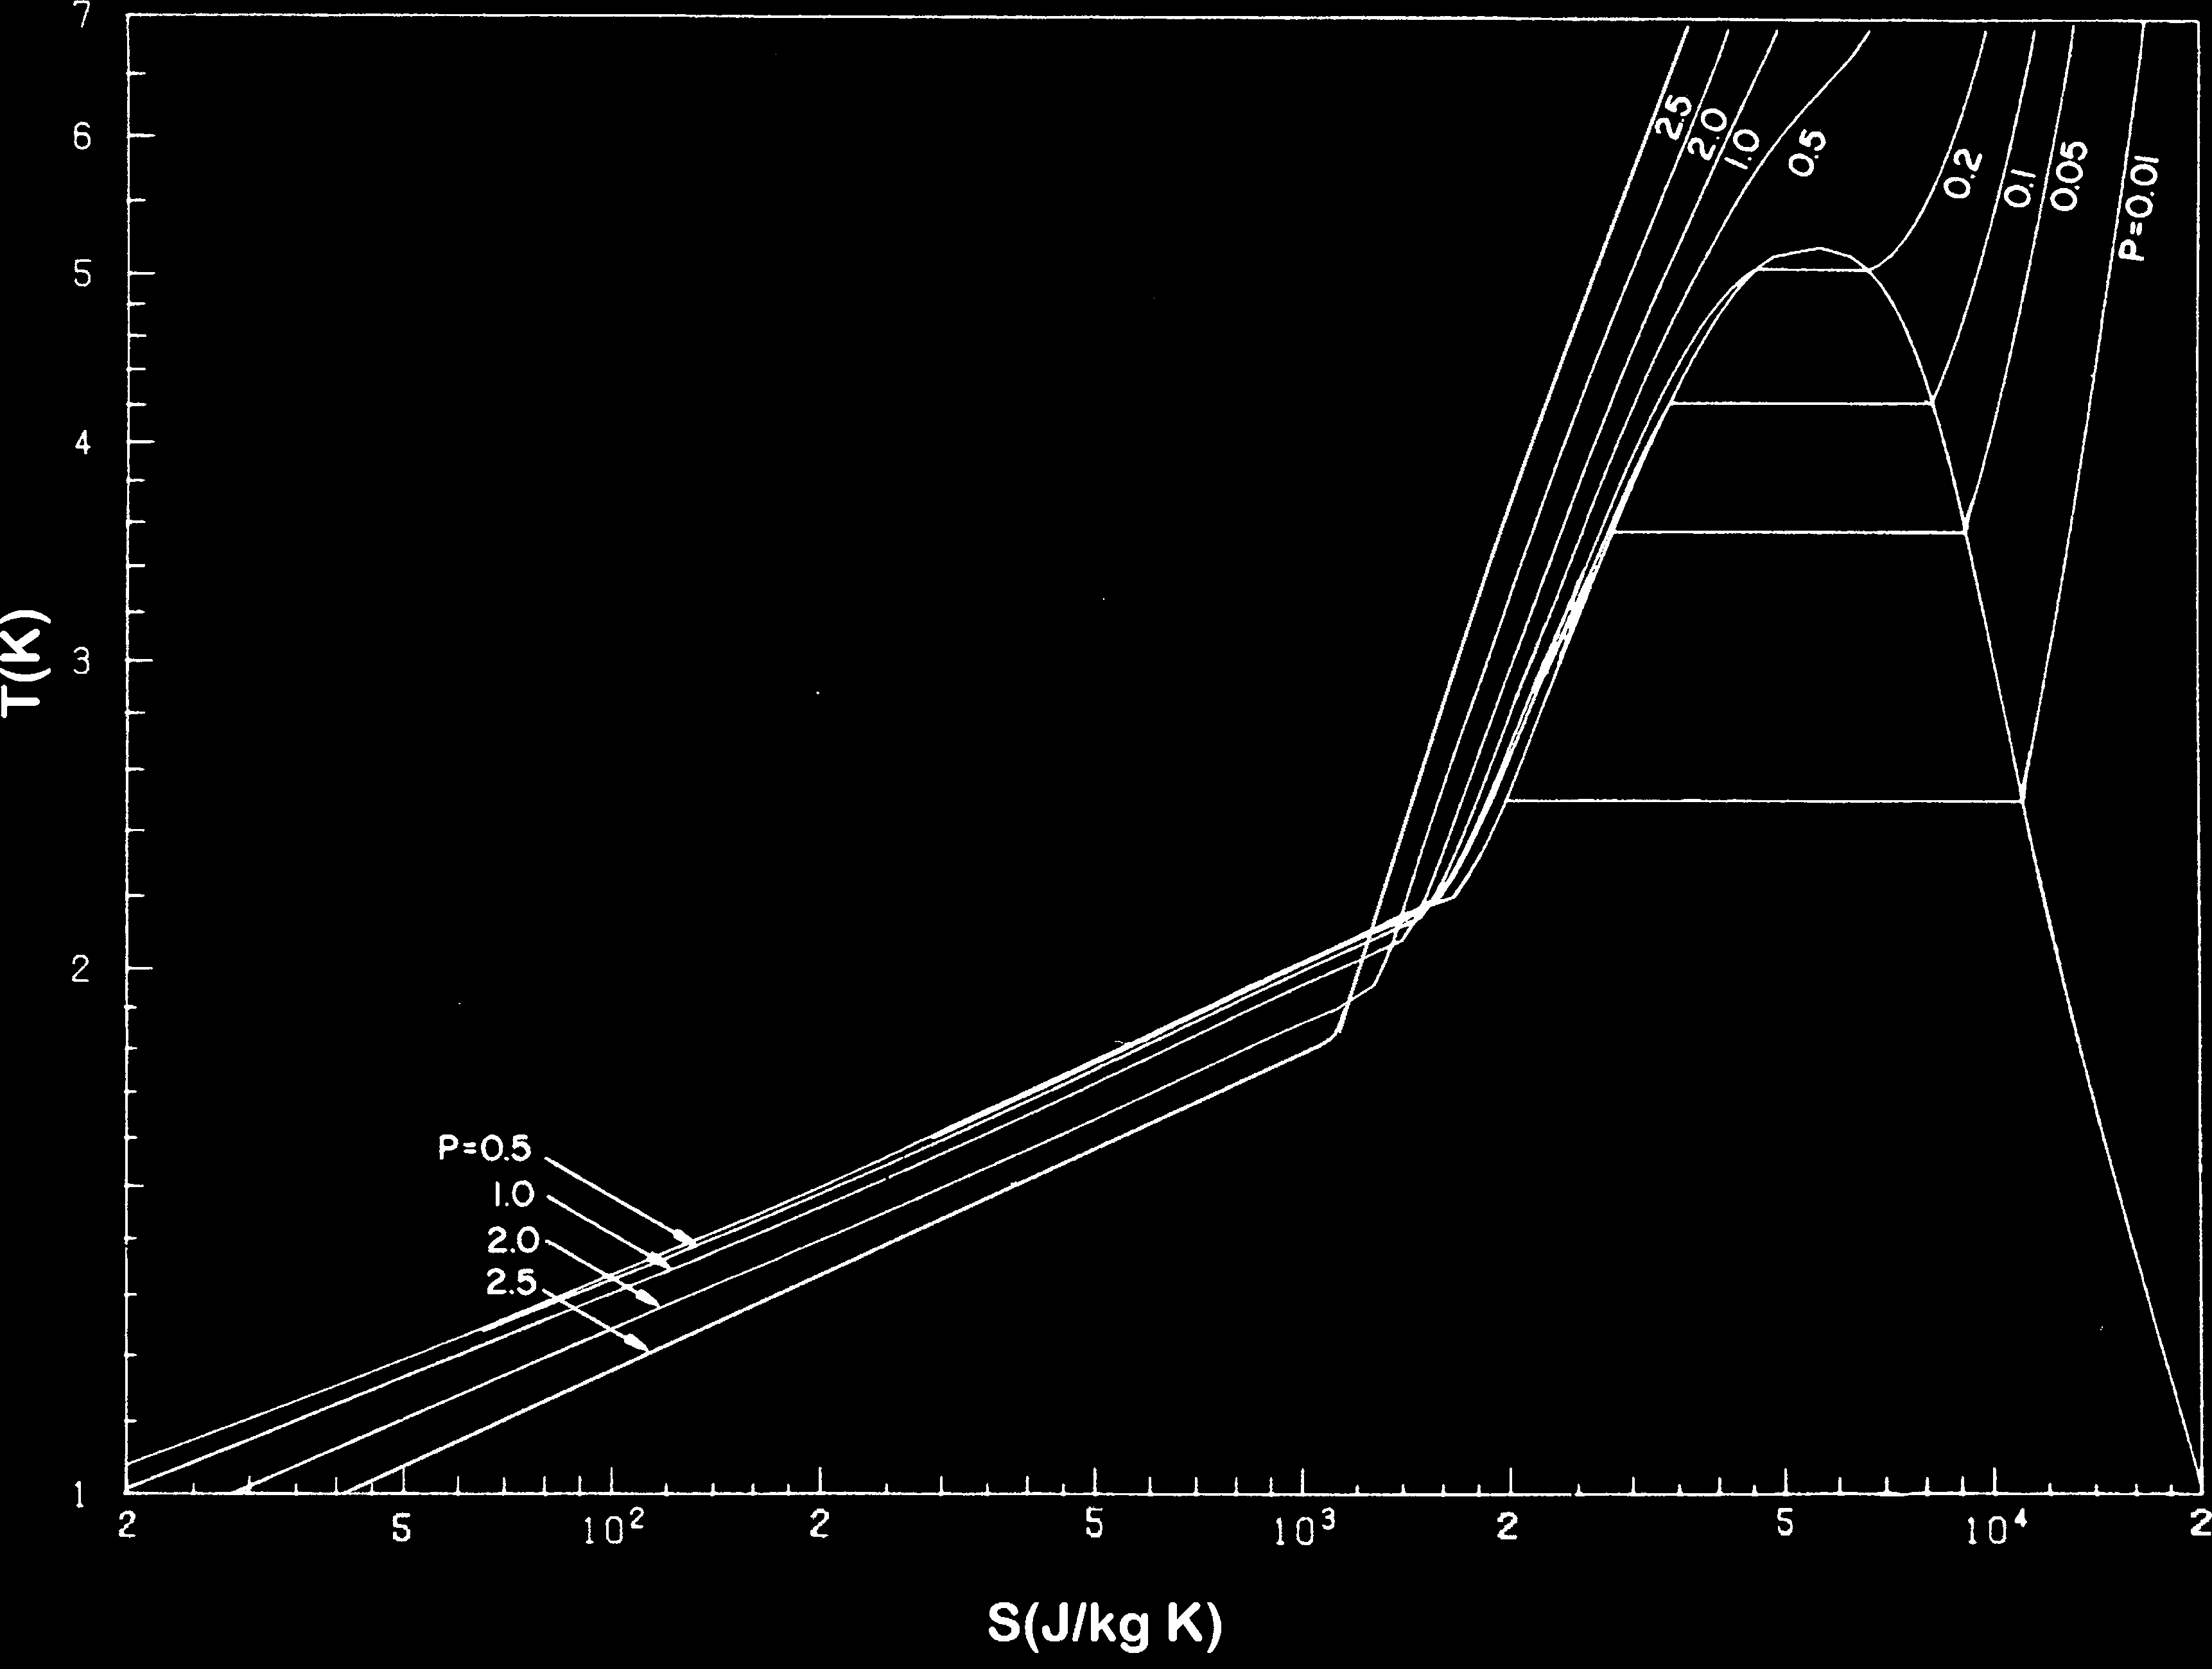
Page: 20 Image: 1

Slide 49
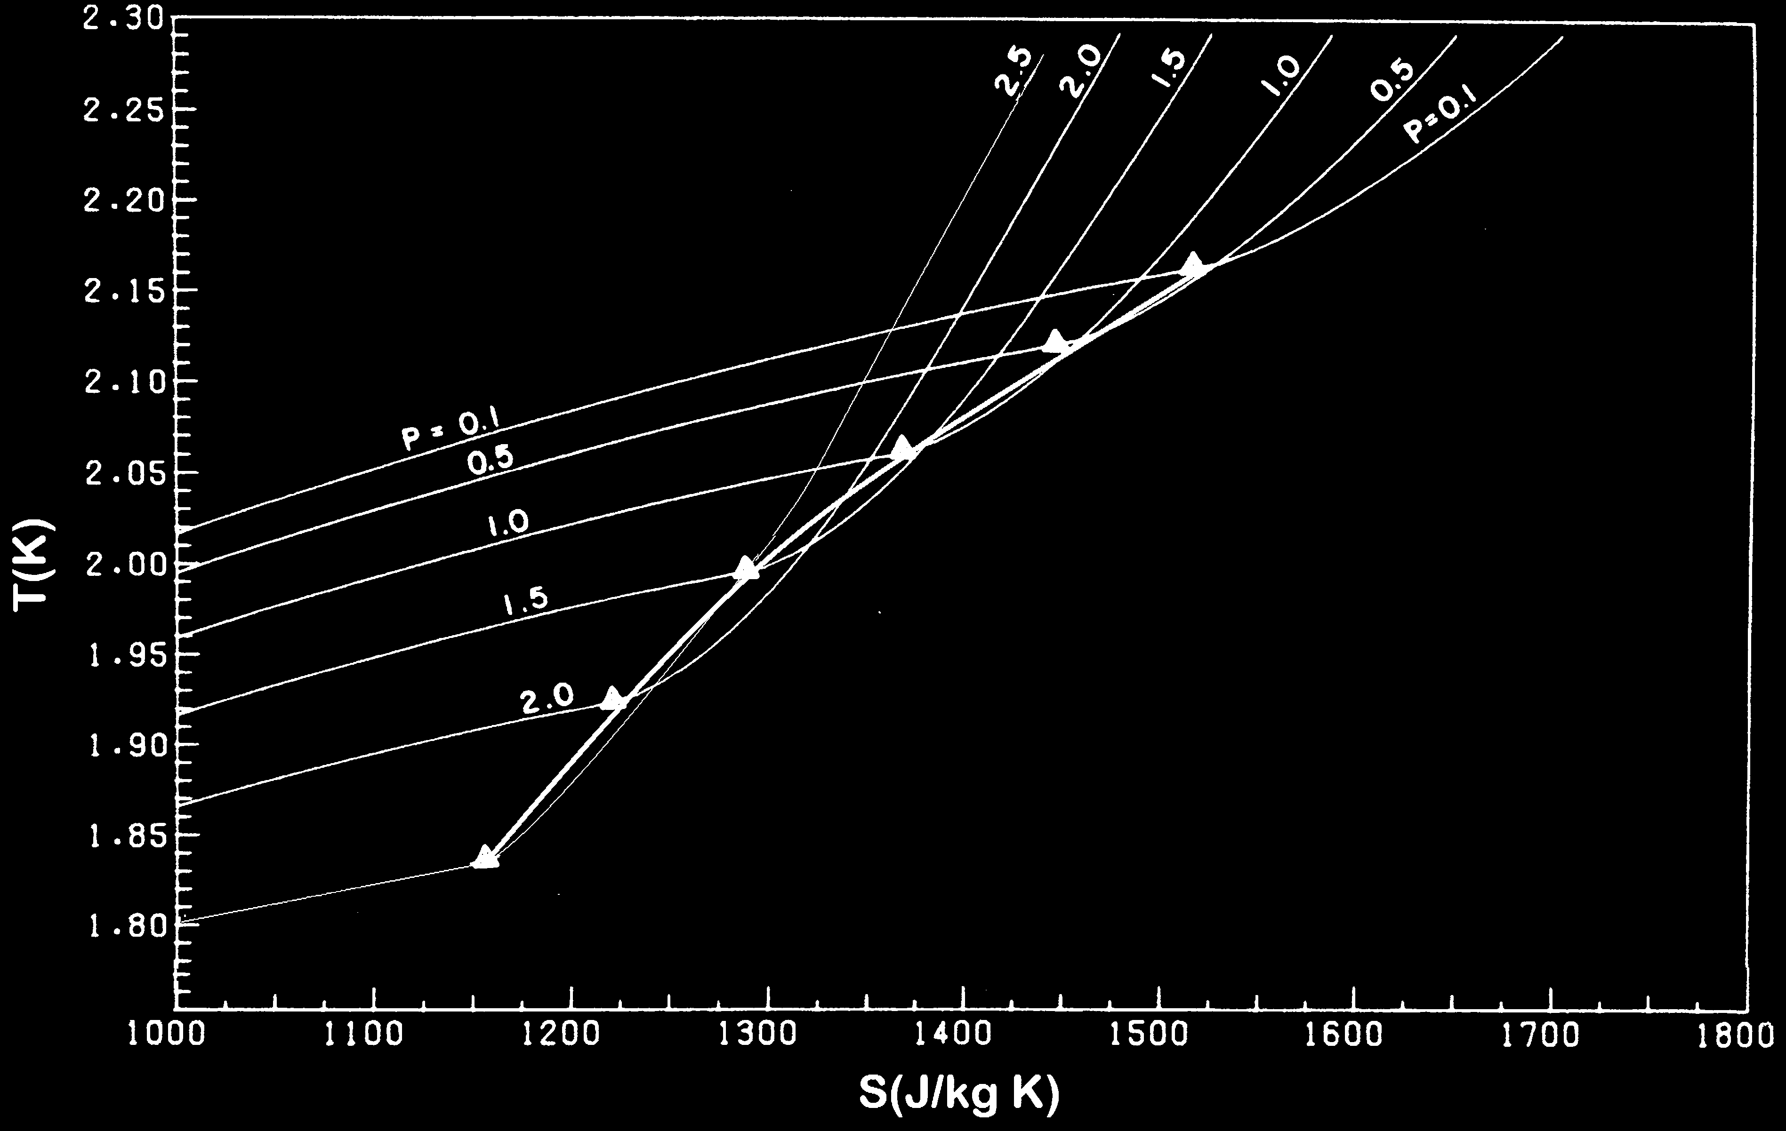
Page: 21 Image: 1

Slide 50
Page: 22 Image: 1

Slide 51
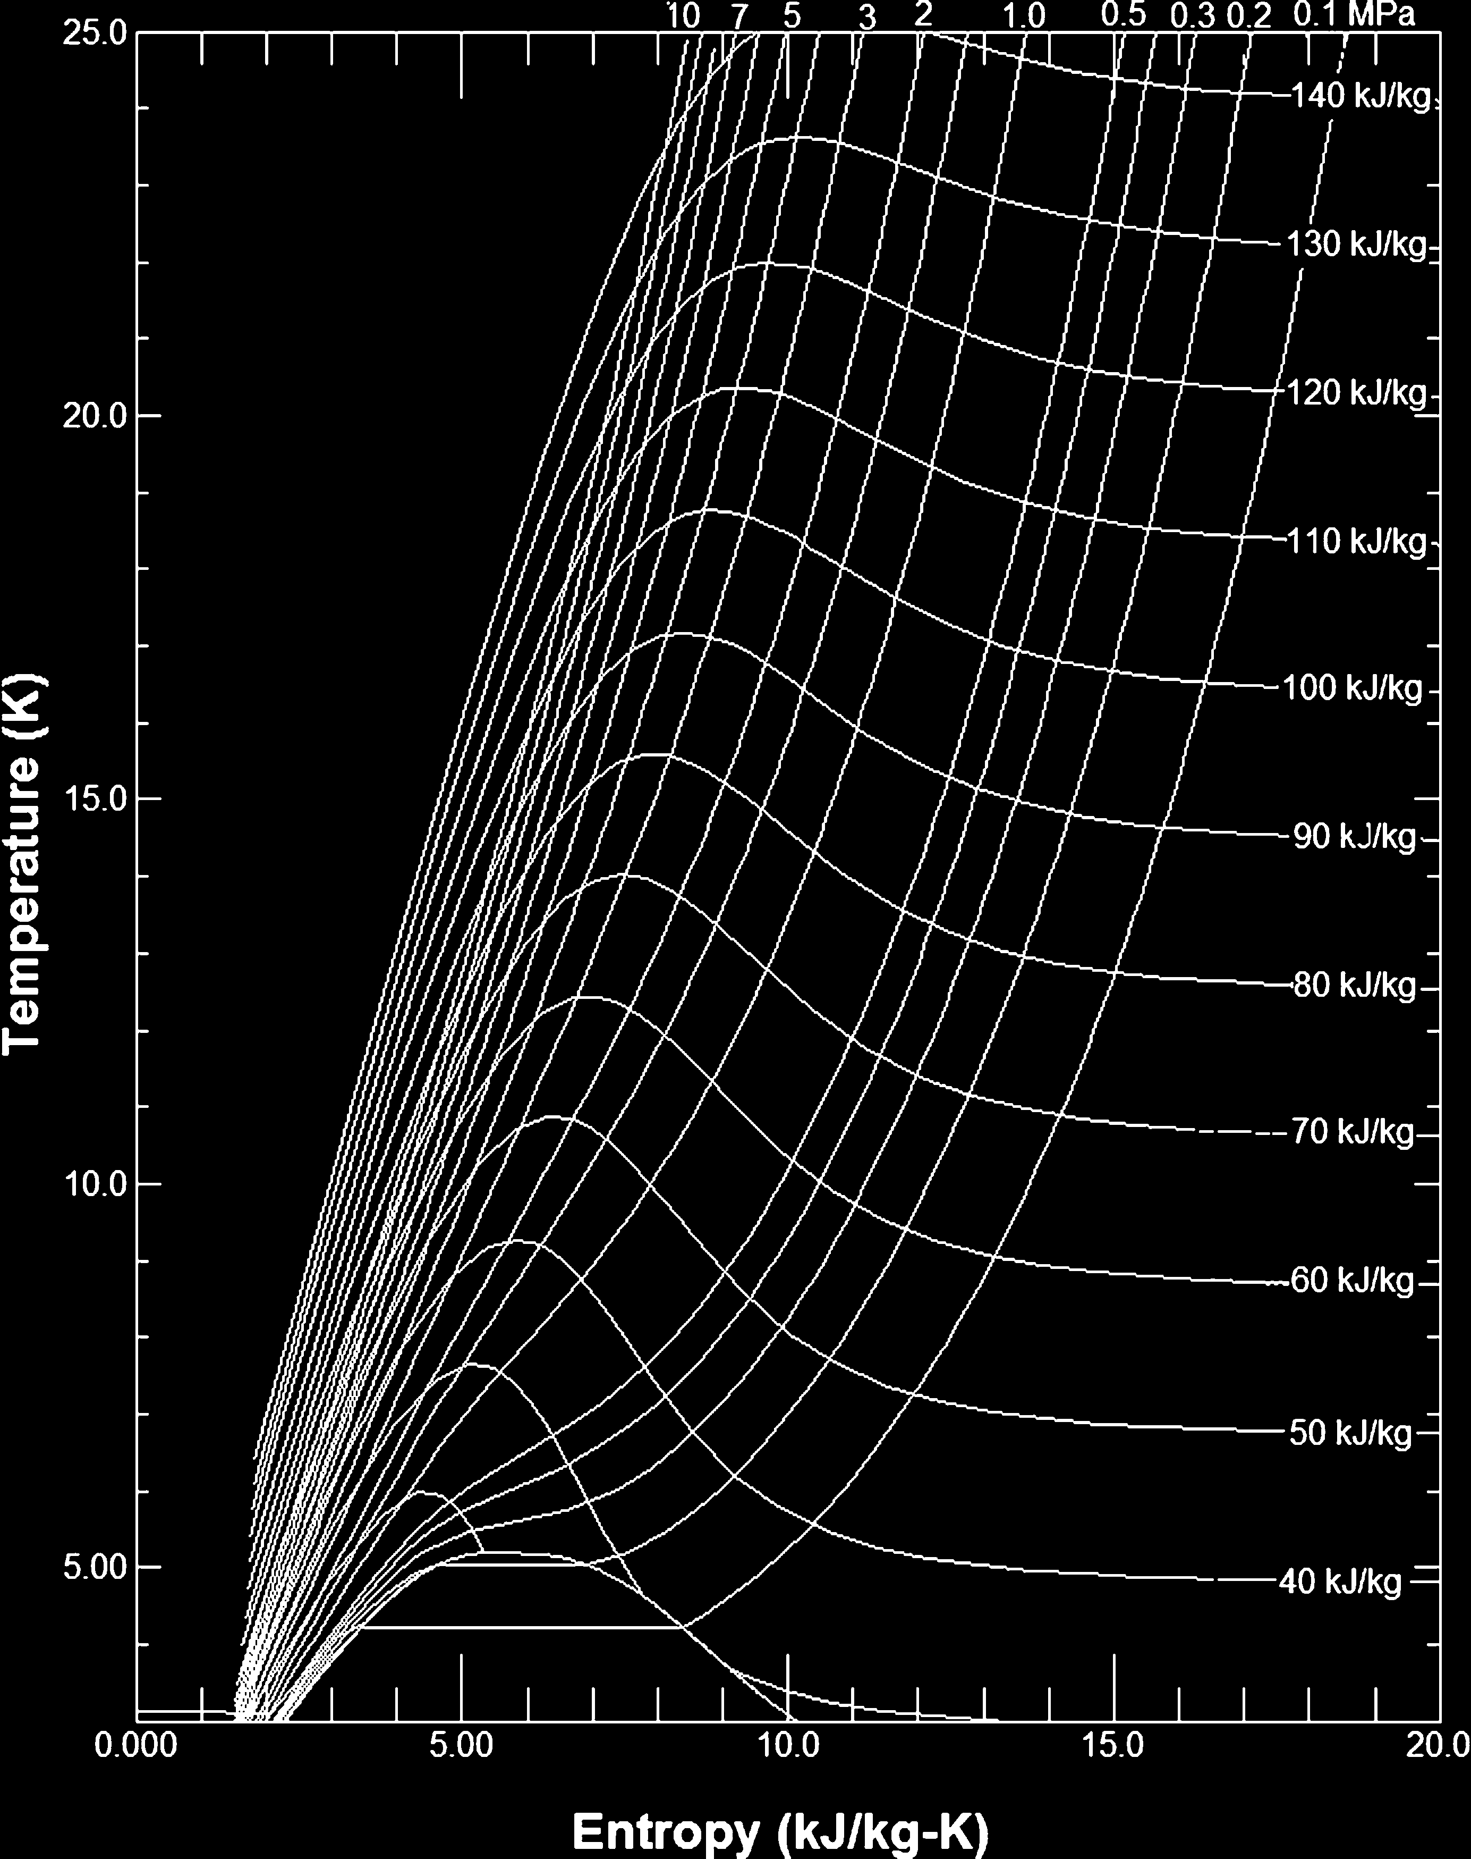
Page: 23 Image: 1

Slide 52
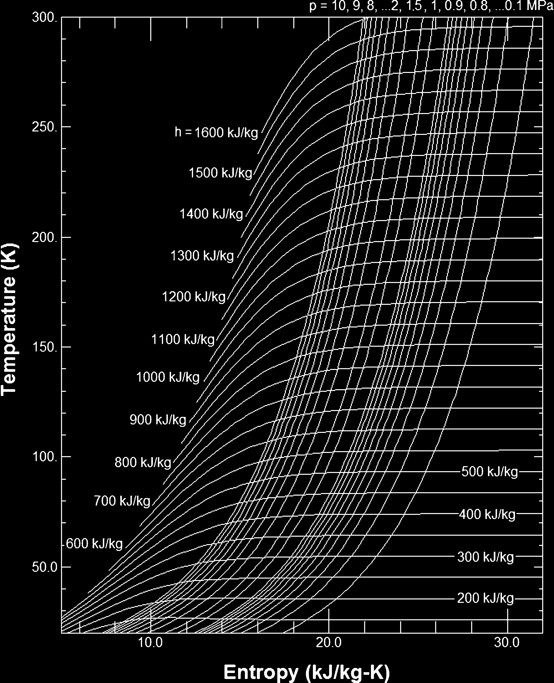
Page: 24 Image: 1

Slide 53
Page: 25
volume 1 m3 (103 L) 106 cm3 35.31 ft3 Mass 1 kg 1,000 g 2.205 lbm Density 1 kg/m3 10 3 g/cm3 6.243 10 2 lm/ft3/

Slide 54
Page: 25 Table: 1
Length 1 m | 100 cm | 3.281 ft | nan | nan | nan | nan
2Area 1 m 2 | 4 10 cm 2 | 10.76 ft | nan | nan | nan | nan
3Volume 1 m (10 L) 3 | 3 10 6 cm 3 | 35.31 ft | nan | nan | nan | nan
Mass 1 kg | 1,000 g | 2.205 lbm | nan | nan | nan | nan
nan | 3 3 | 3 | 2 | nan | nan | 3.0
Density 1 kg/m | 10 g/cm | 6.243 | 10 lbm/ft | nan | nan | nan
Velocity 1 m/s | 100 cm/s | 3.281 ft/s | nan | nan | nan | nan
5Force 1 N | 10 dynes | 0.2248 lbF | nan | nan | nan | nan
2Pressure 1 Pa | 10 dynes/cm | 2 1.45 | 4 10 lbf/in | nan | nan | nan
5 | nan | 6 | nan | nan | nan | nan
10 | bar 9.869 | 10 atm | nan | nan | nan | nan
nan | 37.501 | 10 torr | nan | nan | nan | nan
Temperature 1 K | 1 K | 9/5 R | nan | nan | nan | nan
nan | 7 | nan | 4 | nan | nan | nan
Energy 1 J | 10 erg | 9.479 | 10 Btu | nan | nan | nan

Slide 55
Page: 26
ant eo 14 8.85 10 12 F/m Bohr magneton me 0.927 10 23 J/T Elementary charge e 14.60 10 19 Coul Gravitational acceleration g 14" 9.807 m/s2 4

Slide 56
Page: 27
Claude cycle isothermal refrigerator, 353, 354 liquefier, 343, 353 Clausius–Clapeyron equation saturated He II, 237, 246, 248 solid-liquid helium, 387 vapor nucleation theory,

Slide 57
Page: 28
168–170 a Fermi gas, 385 He II under SVP, 383, 386–388, 420, 422–424, 427 nuclear, 6, 426–427 Density of a Bose gas .

Slide 58
Page: 28
178 of liquid 3He, 388 of liquid 4He, 72 of mixing in two phase helium, 381 of paramagnetic salts, 427 statistical definition, 12, 13 thermodynamic definition, 16, 408 transition from superconducting to normal state .

Slide 59
Page: 29
in 4He, 164, 378 Feynmann theory, 210 Figure of merit (FOM) definition of, 44, 352 in a Claude liquefier, 345, 349 in an a Joule–Thomson lique

Slide 60
Page: 29
304 Gr€uneisen coefficient, 27, 28 H He I density of, 69–71, 239 heat transfer film boiling . 139, 227, 295 Prandtl number (Pr), 83 state properties .

Slide 61
Page: 29
142, 156, 239, 295 in He II, 235–239, 265, 295, 305 pool boiling, 117, 130, 144 radiant, 282, 401, 402 Heat transfer correlations channel in He I, 150,

Slide 62
Page: 30
Joule–Thomson effect coefficient definition of, 93, 317, 324, 325 in liquefaction, 5, 317 . 324–341, 346 internal flow, 346 Isotherm adsorption .

Slide 63
Page: 30
4 dependence on Debye temperature, 40, 41, 281, 282, 284, 288, 289 experimental values, 283, 284, 290 helium pressure dependence, 291 in He I, 155, 156, 295 in He II, 278, 280

Slide 64
Page: 30
magnetization magnetization adiabatic, 55 of paramagnetic ions, 415–420 of superconductors, 47, 51 Magnetocaloric coefficient, 420–422 Matthiessen’s rule, 30 Maxwell–Boltz

Slide 65
Page: 31
88 in He II, 199, 202 Polycritical point (3He), 389 Pomaranchuk cooling . 82, 147 ideal gas, 82 of common liquids, 83 pressure drop compressible fluid .

Slide 66
Page: 31
Riemann–Zeta function, 169, 171, 172 Rollin film, 182, 183, 341, 413 S Schrodinger equation, 166 Second virial coefficient classical expression for, 65, 83 empirical expression for .

Slide 67
Page: 32
heat conductivity effective in He II, 175, 202, 228, 235, 241, 245, 254, 261, 295 in superfluid 4He, 391 integrated value, 37 lattice contribution, 37–39 metals, 29, 34–38,

Slide 68
Page: 32
elength, 167, 168, 172 Thermodynamic laws Clausius’ statement, 12 first, 9–14, 190, 346, 353, 356, 367, 420, 421 first of steady flows, 323–324,

Slide 69
Page: 33
251, 273, 278 superfluid, 188, 195, 197, 203, 209, 212, 213, 215, 218, 251 Virial expansion, 61, 64–67, 80, 224 Viscosity measurement of,

Slide 70
Page: 33
Dr. van Sciver is a Distinguished Research Professor and John H. Gorrie Professor of Mechanical Engineering at Florida State University . he is also a Program Director at the national high magnetic field laboratory .

Slide 71
Page: 34
fessor of nuclear engineering, engineering Physics and Mechanical Engineering at the University of Wisconsin-Madison from 1976 to 1991 . he served as the Associate Director of the Applied Superconductivity Center .

Slide 72

Page: 34 Image: 1

