Slide 1
Page: 1
ARTHUR J. MAYORGA, ASHUTOSH DALVI, MICHELLE E. PAGE, SARAH ZIMOV-LEVINSON, RENE HEN, and IRWIN LUCKI Departments of psychi

Slide 2
Page: 1
ine (5-HT)1A and 5-HT1B receptor mutant mice decreased baseline immobility . fluoxetine (10.0–20.0 mg/kg i.p.) and desipra- mine (5.0– 20.0 mg /kg) .

Slide 3
Page: 1
administration of selective 5-HT receptor antagonists in wild-type mice partially reproduced the phenotypes of the mutant mice . 5-HT1A receptors have different roles in the modulation of the response to antidepressant drugs in the TST .

Slide 4
Page: 1
5-HT receptor ago- nists produce behavioral re- sponses characteristic of conventional antidepressants using selective agonists . selective 5-HT1A receptor agons produce responses in rodent behaviors, such as the forced swimming test (FST) and

Slide 5
Page: 1
the recent development of 5-HT receptor knockout mice has allowed the study of behavioral effects and drug re- sponses in animals that have genetic deletion of targeted . this research was supported by U.S. Public Health Service Grant P01-MH 48125 .

Slide 6
Page: 1 Table: 1

Slide 7
Page: 2
the 5-HT1A receptor knockout mice showed behaviors consistent with an increase in anxiety . these receptor subtypes may play a role in affective disorders .

Slide 8
Page: 2
studies of antidepressant-like behaviors using mice with genetic deletions targeted at 5-HT1A receptors may provide complementary information . genetic techniques produce more selective and total deletion of targeted receptors than acute pharmacological tools .

Slide 9
Page: 2
psy-chiatric medications may be related to human homologs of the murine-disrupted gene . current studies examined the effects of antide- pressant drugs on the immobility of mice in the TST .

Slide 10
Page: 2
wild-type, and homozygote 5-HT1A mice were bred and housed in a colony at the university of Pennsylvania (Philadelphia, PA) . es- tablished colonies derived from the 129/Sv strain

Slide 11
Page: 2
subjects were randomly allocated to treatment conditions and tested in coun- terbalanced order . mice were individ- ually suspended by tail to a horizontal ring-stand bar . a 6-min test session was videotaped .

Slide 12
Page: 2
all drugs were dissolved in distilled water and administered via intraperitoneal route . the selective 5-HT1A receptor antagonist WAY 100635 (0.1 mg/kg; Fletcher et al., 1996) were administered immediately prior to fluoxetine .

Slide 13
Page: 2
brain tissue samples were taken for determination of brain monoamine levels in mice treated with either PCPA or AMPT . mice were sacrificed by decapitation 1 h after behavioral testing . whole brain was removed and separated from cerebellum .

Slide 14
Page: 2
the mobile phase consisted of 60 mM sodium phosphate buffer (pH 4.2) with 100 M EDTA . the flow rate through the system was 700 l/min .

Slide 15
Page: 2 Table: 1
TST without drugs given (Heisler et al., 1998; Parks et al., | terbalanced order. Thirty minutes after injection, mice were individ-
1998; Ramboz et al., 1998). Although this behavior is similar | ually suspended by the tail to a horizontal ring-stand bar (distance

Slide 16
Page: 3
the mobile phase con-sisted of 90 mM NaAc, 35 mm citric acid, 0.34mM EDTA, 1.2mm octyl sulfate and 9% (v/v) methanol adjusted to

Slide 17
Page: 3
PCPA reduced 5-HT levels by 70% in wild-type mice and 67% in 5-HT1A receptor knockout mice without signifi- cant effects on DA or NE . AMPT did not significantly affect levels of 5-HT .

Slide 18
Page: 3
n 7 8 8 8 5-HTa,b 1009.0 27.7 300.6 36.2* 1187.5 57.7 394.7 57,7* 5-HIAAa,c 880.3 29.9 403.6 19.2* 1109.8 103.4 37

Slide 19
Page: 3
n 7–9 mice/group. *p 0.05 versus same genotype saline control . the depletion of catecholamines with AMPT reversed the reduced baseline immobility of 5-HT1A receptor knockout mice .

Slide 20
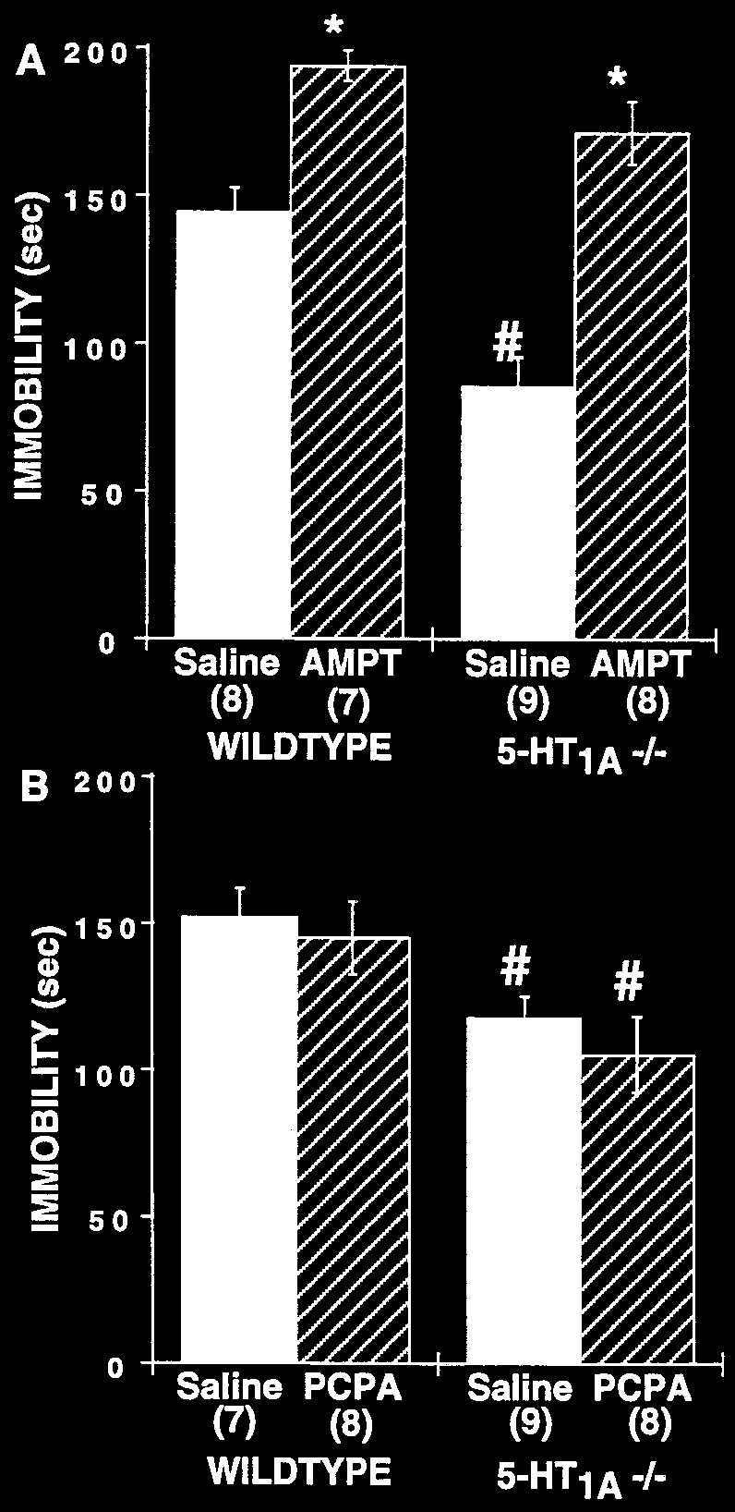
Page: 3 Image: 1

Slide 21
Page: 4
test doses of SSRIs fluoxetine and paroxetine failed to reduce immobility values in 5-HT1A receptor mu- tants . the highest dose of desipramine that was effective in the 55%, p 0.05 .

Slide 22
Page: 4
two-way ANOVA revealed a significant genotype treat-ment interaction on immobility . 5-HT1B / mice showed an increase in sensitivity to the behavioral effects of fluoxetine .

Slide 23
Page: 4
pretreatment with 5-HT receptor antagonist WAY 100635 (p 0.05) blocked anti-immobility effect of 20.0 mg/kg fluox- etine . effects of desipramine, fluoxetine and paroxetine on wild-type mice

Slide 24
Page: 4
effects of desipramine (2.5–20.0 mg/kg) on the behavior of wild-type 5-HT1B receptor knockout mice in the tail suspension test . for both genotypes, n 9 to 22 mice for each dose .

Slide 25
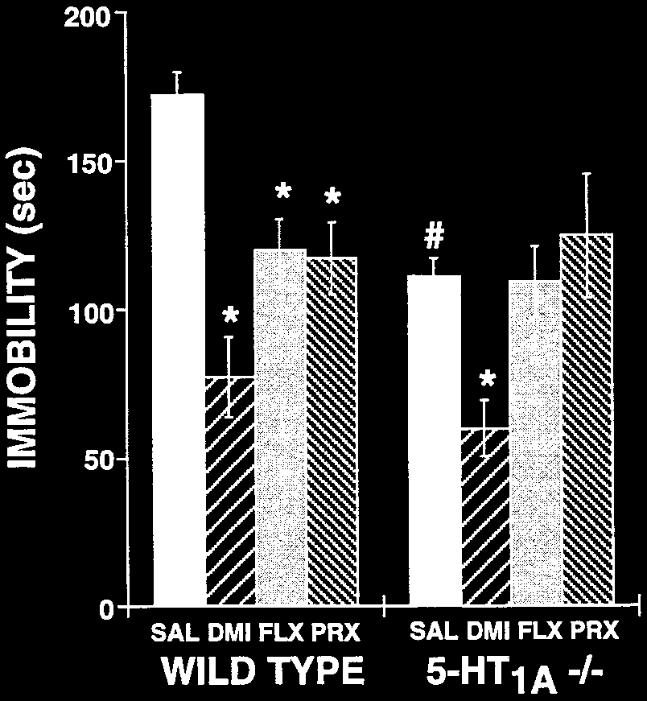
Page: 4 Image: 1

Slide 26
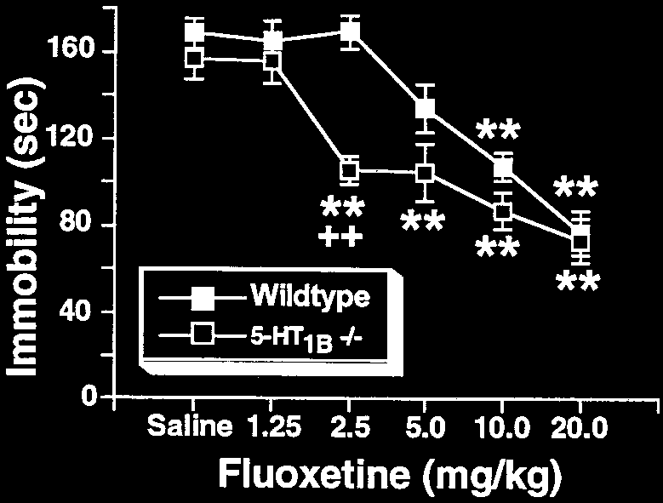
Page: 4 Image: 2

Slide 27
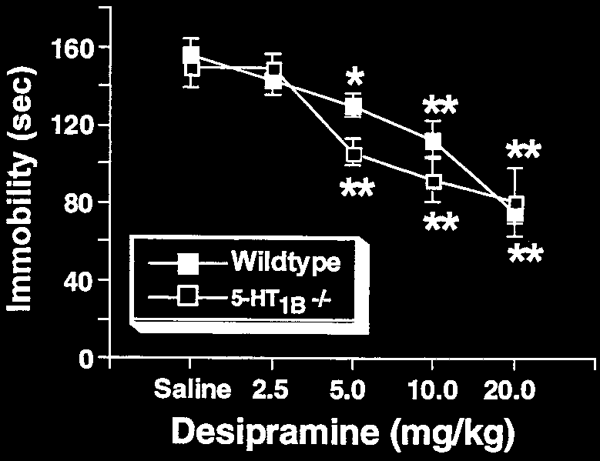
Page: 4 Image: 3

Slide 28
Page: 5
5-HT1A receptors have different roles in the modulation of the response to antidepressant drugs in the TST . the ab- sence of 5-HT1,5 and 5HT1B receptors was associated with a decrease in immobility under baseline conditions

Slide 29
Page: 5
5-HT1A receptor mutants showed a decrease of baseline im-mobility values . ant mice have also been reported to show reduction of immobility in the FST .

Slide 30
Page: 5
the lack of a behavioral response to PCPA pretreatment is quite significant because it suggests that the TST behavior is not caused by the absence of pre- synaptic 5-HT1A receptors .

Slide 31
Page: 5
antidepressant-like responses of 5-HT1A receptor mu- tants could involve altered regulation of NE or DA transmission . this hypothesis was tested using the tyrosine hydroxylase inhibitor AMPT .

Slide 32
Page: 5
pretreatment on the effect of fluoxetine (2.5 and 20.0 mg/kg) on the behavior of wild-type mice . n 10 to 11 mice/group. *p 0.05 versus saline control with same pretreatment .

Slide 33
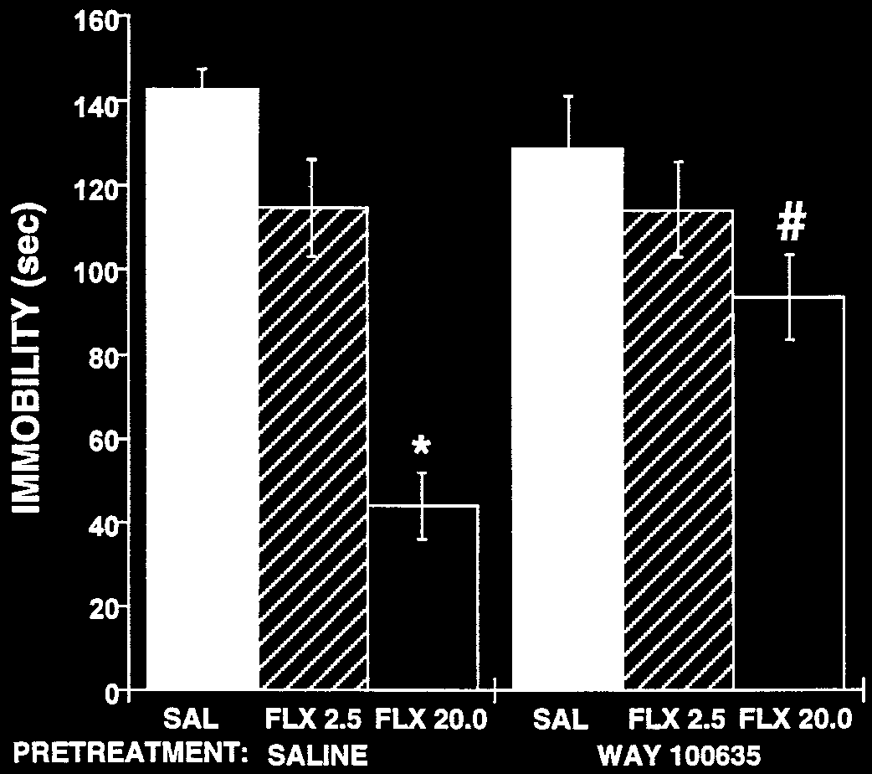
Page: 5 Image: 1

Slide 34
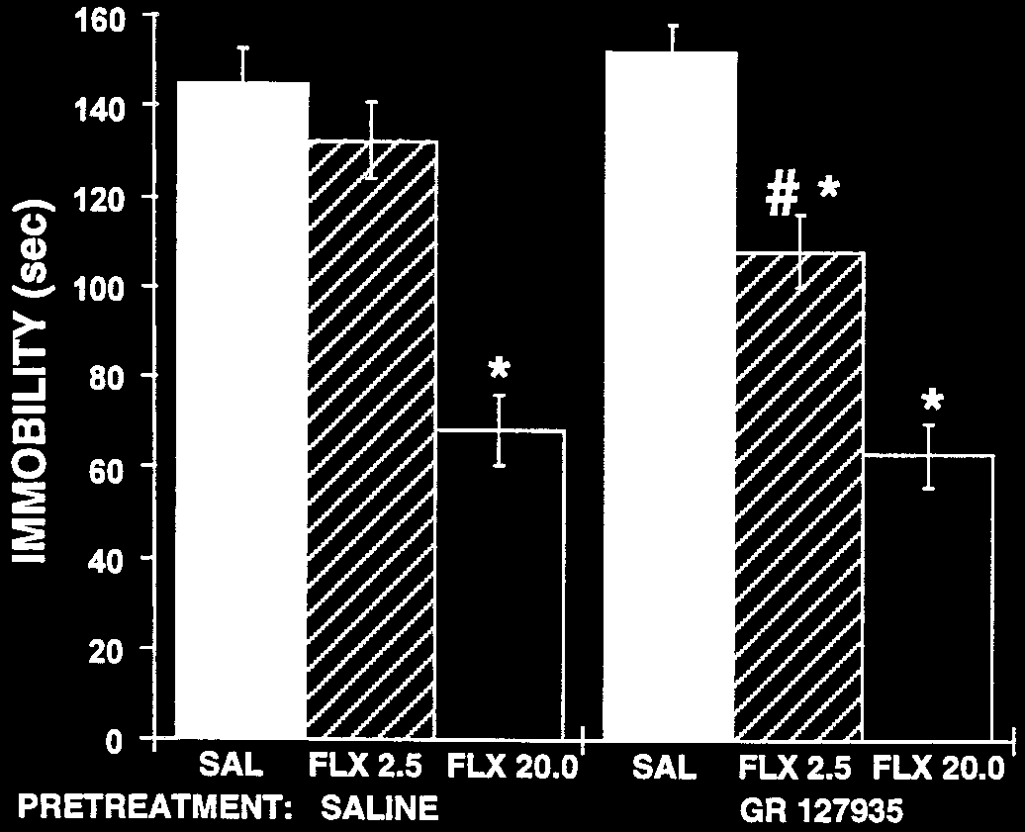
Page: 5 Image: 2

Slide 35
Page: 5 Table: 1
the response | to antidepressant | nan | drugs | nan | in | the | TST. The ab- | nan | nan | PCPA pretreatment is quite significant because it suggests | nan | nan | nan | nan | nan | nan | nan | nan | nan
nan | nan | nan | nan | nan | nan | nan | nan | nan | nan | that the TST behavior is not caused by the absence of pre- | nan | nan | nan | nan | nan | nan | nan | nan | nan
nan | nan | nan | nan | nan | nan | nan | nan | nan | nan | synaptic 5-HT1A | nan | receptors. | nan | Parsons | nan | nan | et al. (2001) | reported | nan
nan | nan | nan | nan | nan | nan | nan | nan | nan | nan | increases in basal and stress-induced extracellular levels of | nan | nan | nan | nan | nan | nan | nan | nan | nan
nan | nan | nan | nan | nan | nan | nan | nan | nan | nan | 5-HT in 5-HT1A receptor knockout mice. However, we found | nan | nan | nan | nan | nan | nan | nan | nan | nan
nan | nan | nan | nan | nan | nan | nan | nan | nan | nan | no such change | nan | in basal | nan | levels | testing | nan | a larger | group | of
nan | nan | nan | nan | nan | nan | nan | nan | nan | nan | 5-HT1A receptor | nan | knockout | nan | mice | from | nan | the same | background | nan
nan | nan | nan | nan | nan | nan | nan | nan | nan | nan | (129 mice) as used in this behavioral study (Knobelman et al., | nan | nan | nan | nan | nan | nan | nan | nan | nan
nan | nan | nan | nan | nan | nan | nan | nan | nan | nan | 2001). Although differences in age and background strain of | nan | nan | nan | nan | nan | nan | nan | nan | nan
nan | nan | nan | nan | nan | nan | nan | nan | nan | nan | the mice may explain these experimental differences, assess- | nan | nan | nan | nan | nan | nan | nan | nan | nan
nan | nan | nan | nan | nan | nan | nan | nan | nan | nan | ing the role of 5-HT transmission in mediating baseline be- | nan | nan | nan | nan | nan | nan | nan | nan | nan
nan | nan | nan | nan | nan | nan | nan | nan | nan | nan | havioral differences | nan | in | 5-HT1A | nan | receptor | nan | knockout | mice has | nan
nan | nan | nan | nan | nan | nan | nan | nan | nan | nan | taken on added importance in view of these reports. Alterna- | nan | nan | nan | nan | nan | nan | nan | nan | nan
nan | nan | nan | nan | nan | nan | nan | nan | nan | nan | tively, antidepressant-like responses of 5-HT1A receptor mu- | nan | nan | nan | nan | nan | nan | nan | nan | nan
nan | nan | nan | nan | nan | nan | nan | nan | nan | nan | tants resulting from the absence of 5-HT1A receptors could | nan | nan | nan | nan | nan | nan | nan | nan | nan
nan | nan | nan | nan | nan | nan | nan | nan | nan | nan | involve altered | nan | regulation | nan | of NE | or | nan | DA transmission. | This | nan
nan | nan | nan | nan | nan | nan | nan | nan | nan | nan | hypothesis | was | tested | by | the depletion | nan | nan | of catecholamines | nan | nan
nan | nan | nan | nan | nan | nan | nan | nan | nan | nan | using the tyrosine | nan | hydroxylase | nan | nan | inhibitor | nan | AMPT. | Although | nan
nan | nan | nan | nan | nan | nan | nan | nan | nan | nan | the immobility | nan | of wild-type | nan | mice | nan | was | increased | by AMPT | nan
nan | nan | nan | nan | nan | nan | nan | nan | nan | nan | pretreatment, the significantly larger proportional | nan | nan | nan | nan | nan | nan | nan | increase | nan
nan | nan | nan | nan | nan | nan | nan | nan | nan | nan | in the immobility of the 5-HT1A receptor knockout mice sug- | nan | nan | nan | nan | nan | nan | nan | nan | nan
Fig. 6. Effects of GR 127935 (0.056 mg/kg) pretreatment on the effect of | nan | nan | nan | nan | nan | nan | nan | nan | nan | gested selective vulnerability for the effects of catecholamine | nan | nan | nan | nan | nan | nan | nan | nan | nan
fluoxetine (2.5 and 20.0 mg/kg) on the behavior of wild-type mice. n | nan | nan | nan | nan | nan | nan | 10 | nan | nan | nan | nan | nan | nan | nan | nan | nan | nan | nan | nan
to 11 mice/group. *p | 0.05 versus saline control with same pretreatment; | nan | nan | nan | nan | nan | nan | nan | nan | depletion. In the absence of other evidence, however, AMPT | nan | nan | nan | nan | nan | nan | nan | nan | nan

Slide 36
Page: 6
5-HT1A receptor deletion did not alter the antidepressant behavioral response to desipramine, a selective NE reuptake inhibitor . a low 2.5-mg/kg dose of fluoxetine produced an augmented increasing response .

Slide 37
Page: 6
5-HT1B receptor mutant mice may potentiate antidepressant-like behaviors to SSRIs because they are important in regulating extracellular 5-HT in regions, like the hippocampus, that are critical for their expression . 5-HT

Slide 38
Page: 6
the decreased baseline immobility in 5-HT1A receptor mutant mice was not mimicked by administration of WAY 100635 alone . the duration of treatment with the antago- nist was brief, but developmental compensation may account for the dramatic differences .

Slide 39
Page: 6
ited response to GR 127935 may be due to its poor selectivity, partial efficacy at 5-HT1B receptors, or the need to block receptors for longer periods of time . new compounds may be available that can discriminate the effects of 5-HT

Slide 40
Page: 6
129 mice were among the mouse strains that failed to show antidepressant-like responses to SSRIs in the FST . a recent strain survey study found that 129 showed immobility for nearly the entire 4-min testing period .

Slide 41
Page: 6
the functional consequences of 5-HT receptor mutations may depend on the pharmacological selectivity of the antide- pressants because they were unnecessary for the behavioral activity of the selective NE reuptake inhibitor desipramine . future studies with genetic mu- tant mice will

Slide 42
Page: 6
serotonin inhibits acetylcholine release in rat frontal cortex through 5-HT1B receptors . fluoxetine anti-immobility effect in forced swimming test in mice .

Slide 43
Page: 7
tryptophan-depletion challenge in depressed patients treated with desipramine or fluoxetine: implications for the role of serotonin in the mechanism of antidepressant action .

Slide 44
Page: 7
Knobelman DA, Kung HF and Lucki I (2000) Regulation of extracellular sero- tonin by 5-hydroxytryptamine1A and 5-HT1B autoreceptors in dif- ferent brain regions .

Slide 45
Page: 7
tchins LJ, Gosden J and Heal DJ (1993) Mediation of the antidepressant-like effect of 8-OH-DPAT in mice by postsynaptic 5-HT1A receptors .

Slide 46
Page: 7
5-HT1A receptor mutant mice exhibit enhanced tonic, stress-induced and fluoxetine-induced serotonergic transmission . perrault GH, Morel E, Zivkovic B and Sanger DJ .

Slide 47
Page: 7
h5-HT1B receptors are discriminated against in mice . the role of 5-HT1A receptors in antidepressant drug actions in the mouse forced swimming test .

Slide 48
Page: 7
ne-evoked dopamine levels following constitutive deletion of the serotonin(1B) receptor . a new method for screening antidepressant drugs .

Slide 49
Page: 7
Eur J Pharmacol 410:165–181 . altered emotional states in knockout mice lacking 5HT1A or 5-HT1B receptors .

