Slide 1
Page: 1
Article to Powerpoint Converter is a software that will convert a PDF article into a powerpoint presentation . the target consumer is anyone who needs a succinct way to give an overview of their work .

Slide 2
Page: 2
the environment will be a folder of classes on Github . the user will have to download the needed apis to run the script . it will also allow for our code to be taken and used by others .

Slide 3
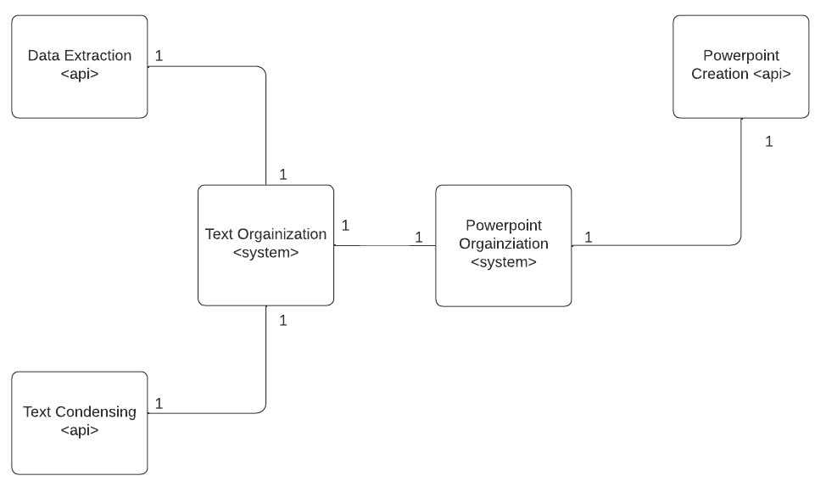
Page: 2 Image: 1

Slide 4
Page: 3
our product must be able to extract as much data as possible from the article to create an accurate overview of it in a powerpoint format . the main four types of data that need to be extracted are text, tables, images and equations .

Slide 5
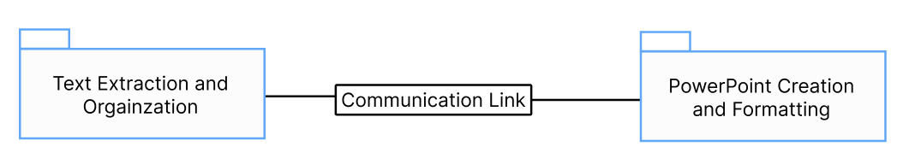
Page: 3 Image: 1

Slide 6
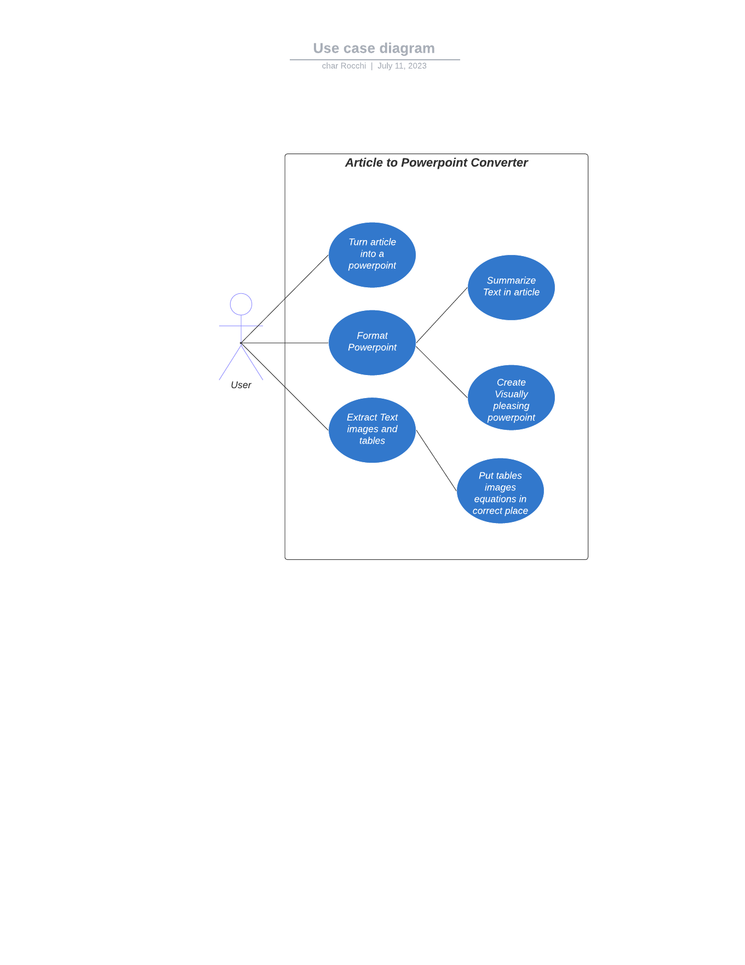
Page: 3 Image: 2

Slide 7
Page: 4
the system needs to be able to find the images, tables and equations . Once found the system will extract the data and organize them in a way that can be correlated to the text .

Slide 8
Page: 4
all required data will be extracted from the article in a way that can be used in the code . this is essentially making sure that the text aligns with the images and that the powerpoint can be produced in an order that makes sense .

Slide 9
Page: 4 Table: 1
Use Case | Extract Tables and images
Actors | User (professor, scholar, student)
Description | The system needs to be able to find the images, tables and
nan | equations. Once found the system will extract the data and organize
nan | them in a way that can be correlated to the text.
Stimulus | Script has started and article being extracted from
Response | Arrays are created of each data type by page
Comments | System will not be able to account for data types other than the ones
nan | mentioned

Slide 10
Page: 4 Table: 2
Use Case | Format Powerpoint
Actors | User (professor, scholar, student)
Description | The powerpoint needs to be formatted in a way that is appealing and
nan | readable by its user. This means the system must make sure the
nan | text matches the tables, equations and images to prevent confusion.
nan | Also the text must be summarized in a way that users can read and
nan | decipher what is happening in the presentation
Stimulus | Data has finished being extracted from the article
Response | Text is summarized then put into the powerpoint and the images,
nan | tables and equations are inputted in their correct spots.
Comments | N/A

Slide 11
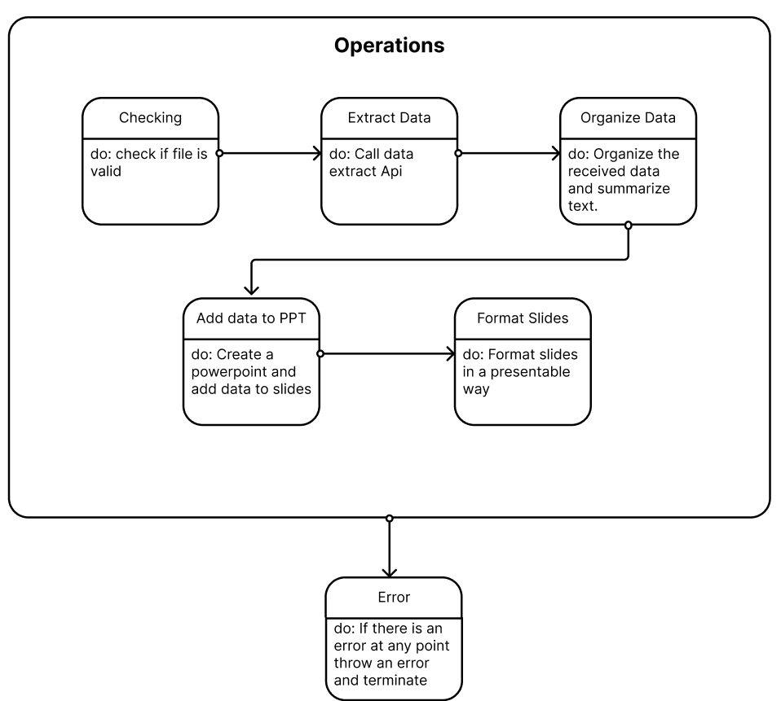
Page: 5 Image: 1

Slide 12
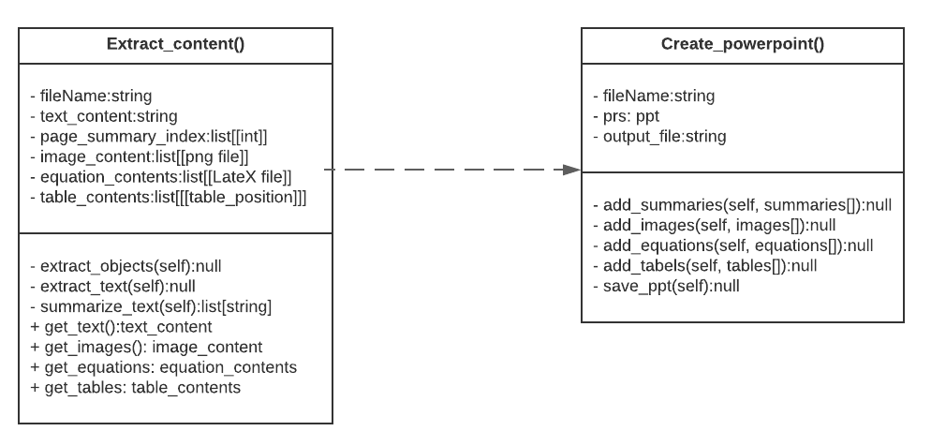
Page: 5 Image: 2

Slide 13
Page: 6
extract_objects() class is used to extract images, equations and tables from the article . it will populate all these attributes as a 3D array . outer list will be the page that the piece of data is on .

Slide 14
Page: 6
extract_text() function is used to extract the actual text of the article into string formatting stored in one large string . this function will keep the index of where the page ends and divide that by 1024 letters which is the length of the summaries created .

Slide 15
Page: 6
extract_content class will be used to create a powerpoint presentation . the attributes of this class are the file name of the output presentation and a link to the powerpoint that the functions can use to reference it .

Slide 16
Page: 6
the position of the image, equation and table slides will be after the last summary corresponding to its page . this makes sure they are in the relative area of their corresponding text . slides can be moved around easily after the powerpoint is created by the user .

Slide 17
Page: 7
extract_objects() Functions - extract_text(self):null Loops through the article and extracts the images, equations and tables . put them in their respective attributes .

Slide 18
Page: 7
formats and add the respective text . Put the slide behind the summary of the corresponding page . Interactions This sequence diagram shows how the script will run from start to finish and the order in which each function will be called.

Slide 19
Page: 7 Table: 1
Attribute | description
- fileName:string | Is the path to the pdf article that is to be used by the
nan | program
- text_content:string | Is the raw text from the article. populated by extract_text()
- page_summary_index:list[int] | Is the summary that would represent the ending of a
nan | specific page. Used to organize data in powerpoint.
nan | Populated by extract_text()
- Image_content:list[[png]], | These are the images, equations and tables from the
- Equation_content:list[[LateX]], | article. Stored by page order then first to last seen.
- Table_content:list[[[string]]] | Populated by extract_objects()
Functions | nan
- extract_objects(self):null | Loops through the article and extracts the images,
nan | equations and tables. Put them in their respective
nan | attributes.
- extract_text(self):null | Loops through the article and extracts the text. Populates
nan | page_summary_index with (len(end of page)/ 1024) to
nan | correlate pages with the summaries.
- summarize_text(self):list[string] | Take the text extracted from extract_text() and divide the
nan | text in blocks of 1028 letters. Summarizes those blocks
nan | and returns a list of all the summaries
+ get_text(), get_images(), | Allows users to see a specific type of data extracted from
get_equations(), get_tables() | the article.

Slide 20
Page: 7 Table: 2
attributes | description
- output_name:string | What the output powerpoint filename will be called
- prs:powerpoint | Is a reference to the powerpoint that is being created and
nan | reformatted
functions | nan

Slide 21
Page: 8
create_powerpoint class will automatically create a blank powerpoint . this will be done first because where we put the image, table and equation slides relies on the corresponding text slides . after the summary slides are created, the data type slides will be created .

Slide 22
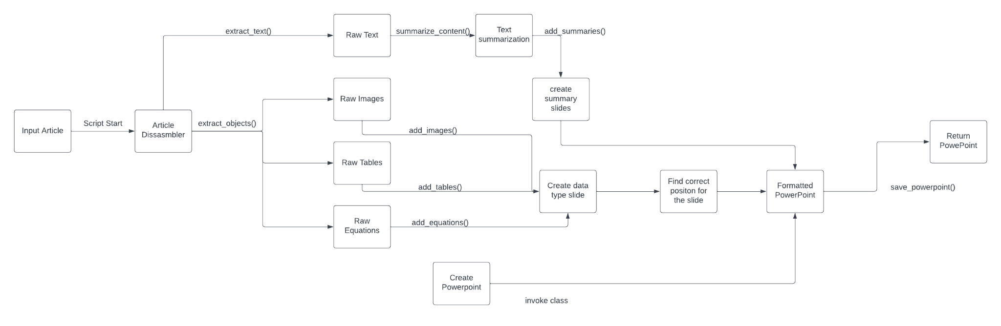
Page: 8 Image: 1

Slide 23
Page: 8 Table: 1
nan | and add the respective text
- add_images():null | Creates a new slide for each data type. Put the slide
- add_tables():null | behind the summary of the corresponding page. Formats
- add_equation():null | and adds the respective data type.

Slide 24
Page: 9
the code saw the regular text as a table . this resulted in a combined table and text extraction . it would be too time consuming to make sure the system works for every formatting method .

Slide 25
Page: 9
ded that 1024 was a good number as it gives us enough content to summarize in one slide and will make around 2-3 slides per page . a whole page is too much to summarize on one slide; this would lead to vague and convoluted slides .

Slide 26
Page: 9
when extracting the text we figure out where each page ends corresponding to the summaries using the formula len (end of page)/1024 . this is not perfect as the items are not in the exact position they need to be .

Slide 27
Page: 10
the system is very slow, taking several minutes to run if the article is larger than 10 pages . the part of the system that is slowing it down is the summarization of the text .

Slide 28
Page: 10
PDF Extract_images Extract_content extract_objetc s() REQ-02 Extract tables from PDF Extract tables . .

Slide 29
Page: 10 Table: 1
ID | Description | Elements | nan | nan
REQ-01 | Extract images | Extract_images | Extract_content | extract_objetc
nan | from PDF | nan | nan | s()
REQ-02 | Extract tables from | Extract tables | Extract_content | extract_objetc
nan | PDF | nan | nan | s()
REQ-03 | Extract equations | Extract | Extract_content | extract_objetc
nan | from PDF | equations | nan | s()

Slide 30
Page: 11 Table: 1
nan | PDF | nan | nan | nan
REQ-05 | Summarize | Summarize text | Extract_content | extract_summ
nan | extracted text | nan | nan | aries()
REQ-06 | Create a new | Create | Create_powerpoint | add_summari
nan | PowerPoint file | PowerPoint | nan | es()
REQ-07 | Add summaries to | Add summaries | Create_powerpoint | add_summari
nan | PowerPoint | nan | nan | es()
REQ-08 | Add images to | Add images | Create_powerpoint | add_images()
nan | PowerPoint | nan | nan | nan
REQ-09 | Add equations to | Add equations | Create_powerpoint | add_equation
nan | PowerPoint | nan | nan | s()
REQ-10 | Add tables to | Add tables | Create_powerpoint | add_tables()
nan | PowerPoint | nan | nan | nan
REQ-11 | Save and download | Save PPT | Create_powerpoint | save_ppt()
nan | the PowerPoint | nan | nan | nan

