Slide 1
All-to-all communication
Gorums

Slide 2
Distributed systems
Benefits:
  Scalability
  Availability
  Performance
  Modularity
Challenges:
  Coordination
  Communication
  Fault-tolerance
  Complexity
source

Slide 3
Preliminary
It is assumed that all nodes know about each other in advance
Request-response (QuorumCall) ← Currently uses this
Push (Multicast)
Proposition:
  Use QuorumCall for Client to Server communication
  Use Multicast for Server to Server communication

Slide 4
Constraints/requirements
Servers can invoke the same gRPC call
Servers can invoke another gRPC call
Guarantee that a broadcast happens exactly once
Guarantee a broadcast request is unique
Out of order requests should be handled
Client timeouts should be handled
Failed requests should be dropped

Slide 5
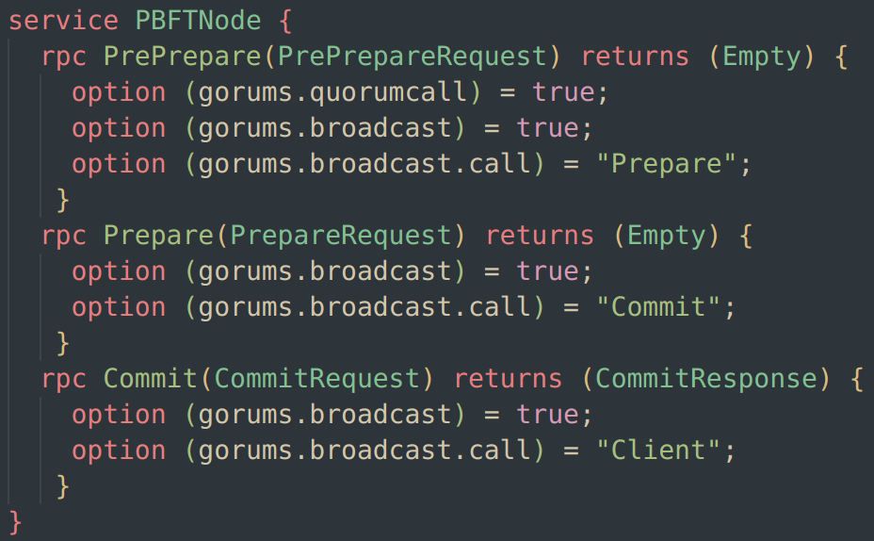
Code

Slide 6
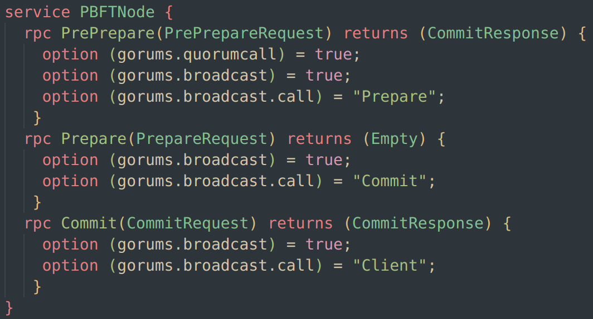
Code

Slide 7
Code

Slide 8
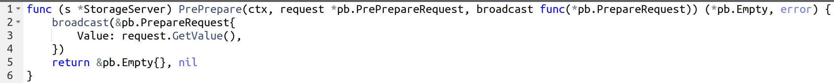
Code

Slide 9
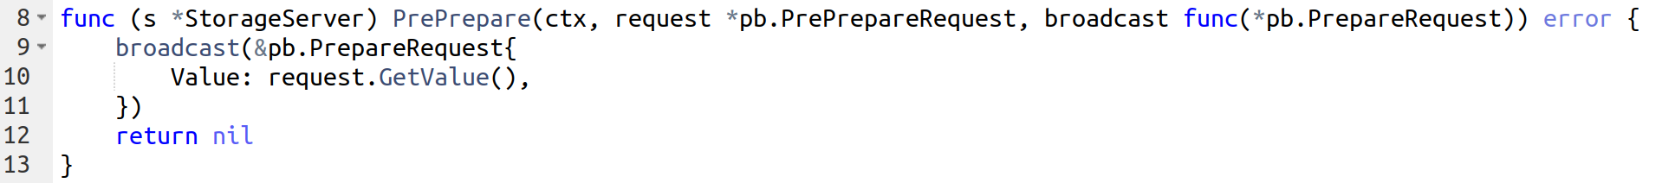
Code
Is this function signature better when the response is not needed?

Slide 10
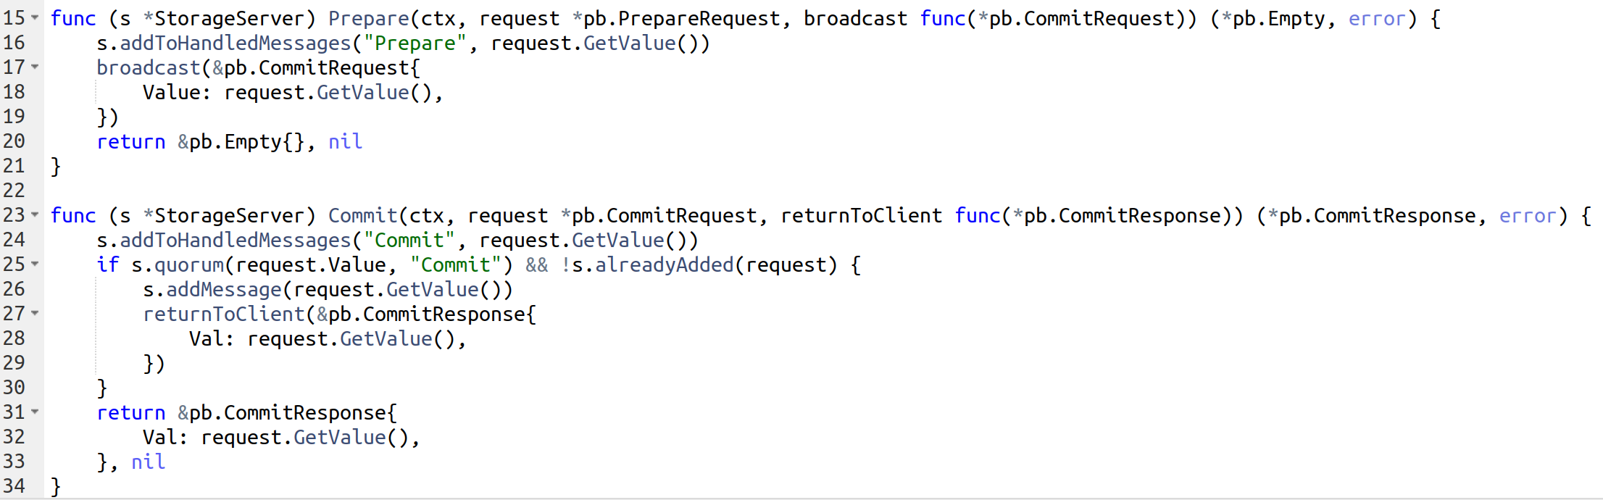
Code

Slide 11
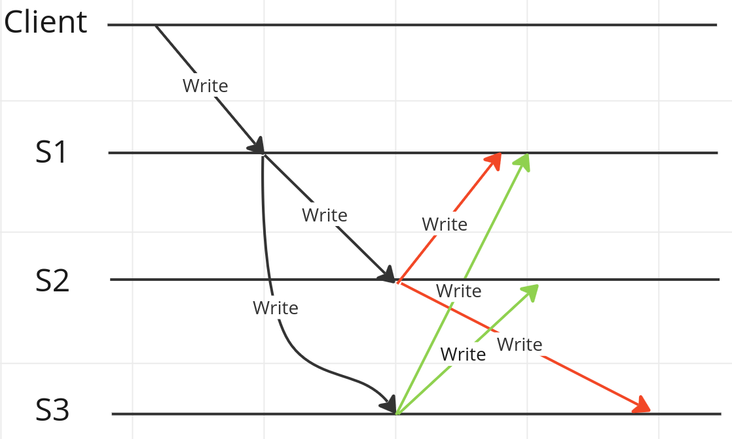
All-to-all invoking same method

Slide 12
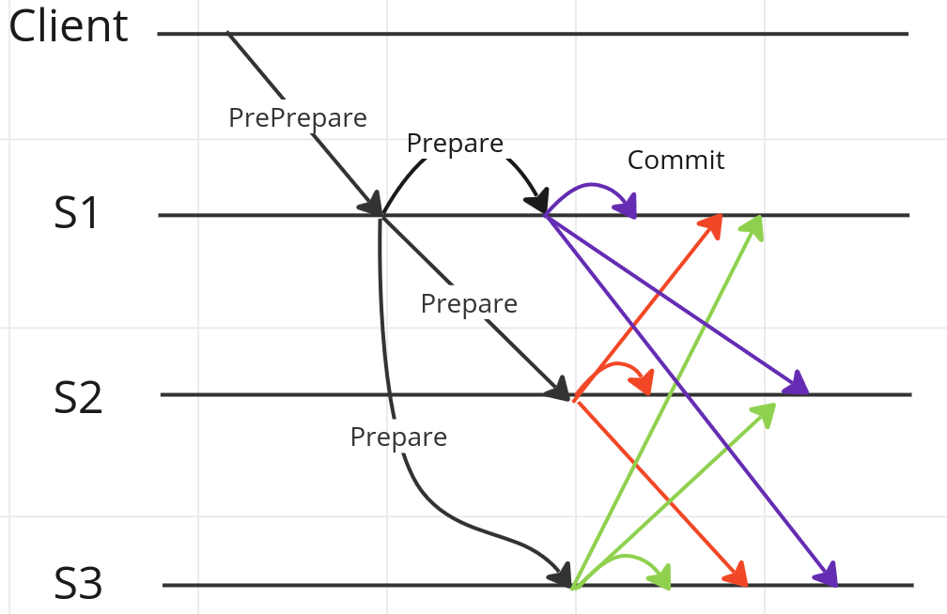
All-to-all invoking another method

Slide 13
All-to-all invoking another method
Note: Server broadcasting to itself

Slide 14
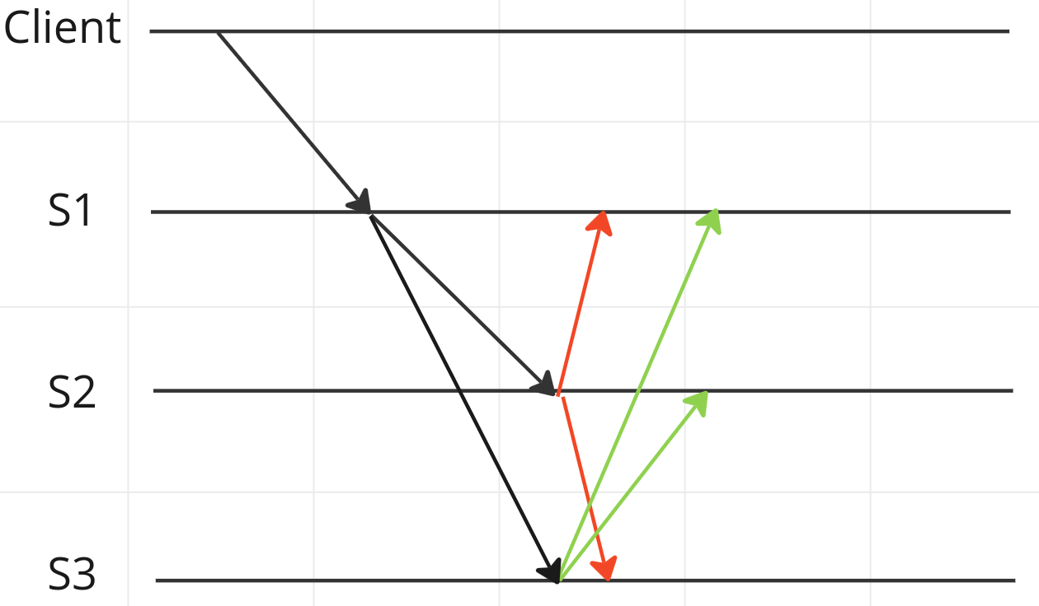
Guarantee that a node broadcasts only once

Slide 15
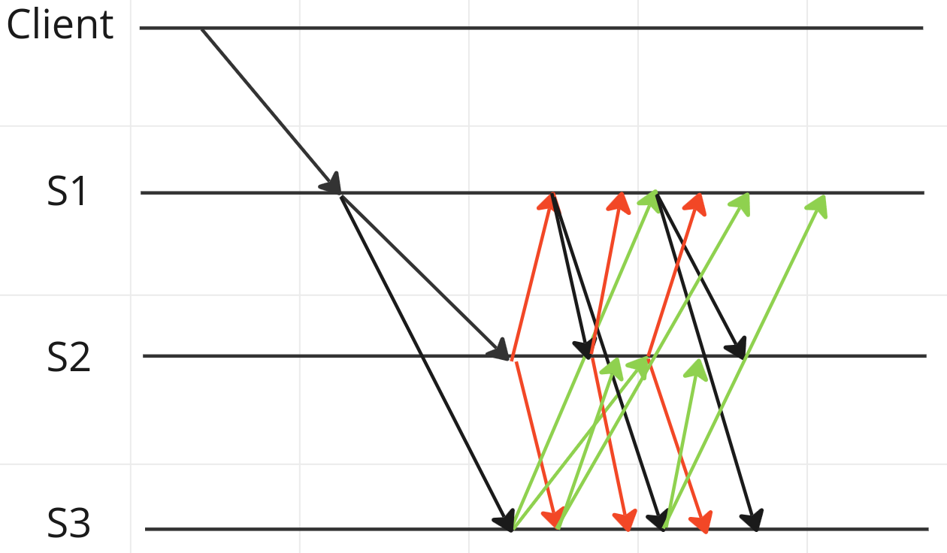
We don’t want this

Slide 16
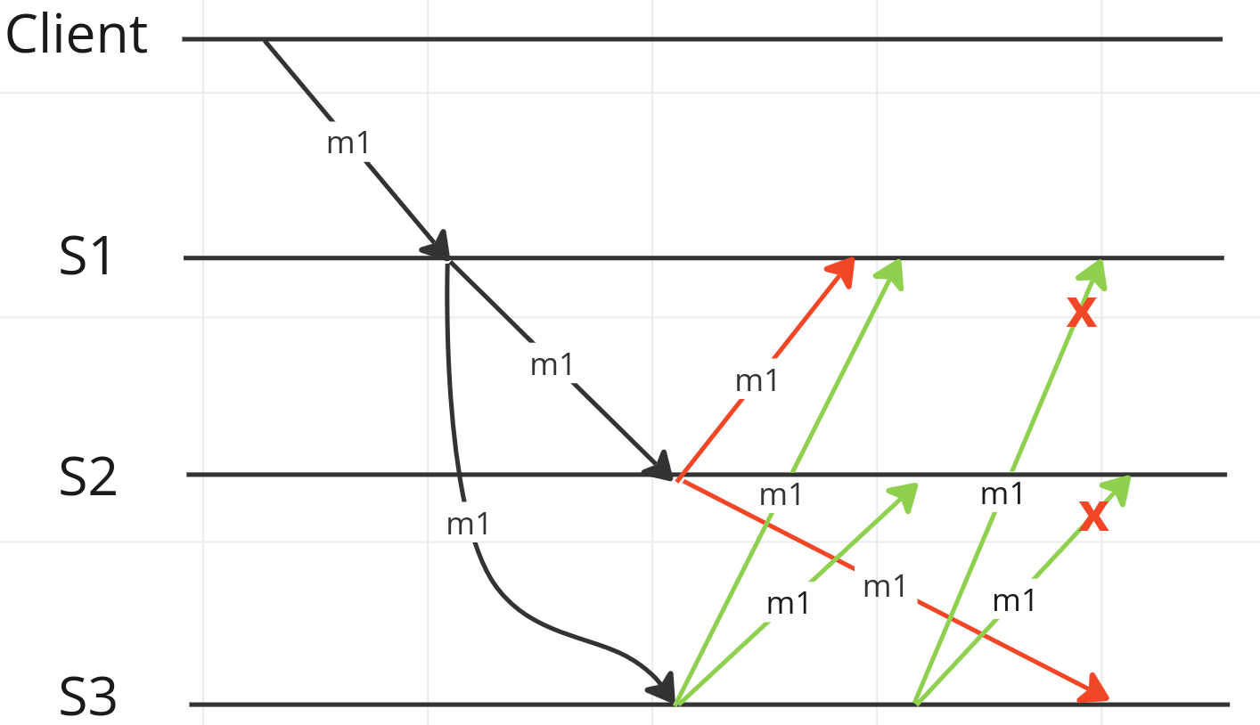
Guarantee that a request is unique (duplicates are dropped at the receiver)

Slide 17
Guarantee that a request is unique
Note:
  m1 != message 1
  m1 = gRPC method 1
A request is defined as following:
  A client issues a gRPC call with a message request
  This message request is tagged with a unique ID
  All following broadcast messages will contain this ID
  Hence, all broadcasts can be seen as part of the initial client request
  This way, subsequent gRPC calls to the same method won’t be dropped

Slide 18
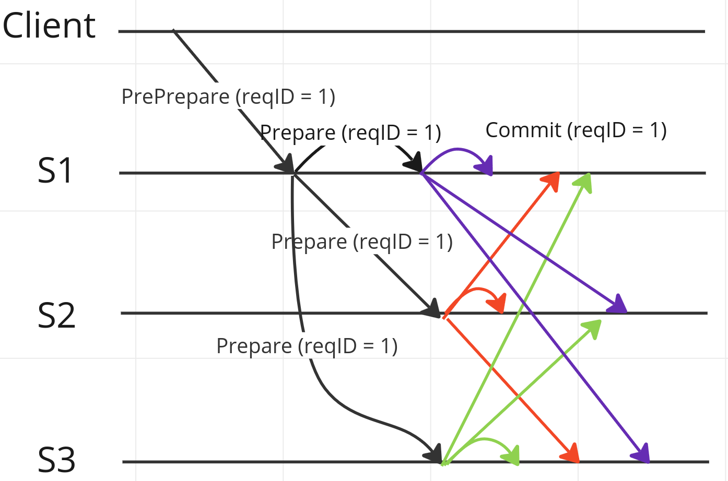
Guarantee that a request is unique

Slide 19
Out of order requests
Guarantee that requests will be executed in correct order.
E.g. execution flow:
  PrePrepare
  Prepare
  Commit
Commit will never be executed before Prepare has been received for a particular request ID.
Out of order requests should be temporarily stored and executed immediately after receiving the preceding request

Slide 20
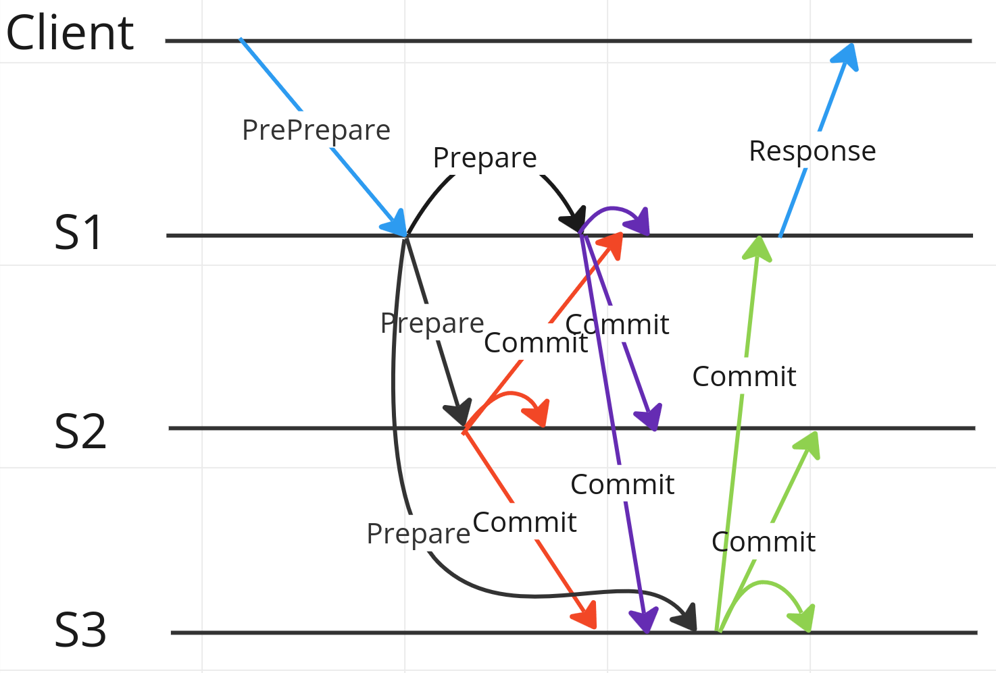
Out of order requests

Slide 21
Out of order requests

Slide 22
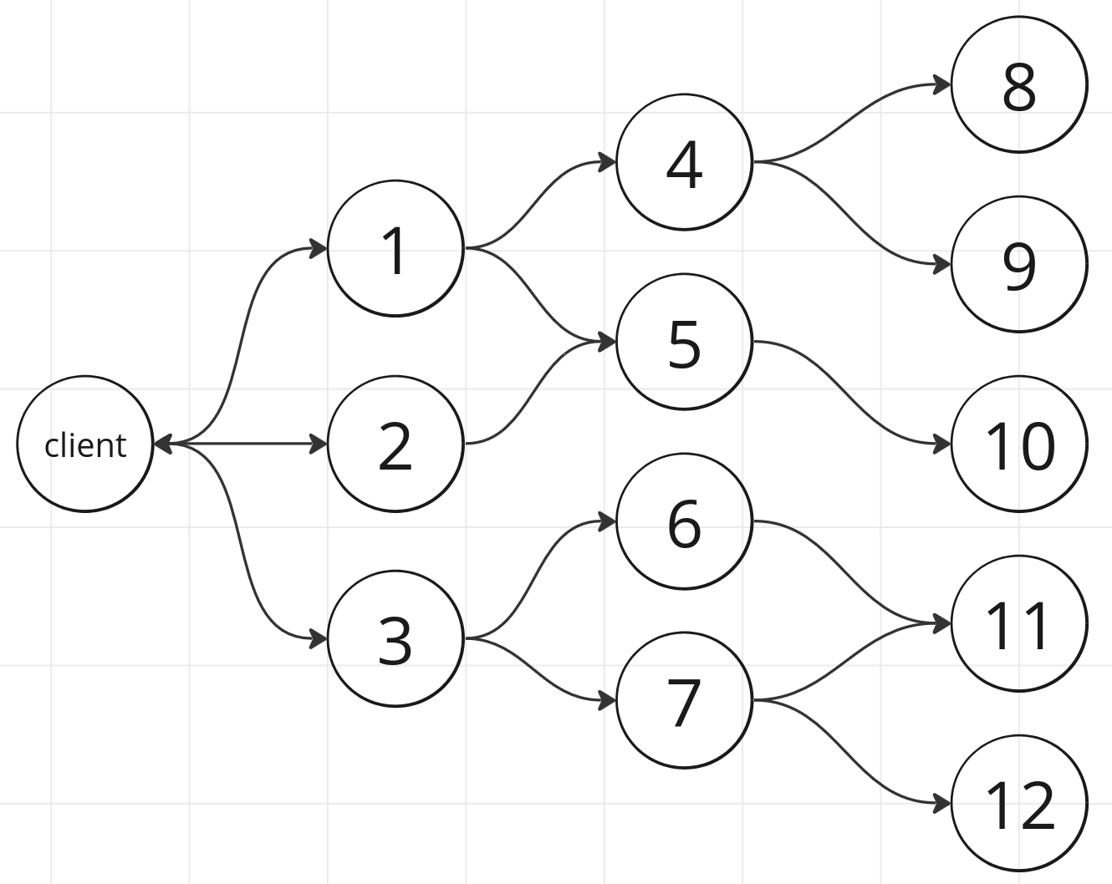
Client timeouts
A client timeout should cancel the request context.
This should be propagated to all servers.
The implementer could then do necessary “cleanup”. E.g. revert stored values, etc.

Slide 23
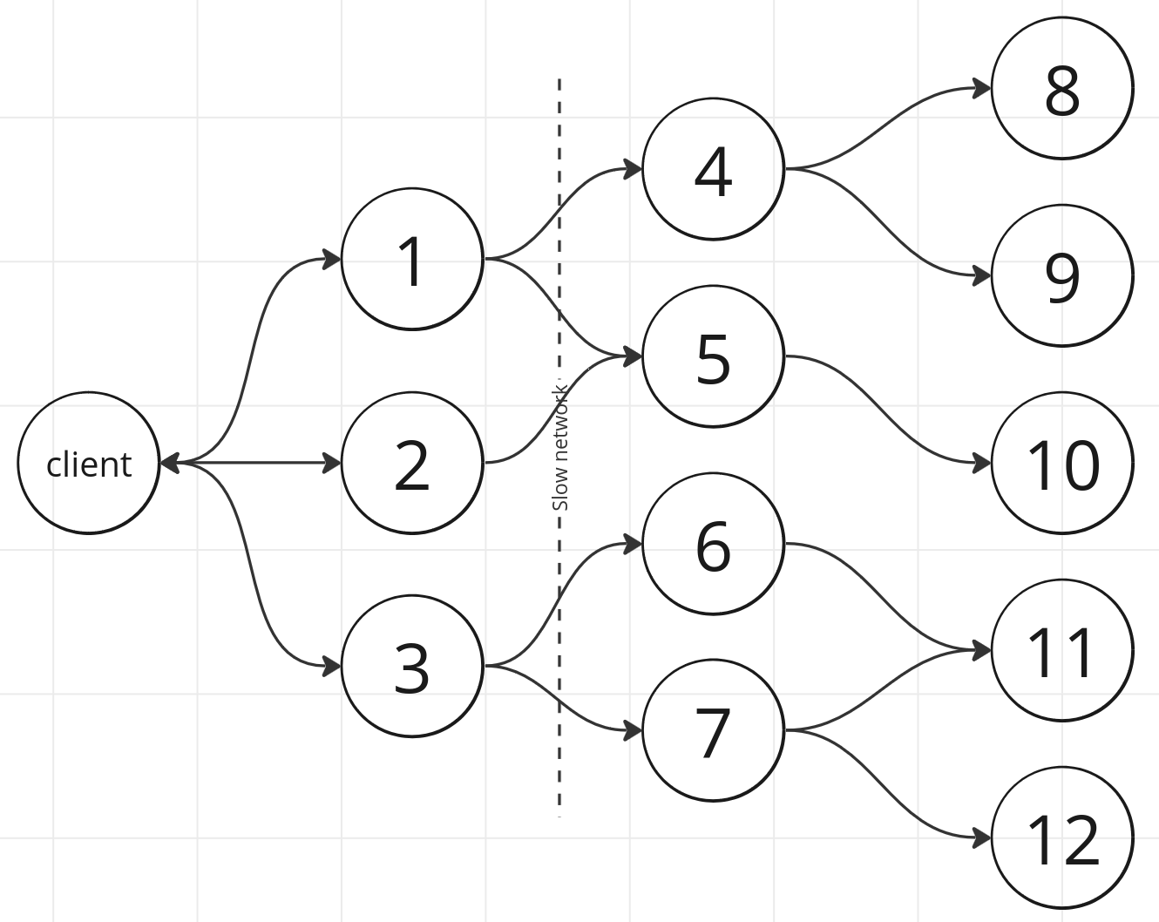
Client timeouts

Slide 24
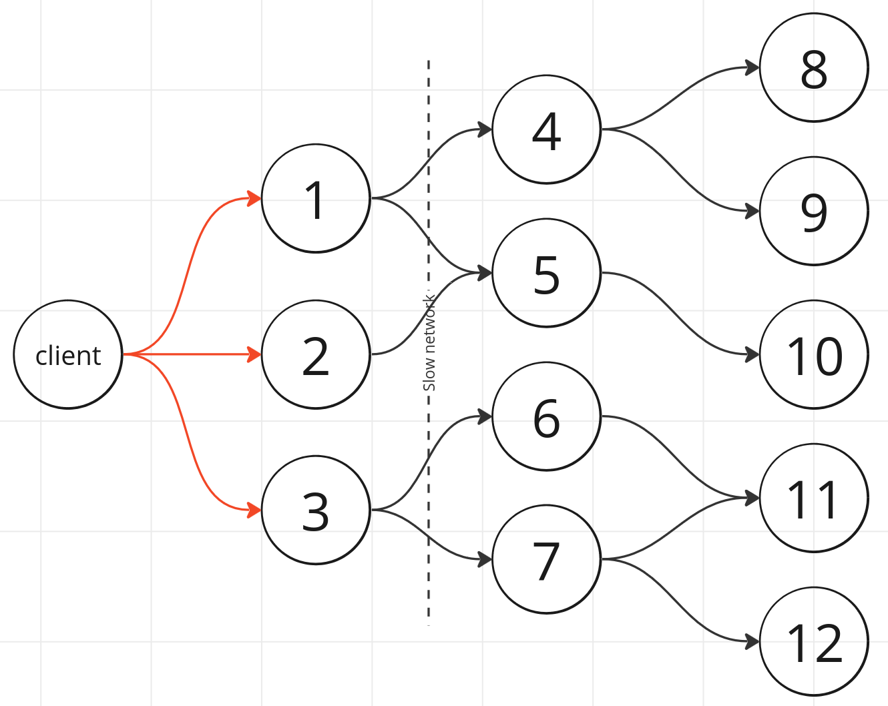
Client timeouts

Slide 25
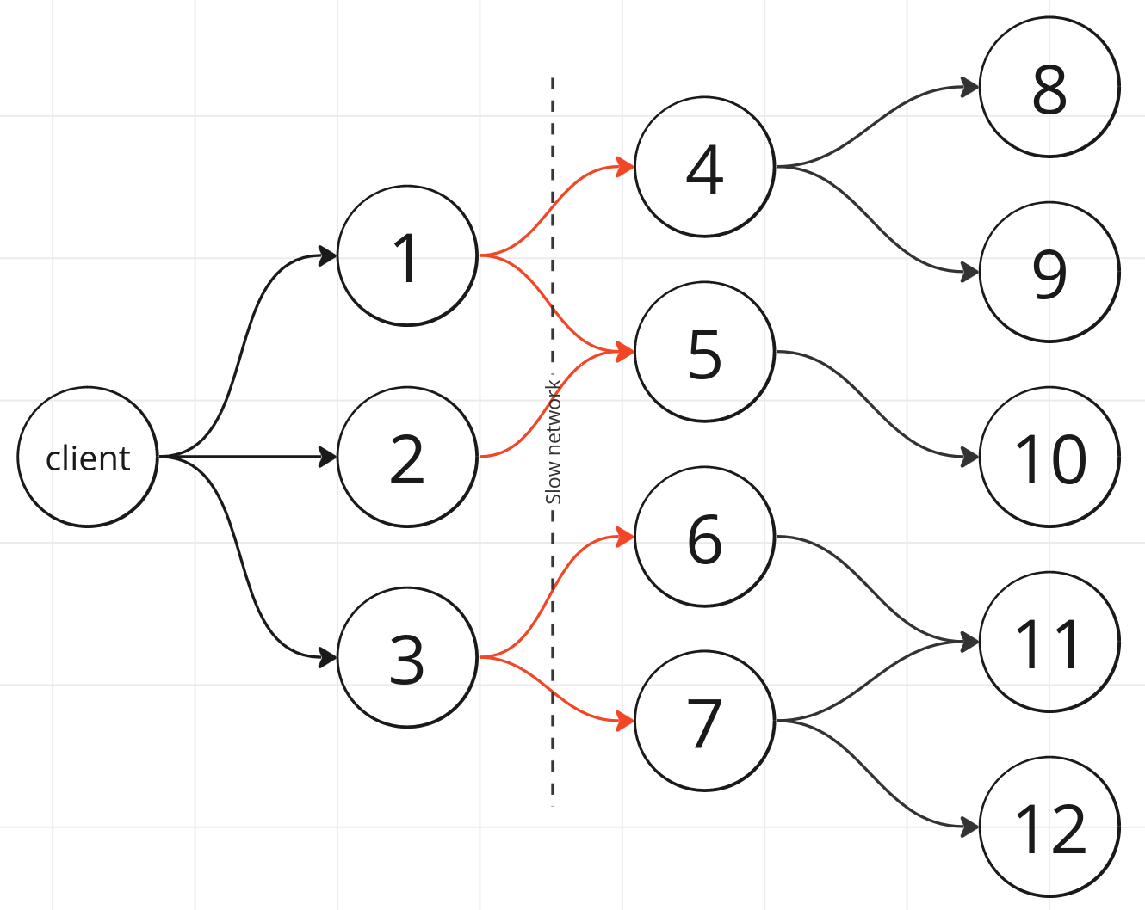
Client timeouts

Slide 26
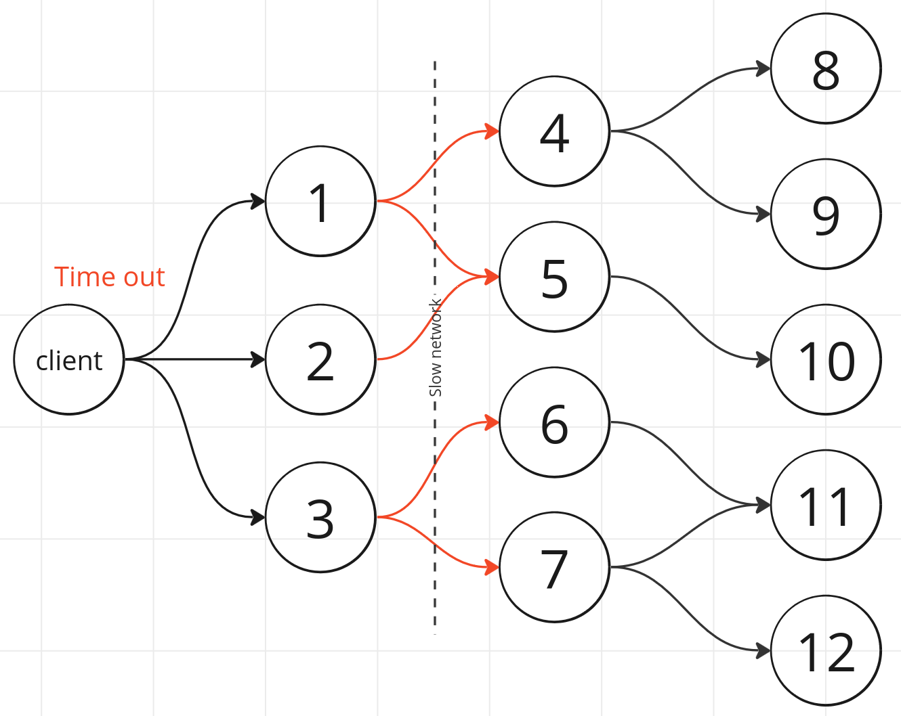
Client timeouts

Slide 27
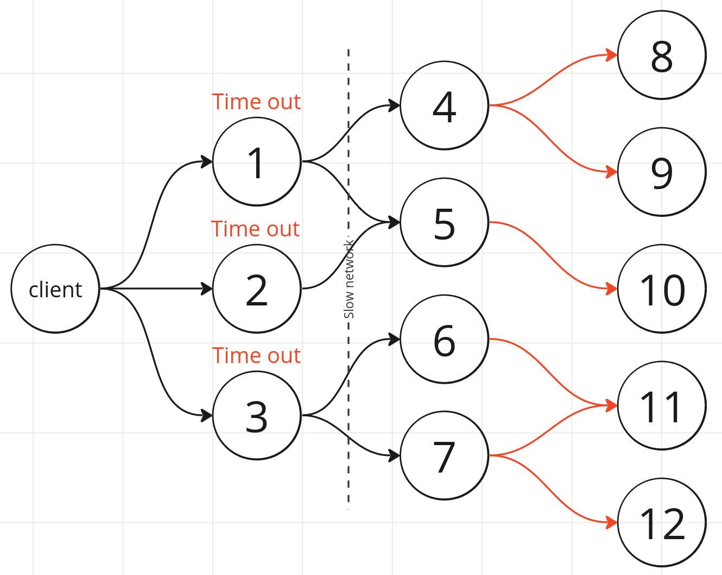
Client timeouts

Slide 28
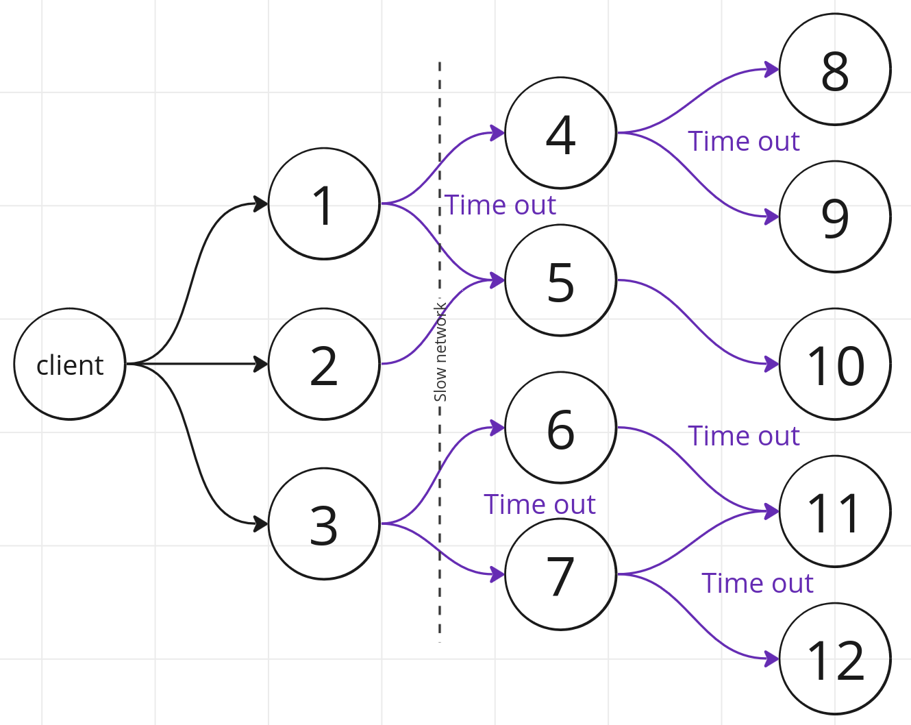
Client timeouts

Slide 29
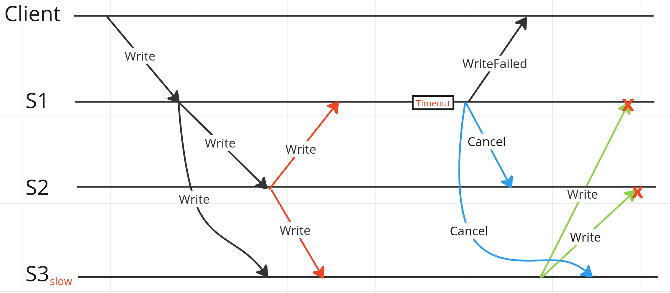
Failed requests should be dropped

Slide 30
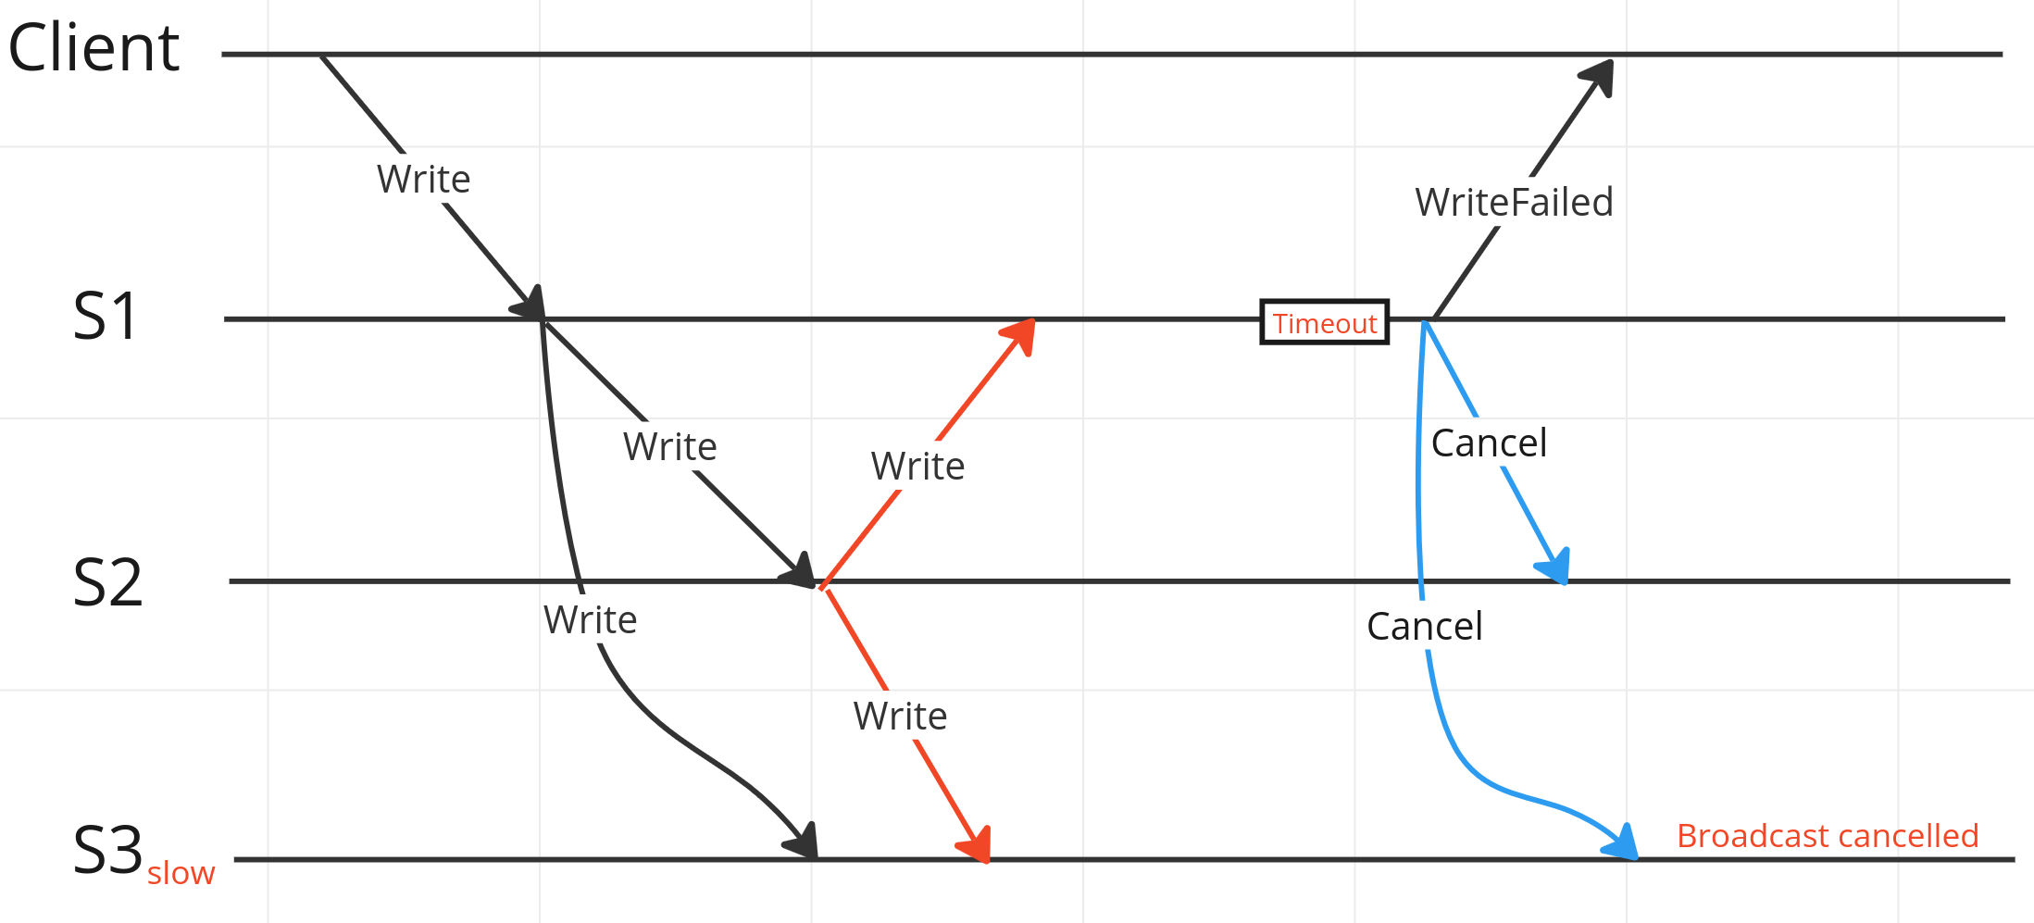
Failed requests should be dropped

Slide 31
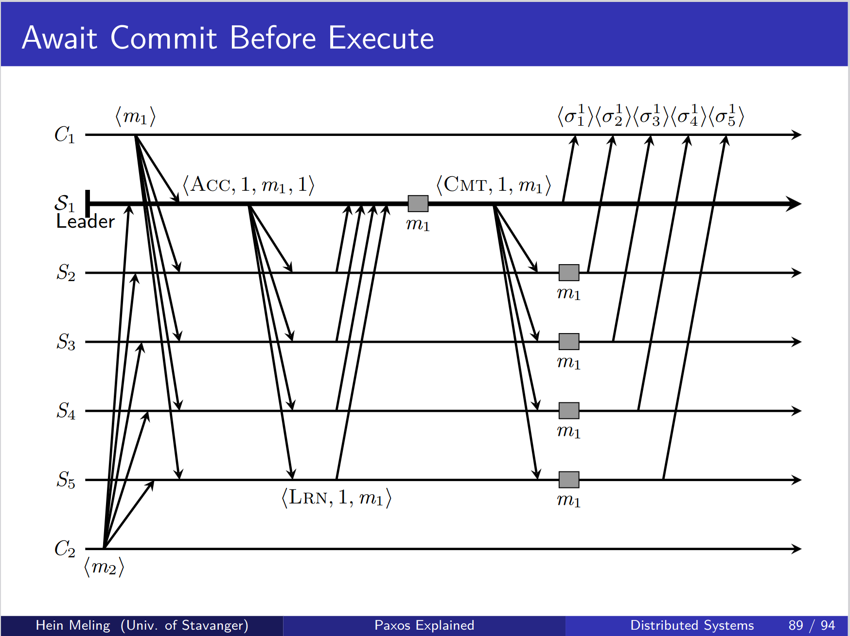
Paxos without all-to-all

Slide 32
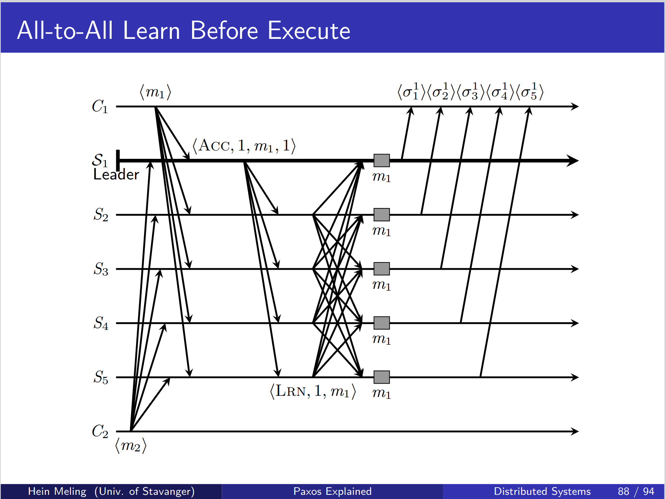
Paxos with all-to-all

Slide 33
Paxos with all-to-all
One less communication step needed (Commit)

Slide 34
Response
Client to server: Return a response based upon a criteria
  Some default criteria can be provided:
    Immediately
    Quorum
    Majority
    All
  User defined function:
    Do you have any suggestions for use cases?
Server to server:
  Responses are ignored. Are there use cases for this?

Slide 35
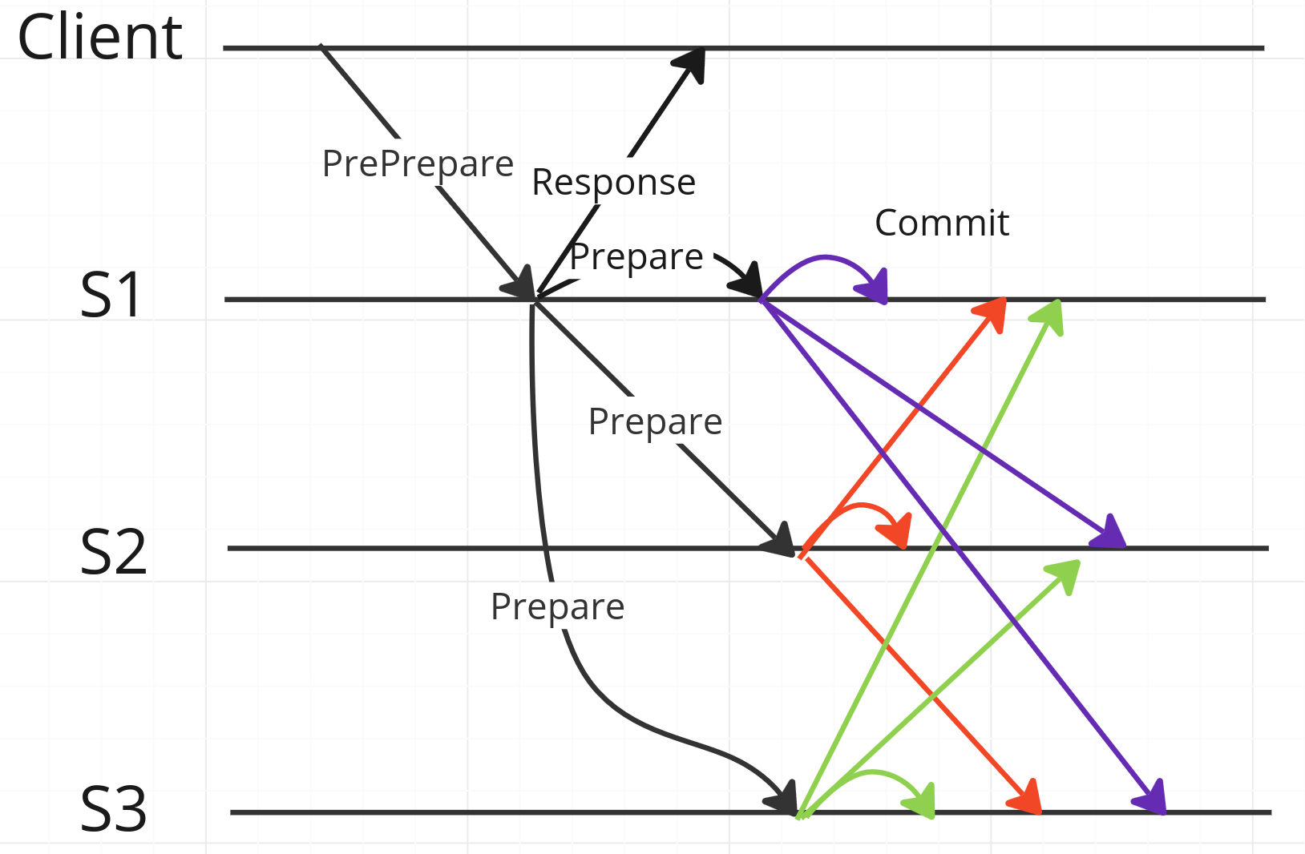
Response – Return (immediately)

Slide 36
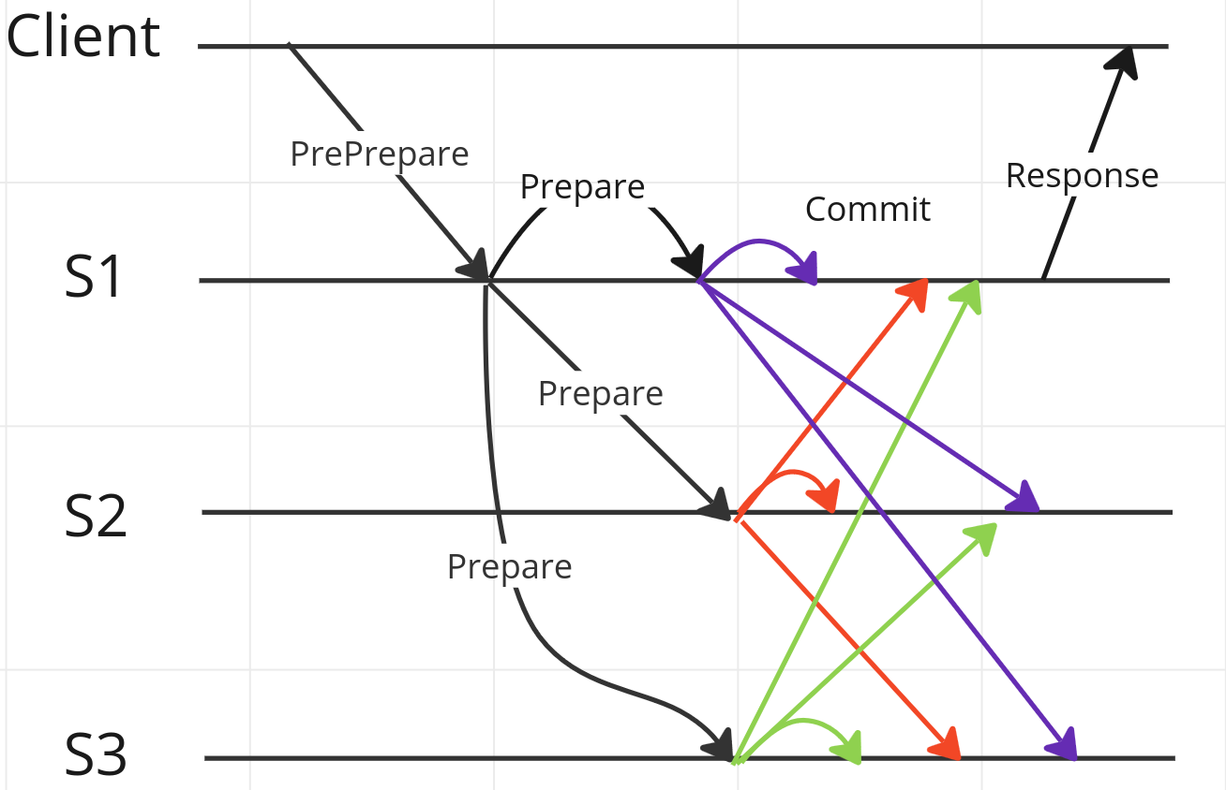
Response – Return (criteria)

Slide 37
Miscellaneous
Support streaming? Use cases?
Authentication?
Have you come across similar frameworks?
Is it possible to hijack a gRPC stream?
  Server to server streams could be setup at the start with auth
  Subsequent communication can be trusted because a stream is already setup? Or is it necessary to verify all communication?

Slide 38
Library functions
Implement a set of broadcast functions?
  Best effort broadcast
  Reliable broadcast
  Uniform broadcast
Implement leader election?
  Failure detector
  Leader election
Others suggestions?

Slide 39
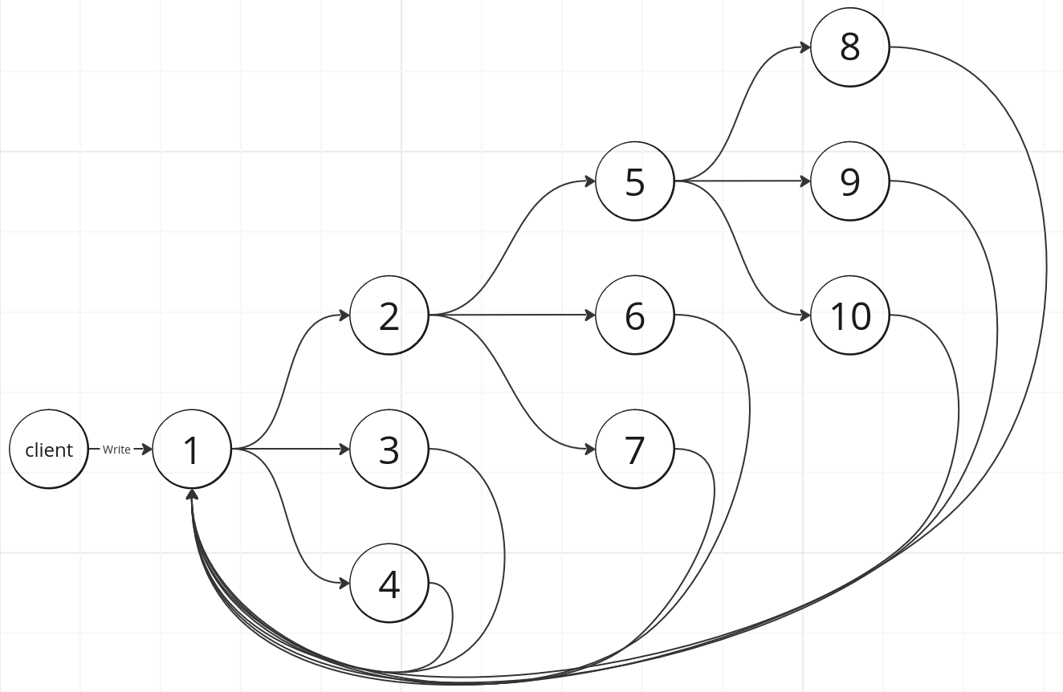
Gossiping

Slide 40
“A distributed system is one in which the failure of a computer you did not even know existed can render your own computer unusable.”
- Leslie Lamport

