Slide 1
All-to-all communication
Gorums

Slide 2
Distributed systems
Benefits:
Scalability
Availability
Performance
Modularity
Challenges:
Coordination
Communication
Fault-tolerance
Complexity
Gorums should offer the benefits and mitigate the challenges.
source

Slide 3
Gorums
Specifically, Gorums should act as the communication layer for a distributed system.
Distributed system algorithms such as Paxos, Raft, etc. can be implemented on top of Gorums.

Slide 4
Preliminary
Request-response (QuorumCall) ← Currently uses this
Push (Multicast)
It is assumed that all nodes know about each other in advance (more on this later)

Slide 5
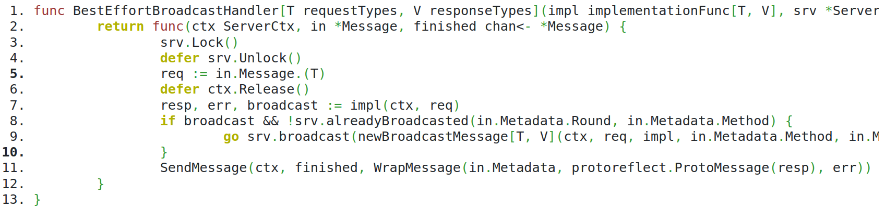
Code

Slide 6
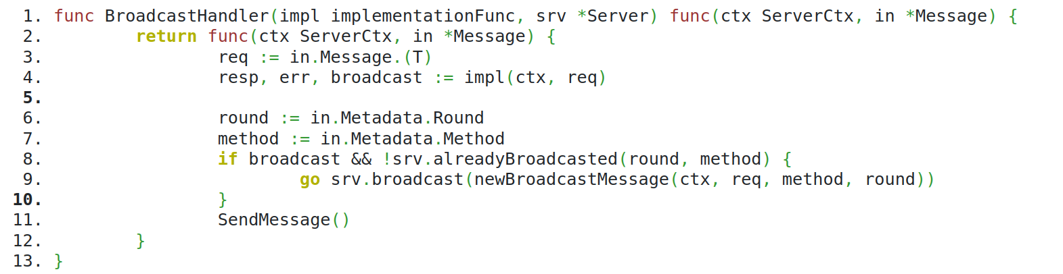
Code

Slide 7
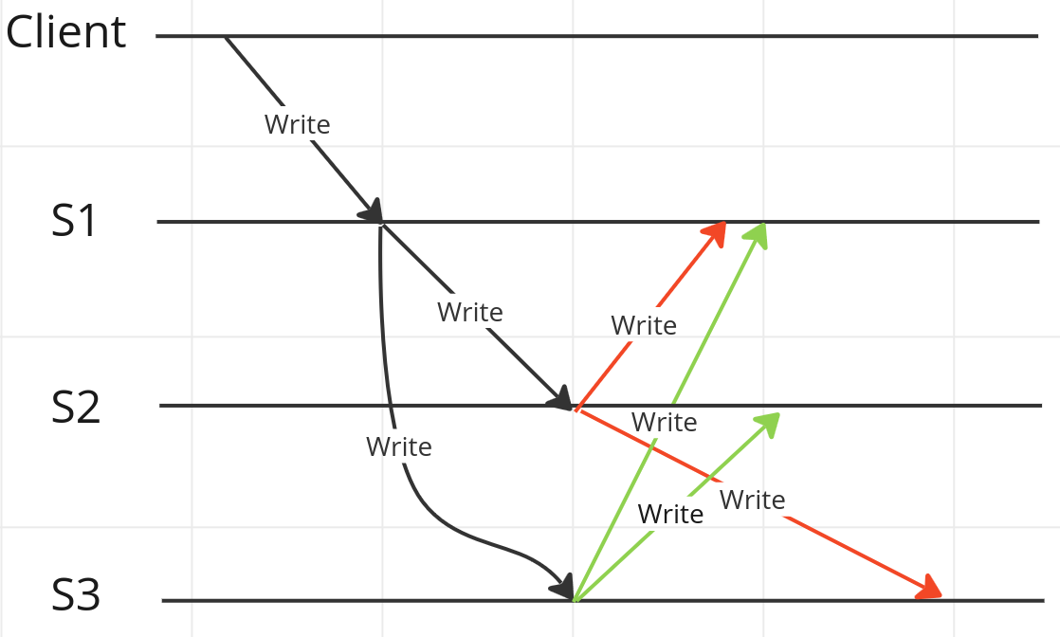
All-to-all invoking same method

Slide 8
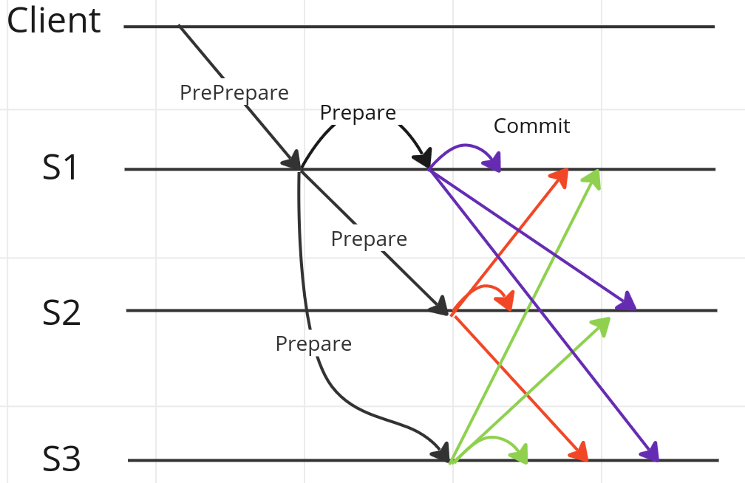
All-to-all invoking another method

Slide 9
All-to-all invoking another function
Note: Server broadcasting to itself

Slide 10
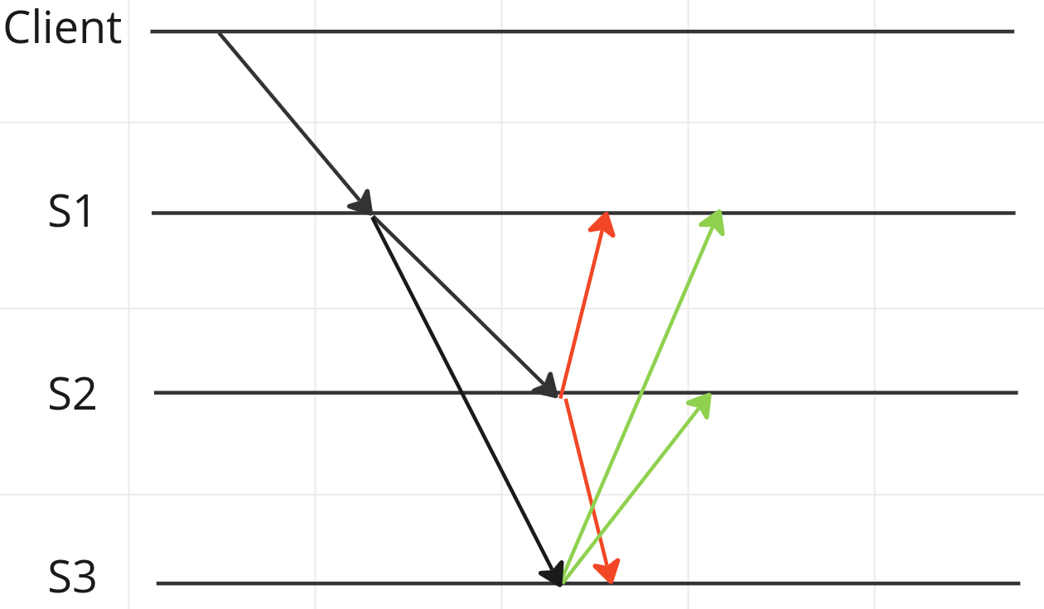
Guarantee that a node broadcasts only once

Slide 11
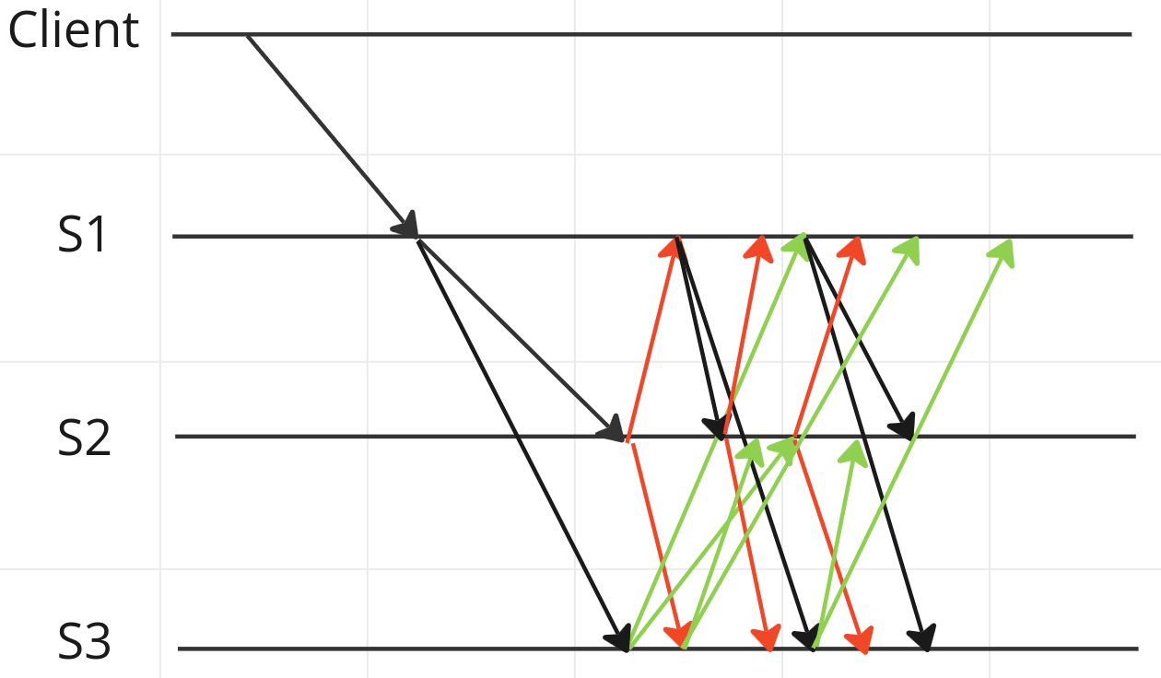
We don’t want this

Slide 12
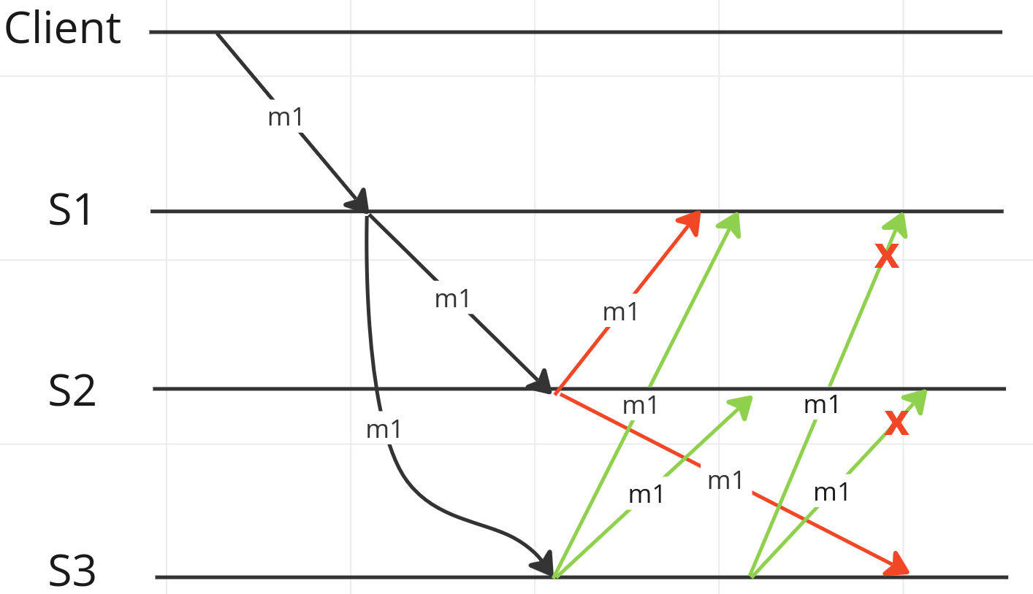
Guarantee that a request is unique (duplicates are dropped at the receiver)

Slide 13
Guarantee that a request is unique
Note:
m1 != message 1
m1 = gRPC method 1
A request is defined as following:
A client issues a gRPC call with a message request
This message request is tagged with a unique ID
All following broadcast messages will contain this ID
Hence, all broadcasts can be seen as part of the initial client request
This way, subsequent gRPC calls to the same method won’t be dropped

Slide 14
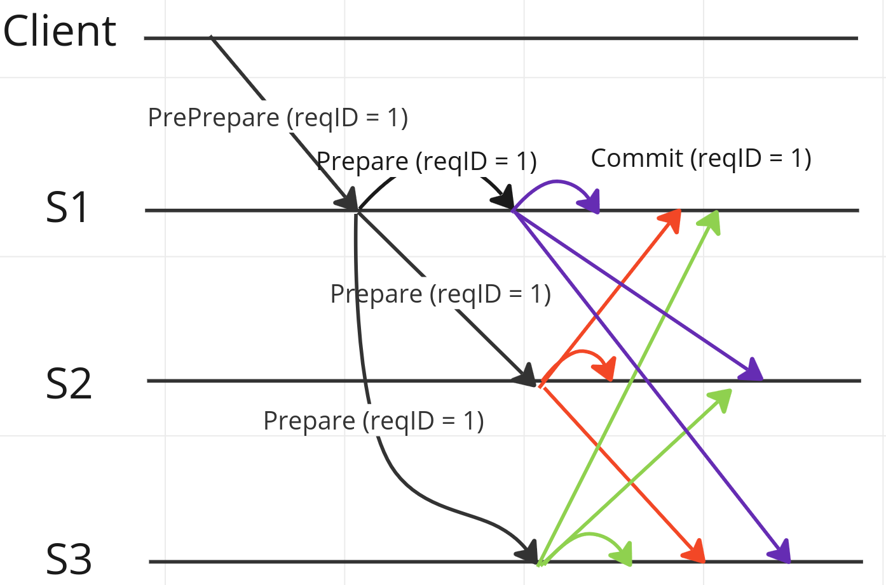
Guarantee that a request is unique

Slide 15
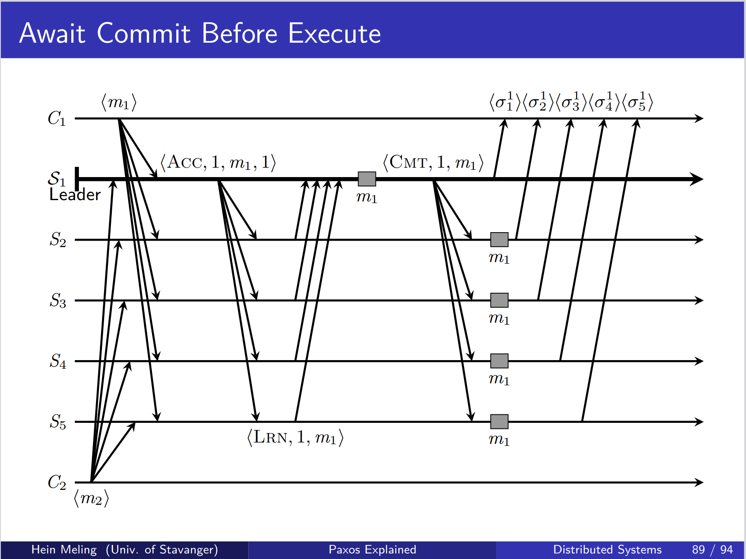
Paxos without all-to-all

Slide 16
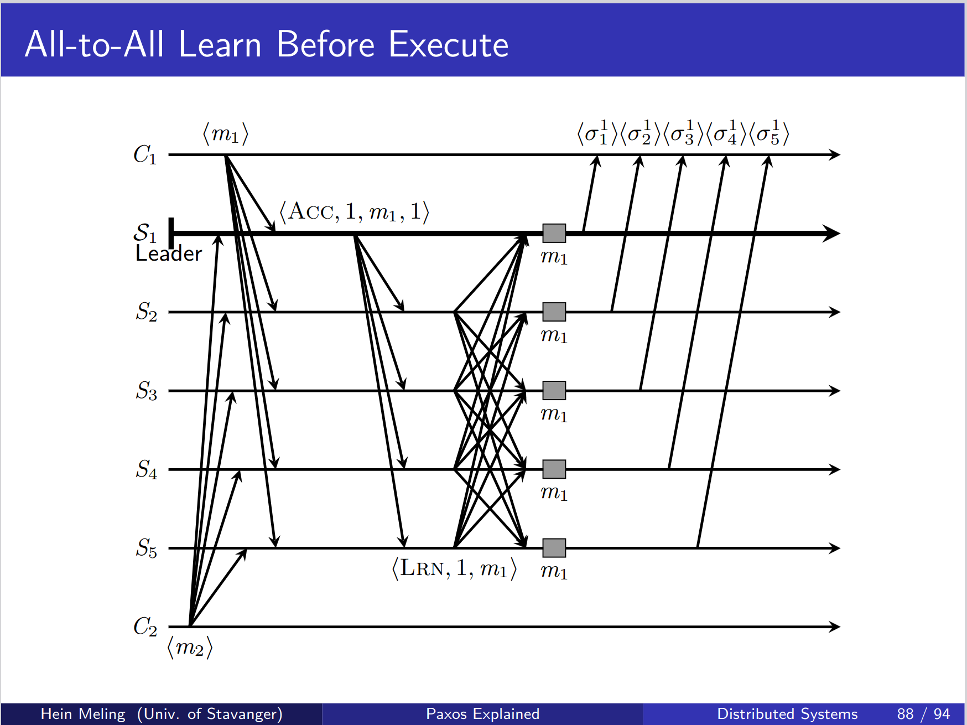
Paxos with all-to-all

Slide 17
Paxos with all-to-all
One less communication step needed (Commit)

Slide 18
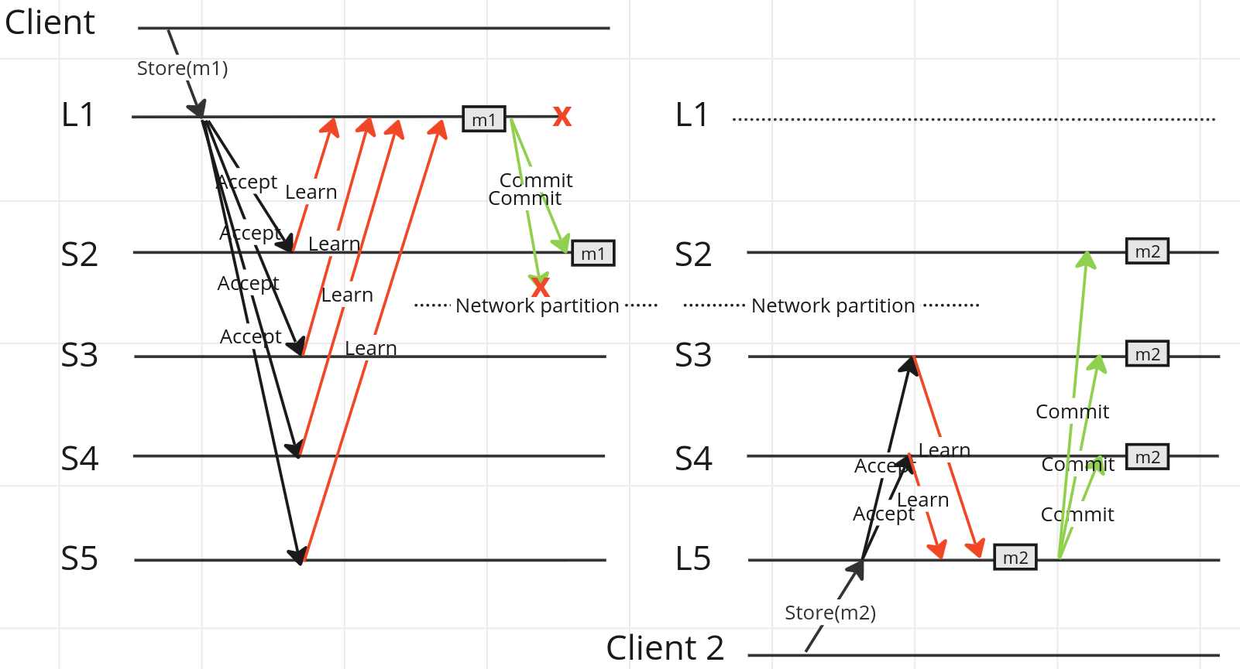
Problematic Paxos?

Slide 19
Problematic Paxos?
Will S2 be inconsistent since it has commited m1?
Possible remedies:
All servers respond to the client. The client only confirms when majority is reached.
What happens after S2 rejoins the network? m1 is commited in S2, but the client will never confirm that the message was stored. When S2 rejoins the network it will still have m1 commited, but the first client haven’t confirmed that it was actually stored.
m1 is commited in a slot prior to the slot m2 is commited in. Hence, the leader needs to request the values for all missing slots.
This could still lead to inconsistency. S2 could fail before joining the network again (meaning m1 would be lost).

Slide 20
Configuration problems
How to change configuration?
Adding and removing nodes
Views?
How to configure gossiping?
How should adding and removing of nodes be handled?
Autoconfiguration?
Other problems?
Maybe a nearest neighbours configuration (e.g. swarm networks) should be implemented?

Slide 21
Library functions
Implement a set of broadcast functions?
Best effort broadcast
Reliable broadcast
Uniform broadcast
Others suggestions?

Slide 22
Support streaming? Use cases?
Implement leader election?
What about response values?

Slide 23
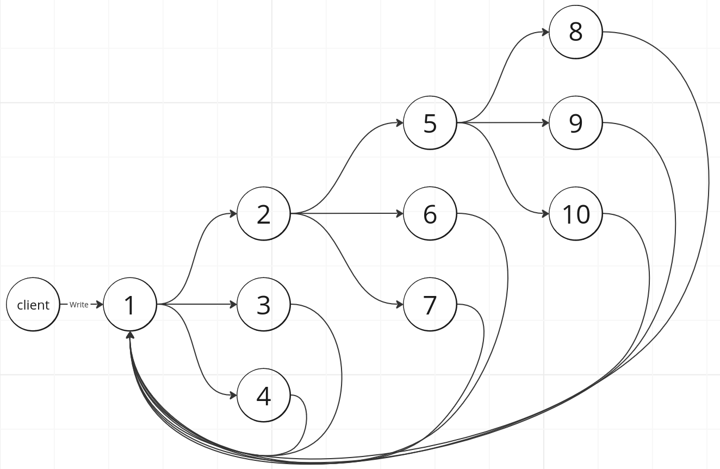
Gossiping

Slide 24
“A distributed system is one in which the failure of a computer you did not even know existed can render your own computer unusable.” - Leslie Lamport

