Slide 1
Timeouts

Slide 2
Preliminary
The context object is created at the initialization of a stream. This ctx is immutable.
Subsequent requests don’t include a new context object.
I.e. contexts provided to multicasts and quorumcalls only has one job:
If the context is canceled, then it cancels the stream
Meaning a new stream has to be created to send new requests
Also meaning it is not possible to cancel a request without creating a new config

Slide 3
Desired outcome
A client should be able to cancel a request. (give up on waiting)
Servers should be able to timeout in order to stop “stuck” jobs

Slide 4
Problem
A client can either timeout or disconnect. Should both be handled equally?
How long should a timeout be?
How to prevent servers from timing out when they are not supposed to?
How to prevent byzantine servers to send fake cancellations?
How should a server handle a timeout?
When can a server safely assume that a request has finished?
How to guarantee correct execution of algorithms?
What level of manual control over timeouts should the implementer have?
The problem gets easier by constraining the user implementation, but this might be counter productive? E.g. by enforcing rules such as “Only the leader can cancel a request.”
It could be necessary for the client to wait for replies when it cancels a request. Instead of canceling a request it instead sends a cancellation request. This can also fail and suffer from the problems which timeouts are trying to solve.
A timeout can’t be considered as a server failure or as a request never arrived at the server. This is because the server can correctly complete all steps in an algorithm, but the execution might still be wrong due to external influence (slow servers/network) not considered by the implementer.

Slide 5
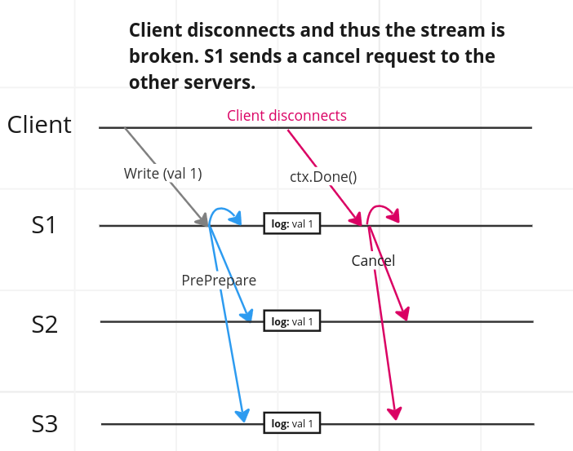

Slide 6
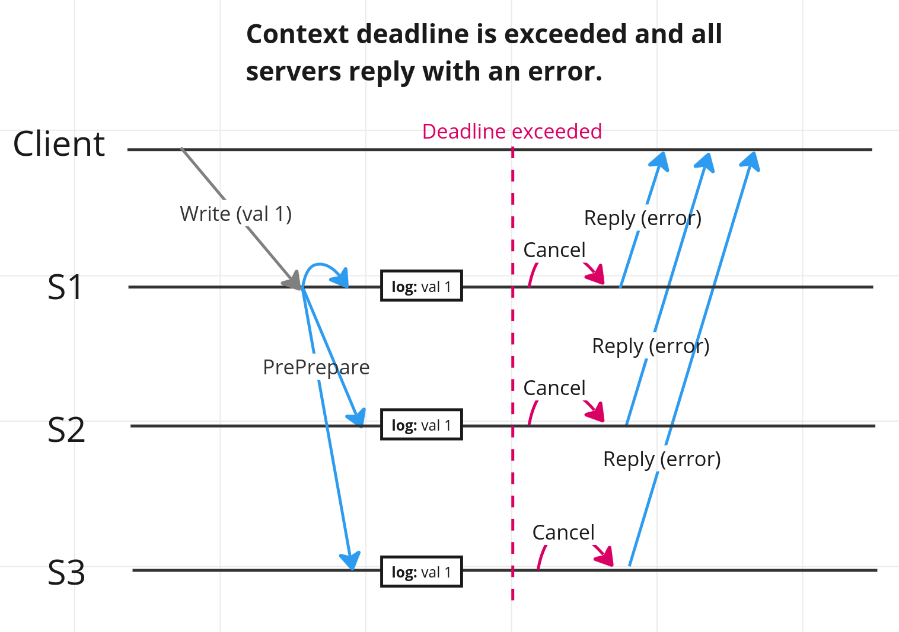

Slide 7
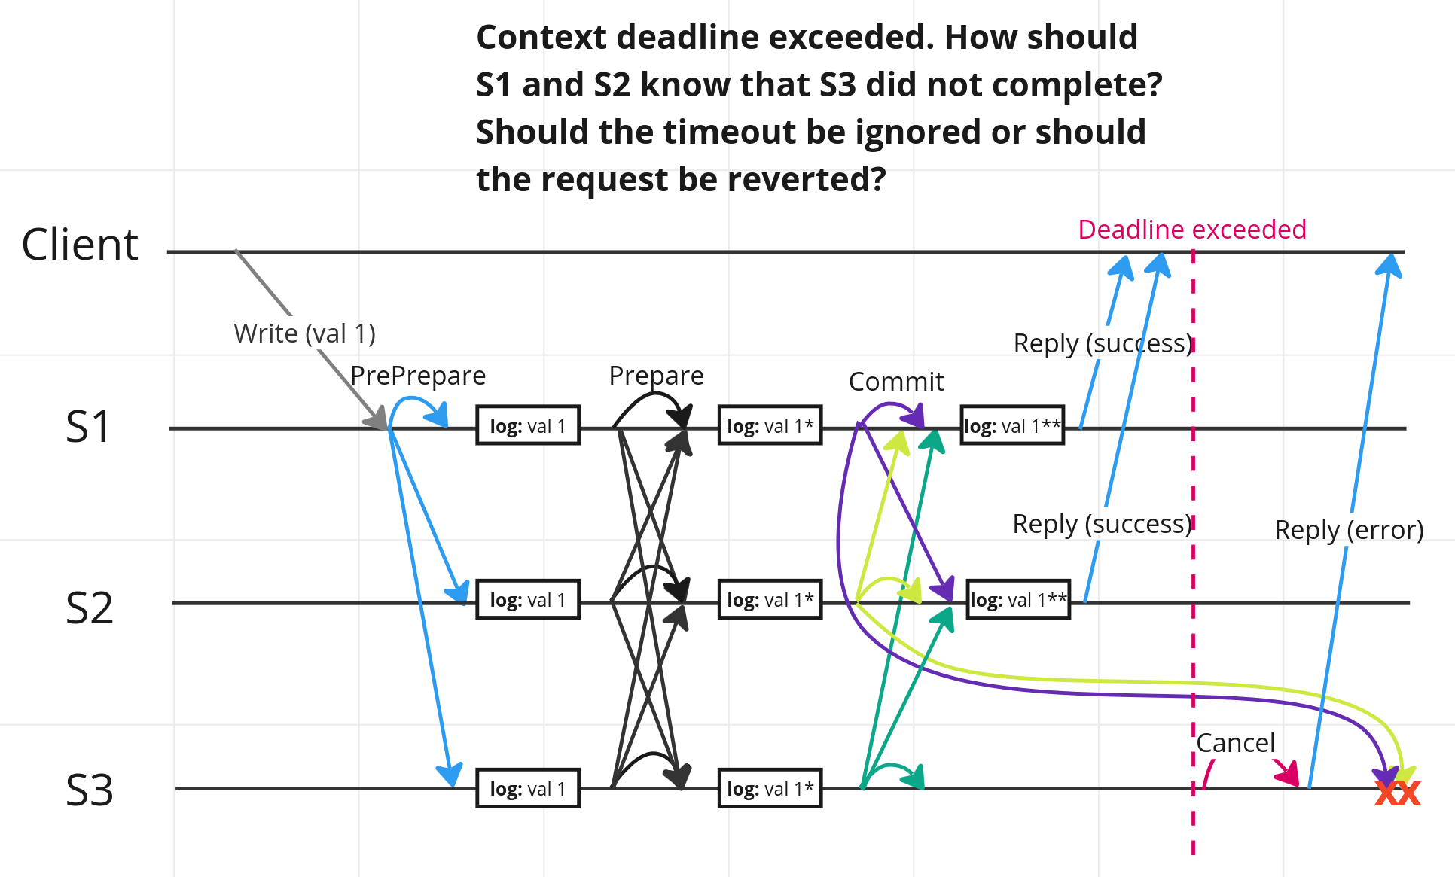

Slide 8
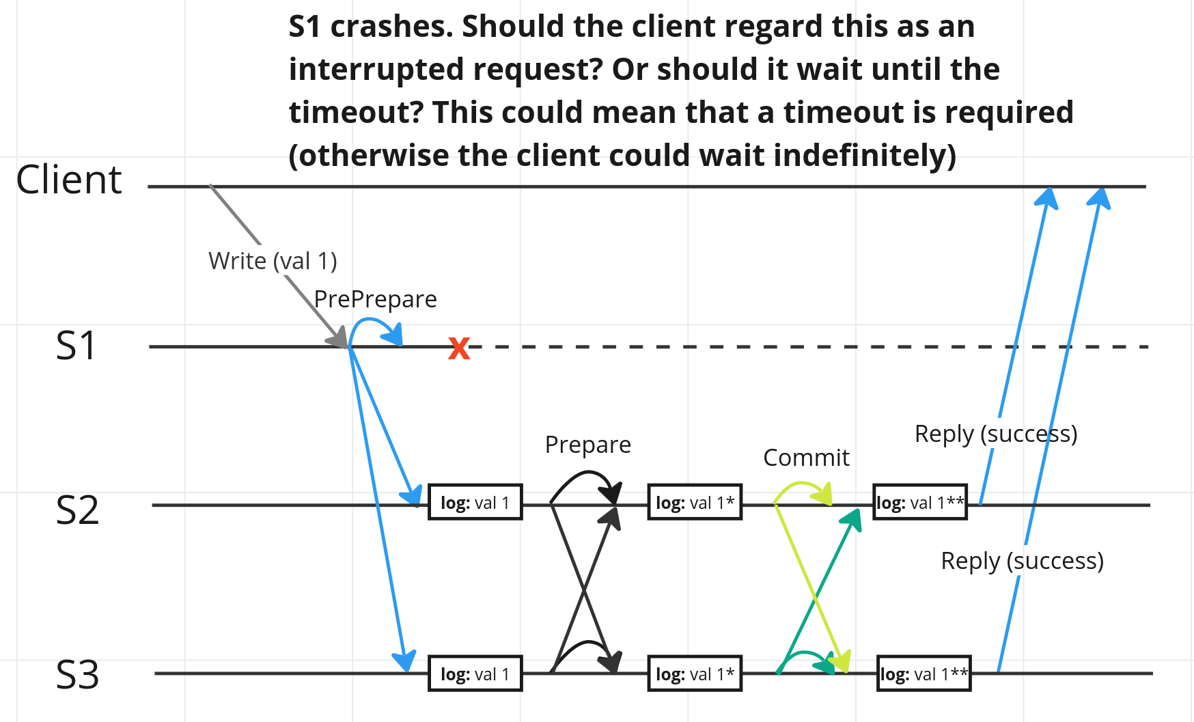

Slide 9
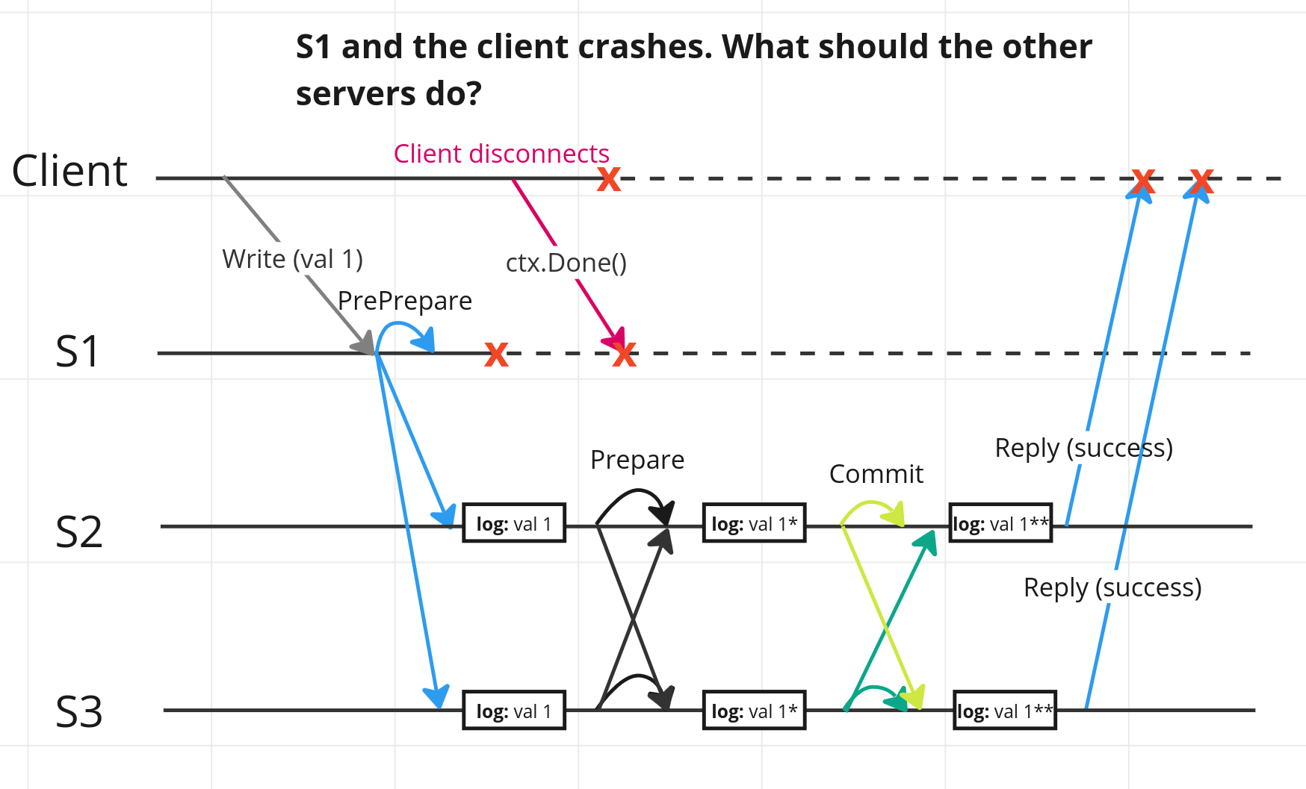

Slide 10
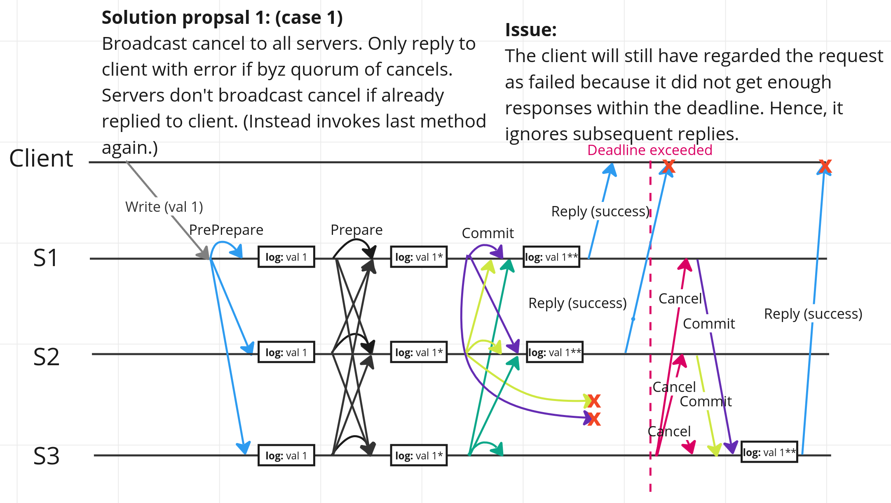

Slide 11
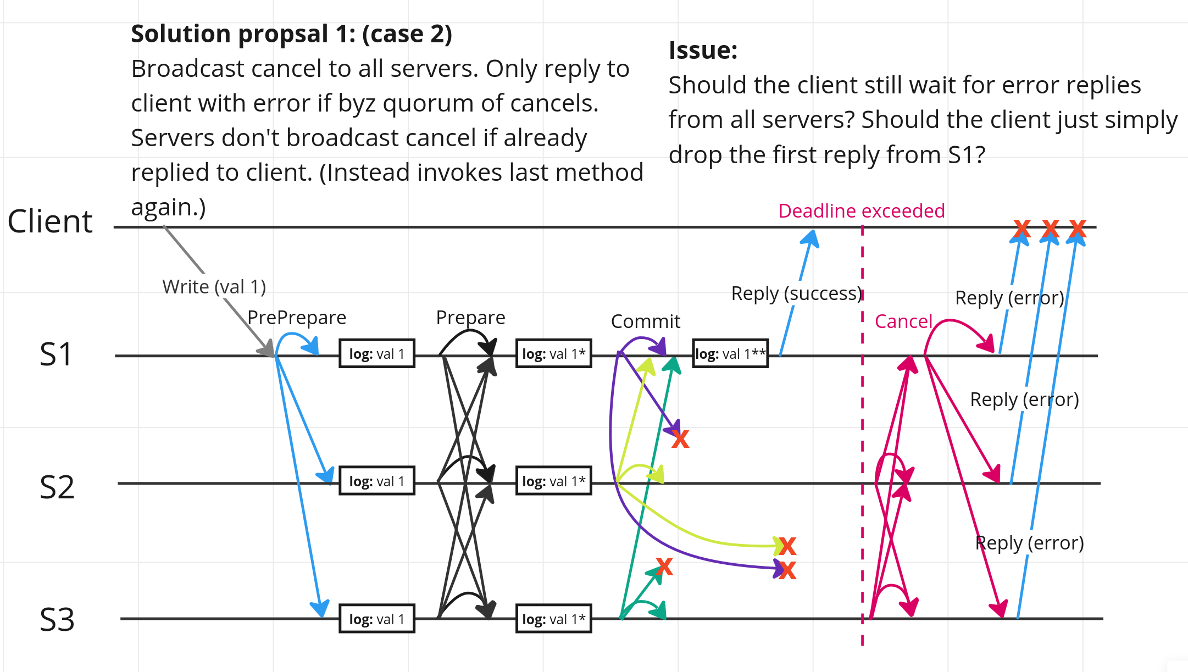

Slide 12
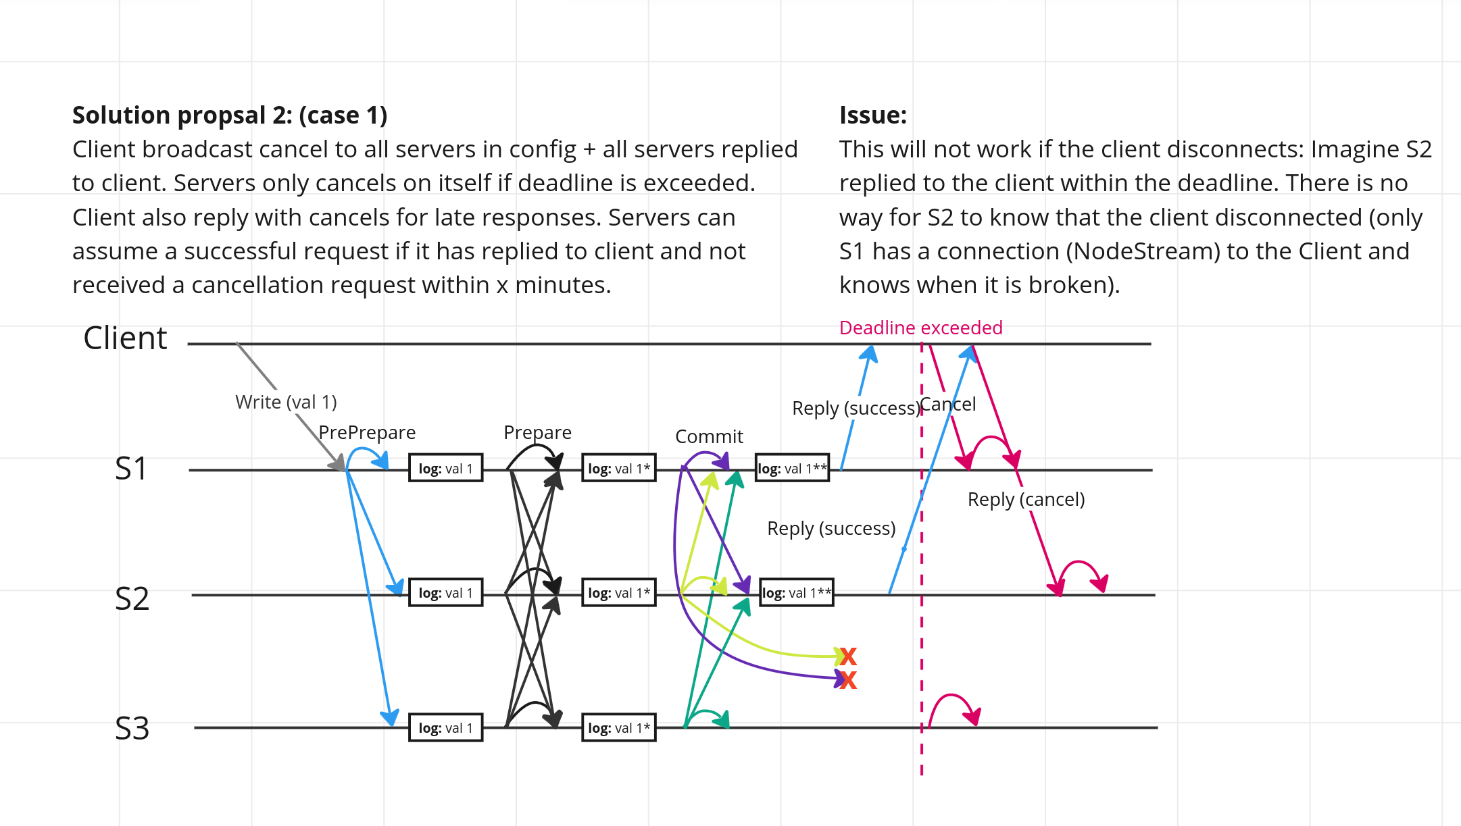

Slide 13
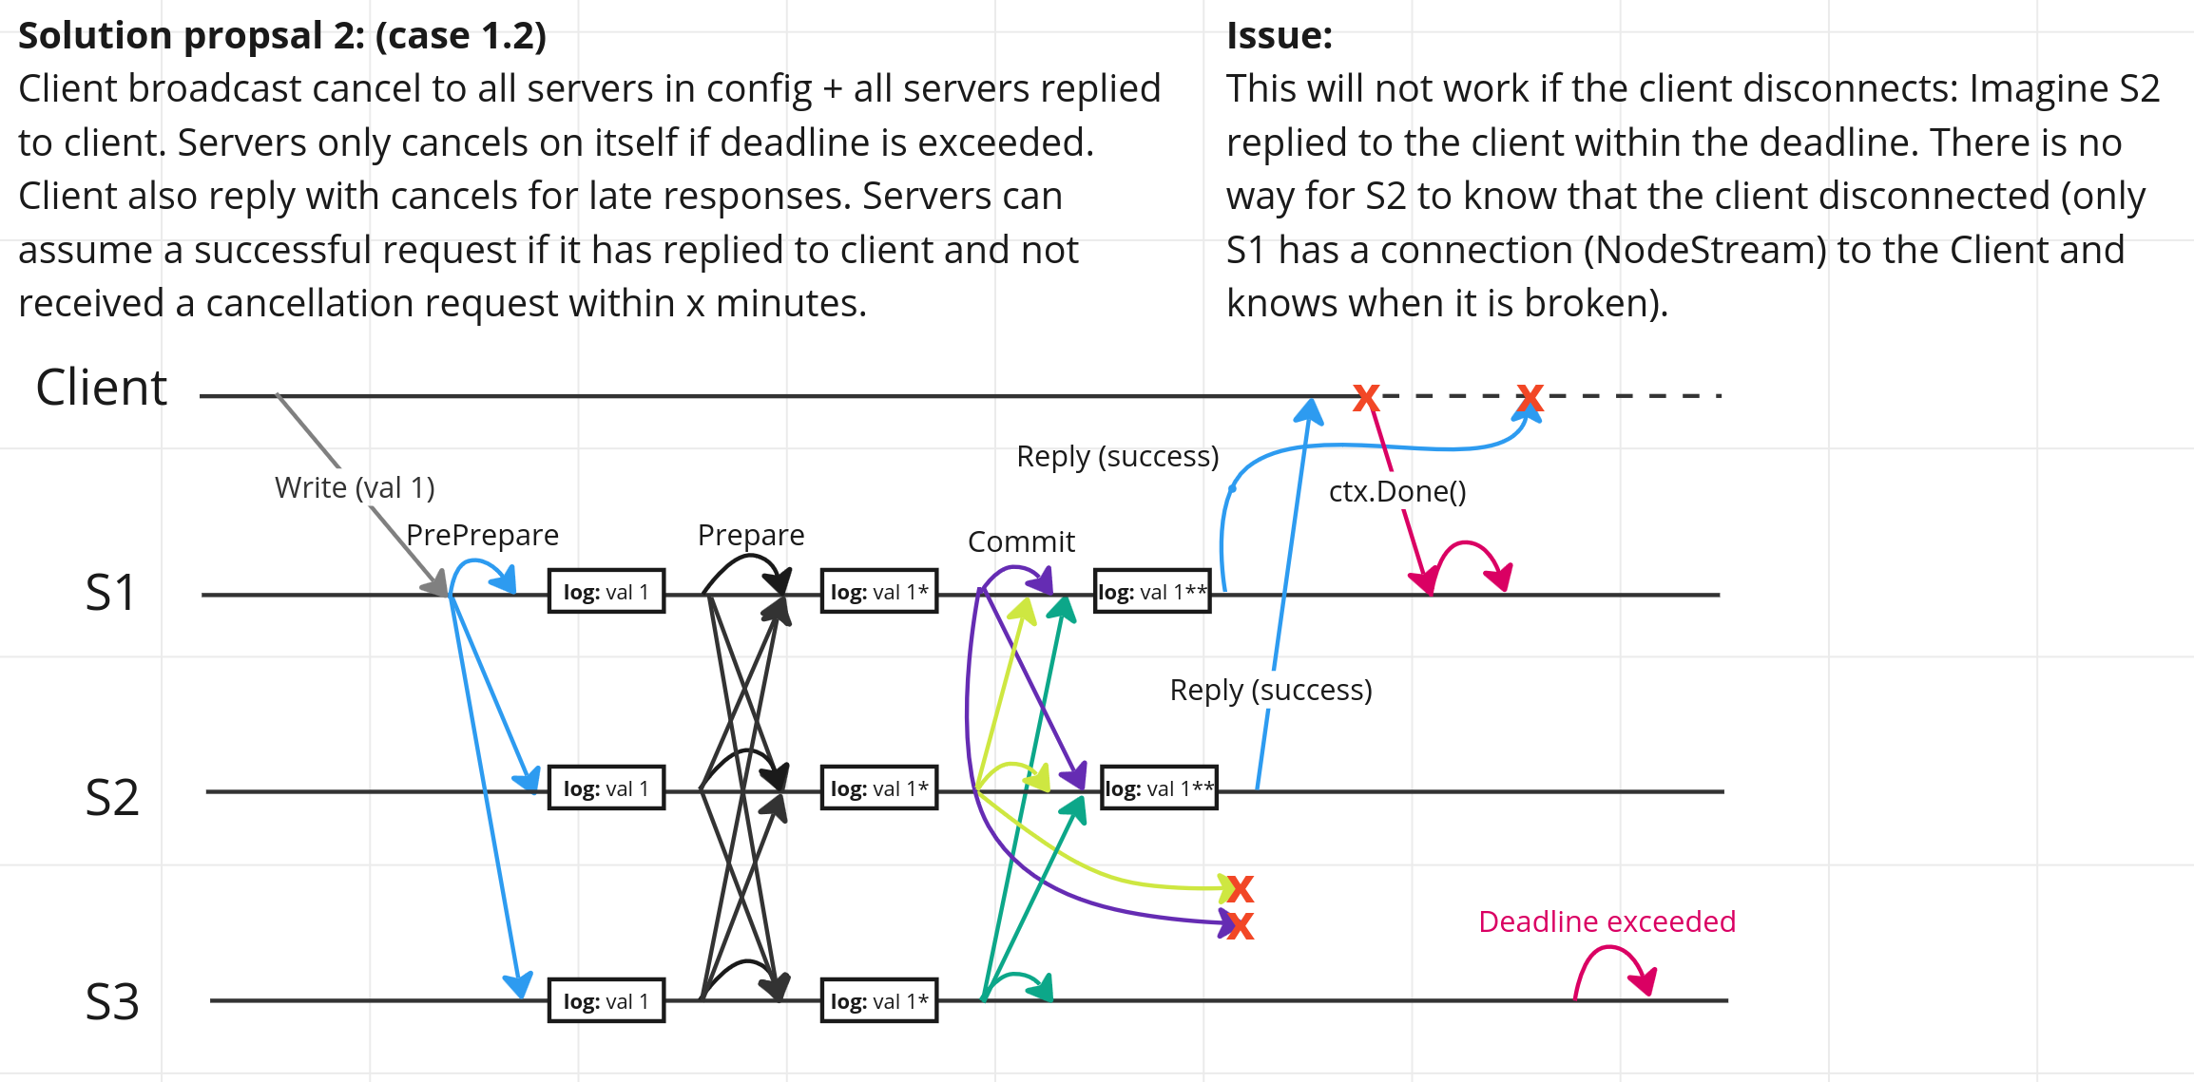

Slide 14
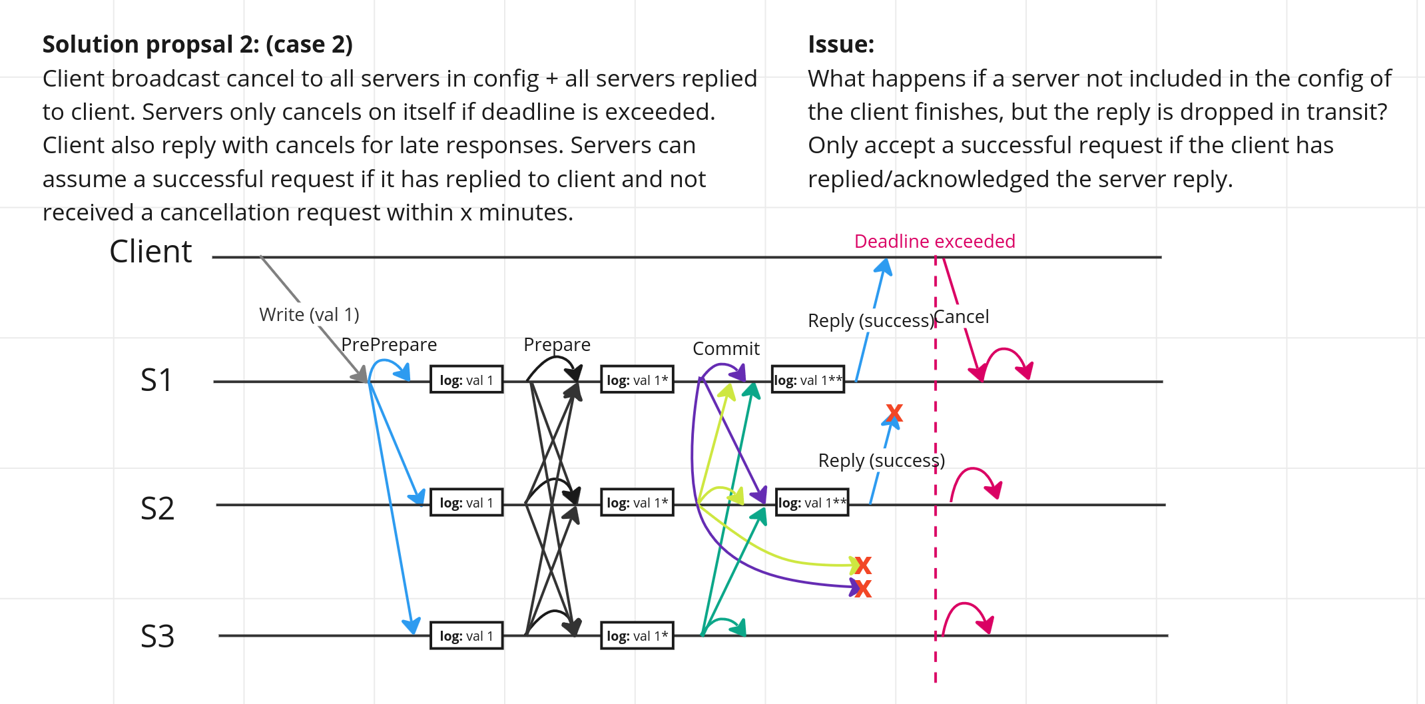

Slide 15
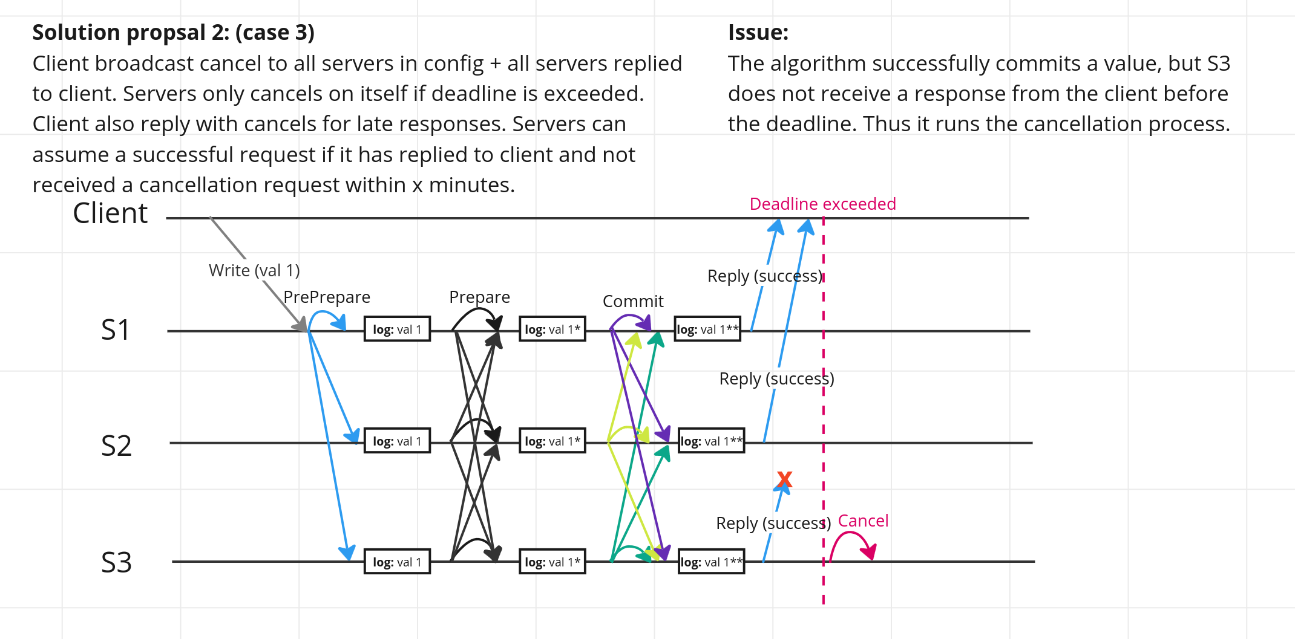

Slide 16
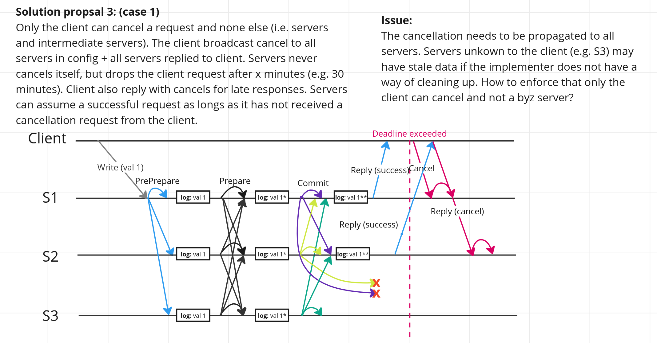

Slide 17
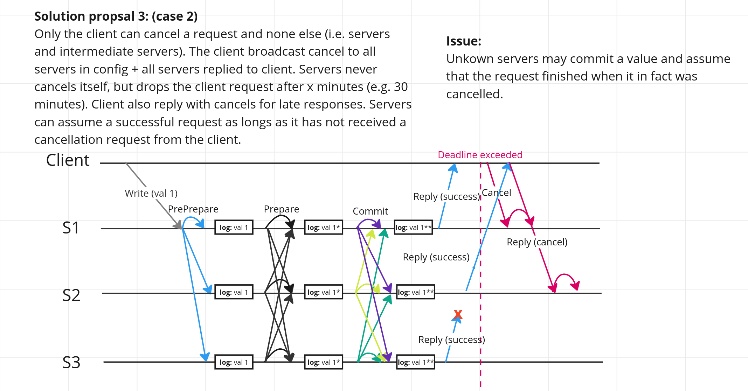

Slide 18
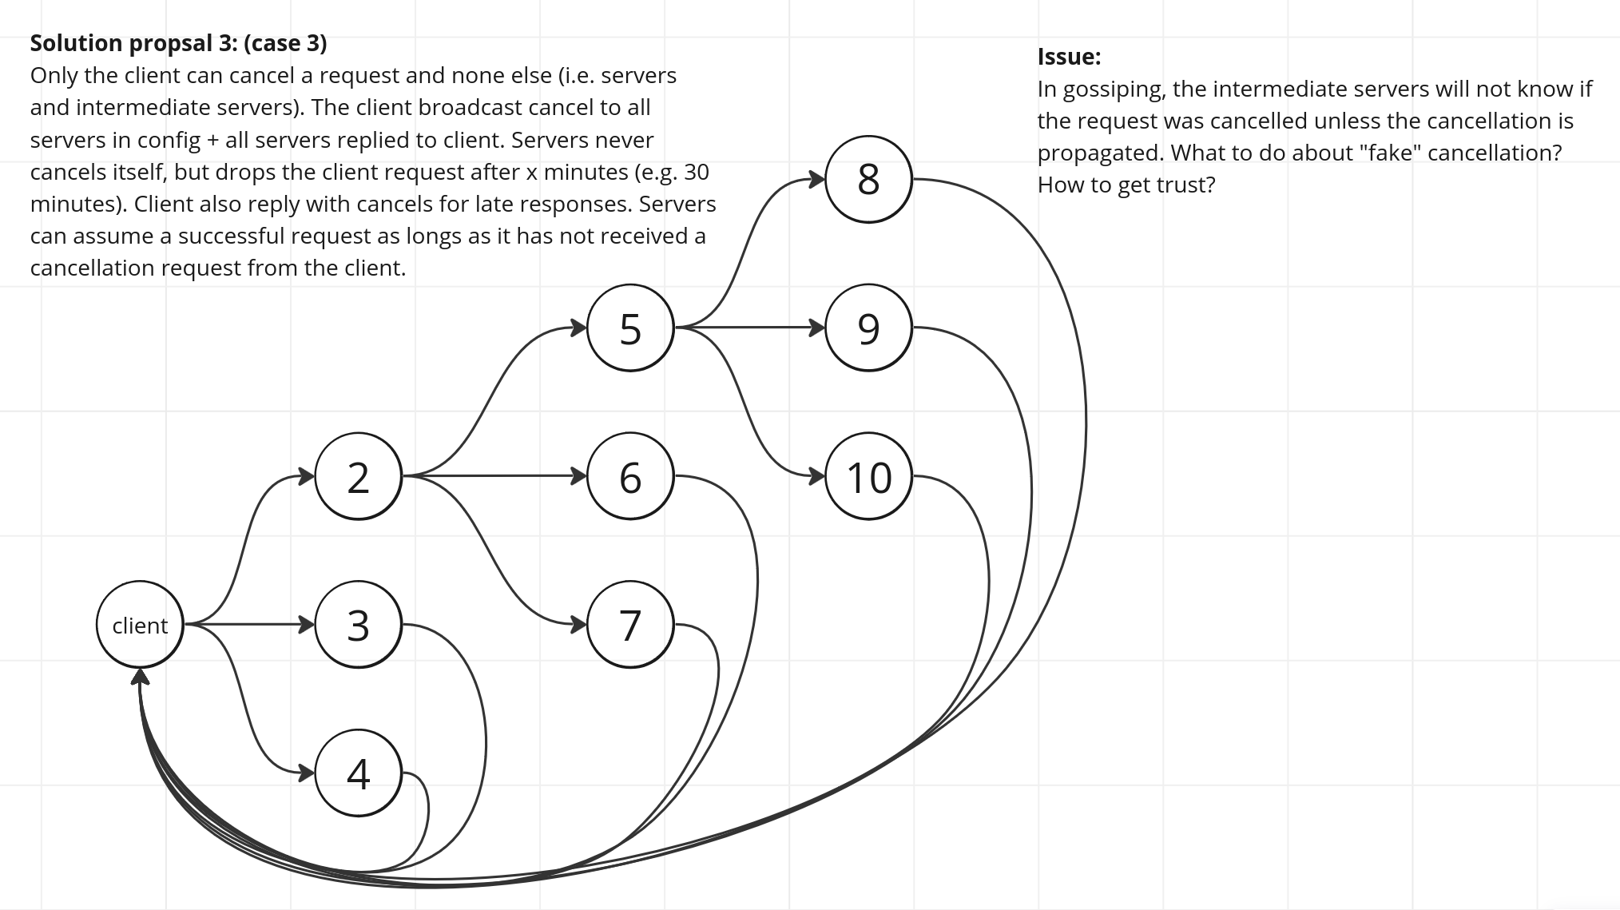

Slide 19
PBFT
A server timeout can interfere with the correctness of the algorithm because it relies on an “all or nothing” execution (atomicity requirement)
All servers must revert the state if a request is canceled. Hence, a cleanup function needs to be implemented.

Slide 20
A possible solution
Employ a consensus algorithm to determine when a request has been canceled by a client or finished (either by replying to the client or by timing out)
Can also regard requests as failed if nothing happens for 30 minutes (to prevent stale data). This can be overridden by the implementer.

Slide 21
Timeout options
None:
A request cannot be canceled
The handling of timeouts is entirely left to the implementer
Simple:
A server drops a request after the deadline/timeout or if the client disconnects
Implementer can provide a cleanup/timeout function
No consensus mechanisms
Full fledged:
Employ consensus mechanisms to ensure all servers are in sync

Slide 22
Conclusion
A client is too unreliable and therefore can never be the source of truth. Hence, a client can only try to cancel a request, but it cannot be given any gurantees. Furthermore, it should ask for the results for a given task/execution.
There might not exist a “one size fits all” solution for timeouts. It is highly dependent on the implementation and can thus be a hindrance.

